Slide 1
AMIB and BCS Test Automation

Slide 2
AMIB and BCS
Introduction
AusCheck Branch works with its partners to protect Australia by mitigating trusted insider risks in the aviation, maritime, naval shipbuilding identification assurance program (NSIAP), national health security (NHS) and major national event (MNE) sectors. AusCheck operates on a cost recovery basis to coordinate background checks for employment applicants in those sectors, and also acts as an issuing body for federal, state and territory government officials seeking aviation, maritime and naval shipbuilding security identification cards (ASICs, MSICs and NSSICs). AusCheck maintains a comprehensive database of all applicants and cardholders.
Business Context
The AMIB solution is a key capability for Home Affairs. It facilitates turnkey provision of background check and card management services, direct to applicants and other stakeholders. The AMIB solution supplements existing AusCheck channels, where applicants primarily deal with another party (who then transact with Home Affairs regarding them). The other party is typically their employer, the operator of a secure facility they need to access, or a major national event organiser.
Home Affairs is the lead agency for the Australian Government’s Issuing Body Reforms (IBR) initiative. A major impact from IBR will be extension of AMIB operations to more than just government personnel seeking ASICs, MSICs and NSSICs. The extension involves major changes to AusCheck Branch services, structure, people, finances, training, facilities, equipment, procurements, strategic plans and operational plans. There are also flow-on changes to Identity and Biometric Division (where AusCheck represents a major public-facing service).
AusCheck delivers (or has been listed in Joint Parliamentary Committee reports and similar to deliver) background checking and card management for additional schemes. The AMIB solution may need to be extended in future iterations to support:
Emerging Critical Infrastructure schemes (addressing insider threat, positions of trust and secure facilities risks)
National Health Security (security sensitive biological agents)
Major National Events (ICC T20 World Cup cricket 2020 and 2022, FIFA Women’s World Cup 2023)
US Global Entry Program

Slide 3
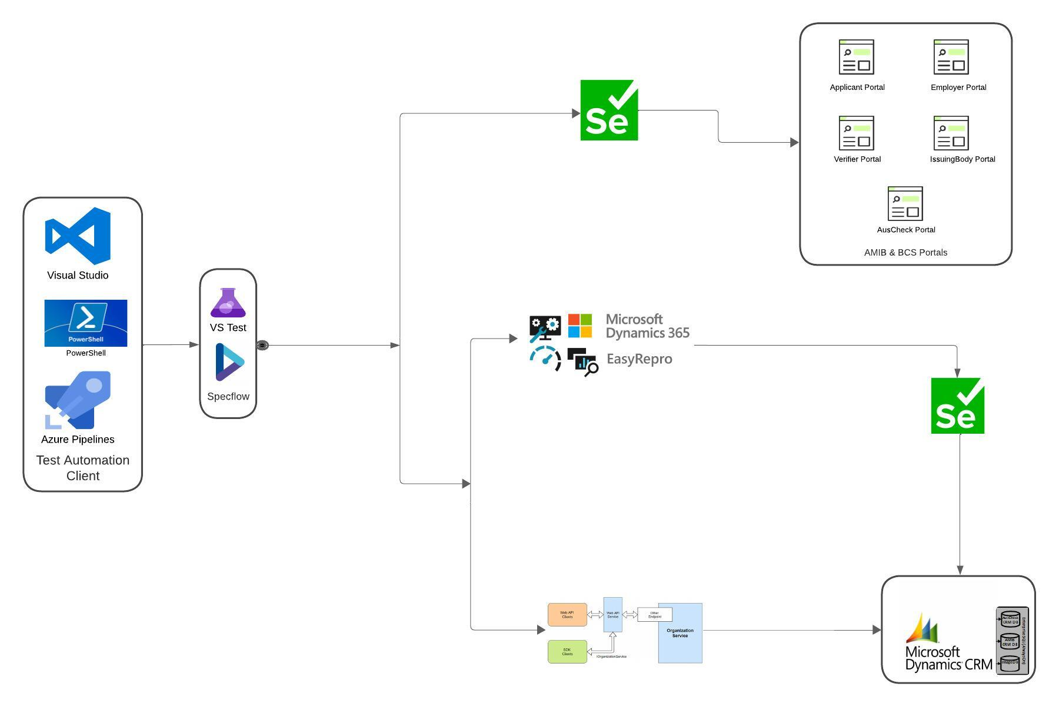
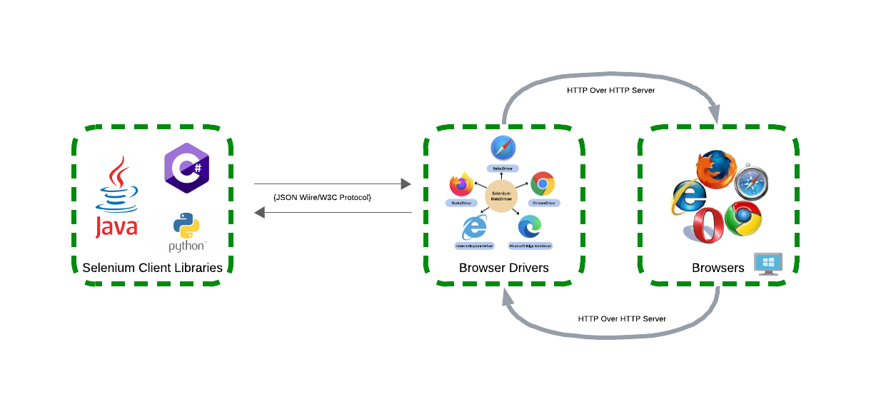

Test Automation Solution
Selenium Architecture
Step 1: It all begins when we trigger the Selenium script (which has been written in C#/JavaScript programming languages). When the script is triggered, it initiates the WebDriver server on a specific port.
Step 2: Subsequently, the Selenium client library transfers the user action request to the WebDriver. To facilitate this interaction, the WebDriver employs the W3C protocol. This streamlined transfer is possible because the WebDriver now interacts with the browser exclusively through the W3C protocol, eliminating the need for complex conversions.
Step 3: As the WebDriver sends command to the browser, the browser responds to the requested commands, executing the required steps and providing feedback to the WebDriver regarding the process acknowledgment.
Open Source Technologies
Solution to test most of the testing interface landscape
Behaviour Driven Development (BDD) technique
The Visual Studio Test Platform with the MsTest V2 test framework
Fits into current Azure DevOps lifecycle and can be seamlessly migrated to any other
CI/CD tool stack

Slide 4
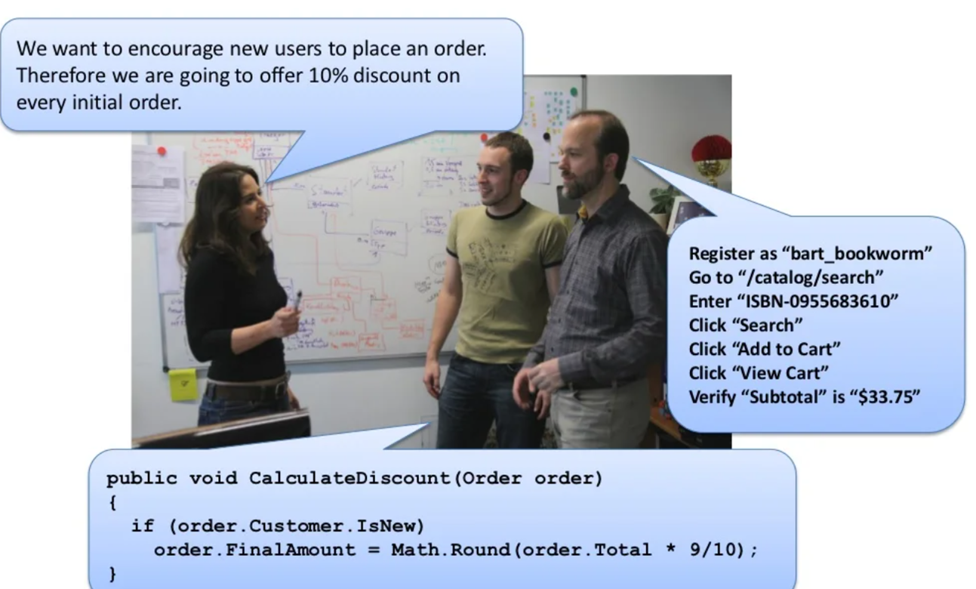
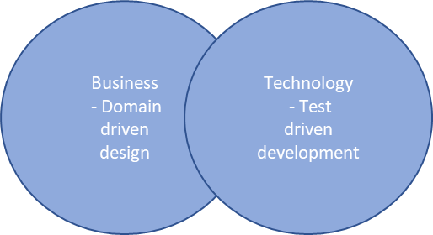
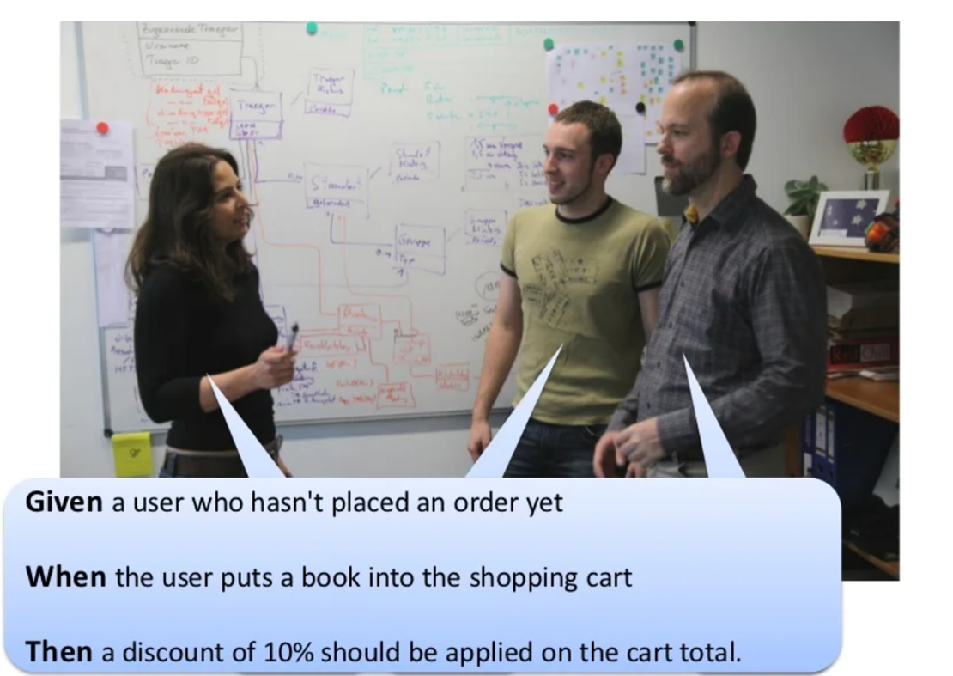
Behaviour Driven Development (BDD)
Why?
It is a TDD approach
It is a ubiquitous language
It is an executable documentation
Driven by business value
It promotes communication
Helps develop common vocabulary and metaphor
Can be used by programmers, testers, business analysts, domain experts
Helps Building Stories
Define user stories as a series of acceptance criteria as scenarios
It has the givens, events, and outcomes
That is
Given some initial condition(s)
When event(s) occurs,
Then ensure some outcome(s)
Executable Criteria
The specification is specified in a way it is executable
Directly represented in code and used to exercise the application code

Slide 5
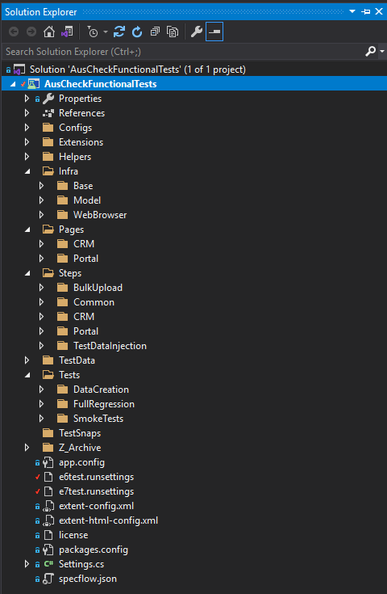
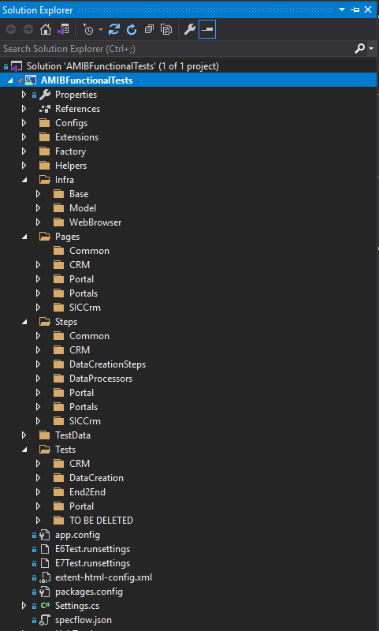
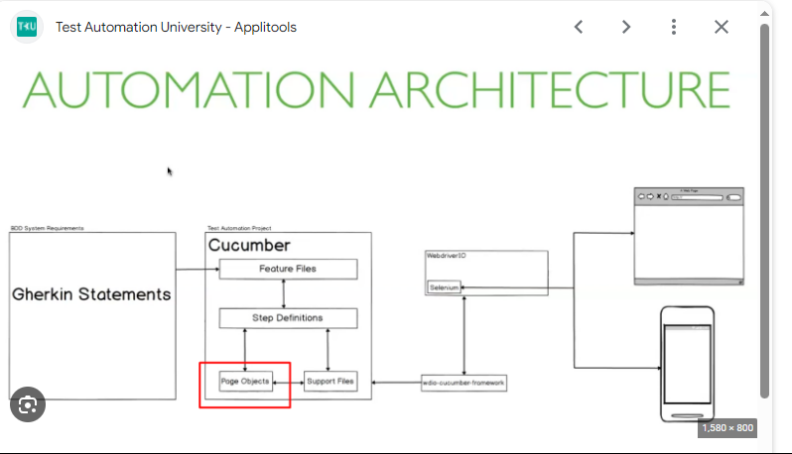
Test Automation Solution Code
BCS Test Solution
AMIB Test Solution
Page Object is a Design Pattern and recommended to build test automation projects for enhancing test maintenance and reducing code duplication.
Clean separation between the test code and page-specific code, such as locators and layout.
Single repository for the services or operations the page offers rather than having these services scattered throughout the tests.
Solution is developed and maintained in domain specific language (DSL), which provides the user with an expressive means of solving a problem.

Slide 6
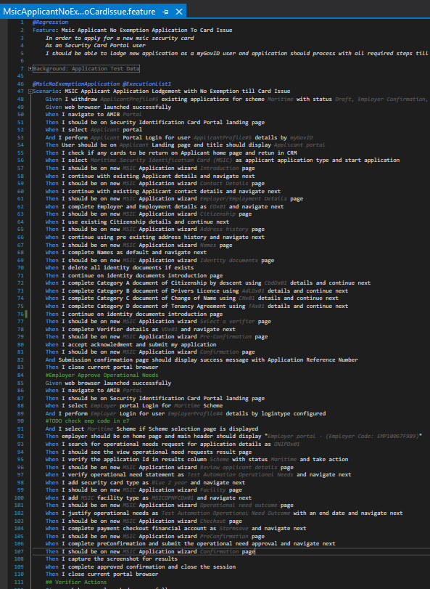
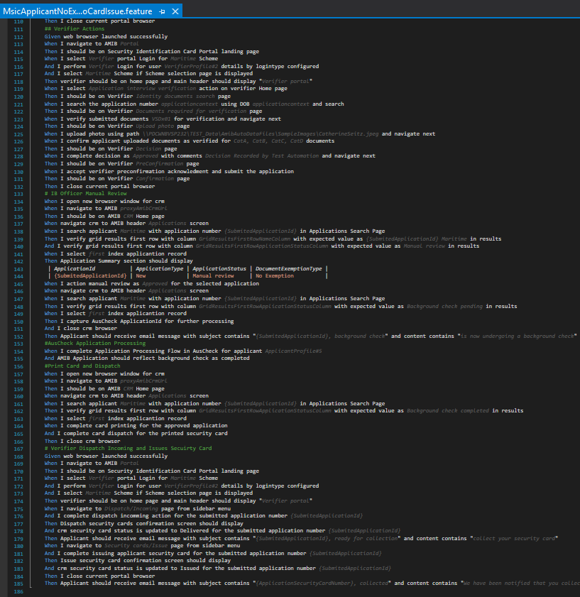
MSIC No Exemption Scenario

Slide 7
Steps to automate any test scenario
Understand the flow of the test case with all required details and the objective of the test case from test team
Understand test data and interfaced where actions and validations will be performed
Implement draft BDD test steps in Gherkin language
Approach has to be taken to whether a new step need to be implemented or a existing step(s) can be modified to parameterise the step to handle the new action/validations
Explore and understand Ms CRM entities and there entity model and their links if something can be achieved via CRM Org Services which helps to run test faster and reliably
Update test to handle flow difference in e6 and e7 environments
Complete implementation and run the test multiple times in both e6 and e7 environments
Once test run reliably multiple times in both e6 and e7 mark the test as done and can be used for future regression executions
Challenges/Issues
Environment stability - Slowness and Non-reliable or unknown errors which are intermittent
Multiple re-runs are required for tests which fail because of unknown reasons which occur only at certain specific time of the execution and cannot be reproducible
When some issue is found then first I confirm the issue with manual testers so that to confirm no test data issues is the cause and also any gaps which may be cause for the failure
Print security card/Dispatch is always challenging as the job picks all the security cards without test in control of the specific card that test is interested

Slide 8
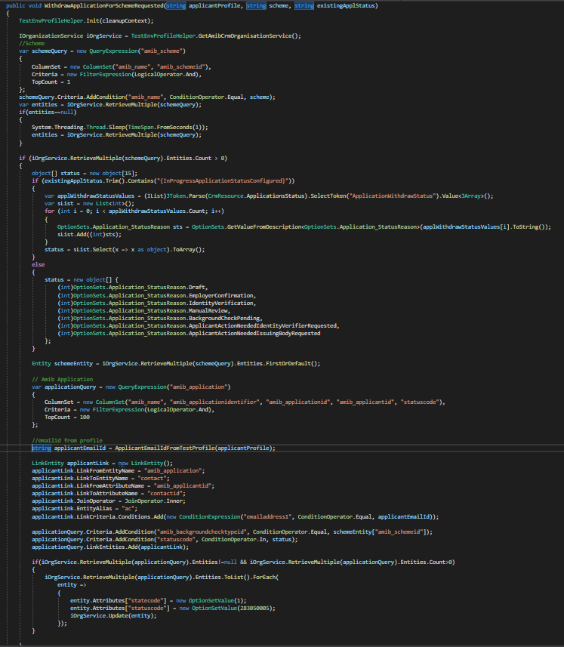
What's Involved (Task Snapshot example)
Task: Withdrawing existing applications to start new application.
Retrieve scheme details
Scenario applicant details
Fetch all application with the required status for the applicant
Update all applications to withdraw status if they are in progress and not BC completed

Slide 9
Handover Details
AMIB
Test Regression Suite was totally broken and only few tests were passing (with hardcode values)
Code does not follow the framework pattern and was developed with substandard coding practices which was too fragile for any updates and fixes
Feature files are not a valid Gherkin (BDD) syntax
Solution code base was not maintainable and not ideal for adding new test scenarios
Xrm/CRM Services implementation was deprecated
Solution dot net framework version is not upgraded for last couple of years which hindering adding new latest nugget packages as required
BCS
Test Regression Suite was running reliably and fully executable
Followed initial framework pattern with good coding standards
Feature files are developed and maintained with valid Gherkin (BDD) syntax
Overall updates required were comparatively low compared to AMIB test suite
Xrm/Crm Services implementation was deprecated
Solution dot net framework version is not upgraded for last couple of years which hindering adding new nugget packages as required
Bulk upload implementation was updated to simplify but resulted in hardcoded pattern which does not support different behaviour in e6 and e7
Major Update/Direction
Decision was taken with-in testing team to rebuild test suite on what's required for regression suite on priority basis following valid BDD syntax and framework pattern
Major Update
BCS was integrated with Biometric systems and test suite names and birth details and photos are all random caused the total suite to fail. Quick fix was done to remove photo from the application for all scenarios to bring the suite operational for regression executions.

Slide 10
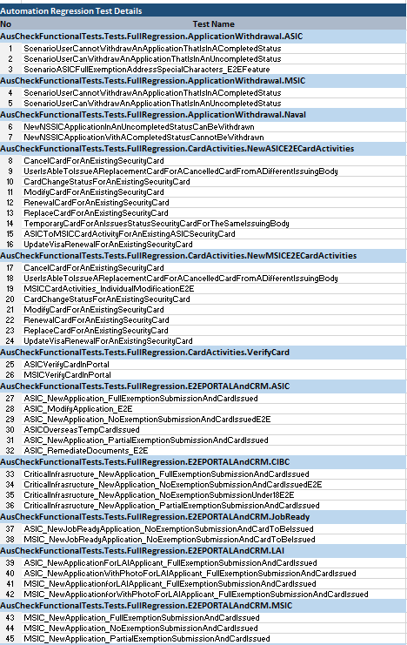
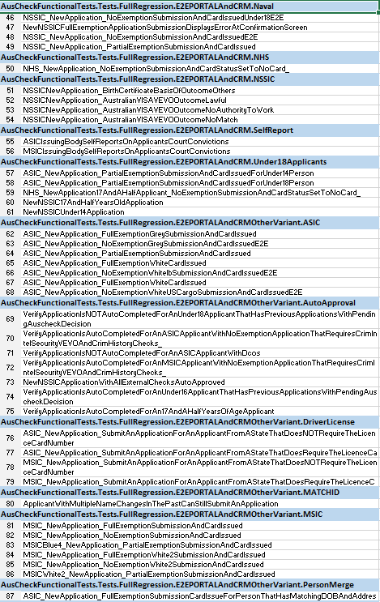
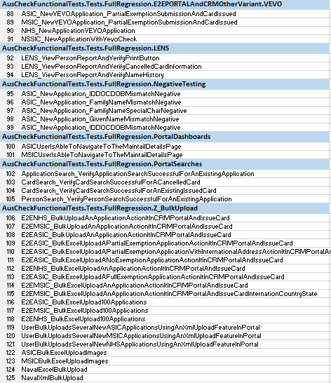
BCS Current and Backlog Status
BCS Scenarios Backlog (High-level Scope)
Web-Services
Biometrics – Auto Merge, Split and Combinations
myGovID logins for e7 to speed up execution
Photo tests
Self report updates
BPF Scenarios
Email verification – Auto Correspondence
Technical Debt – DotNet version upgrade and nuget packages

Slide 11
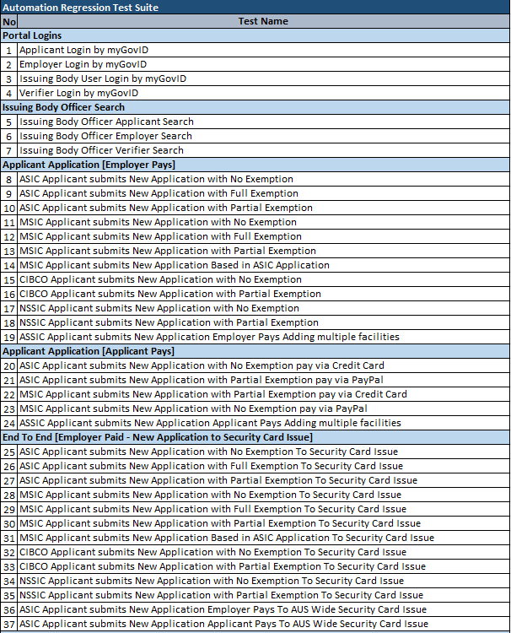
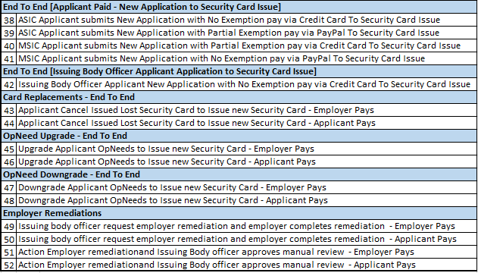
AMIB Current and Backlog Status
AMIB Scenarios Backlog (High-level Scope)
Applicant Full and Targeted remediation (Employer and Applicant Pays including email verifications)
CIBC/Naval – Negative crim history
Card Replacement Faulty Card (Employer and Applicant Pays)
Operational Need Downgrade – MSIC, White card, Naval, CIBC (Employer and Applicant Pays including Email verifications)
Under 18 Application End to End
Facility Management – FO admin, FO users and Employer-Facility
IB officer MSIC paper based application
Few negative outcome scenarios
CIBC and NSSIC – Additional OpNeeds
IB Officer acting as employer and verifier
VEVO applications
Emulating Device testing using screen resolution (Browser Dev Tools)
Note: All the above scenarios were newly implemented with minimal dependency on old the code base

Slide 12
Test Automation FAQs
There’s a lot automated testing brings to the table: efficient testing outcomes, better test coverage, faster feedback and more. But that doesn’t mean you can (or should) automate all of your tests.
In fact, it’s impossible to automate every test – and probably the worst testing decision you can make to even try. Automated tests offer the greatest results when used with manual testing.
Since most automated tests are only capable of checking previously defined scripts, any new feature or integration that gets added must either be tested manually or added to the script.
Prioritizing tests and knowing when (and which tests) to automate is far more important than just knowing how to automate. You will never be able to achieve 100% test coverage just through automated testing. You can, however, increase test coverage by running automated tests with more data and more configurations
When you automate test, you should automate 100%
Test automation totally eliminates the need for manual testing!
Test automation is not a replacement for manual testing. Automated testing is best used to complement manual testing, not replace it entirely.
While automated testing can help speed up the testing process and catch certain types of defects, it cannot replace the human judgment that is needed for certain types of testing (such as exploratory testing)
Test automation is a one-time activity AKA onetime setup and then forget about it
Test automation is not a replacement for manual testing. Automated testing is best used to complement manual testing, not replace it entirely.
While automated testing can help speed up the testing process and catch certain types of defects, it cannot replace the human judgment that is needed for certain types of testing (such as exploratory testing)
There is this belief that machines and technology will always deliver accurate results and lead to success.
However, the automated software is but a component of the entire automation process. It still needs specialized skills to have scripts written, troubleshooting done, and to be run effectively. And the software can still deliver false positives, run into glitches, and occasionally fail to detect bugs.
Clearly, something with its own points of vulnerability cannot be the guarantor of success for your QA all alone.
However, it can increase your likelihood of success and, used in conjunction with other relevant practices, can provide a more comprehensive picture of the application under test.
Automation Guarantees Success
Not everything can be solved by automation. When human observation, upkeep, and collaboration are lacking, automation engineers will always encounter inaccurate results and flaky builds.
New issues can also arise because of automation testing. One issue with automated testing methods, for instance, is coding for more complex scenarios that are simpler to test manually, such as pop-up windows, numerous tabs, and dynamic content.
Testers with particular knowledge and abilities will still be needed for automation testing to manage tools, build scripts, debug issues, and maintain test cases.
All testing issues will be resolved by automation

Slide 13

QUESTIONS

Slide 14
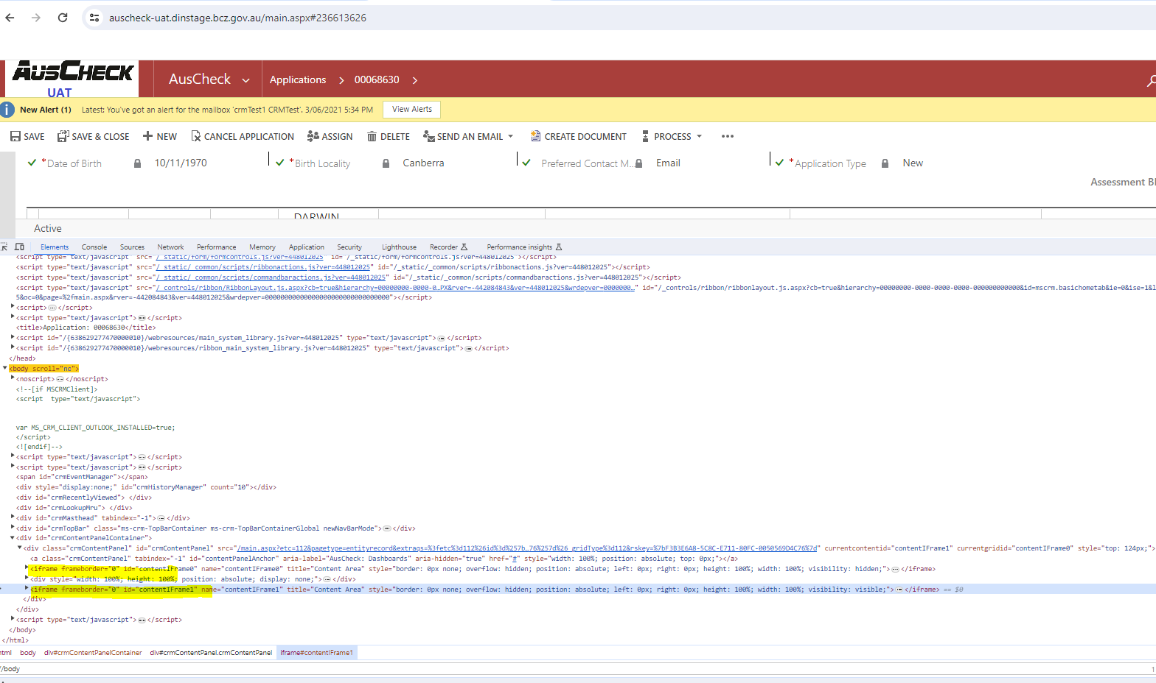
DOM Structure Complexity

Slide 15
Test Automation FAQs
When you automate test, you should automate 100%
There’s a lot automated testing brings to the table: efficient testing outcomes, better test coverage, faster feedback and more. But that doesn’t mean you can (or should) automate all of your tests. In fact, it’s impossible to automate every test – and probably the worst testing decision you can make to even try.
Automated tests offer the greatest results when used with manual testing. Since most automated tests are only capable of checking previously defined scripts, any new feature or integration that gets added must either be tested manually or added to the script. Prioritizing tests and knowing when (and which tests) to automate is far more important than just knowing how to automate. You will never be able to achieve 100% test coverage just through automated testing. You can, however, increase test coverage by running automated tests with more data and more configurations
Test automation totally eliminates the need for manual testing
Test automation is not a replacement for manual testing. Automated testing is best used to complement manual testing, not replace it entirely. While automated testing can help speed up the testing process and catch certain types of defects, it cannot replace the human judgment that is needed for certain types of testing (such as exploratory testing).
Test automation is a one-time activity AKA onetime setup and then forget about it
Test automation is a routine need for your system, like up-keeping a car. Changes, updates, and the natural growth of a business require systems to expand and be tested in new ways. Automated tests must be reviewed regularly to ensure they are still relevant and effective.
Automation Guarantees Success
There is this belief that machines and technology will always deliver accurate results and lead to success. However, the automated software is but a component of the entire automation process. It still needs specialized skills to have scripts written, troubleshooting done, and to be run effectively. And the software can still deliver false positives, run into glitches, and occasionally fail to detect bugs.
Clearly, something with its own points of vulnerability cannot be the guarantor of success for your QA all alone. However, it can increase your likelihood of success and, used in conjunction with other relevant practices, can provide a more comprehensive picture of the application under test.
All testing issues will be resolved by automation
Not everything can be solved by automation. When human observation, upkeep, and collaboration are lacking, automation engineers will always encounter inaccurate results and flaky builds.
New issues can also arise because of automation testing. One issue with automated testing methods, for instance, is coding for more complex scenarios that are simpler to test manually, such as pop-up windows, numerous tabs, and dynamic content.
Testers with particular knowledge and abilities will still be needed for automation testing to manage tools, build scripts, debug issues, and maintain test cases.

