Slide 1
AMIB Test Automation

Slide 2
AMIB Solution
Introduction
AusCheck Branch works with its partners to protect Australia by mitigating trusted insider risks in the aviation, maritime, naval shipbuilding identification assurance program (NSIAP), national health security (NHS) and major national event (MNE) sectors. AusCheck operates on a cost recovery basis to coordinate background checks for employment applicants in those sectors, and also acts as an issuing body for federal, state and territory government officials seeking aviation, maritime and naval shipbuilding security identification cards (ASICs, MSICs and NSSICs). AusCheck maintains a comprehensive database of all applicants and cardholders.
Business Context
The AMIB solution is a key capability for Home Affairs. It facilitates turnkey provision of background check and card management services, direct to applicants and other stakeholders. The AMIB solution supplements existing AusCheck channels, where applicants primarily deal with another party (who then transact with Home Affairs regarding them). The other party is typically their employer, the operator of a secure facility they need to access, or a major national event organiser.
Home Affairs is the lead agency for the Australian Government’s Issuing Body Reforms (IBR) initiative. A major impact from IBR will be extension of AMIB operations to more than just government personnel seeking ASICs, MSICs and NSSICs. The extension involves major changes to AusCheck Branch services, structure, people, finances, training, facilities, equipment, procurements, strategic plans and operational plans. There are also flow-on changes to Identity and Biometric Division (where AusCheck represents a major public-facing service).
AusCheck delivers (or has been listed in Joint Parliamentary Committee reports and similar to deliver) background checking and card management for additional schemes. The AMIB solution may need to be extended in future iterations to support:
Emerging Critical Infrastructure schemes (addressing insider threat, positions of trust and secure facilities risks)
National Health Security (security sensitive biological agents)
Major National Events (ICC T20 World Cup cricket 2020 and 2022, FIFA Women’s World Cup 2023)
US Global Entry Program

Slide 3
CRM Logical Data Model

Slide 4
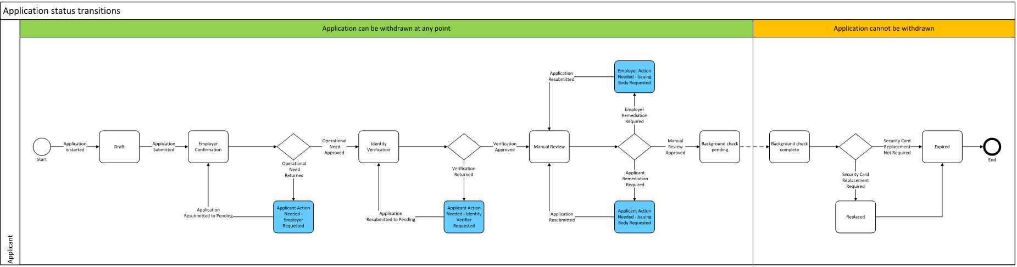
Application Status Flow

Slide 5
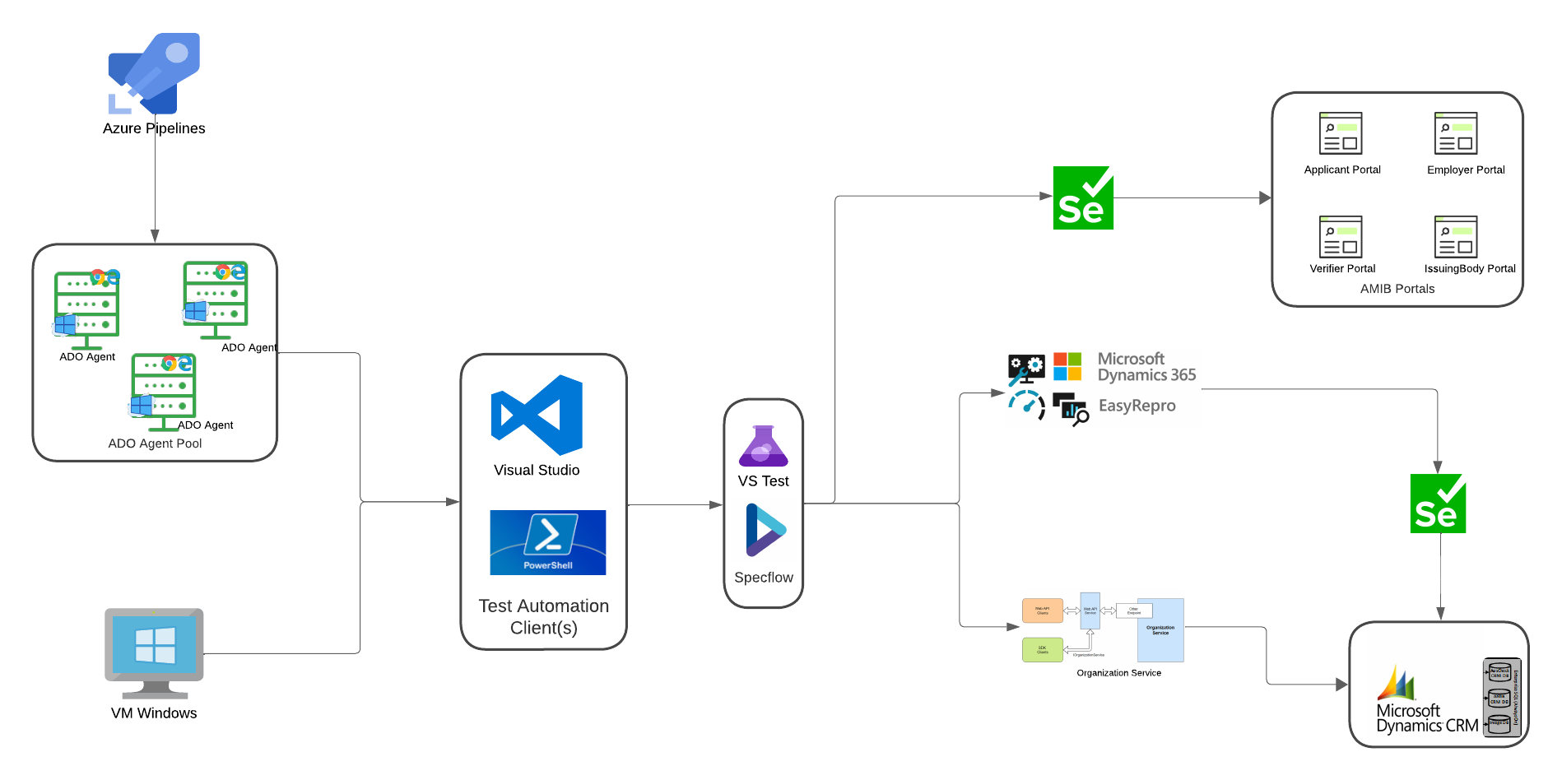
Test Automation Solution

Slide 6
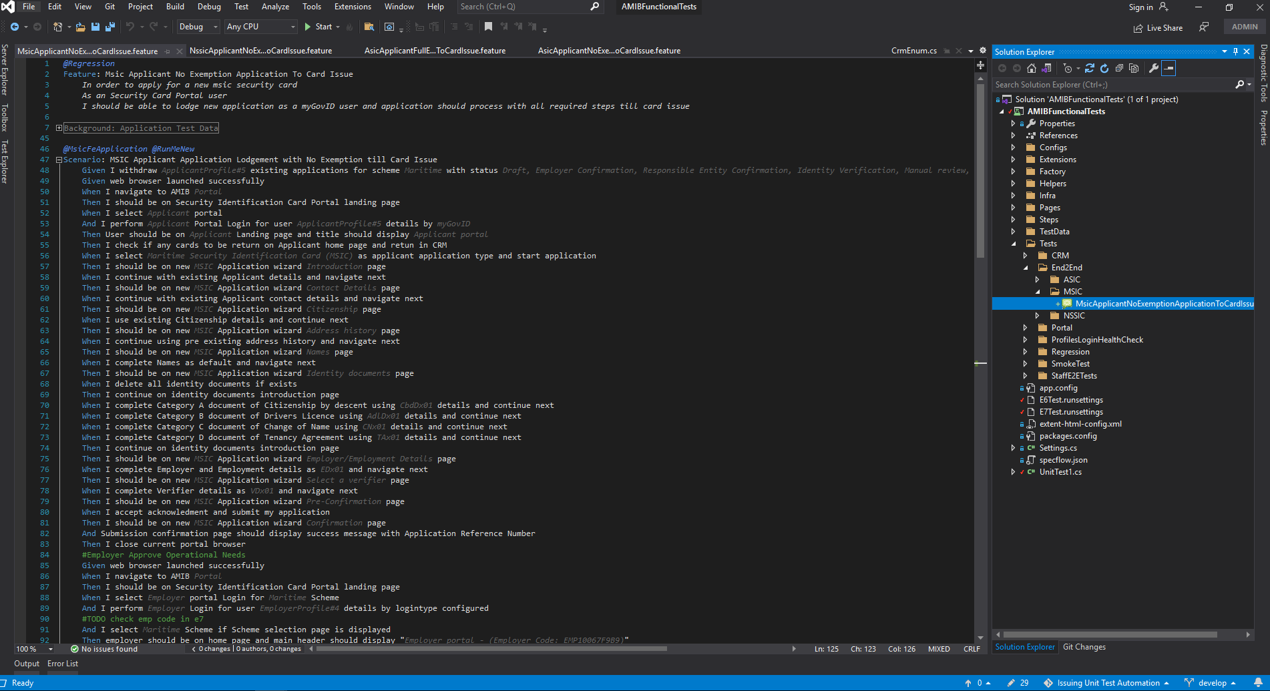
Test Automation Solution Code

Slide 7
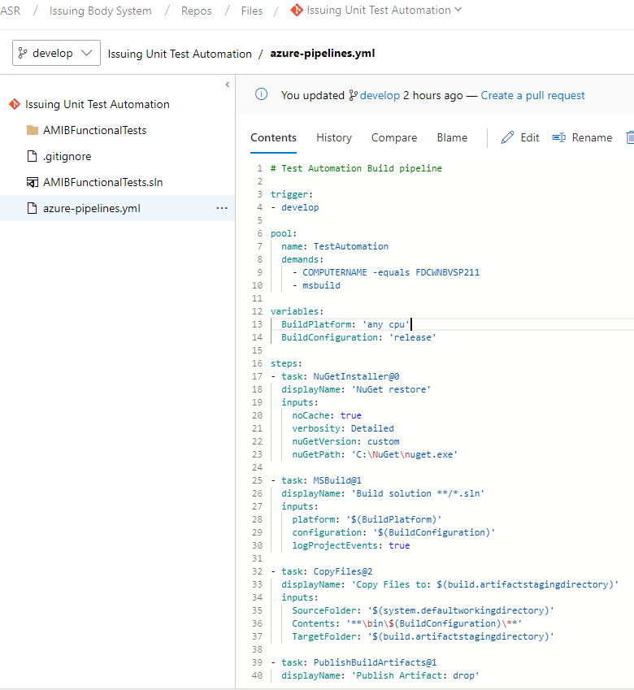
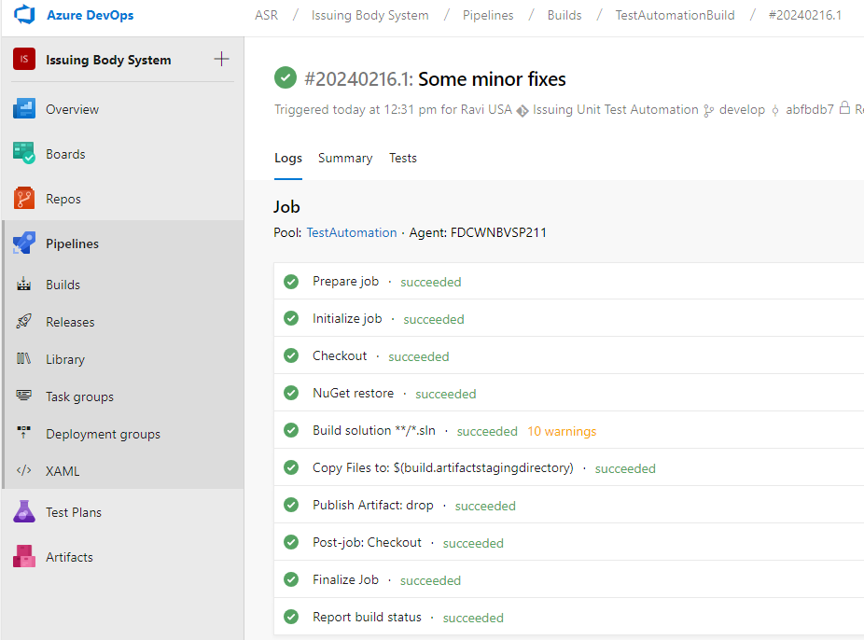
Build Pipeline

Slide 8
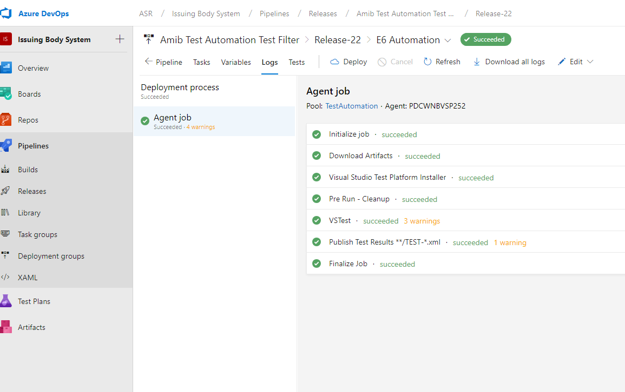
Release Pipeline (Test Execution)

Slide 9
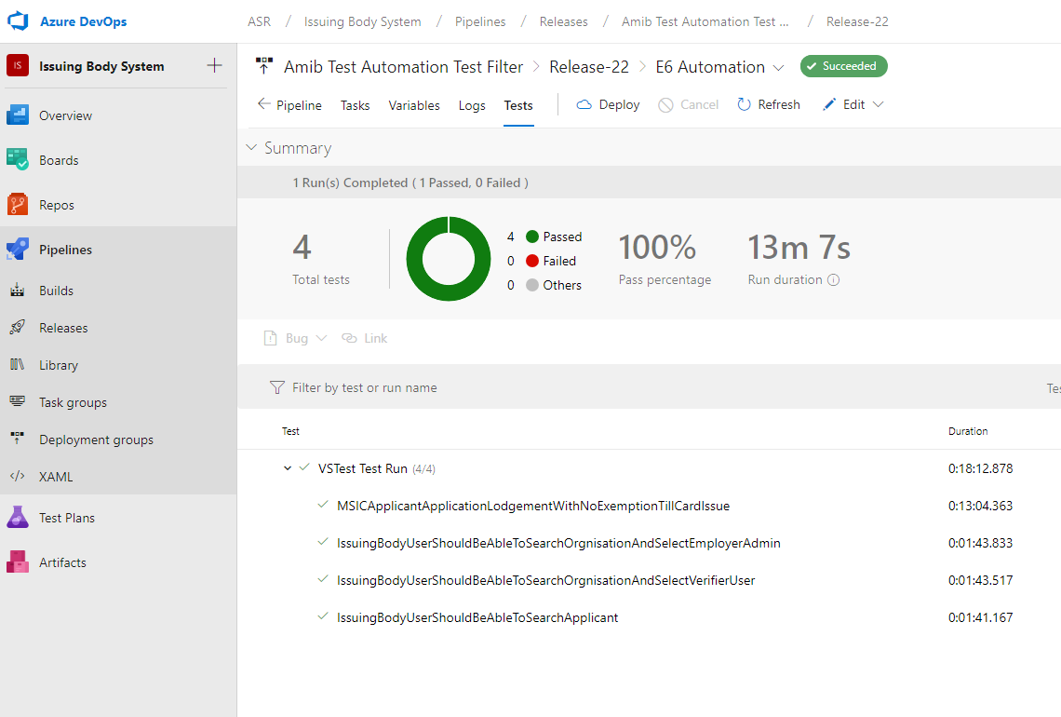
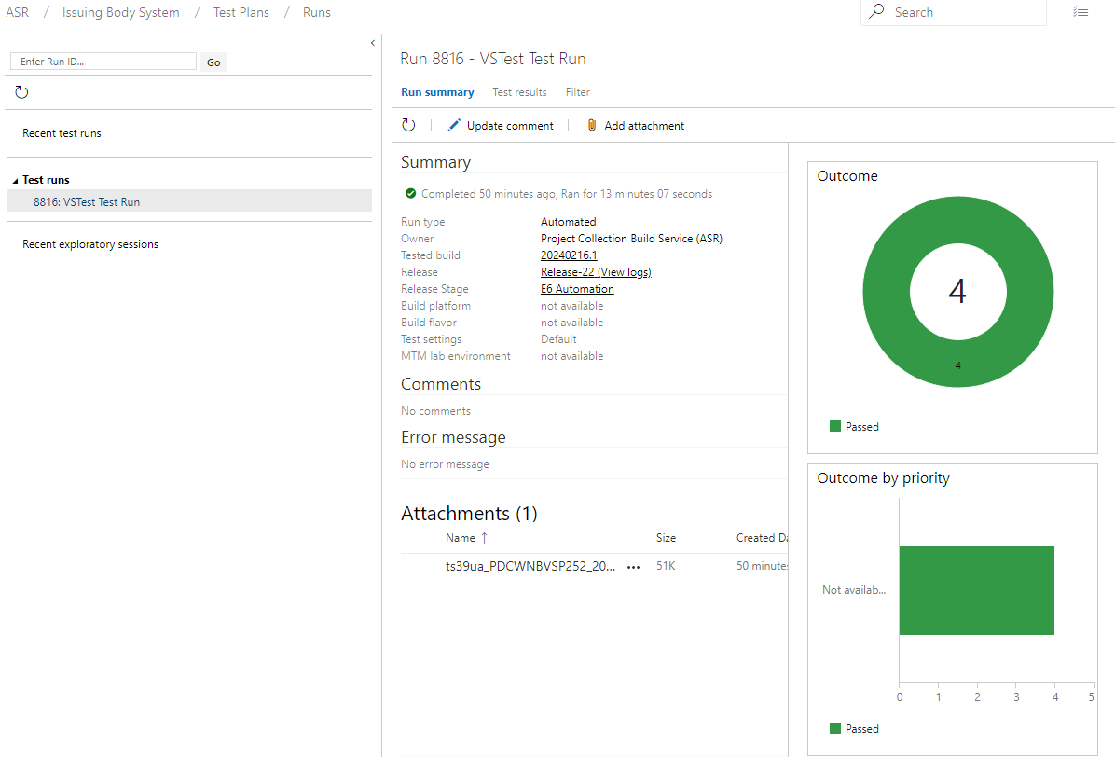
Azure DevOps – Test Run Results

Slide 10
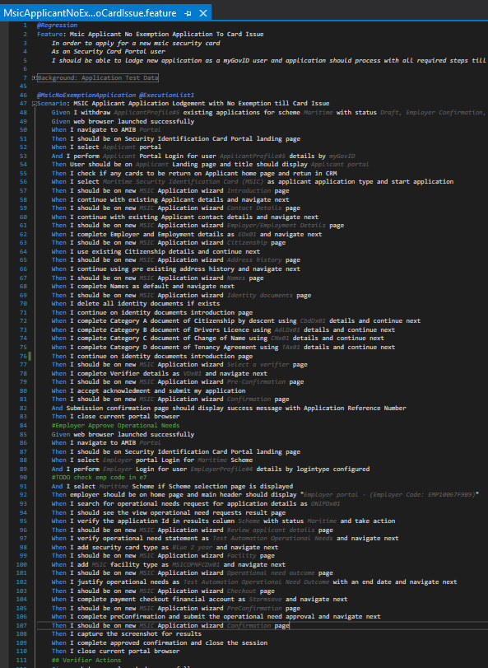
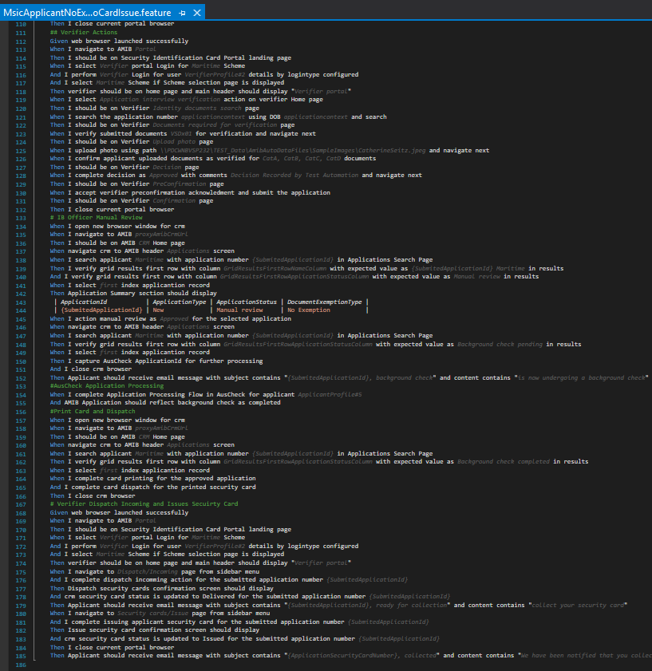
DEMO

Slide 11
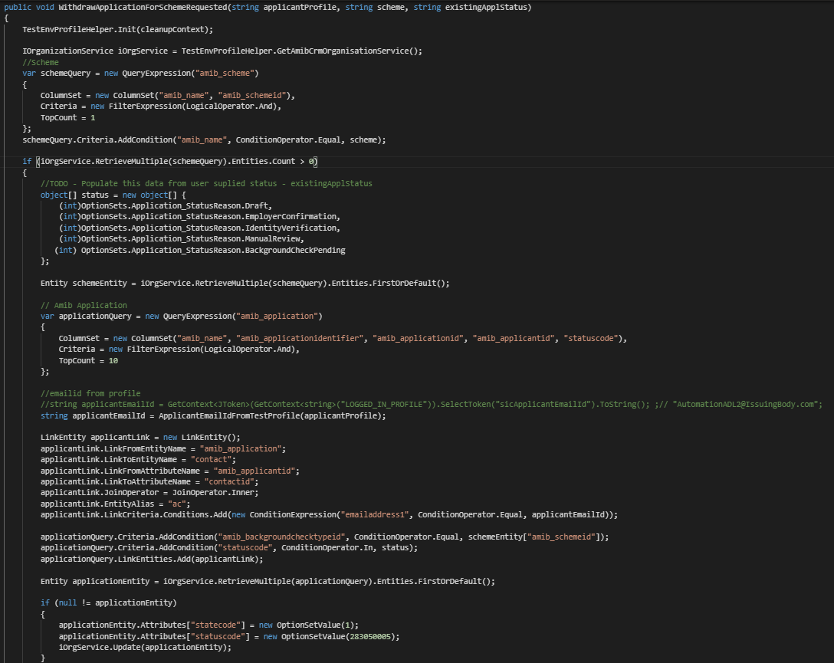

Slide 12
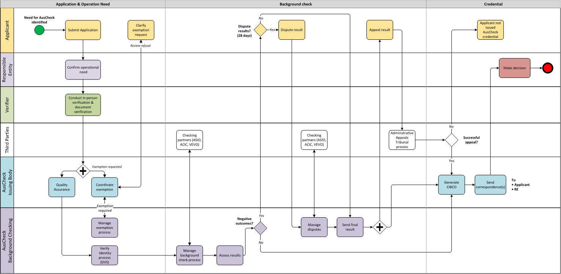
AMIB Application Process

