Slide 1


GROUP 2
MOVEMENT CORRECTION SYSTEM
MEMBERS: Nicolas Schmitt, Hieu Nguyen, Tram Vu, Khoa Dinh

Slide 2
Project Goal
Movement Correction System for a common mistake in boxing
Hardware used: M600 Smartwatch, Verity Sense Sensor, Android phone
real-time identification
Instant feedback on watch/phone
Visualization of Progress: percentage of correct punches in each training session
The mistake explained:
Especially beginner athletes face this problem when punching a straight/cross. After the extension of the arm, they tend to drop their hand towards the ground. With correct technique, the hand is pulled back straight to the jaw.

Slide 3
Methodology
Collection of sample data
  Test person with boxing experience for correct and incorrect samples
  Test person without any experience, instructed
  Test persons without any experience and no instructions
Sample analysis
  Identification of patterns
  Direction and duration of acceleration
Algorithm design
  Search for an algorithm to identify correct/incorrect movements, based on sample analysis
Algorithm testing
  Testing of algorithms with the same test persons

Slide 4
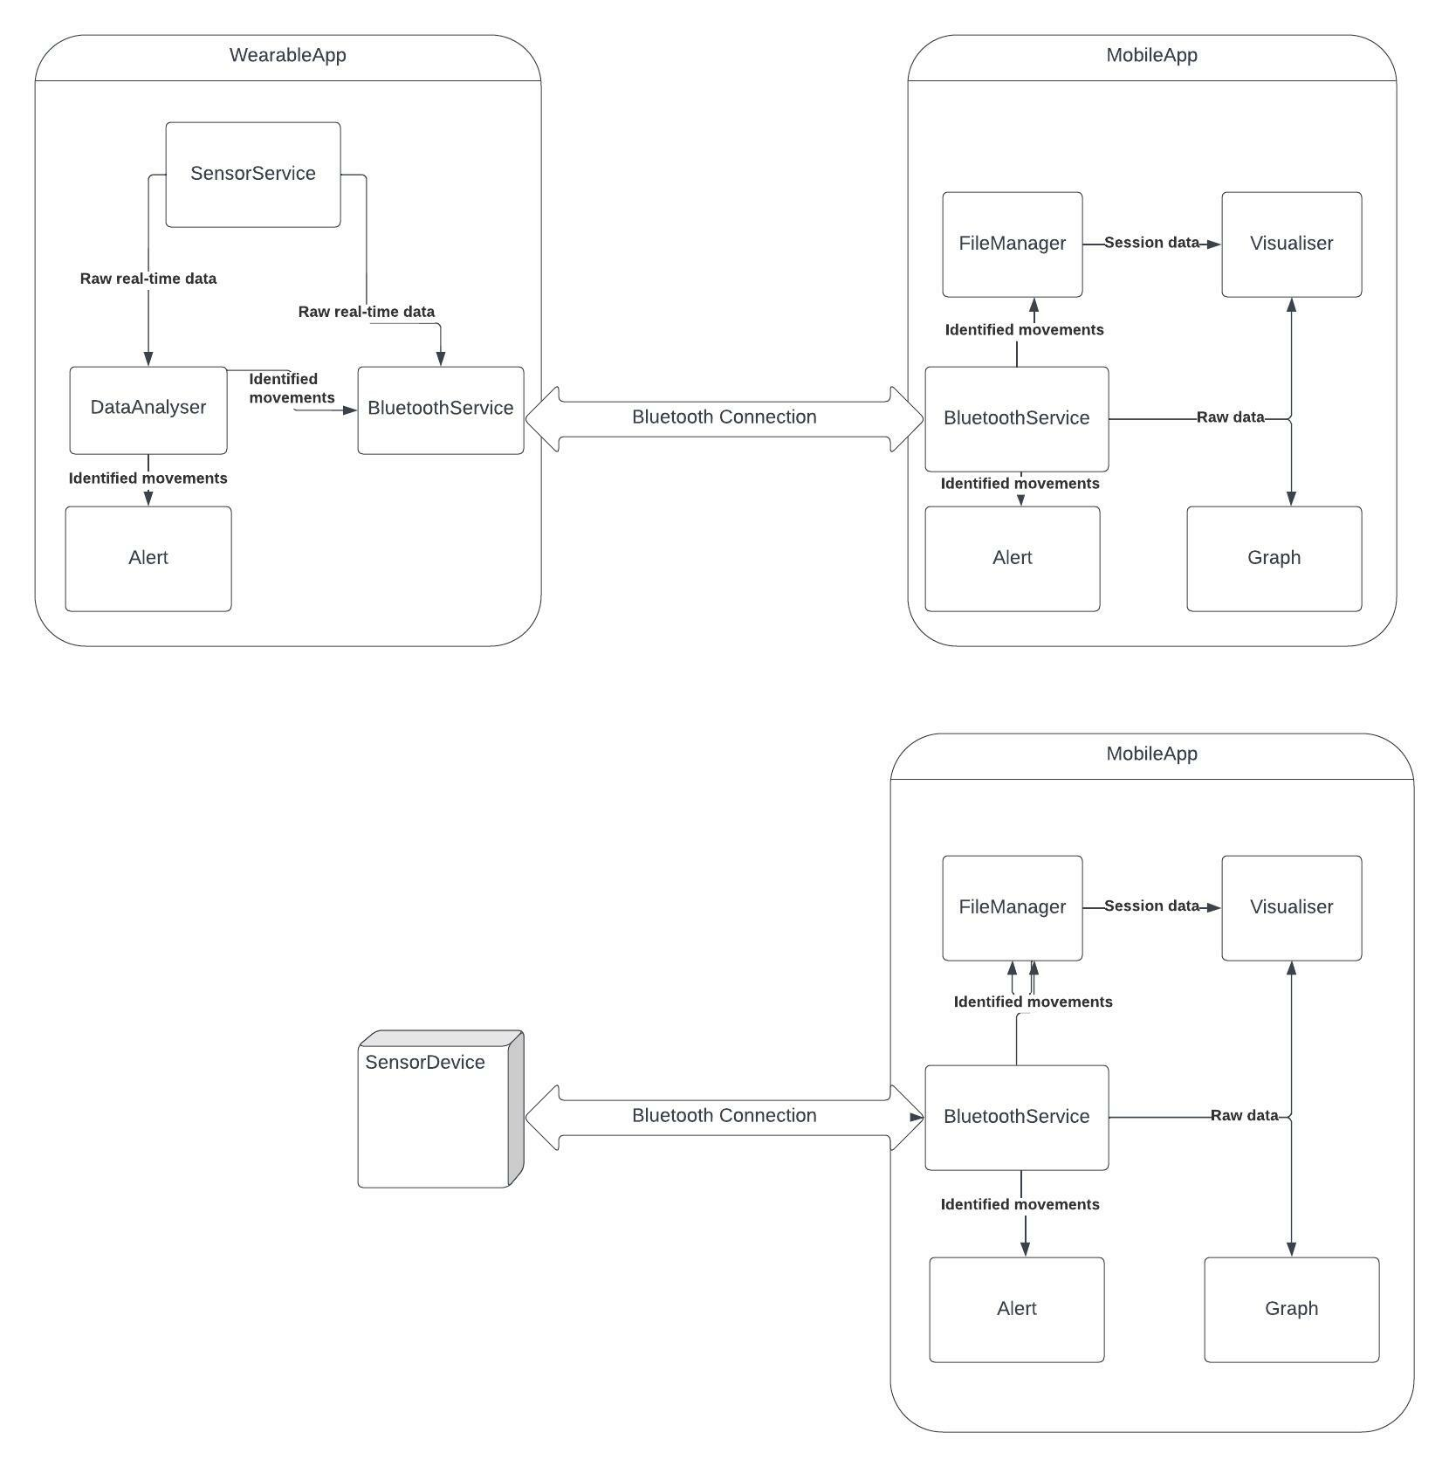
Software Design

Slide 5
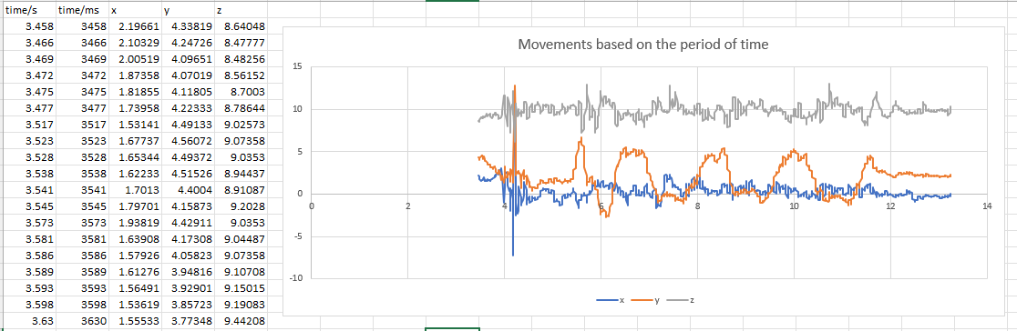
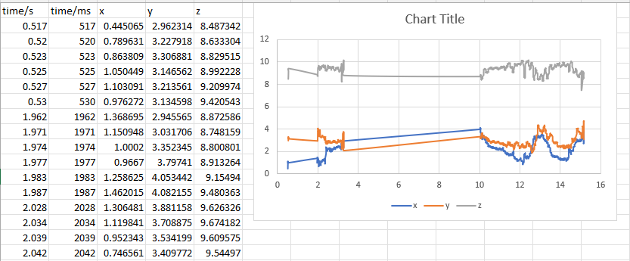
Data analysis

Slide 6
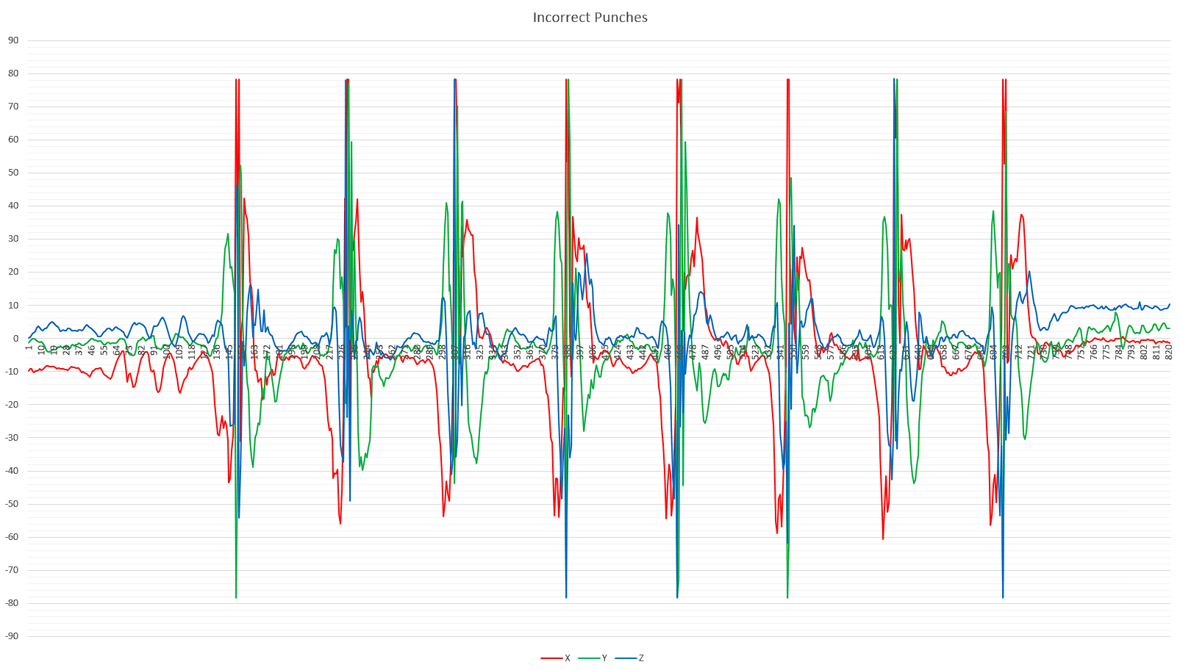
Data Analysis – Incorrect Punches

Slide 7
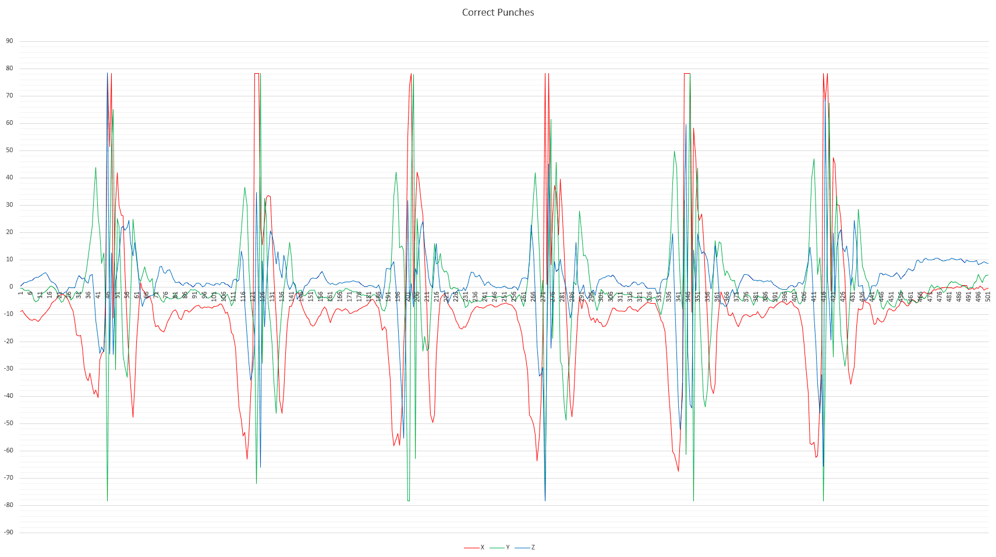
Data Analysis - Correct Punches

Slide 8
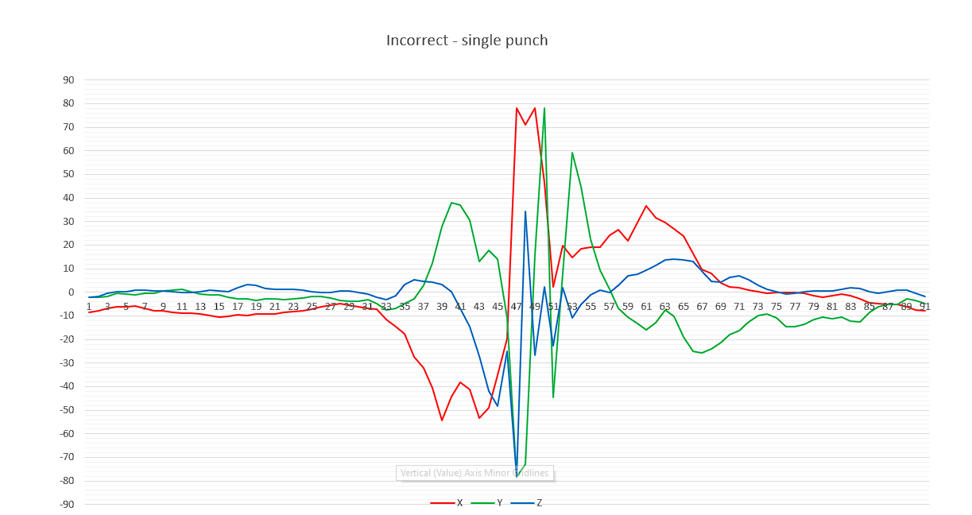
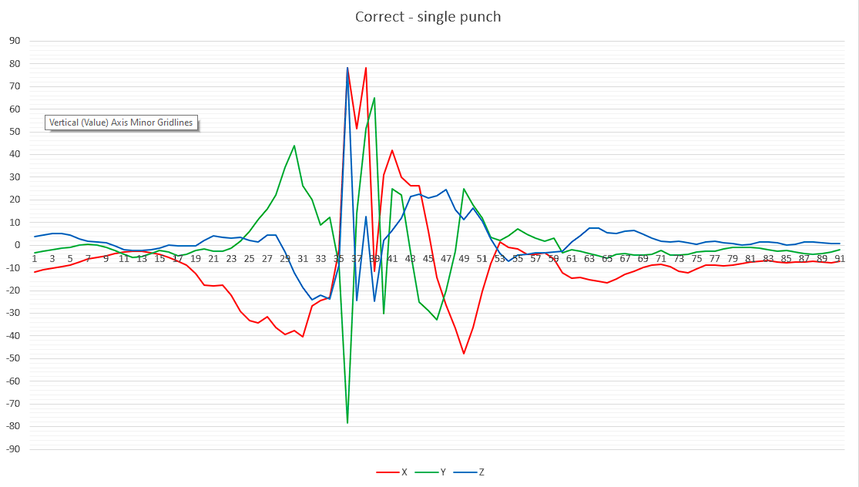
Data Analysis – Comparison

Slide 9
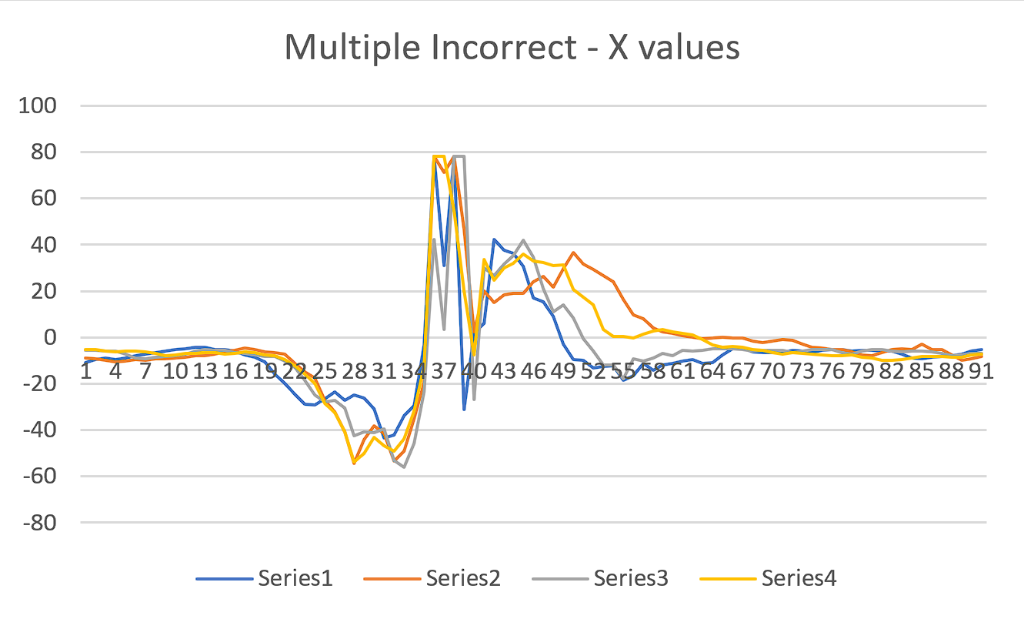
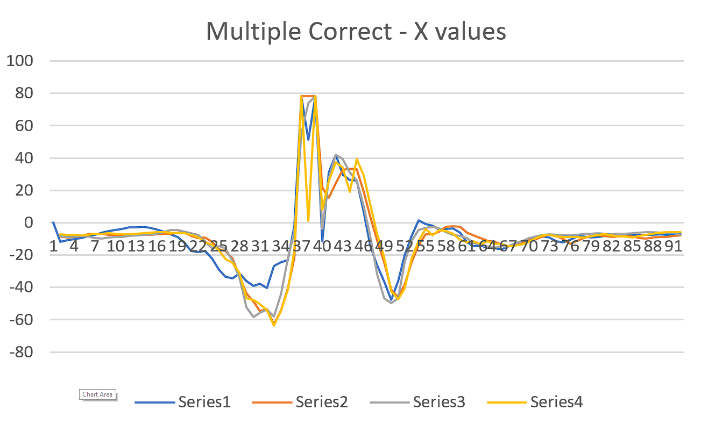
Data analysis - Comparison

Slide 10
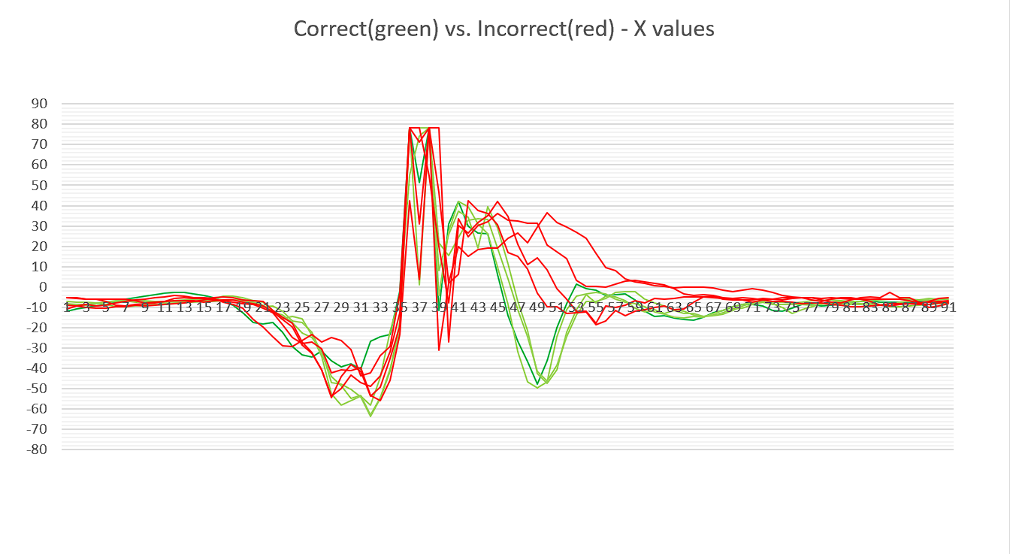
Data Analysis – Comparison of X values

Slide 11
Project Requirements and Milestone
Basic Requirements:
_Read out / extract data from sensor.
_Read out / extract data from watch.
_Analyze data.
_Visualize data in clear and user-friendly format.
Current Milestone:
Data visualization on mobile phone and data analysis finished

Slide 12
Current Status
Wearable App:
  Retrieve sensor data, storage possible in csv file
  Establish Bluetooth connection with phone
  Data streaming from watch to phone
Mobile App:
  Read and show streaming data from the sensor/watch.
  Draw a graph based on the axis data from sensor.
Data Analysis

Slide 13
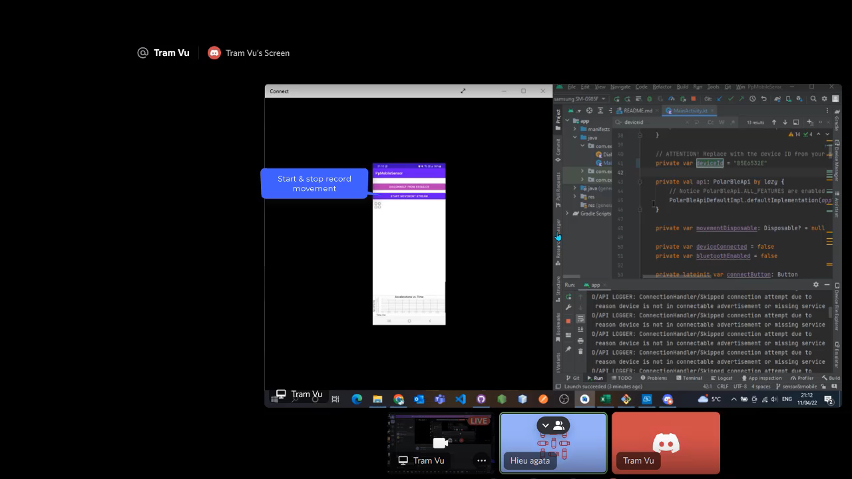
A recording showing how the app works

Slide 14
Upcoming tasks:
Continuing with the Data analysis: collecting more data samples.
Finalize the Software Design and details, UI.
Implementation done.

Slide 15



