Slide 1

Group 2 movement correction system
Nicolas Schmitt, Hieu Nguyen, Khoa Dinh, Tram Vu

Slide 2
Current Milestone?
Final software design
Algorithm for mistake identification

Slide 3
What we changed in our planning
Reaction to last Presentations feedback:
More focus on Product Development
What do users actually want?
User research: Interviews with possible users
Change in requirements based on the interviews
Which data do we want to visualize and how?
Based on User Research: mainly focus on boxing-specific performance data(speed/stamina)

Slide 4
User research
Standardized Interviews with boxers of different skill levels
Main changes/additions in requirements:
Focus on boxing-specific performance data: punching speed and stamina
Round-based training sessions
Less focus on mistake recognition, because beginners are usually not able to correct problems themselves
Full documentation can be found on github

Slide 5
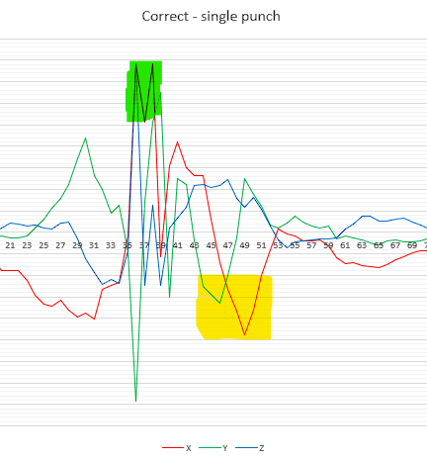
Data analysis & algorithms
Current algorithms for:
Punch recognition
Based on acceleration threshold(x – forward direction)
prevents counting one punch multiple times
Hand dropped after a punch connects
Based on acceleration threshold(x – forward, y – wrist rotation)
Both algorithms successfully tested with sample data, real world testing(with different test subjects) is still needed
Algorithms for speed calculation is still needed

Slide 6
UI DESIGN :
https://www.figma.com/file/Rj2K6yia15705oUkY1Cfv0/Polar-Project?node-id=0%3A1&t=2OtLA0n0b4dZONdw-0
https://www.figma.com/file/Fgp7wYVid2xmknKW4hEb55/Polar-team-library?node-id=0%3A1&t=U1h12dUdxMuoa71z-0
TRELLO BOARD UPDATED:
https://trello.com/b/spMHJ8pW/team2

