Slide 1

GUIDE: 2D Animation Tool
Prepared By: SYSON, Michael B
Last Updated: 2023-03-22
Website: www.usbong.ph
Creative Commons Attribution License BY 4.0
https://creativecommons.org/licenses/by/4.0/

Slide 2
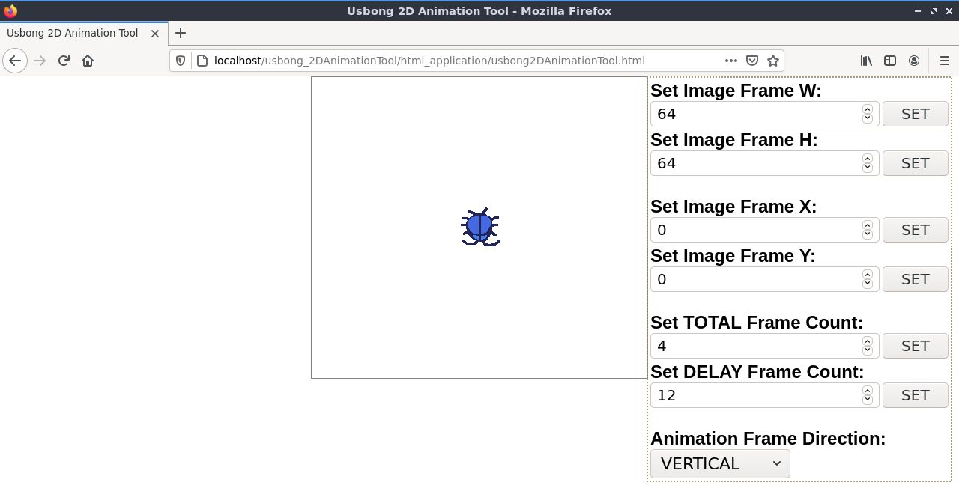
START PAGE
LOCAL WEB ADDRESS:
http://localhost/usbong_2DAnimationTool/html_application/usbong2DAnimationTool.html

Slide 3
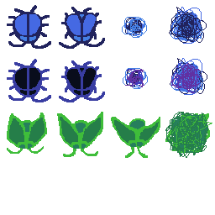
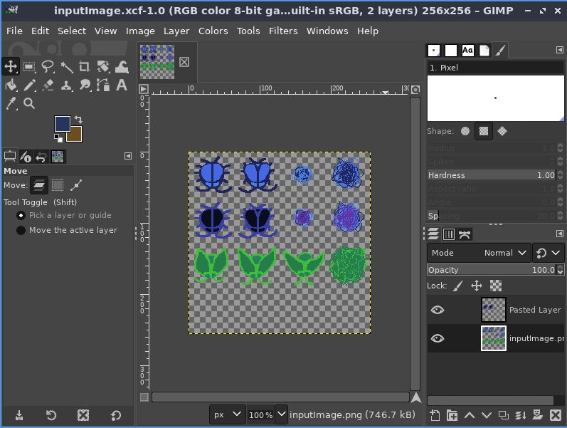
INPUT IMAGE FILE LOCATION:
/var/www/html/usbong_2DAnimationTool/assets/images
inputImage.png
inputImage.xcf
GIMP Image Manipulation Editor Tool

Slide 4
W: 64px
H: 64px

Slide 5
X: 0px
Y: 0
px

Slide 6

X: -64px
Y: 0
px

Slide 7
FRAME COUNT
1 2 3 4

Slide 8

FRAME COUNT
1 2 3 4

