Slide 1


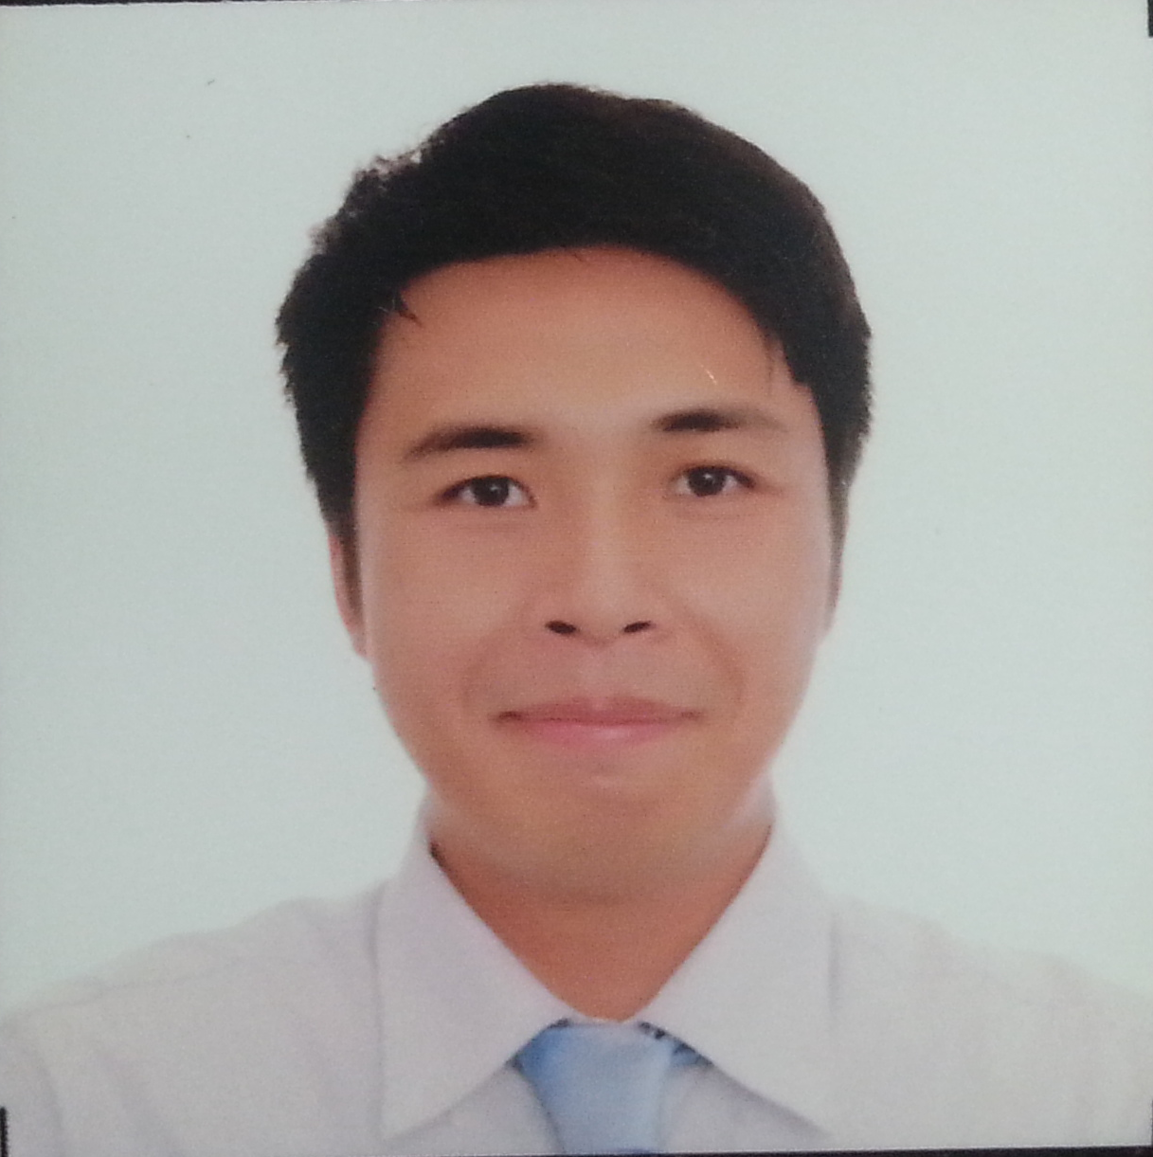

Database: Cloud Computing
Fact (Research by Harvard Business Review Analytic Services):
Cloud Users: Email, Customer Relationship Management, Human Resource Management, Service Management
Cloud Leaders: Procurement, Supply Chain, Accounting
Cloud Leaders+: Clinical Trials, Drug Development
Global Survey: 376 business and technology leaders
Expand into new geographies
Expand into new market segments
Launch new products
Enter new businesses
Cloud Users with Growth Initiatives
Michael B. Syson, Founder
www.usbong.ph | Computer Services
™

Slide 2
™
Introduction to eHealth
USBONG EDUCATION TRAINING COURSE:
In this training course, we use the computer to maintain a good network environment situation by observing, writing, tuning, and using methods to process main troubles. In addition, we learn to make various reports.
Note: network = ugnayan
CA (Computer Associates). (2008). “CA Education Training Guide: 2008 Summer (Vol. EDU0805)”. New York: CA. Translated from nihongo to English and Filipino by Syson, Michael
Michael B. Syson, Founder
www.usbong.ph | Computer Services
™

Slide 3

Practical Application: Philippine Context
Incident Report: Earthquakes off Taiwan damaged undersea cables (2006-12-26)
6 of 7 undersea cable systems (90% of telecom capacity of the region) broke in the quake and its aftershocks.
Initial Magnitude: 7.1
Globe Telecom: “…the entire country’s telecom services to the United States was disrupted.”
PLDT: Internet service and international phone calls intermittent
Schwalbe, K. (2011). “Management of Information Technology Projects”. Philippines: Cengage Learning Asia Pte. Ltd.
Michael B. Syson, Founder
www.usbong.ph | Computer Services
™

Slide 4
Practical Application: Philippine Context
Security Defense Force: The Immune System
External: Skin Barrier
Internal: White Blood Cells to fight invasion/infection
WBC manufactures specific antibodies to destroy or stop the growth of harmful germs via bloodstream
Antibodies remember identified & classified germs
Cybercriminals: budol-budol/swindlers/manloloko
Weapon: wireless/broadcasting technology
Halimbawa:
Ayusin ang aktibong ugnayan ng mga manggagawa upang puksain o ihinto ang paglaganap ng mga manloloko.
Michael B. Syson, Founder
www.usbong.ph | Computer Services
™

Slide 5
References
1) Harvard Business Review. (2015). “Cloud Computing Comes of Age". USA: Harvard Business School Publishing
2) CA (Computer Associates). (2008). “CA Education Training Guide: 2008 Summer (Vol. EDU0805)”. New York: CA. Translated from nihongo to English and Filipino by Syson, Michael
3) Schwalbe, K. (2011). “Management of Information Technology Projects”. Philippines: Cengage Learning Asia Pte. Ltd.
4) Gauwitz, D. (2012). “Administering Medications: Pharmacology for Healthcare Professionals (7th Ed)”. Philippines: The McGraw-Hill Companies, Inc.
5) Rhodes, R. (1986). “The Making of the Atomic Bomb”. NY: Simon & Schuster, Inc.
Michael B. Syson, Founder
www.usbong.ph | Computer Services
™

