Slide 1


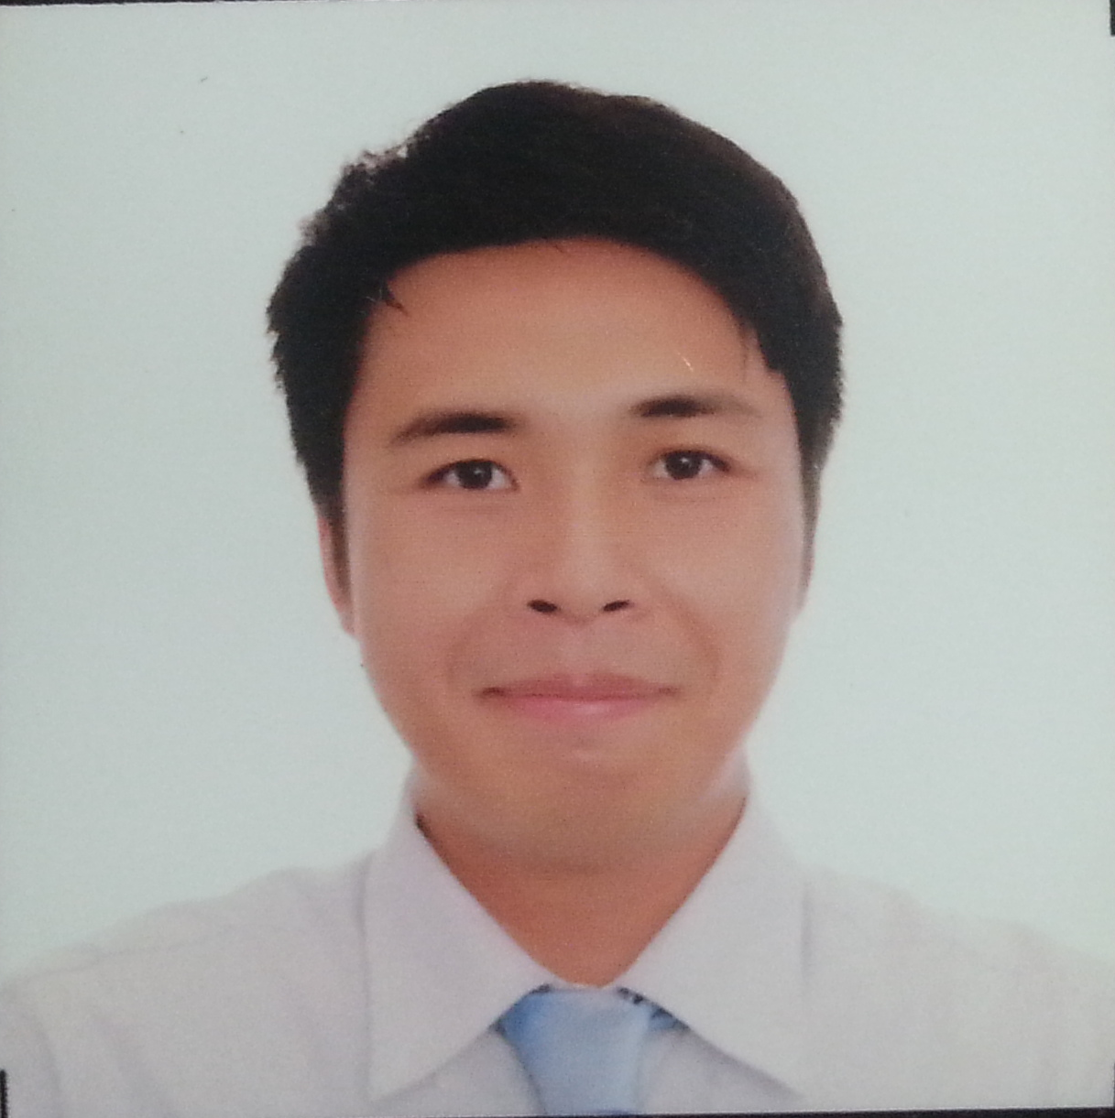

Healthineers: Problem
Employee leaves
Workload increases for remaining employees
Workload and lack of staff impact patient care
Patients report poor satisfaction; profits decline
Staff report poor satisfaction; profits further decline
Fact (Research at German Hospitals):
inefficient system usage
frustrated users
dissatisfied patients
higher costs
wasted time
decline in reputation
Michael B. Syson, Founder
www.usbong.ph | Computer Services
™

Slide 2
Healthineers: Solution
Knowledge Management System (KMS): “ShareNet”
Database Repository, Chat Room, Search Engine
Ginawa ito upang malutas ang problema ukol sa system inefficiency, dahil hindi maiging naibabahagi ang dunong at kaalaman ng mga manggagawa sa isa't isa.
Turban, E., Rainer, Jr., R., Potter, R. (2005). "Introduction to Information Technology (3rd Ed)". Philippines: John Wiley & Sons, Inc.
Michael B. Syson, Founder
www.usbong.ph | Computer Services
™

Slide 3

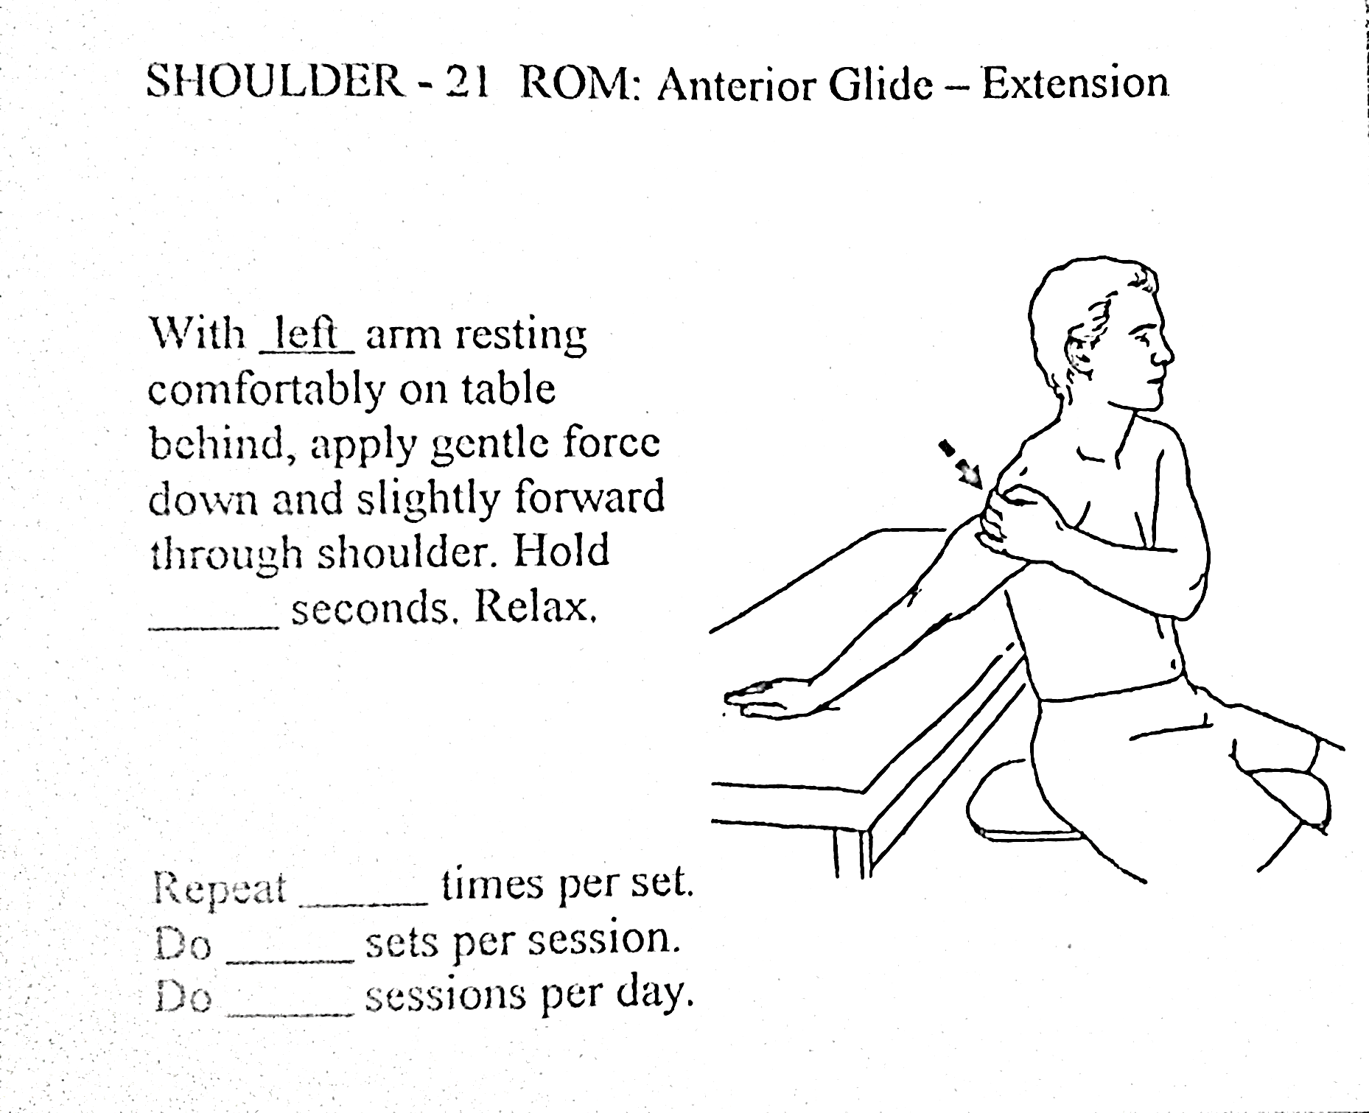
Practical Application: Philippine Context
Knowledge Management System (KMS)
Training/Education:
Computer Automation
Reports
Monthly, Annual
Meeting Minutes
Incident
Advice
Visual Health Information Tool
Michael B. Syson, Founder
www.usbong.ph | Computer Services
™

Slide 4
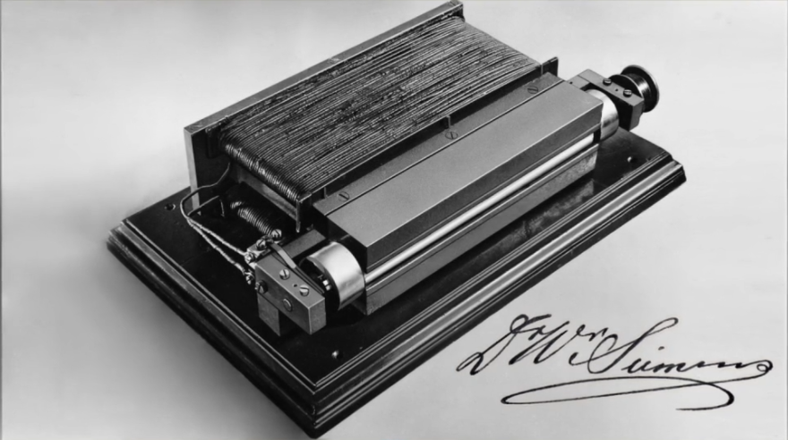
Practical Application: Philippine Context
Finance/Accounting
Isulat ang pang-araw-araw na gastusin.
Mag-ipon ng hindi bababa sa 10% ng kinikita.
Gamitin ang naipon sa mga investment bilang dagdag na kita, bukod pa roon sa kinikita sa hanap-buhay.
Halimbawa:
Mutual Funds
Peso Bonds
Mechanical → Electricity
Michael B. Syson, Founder
www.usbong.ph | Computer Services
™

Slide 5
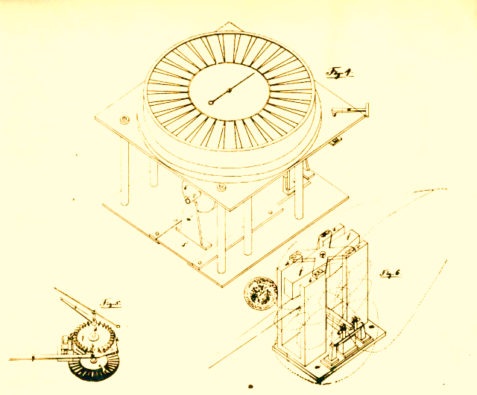
References
Siemens Healthineers. (2018). "Attracting and Retaining Medical Staff: How to transform care delivery by enhancing job satisfaction and developing the skills of healthcare professionals". Germany: Siemens Healthcare GmbH.
Turban, E., Rainer, Jr., R., Potter, R. (2005). "Introduction to Information Technology (3rd Ed)". Philippines: John Wiley & Sons, Inc.
Note: Select Images from https://new.siemens.com/ph/
en/company/about.html; last accessed: 20190721
Michael B. Syson, Founder
www.usbong.ph | Computer Services
™

