Slide 1


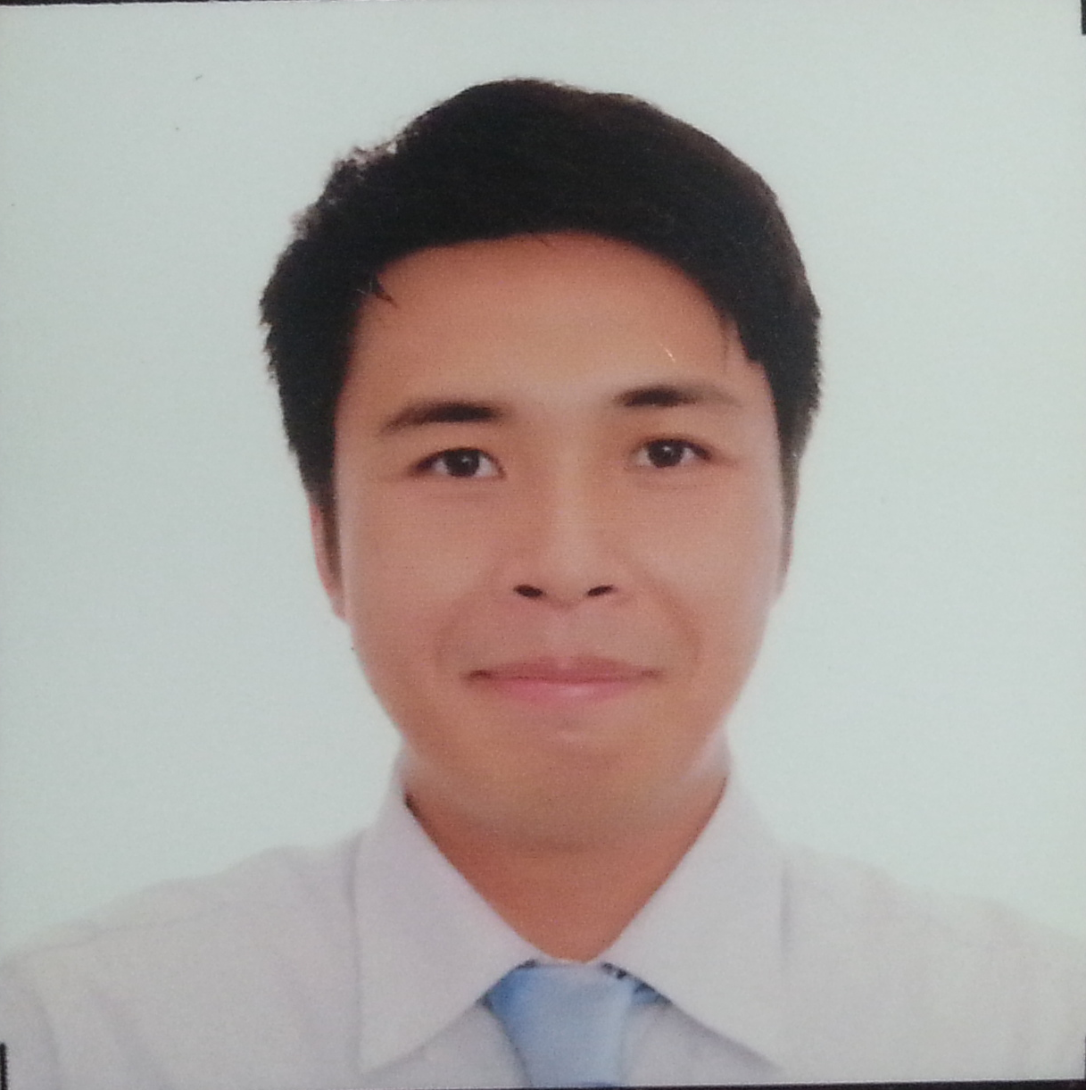

NIPPON TELEGRAPH AND TELEPHONE
“Mathematical Optimization promotes communication”
Practitioner Entities: Japan Railway
Station, Chain Store, Call Center,
Production Center, Air Conditioning
Due Dates
Resources
IT System Integrator
While (!Satisfy(output)) {
Collect data;
Build model;
Solve;
Examine result;
If (budget?) Exit;
}
Managerial Personnel:
Save Cost! Go Digital!
SYSON, MICHAEL B., Founder
www.usbong.ph | Computer Services
™

Slide 2
SONY: HARDWARE EXPANSION VIA SOFTWARE PROFIT
@1USD:54PHP
PLAYSTATION PRICE HISTORY
1. SCPH-1000 (1994-12): 399USD; 21,546PHP
2. SCPH-3000 (1995-07): 299USD; 16,146PHP
3. SCPH-3500 (1996-03): 249USD; 13,446PHP
4. SCPH-5000 (1996-07): 199USD; 10,746PHP
5. SCPH-7000 (1997-11): 180USD; 9,720PHP
1997: 3~4.99Million consoles sold; 1998 >10Million
Solution: Establish overseas markets, e.g. UK, Germany, Italy, Spain, Switzerland, and Austria
Problem: Warehouse (Japan) 500K~600K excess stock due to sales forecast overly optimistic
SYSON, MICHAEL B., Founder
www.usbong.ph | Computer Services
™

Slide 3
SOFTWARE EXPANSION VIA REPEAT PRODUCTION
@1USD:54PHP
Solution: No need to make perfect
demand forecasts; Make copies if title sells
PlayStation software retail price: 58USD (3,132PHP), i.e. ½ that of Super Family Computer (Famicom)
“Greatest Hits” price: 28USD (1,512PHP) each
1993-10~1994-09: Super Famicom software retail price: >100USD (5,400PHP)
—> Sold quickly by kids to used-software dealer for 50USD
—> Dealer: Resells 70USD (3,780PHP); 50USD + 20USD
SONY verified using simulations: software producers and retailers still make profit at the reduced price and royalty
SYSON, MICHAEL B., Founder
www.usbong.ph | Computer Services
™

Slide 4
Practical Application: Philippine Context
PlayStation Sales Results: 1.78 price elasticity
where value <1 = necessity, i.e. people buy
with less and less regard for price
Example (at present): insulin medicine
Ayusin via Maparaang Pagbibilang ang sistema
sa Pinas upang may 1.78 price elasticity
ang PlayStation sa “general public”
Halimbawa:
2020: Filipino family bumibili ng PlayStation 4 console + Minecraft Dungeons @PHP10K
Previously:
2007: Nintendo DS Lite + New Super Mario Bros. @PHP10K
1996: PlayStation + Street Fighter Zero @PHP10K
SYSON, MICHAEL B., Founder
www.usbong.ph | Computer Services
™

Slide 5
References
1) Tanabe, T. (2019). 'Optimization'. Japan: NTT Data Mathematical Systems Inc. https://www.msi.co.jp/english/optimization.pdf;
last accessed: 20201113;
2) Asakura, R. (2000). "Revolutionaries at Sony". USA: The McGraw-Hill Companies, Inc.
3) Hayes, A., et al. (2020). Business Essentials: Elasticity. https://www.investopedia.com/terms/e/
elasticity.asp; last accessed: 20201113
4) Khan Academy. (2020). “Microeconomics Unit: Elasticity”. https://www.khanacademy.org/economics-finance-domain/microeconomics/elasticity-tutorial; last accessed: 20201113
SYSON, MICHAEL B., Founder
www.usbong.ph | Computer Services
™

