Slide 1
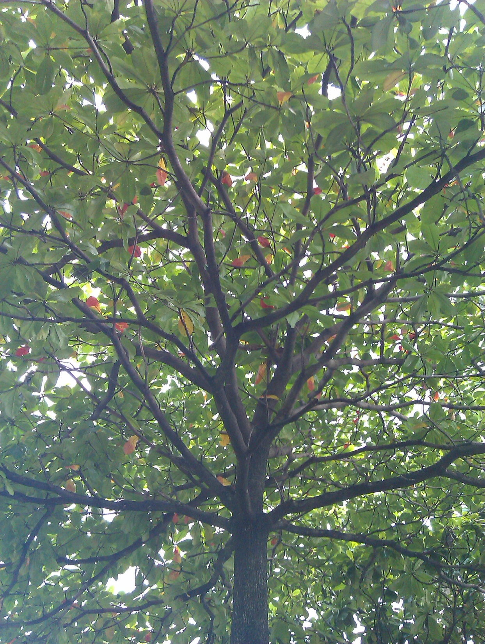



Usbong
step-by-step guideline
decision tree
mobile application
Michael Syson, M.S.
Ateneo Innovation Center
m.syson@ateneoinnovation.org

Slide 2
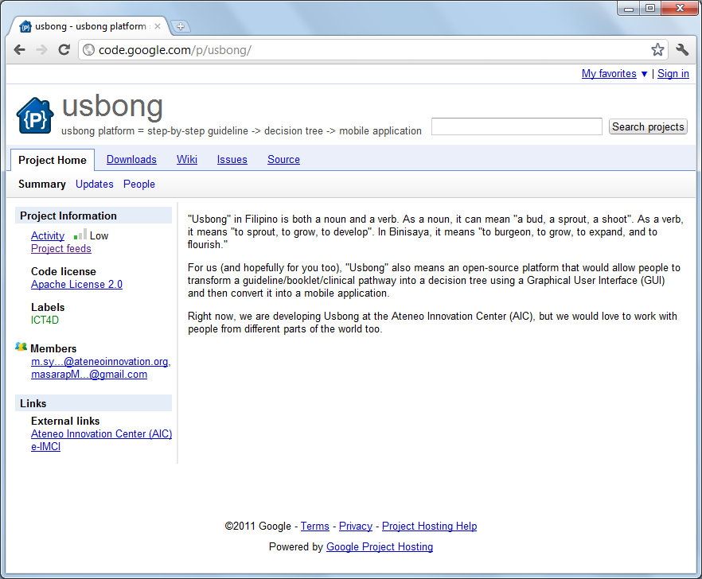

Slide 3
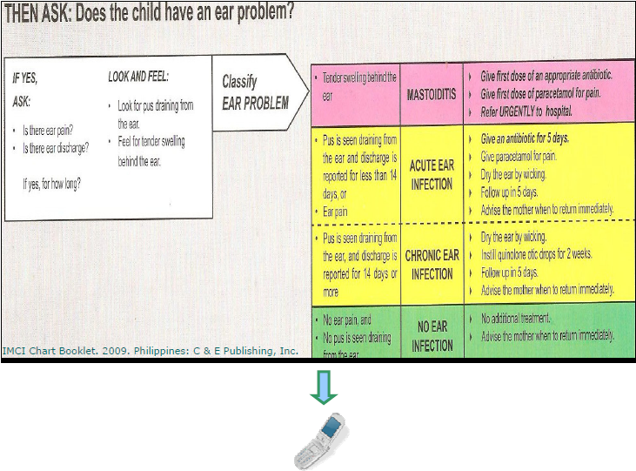
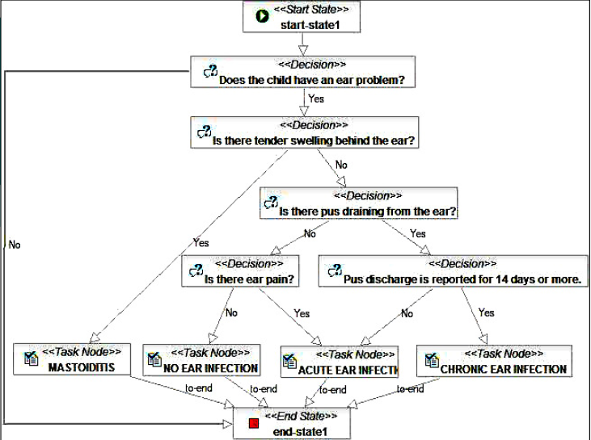
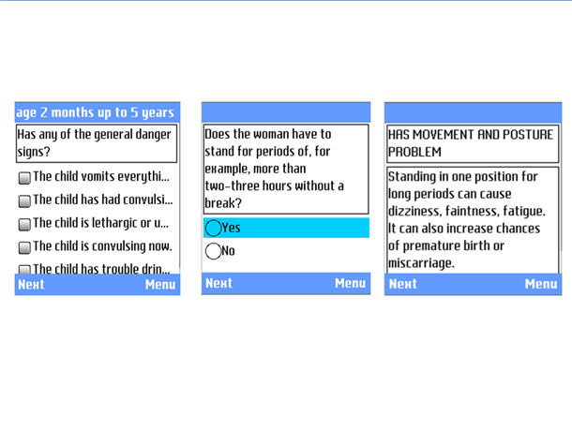
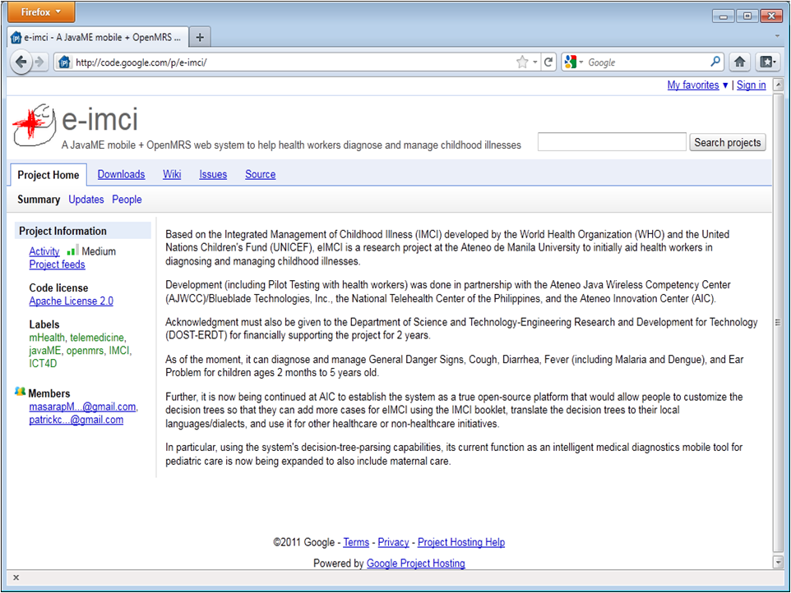

Usbong: Mobile Decision Tree Platform
Notes:
Usbong was initially used to diagnose and manage childhood illnesses (eIMCI) on a low-cost JavaME mobile phone

Slide 4
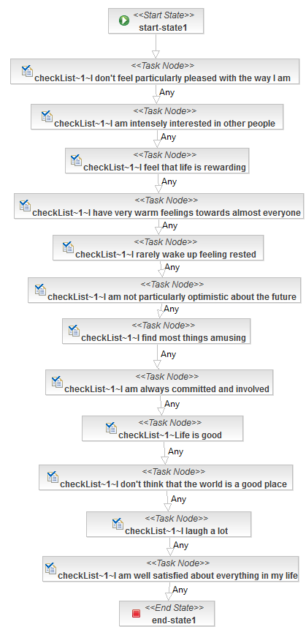
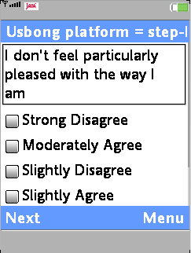
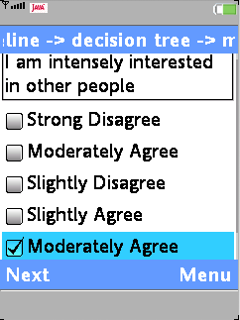
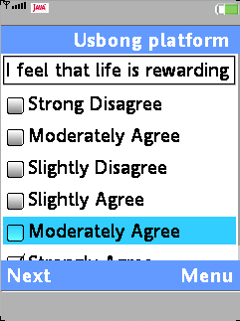
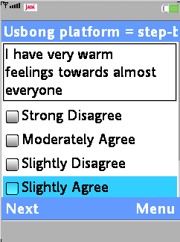
Notes:
Here’s Usbong used to create a Happiness Survey.
It uses checklists instead of radio buttons, because JavaME version of Usbong has only Yes/No radio buttons. Having multiple radio buttons (where only one gets selected/ticked) would definitely be included in Usbong for Android.

Slide 5
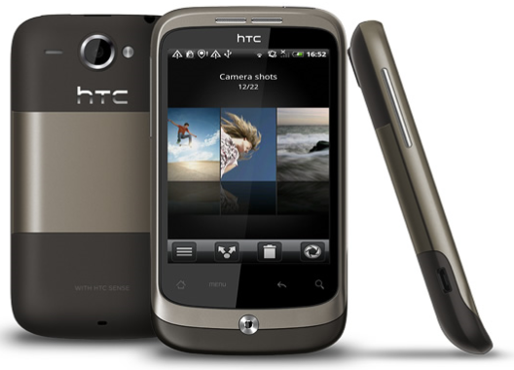

Notes:
In-progress: conversion of Usbong from JavaME to Android

Slide 6

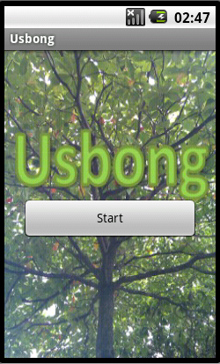
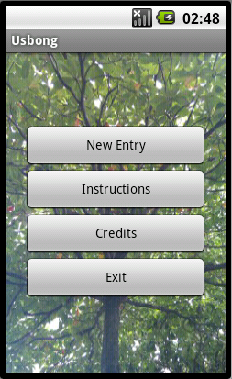
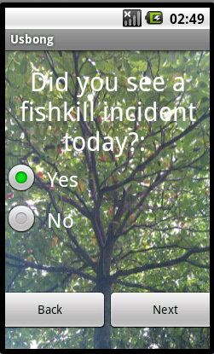
Notes:
Here’s a work-in-progress screenshots of Usbong for the Android.
It’s now being developed with the 7 Lakes Aquaculture Network team for fishkill monitoring and will be deployed in Lake Palakpakin in Laguna, Philippines.

