Slide 1

Marketing Product X in North America
Company: Square Enix
Product: X

Slide 2
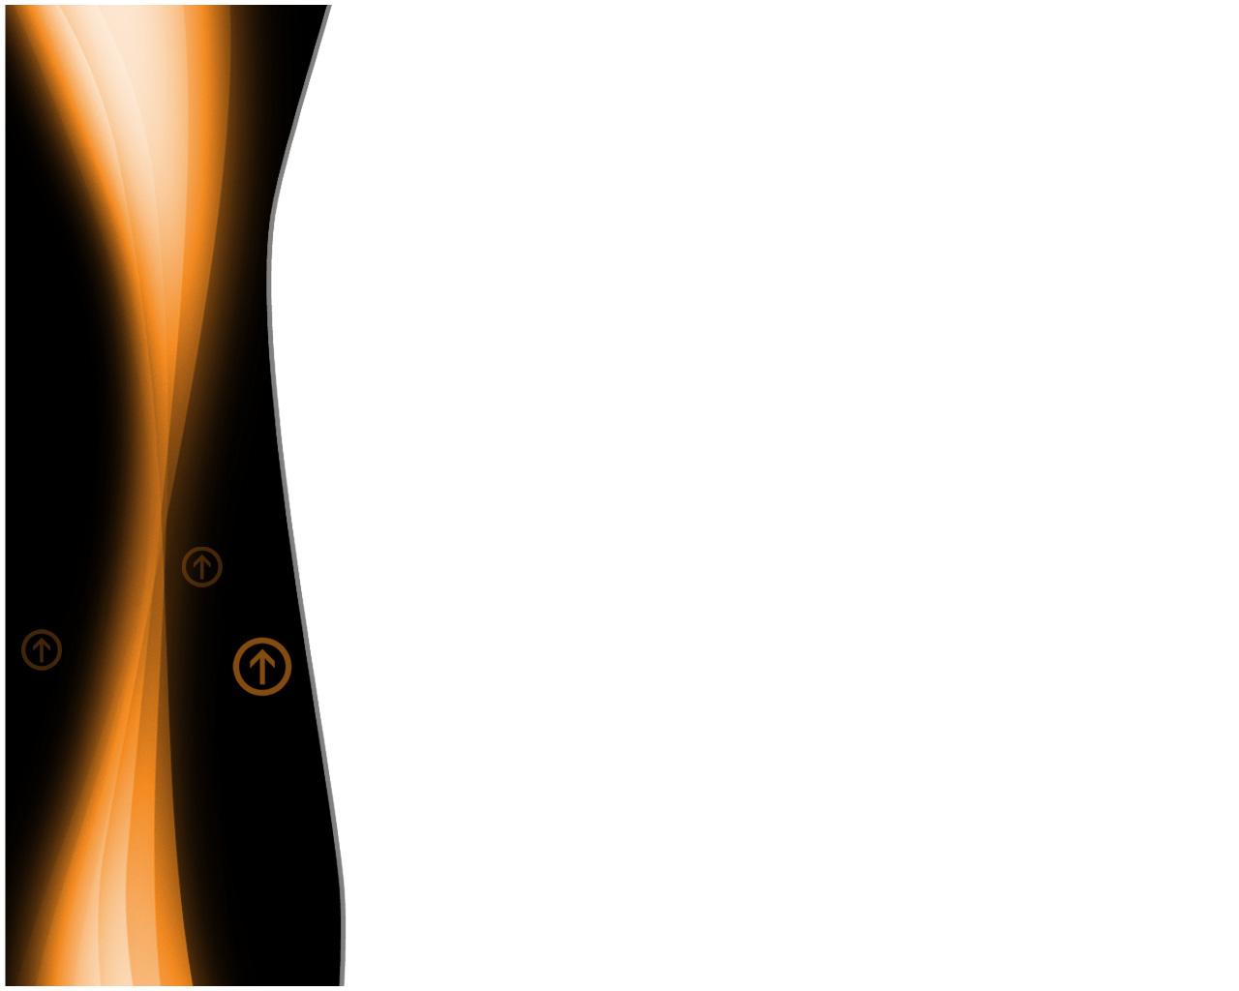
Corporation Basics
Since 2003, Square Enix has been a well known name on the market
Recent stock holdings budging all-time highest, permitting expansion with product X.
Familiar previous products:
Kingdom Hearts - most recent
Final Fantasy – known legacy.

Slide 3

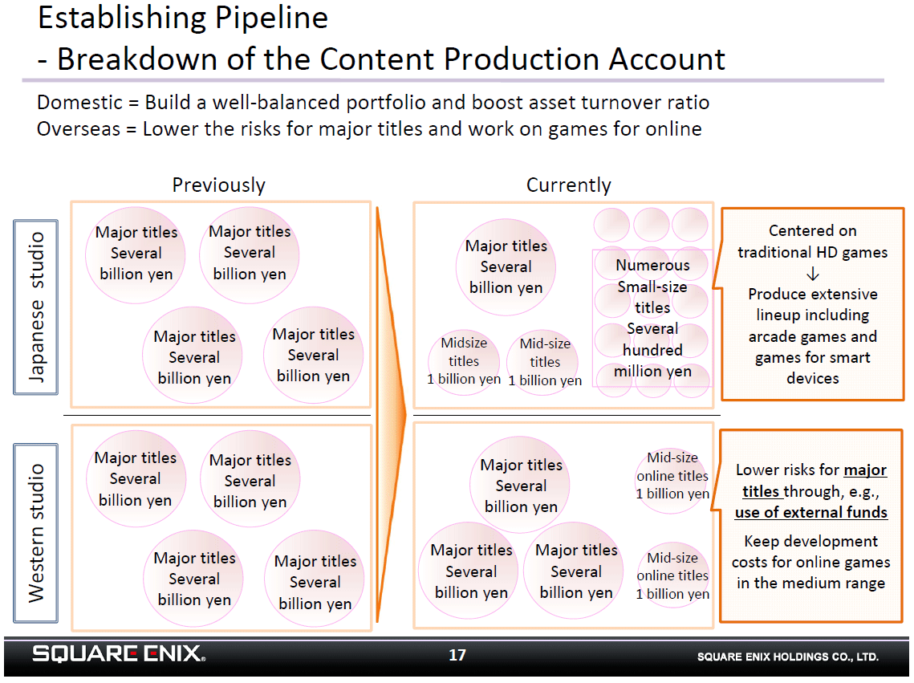
Budget
Work cited:
X, I. (2014, November 25). A Breakdown Of Square Enix’s Development Pipeline - Siliconera. Retrieved November 25, 2014, from http://www.siliconera.com/2014/11/12/breakdown-square-enixs-development-pipeline/

Slide 4

SWOT Analysis
Strongest asset: or backbone of the marketing campaigns would be the recognizable name- product association.
Possible weakness: lack of capital reinvestment for lateral creation. Examples: Offices and distribution facilities in other markets. Focusing on too few, if ever more than one, product(s).

Slide 5
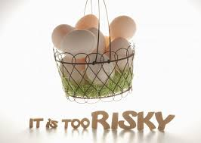
A common comparison: Don’t put all of your eggs in one basket.

Slide 6

Advertising
Direct to consumer via general publicity of the current gaming society would be the most likely to achieve marketing supremacy.
Demographic or target market has been a fellowship or a ‘quasi-subculture.’ The discussions about the current levels of achievement and accomplishments within one game and the other games being played get heated yet become the most fundamental marketing source.
Retailers would be the secondary or tertiary objective of the marketing campaign: Wal-Mart, Target, BestBuy in the North American market.

Slide 7
Marketing this product would be a mix of advertising, public relations and mild promotion through currently used media of similar or popular topic integration. Many of the marketing strategies would be using API, or advertising product integration html coding and embedding, on websites and forums.
API (HTML Code embedding) morphs into networks unbound. Because the product is electronic, internet and computerized media the links provided through API would fundamentally route directly to the point of sale.
Public relations: Word of mouth would and could lead to the sales promotion of the product at point of sale.
By having a “referral” program, the person referring, another person, would get ‘credit’ or ‘discounts’ to purchase additional components within the products line-up.

Slide 8

THE ALL NEW…
PRODUCT X available now… RIGHT NOW on your SMART PHONE OR TABLET! No , really it is!

