Slide 1
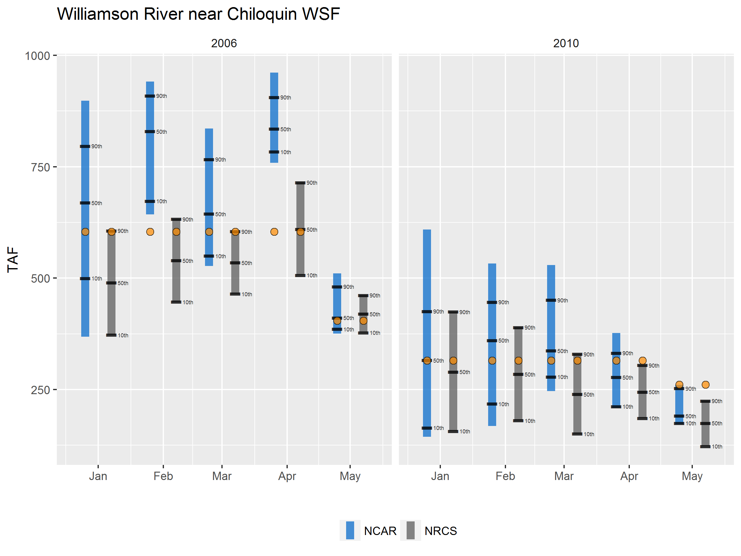
Observed
Note: Water supply forecasts issued in Jan-Apr show Apr-Sep Volumes. Water supply forecasts issued in May show May-Sep Volumes

