Slide 1
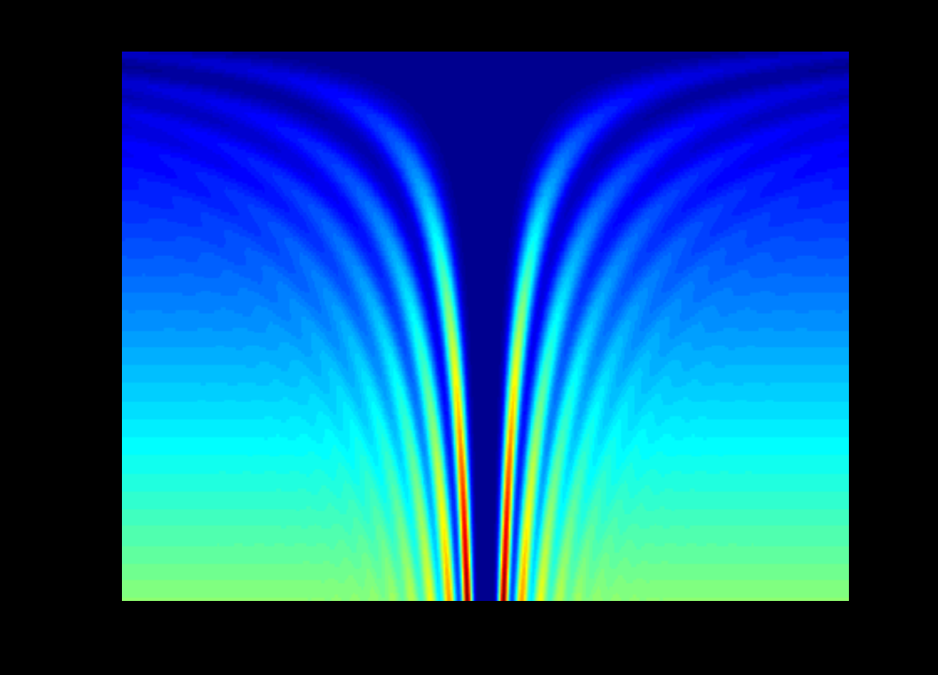


Using spike-triggered averaging to investigate differential force generation and connectivity among motor units
Jason Kutch
Ph.D. Student, Applied Mathematics
University of Michigan, Ann Arbor
University of Michigan:
Tony Bloch, Mathematics
Art Kuo, Mechanical Engineering
Rehabilitation Institute of Chicago:
Nina Suresh
C.J. Heckman
W. Zev Rymer
The autocorrelogram as a function of firing rate
®
Rehabilitation Institute of Chicago
Slide <number>
Notes:
Thank people for helping apply theoretical ideas to the interpretation of data.

Slide 2
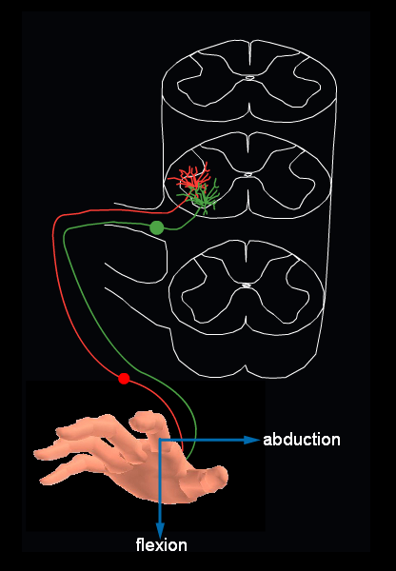
Introduction
Hypothesis – FDI has motor units with
varied twitch direction.
Objectives
1. Model – Can STA test this hypothesis?
(Can STA detect varied twitch directions in the FDI if they exist?)
2. Data – What is observed when the STA technique is applied to examine twitch
direction of FDI motor units?
Adapted from Principles of Neuroscience and Jie Liu
Slide <number>
Notes:
Model is used to evaluate the technique. Emphasize that the animation highlights the difference between time course and direction.

Slide 3
Part 1 - Model for STA evaluation
Excitatory Drive
MN
Induced
Synchrony
MN
MN
Extension of Fuglevand et al. (1993)
How is the ability of STA to assess
motor unit twitch direction affected by:
1. Firing rate
2. Synchronization
abd
flex
Slide <number>
Notes:
Use model to determine what we would expect to see under various conditions. Compare to experiments.

Slide 4
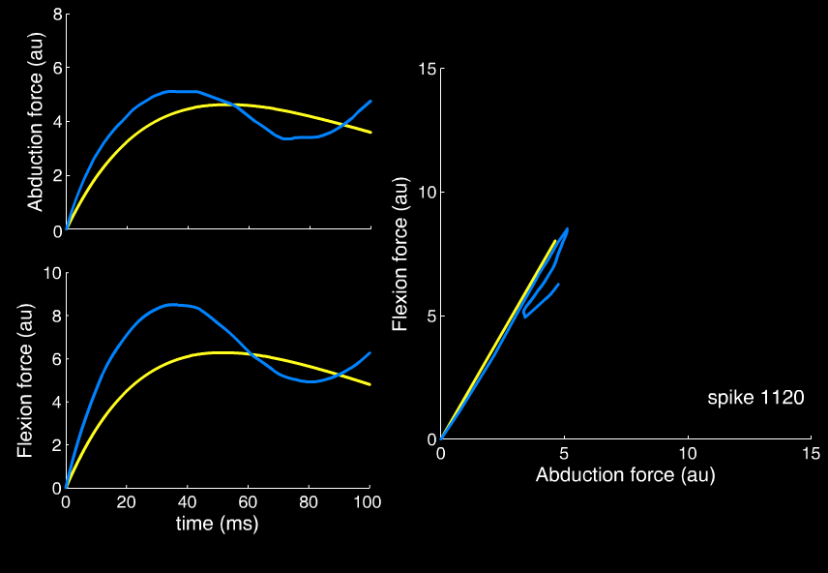
STA does not need unrealistically low rates
STA can not characterize twitch waveforms,
but can accurately represent direction.
Slide <number>
Notes:
Unit firing about 8 Hz

Slide 5
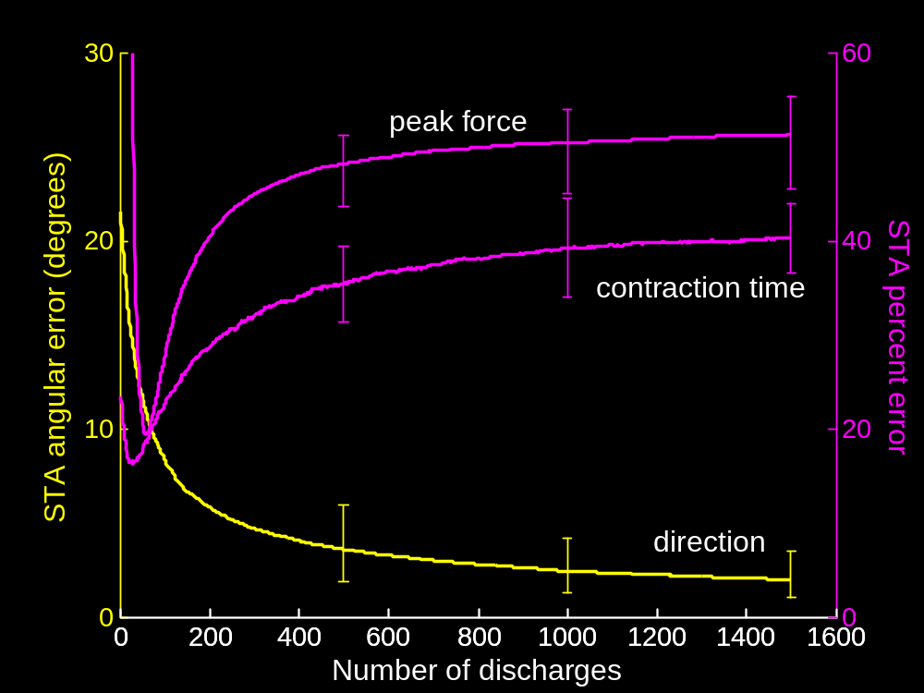
STA convergence
Slide <number>
Notes:
Something very different may happen when STA estimates direction

Slide 6
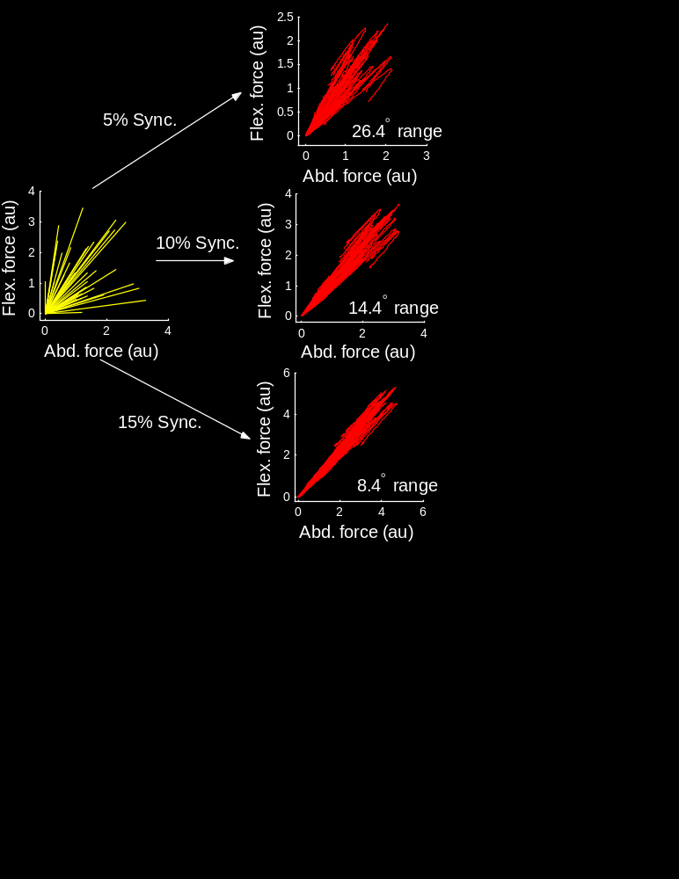
Synchrony - Uniform
Effect of varying
uniform synchronization
at 5% MVC
Rapid collapse predicted by
the equations of Kutch et al. (2006).
Synchrony distortion compounds.
Slide <number>
Notes:
Equations looked at a completely uniform pool. not a fundamental distortion of STA, but depends on the number of active units.

Slide 7
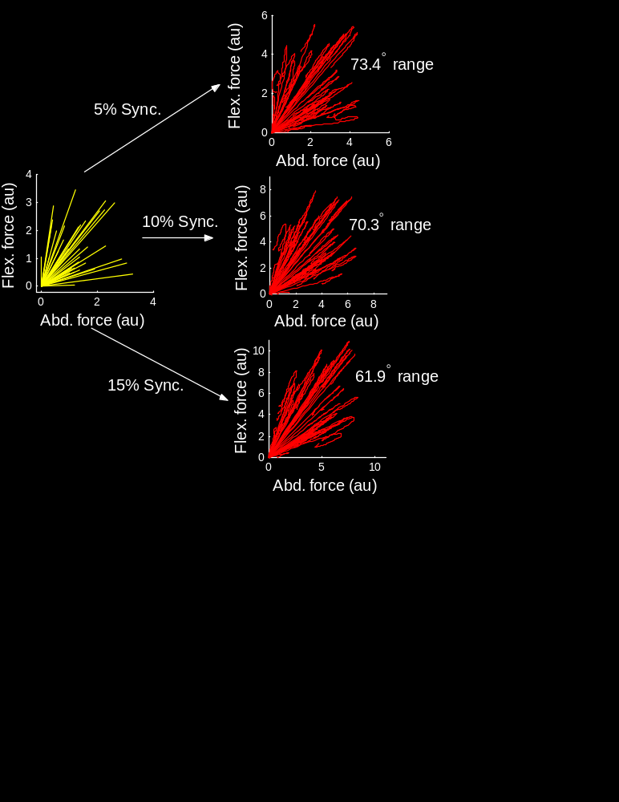
Synchrony - localized
Effect of varying
limited (20°)
synchronization
at 5% MVC
Synchronization can only reduce the
range of STA directions.
This distortion will be modest if
synchrony is localized.
Slide <number>
Notes:
Stress that synchrony can only reduce range of angles. If synchrony with another muscle, uniform synchrony can only move angle, sporadic synchrony would not work either. Range could only increase with extremely directed synchrony (not likely).

Slide 8
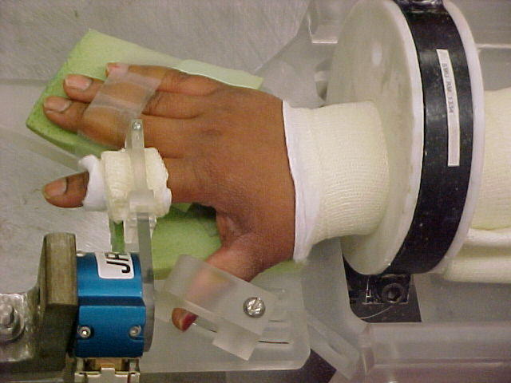
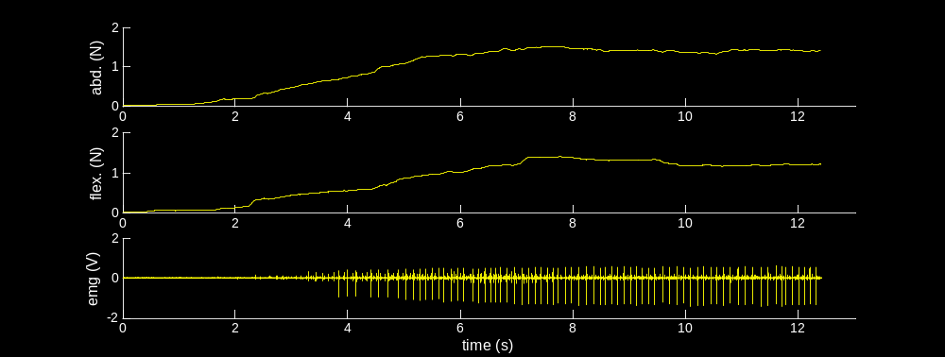
Part 2 – Experimental Results
Subject instructions – produce a steady force magnitude in a given direction
Firing rate limited from 7-11 Hz
~60 seconds
~600 spikes for averaging
…
Slide <number>
Notes:
Emphasize data borrowed from Nina for the purpose of testing model predictions.

Slide 9
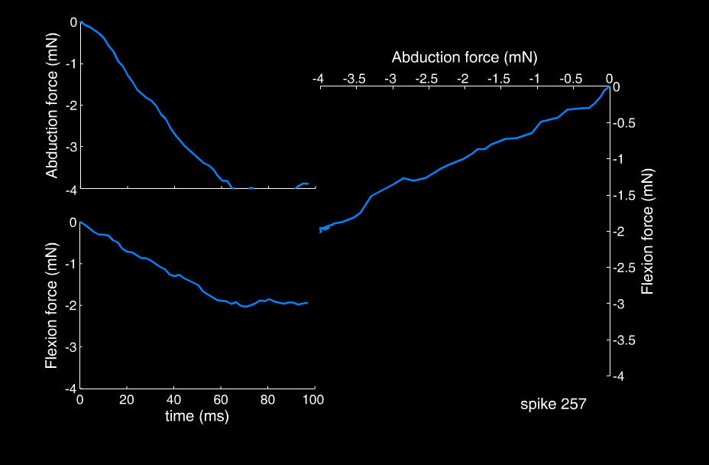
Similarity with model
Slide <number>
Notes:
Still can check convergence, but don’t have the advantage of checking against know direction. Would like to interpret line as indicative of motor unit twitch direction. But need to look at distribution to make this claim.

Slide 10
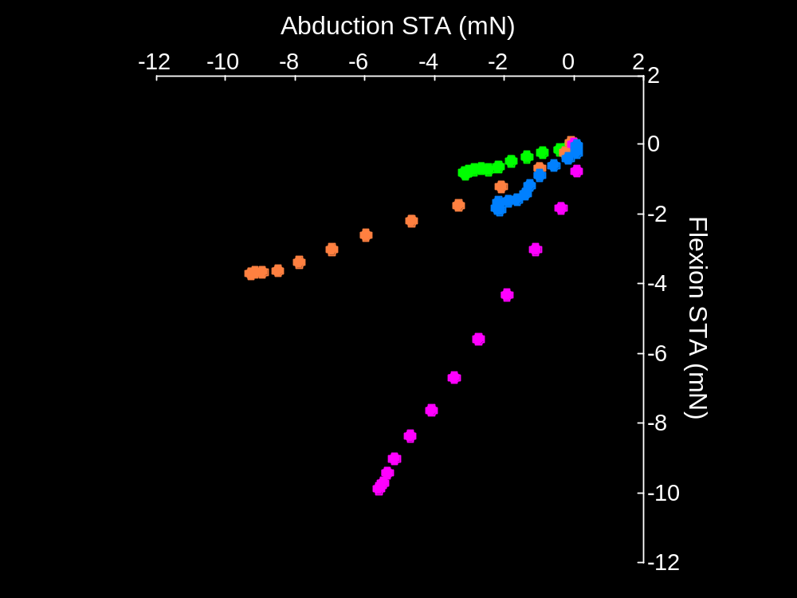
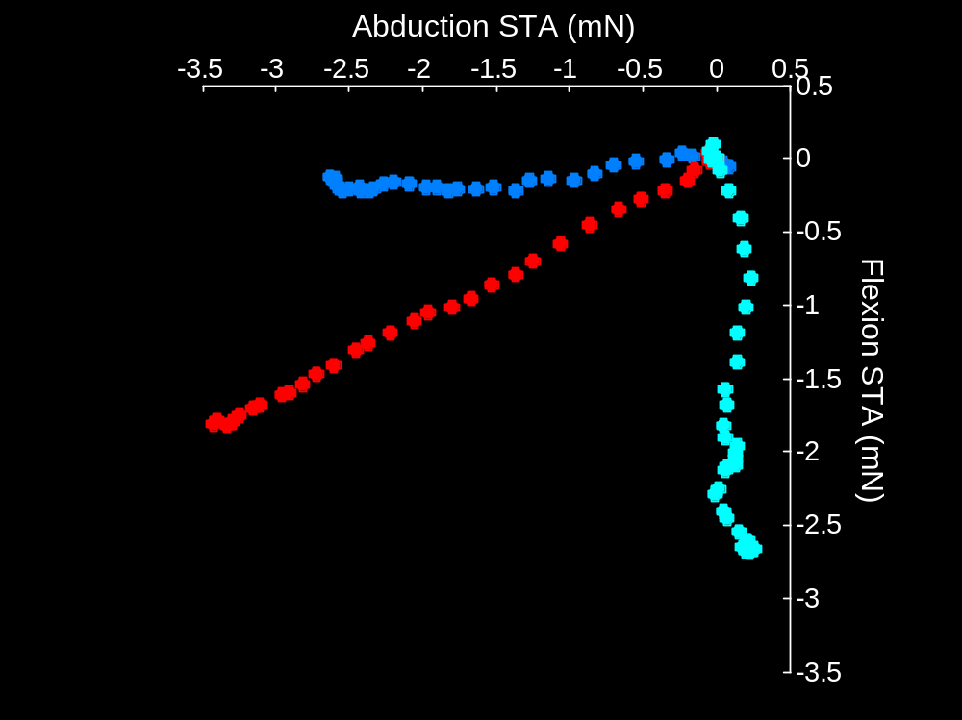
A range of STA directions can be observed from the FDI
Subject A, single session
Subject B, single session
Synchrony estimates: same order of magnitude as literature values
72% of pairs with mean level of 6.17%
Slide <number>
Notes:
Plotting zero to peak. Preliminary data suggests a large range, and remember, STA is very unlikely to expand ranges.

Slide 11
Interpretation of data based on simulations
The FDI may contain motor units with varied
twitch direction about the MCP joint.
2. Synchronization may be limited to motor units
with similar twitch direction.
Slide <number>

Slide 12
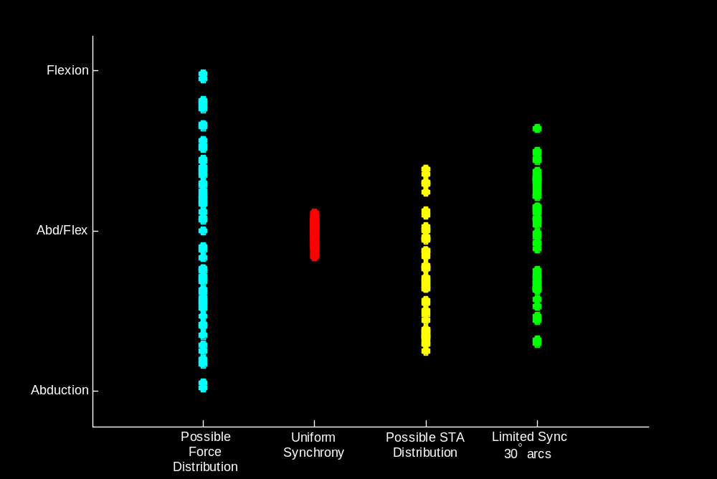
Speculation on Connectivity
~60% pairs synchronized
Descending Commands ?
Descending
Command
Slide <number>
Notes:
Don’t forget about the percentage of synchronized pairs, consistent with human studies.

