Slide 1
Discovering and Building Semantic Models of Web Sources
Craig A. Knoblock
University of Southern California
Joint work with
J. L. Ambite, K. Lerman, A. Plangprasopchok, and T. Russ, USC
C. Gazen and S. Minton, Fetch Technologies
M. Carman, University of Lugano

Slide 2
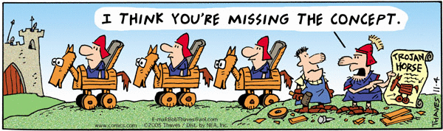
The Semantic Web Today?
Most work on the semantic web assumes that the semantic descriptions of sources and data are given
What about the rest of the Web??
Huge amount of useful information that has no semantic description

Slide 3
Goal
Automatically build semantic models for data and services available on the larger Web
Construct models of these sources that are sufficiently rich to support querying and integration
Such models would make the existing semantic web tools and techniques more widely applicable
Current focus:
Build models for the vast amount of structured and semi-structured data available
Not just web services, but also form-based interfaces
E.g., Weather forecasts, flight status, stock quotes, currency converters, online stores, etc.
Learn models for information-producing web sources and web services

Slide 4
Approach
Start with an some initial knowledge of a domain
Sources and semantic descriptions of those sources
Automatically
Discover related sources
Determine how to invoke the sources
Learn the syntactic structure of the sources
Identify the semantic types of the data
Build semantic models of the source
Validate the correctness of the results

Slide 5
Outline
Integrated Approach
Discovering related sources
Constructing syntactic models of the sources
Determining the semantic types of the data
Building semantic models of the sources
Experimental Results
Related Work
Discussion

Slide 6
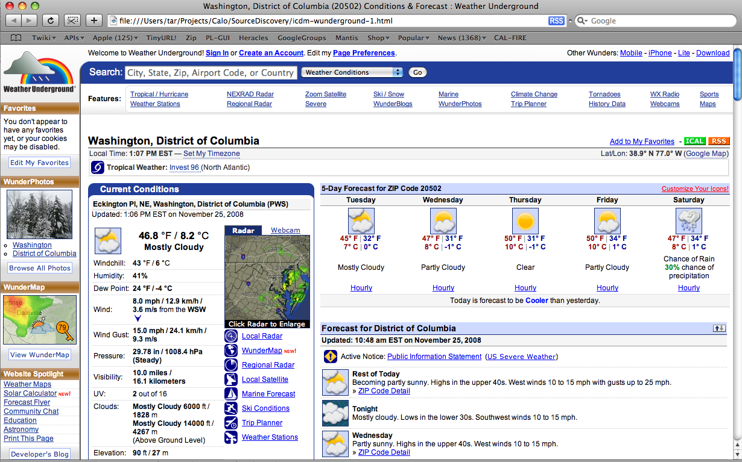
Seed Source

Slide 7
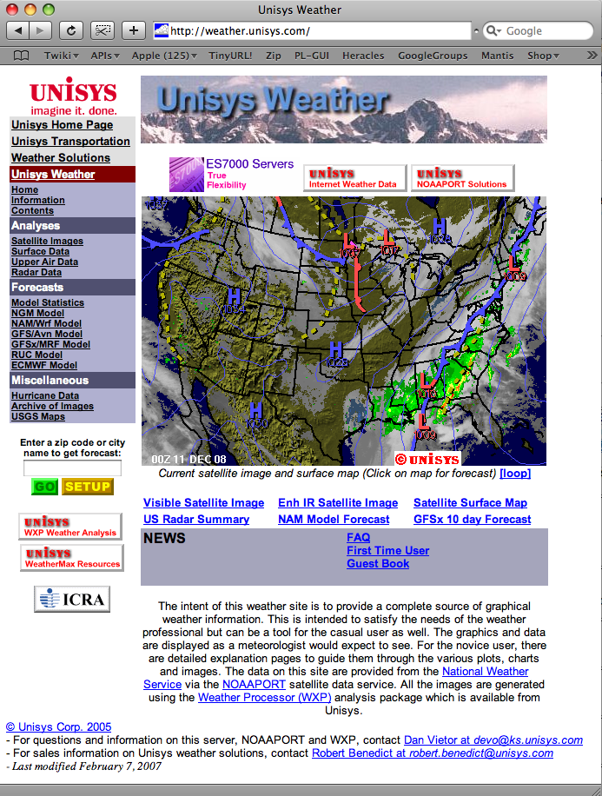
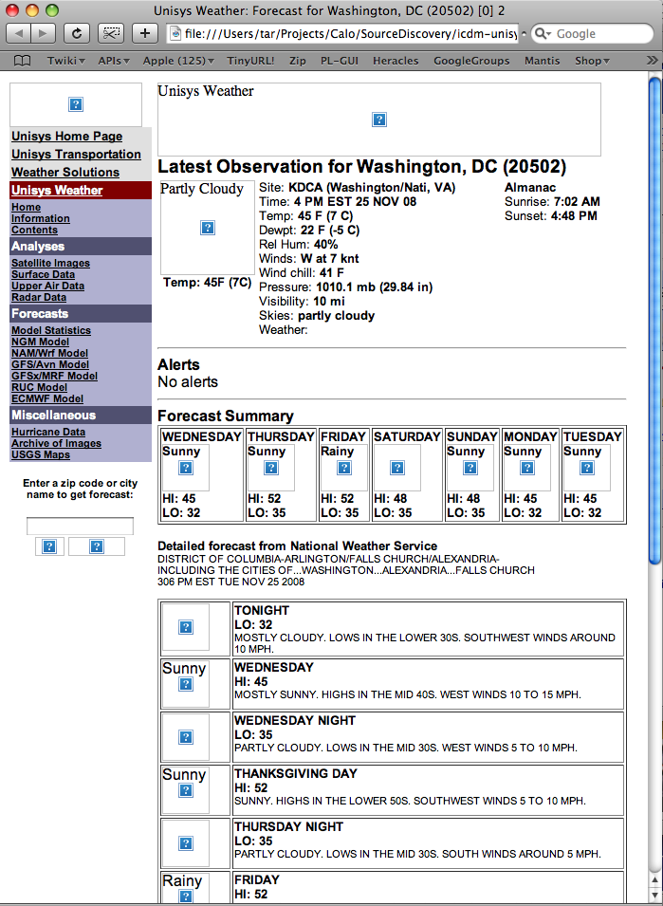
Automatically Discover and Model a Source in the Same Domain

Slide 8
Integrated Approach
discovery
unisys
Invocation &
extraction
anotherWS
Background knowledge
sample
input
values
“90254”
Seed URL
unisys
http://wunderground.com
unisys(Zip,Temp,…)
:-weather(Zip,…,Temp,Hi,Lo)
definition of known sources
sample values
patterns
domain
types
source
modeling
semantic
typing
unisys(Zip,Temp,Humidity,…)

Slide 9
Background Knowledge
discovery
unisys
Invocation &
extraction
anotherWS
Background knowledge
sample
input
values
“90254”
Seed URL
unisys
http://wunderground.com
unisys(Zip,Temp,…)
:-weather(Zip,…,Temp,Hi,Lo)
definition of known sources
sample values
patterns
domain
types
source
modeling
semantic
typing
unisys(Zip,Temp,Humidity,…)

Slide 10
Background Knowledege
Ontology of the inputs and outputs
e.g., TempF, Humidity, Zipcode;
Sample values for each semantic type
e.g., “88 F” for TempF, and “90292” for Zipcode
Domain input model
a weather source may accept Zipcode or a combination of City and State as input
Sample input values
Known sources (seeds)
e.g., http://wunderground.com
Source descriptions in Datalog
wunderground($Z,CS,T,F0,S0,Hu0,WS0,WD0,P0,V0,FL1,FH1,S1,FL2,FH2,S2,FL3,FH3,S3,FL4,FH4,S4,FL5,FH5,S5) :- weather(0,Z,CS,D,T,F0,_,_,S0,Hu0,P0,WS0,WD0,V0) weather(1,Z,CS,D,T,_,FH1,FL1,S1,_,_,_,_,_), weather(2,Z,CS,D,T,_,FH2,FL2,S2,_,_,_,_,_), weather(3,Z,CS,D,T,_,FH3,FL3,S3,_,_,_,_,_), weather(4,Z,CS,D,T,_,FH4,FL4,S4,_,_,_,_,_), weather(5,Z,CS,D,T,_,FH5,FL5,S5,_,_,_,_,_).

Slide 11
Source Discovery
discovery
unisys
Invocation &
extraction
anotherWS
Background knowledge
sample
input
values
“90254”
Seed URL
unisys
http://wunderground.com
unisys(Zip,Temp,…)
:-weather(Zip,…,Temp,Hi,Lo)
definition of known sources
sample values
patterns
domain
types
source
modeling
semantic
typing
unisys(Zip,Temp,Humidity,…)

Slide 12
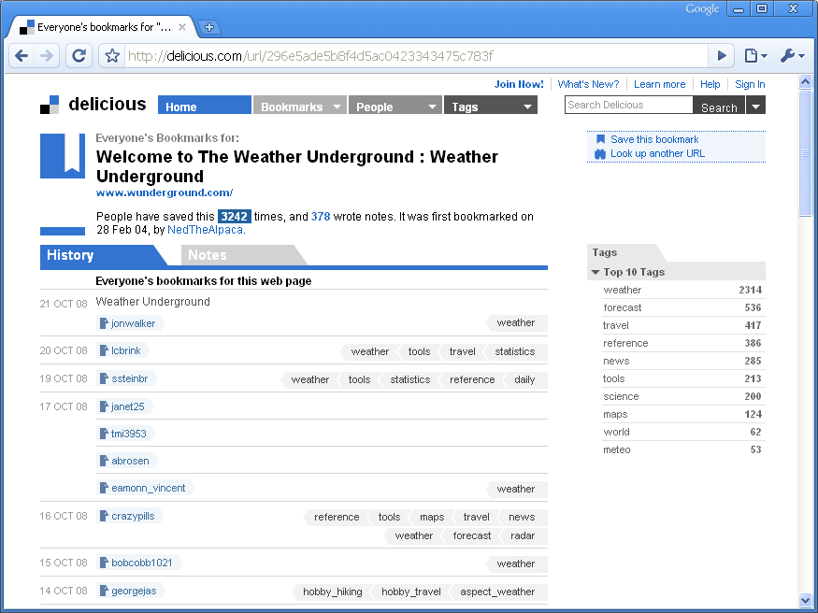
Source Discovery [Plangprasopchok and Lerman]
Leverage user-generated tags on the social bookmarking site del.icio.us to discover sources similar to the seed
Most common tags
User-specified tags
Notes:
Observation: sources providing similar functionality are annotated with “similar” tags

Slide 13
Group Tags and Content into Concepts
Content
“Animal”
“Car”
Tags
?
“Flower”
Group semantically related tags and content
A group ~ A concept
Notes:
Goal of this contribution is to find concepts from social annotation.
By a concept, I mean a group of related items.
Given content and tags, we want to group related content and tags together by their “meaning.”

Slide 14
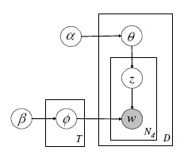
A Stochastic Process of Tag Generation
PLSA (Hofmann99);
LDA (Blei03+)
Document (r)
Concepts (z)
Possible Words
Possible
Concepts
Generated tags (t)
A data point (tuple) <r,t,z>
Notes:
Existing approach on modeling document. The idea is a document is consisting of a set of possible concepts (topics). Then each concept has some dominant words representing it.
Straightforward application of this model:
One can apply this process to tagging process: by treating all tags as if they were generated from the document creator. And you will lose user information.

Slide 15
Exploiting Social Annotations for Resource Discovery
Resource discovery task : “given a seed source, find other most similar sources”
Gather a corpus of <user, source, tag> bookmarks from del.icio.us
Use probabilistic modeling to find hidden topics in the corpus
Rank sources by similarity to the seed within topic space
Seed source
Sources
Obtain Annotation
From Delicious
Probabilistic
Model
LDA
Users
Tags
Candidates
Source’s distribution
over concepts, p(z|r)
Rank sources by similarity to seed
Compute Source Similarity
Notes:
The items (seed item and other items here) could be web pages that take some inputs and return some outputs.
Resource -> web resource such as web page that take some inputs and return some outputs.
After computing similarity score, we rank them and see if they are actually similar to the seed (by manually inspection if they take the same input types and return the same output types)

Slide 16
Source Invocation & Extraction
discovery
unisys
Invocation &
extraction
anotherWS
Background knowledge
sample
input
values
“90254”
Seed URL
unisys
http://wunderground.com
unisys(Zip,Temp,…)
:-weather(Zip,…,Temp,Hi,Lo)
definition of known sources
sample values
patterns
domain
types
source
modeling
semantic
typing
unisys(Zip,Temp,Humidity,…)

Slide 17
Target Source Invocation
To invoke the target source, we need to locate the form and determine the appropriate input values
Locate the form
Try different data type combinations as input
For weather, only one input - location, which can be zipcode or city
Submit Form
Keep successful invocations
Form Input
Notes:
Note: The paper describes the slightly older behavior where we stopped with the first “successful” invocation. We now will try all combinations and keep all successful invocations. This is a change in the system from when the paper was written.

Slide 18
Invoke the Target Source with Possible Inputs
http://weather.unisys.com
Weather conditions for 20502
input
20502

Slide 19
Form Input Data Model
Each domain has an input data model
Derived from the seed sources
Alternate input groups
Each domain has sample values for the input data types
domain name="weather
• input “zipcode” type PR-Zip
• input “cityState” type PR-CityState
• input “city” type PR-City
• input “stateAbbr” type PR-StateAbbr
PR-Zip | PR-CityState | PR-City | PR-StateAbbr
20502 | Washington, DC | Washington | DC
32399 | Tallahassee, FL | Tallahassee | FL
33040 | Key West, FL | Key West | FL
90292 | Marina del Rey, CA | Marina del Rey | CA
36130 | Montgomery, AL | Montgomery | AL

Slide 20

Discovering Web Structure [Gazen & Minton]
Model Web sources that generate pages dynamically in response to a query
Find the relational data underlying a semi-structured web site
Generate a page template that can be used to extract data on new pages
Approach
Site extraction
Exploit the common structure within a web site
Take advantage of multiple structures
HTML structure, page layout, links, data formats, etc.
Homepage
0 AutoFeedWeather
StateList
0 0
0 1
States
0 California CA
1 Pennyslvania PA
CityList
0 0
0 1
0 2
1 3
1 4
CityWeather
0 Los Angeles 70
1 San Francisco 65
2 San Diego 75
3 Pittsburgh 50
4 Philadelphia 55
Homepage
page-type
State
page-type
CityWeather
page-type

Slide 21
Approach to Finding Web Structure
Homepage
0 AutoFeedWeather
States
0 California CA
1 Pennyslvania PA
CityWeather
0 Los Angeles 70
1 San Francisco 65
2 San Diego 75
3 Pittsburgh 50
4 Philadelphia 55
Cluster
California
Pennsylvania
CA
PA
Convert
Experts
Los Angeles
San Franciso
San Diego
Pittsburgh
Philadelphia
70
65
75
50
55
Web Site
Page & Data
Hypotheses
Page & Data
Clusters
Site and Page
Structure

Slide 22
Sample Experts
URL patterns give clues about site structure
Similar pages have similar URLs, e.g.:
http://www.bookpool.com/sm/0321349806
http://www.bookpool.com/sm/0131118269
http://www.bookpool.com/ss/L?pu=MN
Page layout gives clues about relational structure
Similar items aligned vertically or horizontally, e.g.:

Slide 23
Sample Experts
Page Templates
Similar pages contain common sequences of substrings
HTML Structure
List rows are represented as repeating HTML structures
<TR>
<TR>
<TD>
<TD>
<TD>
<TD>
Los Angeles
85
Pittsburgh
65

Slide 24
Extracting Data
Pages
Hypotheses
<td valign="top" width="14%">
<font face="Arial, Helvetica, sans-serif">
<small><b>FRIDAY<br>
<img src="images/Sun-s.png" alt="Sunny"><br>
HI: 65<br>LO: 52<br></b></small></font></td>
<td valign="top" width="14%">
<font face="Arial, Helvetica, sans-serif">
<small><b>SATURDAY<br>
<img src="images/Rain-s.png" alt="Rainy"><br>
HI: 60<br>LO: 48<br></b></small></font></td>
group_member (FRIDAY, SATURDAY)
group_member (Sunny, Rainy)
same_html_context (65, 60)
vertically_aligned (Sun, Rain)
two_digit_number (65, 52, 60, 48)
…
<td valign="top" width="14%">
<font face="Arial, Helvetica, sans-serif">
<small><b>FRIDAY<br>
<img src="images/Sun-s.png" alt="Sunny"><br>
HI: 65<br>LO: 52<br></b></small></font></td>
<td valign="top" width="14%">
<font face="Arial, Helvetica, sans-serif">
<small><b>SATURDAY<br>
<img src="images/Rain-s.png" alt="Rainy"><br>
HI: 60<br>LO: 48<br></b></small></font></td>
Extracted Data
Clusters
FRIDAY | Sun | Sunny | 65 | 52
SATURDAY | Rain | Rainy | 60 | 48
65 52 60 48
FRIDAY
SATURDAY
Sunny Rainy

Slide 25
Data Extraction with Templates
Build templates with the inferred page structure
Use the templates to extract data on unseen pages
Unseen Page
Induced Template
<img src="images/Sun.png" alt="Sunny"><br>
<font face="Arial, Helvetica, sans-serif">
<small><b>Temp: 71F (21C)</b></small></font>
<font face="Arial, Helvetica, sans-serif">
<small>Site: <b>KCQT (Los_Angeles_Dow, CA)</b><br>
Time: <b>11 AM PST 10 DEC 08</b>
<img src="images/â.png" alt="â"><br>
<font face="Arial, Helvetica, sans-serif">
<small><b>Temp: â (â)</b></small></font>
<font face="Arial, Helvetica, sans-serif">
<small>Site: <b>â (â, â)</b><br>
Time: <b>â 10 DEC 08</b>
Extracted Data
Sun | Sunny | 71F | 21C | KCQT | Los_Angeles_Dow | CA | 11 AM PST

Slide 26
Raw Extracted Data from Unisys
Column | Invocation 1 | Invocation 2 | …
1 | Unisys Weather: Forecast for Washington, DC (20502) [0] 2 | Unisys Weather: Forecast for Tallahassee, FL (32399) [0] 2
2 | Washington, | Tallahassee,
3 | DC | FL
4 | 20502 | 32399
5 | 20502) | 32399)
…
14 | Images/PartlyCloudy.png | Images/Sun.png
15 | Partly Cloudy | Sunny
16 | 45 | 63
17 | Temp: 45F (7C) | Temp: 63F (17C)
18 | 45F | 63F
…
217 | 45 | 64
218 | MOSTLY SUNNY. HIGHS IN THE MID 40S. | PARTLY CLOUDY. HIGHS AROUND 64.
Good Field
Extra Garbage
Image URL
Good Field
Hard to Recognize
Too Complex
Good Field
Notes:
Columns prior to type recognition. Many of these columns will be pruned when they are discovered to not contain any domain-useful information. In fact, often a large number of the values are empty (NULL). In this example, the last two lines come from TUESDAY’S forecast and are irrelevant.

Slide 27
Semantic Typing
discovery
unisys
Invocation &
extraction
anotherWS
Background knowledge
sample
input
values
“90254”
Seed URL
unisys
http://wunderground.com
unisys(Zip,Temp,…)
:-weather(Zip,…,Temp,Hi,Lo)
definition of known sources
sample values
patterns
domain
types
source
modeling
semantic
typing
unisys(Zip,Temp,Humidity,…)

Slide 28
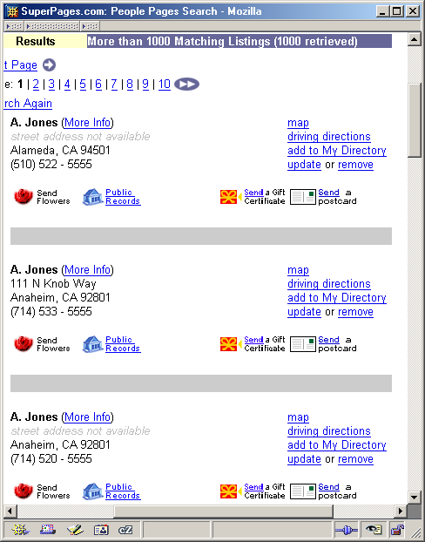
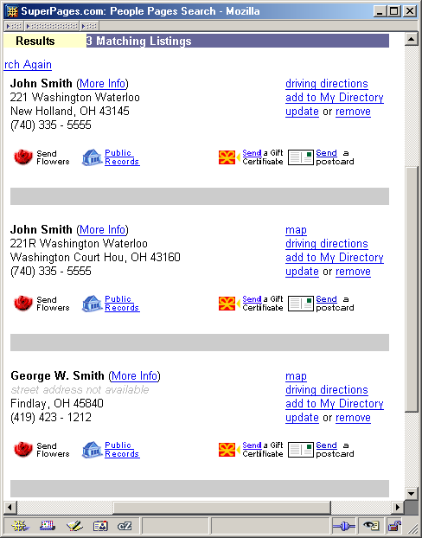
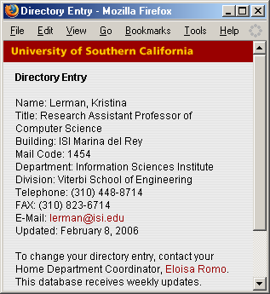
Semantic Typing [Lerman, Plangprasopchok, & Knoblock]
Idea: Learn a model of the content of data and use it to recognize new examples
:StreetAddress: :Email:
4DIG CAPS Rd ALPHA@ALPHA.edu
3DIG N CAPS Ave ALPHA@ALPHA.com
… …
:State: :Telephone:
CA (3DIG) 3DIG-4DIG
2UPPER +1 3DIG 2DIG 4DIG
… …
Background
knowledge
Patterns
learn
label

Slide 29
Learning Patterns to Recognize Semantic Types
Domain-independent language to represent the structure of data as patterns
Pattern is a sequence of tokens and token types
E.g., Phone number
Examples Patterns
310 448-8714
310 448-8775 [( 310 ) 448 – 4DIGIT]
212 555-1212 [( 3DIGIT ) 3DIGIT – 4DIGIT]
Learns patterns from examples for all semantic types in the domain model

Slide 30
Labeling New Data
Use learned patterns to link new data to types in the ontology
Score how well patterns describe a set of examples
Number of matching patterns
How many tokens of the example match pattern
Specificity of the matched patterns
Output top-scoring types
patterns
:StreetAddress: :Email:
4DIG CAPS Rd ALPHA@ALPHA.edu
3DIG N CAPS Ave ALPHA@ALPHA.com
… …
:State: :Telephone:
CA (3DIG) 3DIG-4DIG
2UPPER +1 3DIG 2DIG 4DIG
… …

Slide 31
Weather Data Types
Sample values
PR-TempF
88 F
57°F
82 F ...
PR-Visibility
8.0 miles
10.0 miles
4.0 miles
7.00 mi
10.00 mi
PR-Zip
07036
97459
02102
Patterns
PR-TempF
[88, F]
[2DIGIT, F]
[2DIGIT, °, F]
PR-Visibility
[10, ., 0, miles]
[10, ., 00, mi]
[10, ., 00, mi, .]
[1DIGIT, ., 00, mi]
[1DIGIT, ., 0, miles]
PR-Zip
[5DIGIT]

Slide 32
Labeled Columns of Target Source Unisys
Column | 4 | 18 | 25 | 15 | 87
Type | PR-Zip | PR-TempF | PR-Humidity | PR-Sky | PR-Sky
Score | 0.333 | 0.68 | 1.0 | 0.325 | 0.375
Values | 20502 | 45F | 40% | Partly Cloudy | Sunny
 | 32399 | 63F | 23% | Sunny | Partly Cloudy
 | 33040 | 73F | 73% | Sunny | Rainy
 | 90292 | 66F | 59% | Partly Cloudy | Sunny
 | 36130 | 62F | 24% | Sunny | Partly Cloudy
Notes:
From table weather179. The two PR-Sky columns are from different days in the forecast. This is why we need to apply additional semantics and constraints to figure out the proper source model. That is what a later stage of the processing does for us.
32

Slide 33
Source Modeling [Carman & Knoblock]
discovery
unisys
Invocation &
extraction
anotherWS
Background knowledge
sample
input
values
“90254”
Seed URL
unisys
http://wunderground.com
unisys(Zip,Temp,…)
:-weather(Zip,…,Temp,Hi,Lo)
definition of known sources
sample values
patterns
domain
types
source
modeling
semantic
typing
unisys(Zip,Temp,Humidity,…)

Slide 34
Inducing Source Definitions
source1($zip, lat, long) :-
centroid(zip, lat, long).
source2($lat1, $long1, $lat2, $long2, dist) :-
greatCircleDist(lat1, long1, lat2, long2, dist).
source3($dist1, dist2) :-
convertKm2Mi(dist1, dist2).
Known
Source 1
Known
Source 2
Known
Source 3
Step 1: classify input & output semantic types
New
Source 4
zipcode
distance
source4( $startZip, $endZip, separation)

Slide 35
Generating Plausible Definition
source1($zip, lat, long) :-
centroid(zip, lat, long).
source2($lat1, $long1, $lat2, $long2, dist) :-
greatCircleDist(lat1, long1, lat2, long2, dist).
source3($dist1, dist2) :-
convertKm2Mi(dist1, dist2).
Known
Source 1
Known
Source 2
Known
Source 3
source4($zip1, $zip2, dist):-
source1(zip1, lat1, long1),
source1(zip2, lat2, long2),
source2(lat1, long1, lat2, long2, dist2),
source3(dist2, dist).
Step 1: classify input & output semantic types
Step 2: generate plausible definitions
New
Source 4
source4($zip1, $zip2, dist):-
centroid(zip1, lat1, long1),
centroid(zip2, lat2, long2),
greatCircleDist(lat1, long1, lat2, long2, dist2),
convertKm2Mi(dist1, dist2).
source4( $zip1, $zip2, dist)

Slide 36
Top-down Generation of Candidates
Start with empty clause & generate specialisations by
Adding one predicate at a time from set of sources
Checking that each definition is:
Not logically redundant
Executable (binding constraints satisfied)
New
Source 5
source5(_,_,_,_).
source5( $zip1,$dist1,zip2,dist2)
Expand
source5(zip1,_,_,_) :- source4(zip1,zip1,_).
source5(zip1,_,zip2,dist2) :- source4(zip2,zip1,dist2).
source5(_,dist1,_,dist2) :- <(dist2,dist1).
…

Slide 37
Invoke and Compare the Definition
Step 1: classify input & output semantic types
Step 2: generate plausible definitions
Step 3: invoke service & compare output
source4($zip1, $zip2, dist):-
source1(zip1, lat1, long1),
source1(zip2, lat2, long2),
source2(lat1, long1, lat2, long2, dist2),
source3(dist2, dist).
source4($zip1, $zip2, dist):-
centroid(zip1, lat1, long1),
centroid(zip2, lat2, long2),
greatCircleDist(lat1, long1, lat2, long2,dist2),
convertKm2Mi(dist1, dist2).
match
$zip1 | $zip2 | dist (actual) | dist (predicted)
80210 | 90266 | 842.37 | 843.65
60601 | 15201 | 410.31 | 410.83
10005 | 35555 | 899.50 | 899.21

Slide 38
Approximating Equality
Allow flexibility in values from different sources
Numeric Types like distance
Error Bounds (eg. +/- 1%)
Nominal Types like company
String Distance Metrics
(e.g. JaroWinkler Score > 0.9)
Complex Types like date
Hand-written equality checking procedures.
10.6 km ≈ 10.54 km
Google Inc. ≈ Google Incorporated
Mon, 31. July 2006 ≈ 7/31/06

Slide 39
Example of a Learned Source Model for Weather Domain
Given a set of known sources and their descriptions
wunderground($Z,CS,T,F0,S0,Hu0,WS0,WD0,P0,V0) :- weather(0,Z,CS,D,T,F0,_,_,S0,Hu0,P0,WS0,WD0,V0)
convertC2F(C,F) :- centigrade2farenheit(C,F)
Learn a description of a new source in terms of the known sources
unisys($Z,CS,T,F0,C0,S0,Hu0,WS0,WD0,P0,V0) :- wunderground(Z,CS,T,F0,S0,Hu0,WS0,WD0,P0,V0), convertC2F(C0,F0)

Slide 40
Evaluate the Candidate Definition
Invoke the source and the definition on the sample inputs and compare the results
Seed (wunderground.com)
Target (unisys.com)

Slide 41
Issues in the End-to-End Integration
Source invocation
Sources had to be invoked simultaneously to compare the results
Source extraction
Tokenization of numbers had to be accurate
-38.253432 vs. “38”, “2534322”
Semantic typing
Unit information had to be preserved
Difficult to determine whether 10 is a temperature or windspeed without the unit
Source modeling
Synonyms had to be represented as data sources
Need to know the mapping between airline names and codes

Slide 42
Outline
Integrated Approach
Discovering related sources
Constructing syntactic models of the sources
Determining the semantic types of the data
Building semantic models of the sources
Experimental Results
Related Work
Discussion

Slide 43
Experimental Evaluation
Experiments in 3 domains
Geospatial
Geocoder that maps street addresses into lat/long coordinates
Weather
Produces current and forecasted weather
Flight Status
Current status for a given airline and flight
Evaluation:
1) Can we correctly learn a model for those sources that perform the same task
2) What is the precision and recall of the attributes in the model

Slide 44
Experiments: Source Discovery
DEIMOS crawls social bookmarking site del.icio.us to discover sources similar to domain seeds:
Geospatial: geocoder.us
Weather: wunderground.com
Flight status: Flytecomm.com
For each seed:
retrieve the 20 most popular tags users applied to this source
retrieve other sources that users have annotated with that tags
Compute similarity of resources to seed using model
Manually checked top-ranked 100 resources produced by model
Same functionality if same inputs and outputs as seed
Among the 100 highest ranked URLs:
16 relevant geospatial sources
61 relevant weather sources
14 relevant flight status sources

Slide 45
Experiments: Source Invocation & Extraction, Semantic Typing, and Source Modeling
Invocation & Extraction
Recognize form input parameters and calling method
Learn extraction template for result page
Success: Determines how to invoke a form and builds a template for the result page
Semantic Typing
Automatically assign semantic types to extracted data
Success: If extractor produces output table and at least one output column not part of the input can be typed
Semantic Modeling
Learn Datalog source descriptions based on background knowledge
Success: Learn a source description where at least one output column is not part if the input
Evaluate accuracy of the resulting source model

Slide 46
Candidate Sources after Each Step

Slide 47
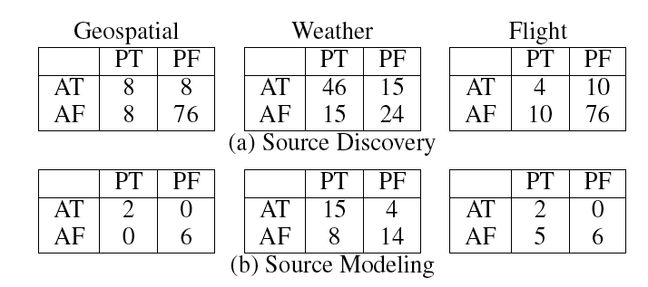
Confusion Matrix
PT=Predicted True
PF=Predicted False
AT=Actual True
AF=Actual False

Slide 48
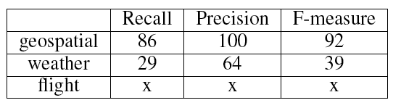
Evaluation of the Models
86
100
92
29
64
39
35
69
46

Slide 49
Outline
Integrated Approach
Discovering related sources
Constructing syntactic models of the sources
Determining the semantic types of the data
Building semantic models of the sources
Experimental Results
Related Work
Discussion

Slide 50
Related Work
ILA & Category Translation (Perkowitz & Etzioni 1995)
Learn functions describing operations on internet
Known static sources with no binding constraints
Assumes single input and single tuple as output
iMAP (Dhamanka et. al. 2004)
Discovers complex (many-to-1) mappings between DB schemas
Used specialized searchers to find mappings
Metadata-based classification of data types used by Web services and HTML forms (Hess & Kushmerick, 2003)
Naïve Bayes classifier
Only classified the source type, no model
Woogle: Metadata-based clustering of data and operations used by Web services (Dong et al, 2004)
Groups similar types together: Zipcode, City, State
Also supported only classification of sources

Slide 51
Related Work (cont.)
Mining Semantic Descriptions of Bioinformatics Web Resources [Afzal et al., in EWSC 2009]
Extracts the semantic descriptions of web services from the natural languages text about the services
Useful for people to discover new sources, but the descriptions don’t provide the level of description needed for reasoning and composition
Automatic Annotation of Web Services [Belhajjame et al., 2006]
Automatic annotation of web service parameters
Addresses the part of the problem related to semantic typing
…and much related work on subproblems

Slide 52
Outline
Integrated Approach
Discovering related sources
Constructing syntactic models of the sources
Determining the semantic types of the data
Building semantic models of the sources
Experimental Results
Related Work
Discussion

Slide 53
Coverage
Assumption: overlap between new & known sources
Nonetheless, the technique is widely applicable:
Redundancy
Scope or Completeness
Binding Constraints
Composed Functionality
Access Time
Bloomberg
Currency
Rates
Yahoo
Exchange
Rates
Worldwide
Hotel Deals
US Hotel
Rates
5* Hotels
By State
Hotels By
Zipcode
Distance
Between
Zipcodes
Centroid
of Zipcode
Great Circle
Distance
Google
Hotel
Search
Government
Hotel List

Slide 54
Discussion
Integrated approach to discovering and modeling online sources and services:
Discover new sources
How to invoke a source
Discovering the template for the source
Finding the semantic types of the output
Learning a definition of what the service does
Provides an approach to generate source descriptions for the Semantic Web
Little motivation for providers to annotate services
Instead we can generate metadata automatically

Slide 55
Future Work
Coverage, Precision, & Recall
Difficult to invoke sources with many inputs
Hotel reservation sites
Hard to learn sources that have many attributes
Some weather sources could have 40 attributes
Mislabels attributes due to similar values
Need to build models using more input data
Learning beyond the domain model
Learn new semantic types
Discovery barometric pressure
Learn new source attributes
Learn about 6-day high and low temperatures
Learn new source relations
Learn conversion between Farenheit and Celsius
Learn the domain and range of the sources
Learn that a source provides world weather vs. US weather

Slide 56
Acknowledgements & Papers
Sponsors
DARPA CALO Program, AFOSR, & NSF
Papers
Integrated Approach
[Ambite, Gazen, Knoblock, Lerman, & Russ, II-Web 2009]
Source discovery
[Plangprasopchok and Lerman, WWW, 2009]
Source extraction
[Gazen, CMU Ph.d. thesis, 2008]
Semantic typing
[Lerman, Plangprasopchok, & Knoblock, IJSWIS, 2008]
Source modeling
[Carman & Knoblock, JAIR, 2007]

