Slide 1
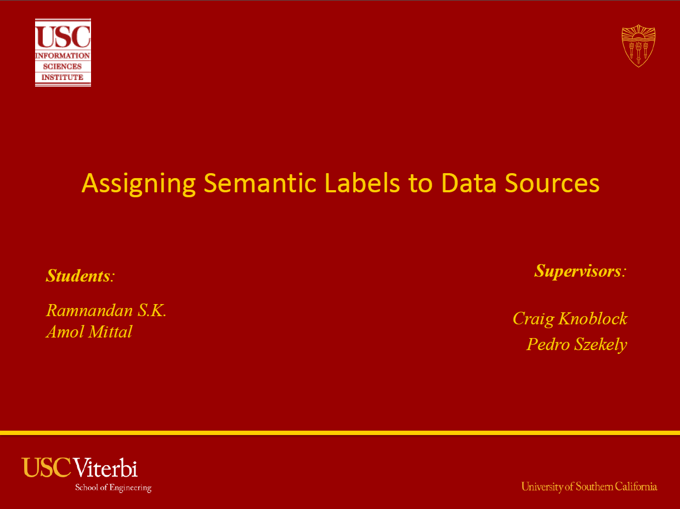

Implementation of
Efficient Massive Record Linkage
and Deduplication
Hao Yuan
Yufei Ou
Zhuqi Wang

Slide 2
Overview
Data Linkage and Deduplication
Comparison
F-Swoosh
Silk
Limes
Notes:
Record linkage (RL) refers to the task of finding records in a data set that refer to the same entity across different data sources (e.g., data files, books, websites, databases).
But most of the existing systems dealing with this problem lack enough time to deal with large-scale data-cleansing software.
During our staying in ISI we are trying to do comparisons between systems such as Silk… and Limes…, and in the meantime, implement new systems, introducing algorithms with better efficiency on this problem.

Slide 3
Overview
Part I. Silk
Part II. F-Swoosh

Slide 4
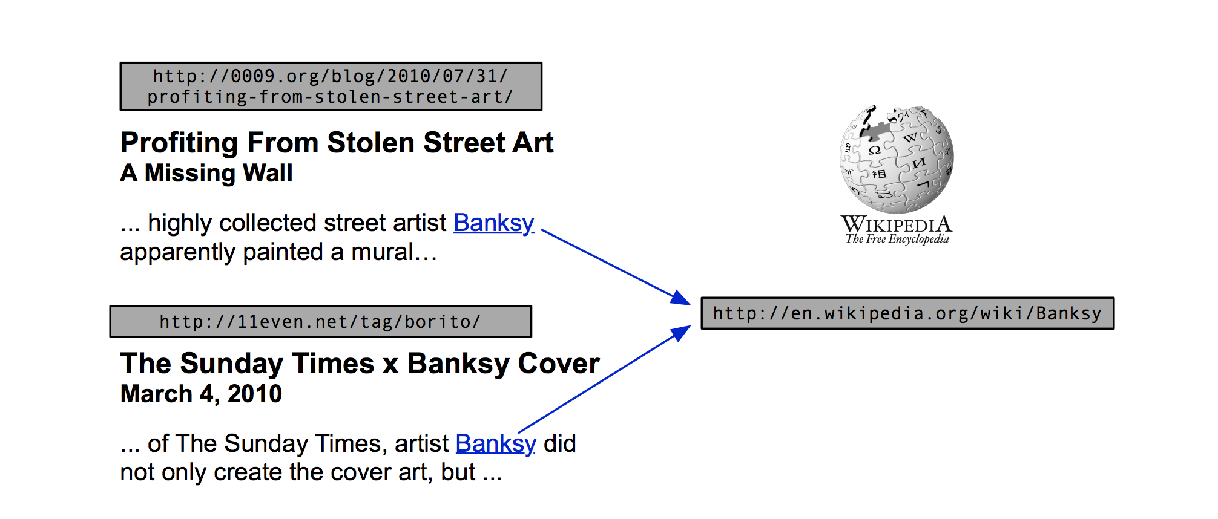
Why we do linkage work
Different records shown
as a name “Banksy” may
lead to a same entity
It is very important to figure out whether two records are the same (How to?)
Usually a record may have several attributes to help us improve the result
Notes:
First, I want to introduce a problem we always meet on the internet: that is different records from different datasets may refer to a same entity. Here is a simple example from wikipedia, two different articles refer to a same artist Banksy. Thus, if we actually know they refer to a same person, we could have more information of this person. In order to have a full comprehension toward a certain entity, it is very important to know whether two records are actually the same.
Although duplication of name usually happened, we could still distinguish two things by their other attributes. Two different people may share a same name, but not likely to share name, birth year, birth place simultaneously. That is the key idea to guarantee the precision.

Slide 5
Main problem
Spelling error: “David Smith” vs. “Davod Smith”
Different formatting conventions: “10/8/2009” vs. “Oct 8, 2009”
Custom abbreviation: “Daniel Walker Herbert Smith” vs. “Dan W. Smith”
Shuffling parts of the string: “Dept. of Computer Science,” vs. “Computer Science Dept.”
Count “replacement”
Deal with specified number
Set different weights
Base comparison on set of substring
The general idea of dealing with these subtle differences is:
designing appropriate “metrics” and calculating the “distance” of two strings
Notes:
However, it is harder to know whether two records are actually the same than to say they are different, that is because even a same entity may appear different in different datasets.
The reasons for appearing different include typing and OCR errors (e.g., David Smith is misspelled as Davod Smith), different formatting conventions (10/8/2009 vs. Oct 8, 2009), custom abbreviation, shortening of strings or omission (Daniel Walker Herbert Smith vs. Dan W. Smith), different names or nicknames (William Smith vs. Bill Smith), and shuffling parts of the string (Dept. of Computer Science, UW-Madison vs. Computer Science Dept., UW-Madison).
The general idea of dealing with these subtle difference is designing appropriate metrics and calculating the distance of two strings. The basic idea of designing appropriate metrics in different situation could be seen in the book “Principles of Data Integration.”

Slide 6
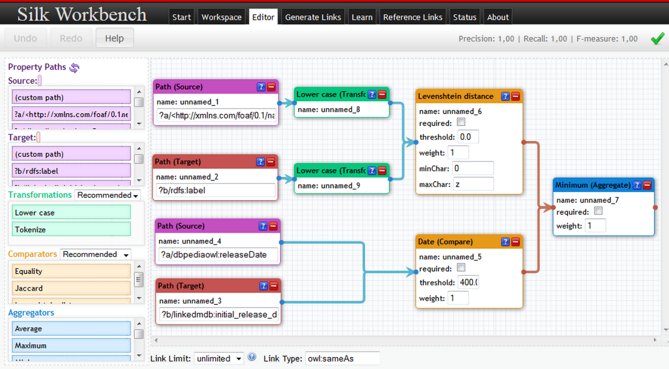
Silk
flexible enough to
compare different
attributes at the
same time.
adequate good metrics
load dataset(usually RDF file) -> compare certain attributes -> reflect linkage result
Notes:
In order to do deal with these problem, we need a tool which has adequate useful metrics and is flexible enough to compare different attributes at the same time. Fortunately, Mr. Craig Knoblock introduced me an excellent tool called silk to deal with this problem.
So, why we choose silk to do linkage work? As we can see from the slides, it has adequate good metrics and is flexible enough to compare different attributes at the same time. Usually silk will load the specified dataset, and we design suitable attributes and metrics by ourselves. Then silk will reflect the result based on these whole pattern

Slide 7
How to utilize silk
How to choose suitable attributes and metrics
How can silk improve our work
How to comprehend the linkage result and consummate it
Notes:
Thus, my work focus on the following three aspects: First, the approach to choose appropriate attributes and metrics. Second, how can silk improve our work of solving certain kind of problems? Third, what we can do when we get linkage result.

Slide 8
Design pattern
Step 1: dataset reconnaissance
Step 2: pick out more distinguishable and complete attributes
Step 3: design suitable metrics and parameters
Step 4: test part of the dataset to see if this pattern works as you wish
Notes:
So I will talk about how to choose appropriate attributes and metrics first:
After I read a lot of data and tried to give a good pattern, I found out actually even this step, I mean the pretreatment work, could be concluded as a regular process. I summarize my experience as follows
Step 1: dataset reconnaissance
Step 2: pick out more distinguishable and complete attributes
Step 3: design suitable metrics and parameters
Step 4: test part of the dataset to see if this pattern works as you wish

Slide 9
Design pattern (cora)
Cora is a testing dataset, we do reconnaissance and analysis on this dataset as an example
fact 1: only title and authorNames appear in all 1295 records.
fact 2: venue appears in about 1100 records, and no more parameters are as useful as these three parameters.
fact 3: exact same title and authorNames may refer to different entities
analysis based on the facts:
① the attributes we choose are title, anthorNames and maybe venue;
② best metric for title is Levenshtein Distance, because they are long and usually have little difference (maybe a single word or a number);
③ best metric for authorNames is Affine Gap Distance, since silk does not have this, so we choose Jaccard Measure (or qGram) instead.
Notes:
Cora is a testing dataset, we do reconnaissance and analysis on this dataset as an example, here is some facts of the dataset. And we could analyze them and make a little conclusion. These are details of my work, and if you need more information of how to pick out suitable metrics, you can contact with me.

Slide 10
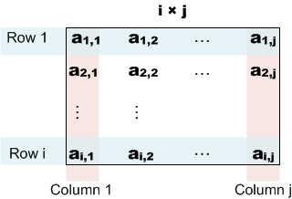
Apply silk
Basically: do linkage between two different dataset to figure out the same entity
Other idea: help us do clustering work
i = j = 1295
ap,q is the similarity
score of record i and
record j given by silk
link the dataset cora with
itself using silk, we could get
a matrix of similarity score
Notes:
Second, we must know how can silk improve our work, and that is the most important aspect of the whole thing. We already know that silk could do linkage between different dataset and give a full comprehension to the entity. In fact, it can do more than that. Here is one way professor Pedro and I find what silk could achieve: do clustering.
Let me set the same dataset cora as an example: as I introduced before, it has 1295 records and actually 104 entities. If we link this dataset with itself using silk, we could get a matrix, the elements in this matrix reflect the similarity score between different records given by silk.

Slide 11
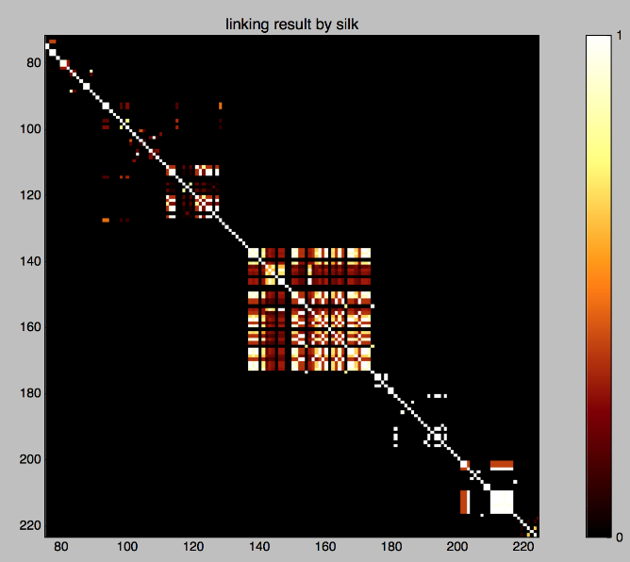
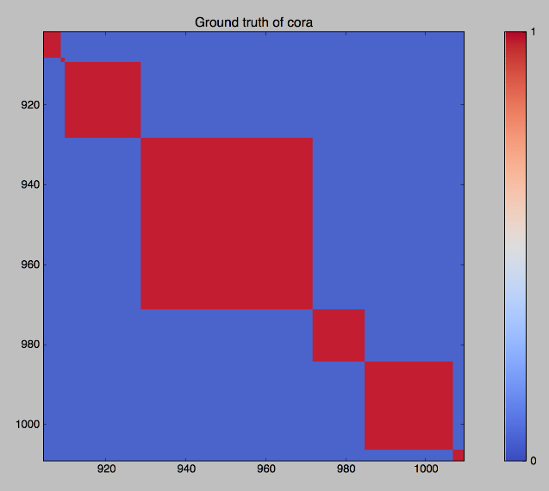
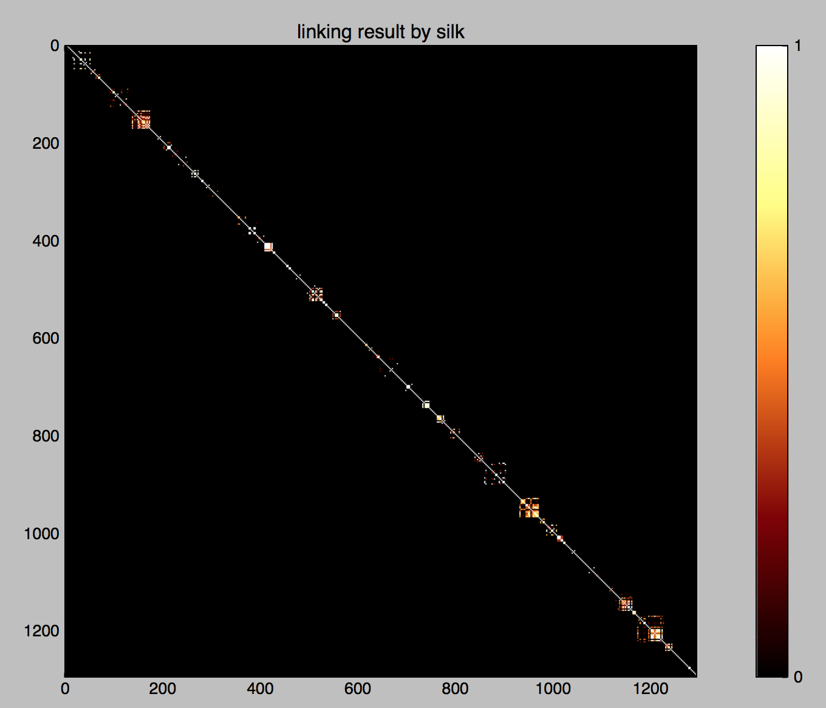
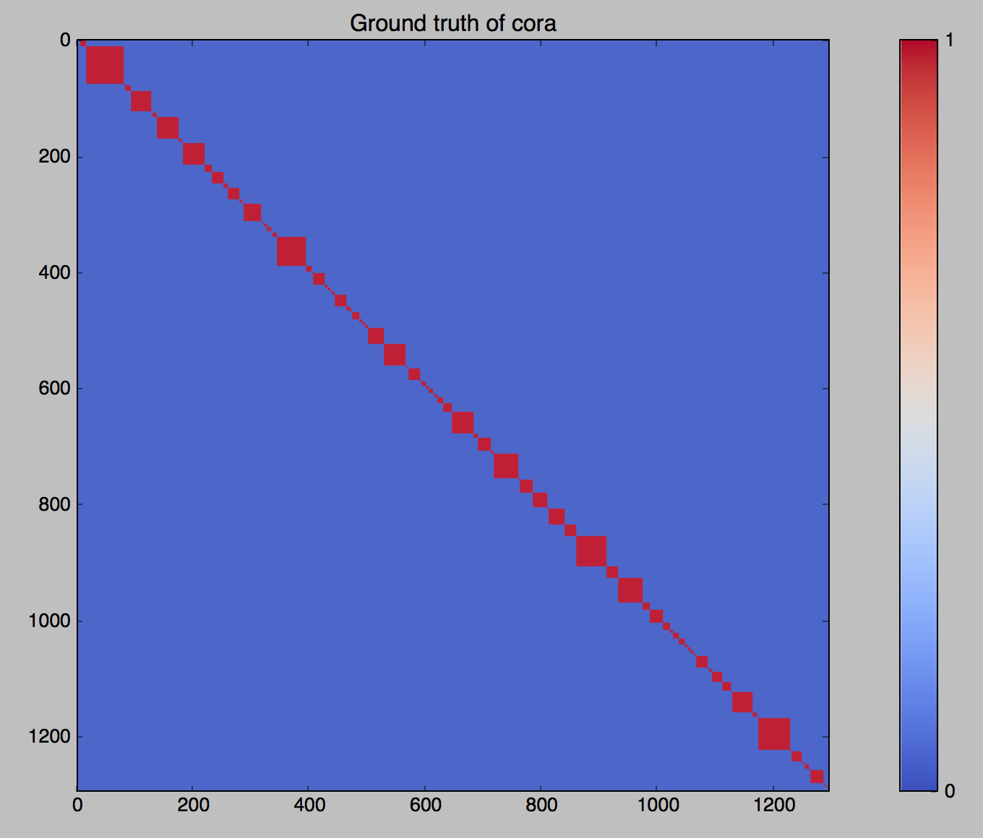
Do clustering
Precision: 99%
We use different color to show the linkage result, the brighter means the higher score
Notes:
And if we use the color to reflex the matrix, we could get an impression of the matrix like this: the brighter color means the higher similarity and means they are more likely to be the same.
After we got this matrix, I use it to graph clustering. The main idea of that is kind like page rank algorithm. Thanks to the silk, we could do that very efficiently.

Slide 12
Deal with the linkage result
How to change linkage result to ground truth
1. How to find new information through several existed different linkage results
2. How to limit the bound of manual checking, in other words, how to know where the linkage error could or could not happen
Notes:
Last, when we get the linkage result, it is natural to think the difference between the ground truth and it. And we usually check the result manually at small dataset to see if it is correct. So how could we change the linkage result to the ground truth efficiently? I am still working on that. Two basic ideas are finding new information through several existed different linkage results and limiting the bound of manual checking.

Slide 13
Conclusion & Future work
Though doing linkage itself is not very complicated, it is really interesting and tough to improve the linkage result and utilize it
Develop theory and pretreatment API to analyze the dataset and pick metrics automatically
Develop a method to get better linkage result from different “good” linkage results

Slide 14
Overview
Part I. Silk
Part II. F-Swoosh

Slide 15
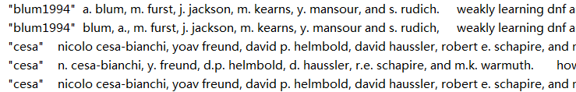
F-Swoosh
What is it
An algorithm[1] for intra-set clustering.
Integrate records referring to a same entity into a single record containing more information.
[1] Benjelloun, O., Garcia-Molina, H., Menestrina, D., Su, Q., Whang, S. E., & Widom, J. (2009). Swoosh: a generic approach to entity resolution. The VLDB Journal—The International Journal on Very Large Data Bases, 18(1), 255-276.

Slide 16
F-Swoosh
Feature of a record
A combination of certain dimension values of a record, usually with real-word meaning.
Examples
A record: [‘Woody Allen’, ‘USA’, ‘New York City, NY’, ‘December 1, 1935’, ‘American Director’, …]
Feature 1: name + nation + description
[‘Woody Allen’, ‘USA’, ‘American Director’]
Feature 2: name + birthplace + birthdate
[‘Woody Allen’, ‘New York City, NY’, ‘December 1, 1935’]

Slide 17
F-Swoosh
Approach
Compare → Match → Merge
Matching
Design matching functions to decide whether two values (of a same feature from two different records) match.
Merging
[‘Hao Yuan’, ‘China’, null, ‘LA, California’]
[‘Hao Y.’, null, ‘male’, ‘Los Angeles, USA]
[‘Hao Yuan’, ‘China’, ‘male’,
‘Los Angeles, California, USA’]
Notes:
Do pairwise comparison in a set of records, merge information into a single record when a pair are detected a match.
Merge two matching records into one.

Slide 18
F-Swoosh
Matching functions
Traditional string / numeric data-similarity metrics
Customized parameters.
Records match: values match in at least one feature.
Merging functions
E.g.: concatenating, choosing by contribution, choosing by length, etc.
Avoid overfitting
Use simple, well-known functions.
Notes:
Levenshtein, Jaccard, Jaro-Winkler, etc.
For example, we required two match features have levDist in their names of at least 90% of the length of the shorter one.
We can integrate result in those features and customize our rules of prerequisites of A MATCH.

Slide 19

F-Swoosh
How it works
Human knowledge introduced on how to recognize records referring to the same entity.
Merging products are stronger to absorb other related records in the set.
Ability to process high dimensions.
Notes:
First, assume we merge the records simply by union their content in corresponding fields.
And two records match as long as they have two fields in common.
We recognize each dimension as a single feature and design different match functions for them.
R3 at first will not match R1 or R2 because D is a common initial of a person’s last name.
R1 match R2, we merge them. Then we got two phone numbers in the second dimension. We call the product R4.
R4 now has the ability to match R3 and merge with it. Finally we got a record, R5, containing all the information existing in the set.

Slide 20
F-Swoosh
Problem
Time-consuming: N-square complexity
Solution
Reducing redundant comparisons
Using blocking techniques
Minhash+LSH
Simhash

Slide 21
F-Swoosh
Reducing redundant comparisons
Two hashtables
P and N, recording positive / negative comparisons conducted.
Redis backend adaptable.
Efficient in some dataset
e.g.: Cora (repeatful feature value).

Slide 22
F-Swoosh
Minhash+LSH [1]
Minhash
Extract signature vector from a too-long (probably) shingle vector of a text data.
Similarity of data --> similarity of vectors
LSH (Locality-sensitive hashing)
Divide sig-vecs into bands, indexing records in multiple hashtables using band-values as keys.
Querying: Pick up candidates from hashtables.
How to do blocking: View a set of candidates as a block(bucket).
[1] A. Rajaraman, J. Ullman, J. Leskovec, -- “Mining of Massive Datasets “ http://www.mmds.org/
Notes:
However, in fact LSH strictly, is not an algorithm designed for blocking, but querying and searching for the most similar target.
So there must be a bunch of redundant candidates that are not competitive at all every time we do the query.
But it can still accelerate the whole process, comparing to the raw F-Swoosh implementation.

Slide 23
F-Swoosh
Simhash
Why blocking?
Two methods
Adapt to large dataset
Result
Notes:
And then there’s another algorithm, Simhash, has better efficiency, also good precision.

Slide 24
Why blocking?
Pick up candidate sets
Reduce the computational work
Easily use parallel strategy
Notes:
When we use some linking algorithm in some small data set, blocking may not be necessary. However, with the growing of the data set, these linking algorithm becomes more and more time-consuming. In this case, the blocking can make the whole process more efficient.
Actually, blocking can also be regarded as a roughly clustering, which picks up similar records into several subset. So that we can reduce the computational work and we can also easily apply some parallel algorithm in our task

Slide 25
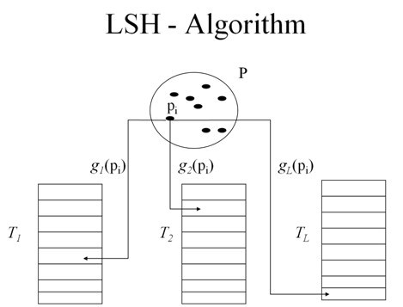
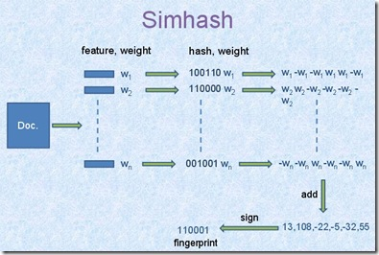
Two method
Locality-sensitive hashing
simhash
Notes:
Locality-sensitive hashing (LSH) is a method of performing probabilistic dimension reduction of high-dimensional data. The basic idea is to hash the input items so that similar items are mapped to the same buckets with high probability (the number of buckets being much smaller than the universe of possible input items). The hashing used in LSH is different from conventional hash functions, such as those used in cryptography, as in the LSH case the goal is to maximize probability of "collision" of similar items rather than avoid collisions. Note how locality-sensitive hashing, in many ways, mirrors data clustering andNearest neighbor search.
simhash is one where similiar items are hashed to similiar hash values

Slide 26
Simhash
The official SimHash algorithm is:
Define a fingerprint size (for instance 32 bits)
Create an array V[] filled with this size of zeros
For each element in the dataset, we create a unique hash with md5, sha1 of any other hash algorithm that give same-sized results
For each hash, for each bit i in this hash
If the bit is 0, we add 1 to V[i]
If the bit is 1, we take 1 to V[i]
For each i
If V[i] > 0, i = 1
If V[i] < 0, i = 0
It gives us a fingerprint characterizing our text, an approximation of the text data.
Notes:
To compare fingerprints, we need an algorithm that generate them using a bigger dataset. The firs idea would be to use hash (md5, sha1). However, these hash change if the input change a bit. We need another algorithm that change a bit if the text does not change a lot. Simhash does that.

Slide 27
Adapt to large data set
Process part of data
Save in disk
Read from disk
Strategy for large data set
Find efficient storage scheme
Size of file
Number of file
Notes:
However, if we want to deal with some large data set, we can not load all data into the memory. A common practice for solving this problem is split the data set into several parts and do simhash separately. This step will not influence the precision and some parallel algorithm can be used to accelerate the whole process.
Choose an efficient storage system is also important. How to get the balance between the size and number At first, we save each bucket of hash table into a individual file. But it will produce a lot of temp files, nearly 1 millions, which makes my machine runs badly. Then I change the method, buckets which have the same first three letters of key will be saved into a file. Finally it makes the simhash works more efficient and reduce the pressure on the file system of my machine

Slide 28
Result
Data set | Number of record | Time(s)
Museum | 10,000 | 14.2
dbpedia | 649,051 | 823
1/10 wiki(one part) | 1,080,000 | 4,576
wiki | 10,893,248 | 45,992

Slide 29
F-Swoosh
Application examples
Deduplication on Cora
1295 records, 114 entities (labeled ground truth).
Try different feature designs, and different matching and merging function-list.
Adjusting thresholds in functions.
Preparation: Splitting author-list for records.
The best result:
 | Precision | Recall | F-1 score | Time (s) | Candidate Num.
Raw | 0.762 | 0.876 | 0.815 | 5.335(*) | 1294(*)
Minhash+LSH | 0.762 | 0.903 | 0.826 | 5.461 | 505
Simhash | 0.761 | 0.915 | 0.831 | 24.116 | 2544
Notes:
So finally we chose Simhash to do the blocking job.
But LSH still has its advantages. Since it’s a 2-layer design, we can easily change the banding technique or more intricate hashing functions
to adapt various kinds of datasets. It’s more flexible than Simhash.

Slide 30
F-Swoosh
Application examples
Linkage from Museum to DBPedia
Datasets
Museum: 10k records.
DBPedia: about 650k records.
Preparation
Converting / discarding hard UTF-8 characters.
Adjusting the ground-truth file.
Blocking
Matching / linking

Slide 31
F-Swoosh
Application examples
Linkage from Museum to DBPedia
Datasets
Preparation
Blocking
Simhash
Matching / linking

Slide 32
F-Swoosh
Application examples
Linkage from Museum to DBPedia
Datasets
Preparation
Blocking
Matching / linking
Find the DBPedia buckets for a Museum record.
Design feature-list and matching functions.
Change matching functions into scoring functions.
Use scoring functions to find the optimal target.
Testing (see next page)

Slide 33
F-Swoosh
Testing
Testset
All ‘A’-initial records in Museum (747).
Result
Time cost (seconds)
 | Precision | Recall(*) | F-1 Score
Longer keys | 1.000 | 0.830 | 0.907
Longer keys (date toleration) | 0.466 | 0.950 | 0.625
Shorter keys | 0.952 | 0.842 | 0.894
 | t1 | t2 | t3 | t4
Only ‘A’-initial | 8.478 | 7.372 | 6.000 | 0.005
Whole dataset | 7.993 | 7.382 | 95.734 | N/A

Slide 34
F-Swoosh
Testing
Testset
Result
Time cost
Notices
Problem in recall: versions of DBPedia
Small optimization: ignore empty features
Conclusion

Slide 35
F-Swoosh
Testing
Testset
Result
Time cost
Notices
Conclusions
Notes:
Now we can draw some conclusion.

Slide 36
The End
Thanks for listening.

