Slide 1


Efficient Graph-based Document Similarity
Christian Paul, Achim Rettinger, Aditya Mogadala, Craig A. Knoblock, Pedro Szekely

Slide 2
Common task: Related-document Search
Query
document
Apple breaks laptop sales record
Document
Collection
.
.
.
He drinks apple juice during half-time break
All-time high in MacBooks sold
U2 record pre-installed on iPhones
.
.
.
Notes:
Klasse Beispiel!

Slide 3
Matching words do not always indicate similarity
Query
document
Apple breaks laptop sales record
Document
Collection
.
.
.
He drinks apple juice during half-time break
All-time high in MacBooks sold
U2 record pre-installed on iPhones
.
.
.

Slide 4
Word co-occurrence can be misleading, too
Query
document
Apple breaks laptop sales record
Document
Collection
.
.
.
He drinks apple juice during half-time break
All-time high in MacBooks sold
U2 record pre-installed on iPhones
.
.
.
Notes:
Word co-occurrence, namely the analysis of how words occur together in a sentence, paragraph or document, can be very valuable, here in this example indicating that Apple and iPhones occur together frequently. But again, like in the case of „juice“, it can be misleading – also, some words that are very similar may never or rarely appear together.

Slide 5
Semantic Technologies: resolve ambiguity & exploit relational knowledge
Query
document
Apple breaks laptop sales record
Apple Juice
Document
Collection
Laptop
.
.
.
Apple Inc.
He drinks apple juice during half-time break
developer
type
developer
All-time high in MacBooks sold
MacBook
iPhone
U2 record pre-installed on iPhones
.
.
.
Notes:
By linking mentions in text to knowledge graph entities, you can resolve ambiguity, and then building on those entities and the graph, exploit its relational knowledge to assess similarity

Slide 6
Semantic Technologies: resolve ambiguity & exploit relational knowledge
Query
document
Apple breaks laptop sales record
Apple Juice
Document
Collection
Laptop
.
.
.
Apple Inc.
He drinks apple juice during half-time break
developer
type
developer
All-time high in MacBooks sold
MacBook
iPhone
U2 record pre-installed on iPhones
.
.
.
Expensive graph traversal
Notes:
We wanted to see how far can we can come with explicit representation of documents in a field that is dominated by statistical approaches

Slide 7
Related Work
TF-IDF,
Vector Space Model
PathSim [SHY +11]
HeteSim [SKH +14]
Distributional:
+ scalable, fast
- No explicit
disambiguation
and conceptual
relations
Knowledge-based:
+ rich semantic
knowledge
- expensive graph
traversal
Nunes et al.:
Transversal doc. similarity
[NKF +13]
Explicit Semantic
Analysis (ESA) [GM07]
Schuhmacher, Ponzetto:
Graph Edit Distance [SP14]
Salient Semantic
Analysis (SSA) [HM11]
AnnSim: 1-1 matching,
hierarchical similarity
[PVH +13]
Notes:
Builds its term statistics using all of wikipedia and represents documents in the space of wikipedia articles

Slide 8
Bridging the gap
TF-IDF,
Vector Space Model
PathSim [SHY +11]
HeteSim [SKH +14]
Distributional:
+ scalable, fast
- No explicit
disambiguation
and conceptual
relations
Knowledge-based:
+ rich semantic
knowledge
- expensive graph
traversal
Nunes et al.:
Transversal doc. similarity
[NKF +13]
Efficient Graph-based Document
Similarity
Explicit Semantic
Analysis (ESA) [GM07]
Schuhmacher, Ponzetto:
Graph Edit Distance [SP14]
Salient Semantic
Analysis (SSA) [HM11]
AnnSim: 1-1 matching,
hierarchical similarity
[PVH +13]

Slide 9
Core Contributions
Scalable related-document search process
  Graph traversal during pre-processing
  Light-weight tasks at search time
  We achieve similar computational efficiency as statistical approaches

Slide 10
Core Contributions
Scalable related-document search process
  Graph traversal during pre-processing
  Light-weight tasks at search time
  We achieve similar computational efficiency as statistical approaches
Bag-of-entities document model & similarity
  Document similarity as combination of pairwise entity similarities
  Exploits hierarchical & transversal knowledge graph relations
  In our experiments, we achieve higher correlation with human notion of document similarity than the competition

Slide 11
Related-document Search using Graph-based Similarity
  Semantic Document Expansion
    Enrich query document with relational knowledge
  Inclusion in corpus
    Store & index expanded document
  Pre-search
    Use inverted index to generate candidate set
  Full search
    Entity-level, path-based similarities

Slide 12
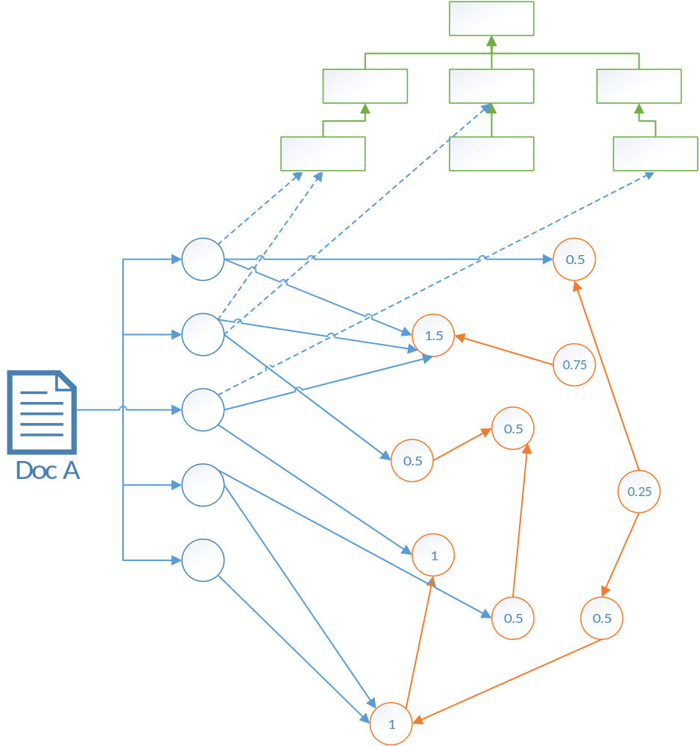
Semantic Document Expansion
Enrich document annotations
Hierarchically
  Categories & their ancestors + hierarchical depths
Transversally
  Weight neighboring entities based on
    number of paths
    length of paths
$w\left(e\right)=\sum_{l=1}^{L}{β^{l}}∗\left|{paths}_{a,e}^{\left(l\right)}\right|$

Slide 13
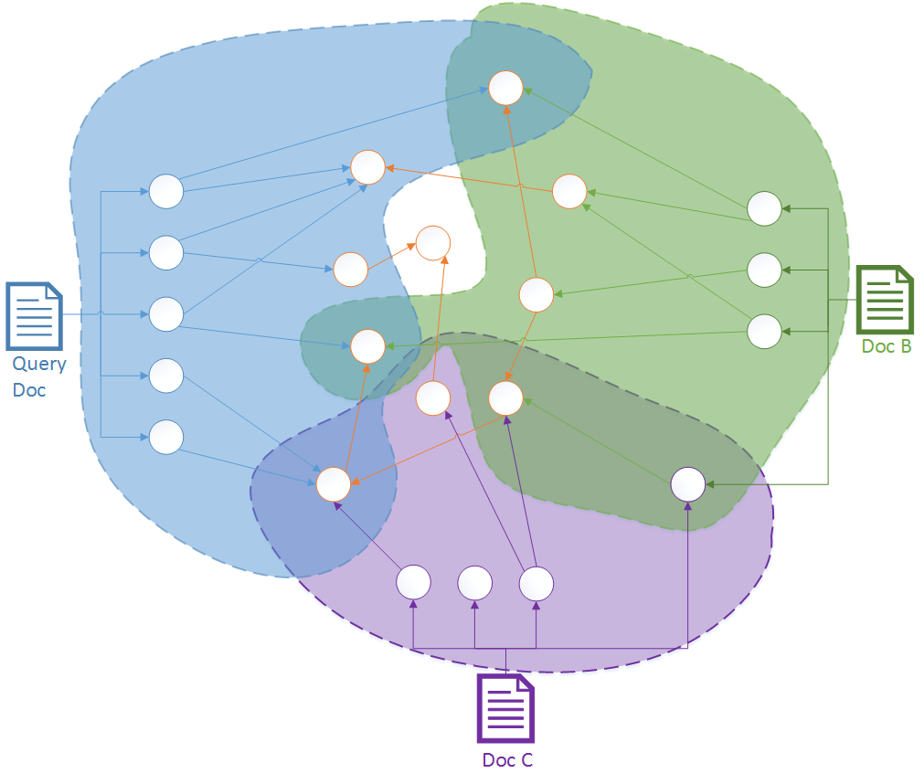
Pre-Search: Generate Candidate Set
Inverted index from entities to documents
  Retrieve candidates efficiently
Assumption: Entity overlap → contextual similarity
  Coarse, document-level assessment

Slide 14
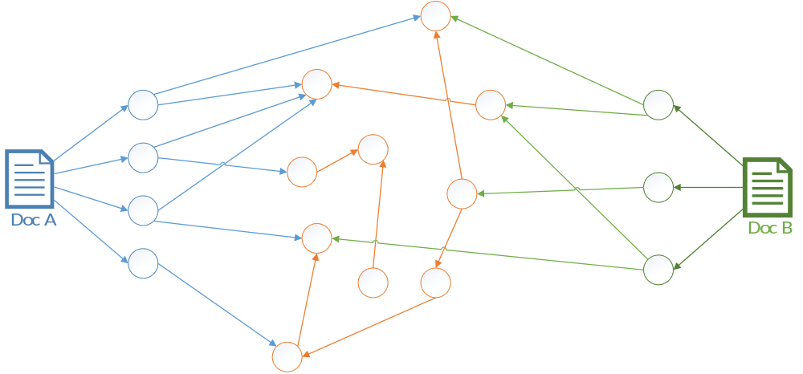
Full Search: Graph-based Document Similarity
For each candidate document, reconstruct query-candidate annotation subgraph - hierarchical & transversal
Compute all pairwise entity similarity scores
Combine into document score

Slide 15
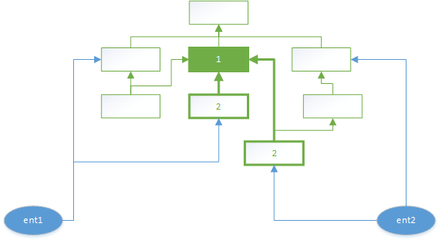
Hierarchical entity similarity
Using stored ancestors & depths to compute
Example:
${hierSim}_{dps}\left(ent1,ent2\right)=\frac{1}{1+2+2}=0.2$
${hierSim}_{dps}\left(ent1,ent2\right)=\frac{1}{1+2+2}=0.2$

Slide 16
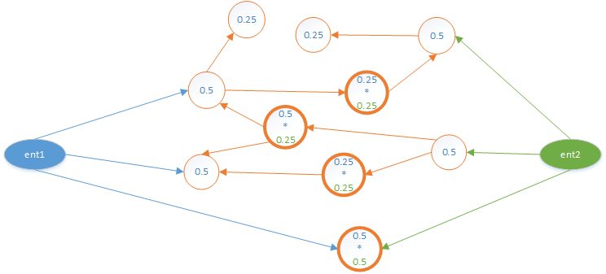
Transversal entity similarity
Use stored neighbors & weights to compute:
Example:
$transSim\left(a,b\right)=\sum_{l=1}^{L∗2}{β^{l}}∗\left|{paths}_{a,b}^{\left(l\right)}\right|$
$transSim\left(ent1,ent2\right)={0.5}^{2}+2∗{0.25}^{2}+0.5∗0.25=0.5$

Slide 17
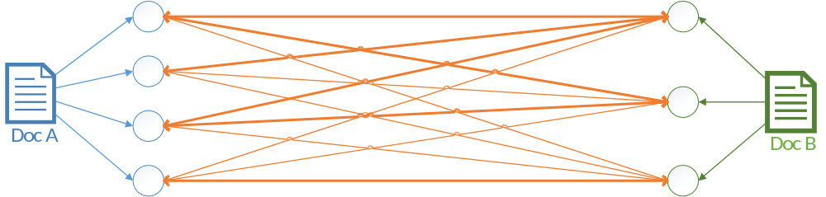
Document similarity: bipartite graph of entity similarities
Annotation pair similarity: Combine transversal & hierarchical scores
Determine maxGraph: for each annotation, choose max. score edge (bold)
Compute document score based on max. edges for each annotation a_{1i} of Doc A:
$\left(a_{1i},matched\left(a_{1i}\right)\right)$
$docSim\left(docA,docB\right)=\frac{\sum_{a_{1i}∈A_{1}}{\left({entSim}_{ent}\left(a_{1i},matched\left(a_{1i}\right)\right)\right)}}{\left|A_{1}\right|+\left|A_{2}\right|}$

Slide 18
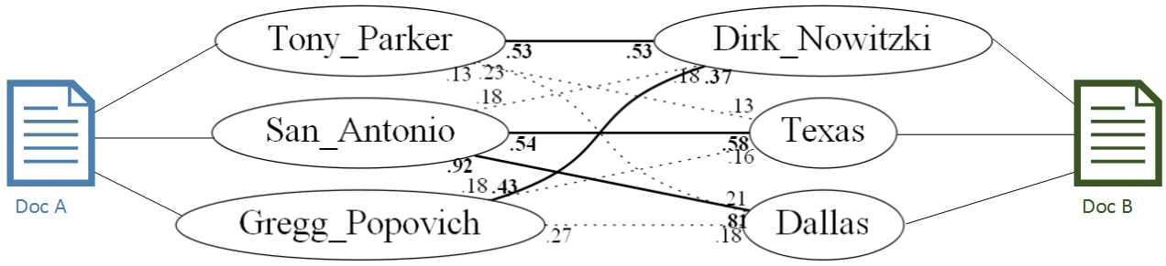
Document similarity: DBpedia example
Example documents score:
$docSim\left(docA,docB\right)=\frac{0.53+0.92+0.43+0.53+0.58+0.81}{3+3}≈0.63$

Slide 19

Evaluation
Task: Measure correlation with human notion of similarity
Datasets
  Document similarity: Lee50^{[1]}
  Sentence similarity: 2012-MSRvid-Test^{[2]}, 2015-Images^{[3]}
... using and X-LiSA[ZR14] entity extractor
[1] https://webfiles.uci.edu/mdlee/LeePincombeWelsh.zip
[2] http://research.microsoft.com/en-us/downloads/38cf15fd-b8df-477e-a4e4-a4680caa75af/
[3] http://ixa2.si.ehu.es/stswiki/index.php/
Notes:
Kapanipathi et al.

Slide 20
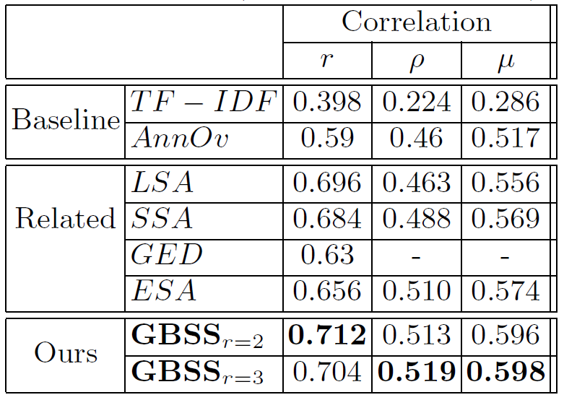
Document Similarity: Lee50 corpus
50 short news articles (51 to 126 words)
Gold standard set of full pairwise document similarity scores
Outperforming baselines
& competition:
  Statistical
  (LSA, ESA, SSA)
  Knowledge-based
  (GED)
Notes:
Pearson (r), Spearman (p)
Very well established dataset
Todo: nachschauen wie oft Paper referenziert

Slide 21
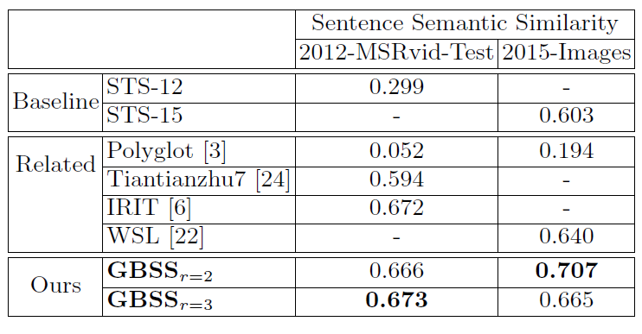
Sentence Similarity
Compared to related unsupervised approaches
(on texts with one or more extracted entities)
  2012-MSRvid-Test: Video descriptions from MSR Video Paraphrase Corpus
  2015-Images: Flickr image descriptions
Outperforming
baselines &
competition
  Statistical
  (Polyglot)
  Knowledge-based
  (Tiantianzhu7,
  IRIT, WSL)
Notes:
We tried on single entities which didn‘t work very well, so we wanted to see how far we can get with less context.
Semantic Text Similarity (STS) Challenges 2012, 2015
STS-12: Baseline approach reported in SemEval-2012 [2] for MSRvid-Test
dataset.
{ STS-15: Baseline approach reported in SemEval-2015 [1] for Images dataset.
{ Polyglot: Word embeddings obtained from Al-Rfou et al. [3] is used to calcu-
late the sentence embeddings by averaging over word embeddings. Sentence
words that are not observed in the word embedding database are ignored.
{ Tiantianzhu7: Uses a graph-based word similarity based on word-sense
disambiguation.
{ IRIT: Uses a n-gram comparison method combined with WordNet to cal-
culate the semantic similarity between a pair of concepts.
{ WSL: Uses an edit distance to include word order by considering word
context. (uses WordNet, Li et al. 2006)

Slide 22
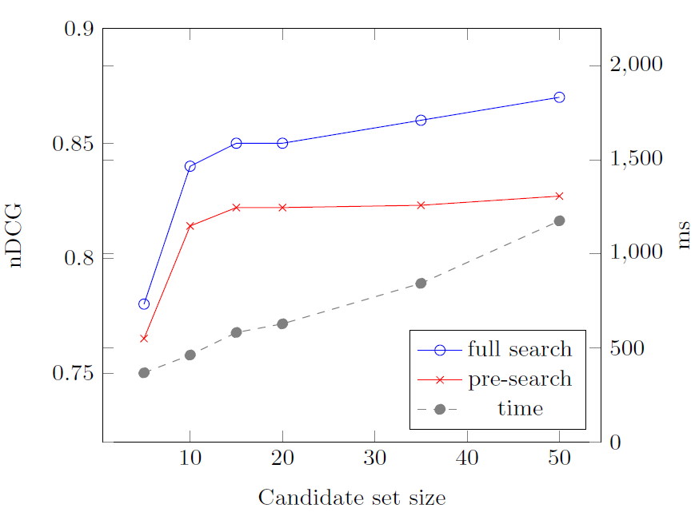
Related-document Search: Pre-Search, Full Search & Efficiency
Ranking score (nDCG) improves from Pre-Search to Full Search
Computation time grows linearly with candidate set size
Here: candidate set of size ~15 achieves high performance

Slide 23
Conclusion & Outlook
Efficient Graph-based Document Similarity
  … combines hierarchical & transversal relational knowledge
  … outperforms related distributional & knowledge-based approaches, on both articles and sentences
  … is computationally efficient: related-document search
Lessons learned
  Value of DBpedia for semantic similarity
  The more entities (at least one) per document, the better:
    Few entities: disambiguation helps
    Many entities: maxGraph entity pairing emphasizes meaningful relations
Resources (code, data, documents):
http://people.aifb.kit.edu/amo/eswc2016/
Notes:
If you have very few entities per document, at least the disambiguation helps
If your document can be presented with a lot of entities than also the max-score pairing provides the advantage

Slide 24
References I
[TMS08] Thiagarajan, Manjunath, Stumptner. Computing semantic similarity using ontologies. In ISWC 08, the International Semantic Web Conference (ISWC), 2008.
[LD08] Lemaire, Denhière. Effects of high-order co-occurrences on word semantic similarities.
[GM07] Gabrilovich, Markovitch. Computing semantic relatedness using wikipedia-based explicit semantic analysis. In IJCAI, volume 7, pages 1606–1611, 2007.
[HM11] Hassan, Mihalcea. Semantic relatedness using salient semantic analysis. In AAAI, 2011.
[SP14] Schuhmacher, Ponzetto. Knowledge-based graph document modeling. In Proceedings of the 7th ACM International Conference on Web Search and Data Mining, WSDM ’14.
[NKF⁺13] Nunes, Kawase, Fetahu, Dietze, Casanova, Maynard. Interlinking documents based on semantic graphs. Procedia Computer Science, 22:231–240, 2013.
[PSA08] Potthast, Stein, Anderka. A wikipedia-based multilingual retrieval model. In Advances in Information Retrieval, pages 522–530. Springer, 2008.
[SHY+11] Sun, Han, Yan, Yu, Wu. Pathsim: Meta path-based top-k similarity search in heterogeneous information networks. VLDB’11, 2011.
[SKH+14] Chuan, Xiangnan, Yue, Yu, Bin. Hetesim:A general framework for relevance measure in heterogeneous networks. IEEE Transactions on Knowledge & Data Engineering.
[PVH⁺13] Palma, Vidal, Haag, Raschid, Thor. Measuring relatedness between scientific entities in annotation datasets. In Proceedings of the International Conference on Bioinformatics,Computational Biology and Biomedical Informatics, BCB’13.
[ZR14] Zhang, Rettinger. X-lisa: Cross-lingual semantic annotation. Proceedings of the VLDB Endowment (PVLDB), the 40th International Conference on Very Large Data Bases (VLDB).
[KJC⁺15] Pavan Kapanipathi, Prateek Jain, Chitra Venkataramani, Amit Sheth. Hierarchical interest graph, 21 January 2015. wiki.knoesis.org/index.php/Hierarchical_Interest_Graph, last accessed 07/15/2015

Slide 25
References II
[LIJ⁺15] Lehmann, J., Isele, R., Jakob, M., Jentzsch, A., Kontokostas, D., Mendes, P.N., Hellmann, S., Morsey, M., van Kleef, P., Auer, S., et al.: Dbpedia-a large-scale, multilingual knowledge base extracted from wikipedia. Semantic Web 6(2), 167-195 (2015)

