Slide 1
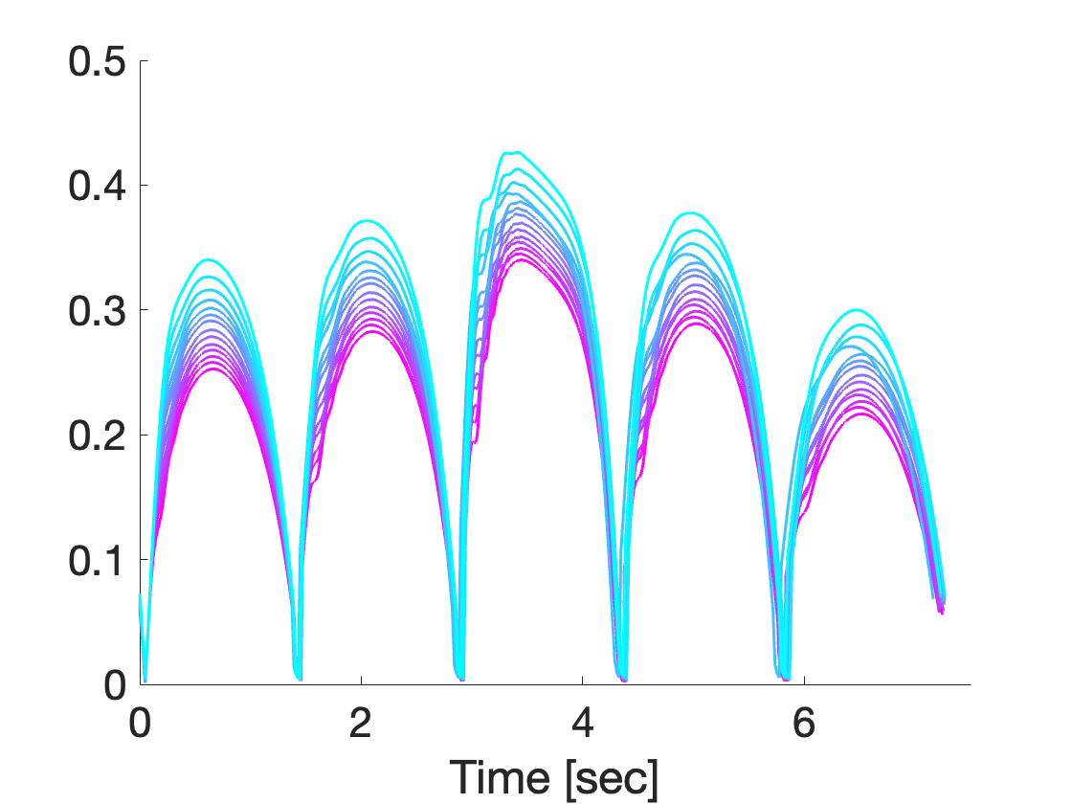
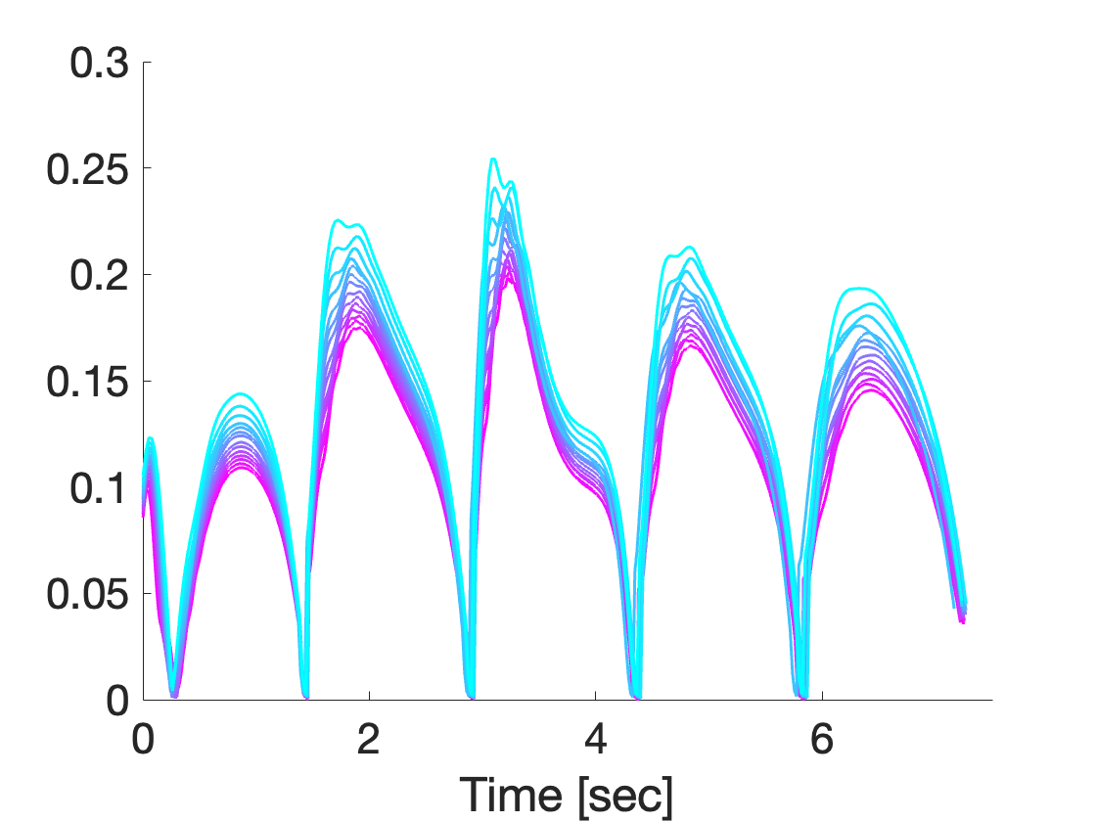
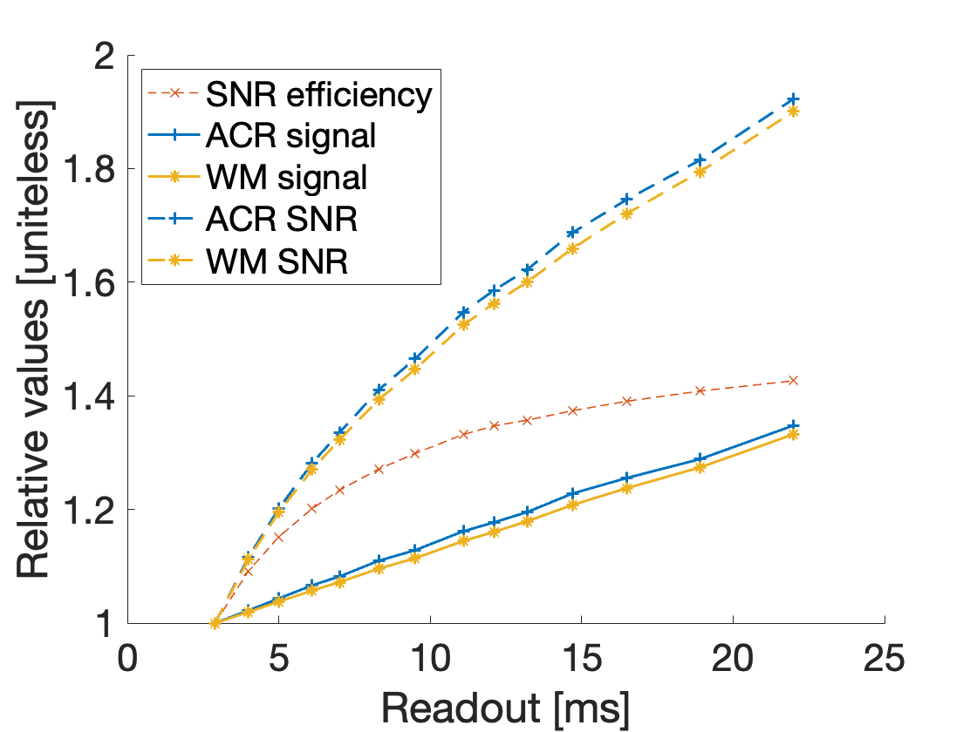
(A) ACR phantom, T₁ = 100 ms, T₂ = 100 ms
(B) White matter, T₁ = 500 ms, T₂ = 80 ms
(C) Relavtive SNR

