Slide 1
ECE 105: Introduction to Electrical Engineering
Lecture 5
Device 1
Yasser Khan
Rehan Kapadia

Slide 2
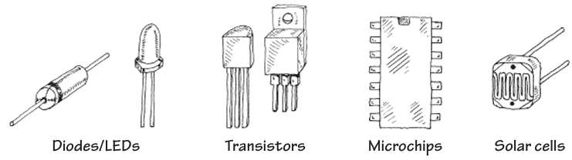
What’s after resistors, capacitors, and inductors

Slide 3
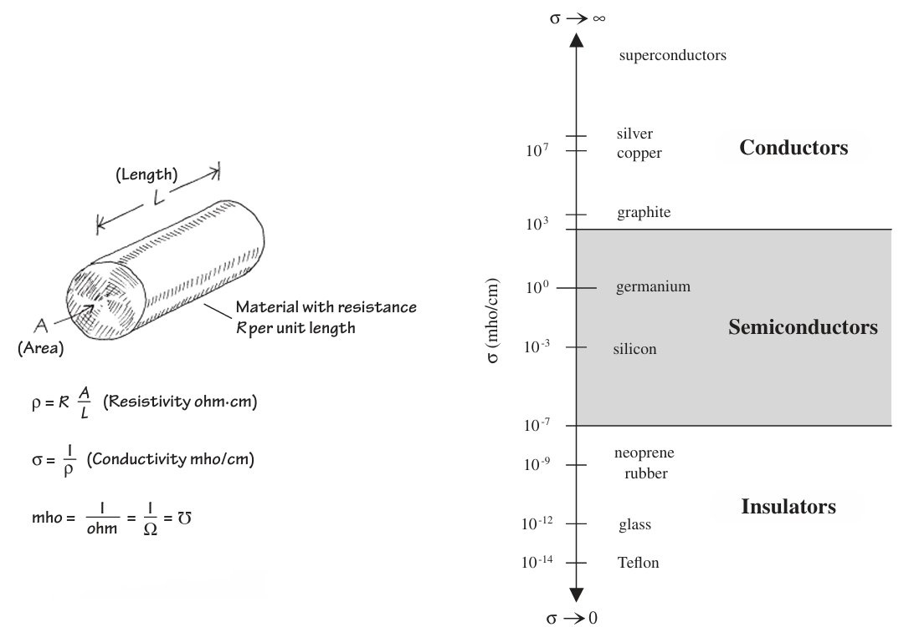
Types of materials used in electronics

Slide 4
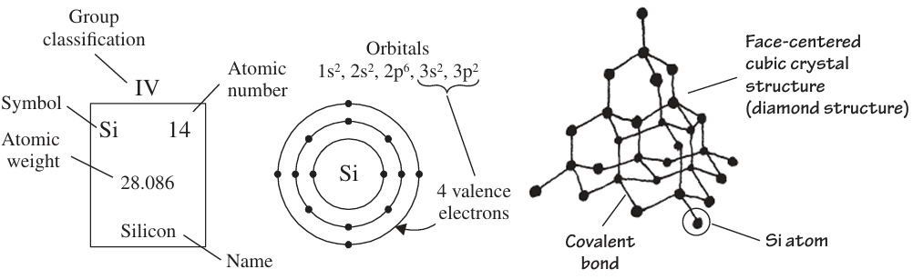
Silicon – the workhorse of electronics

Slide 5
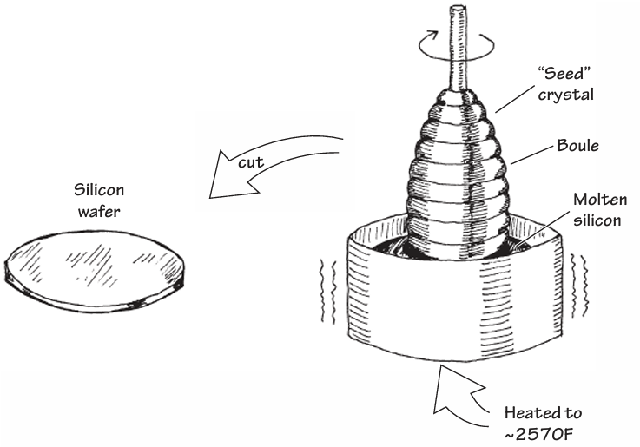
From sand to silicon wafers

Slide 6
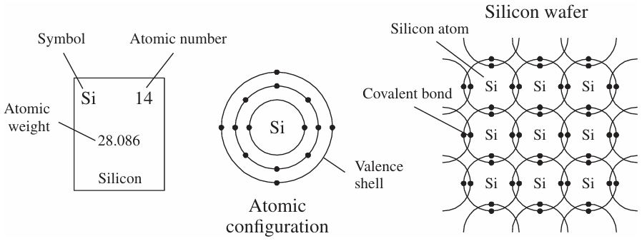
Silicon’s atomic configuration

Slide 7
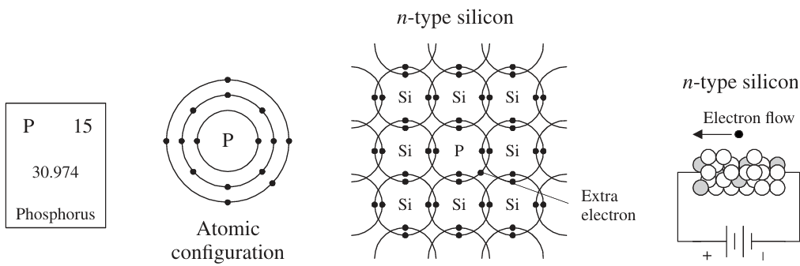
N-type silicon

Slide 8
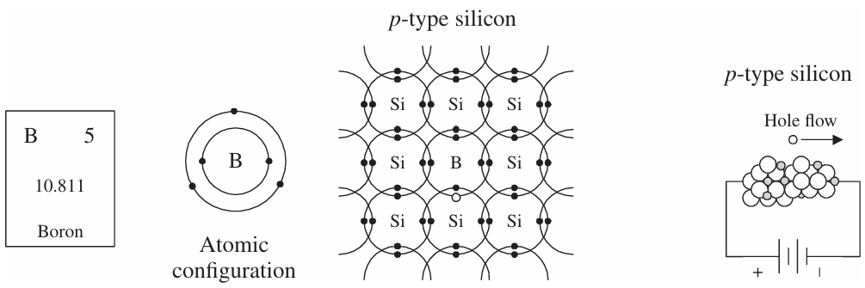
P-type silicon

Slide 9
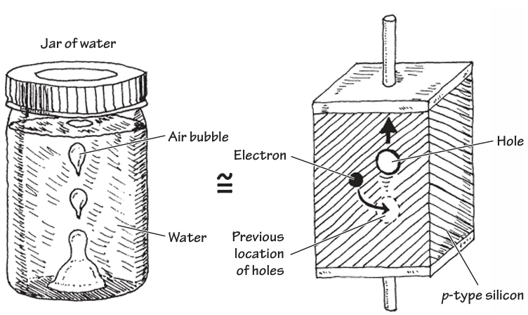
Air bubble in a water jar – hole transport in silicon

Slide 10
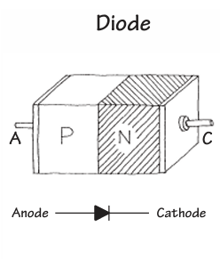
What is a diode

Slide 11
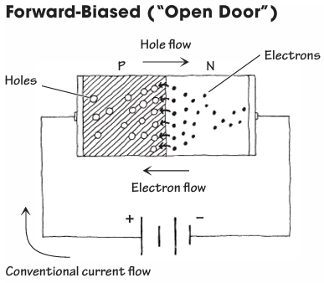
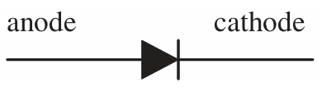
Forward biasing a diode

Slide 12
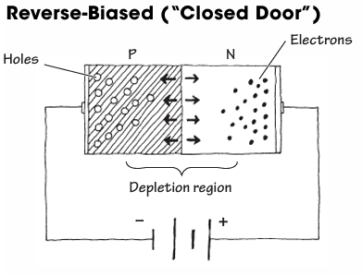
Reverse biasing a diode

Slide 13
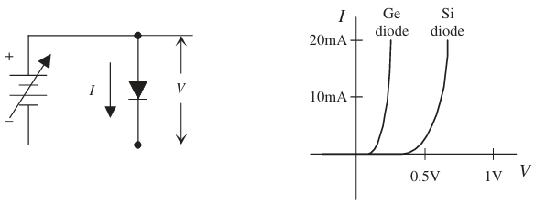
Diode characterization

Slide 14
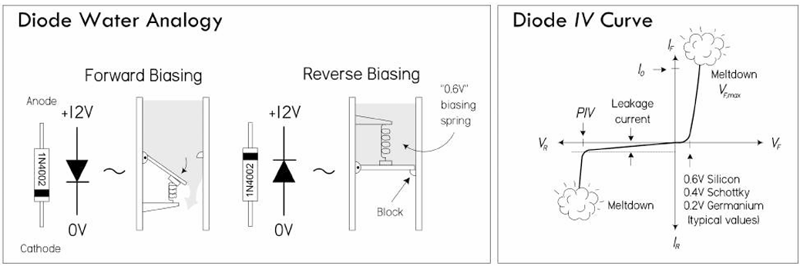
Water analogy

Slide 15
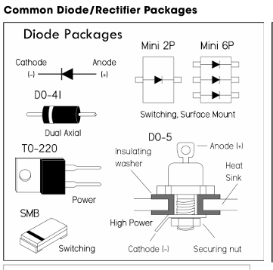
How does a diode look like on a PCB board

