Slide 1
ECE 105: Introduction to Electrical Engineering
Lecture 6
Device 2
Yasser Khan
Rehan Kapadia

Slide 2
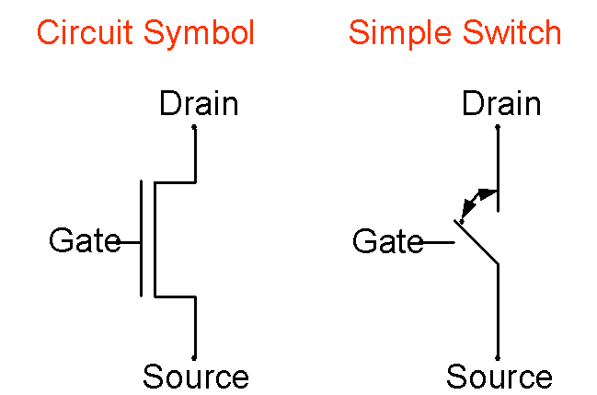
Transistor

Slide 3
MOSFET – we’ll only use MOSFET transistors in this class

Slide 4
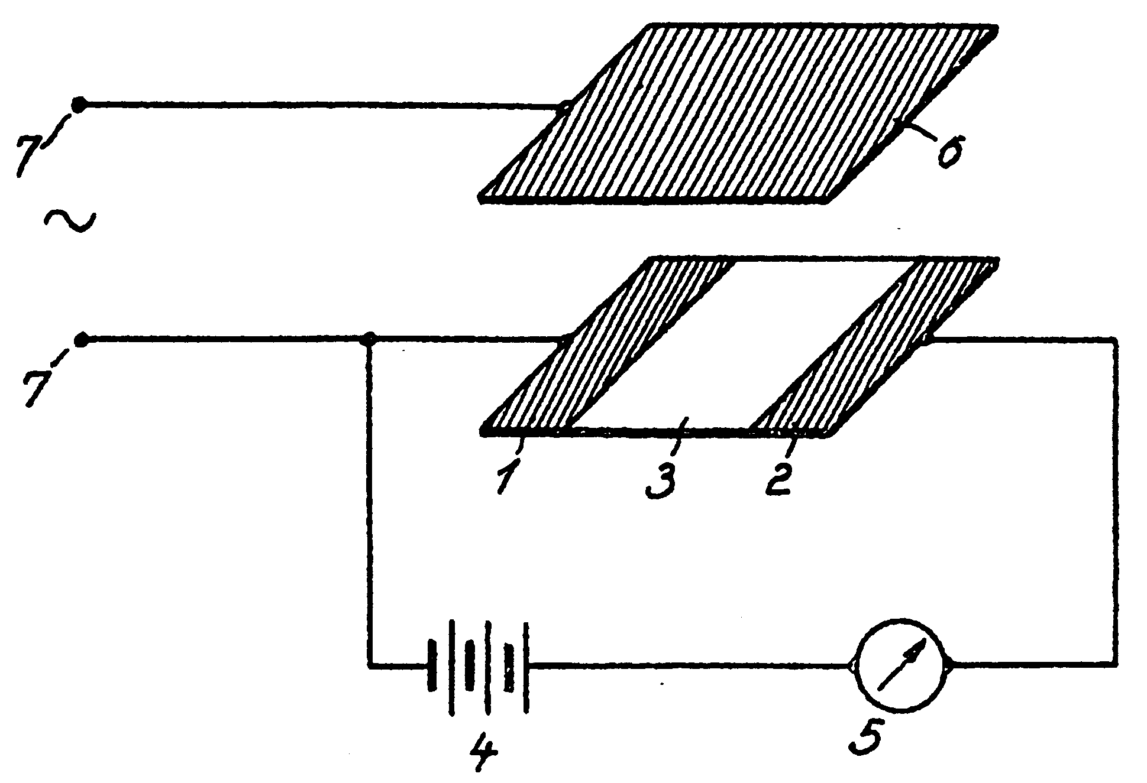
Early Patents on the Field-Effect Transistor
In 1935, a British patent was issued to Oskar Heil.
A working MOSFET was not demonstrated until 1955.
Using today’s terminology, what are 1, 2, and 6?

Slide 5
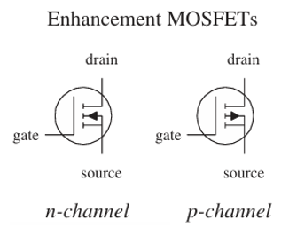
What are n- and p-channel transistors

Slide 6
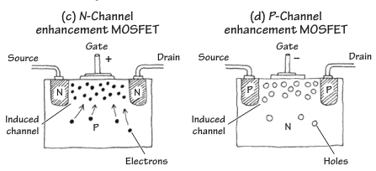
How does the charge flow

Slide 7
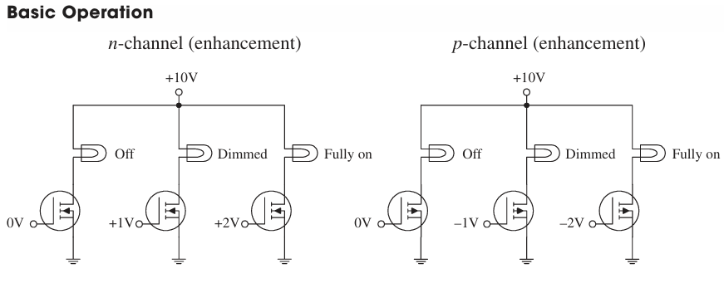
Transistor operation in circuit

Slide 8
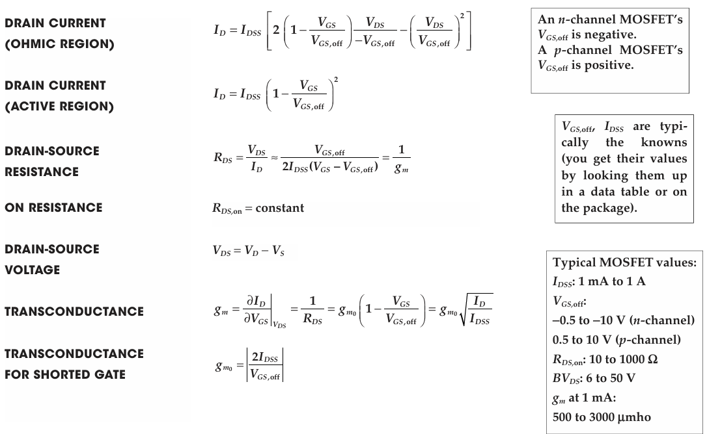

Slide 9
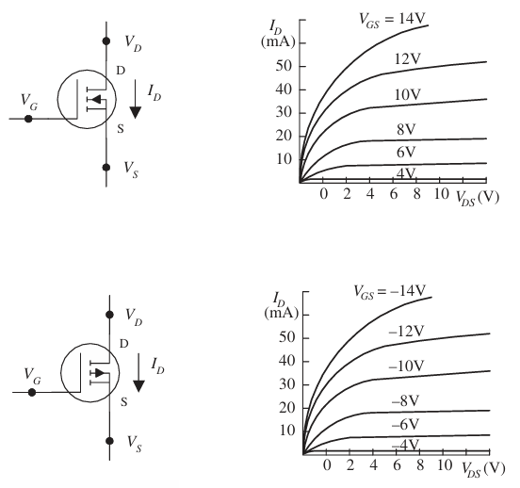

Slide 10
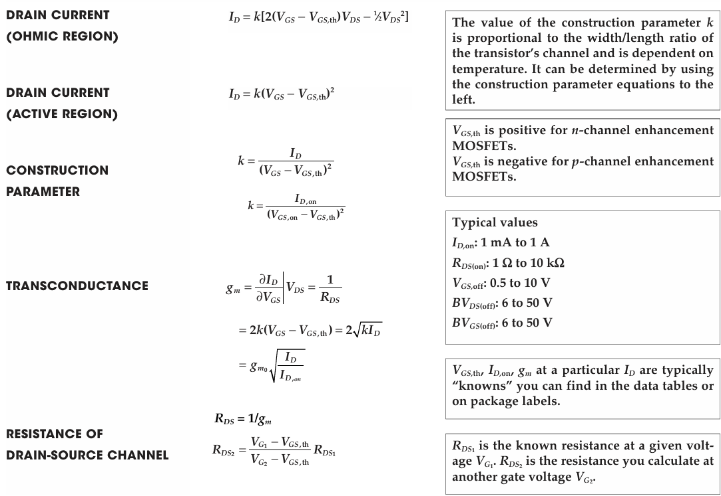

Slide 11
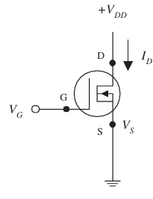

Slide 12
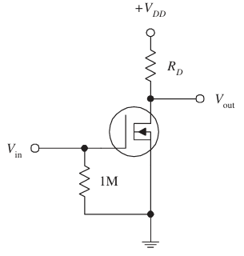

Slide 13
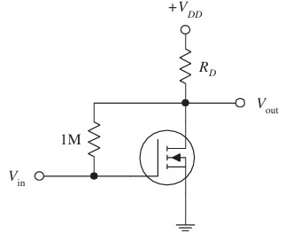

Slide 14
