Slide 1
EE-105 Arduino Installation
8/29/2024

Slide 2
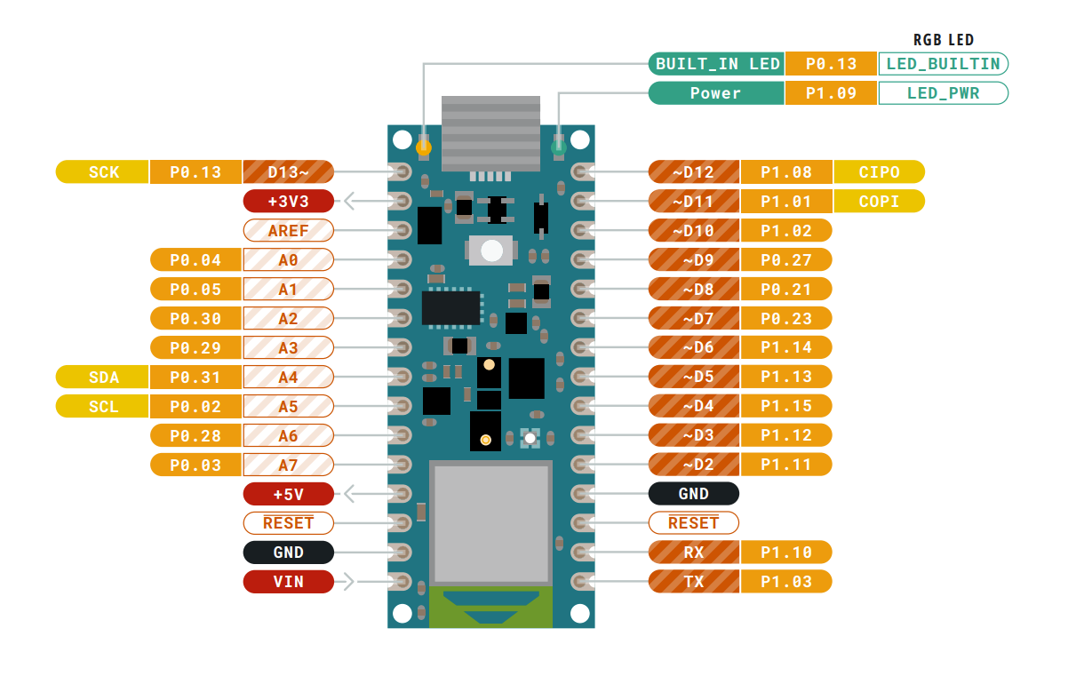
Arduino Nano 33 BLE

Slide 3
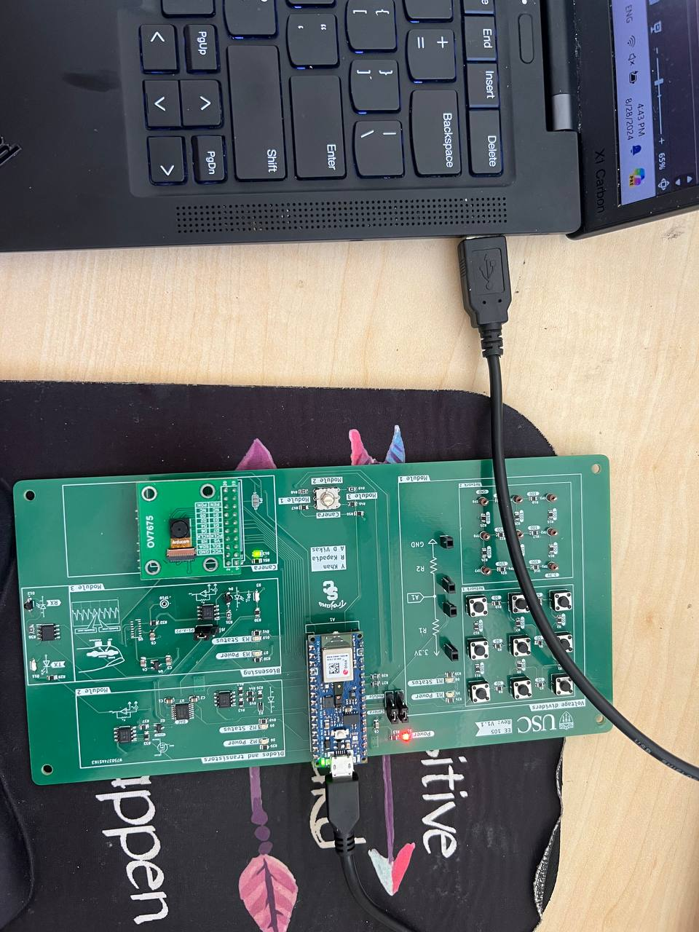
Installing the Arduino IDE
Connect the USB cable to Arduino
Download the latest release of the Arduino IDE here
https://support.arduino.cc/hc/en-us/articles/360019833020-Download-and-install-Arduino-IDE

Slide 4
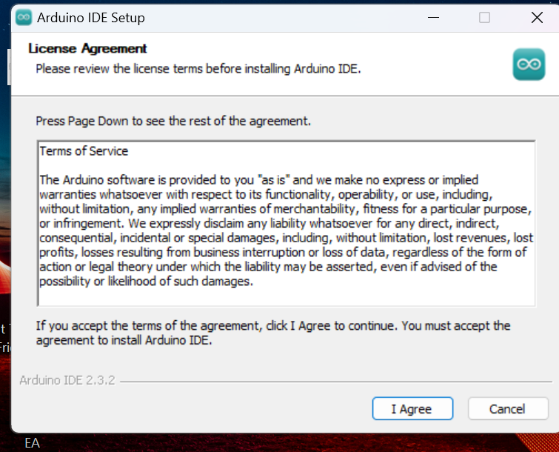
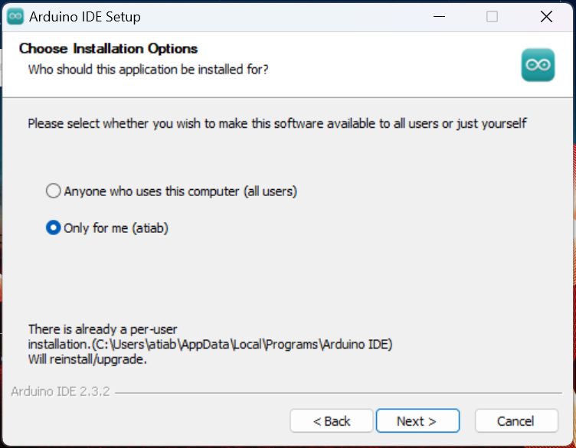
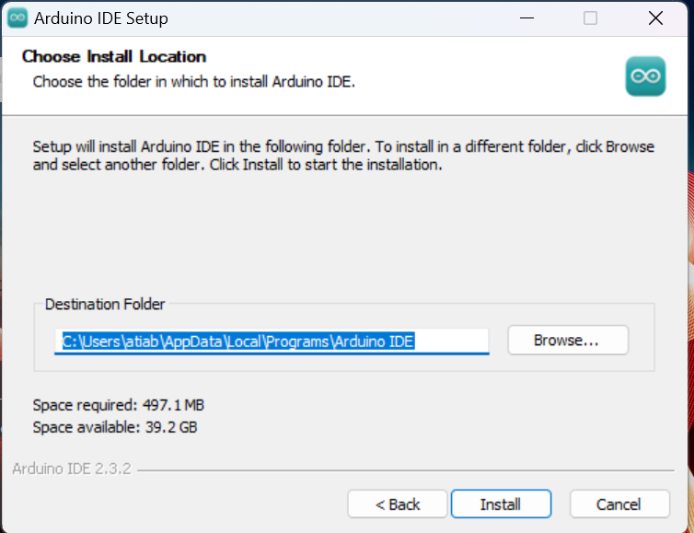
1
2
3

Slide 5
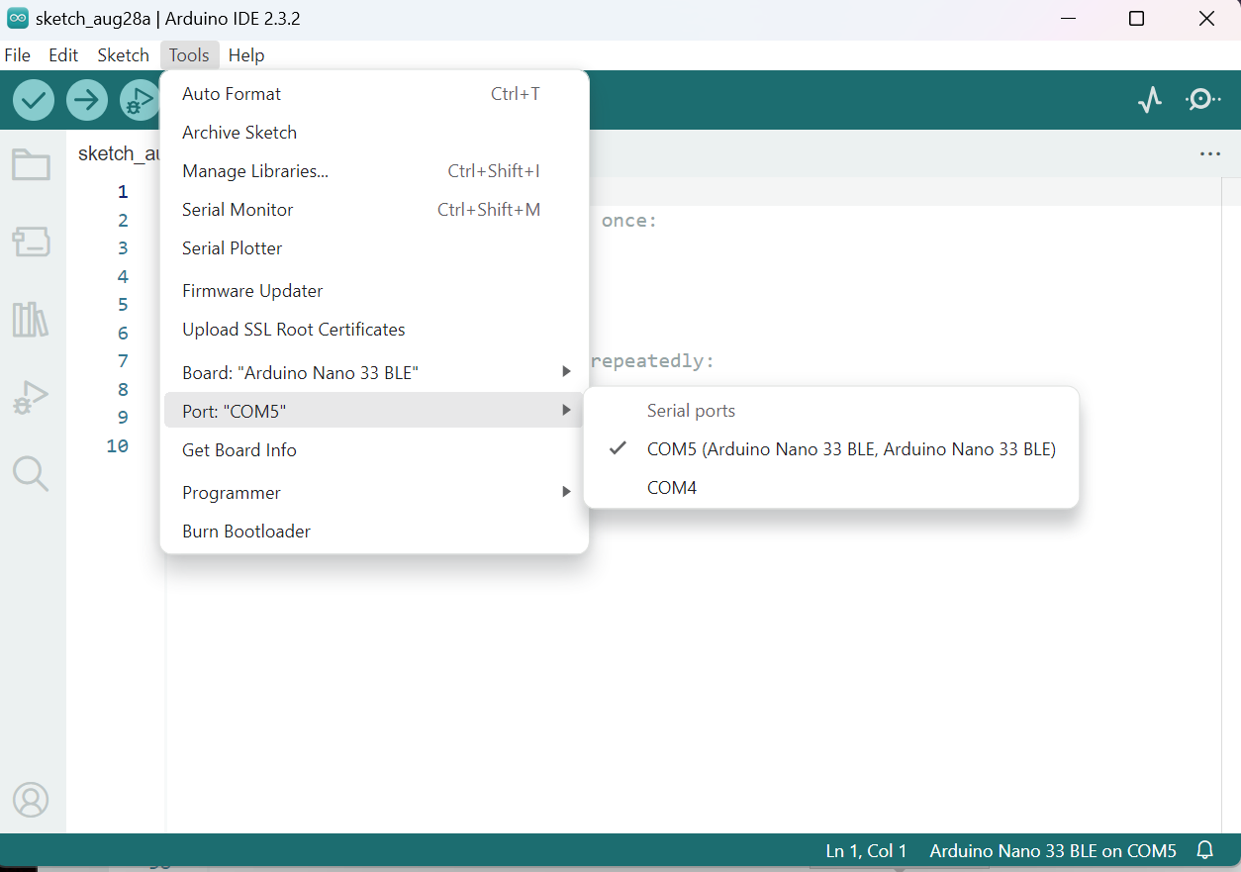
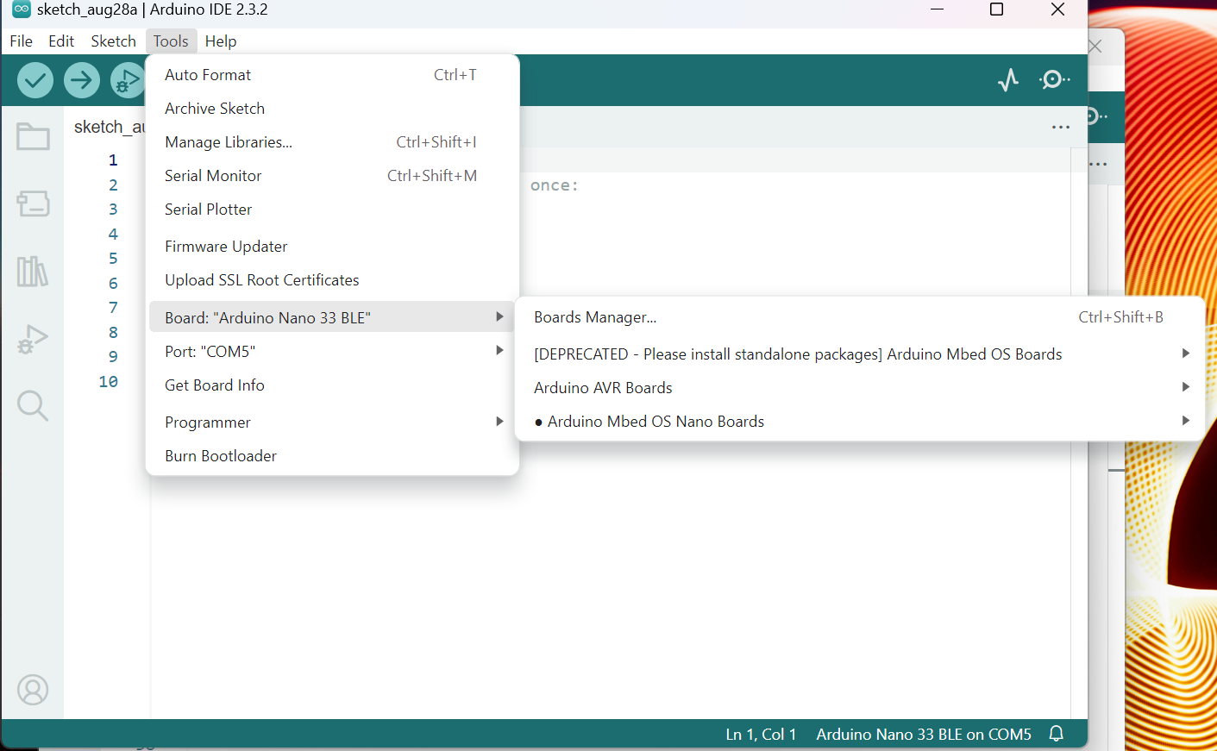
1. Identify the COM port that Arduino is connected
2.Ensure that the Mbed OS Nano Boards package is installed
Tools -> Board: -> Boards Manager... -> Install "Arduino Mbed OS Nano Boards"

Slide 6
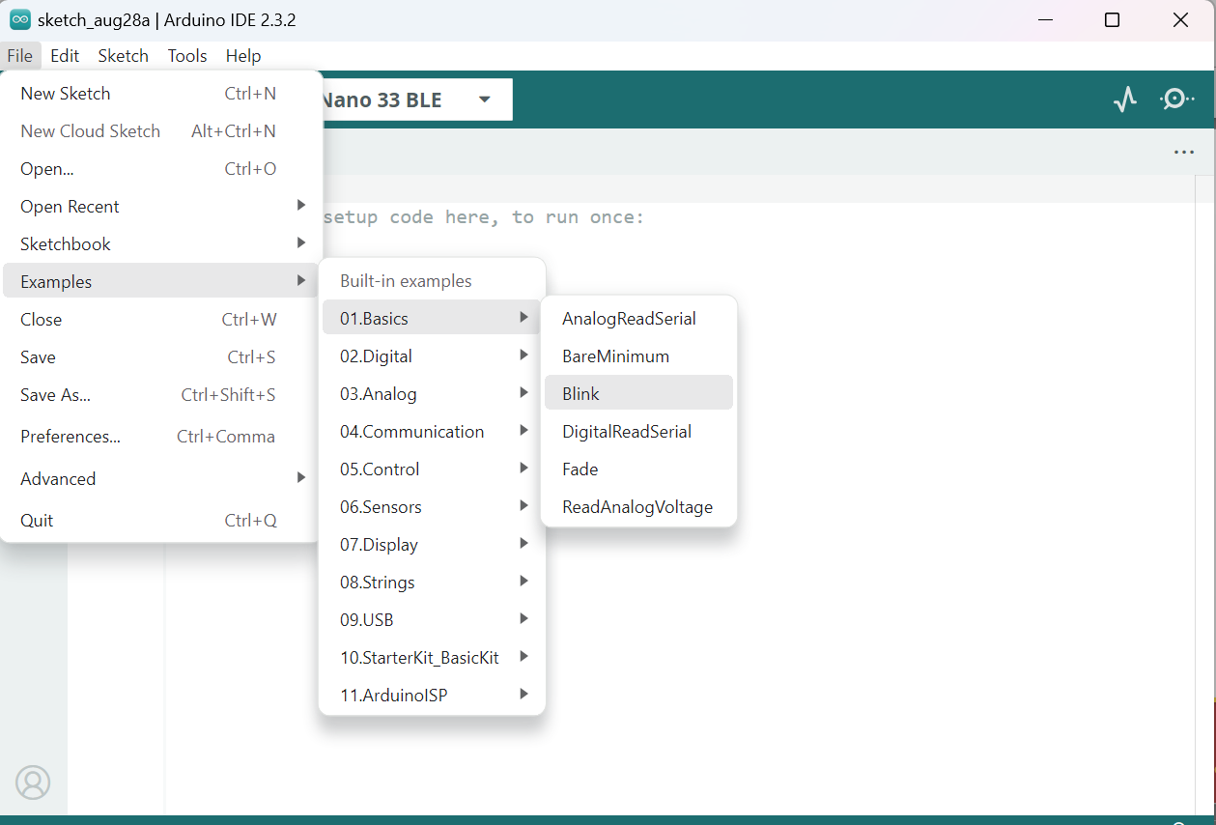
void setup() {
// initialize digital pin LED_BUILTIN as an output.
pinMode(LED_BUILTIN, OUTPUT);
}
// the loop function runs over and over again forever
void loop() {
digitalWrite(LED_BUILTIN, HIGH); // turn the LED on (HIGH is the voltage level)
delay(1000); // wait for a second
digitalWrite(LED_BUILTIN, LOW); // turn the LED off by making the voltage LOW
delay(1000); // wait for a second
}

Slide 7
Another way of coding
// Pin number for the built-in LED
const int ledPin = 13;
void setup() {
// initialize digital pin 13 as an output.
pinMode(ledPin, OUTPUT);
}
void loop() {
digitalWrite(ledPin, HIGH); // turn the LED on (HIGH is the voltage level)
delay(1000); // wait for a second
digitalWrite(ledPin, LOW); // turn the LED off by making the voltage LOW
delay(1000); // wait for a second
}

Slide 8
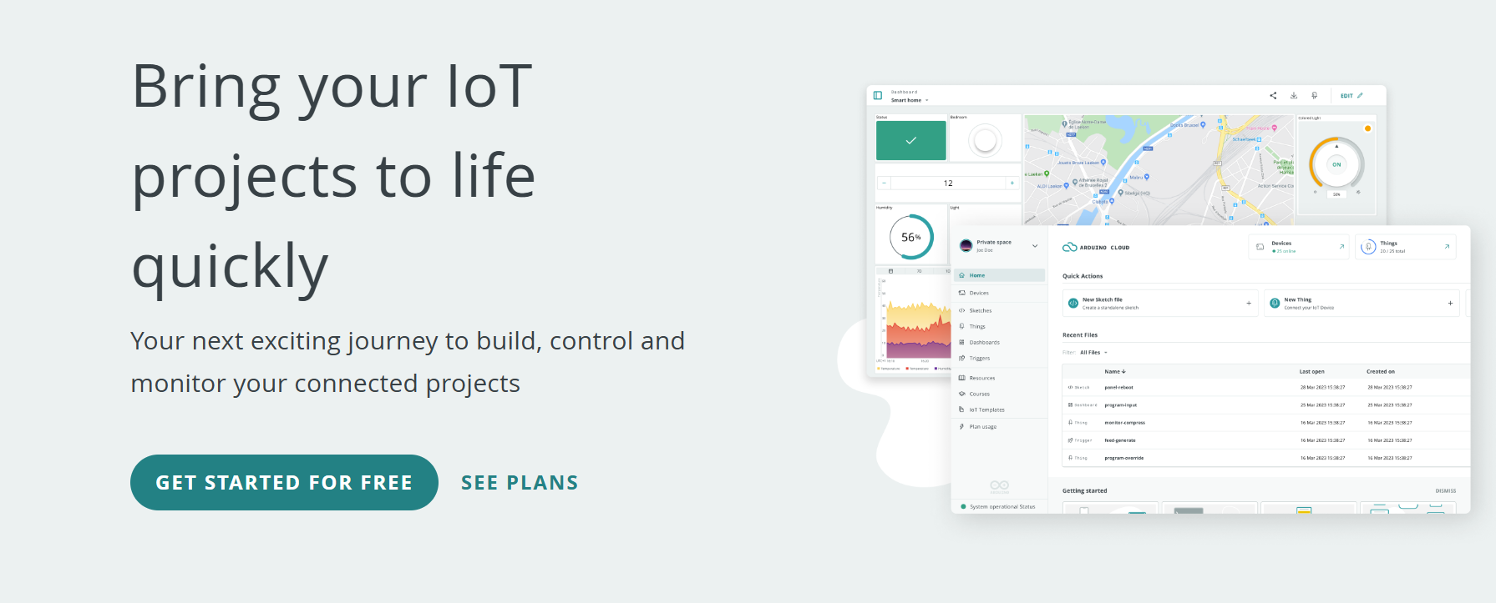
Streaming Sensor Data to a Web App
Let’s start using Arduino Cloud https://cloud.arduino.cc/?gad_source=1&gbraid=0AAAAACbEa84ofzTu6ZqKTNrvfC00iYeOK&gclid=CjwKCAjwlbu2BhA3EiwA3yXyuyRs52Pa6IMOnlhxourjC6ZlovP8tXgo2qfPTzjIE3rKl_pymK4kmxoCDSMQAvD_BwE
2. You need to install Arduino Cloud Agent: You need Arduino cloud agent to be able to detect or interact with your Arduino board, because web browsers don’t have direct access to your computer’s hardware.
https://support.arduino.cc/hc/en-us/articles/360014869820-Install-the-Arduino-Create-Agent

Slide 9
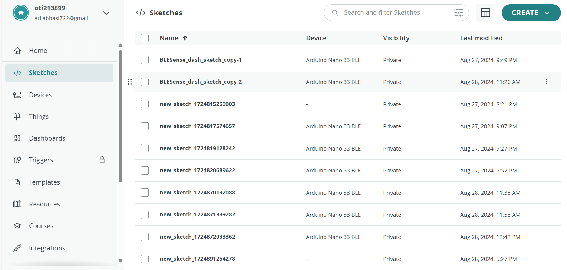
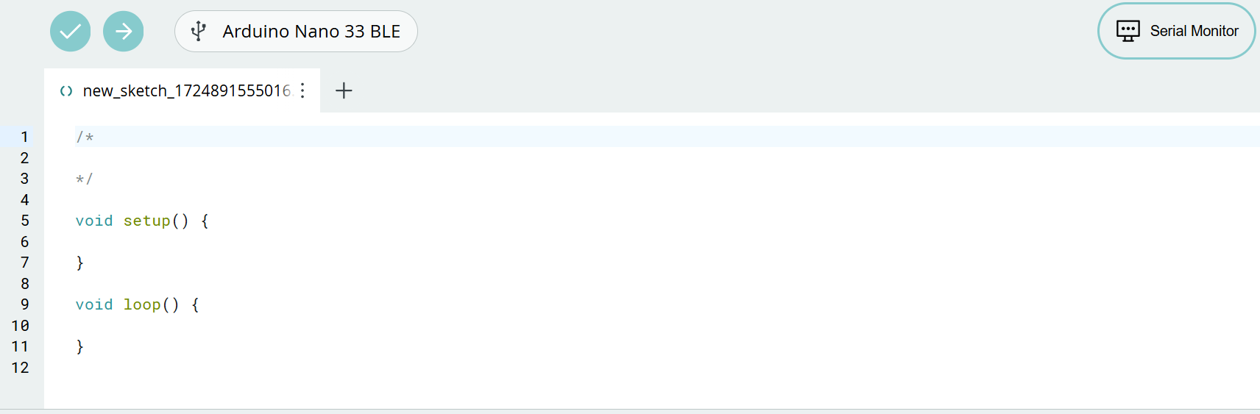
Sketches → Create

Slide 10
How can we monitor the streamed data?
Webapp link: https://arduino.github.io/ArduinoAI/BLESense-test-dashboard/
Upload this code to Arduino nano 33 ble to be able to stream the sensor data to a webapp
https://app.arduino.cc/sketches/71cdba81-1380-4aee-9cb1-14cde2da7607?view-mode=preview
Testing pressure sensor
https://app.arduino.cc/sketches/4573b54c-d240-41b0-94a4-4ac0dca97e66?view-mode=preview

Slide 11
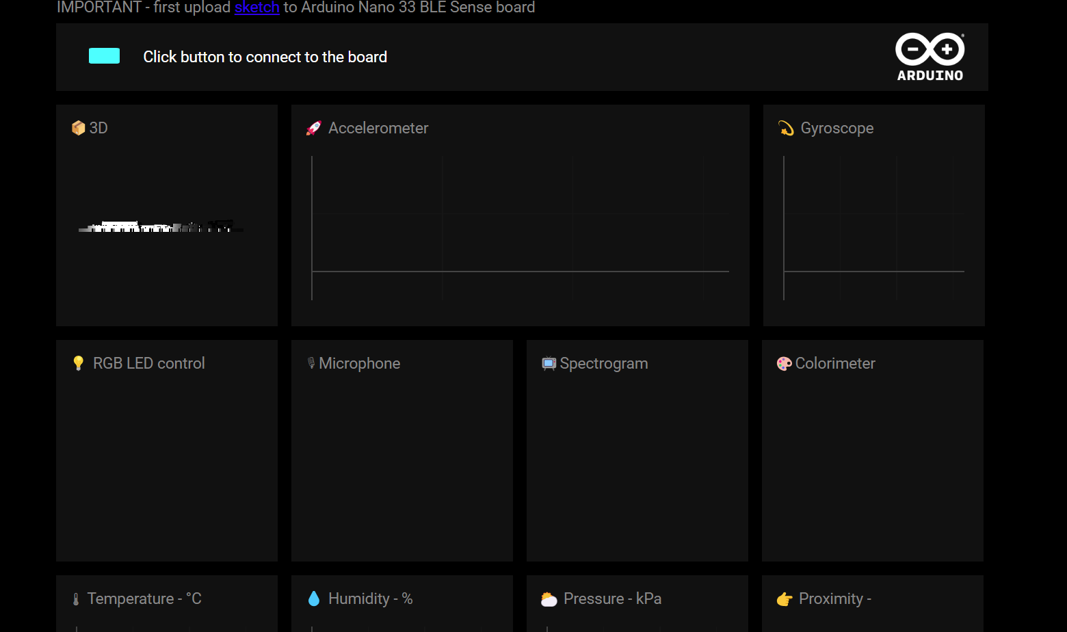
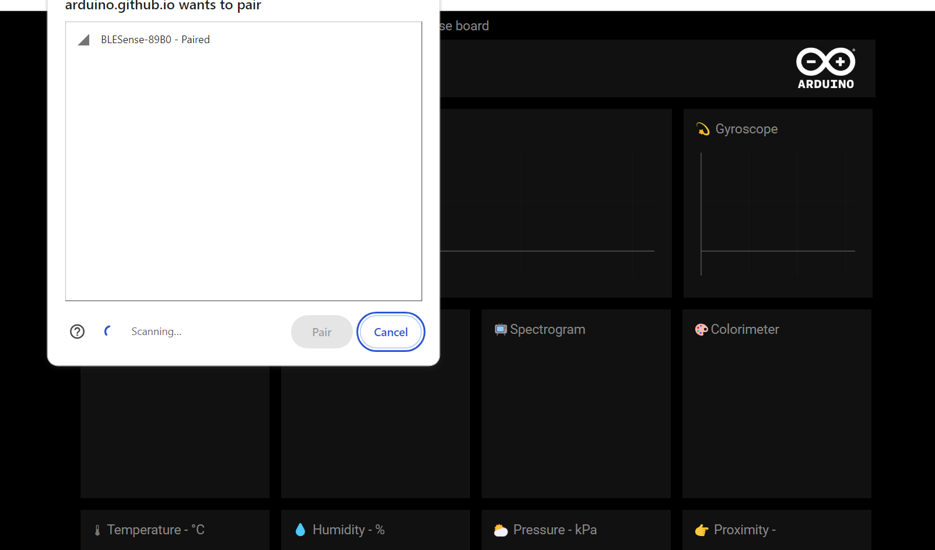
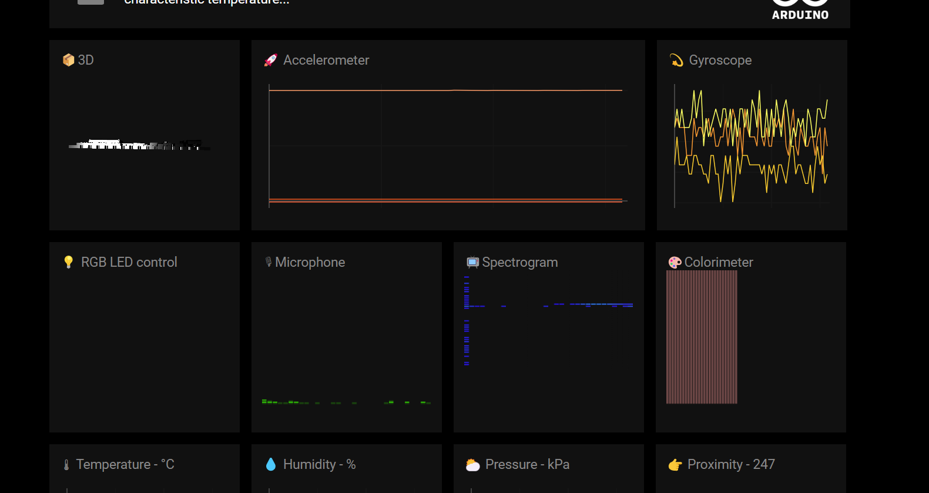
1.After uploading the code, click on the green button
2. Now your Arduino BLE will pair with the web app
3. The sensor data is streaming to the web app

Slide 12
The Arduino Nano 33 BLE is equipped with several built-in sensors, making it a powerful tool for various applications without needing additional hardware.
APDS9960: Detects ambient light, color, proximity, and gestures.
LPS22HB: Measures atmospheric pressure
LSM9DS1: Tracks acceleration, rotation, and magnetic field orientation.
PDM Microphone: Captures and analyzes sound signals.
RGB LED: Provides visual feedback with controllable colors.

Slide 13
Color Detection: The Colorimeter function in the web app is designed to detect and analyze the color of objects in the sensor's view. The APDS9960 sensor can measure the intensity of red, green, and blue light (RGB values) that is reflected from an object or present in the environment.
Proximity Sensor: This sensor can detect objects within a certain distance, ranging from a few centimeters up to about 10 centimeters. It is commonly used in gesture control applications, where you can interact with devices without physical contact.
Gesture Detection: The APDS9960 can recognize simple gestures like up, down, left, and right swipes. This feature enables touchless interaction with devices, such as controlling media playback or navigating menus with hand gestures.

Slide 14
Accelerometer: This sensor measures acceleration forces along the X, Y, and Z axes. It is used to detect movement, orientation, and vibration. Applications include motion tracking, tilt sensing, and detecting free fall in devices like smartphones and wearables.
Gyroscope: The gyroscope measures angular velocity (rotation) around the X, Y, and Z axes. It is used to detect and control the orientation of an object in 3D space. Common applications include stabilization in drones, gesture recognition, and gaming controllers.
Microphone: The PDM microphone captures audio signals by converting sound waves into electrical signals. The microphone’s data is processed using an FFT (Fast Fourier Transform) to analyze the frequency components of the sound.
Spectrogram is a visual representation of the spectrum of frequencies in a signal as it varies with time. In this case, the code is generating a spectrogram from audio data captured by a microphone, likely using the PDM (Pulse Density Modulation) microphone on the Arduino Nano 33 BLE Sense

