Slide 1
ECE 105: Introduction to Electrical Engineering
Lecture 7
Circuit Analysis - 3
Yasser Khan
Rehan Kapadia

Slide 2
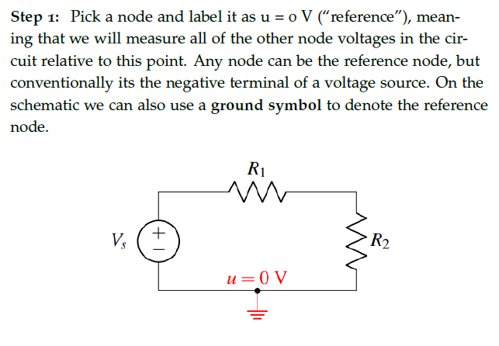











Nodal analysis

Slide 3
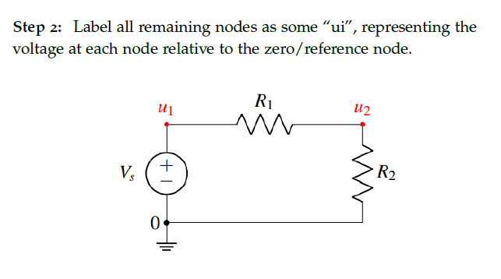





Label nodes

Slide 4
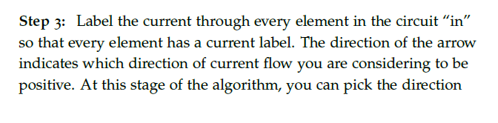
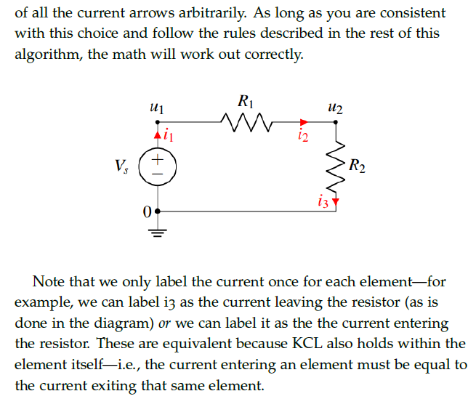


















Label currents

Slide 5




















Slide 6
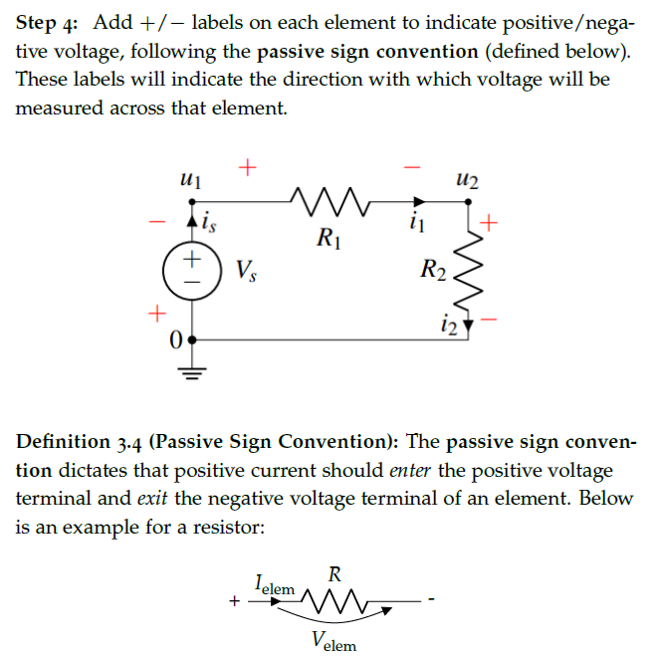




Voltage drop directions

Slide 7















Voltage drop directions

Slide 8























Voltage drop directions

Slide 9
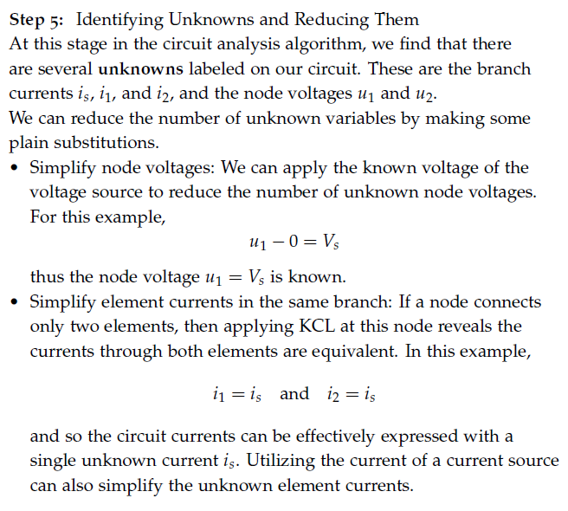





Write equations based on KCL and Ohm’s law

Slide 10
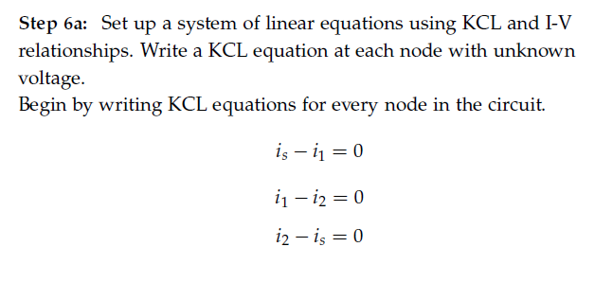











Write equations based on KCL and Ohm’s law

Slide 11
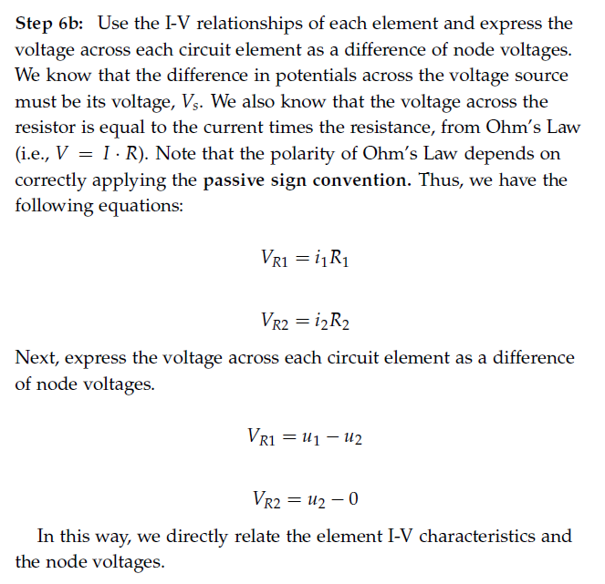
Write equations based on KCL and Ohm’s law

Slide 12
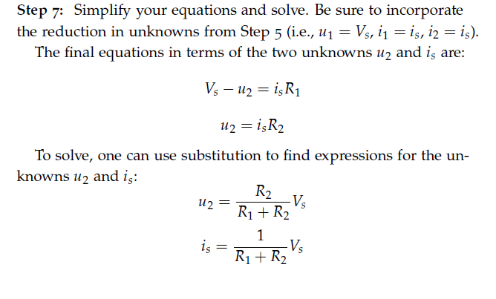
Solve for unknowns

Slide 13















Touchpad – Network 2 in the demo board

Slide 14








Touchpad – Network 2 in the demo board

Slide 15

Touchpad – Network 2 in the demo board

Slide 16













Touchpad – Network 2 in the demo board

Slide 17




















Touchpad – Network 2 in the demo board

Slide 18



















Touchpad – Network 2 in the demo board

Slide 19



















Touchpad – Network 2 in the demo board

Slide 20




Touchpad – Network 2 in the demo board

Slide 21









Touchpad – Network 2 in the demo board

Slide 22
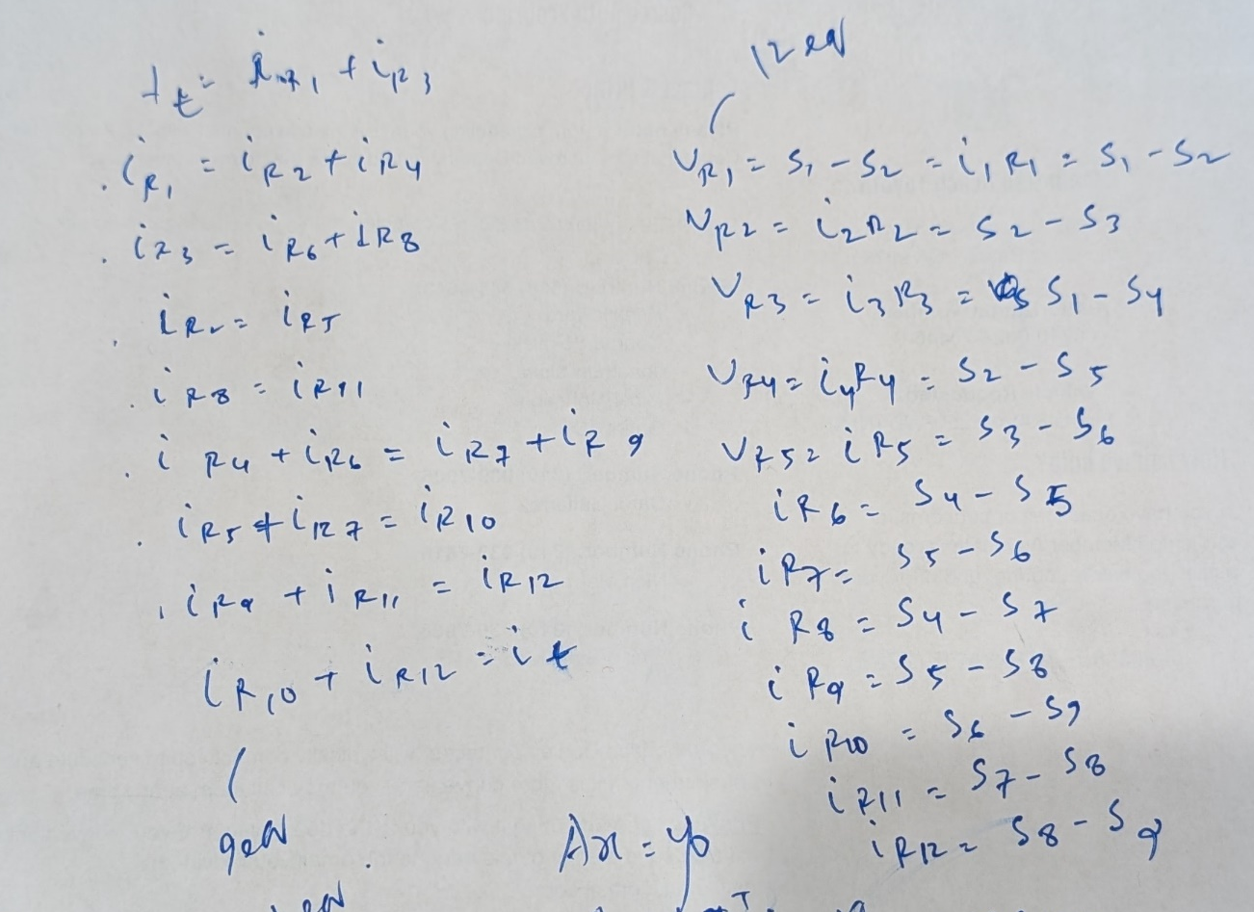
Touchpad – Network 2 in the demo board

Slide 23

Touchpad – Network 2 in the demo board

Slide 24
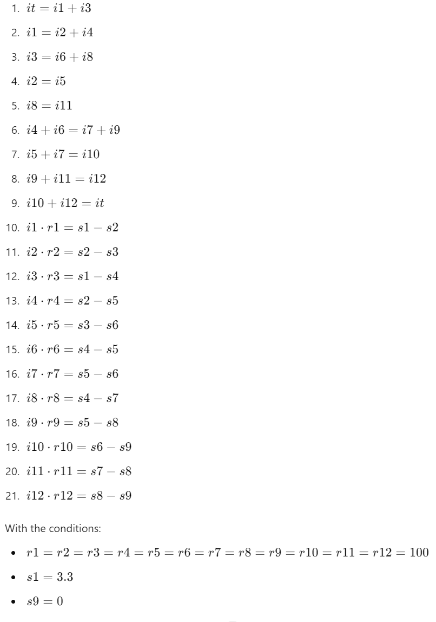
Touchpad – Network 2 in the demo board

Slide 25
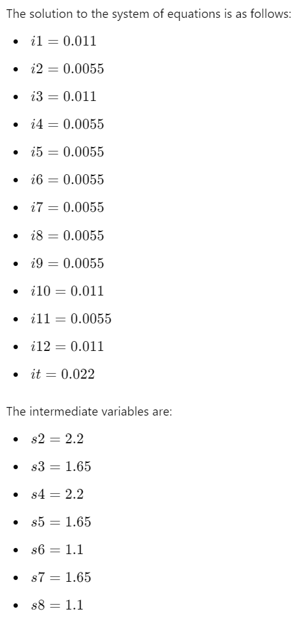
Touchpad – Network 2 in the demo board

Slide 26
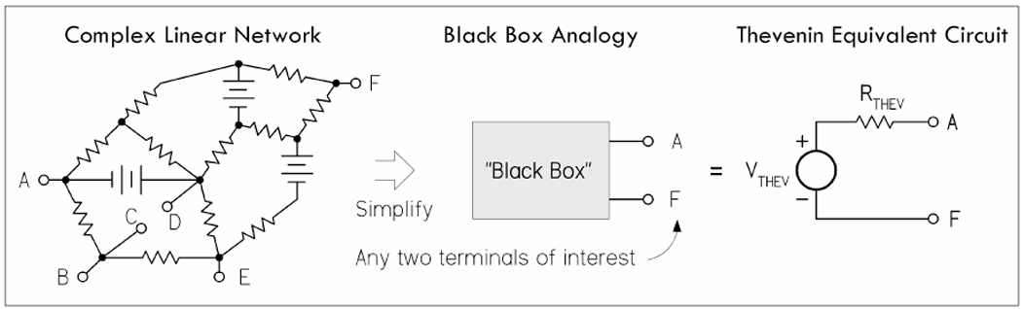
Equivalent circuits

Slide 27
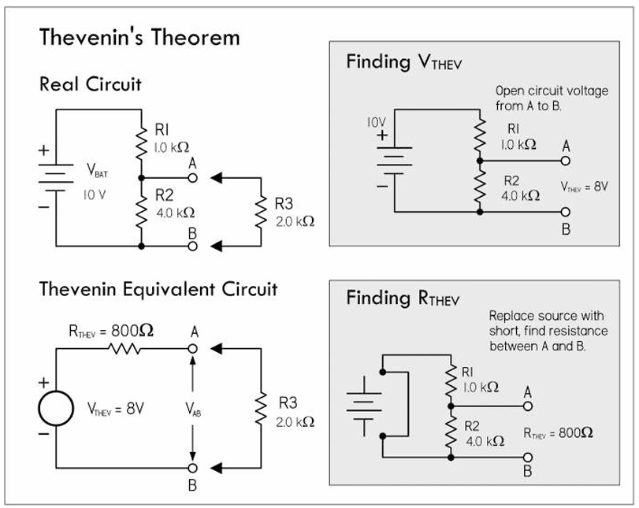
Thevenin’s equivalent circuit

Slide 28
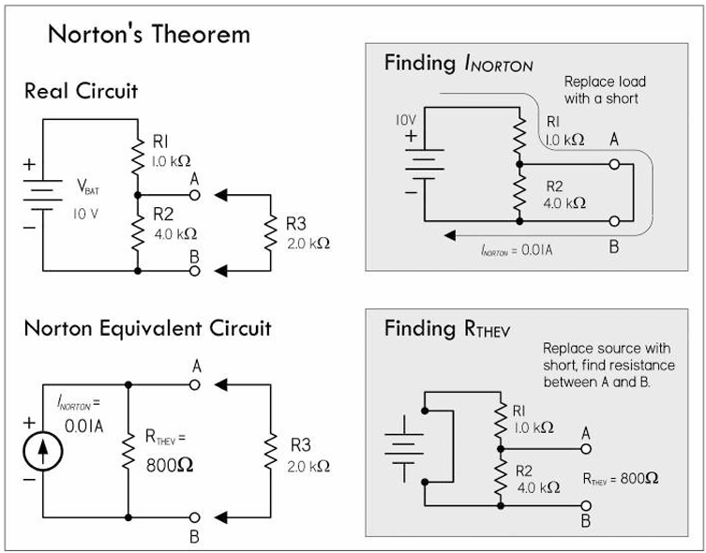
Norton’s equivalent circuit

Slide 29
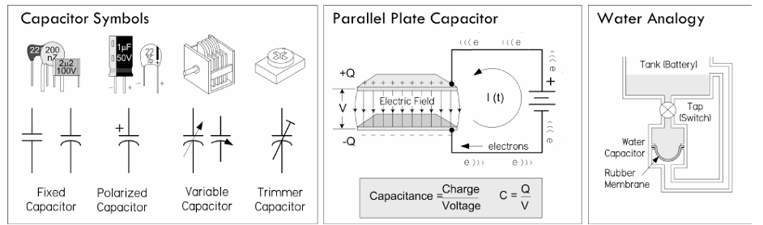
Capacitors

Slide 30
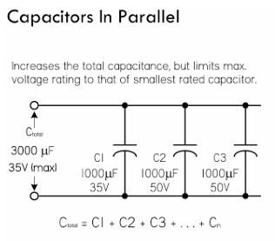
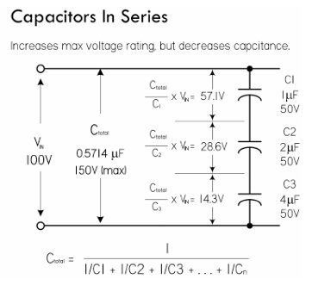
Capacitors

Slide 31
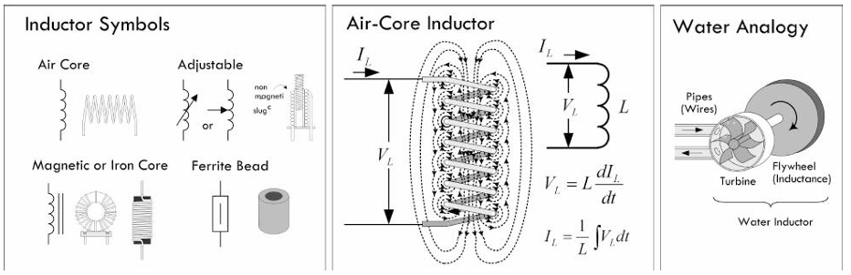
Inductors

Slide 32
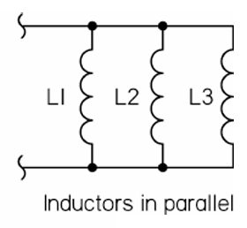
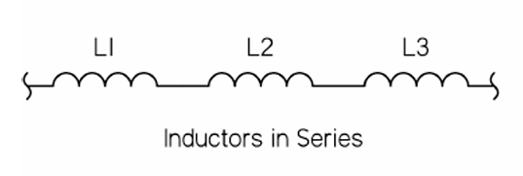
Inductors

