Slide 1
ECE 105: Introduction to Electrical Engineering
Lecture 5
Circuit analysis 1
Yasser Khan
Rehan Kapadia

Slide 2
Basic circuit quantities
Quantity | Symbol | Units
Voltage | V | Volts (V)
Current | I | Amperes (A)
Resistance | R | Ohms (Ω)
Capacitance | C | Coulomb (C)
Inductance | L | Henry (H)

Slide 3
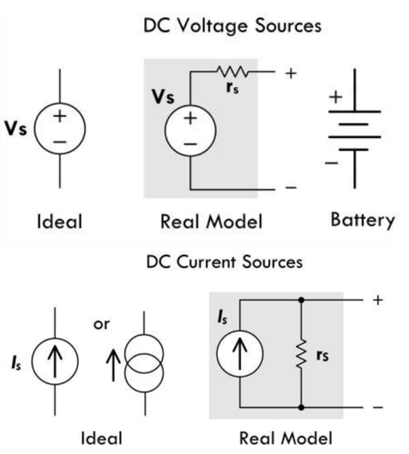
Notations

Slide 4
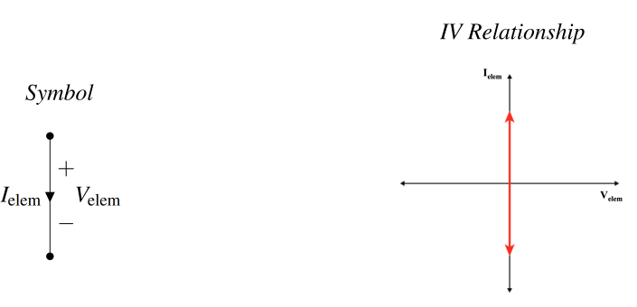
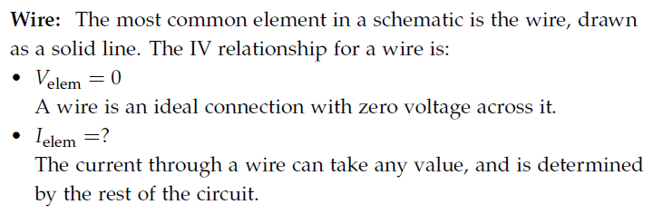
Wire

Slide 5
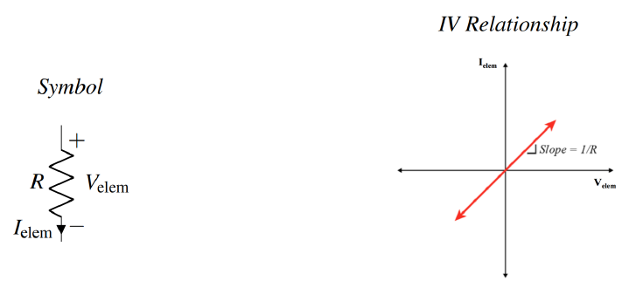

Resistor

Slide 6
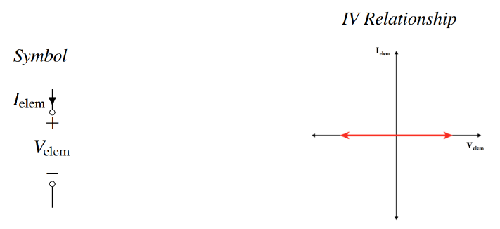

Open circuit

Slide 7
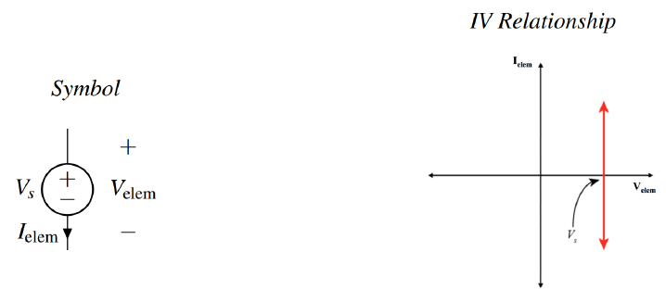
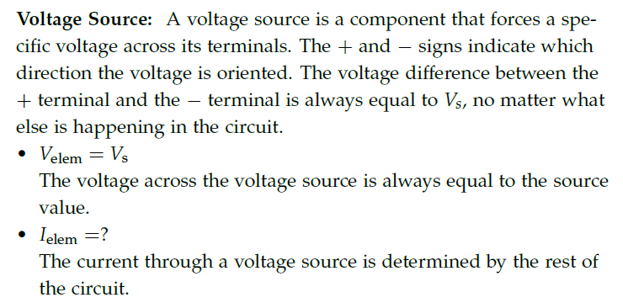
Voltage source

Slide 8
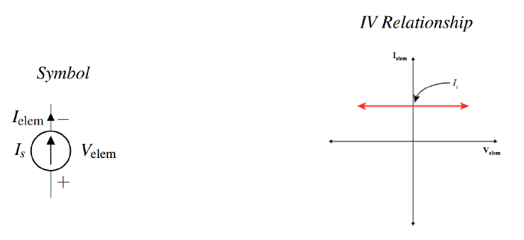
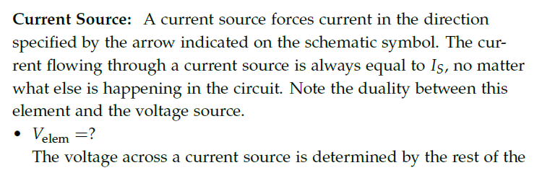

Current source

Slide 9
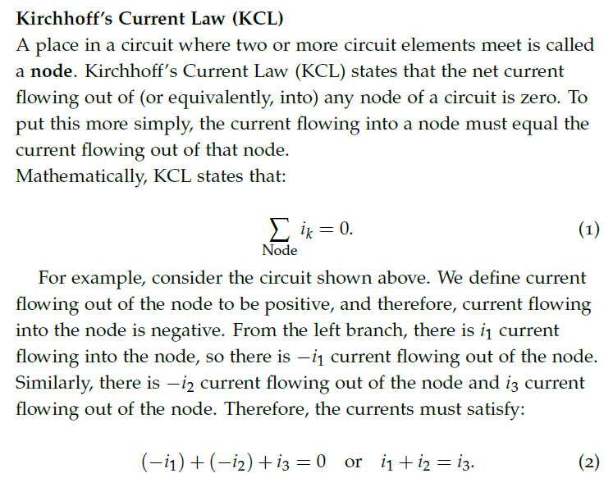
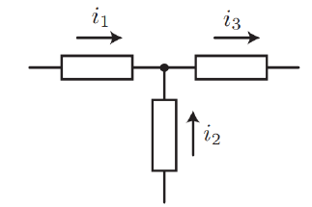
Rule of circuit analysis - KCL

Slide 10

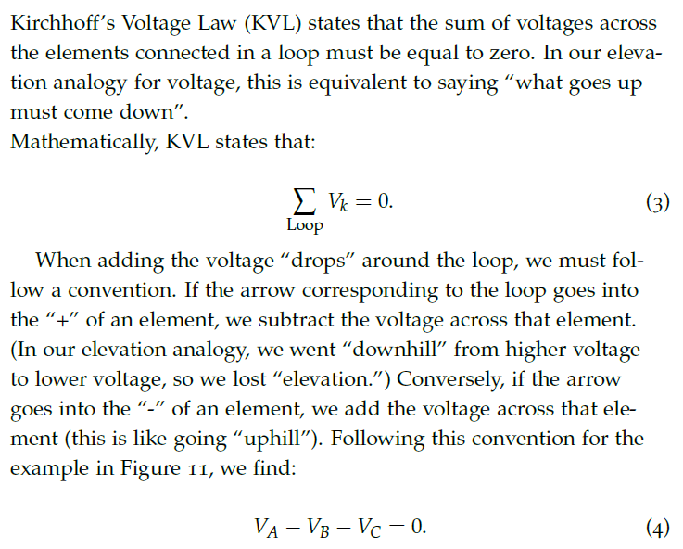
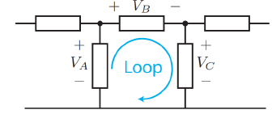
Rule of circuit analysis - KVL

Slide 11
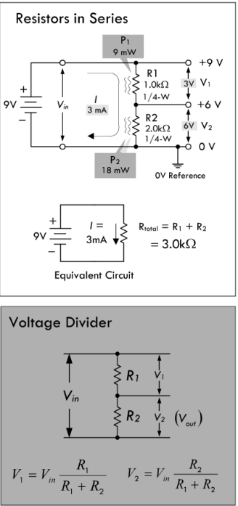
Resistors in series

Slide 12
Voltage divider

Slide 13
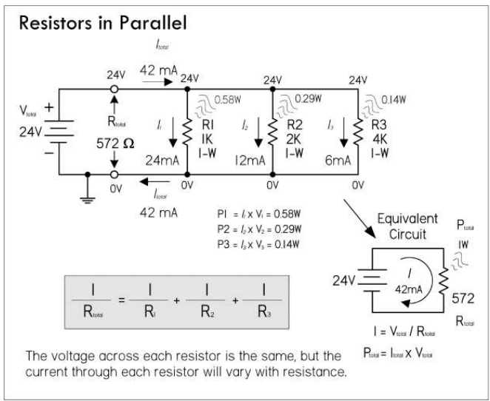
Resistors in parallel

Slide 14
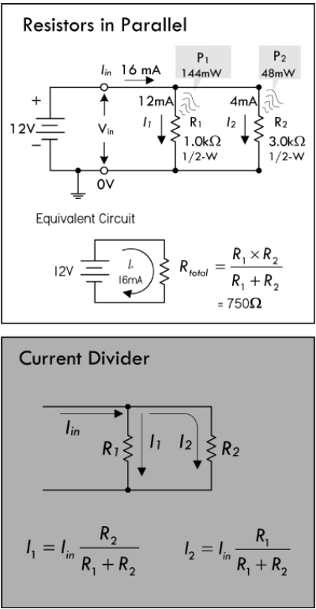
Current divider

Slide 15


Measuring voltage, current, resistance

Slide 16
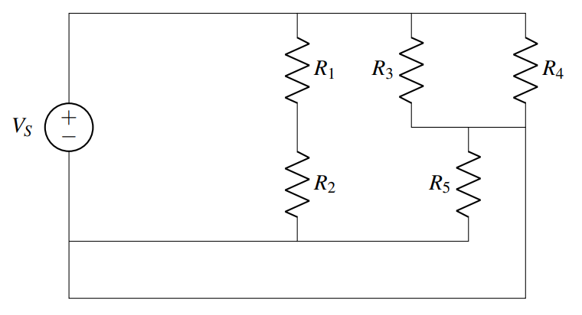
Finding nodes

Slide 17
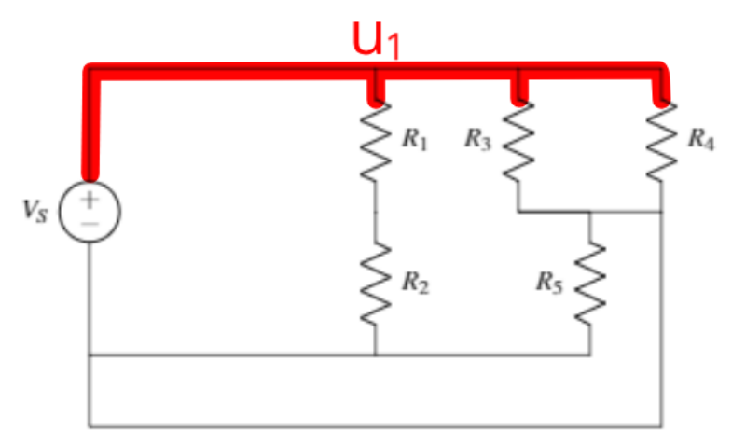
Find the node connected to the source

Slide 18
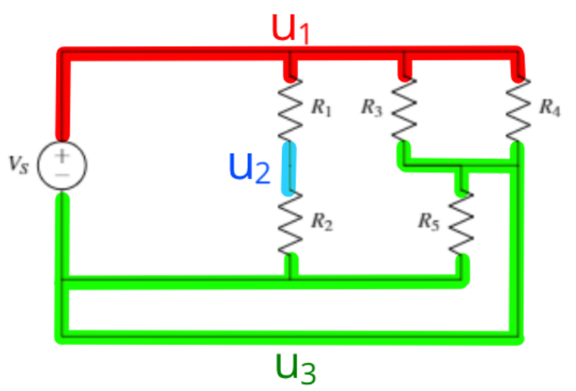
Find other nodes

Slide 19
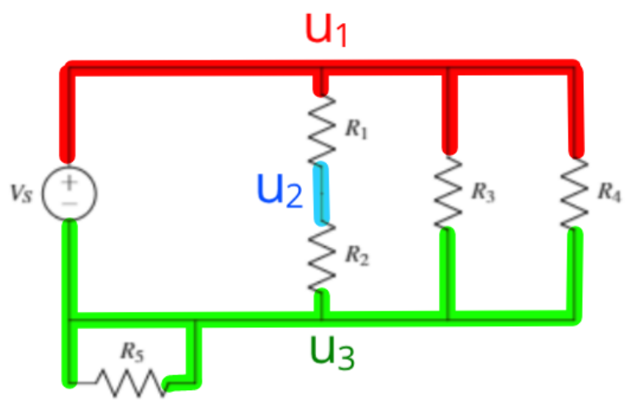
Merge elements sharing the same nodes

Slide 20
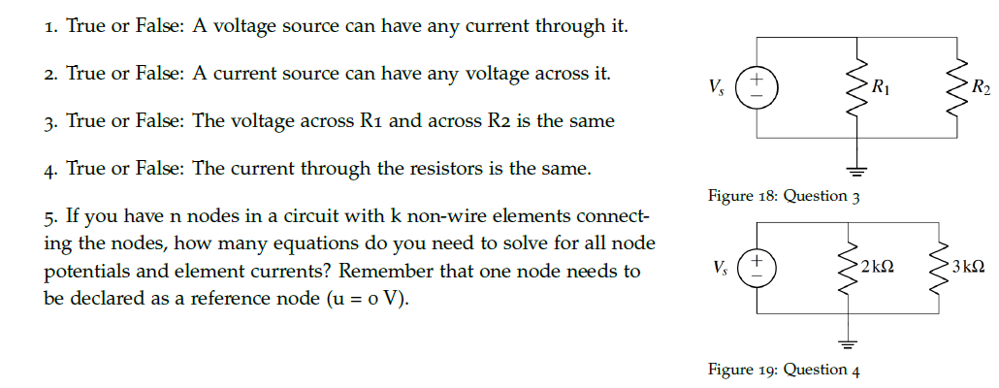
Practice problems

Slide 21

Practice problems

Slide 22
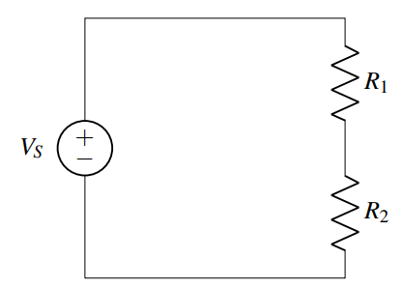
Practice

Slide 23
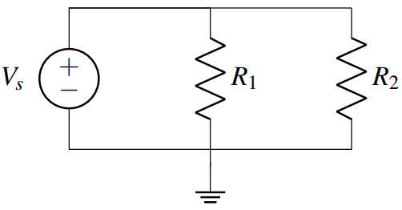
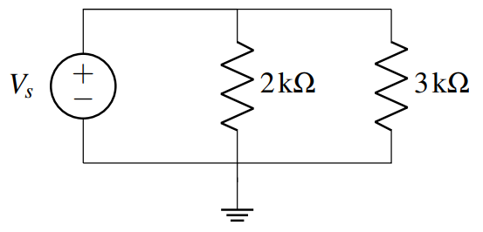
Practice

Slide 24























Touch panel

Slide 25



Fuse

