Slide 1
ECE 105: Introduction to Electrical Engineering
Lecture 13
Sensors 1
Yasser Khan
Rehan Kapadia

Slide 2










What is a sensor?

Slide 3









Slide 4








Slide 5







Slide 6










Slide 7








Slide 8
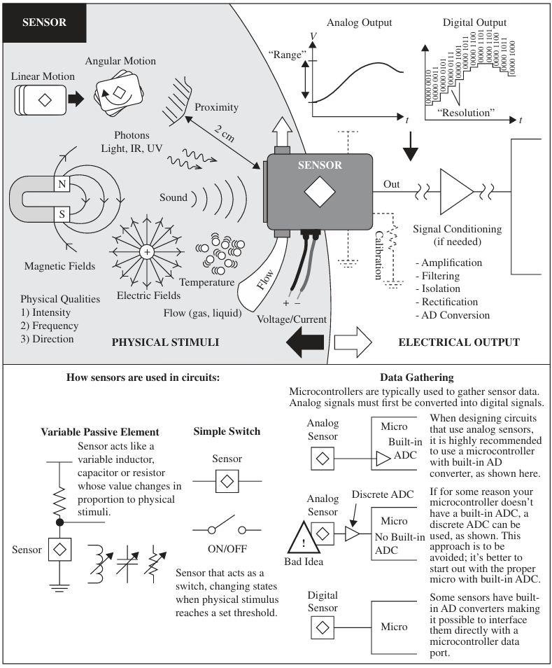





What is a sensor?

Slide 9






What is a sensor?

Slide 10













Slide 11








Slide 12






Sensors in circuits:

Slide 13
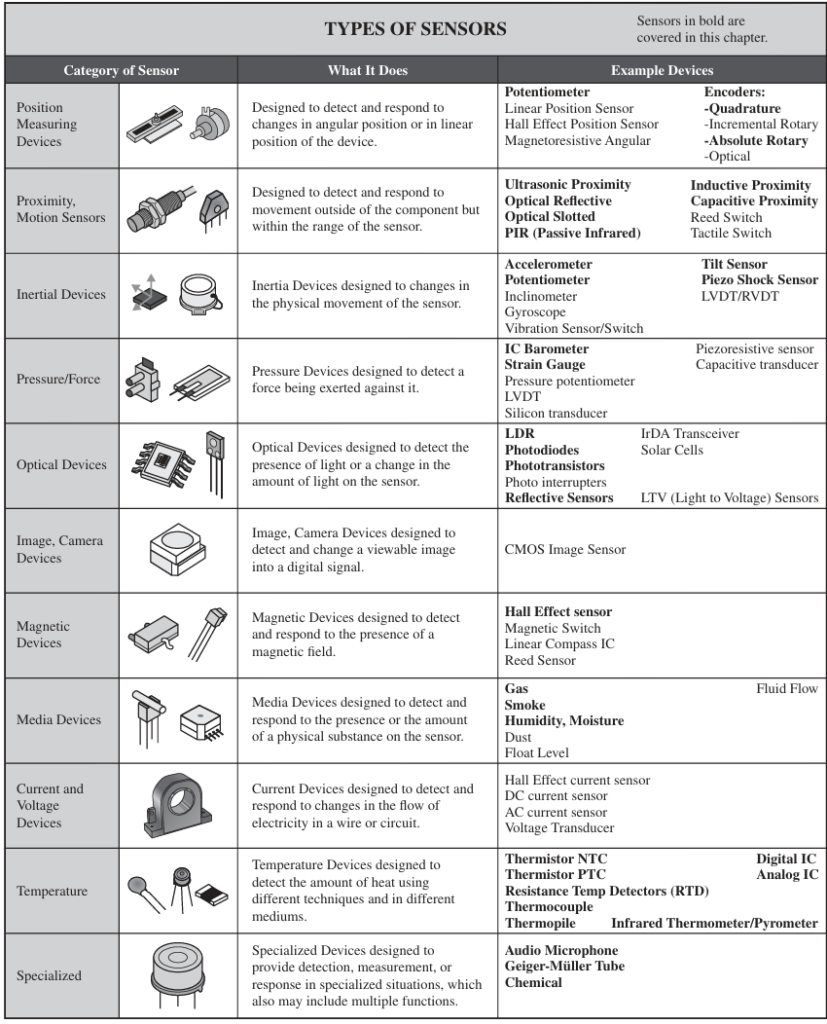


Types of sensors

Slide 14
Types of sensors

Slide 15
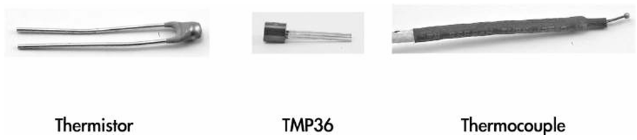

Temperature sensor
Notes:
TMP transistor based
A thermocouple is a device for measuring temperature. It comprises two dissimilar metallic wires joined together to form a junction. When the junction is heated or cooled, a small voltage is generated in the electrical circuit of the thermocouple which can be measured, and this corresponds to temperature.

Slide 16
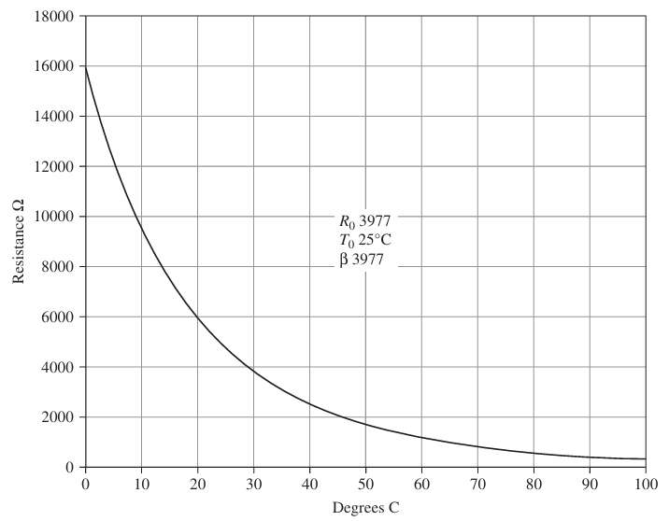



Sensor calibration

Slide 17





Slide 18
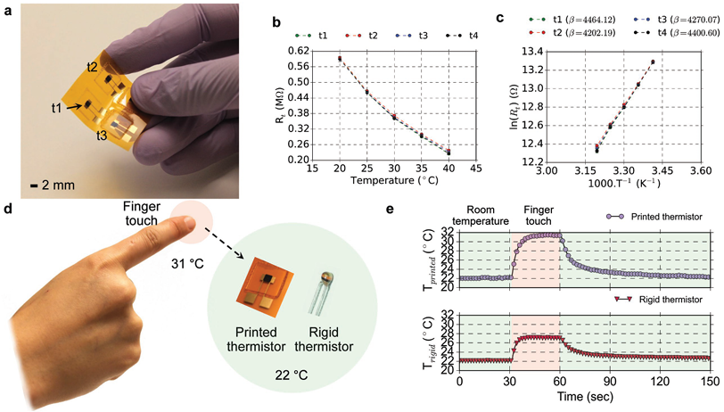














Sensor calibration

Slide 19














Slide 20
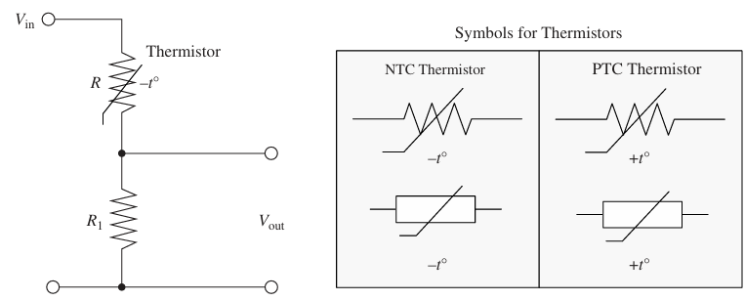


Using sensors in circuits

Slide 21




















Slide 22



























Slide 23
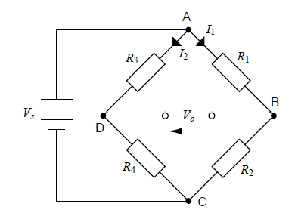
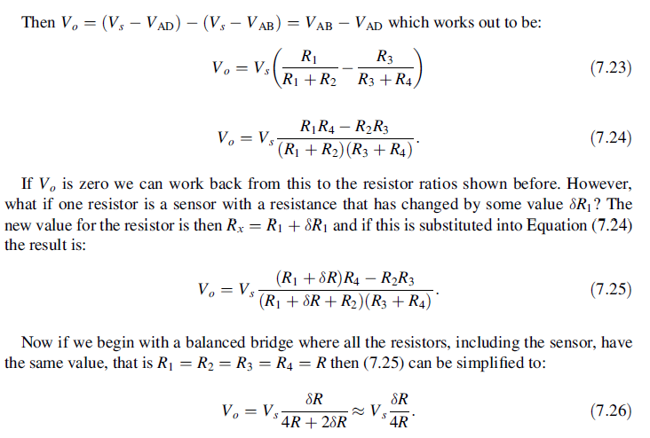
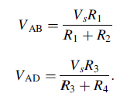





Wheatstone bridge

Slide 24
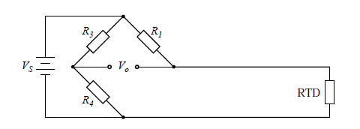
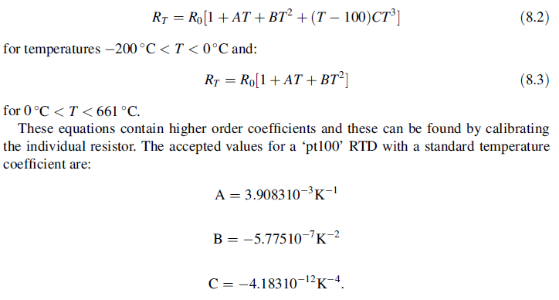


Precise thermistor measurement steps

Slide 25
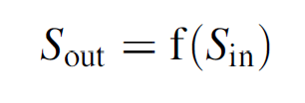
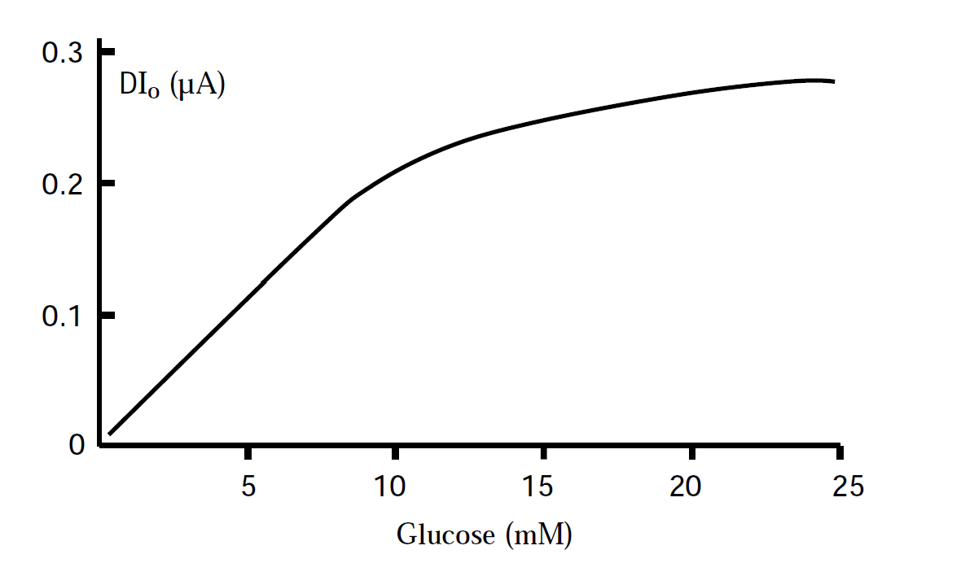













Sensitivity

Slide 26
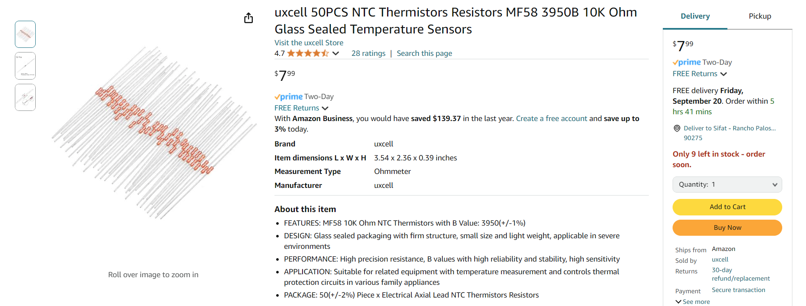
Let’s build our temperature sensor circuit

Slide 27
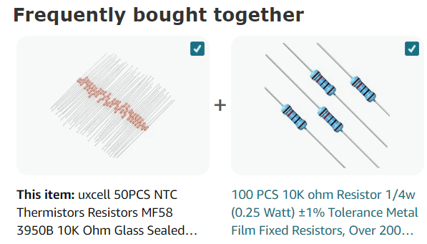
What else is needed to create this circuit?

Slide 28
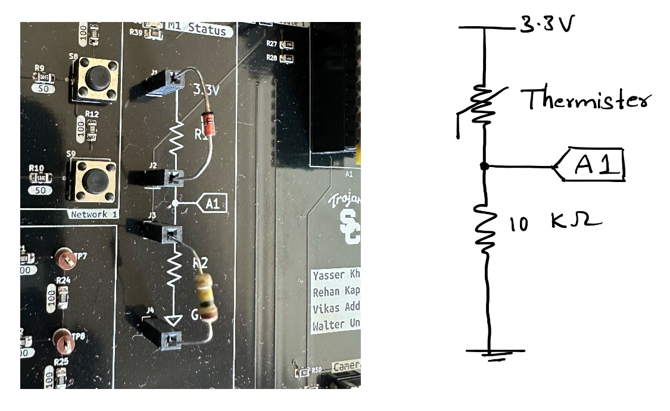
Demo board setup

Slide 29
Sensor circuit

Slide 30
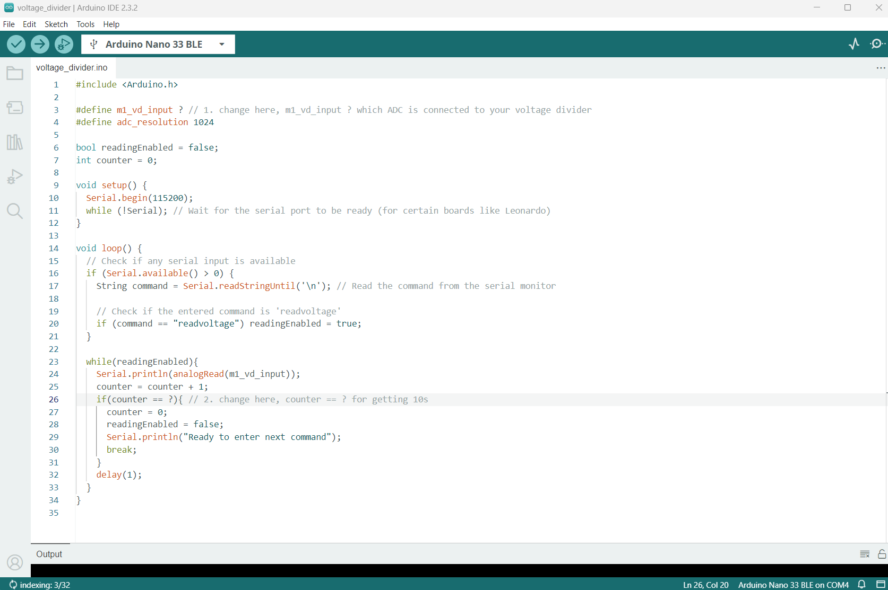






Arduino sketch

Slide 31
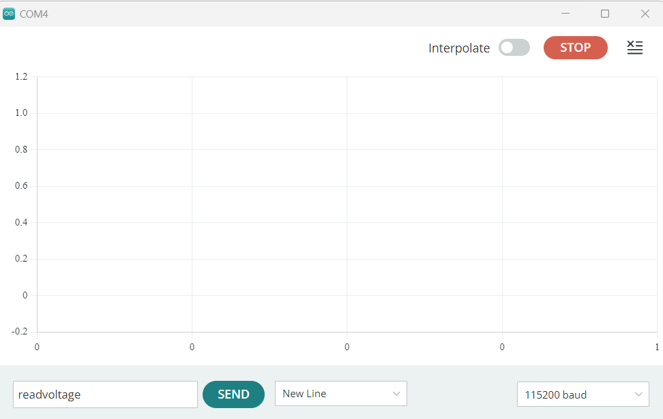
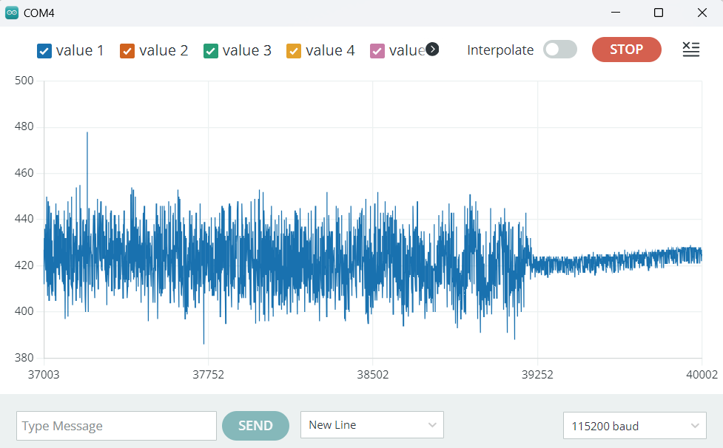
Serial plotter

Slide 32
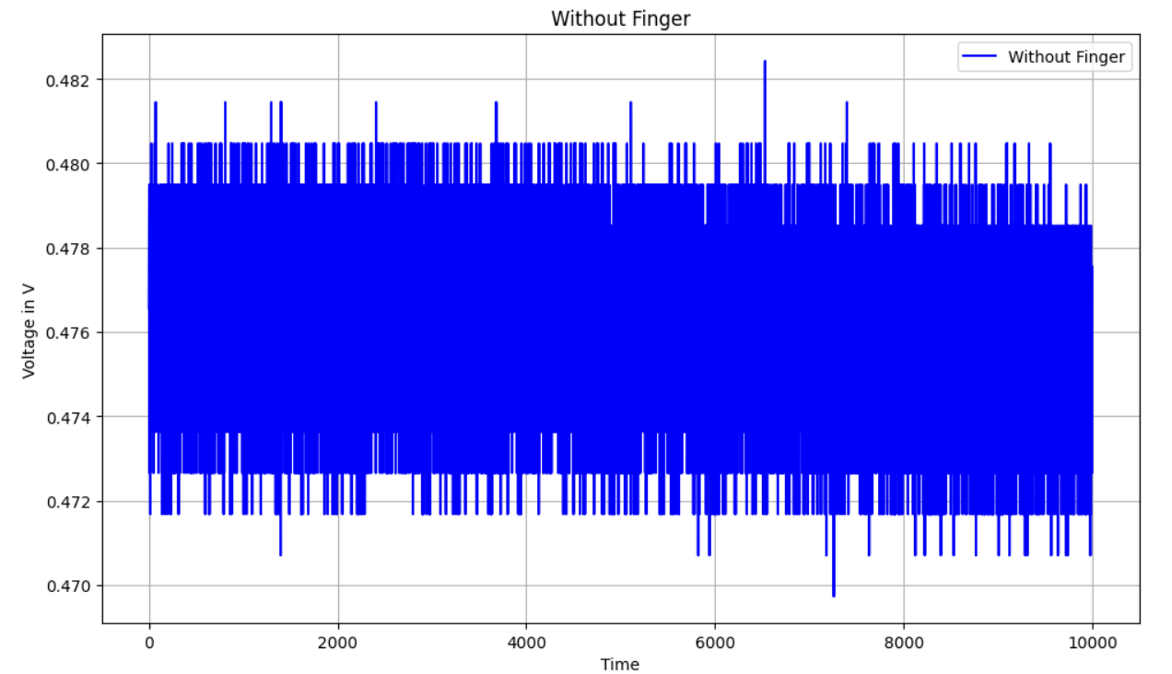
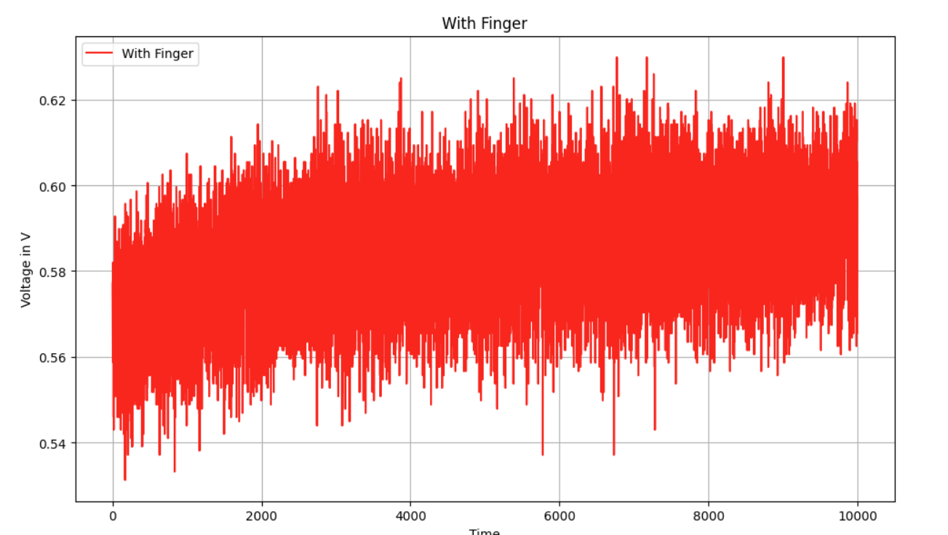
Temperature plots

Slide 33
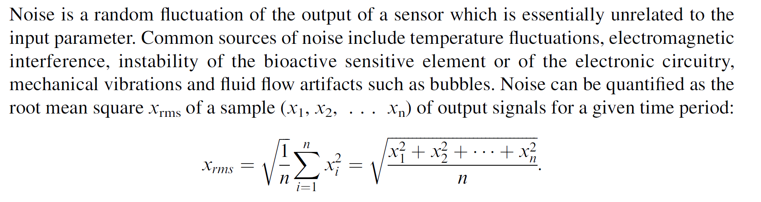
Noise

Slide 34



Project teaming

