Slide 1
ECE 105: Introduction to Electrical Engineering
Lecture 6
Circuit Analysis 2
Yasser Khan
Rehan Kapadia

Slide 2
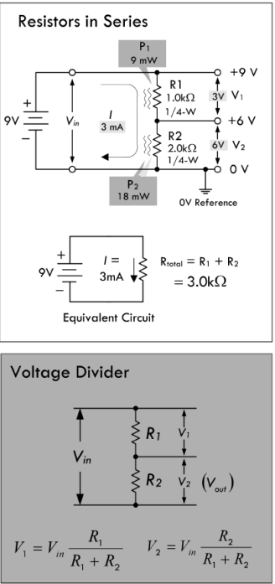





Voltage divider

Slide 3




Voltage divider

Slide 4
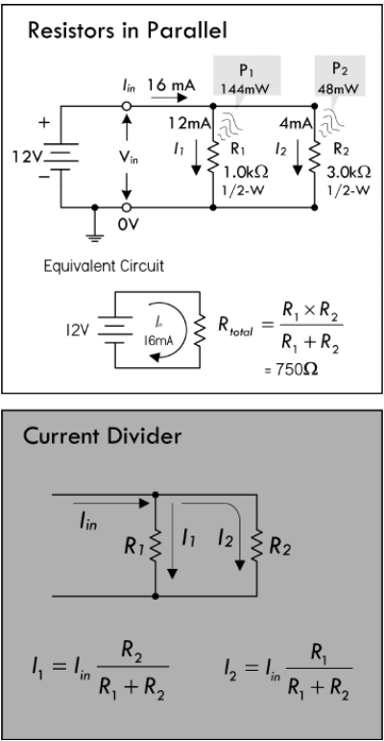






Current divider

Slide 5





Current divider

Slide 6
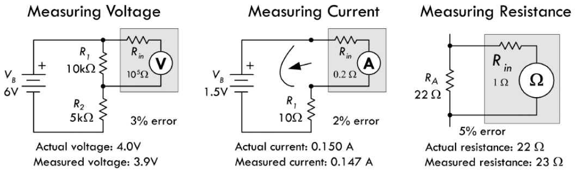
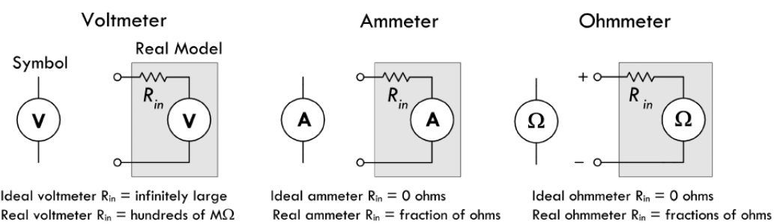








Measuring voltage, current, resistance

Slide 7
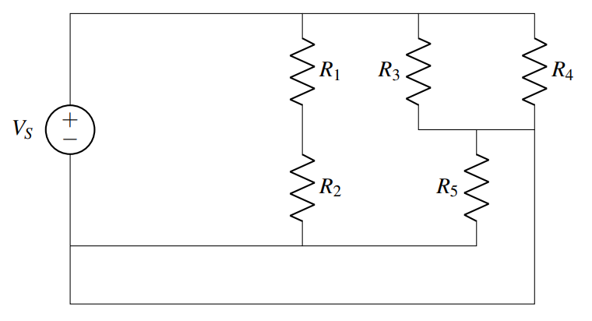






















Finding nodes

Slide 8

















Finding nodes

Slide 9
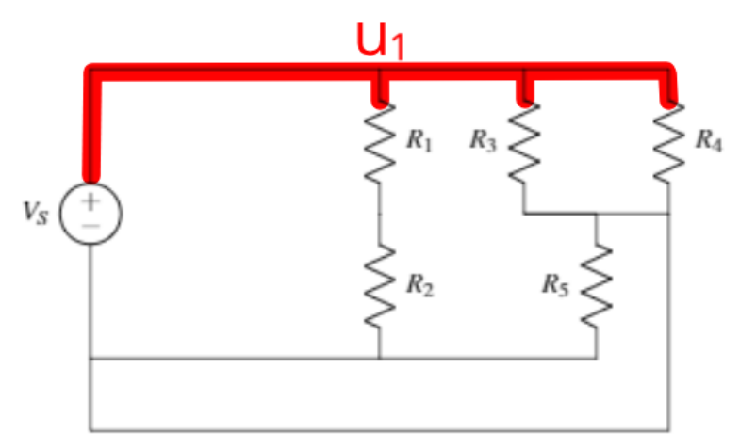

Find the node connected to the source

Slide 10
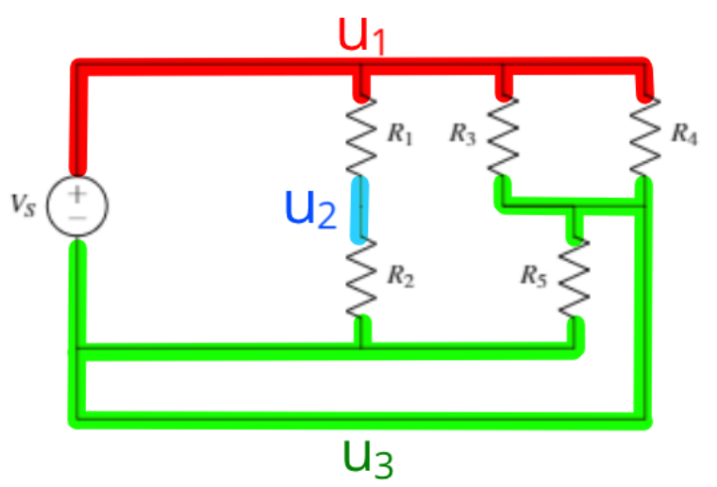



Find other nodes

Slide 11
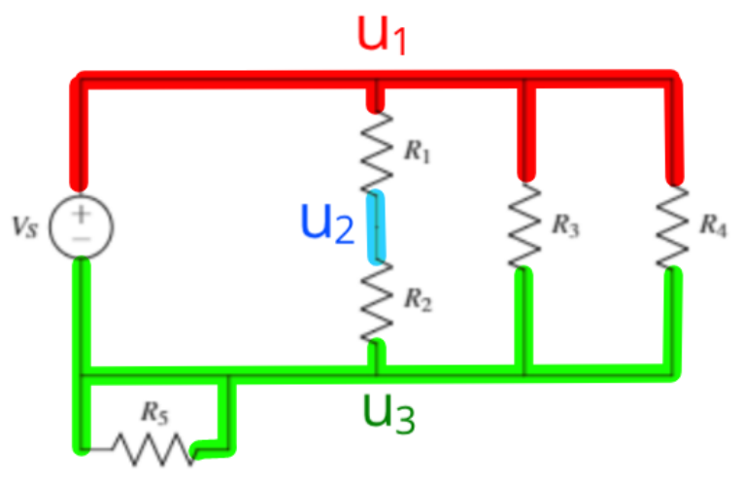













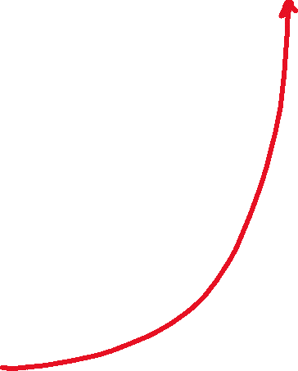









Merge elements sharing the same nodes

Slide 12
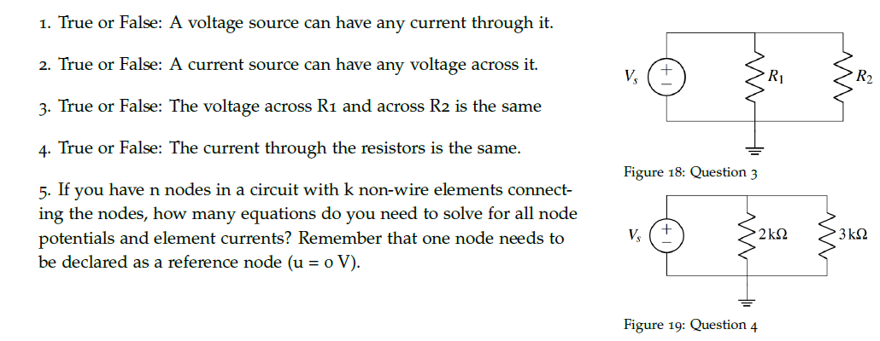











Practice problems

Slide 13




















Practice problems

Slide 14
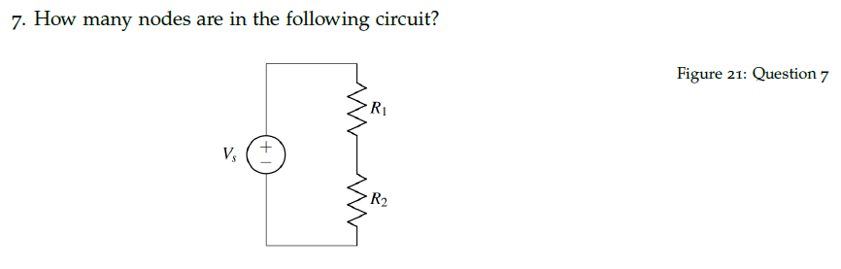



Practice problems

Slide 15
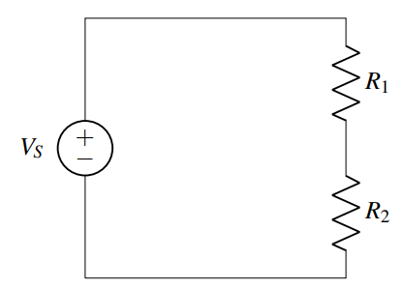




Practice

Slide 16
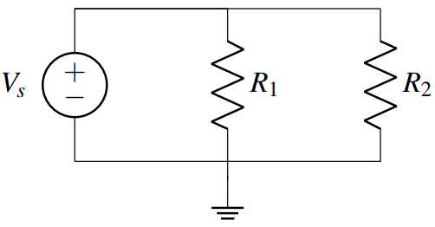
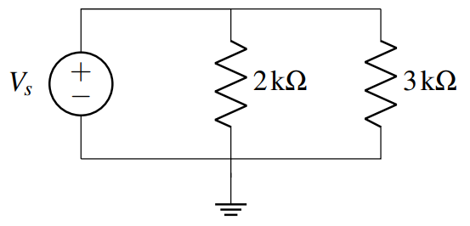
Practice

Slide 17
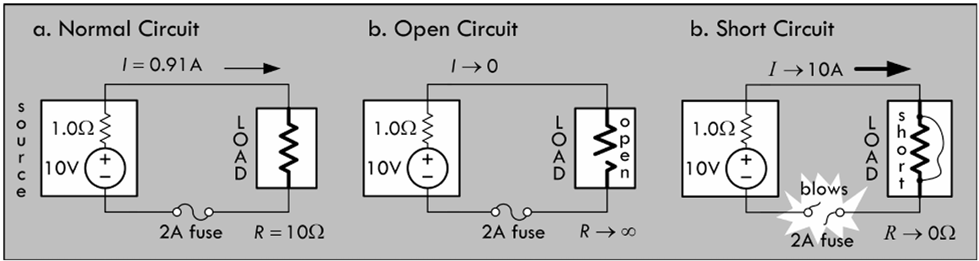
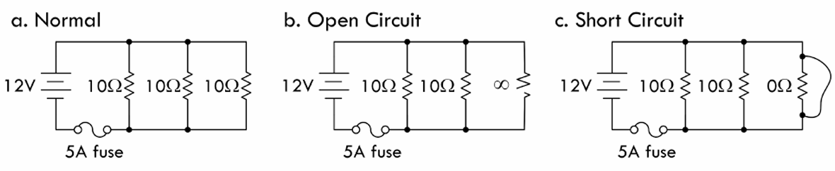

Fuse

Slide 18








Slide 19
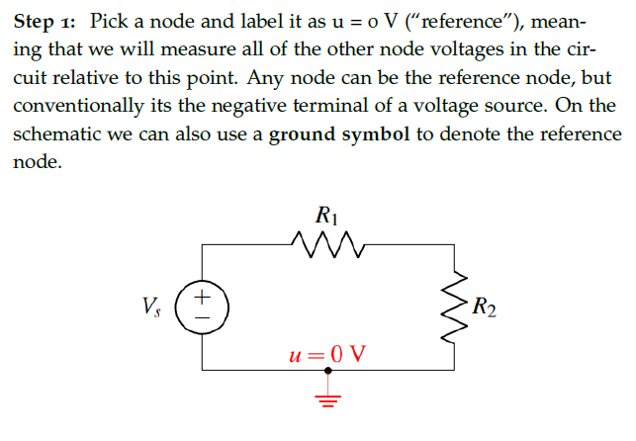

Nodal analysis

Slide 20
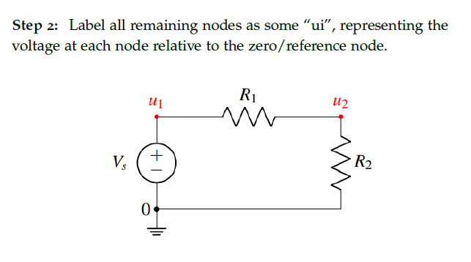
Label nodes

Slide 21
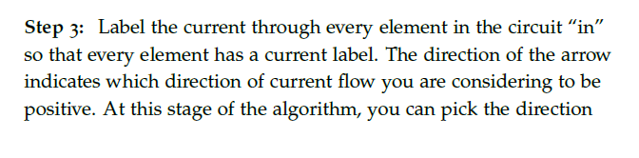
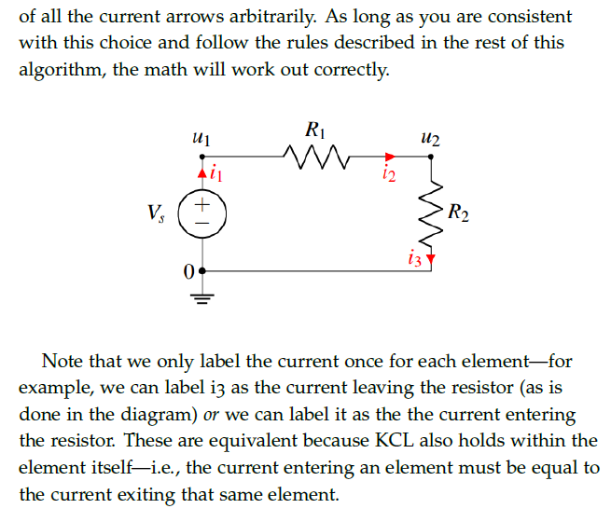



Label currents

Slide 22
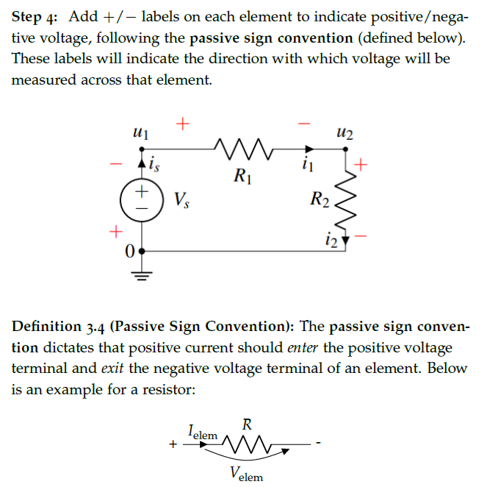
Voltage drop directions

Slide 23
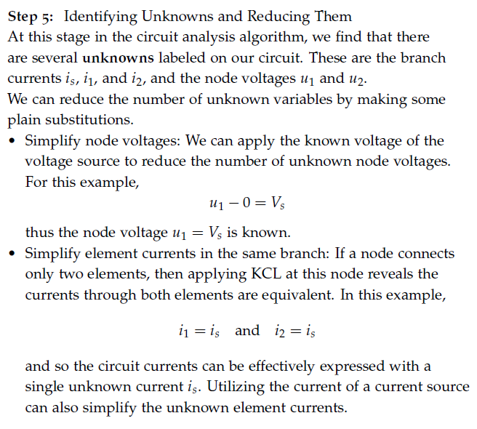





Write equations based on KCL and Ohm’s law

Slide 24
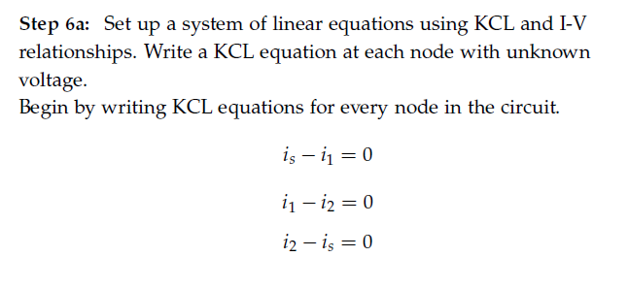











Write equations based on KCL and Ohm’s law

Slide 25
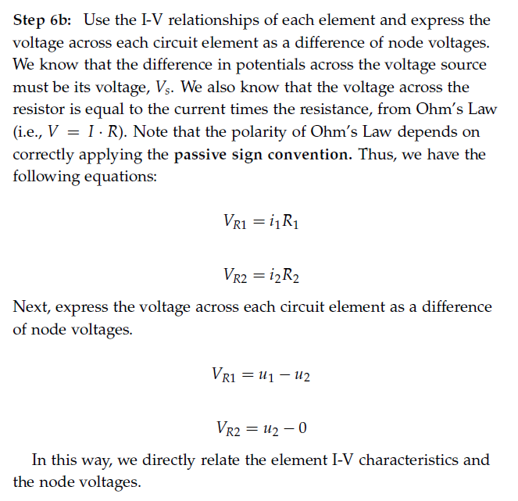
Write equations based on KCL and Ohm’s law

Slide 26
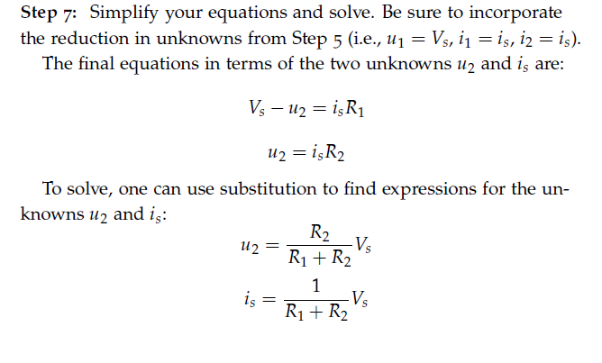
Solve for unknowns

Slide 27








Touchpad – Network 2 in the demo board

Slide 28








Touchpad – Network 2 in the demo board

Slide 29

Touchpad – Network 2 in the demo board

Slide 30













Touchpad – Network 2 in the demo board

Slide 31



















Touchpad – Network 2 in the demo board

Slide 32
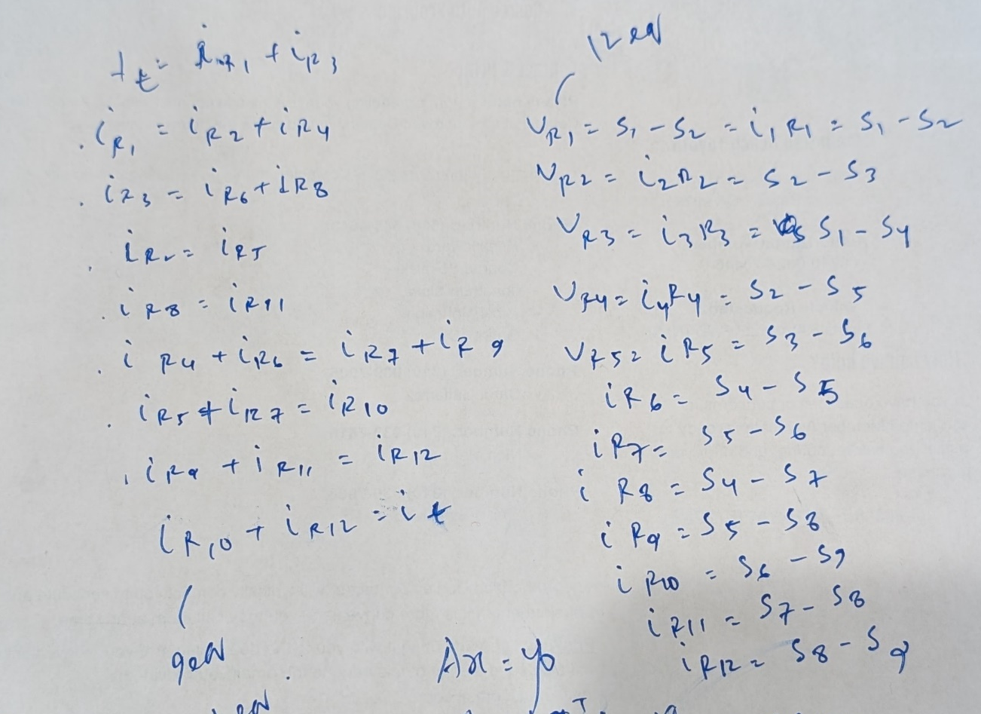
Touchpad – Network 2 in the demo board

Slide 33

Touchpad – Network 2 in the demo board

Slide 34
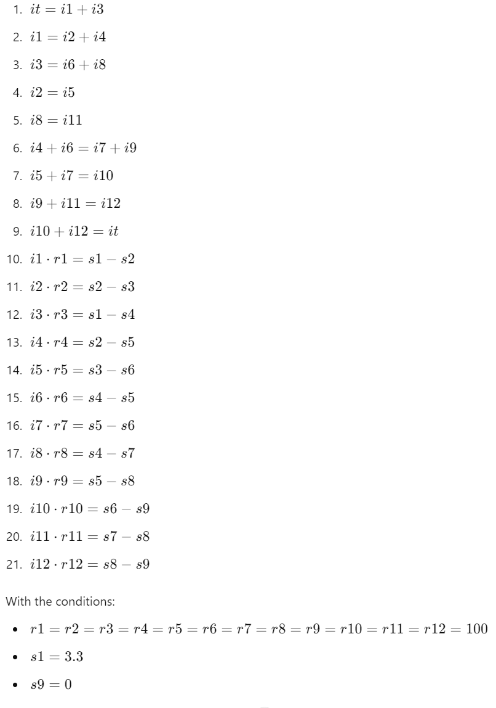
Touchpad – Network 2 in the demo board

Slide 35
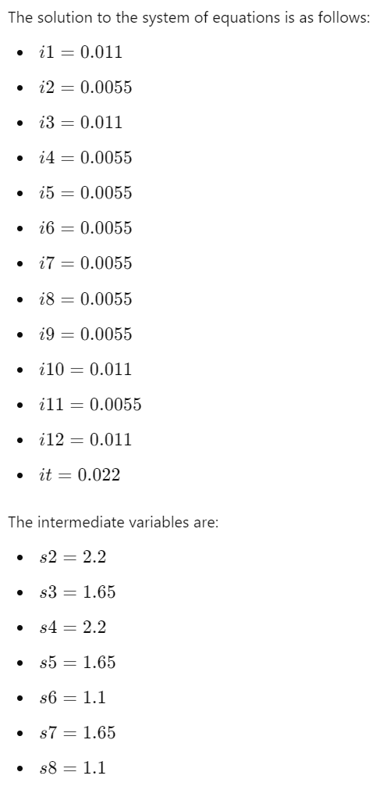
Touchpad – Network 2 in the demo board

Slide 36
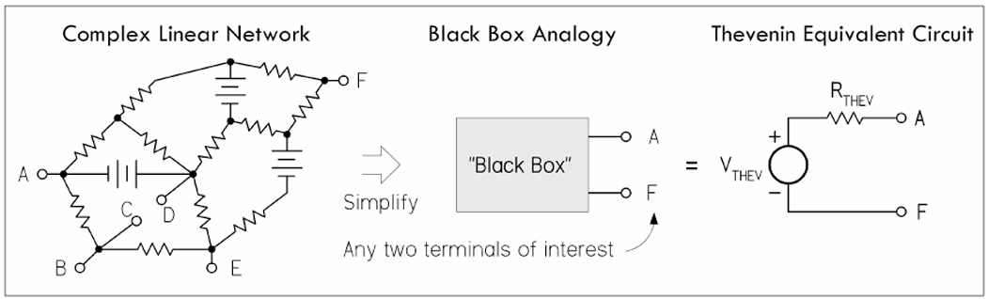
Equivalent circuits

Slide 37
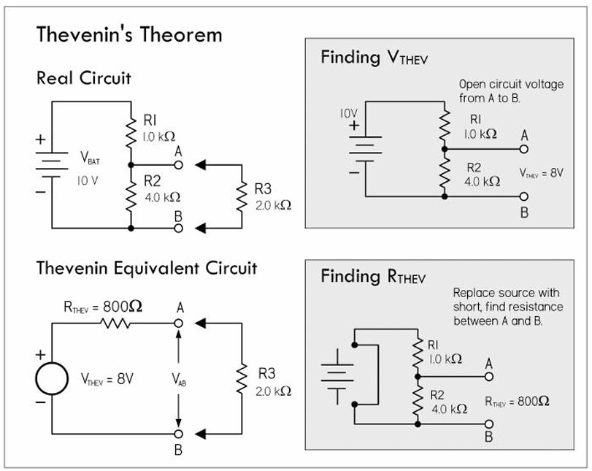
Thevenin’s equivalent circuit

Slide 38
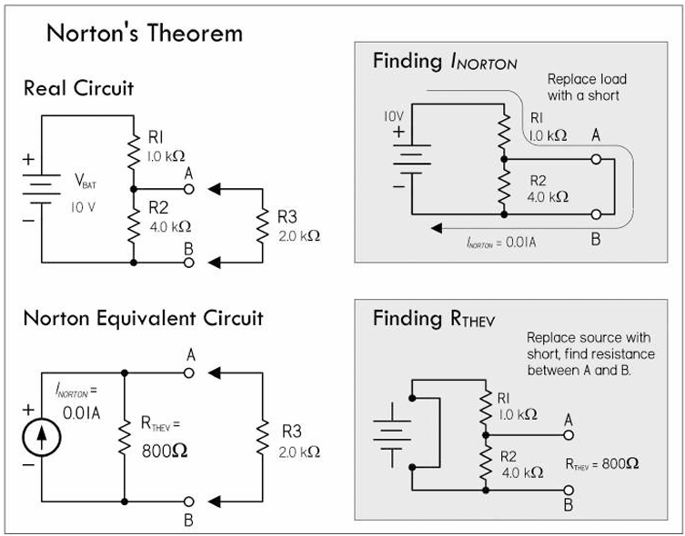
Norton’s equivalent circuit

Slide 39
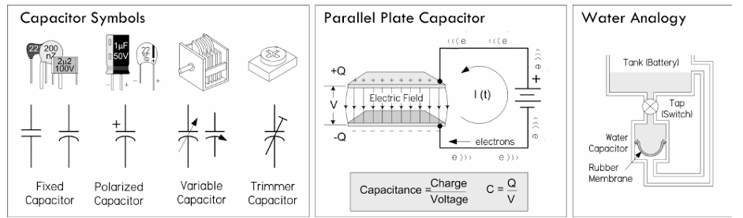
Capacitors

Slide 40
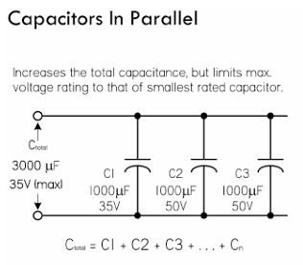
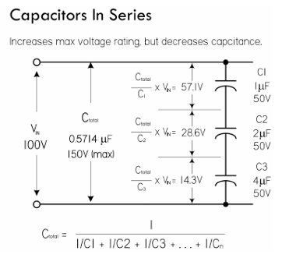
Capacitors

Slide 41
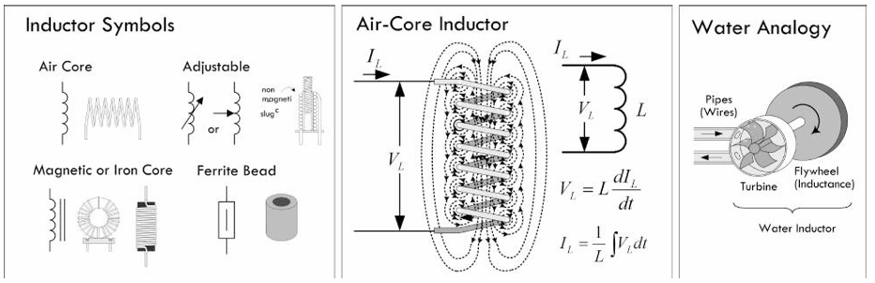
Inductors

Slide 42
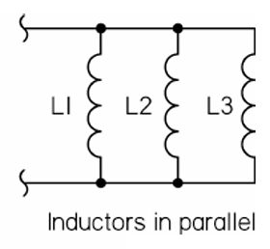
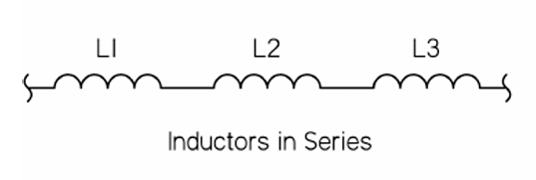
Inductors

