Slide 1
ECE 105: Introduction to Electrical Engineering
Lecture 7
Circuit Analysis - 3
Yasser Khan
Rehan Kapadia

Slide 2












Source transformation – Voltage <> Current

Slide 3




Source transformation – Voltage <> Current

Slide 4




Source transformation – Voltage <> Current

Slide 5







Voltage transformation example

Slide 6
















Voltage transformation example

Slide 7




Voltage transformation example

Slide 8





Voltage transformation example

Slide 9
Voltage transformation example

Slide 10














Voltage transformation example

Slide 11










Voltage transformation example

Slide 12
Voltage transformation example

Slide 13




Voltage transformation example

Slide 14










Voltage transformation example

Slide 15
















Voltage transformation example

Slide 16

















Voltage transformation example

Slide 17



















Voltage transformation example

Slide 18







Voltage transformation example

Slide 19












Voltage transformation example

Slide 20














Voltage transformation example

Slide 21




Voltage transformation example

Slide 22
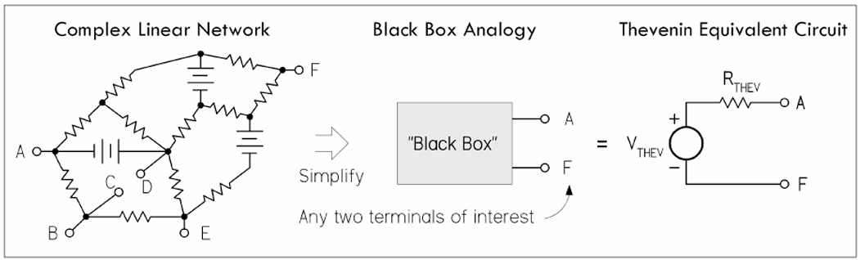
Equivalent circuits

Slide 23
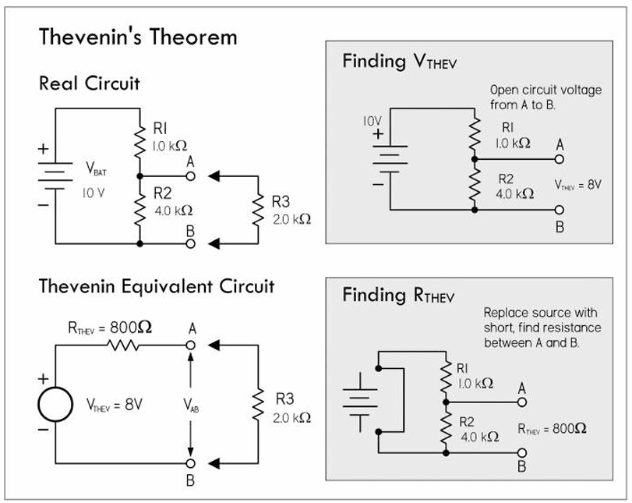
Thevenin’s equivalent circuit

Slide 24

Thevenin’s equivalent circuit

Slide 25




Thevenin’s equivalent circuit

Slide 26
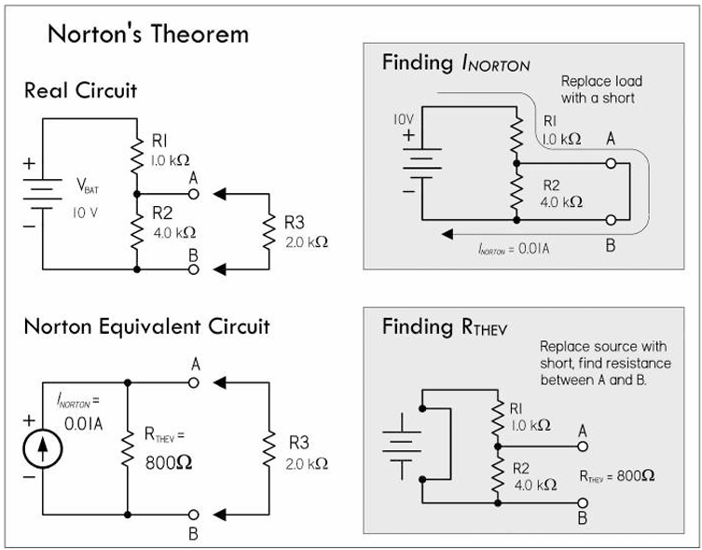





Norton’s equivalent circuit

Slide 27















Norton’s equivalent circuit

Slide 28
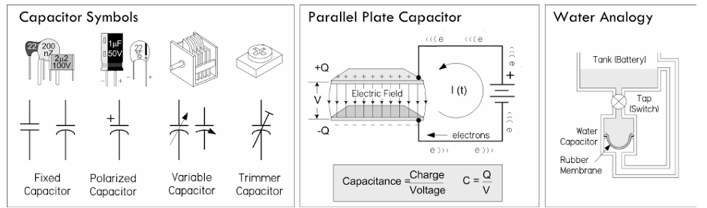
Capacitors

Slide 29
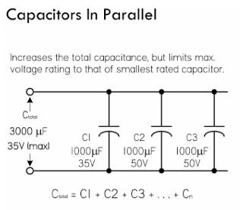
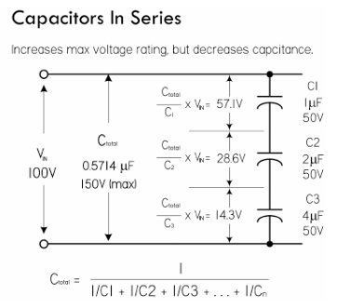
Capacitors

Slide 30
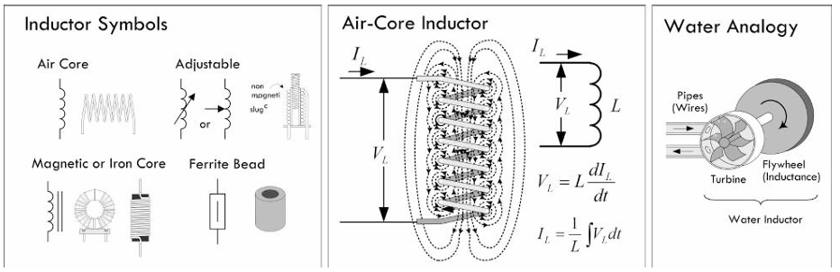
Inductors

Slide 31
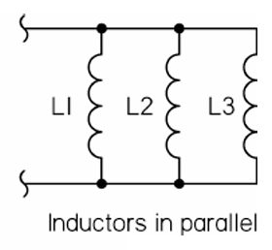
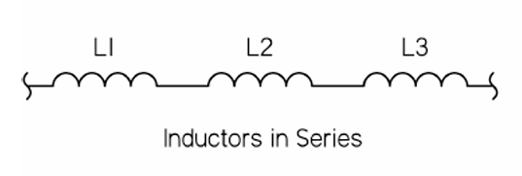


Inductors

Slide 32








Touchpad – Network 2 in the demo board

Slide 33








Touchpad – Network 2 in the demo board

Slide 34

Touchpad – Network 2 in the demo board

Slide 35






Touchpad – Network 2 in the demo board

Slide 36





Touchpad – Network 2 in the demo board

Slide 37
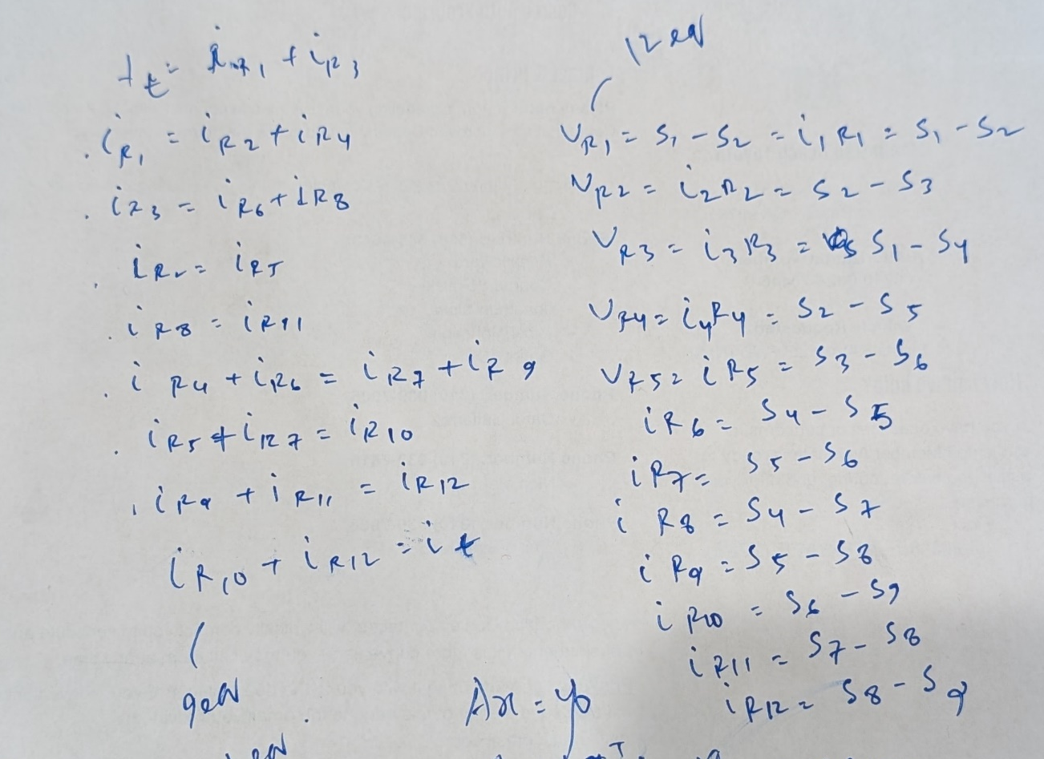
Touchpad – Network 2 in the demo board

Slide 38

Touchpad – Network 2 in the demo board

Slide 39
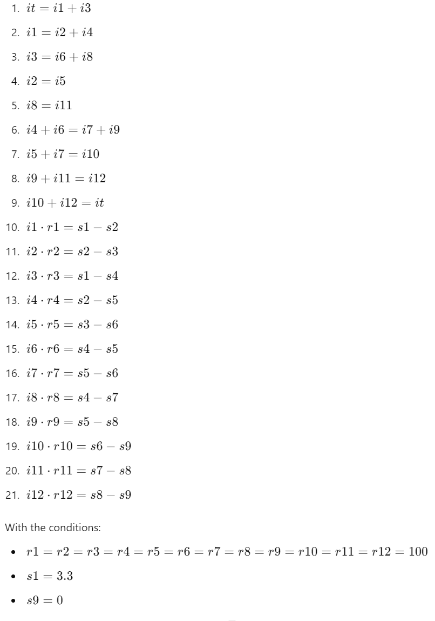
Touchpad – Network 2 in the demo board

Slide 40
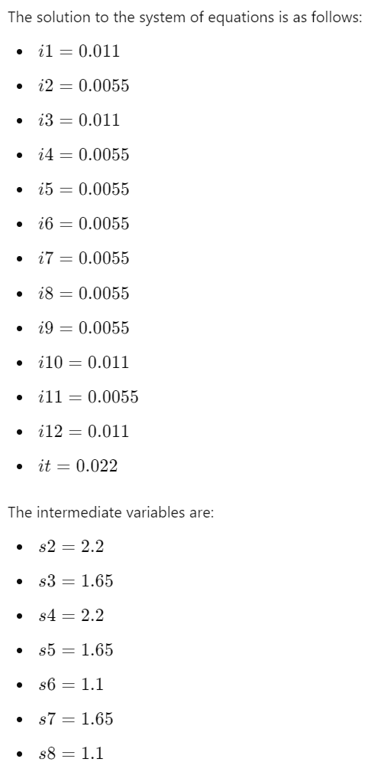
Touchpad – Network 2 in the demo board

