Slide 1
Chapter 6 MOSFET
The MOSFET (MOS Field-Effect Transistor) is the building block of Gb memory chips, GHz microprocessors, analog, and RF circuits.
Match the following MOSFET characteristics with their applications:
  small size
  high speed
  low power
  high gain
Modern Semiconductor Devices for Integrated Circuits (C. Hu)
Slide 6-<number>

Slide 2
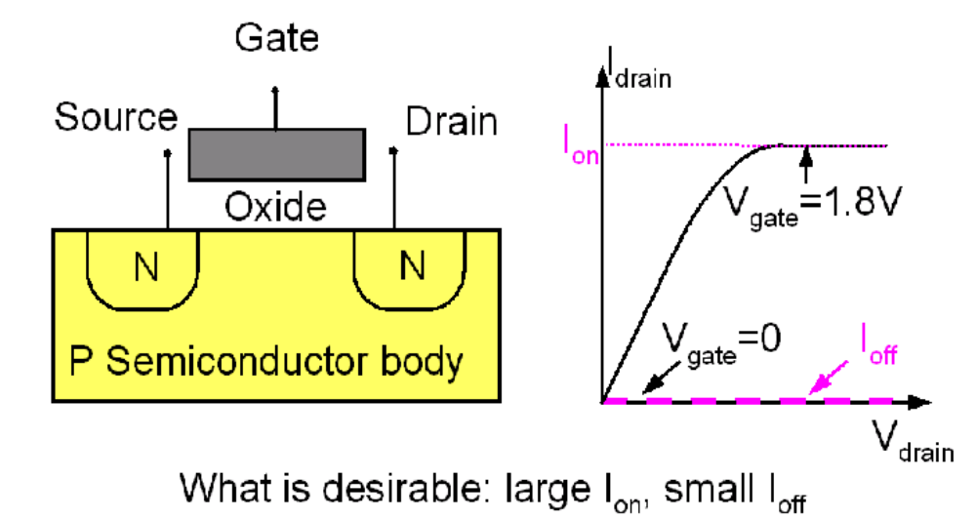
6.1 Introduction to the MOSFET
Basic MOSFET structure and IV characteristics
+
+
Modern Semiconductor Devices for Integrated Circuits (C. Hu)
Slide 6-<number>

Slide 3
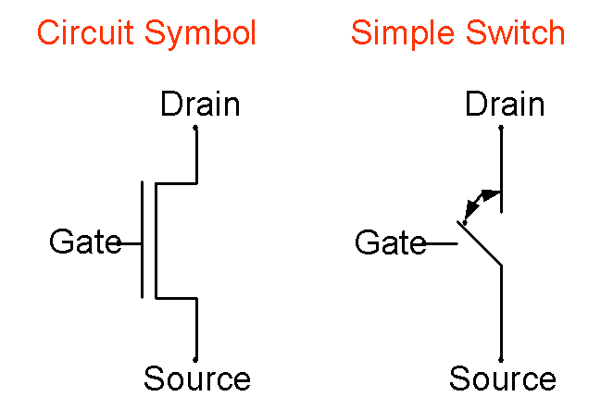
6.1 Introduction to the MOSFET
Two ways of representing a MOSFET:
Modern Semiconductor Devices for Integrated Circuits (C. Hu)
Slide 6-<number>

Slide 4
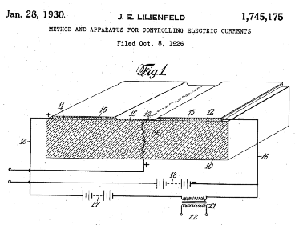
Early Patents on the Field-Effect Transistor
Modern Semiconductor Devices for Integrated Circuits (C. Hu)
Slide 6-<number>

Slide 5
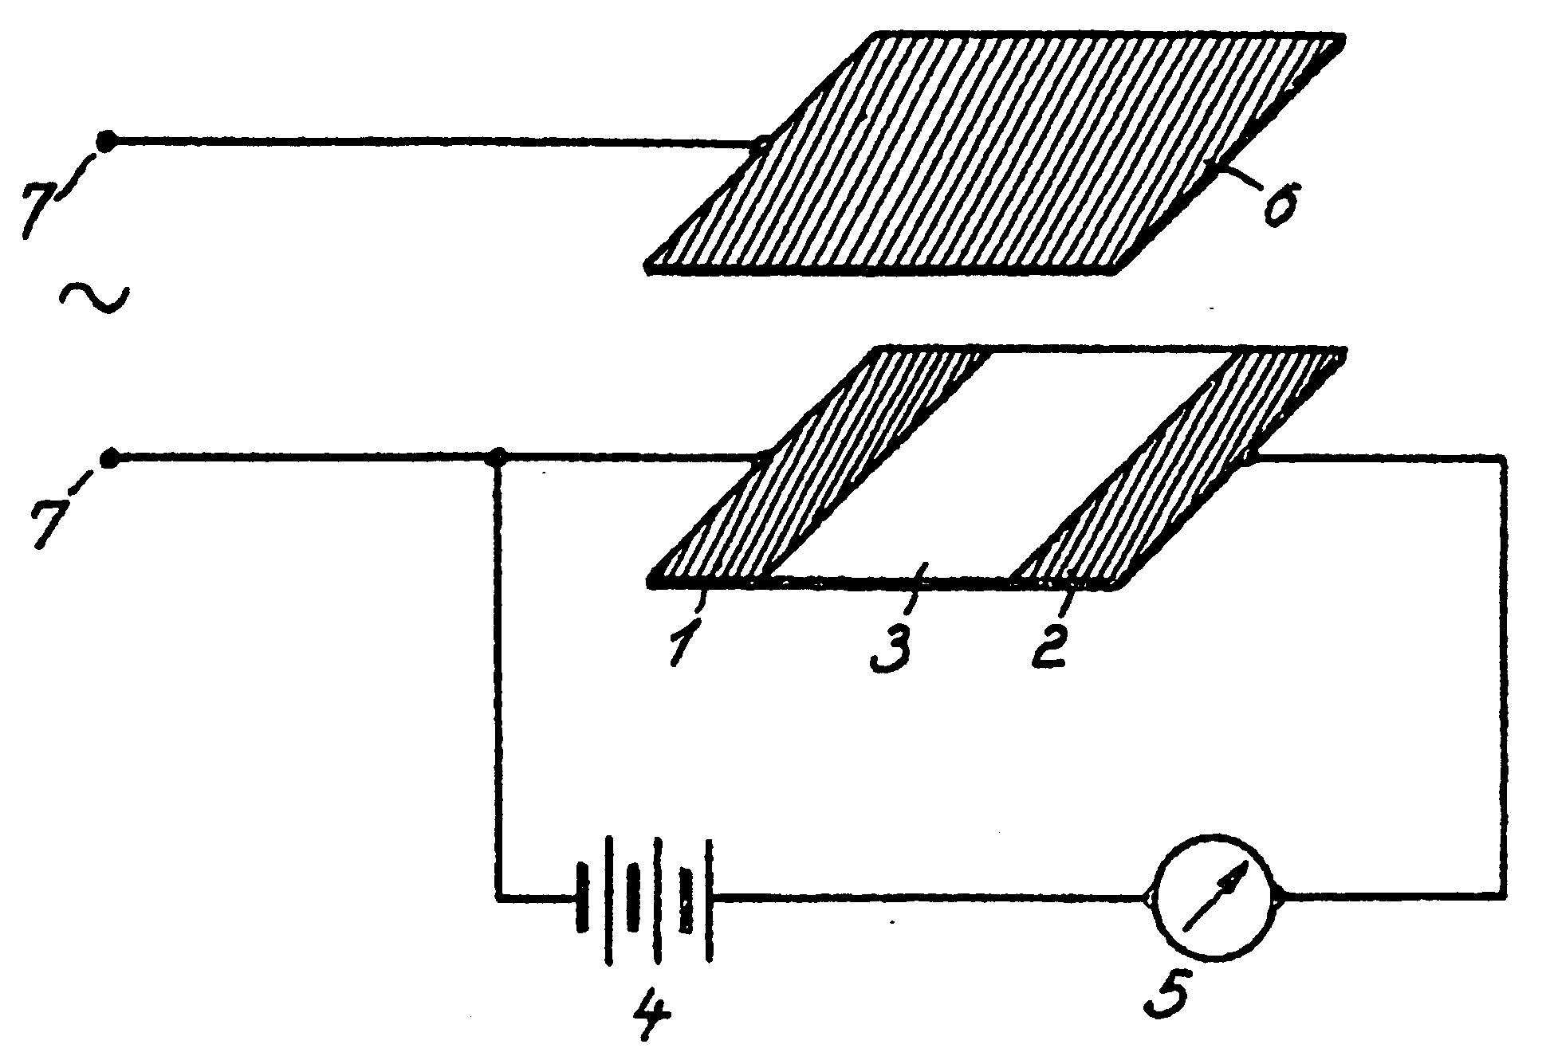
Early Patents on the Field-Effect Transistor
In 1935, a British patent was issued to Oskar Heil.
A working MOSFET was not demonstrated until 1955.
Using today’s terminology, what are 1, 2, and 6?
Modern Semiconductor Devices for Integrated Circuits (C. Hu)
Slide 6-<number>

Slide 6
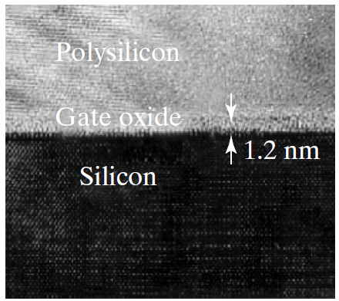
6.2 MOSFETs Technology
Polysilicon gate and 1.2nm SiO₂
1.2 nm SiO₂ used in production. Leakage current through the oxide limits further thickness reduction.
Modern Semiconductor Devices for Integrated Circuits (C. Hu)
Slide 6-<number>

Slide 7
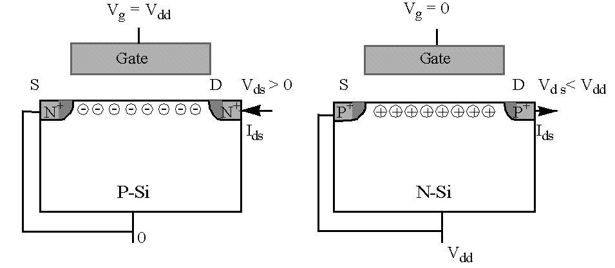
6.2 Complementary MOSFETs Technology
NFET PFET
When V_{g} = V_{dd} , the NFET is on and the PFET is off.
When V_{g} = 0, the PFET is on and the NFET is off.
Modern Semiconductor Devices for Integrated Circuits (C. Hu)
Slide 6-<number>

Slide 8
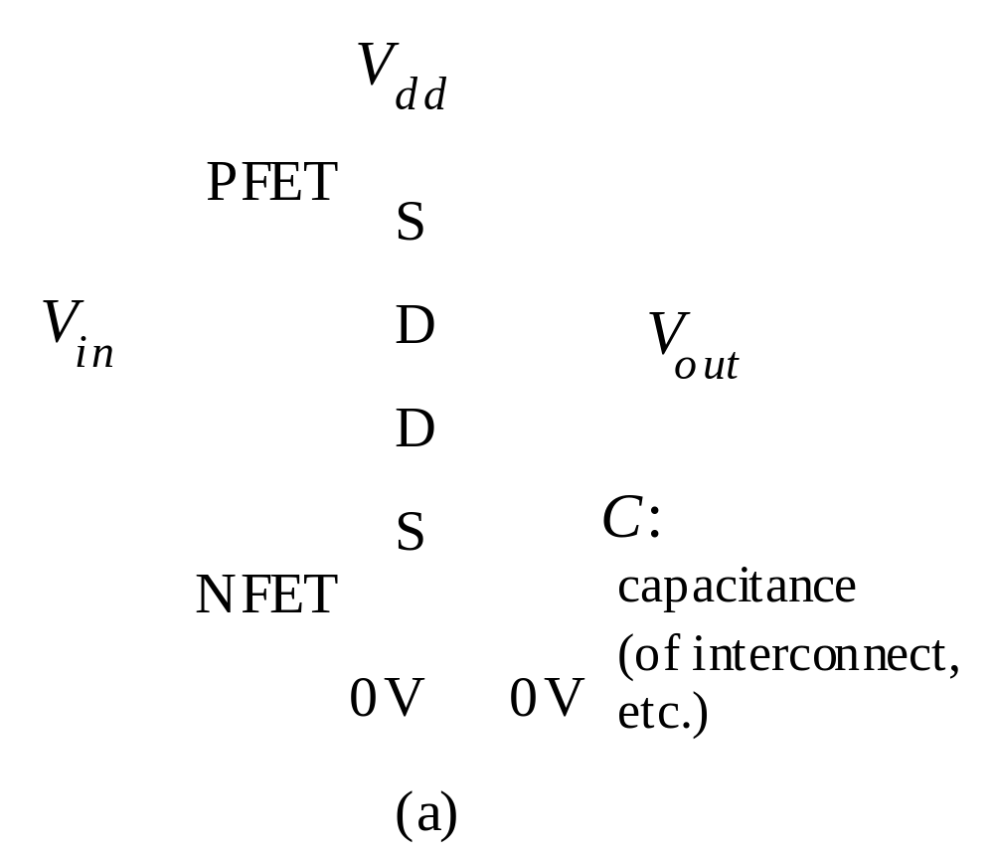
CMOS (Complementary MOS) Inverter
A CMOS inverter is made of a PFET pull-up device and a NFET pull-down device. V_{out} = ? if V_{in} = 0 V.
Modern Semiconductor Devices for Integrated Circuits (C. Hu)
Slide 6-<number>

Slide 9
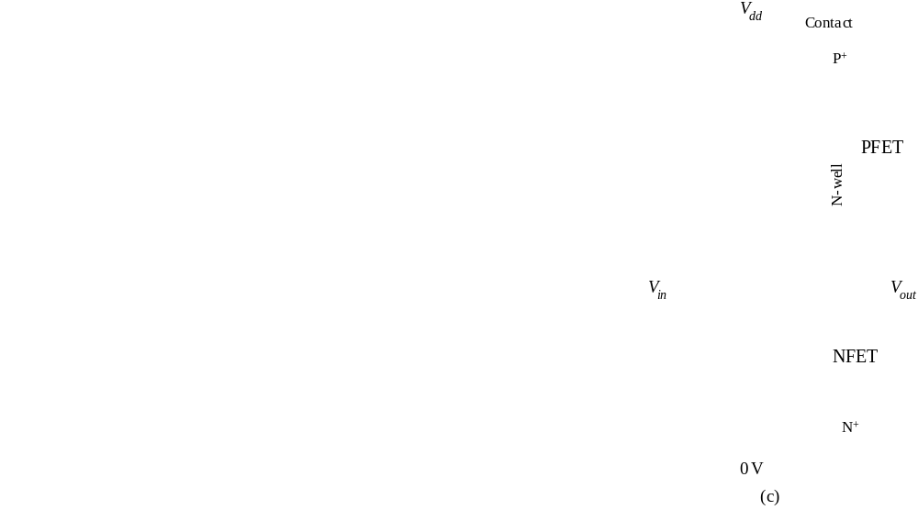
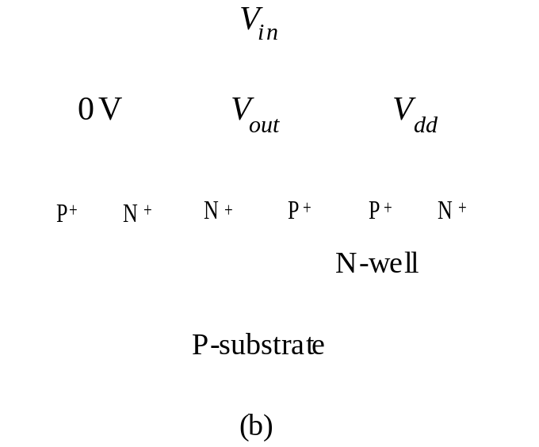
CMOS (Complementary MOS) Inverter
NFET and PFET can be fabricated on the same chip.
basic layout of a CMOS inverter
Modern Semiconductor Devices for Integrated Circuits (C. Hu)
Slide 6-<number>

Slide 10
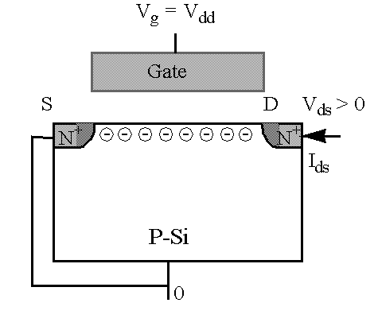
6.3 Surface Mobilities and High-Mobility FETs
6.3.1 Surface Mobilities
V_{g} = V_{dd} , V_{gs} = V_{dd}
V_{ds} > 0
I_{ds}
How to measure the surface mobility:
I
=
W
⋅
Q
⋅
v
=
WQ
μ
E
=
WQ
μ
V
/
L
ds
inv
inv
ns
inv
ns
ds
=
WC
(
V
−
V
)
μ
V
/
L
oxe
gs
t
ns
ds
Modern Semiconductor Devices for Integrated Circuits (C. Hu)
Slide 6-<number>

Slide 11
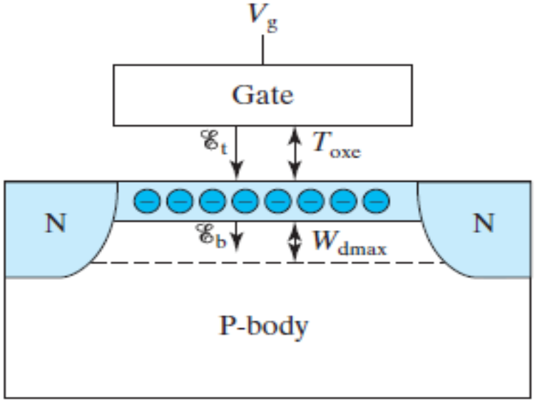

Mobility is a function of the average of the fields at the bottom and the top of the inversion charge layer, E_{b} and E_{t} .
From Gauss’s Law,
E_{b} = – Q_{dep}/ε_{s}
Therefore,
=
C
−
−
φ
E
oxe
(
V
V
)
b
ε
t
fb
st
s
∴
1
C
(
E
+
E
)
=
oxe
(
V
+
V
−
2
V
−
2
φ
)
E
=
−
(
Q
+
Q
)
/
ε
2
b
t
2
ε
gs
t
fb
st
t
dep
inv
s
s
C
≈
C
+
+
=
E
−
Q
/
ε
=
E
+
oxe
(
V
−
V
)
oxe
(
V
V
0
.
2
V
)
b
inv
s
b
ε
gs
t
2
ε
gs
t
s
s
C
V
+
V
+
0
.
2
V
=
oxe
(
V
−
V
−
φ
)
=
gs
t
ε
gs
fb
st
6
T
s
oxe
Modern Semiconductor Devices for Integrated Circuits (C. Hu)
Slide 6-<number>

Slide 12
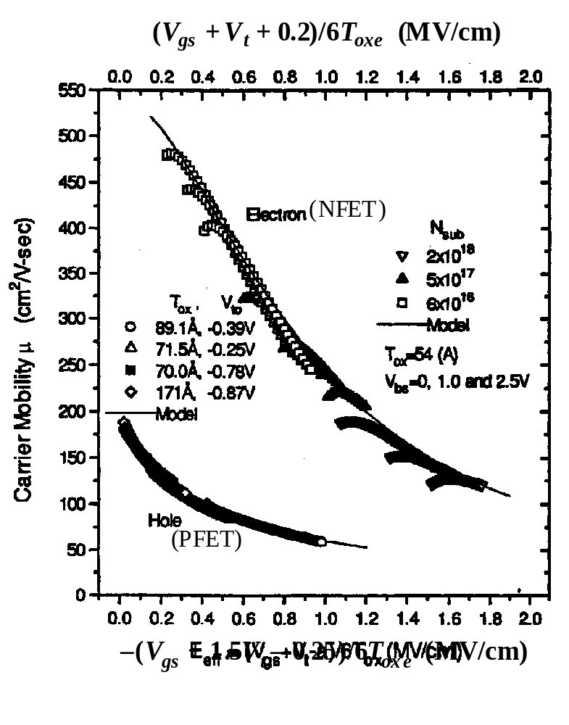
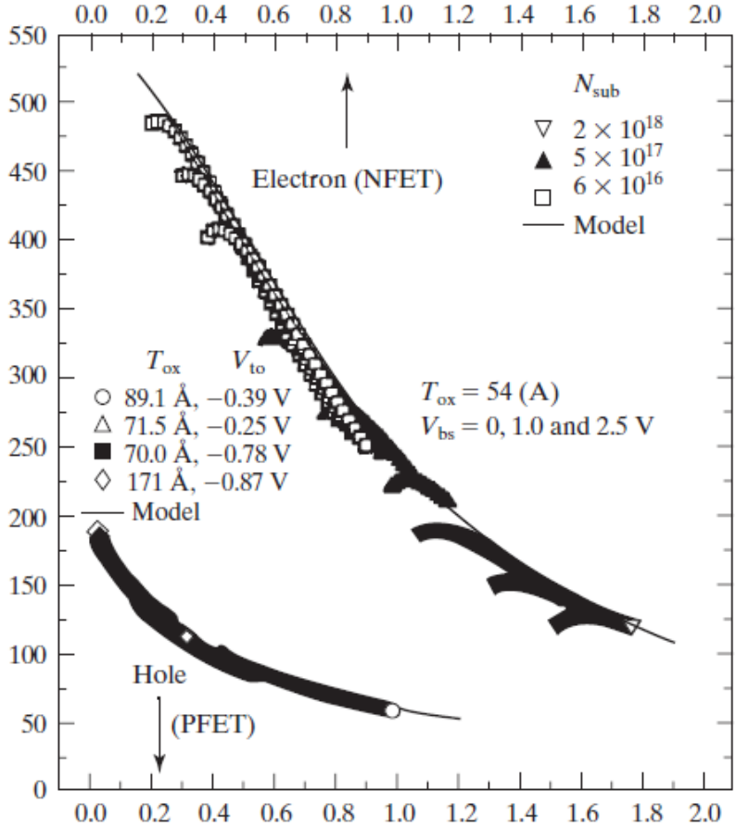
Universal Surface Mobilities
Surface roughness
scattering is stronger (mobility is lower) at higher V_{g}, higher V_{t}, and thinner T_{oxe}.
Surface mobility (cm²/V-s)
Modern Semiconductor Devices for Integrated Circuits (C. Hu)
Slide 6-<number>

Slide 13
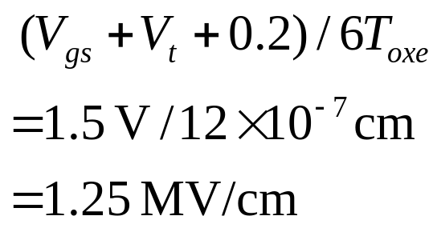
EXAMPLE: What is the surface mobility at V_{gs}=1 V in an N-channel MOSFET with V_{t}=0.3 V and T_{oxe}=2 nm?
Solution:
1 MV is a megavolt (10⁶ V). From the mobility figure, μ_{ns}=190 cm2/Vs, which is several times smaller than the bulk mobility.
Modern Semiconductor Devices for Integrated Circuits (C. Hu)
Slide 6-<number>

Slide 14
6.3.2 GaAs MESFET
gate
source
drain
metal
+
N-channel
+
N
N
GaAs
Semi-insulating substrate
MESFET IV characteristics are similar to MOSFET’s but does not require a gate oxide.
Question: What is the advantage of GaAs FET over Si FET?
Terms: depletion-mode transistor, enhancement-mode transistor
Modern Semiconductor Devices for Integrated Circuits (C. Hu)
Slide 6-<number>

Slide 15
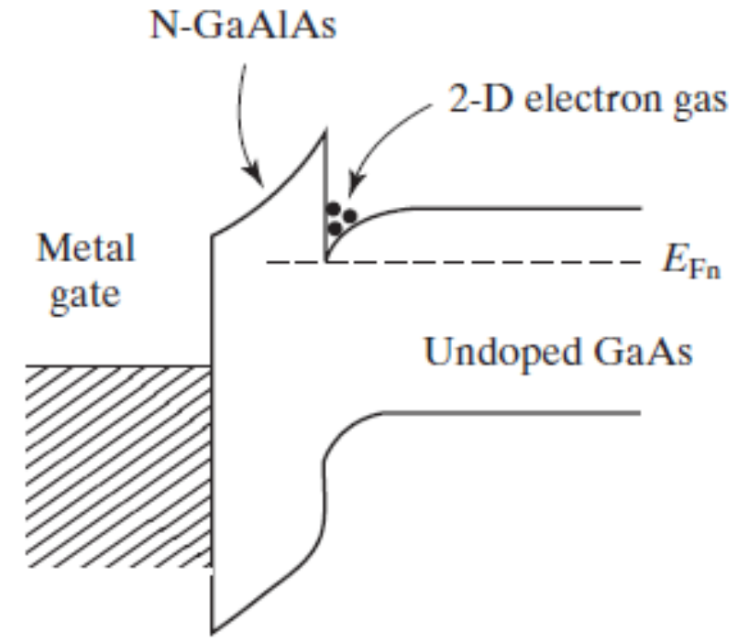
6.3.3 HEMT, High Electron Mobility Transistor
N-GaAlAs
source
metal gate
drain
….......
N
+
N
+
Undoped GaAs
A large-Eg semiconductor serves as the “gate dielectric”.
The layer of electrons is called 2D-electron-gas, the equivalent of the inversion or accumulation layer of a MOSFET.
Modern Semiconductor Devices for Integrated Circuits (C. Hu)
Slide 6-<number>

Slide 16
6.3.4 JFET
P⁺
gate
source
drain
N
+
N-channel
N
+
P-Si
The gate is a P⁺N junction.
The FET is a junction field-effect transistor (JFET).
Modern Semiconductor Devices for Integrated Circuits (C. Hu)
Slide 6-<number>

Slide 17
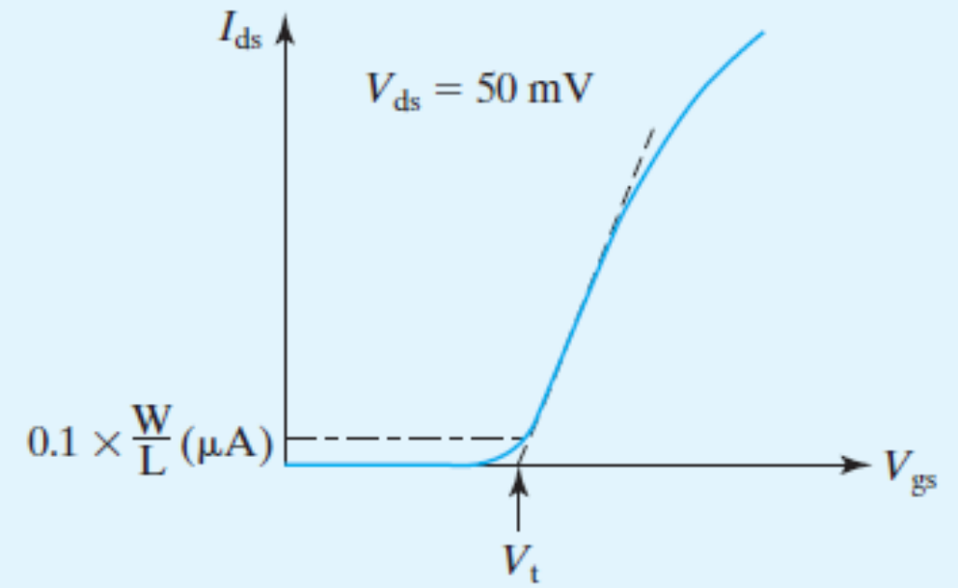
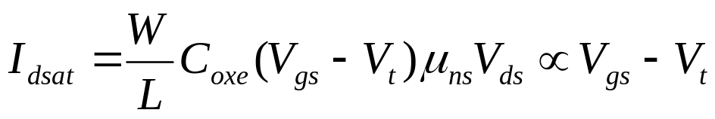

6.4 V_{t} and Body Effect
How to Measure the V_{t} of a MOSFET
A
B
Method A. V_{t} is measured by extrapolating the I_{ds} versus V_{gs} curve to I_{ds} = 0.
Method B. The Vg at which Ids =0.1μA W/L
Modern Semiconductor Devices for Integrated Circuits (C. Hu)
Slide 6-<number>

Slide 18
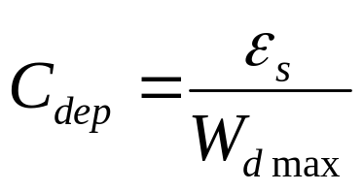
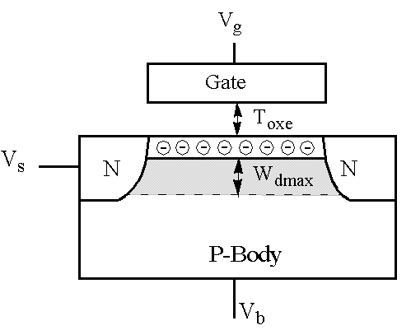
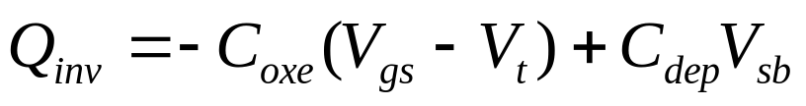
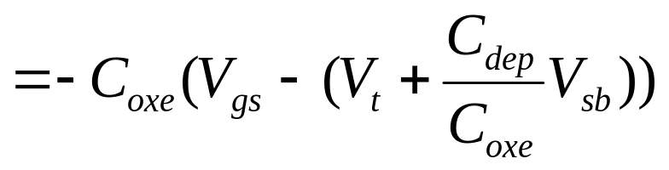
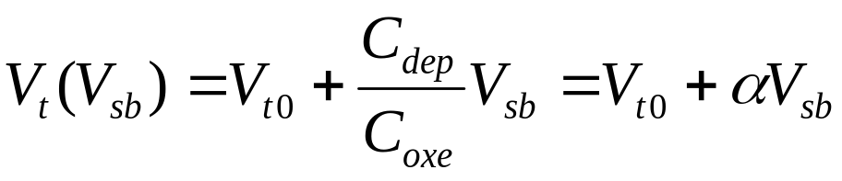
MOSFET V_{t} and the Body Effect
Two capacitors => two charge components
C_{oxe}
Redefine V_{t} as
C_{dep}
Modern Semiconductor Devices for Integrated Circuits (C. Hu)
Slide 6-<number>

Slide 19
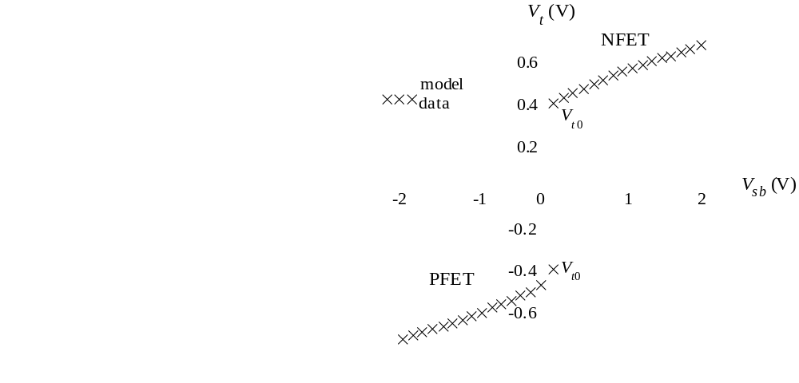
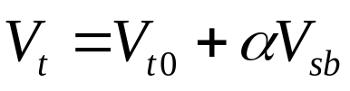
MOSFET V_{t} and the Body Effect
Body effect: V_{t} is a function of V_{sb}. When the source-body junction is reverse-biased, V_{t} increases.
Body effect coefficient:
α = C_{dep}/C_{oxe}
= 3T_{oxe} / W_{dep}
Body effect slows down circuits? How can it be reduced?
Modern Semiconductor Devices for Integrated Circuits (C. Hu)
Slide 6-<number>

Slide 20
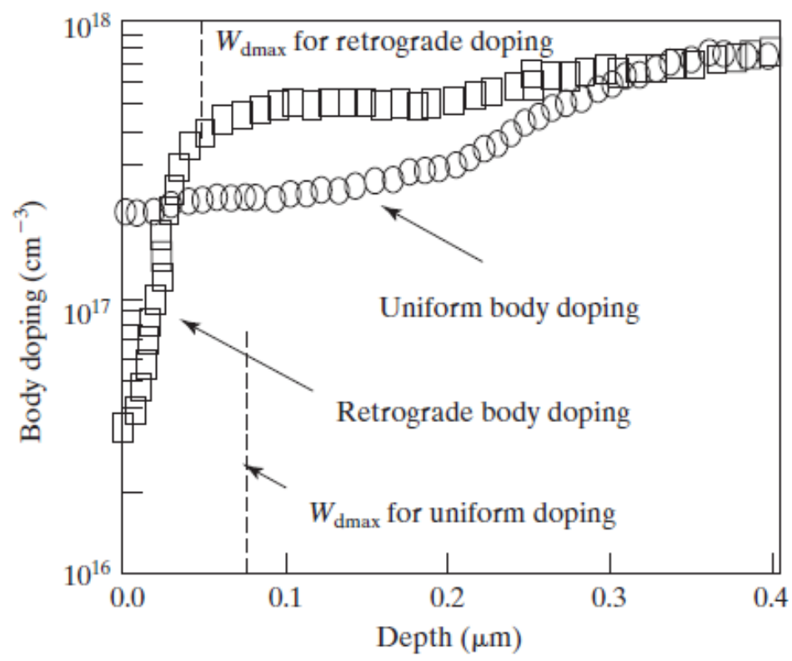
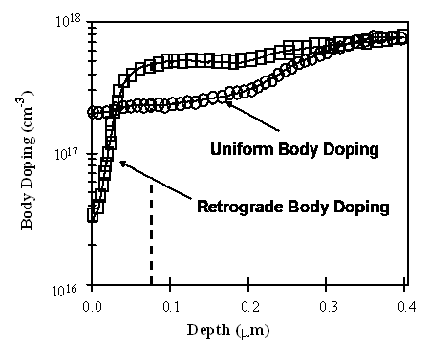
Retrograde Body Doping Profiles
W_{dmax} for retrograde doping
W_{dmax} for uniform doping
W_{dep} does not vary with V_{sb} .
Retrograde doping is popular because it reduces off-state
leakage and allows higher surface mobility.
Modern Semiconductor Devices for Integrated Circuits (C. Hu)
Slide 6-<number>

Slide 21
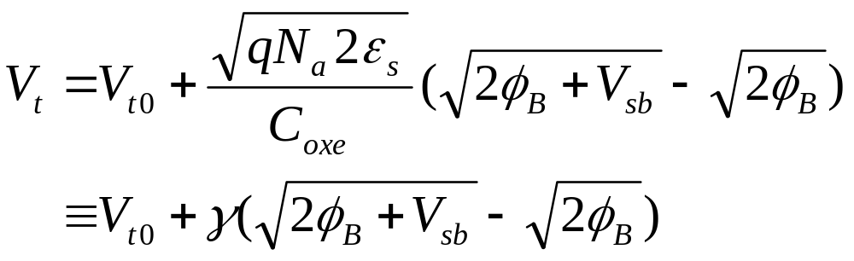
Uniform Body Doping
When the source/body junction is reverse-biased, there are two quasi-Fermi levels (E_{fn} and E_{fp}) which are separated by qV_{sb}. An NMOSFET reaches threshold of inversion when E_{c} is close to E_{fn} , not E_{fp} . This requires the band-bending to be 2φ_{B} + V_{sb} , not 2φ_{B}.
γ is the body-effect parameter.
Modern Semiconductor Devices for Integrated Circuits (C. Hu)
Slide 6-<number>

Slide 22
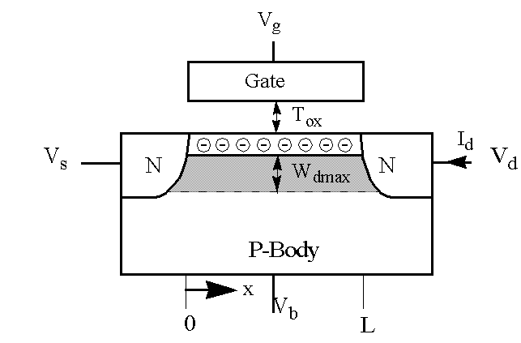
6.5 Q_{inv} in MOSFET
Channel voltage
V_{c}=V_{s} at x = 0 and
V_{c}=V_{d} at x = L.
Q_{inv} = – C_{oxe}(V_{gs} – V_{cs} – V_{t0} – α (V_{sb}+V_{cs})
= – C_{oxe}(V_{gs} – V_{cs} – (V_{t0} +α V_{sb}) – α V_{cs})
= – C_{oxe}(V_{gs} – mV_{cs} – V_{t})
m ≡ 1 +α = 1 + 3T_{oxe}/W_{dmax}
m is called the body-effect factor or bulk-charge factor
Modern Semiconductor Devices for Integrated Circuits (C. Hu)
Slide 6-<number>

Slide 23
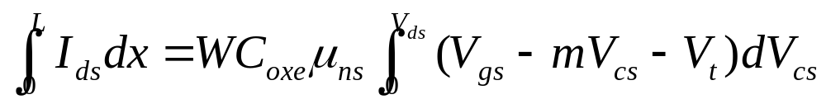
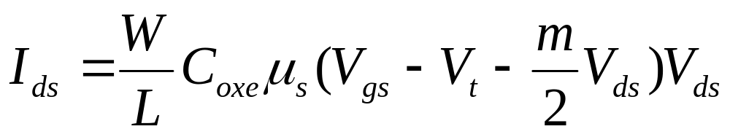
6.6 Basic MOSFET IV Model
I_{ds}= WQ_{inv}v= WQ_{inv}μ_{ns}E
= WC_{oxe}(V_{gs}– mV_{cs} – V_{t})μ_{ns}dV_{cs}/dx
I_{ds}L = WC_{oxe}μ_{ns}(V_{gs} – V_{t} – mV_{ds}/2)V_{ds}
Modern Semiconductor Devices for Integrated Circuits (C. Hu)
Slide 6-<number>

Slide 24
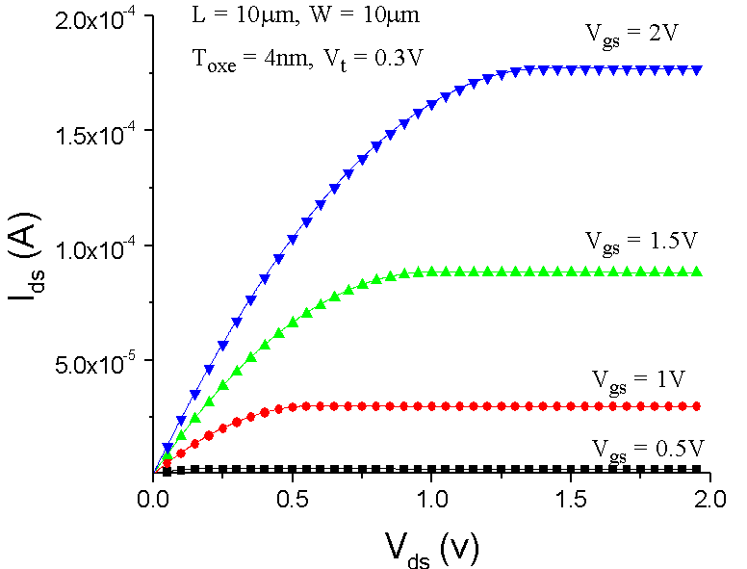
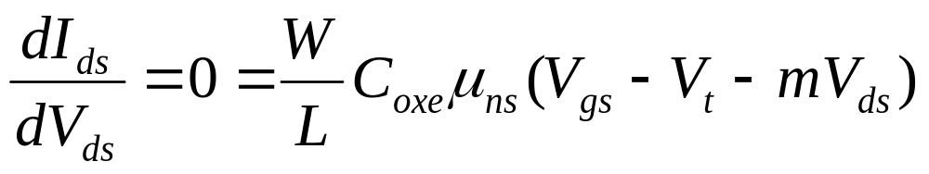
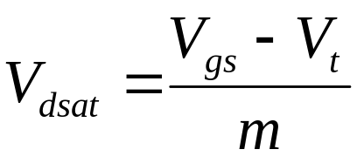
V_{dsat} : Drain Saturation Voltage
Modern Semiconductor Devices for Integrated Circuits (C. Hu)
Slide 6-<number>

Slide 25
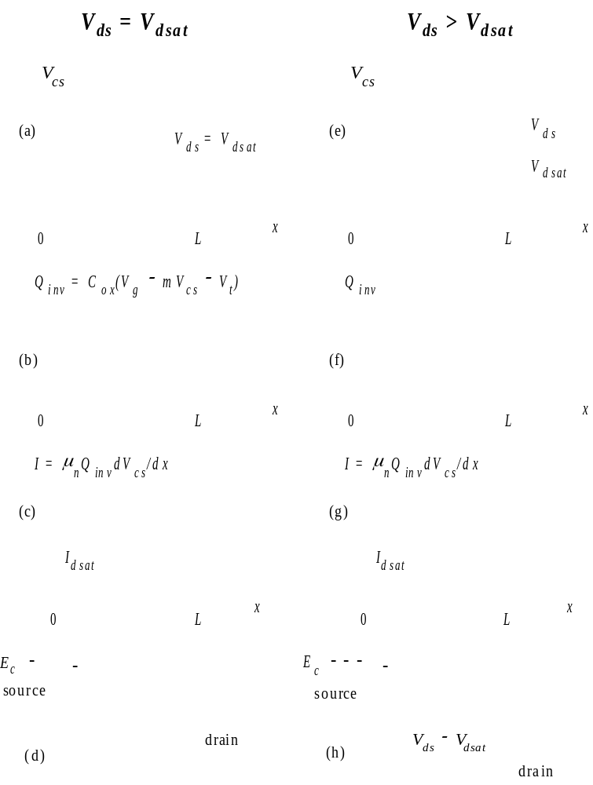
Modern Semiconductor Devices for Integrated Circuits (C. Hu)
Slide 6-<number>

Slide 26
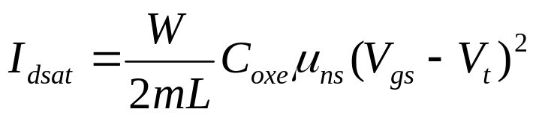
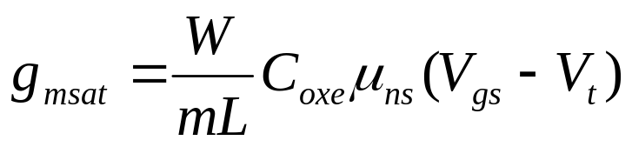
Saturation Current and Transconductance
linear region, saturation region
transconductance: g_{m}= dI_{ds}/dV_{gs}
Modern Semiconductor Devices for Integrated Circuits (C. Hu)
Slide 6-<number>

Slide 27
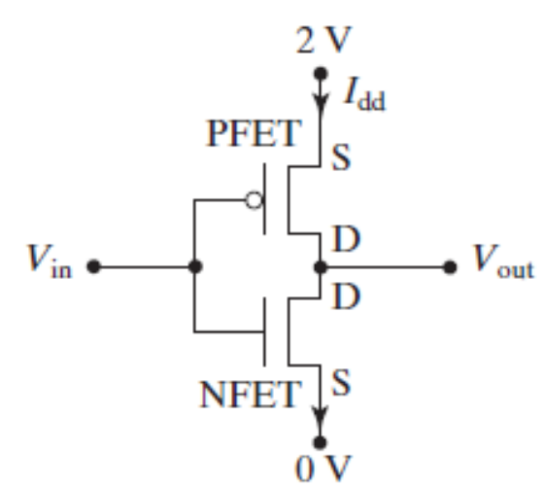
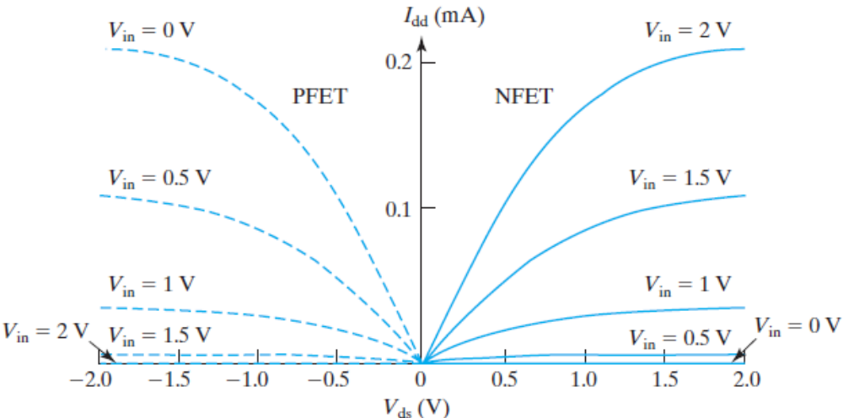
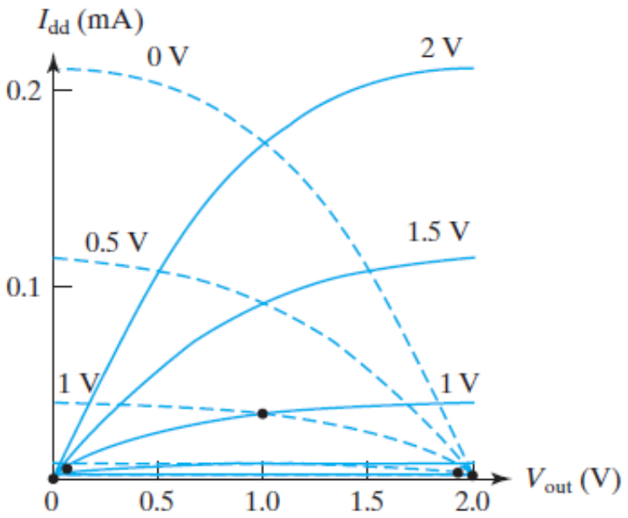
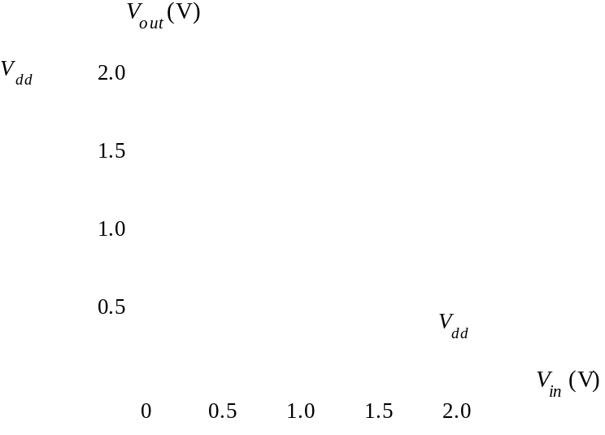
6.7.1 CMOS Inverter--voltage transfer curve
Modern Semiconductor Devices for Integrated Circuits (C. Hu)
Slide 6-<number>

Slide 28
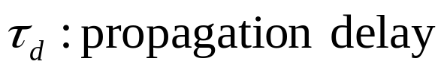
6.7.2 Inverter Speed – propagation delay
V
dd
...........
V
1
V
2
V
3
............
C
C
V
2
V
dd
2
τ
V
3
d
V
1
0
t
Modern Semiconductor Devices for Integrated Circuits (C. Hu)
Slide 6-<number>

Slide 29
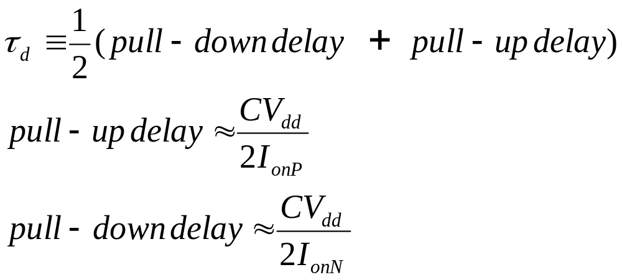
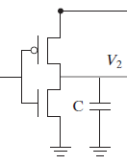
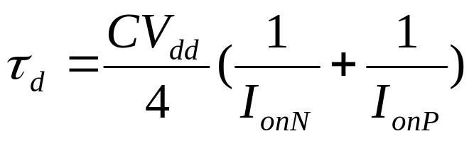
6.7.2 Inverter Speed - Impact of I_{on}
V_{dd}
V_{in}
V_{out}
How can the speed of an inverter circuit be improved?
Modern Semiconductor Devices for Integrated Circuits (C. Hu)
Slide 6-<number>

Slide 30
Logic Gates
V
dd
AB
A
This two-input NAND
gate and many other
logic gates are
extensions of the
inverter.
B
Modern Semiconductor Devices for Integrated Circuits (C. Hu)
Slide 6-<number>

Slide 31
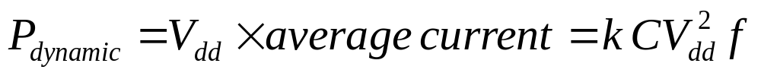
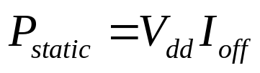
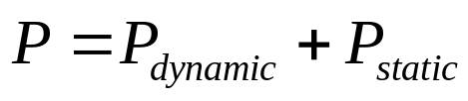
6.7.3 Power Consumption
V_{dd}
V_{in}
V_{out}
Total power consumption
Modern Semiconductor Devices for Integrated Circuits (C. Hu)
Slide 6-<number>

Slide 32
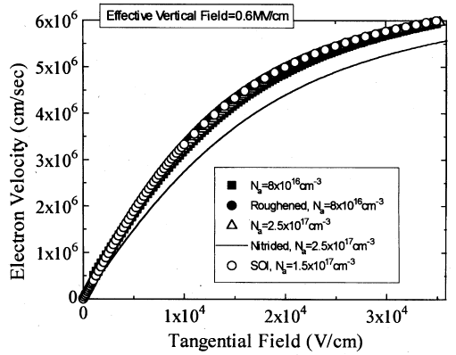
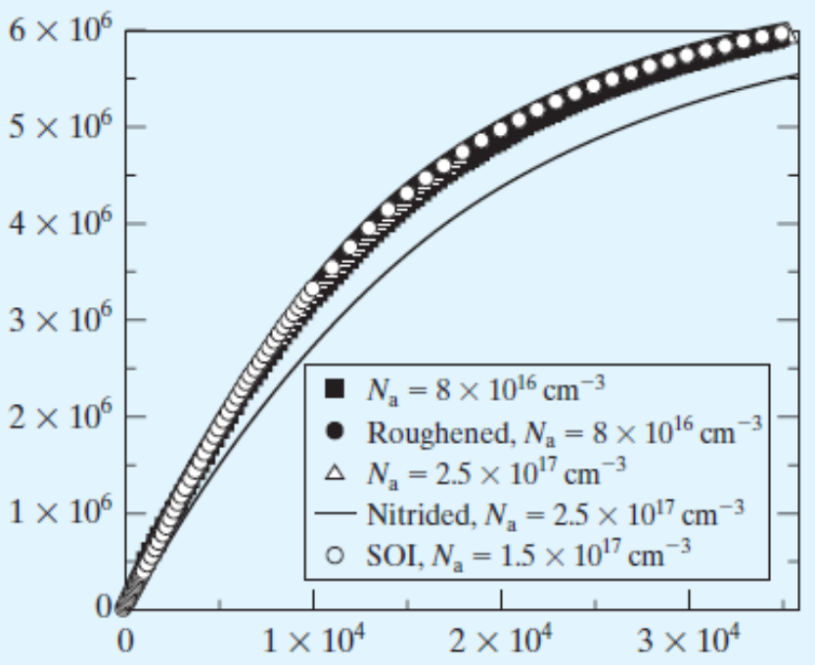
6.8 Velocity Saturation
μ
E
v
=
ns
E
1
+
E
sat
E << E_{sat} : v = μ E
ns
E >> E_{sat} : v = μ E_{sat}
ns
Velocity saturation has
large and deleterious
effect on the I_{on} of
MOSFETS
Modern Semiconductor Devices for Integrated Circuits (C. Hu)
Slide 6-<number>

Slide 33
6.9 MOSFET IV Model with Velocity Saturation
I
=
WQ
v
ds
inv
μ
dV
/
dx
I
=
WC
(
V
−
mV
−
V
)
ns
cs
ds
oxe
gs
cs
t
dV
1
+
cs
/
E
dx
sat
L
V
∫
=
∫
μ
−
−
−
I
dx
ds
[
WC
(
V
mV
V
)
I
/
]
E
dV
0
ds
0
oxe
ns
gs
cs
t
ds
sat
cs
m
I
L
=
WC
μ
(
V
−
V
−
V
)
V
−
I
V
/
E
ds
oxe
ns
gs
t
2
ds
ds
ds
ds
sat
Modern Semiconductor Devices for Integrated Circuits (C. Hu)
Slide 6-<number>

Slide 34
6.9 MOSFET IV Model with Velocity Saturation
W
m
C
μ
(
V
−
V
−
V
)
V
L
oxe
ns
gs
t
2
ds
ds
I
=
ds
V
1
+
ds
E
L
sat
long
-
channel
I
I
=
ds
ds
1
+
V
/
E
L
ds
sat
Modern Semiconductor Devices for Integrated Circuits (C. Hu)
Slide 6-<number>

Slide 35
6.9 MOSFET IV Model with Velocity Saturation
dI
Solving
ds
=
0
,
dV
ds
2
(
V
−
V
)
/
m
V
=
gs
t
dsat
1
+
1
+
2
(
V
−
V
)
/
mE
L
gs
t
sat
A simpler and more accurate V_{dsat} is:
1
m
1
=
+
V
V
−
V
E
L
dsat
gs
t
sat
2
v
E
≡
sat
sat
μ
ns
Modern Semiconductor Devices for Integrated Circuits (C. Hu)
Slide 6-<number>

Slide 36
EXAMPLE: Drain Saturation Voltage
Question: At V_{gs} = 1.8 V, what is the V_{dsat} of an NFET with
T_{oxe} = 3 nm, V_{t} = 0.25 V, and W_{dmax} = 45 nm for (a) L =10 μm, (b) L = 1 um, (c) L = 0.1 μm, and (d) L = 0.05 μm?
Solution: From V_{gs} , V_{t} , and T_{oxe} , μ_{ns} is 200 cm²V⁻¹s⁻¹.
E_{sat}= 2v_{sat}/μ _{ns} = 8 ×10⁴ V/cm
m = 1 + 3T_{oxe}/W_{dmax} = 1.2
⎛
⎞
−
1
⎜
m
1
|
V
=
+
dsat
⎜
V
−
V
L
|
⎝
E
sat
⎠
gs
t
Modern Semiconductor Devices for Integrated Circuits (C. Hu)
Slide 6-<number>

Slide 37
EXAMPLE: Drain Saturation Voltage
⎛
⎞
−
1
⎜
m
1
|
V
=
+
|
dsat
⎜
V
−
V
L
⎝
E
sat
⎠
gs
t
(a) L = 10 μm, V_{dsat}= (1/1.3V + 1/80V)⁻¹ = 1.3 V
(b) L = 1 μm, V_{dsat}= (1/1.3V + 1/8V)⁻¹ = 1.1 V
(c) L = 0.1 μm, V_{dsat}= (1/1.3V + 1/.8V)⁻¹ = 0.5 V
(d) L = 0.05 μm, V_{dsat}= (1/1.3V + 1/.4V)⁻¹ = 0.3 V
Modern Semiconductor Devices for Integrated Circuits (C. Hu)
Slide 6-<number>

Slide 38
I_{dsat} with Velocity Saturation
Substituting V_{dsat} for V_{ds} in I_{ds} equation gives:
W
(
V
−
V
)
2
long
-
channel
I
I
=
C
μ
gs
t
=
dsat
dsat
2
mL
oxe
s
V
−
V
V
−
V
1
+
gs
t
1
+
gs
t
mE
L
mE
L
sat
sat
Very short channel case:
<<
−
E
L
V
V
sat
gs
t
I
=
Wv
C
(
V
−
V
−
mE
L
)
dsat
sat
oxe
gs
t
sat
I
=
Wv
C
(
V
−
V
)
dsat
sat
oxe
gs
t
I_{dsat} is proportional to V_{gs}–V_{t} rather than (V_{gs} – V_{t})² , not
as sensitive to L as 1/L.
Modern Semiconductor Devices for Integrated Circuits (C. Hu)
Slide 6-<number>

Slide 39
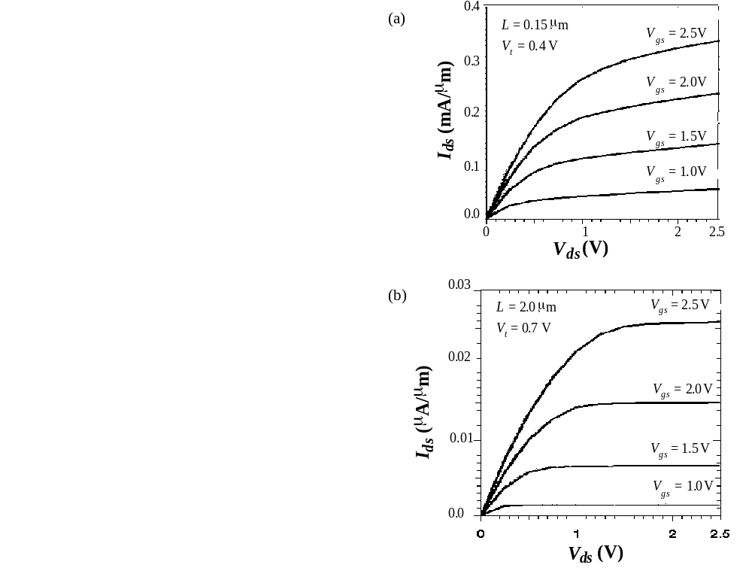
Measured MOSFET IV
What is the main difference between the V_{g} dependence of the long- and short-channel length IV curves?
Modern Semiconductor Devices for Integrated Circuits (C. Hu)
Slide 6-<number>

Slide 40

PMOS and NMOS IV Characteristics
The PMOS IV is qualitatively similar to the NMOS IV, but the current is about half as large. How can we design a CMOS inverter so that its voltage transfer curve is symmetric?
Modern Semiconductor Devices for Integrated Circuits (C. Hu)
Slide 6-<number>

Slide 41
6.9.1 Velocity Saturation vs. Pinch-Off
Current saturation : the carrier velocity reaches V_{sat} at the drain.
Instead of the pinch-off region, there is a velocity saturation region next to the drain where Q_{inv} is a constant (I_{dsat}/W_{vsat}).
Modern Semiconductor Devices for Integrated Circuits (C. Hu)
Slide 6-<number>

Slide 42


6.10 Parasitic Source-Drain Resistance
If I_{dsat0} ∝ V_{g} – V_{t} ,
I_{dsat} can be reduced by about 15% in a 0.1μm MOSFET. Effect is greater in shorter MOSFETs.
V_{dsat} = V_{dsat0} + I_{dsat} (R_{s} + R_{d})
Modern Semiconductor Devices for Integrated Circuits (C. Hu)
Slide 6-<number>

Slide 43
SALICIDE (Self-Aligned Silicide) Source/Drain
contact metal
dielectric spacer
gate
oxide
channel
N
+
source or drain
NiSi
2
or TiSi
2
After the spacer is formed, a Ti or Mo film is deposited. Annealing causes the silicide to be formed over the source, drain, and gate. Unreacted metal (over the spacer) is removed by wet etching.
Question:
What is the purpose of siliciding the source/drain/gate?
What is self-aligned to what?
Modern Semiconductor Devices for Integrated Circuits (C. Hu)
Slide 4-<number>

Slide 44


Definitions of Channel Length
Modern Semiconductor Devices for Integrated Circuits (C. Hu)
Slide 6-<number>

Slide 45




6.11 Extraction of the Series Resistance and the Effective Channel Length
Include series resistance,
R_{ds} ≡ R_{d} + R_{s} ,
Modern Semiconductor Devices for Integrated Circuits (C. Hu)
Slide 6-<number>

Slide 46

6.12 Velocity Overshoot
Velocity saturation should not occur in very short MOSFETs.
This velocity overshoot could lift the limit on Ids .
But…
Modern Semiconductor Devices for Integrated Circuits (C. Hu)
Slide 6-<number>

Slide 47

6.12 Source Velocity Limit
Carrier velocity is limited
by the thermal velocity
with which they enter the
channel from the source.
I_{dsat} = WBv_{thx}Q_{inv}
= WBv_{thx}C_{oxe}(V_{gs} – V_{t})
Similar to
I
=
Wv
C
(
V
−
V
)
dsat
sat
oxe
gs
t
Modern Semiconductor Devices for Integrated Circuits (C. Hu)
Slide 6-<number>

Slide 48

6.13 Output Conductance
I_{dsat} does NOT saturate in the saturation region, especially in short channel devices!
The slope of the I_{ds}-V_{ds} curve in the saturation region is called the output conductance (g_{ds}),
A smaller g_{ds} is desirable for a large voltage gain, which is beneficial to analog and digital circuit applications.
Modern Semiconductor Devices for Integrated Circuits (C. Hu)
Slide 6-<number>

Slide 49



Example of an Amplifier
The transistor operates in the saturation region. A small signal input, v_{in}, is applied.
V_{dd}
R
ν_{out}
ν_{in}
NFET
The voltage gain is g_{msat}/(g_{ds} + 1/R).
A smaller g_{ds} is desirable for large voltage gain.
Maximum available gain (or intrinsic voltage gain) is g_{msat}/g_{ds}
Modern Semiconductor Devices for Integrated Circuits (C. Hu)
Slide 6-<number>

Slide 50


6.14 High-Frequency Performance
High-frequency performance is limited by input R and/or C.
Cutoff frequency (f_{T}) : Frequency at which the output current becomes equal to the input current.
Maximum oscillation frequency (f_{max}) : Frequency at which the power gain drops to unity
Gate-electrode resistance
Intrinsic input resistance
Modern Semiconductor Devices for Integrated Circuits (C. Hu)
Slide 6-<number>

Slide 51


Gate-Electrode Resistance
Drain
Source
Multi-finger layout greatly reduces the gate electrode resistance
Rg-electrode
ρ : resistivity of gate material,
W_{f} : width of each gate finger,
T_{g} : gate thickness,
L_{g} : gate length,
N_{f} : number of fingers.
Modern Semiconductor Devices for Integrated Circuits (C. Hu)
Slide 6-<number>

Slide 52


Intrinsic Input Resistance
G
Rg-electrode
R_{ch}
The gate capacitor current flows through R_{ch} to the source and ground.
Modern Semiconductor Devices for Integrated Circuits (C. Hu)
Slide 6-<number>

Slide 53
6.15 MOSFET Noises
Noise : All that corrupts the signal
External noise:
Inductive and capacitive interferences and cross talks created by wiring
Needs to be controlled with shielding and circuit layout carefully
Fundamental noise:
Noise inherent to the electronic devices.
Due to the random behaviors of the electric carriers inside the device
Modern Semiconductor Devices for Integrated Circuits (C. Hu)
Slide 6-<number>

Slide 54







6.15.1 Thermal Noise of a Resistor
Thermal noise: caused by random thermal motion of the charge carriers
S ( f )
S : noise power density spectrum
f
Modern Semiconductor Devices for Integrated Circuits (C. Hu)
Slide 6-<number>

Slide 55






6.15.2 MOSFET Thermal Noise
G
S
D
G
S
D
Parasitic-resistance noise
B
Modern Semiconductor Devices for Integrated Circuits (C. Hu)
Slide 6-<number>

Slide 56



6.15.3 MOSFET Flicker Noise
Charge trapping and releasing by a single oxide trap generate Random Telegraph Noise
Many traps produce a 1/f power density spectrum. 1/f noise
Modern Semiconductor Devices for Integrated Circuits (C. Hu)
Slide 6-<number>

Slide 57



6.15.4 Signal to Noise Ratio, Noise Factor, Noise Figure
SNR: Signal power noise power.
Decibel or dB:10 times the base-10 logarithm of the noise power.
Noise factor: The ratio of the input SNR and output SNR.
Modern Semiconductor Devices for Integrated Circuits (C. Hu)
Slide 6-<number>

Slide 58
6.16 Memory Devices
 | Keep data without power? | Cell size and cost/bit | Rewrite cycles | Write-one-byte speed | Compatible with basic CMOS fabrication | Main applications
SRAM | No | Large | Unlimited | Fastest | Totally | Embedded in logic chips
DRAM | No | Small | Unlimited | Fast | Needs modification | Stand-alone main memory
Flash memory (NVM) | Yes | Smallest | Limited | Slow | Needs extensive modification | Nonvolatile data and code storage
Modern Semiconductor Devices for Integrated Circuits (C. Hu)
Slide 6-<number>

Slide 59


6.16.1 SRAM
>Fastest among all memories. >Totally CMOS compatible. >Cost per bit is the highest-- uses 6 transistors to store one bit of data.
Modern Semiconductor Devices for Integrated Circuits (C. Hu)
Slide 6-<number>

Slide 60

6.16.2 DRAM
DRAM capacitor can only hold the data (charge) for a limited time because of leakage current.
Word-line 1
Word-line 2
Bit-line 1
Needs refresh.
Bit-line 2
Needs ~10fF C in a small and shrinking area -- for refresh time and error rate.
Modern Semiconductor Devices for Integrated Circuits (C. Hu)
Slide 6-<number>

Slide 61


6.16.2 DRAM capacitor technology
Stacked capacitor and Trench capacitor
Modern Semiconductor Devices for Integrated Circuits (C. Hu)
Slide 6-<number>

Slide 62



6.16.3 Nonvolatile (Flash) Memory
Floating gate (poly-Si)
Charge trap (SONOS)
Nanocrystal
Modern Semiconductor Devices for Integrated Circuits (C. Hu)
Slide 6-<number>

Slide 63



Phase Change Memory
Alloy of Ge, Sb, Te has high resistivity in amorphous phase and low resistivity in polycrystalline phase.
Modern Semiconductor Devices for Integrated Circuits (C. Hu)
Slide 6-<number>

Slide 64


3D (Multi-layer) Memory
Epitaxy from seed windows can produce Si layers.
Ideally memory element is simple and does not need single-crystalline material.
Modern Semiconductor Devices for Integrated Circuits (C. Hu)

Slide 65

Resistive Memory (RRAM)
-- Organic, inorganic, metallic.. material
-- Future extension to 3-D
Modern Semiconductor Devices for Integrated Circuits (C. Hu)

Slide 66




6.17 Chapter Summary
propagation delay
Power Consumption
body effect
for steep retrograde body doping
Modern Semiconductor Devices for Integrated Circuits (C. Hu)
Slide 6-<number>

Slide 67


6.17 Chapter Summary
basic I_{ds} model
Small α and m are desirable. Therefore, small T_{oxe} is good.
Ch.7 shows that large W_{dmax} is not acceptable.
CMOS circuit speed is determined by CV_{dd}/I_{dsat} , and its power by CV_{dd}²f + V_{dd}I_{off} .
Modern Semiconductor Devices for Integrated Circuits (C. Hu)
Slide 6-<number>

Slide 68


6.17 Chapter Summary
IV characteristics can be divided into a linear region
and a saturation region.
I_{ds} saturates at:
transconductance:
Considering velocity saturation,
−
1
long
-
channel
I
⎛
m
1
⎞
I
=
dsat
V
=
⎜
+
⎟
dsat
V
−
V
dsat
⎜
V
−
V
E
L
⎟
1
+
gs
t
⎝
gs
t
sat
⎠
mE
L
sat
Modern Semiconductor Devices for Integrated Circuits (C. Hu)
Slide 6-<number>

Slide 69


6.17 Chapter Summary
At very small L
I
=
Wv
C
(
V
−
V
)
dsat
sat
oxe
gs
t
Velocity overshoot can lift v_{sat} , but source velocity limit sets a similar top over I_{dsat} .
I_{dsat} = WBv_{thx}C_{oxe}(V_{gs} – V_{t})
Intrinsic voltage gain is g_{msat}/g_{ds}
High f_{T} and f_{MAX} need low
Noise arises from the channel, gate, substrate thermal noises, and the flicker noise.
Modern Semiconductor Devices for Integrated Circuits (C. Hu)
Slide 6-<number>

Slide 70

6.17 Chapter Summary
SRAM, DRAM, Nonvolatle memory
Modern Semiconductor Devices for Integrated Circuits (C. Hu)
Slide 6-<number>

