Slide 1
Chapter 7 MOSFETs in ICs – Scaling,
Leakage, and Other Topics
7.1 Technology Scaling
- for Cost, Speed, and Power Consumption
  New technology node every two years or so. Defined by minimum line width-spacing average.
  Feature sizes are ~70% of previous node’s.
  Reduction of circuit area by 2 ― good for cost and speed.
YEAR | 1992 | 1995 | 1997 | 1999 | 2001 | 2003 | 2005 | 2007
Technology Generation | 0.5 μm | 0.35 μm | 0.25 μm | 0.18 μm | 0.13 μm | 90 nm | 65 nm | 45 nm
Modern Semiconductor Devices for Integrated Circuits (C. Hu)
Slide 7-<number>

Slide 2
International Technology Roadmap for Semiconductors
Year of Shipment | 2003 | 2005 | 2007 | 2010 | 2013
Technology Node (nm) | 90 | 65 | 45 | 32 | 22
Lg (nm) (HP/LSTP) | 37/65 | 26/45 | 22/37 | 16/25 | 13/20
EOT_{e}(nm) (HP/LSTP) | 1.9/2.8 | 1.8/2.5 | 1.2/1.9 | 0.9/1.6 | 0.9/1.4
VDD (HP/LSTP) | 1.2/1.2 | 1.1/1.1 | 1.0/1.1 | 1.0/1.0 | 0.9/0.9
Ion,HP (μA/μm) | 1100 | 1210 | 1500 | 1820 | 2200
Ioff,HP (μA/μm) | 0.15 | 0.34 | 0.61 | 0.84 | 0.37
Ion,LSTP (μA/μm) | 440 | 465 | 540 | 540 | 540
Ioff,LSTP (μA/μm) | 1e-5 | 1e-5 | 3e-5 | 3e-5 | 2e-5
Strained Silicon
High-k/Metal-Gate
Wet Lithography
New Structure
V_{dd} is reduced at each node to contain power consumption in spite of rising transistor density and frequency
T_{ox} is reduced to raise I_{on} and retain good transistor behaviors
HP: High performance; LSTP: Low stand-by power
Modern Semiconductor Devices for Integrated Circuits (C. Hu)
Slide 7-<number>

Slide 3
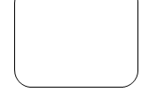
7.1.2 Strained Silicon: example of innovations
Gate
Mechanical strain
Trenches filled with epitaxial SiGe
S
D
N-type Si
The electron and hole mobility can be raised by carefully designed mechanical strain.
Modern Semiconductor Devices for Integrated Circuits (C. Hu)
Slide 7-<number>

Slide 4
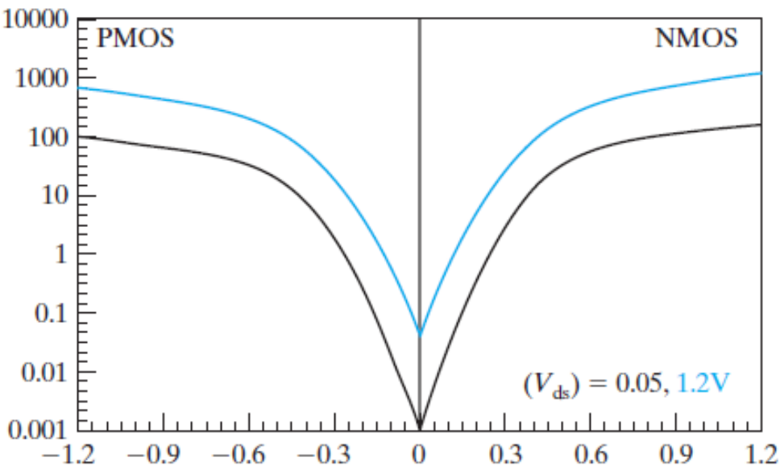
7.2 Subthreshold Current
The leakage current that flows at V_{g}<V_{t} is called the subthreshold current.
)
m
μ
/
A
Intel, T. Ghani et al., IEDM 2003
μ
90nm technology. Gate length: 45nm
(
s
I
d
V_{t}
V_{t}
V_{gs}
The current at V_{gs}=0 and V_{ds}=V_{dd} is called I_{off.}
Modern Semiconductor Devices for Integrated Circuits (C. Hu)
Slide 7-<number>

Slide 5
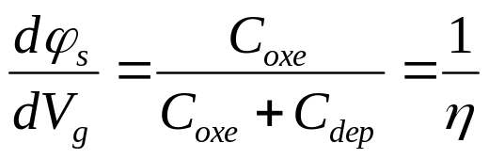
Subthreshold current ∝ n_{s} (surface inversion carrier concentration)
n_{s} ∝ e^{qϕs/kT}
ϕ
S
E_{f}
E_{f}, E_{c}
V_{gs}
ϕ_{s} varies with V_{g} through a capacitor network
V_{g}
C_{ox}
ψ_{S}
C_{dep}
In subthreshold, ϕ_{s} = constant +V_{g}/η
Modern Semiconductor Devices for Integrated Circuits (C. Hu)
Slide 7-<number>

Slide 6
Subthreshold Leakage Current
(
+
) /
I
∝
n
∝
e
q
ϕ
/
kT
∝
e
q
constant
V
gs
/
η
kT
∝
e
qV
gs
/
η
kT
s
ds
s
V_{G}
I
∝
e
qV
gs
/
η
kT
ds
C_{ox}
ϕ_{s}
C_{dep}
C
η = 1 +
dep
C
oxe
Subthreshold current changes 10x for η·60mV change in V_{g.} Reminder: 60mV is (ln10)·kT/q
Subthreshold swing, S : the change in V_{gs} corresponding to 10x change in subthreshold current. S = η·60mV, typically 80-100mV
Modern Semiconductor Devices for Integrated Circuits (C. Hu)
Slide 7-<number>

Slide 7
Subthreshold Leakage Current
Practical definition of V_{t} : the V_{gs} at which I_{ds}= 100nA×W/L
=>
W
q
(
V
−
V
)
/
η
kT
W
(
−
)
I
(
nA
)
≈
100
⋅
⋅
e
g
t
=
100
⋅
⋅
10
V
g
V
t
/
S
subthreshold
L
L
Log (I_{ds} )
V_{ds}=V_{dd}
I_{off} (nA) =
W
100
⋅
⋅
10
−
V
t
/
S
100×W/L(nA)
L
1/S
is determined only by V_{t} and subthreshold swing.
I_{off}
V_{t}
V_{gs}
Modern Semiconductor Devices for Integrated Circuits (C. Hu)
Slide 7-<number>

Slide 8
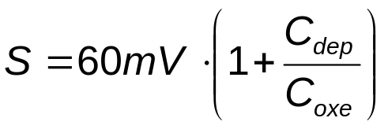
Subthreshold Swing
Smaller S is desirable (lower I_{off} for a given V_{t}). Minimum possible value of S is 60mV/dec.
How do we reduce swing?
  Thinner T_{ox} => larger C_{oxe}
  Lower substrate doping => smaller C_{dep}
  Lower temperature
Limitations
  Thinner T_{ox} ― oxide breakdown reliability or oxide leakage current
  Lower substrate doping ― doping is not a free parameter but set by V_{t}.
Modern Semiconductor Devices for Integrated Circuits (C. Hu)
Slide 7-<number>

Slide 9
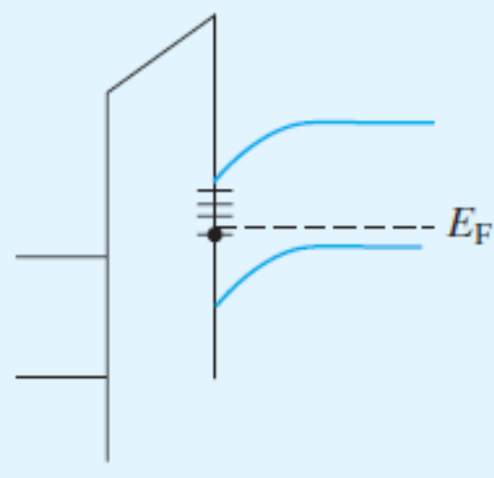
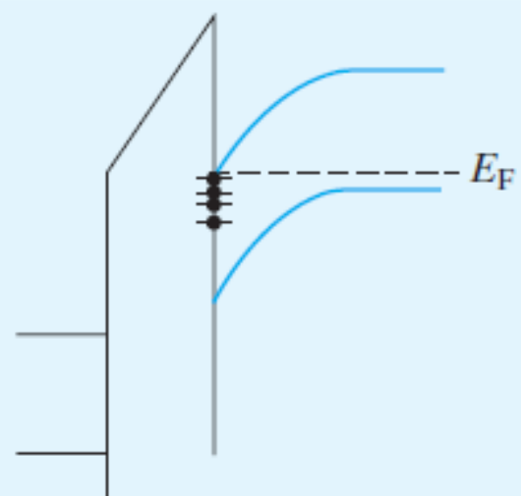

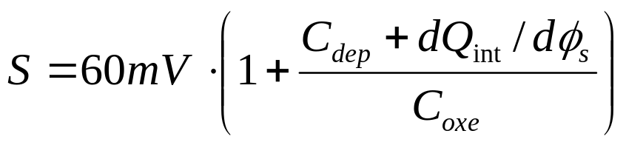
Effect of Interface States on Subthreshold Swing
V_{g1}
V_{g2}>V_{g1}
Interface states may be filled by electrons or empty depending on its energy relative to E_{F}, i.e., depending on V_{g}.
dQ_{int}/d (number or interface state per eV-cm²) presents another capacitance in
parallel with C_{dep}
Modern Semiconductor Devices for Integrated Circuits (C. Hu)
Slide 7-<number>

Slide 10
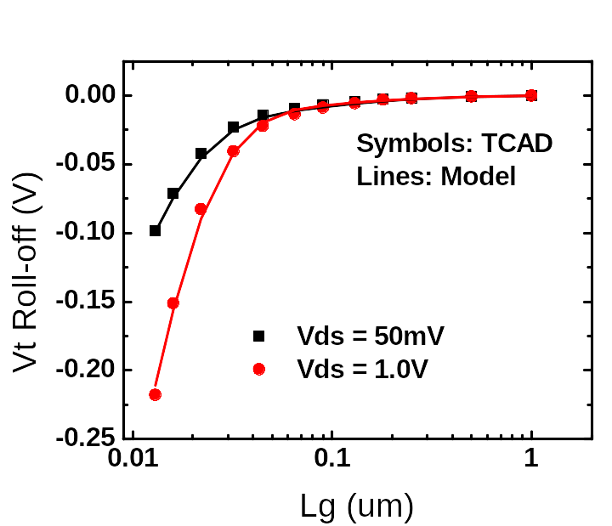
7.3 V_{t} Roll-off
V_{t} roll-off: V_{t} decreases with decreasing L_{g}.
It determines the minimum acceptable L_{g} because I_{off} is too large if V_{t} becomes too small.
K. Goto et al., (Fujitsu) IEDM 2003
65nm technology. EOT=1.2nm, V_{dd}=1V
Question: Why data is plotted against L_{g}, not L?
Answer: L is difficult to measure. L_{g} is. Also, L_{g} is the quantity that manufacturing engineers can control directly.
Modern Semiconductor Devices for Integrated Circuits (C. Hu)
Slide 7-<number>

Slide 11
Why Does V_{t} Decrease with L?― Potential Barrier Concept
Long Channel
V_{gs}=0V
E_{c}
V_{g}=0V
V_{ds}
N⁺ Source
N⁺ Drain
V_{gs}=V_{t-long}
V_{g}=V_{t}
~0.2V
When L is small, smaller V_{g} is needed to reduce the barrier to 0.2V, i.e. V_{t} is smaller.
V_{t} roll-off is greater for shorter L
Modern Semiconductor Devices for Integrated Circuits (C. Hu)
Slide 7-<number>

Slide 12
Energy-Band Diagram from Source to Drain
L dependence
source/channel
barrier
long channel
V_{ds}
short channel
V_{ds} dependence
log(I_{ds})
long channel
V_{ds}=0
V_{ds}=0
V_{ds}
V_{ds}=V_{dd}
V_{ds}=V_{dd}
short channel
V_{gs}
Modern Semiconductor Devices for Integrated Circuits (C. Hu)
Slide 7-<number>

Slide 13
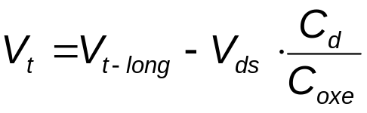
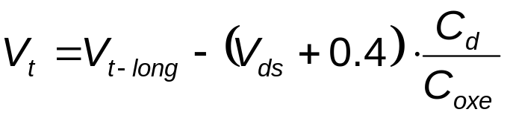
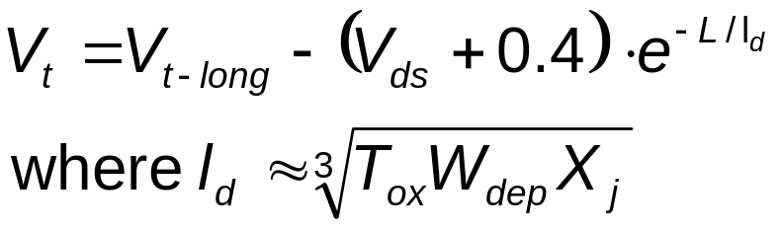
V_{t} Roll-off – Simple Capacitance Model
V_{ds} helps V_{gs} to invert the surface, therefore
V_{gs}
T_{ox}
C_{oxe}
V_{ds}
n+
W_{dep}
X_{j}
C_{d}
Due to built-in potential between N⁻ channel and N⁺ drain & source
P-Sub
2-D Poisson Eq. solution shows that C_{d} is an exponential function of L.
As the channel length is reduced, drain to channel distance is reduced→ C_{d} increases
Modern Semiconductor Devices for Integrated Circuits (C. Hu)
Slide 7-<number>

Slide 14
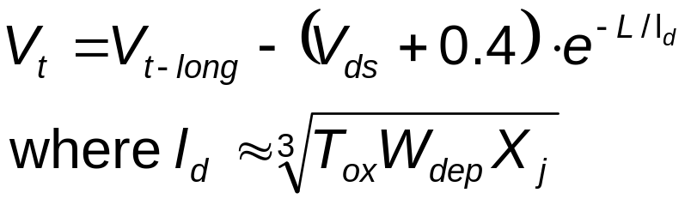
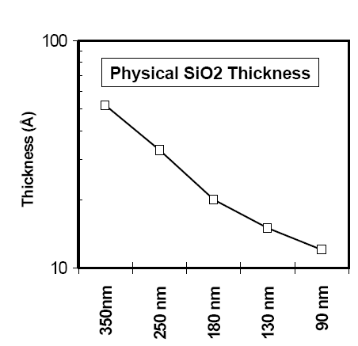
Vertical dimensions (T_{ox}, W_{dep}, X_{j}) must be scaled to support L reduction
Modern Semiconductor Devices for Integrated Circuits (C. Hu)
Slide 7-<number>

Slide 15
7.4 Reducing Gate-Insulator Electrical Thickness and Tunneling Leakage
Oxide thickness has been reduced over the years from 300nm to 1.2nm.
Why reduce oxide thickness?
  Larger C_{ox} to raise I_{on}
  Reduce subthreshold swing
  Control V_{t} roll-off
Thinner is better. However, if the oxide is too thin
  Breakdown due to high field
  Leakage current
Modern Semiconductor Devices for Integrated Circuits (C. Hu)
Slide 7-<number>

Slide 16
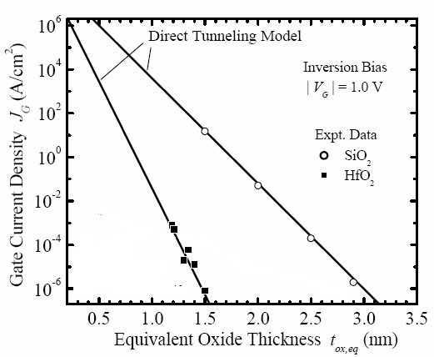
Gate Tunneling Leakage Current
For SiO₂ films thinner than 1.5nm, tunneling leakage current has become the limiting factor.
HfO₂ has several orders lower leakage for the same EOT.
Modern Semiconductor Devices for Integrated Circuits (C. Hu)
Slide 7-<number>

Slide 17
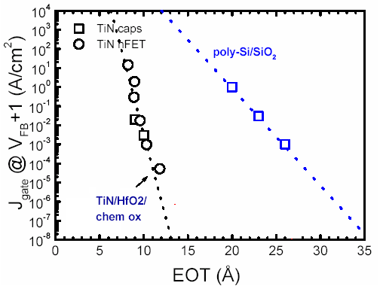
Replacing SiO₂ with HfO₂---High-k Dielectric
(After W. Tsai et al., IEDM’03)
HfO₂ has a relative dielectric constant (k) of ~24, six times large than that of SiO₂.
For the same EOT, the HfO₂ film presents a much thicker (albeit a lower) tunneling barrier to the electrons and holes.
Toxe can be further reduced by introducing metal-gate technology since the poly-depletion effect is eliminated.
Modern Semiconductor Devices for Integrated Circuits (C. Hu)
Slide 7-<number>

Slide 18
Challenges of High-K Technology
The difficulties of high-k dielectrics:
  chemical reactions between them and the silicon substrate and gate,
  lower surface mobility than the Si/SiO₂ system
  too low a V_{t} for P-channel MOSFET (as if there is positive charge in the high-k dielectric).
  long-term reliability
A thin SiO₂ interfacial layer may be inserted between Si-substrate and high-k film.
Question: How can T_{inv} be reduced?
(Answer is in Sec. 7.4 text)
Modern Semiconductor Devices for Integrated Circuits (C. Hu)
Slide 7-<number>

Slide 19
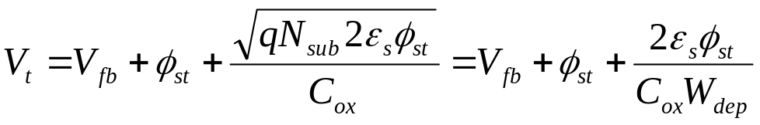
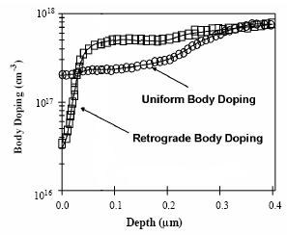
7.5 How to Reduce W_{dep}
W_{dep} can be reduced by increasing N_{sub}
  If N_{sub} is increased, C_{ox} has to be increased in order to keep V_{t} the same.
  W_{dep} can be reduced in proportion to T_{ox}.
Or use retrograde doping with very thin lightly doped surface layer
  Also, less impurity scattering in the inversion layer → higher mobility
Modern Semiconductor Devices for Integrated Circuits (C. Hu)
Slide 7-<number>

Slide 20
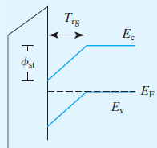

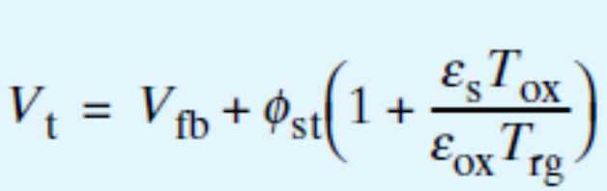
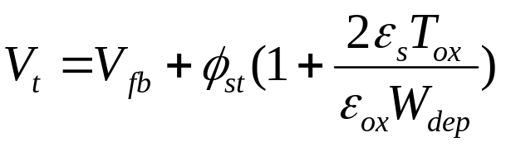
7.5 Ideal Retrograde Doping Profile
Assume the body is heavily doped with an undoped layer, T_{rg} thick, at the surface.
Compared with uniformly doped body
Ideal retrograde doping yields a depletion region width (T_{rg}) half as thick as W_{dep} of a uniform doped body.
Modern Semiconductor Devices for Integrated Circuits (C. Hu)
Slide 7-<number>

Slide 21
7.6 Shallow Junction and Metal Source/Drain
contact metal
dielectric spacer
gate
oxide
channel
shallow junction
extension
Deep
S/D
silicide
The shallow junction extension helps to control V_{t} roll-off.
Shallow junction and light doping combine to produce an undesirable parasitic resistance that reduces the precious I_{on.}
Theoretically, metal S/D can be used as a very shallow “junction”.
Modern Semiconductor Devices for Integrated Circuits (C. Hu)
Slide 7-<number>

Slide 22
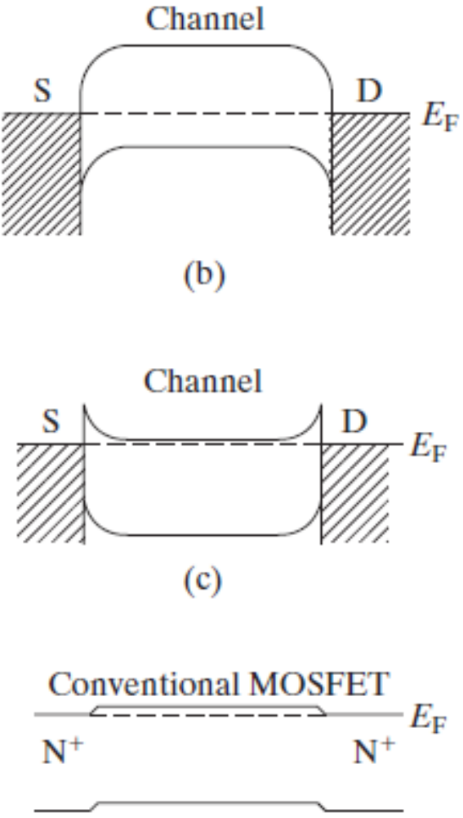
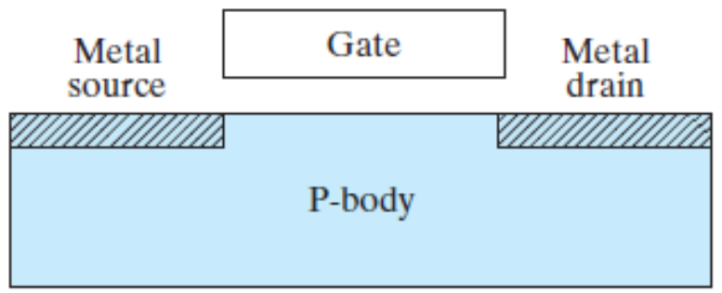

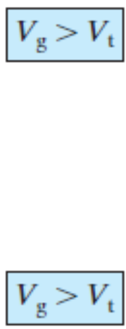


7.6.1 MOSFET with Metal Source/Drain
To unleash the potentials of Schottky S/D MOSFET, a low- Schottky junction is needed for NFETs and low- for PFET.
Modern Semiconductor Devices for Integrated Circuits (C. Hu)
Slide 7-<number>

Slide 23
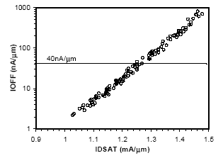
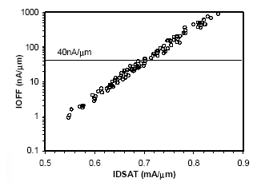
7.7 Variations and Design for Manufacturing
NMOS
PMOS
Intel, T. Ghani et al., IEDM 2003
Higher I_{on} goes hand-in-hand with larger I_{off} -- think L, V_{t}, T_{ox}, V_{dd}.
Figure shows spread in I_{on} (and I_{off}) produced by intentional difference in L_{g} and unintentional manufacturing variatons in L_{g} and other parameters.
Modern Semiconductor Devices for Integrated Circuits (C. Hu)
Slide 7-<number>

Slide 24
Variation Tolerant Circuit Design
Multiple V_{t}
  Lower V_{t} is used only in the blocks that need speed
Multiple V_{dd}
  Higher V_{dd} is used only in the blocks that need speed
Substrate (well) bias
  Only some circuit blocks need to operate at high speed.
  Can use reverse well bias to raise the V_{t} for the rest.
  This techniques can also reduce the chip-to-chip and block-to-block variations with intelligent control circuitry.
  Would like larger body effect than conventional MOSFET.
Modern Semiconductor Devices for Integrated Circuits (C. Hu)
Slide 7-<number>

Slide 25
7.8 Ultra-Thin-Body SOI and Multigate MOSFETs
Reducing T_{ox} gives the gate excellent control of Si surface potential.
But, the drain could still have more control than the gate along sub-surface leakage current paths. (Right figure.)
V_{gs}
V_{gs}
T_{ox}
C_{g}
V_{ds}
V_{ds}
S
D
S
C_{g}
C_{d}
D
C_{d}
P-Sub
leakage path
Modern Semiconductor Devices for Integrated Circuits (C. Hu)
Slide 7-<number>

Slide 26
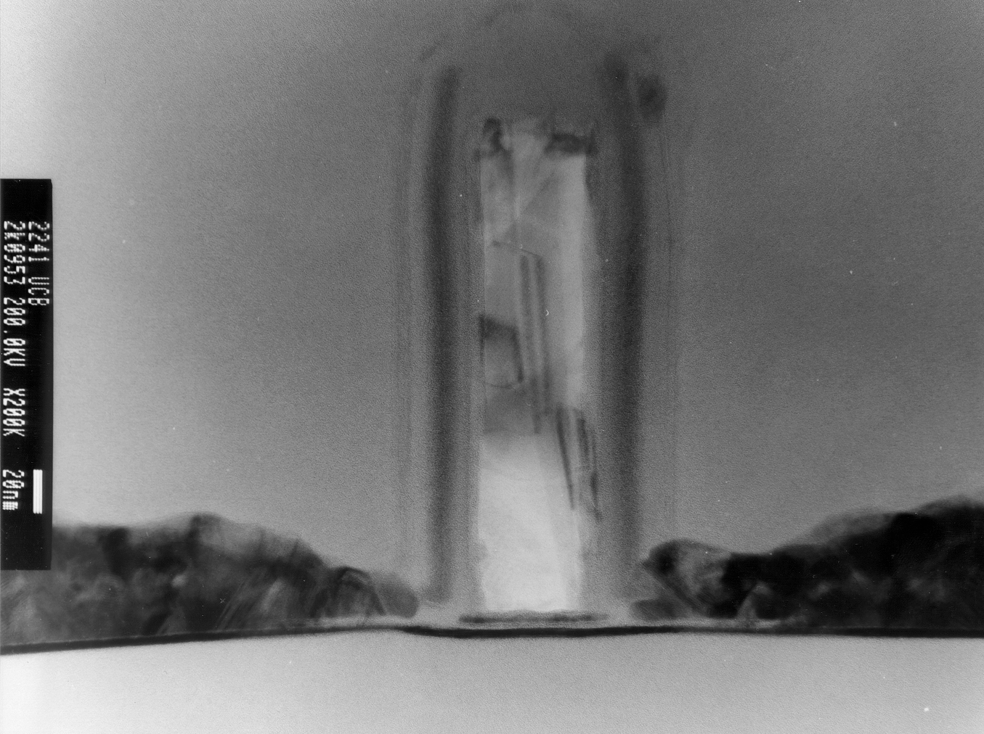
7.8.1 Ultra-Thin-Body MOSFET and SOI
UTB MOSFET built on ultra thin silicon film on an insulator (SiO₂).
Since the silicon film is very thin, perhaps less than 10nm, no leakage path is very far from the gate.
Electron Micrograph of UTB MOSFET
Gate
N⁺
N⁺
Gate
SiO₂
Source
Drain
SiO₂
Si
T_{Si} = 3 nm
Modern Semiconductor Devices for Integrated Circuits (C. Hu)
Slide 7-<number>

Slide 27
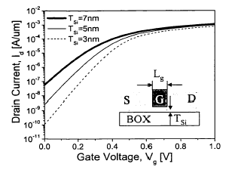
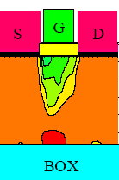
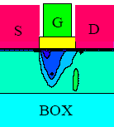


Ultra-Thin-Body MOSFET
The subthreshold leakage is reduced as the silicon film is made thinner.
T_{ox}=1.5nm, N_{sub}=1e15cm⁻³, V_{dd}=1V, V_{gs}=0
Modern Semiconductor Devices for Integrated Circuits (C. Hu)
Slide 7-<number>

Slide 28
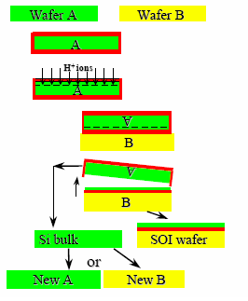
Producing Silicon-on-Insulator (SOI) Substrates
Initial Silicon wafer A and B
Oxidize wafer A to grow SiO2
Implant hydrogen into wafer A
Place wafer A, upside down, over wafer B.
A low temperature annealing causes the two wafers to fuse together.
Apply another annealing step to for H₂ bubbles and split wafer A.
Polish the surface and the SOI wafer is ready for use.
Wafer A can be reused.
Modern Semiconductor Devices for Integrated Circuits (C. Hu)
Slide 7-<number>

Slide 29
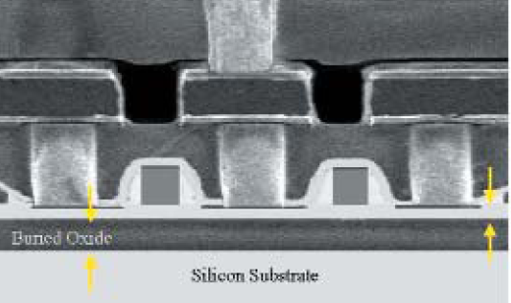
Cross-Section of SOI Circuits
Si
Buried Oxide
Si substrate
Due to the high cost of SOI wafers, only some microprocessors, which command high prices and compete on speed, have embraced this technology.
In order to benefit from the UTB concept, Si film thickness must be agreesively reduced to ~ Lg/4
Modern Semiconductor Devices for Integrated Circuits (C. Hu)
Slide 7-<number>

Slide 30
7.8.2 Multi-gate MOSFET and FinFET
The second way of eliminating deep leakage paths is to provide gate control from more than one side of the channel.
The Si film is very thin so that no leakage path is far from one of the gates.
Because there are more than one gates, the structure may be called multi-gate MOSFET.
Gate 1
V_{g}
Source
Si
Drain
T_{Si}
T_{ox}
Gate 2
double-gate MOSFET
Modern Semiconductor Devices for Integrated Circuits (C. Hu)
Slide 7-<number>

Slide 31
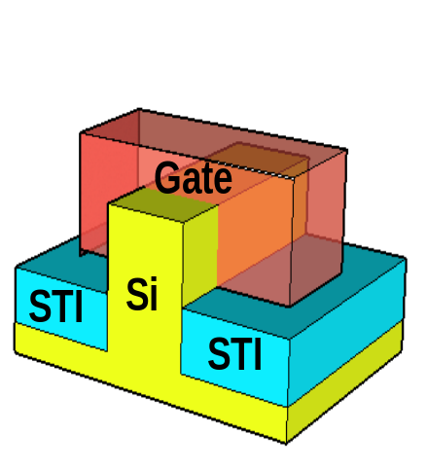
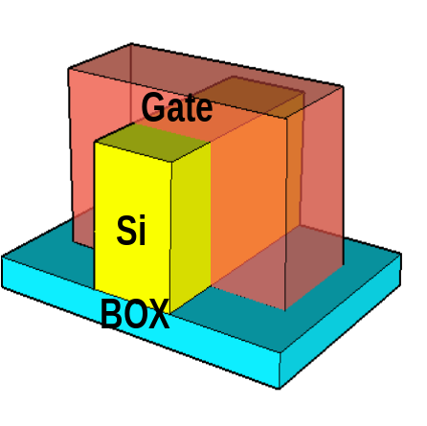
FinFET
Drain
Gate
Source
One multi-gate structure, called FinFET, is particularly attractive for its simplicity of fabrication.
The channel consists of the two vertical surfaces and the top surface of the fin.
Question: What is the channel width, W?
Answer: The sum of twice the fin height and the width of the fin.
L_{g}
Source
SOI FinFET
Bulk FinFET
Modern Semiconductor Devices for Integrated Circuits (C. Hu)
Slide 7-<number>

Slide 32
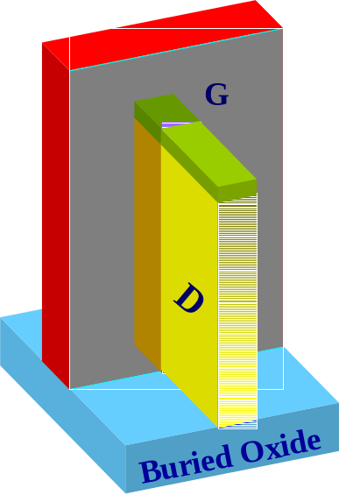
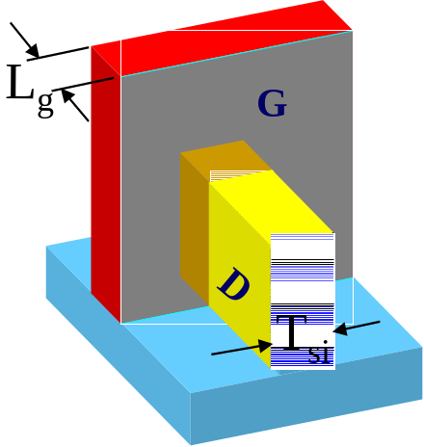
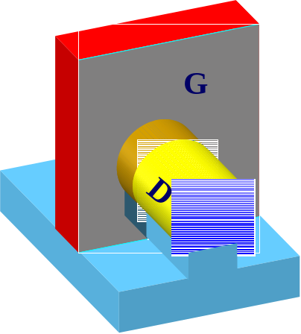
Variations of FinFET
Tall FinFET
Short FinFET
Nanowire FinFET
Tall FinFET has the advantage of providing a large W and therefore large I_{on} while occupying a small footprint.
Short FinFET has the advantage of less challenging lithography and etching.
Nanowire FinFET gives the gate even more control over the silicon wire by surrounding it.
Modern Semiconductor Devices for Integrated Circuits (C. Hu)
Slide 7-<number>

Slide 33
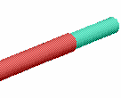
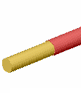
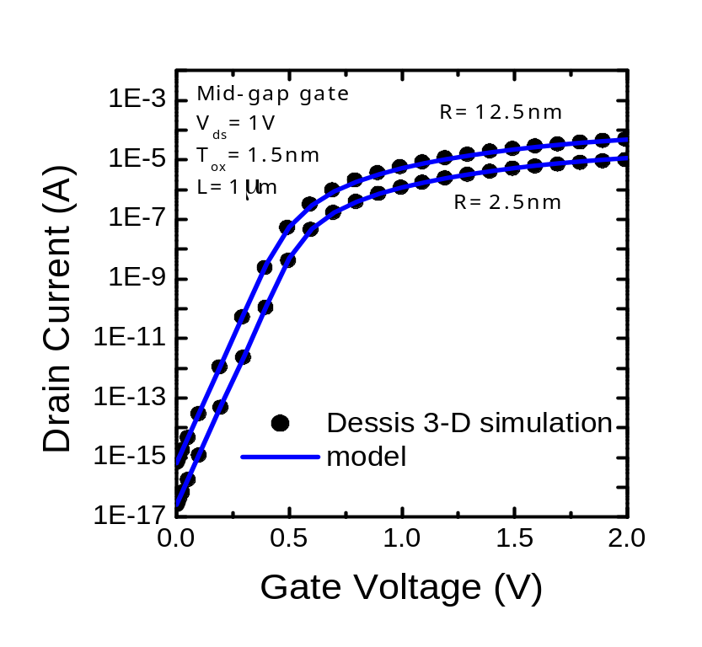
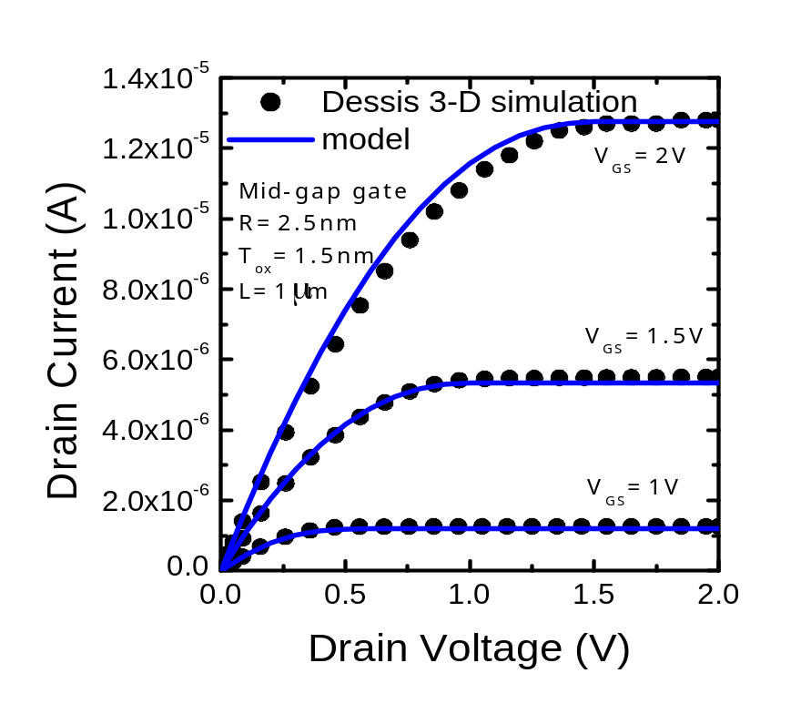
I-V of a Nanowire “Multi-Gate” MOSFET
Gate
Drain
Source
Modern Semiconductor Devices for Integrated Circuits (C. Hu)
Slide 7-<number>

Slide 34
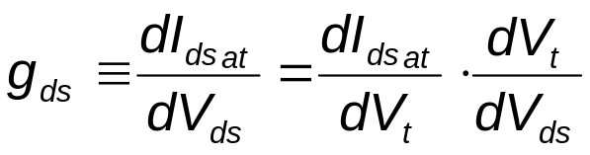
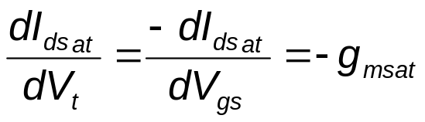
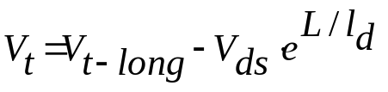
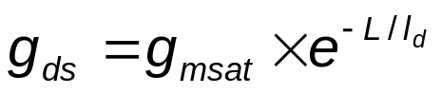
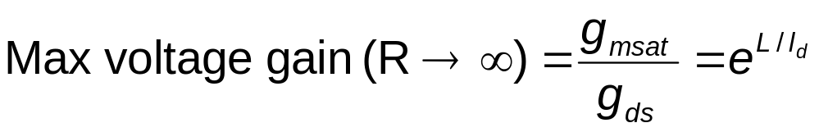
What Parameters Determine the g_{ds} ?
7.9 Output Conductance
dV
=
−
L
/
l
and
T
e
d
dV
ds
I_{dsat} is a function of V_{gs}-V_{t}
(From Eq. 7.3.3, )
A larger L or smaller l_{d} , i.e. smaller Tox, Wdep, Xj, can increase the maximum voltage gain.
The cause is “V_{t} dependence on V_{ds}”in short channel transistors.
Modern Semiconductor Devices for Integrated Circuits (C. Hu)
Slide 7-<number>

Slide 35
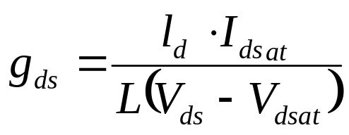
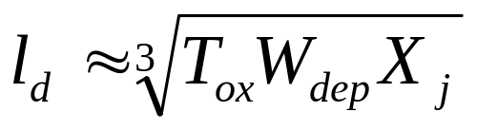
Channel Length Modulation
For large L and V_{ds} close to V_{dsat}, another mechanism may dominate g_{ds}. That is channel length modulation.
V_{ds}-V_{dsat}, is dissipated over a short distance next to drain, causing the “channel length” to decrease. More with increasing V_{ds}.
V_{d}>V_{dsat}
ΔL
V_{c}=V_{dsat}
Modern Semiconductor Devices for Integrated Circuits (C. Hu)
Slide 7-<number>

Slide 36
7.10 Device and Process Simulation
Device Simulation
  Commercially available computer simulation tools can solve all the equations presented in this book simultaneously with few or no approximations.
  Device simulation provides quick feedback about device design before long and expensive fabrication.
Process Simulation
  Inputs to process simulation: lithography mask pattern, implantation dose and energy, temperatures and times for oxidization and annealing steps, etc.
  The process simulator generates a 2-D or 3-D structures with all the deposited or grown and etched thin films and doped regions.
  This output may be fed into a device simulator as input together with applied voltages.
Modern Semiconductor Devices for Integrated Circuits (C. Hu)
Slide 7-<number>

Slide 37
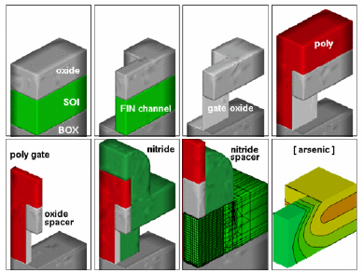
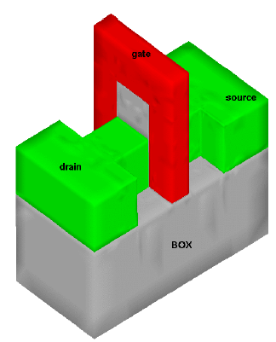
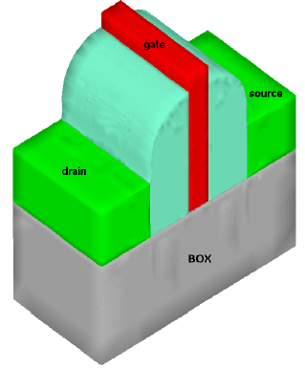
Example of Process Simulation
FinFET Process
The small figures only show 1/4 of the complete FinFET--the quarter farthest from the viewer.
Manual, Taurus Process, Synoposys Inc.
Modern Semiconductor Devices for Integrated Circuits (C. Hu)
Slide 7-<number>

Slide 38



Example of Device Simulation---
Density of Inversion Charge in the Cross-Section of a FinFET Body
D
G
S
C.-H. Lin et al., 2005 SRC TECHCON
Tall FinFET
Short FinFET
The inversion layer has a significant thickness (T_{ch}).
There are more more subthreshold inversion electrons at the corners.
Modern Semiconductor Devices for Integrated Circuits (C. Hu)
Slide 7-<number>

Slide 39
7.11 MOSFET Compact Modeling for Circuit Simulation
For circuit simulation, MOSFETs are modeled with analytical equations.
Device model is the link between technology/manufacturing and design/product. The other link is design rules.
Circuits are designed A. through circuit simulations or B. using cell libraries that have been carefully designed beforehand using circuit simulations.
BSIM is the first industry standard MOSFET model. It contains all the models presented in these chapters and more.
Modern Semiconductor Devices for Integrated Circuits (C. Hu)
Slide 7-<number>

Slide 40


Examples of BSIM Model Results
Modern Semiconductor Devices for Integrated Circuits (C. Hu)
Slide 7-<number>

Slide 41


Example of BSIM Model Results
Modern Semiconductor Devices for Integrated Circuits (C. Hu)
Slide 7-<number>

Slide 42


Example of BSIM Model Results
Modern Semiconductor Devices for Integrated Circuits (C. Hu)
Slide 7-<number>

Slide 43




7.12 Chapter Summary
The major component of I_{off} is the subthreshold current
V_{t} decreases with L, a fact known as V_{t} roll-off, caused by drain-induced barrier lowering (DIBL).
Output conductance of short channel transistors
Modern Semiconductor Devices for Integrated Circuits (C. Hu)
Slide 7-<number>

