Slide 1
ECE 105: Introduction to Electrical Engineering
Lecture 13
Bio 3
Yasser Khan
Rehan Kapadia

Slide 2
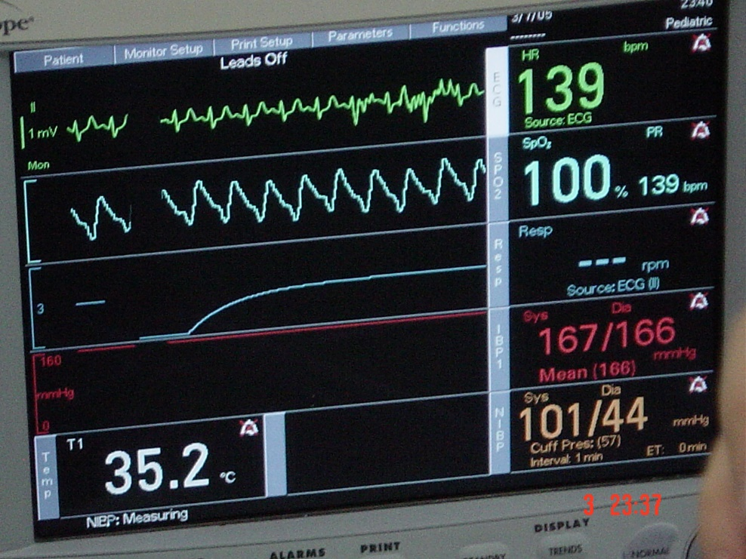
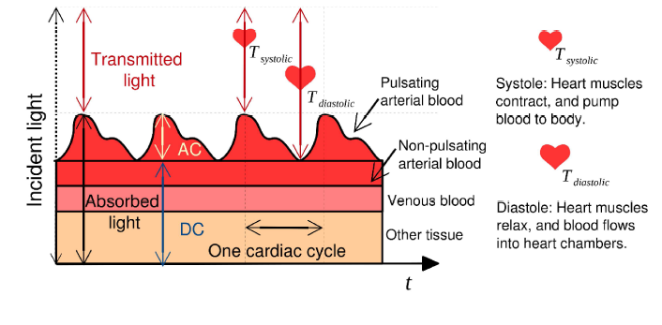
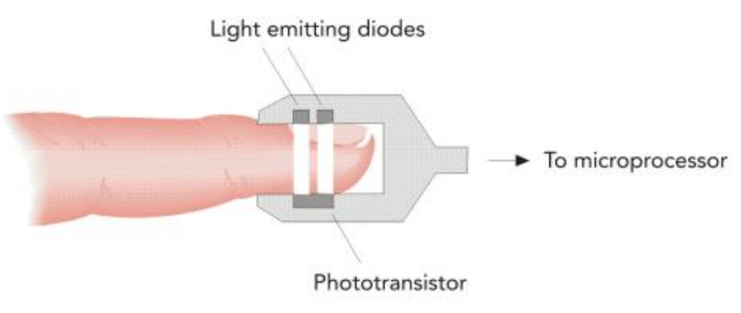
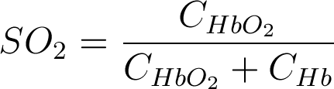
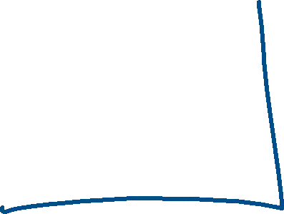

Pulse oximetry
ECG
Pulse oximetry measures blood oxygenation. Using spectrophotometry of absorptivity of blood at two distinct wavelengths, blood oxygen saturation is quantified.
Can detect hypoxemia, ie. lower than normal blood oxygenation.
Pulse Ox
Respiration
Blood
Pressure
Temperature
SO₂ The saturation of oxygen in blood,
C_{HbO2} Concentration of oxygenated hemoglobin (HbO₂),
C_{Hb} Concentration of deoxygenated hemoglobin (Hb).

Slide 3
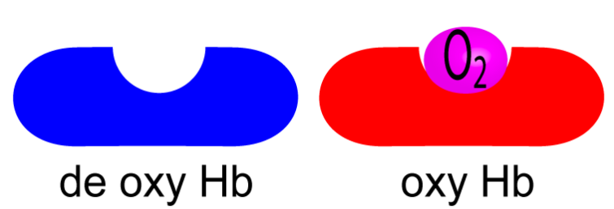
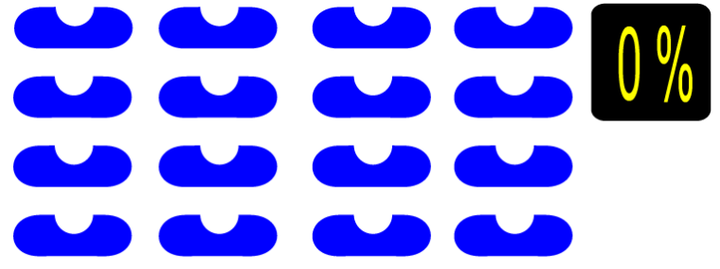
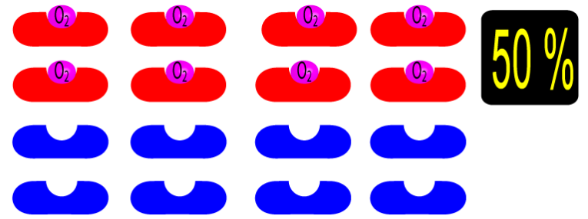

Oxy and deoxy-hemoglobin

Slide 4
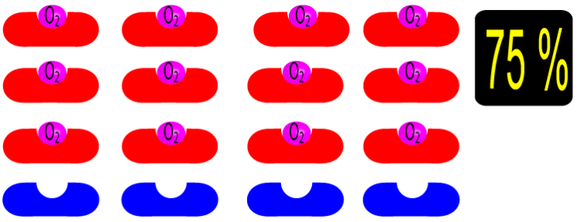
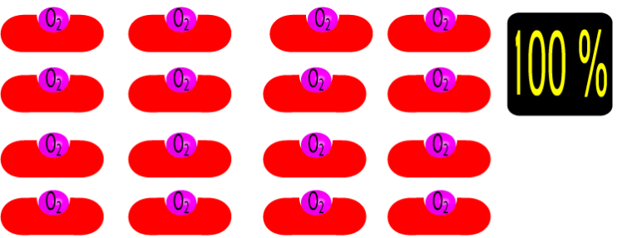


Oxy and deoxy-hemoglobin

Slide 5
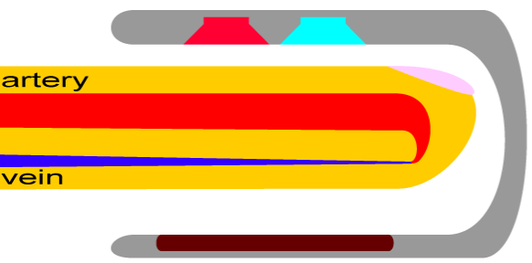
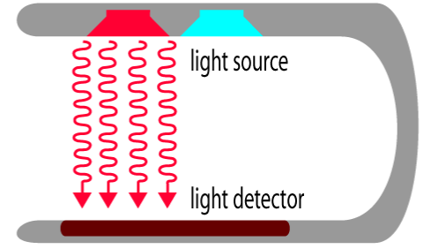






Transmission-mode oximetry

Slide 6
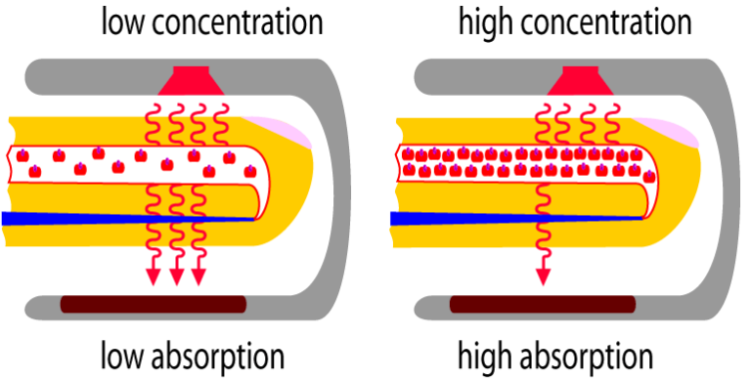
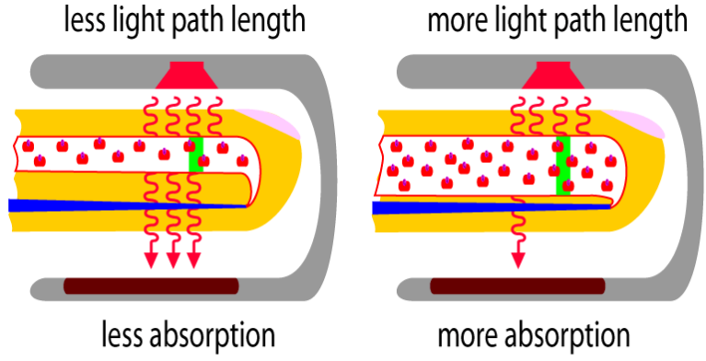




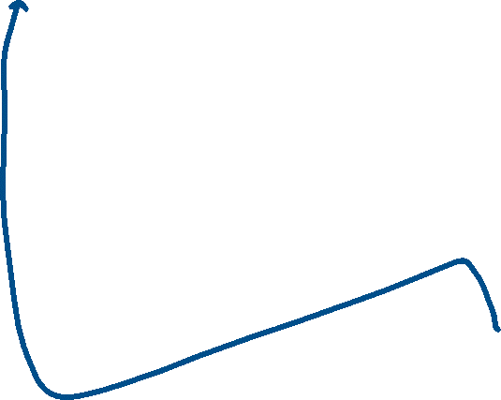


How the transmitted light is changing

Slide 7
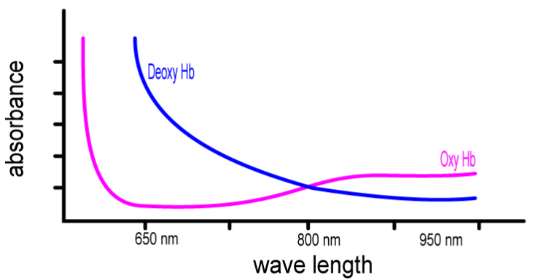




Oxy and de-oxy abs.

Slide 8
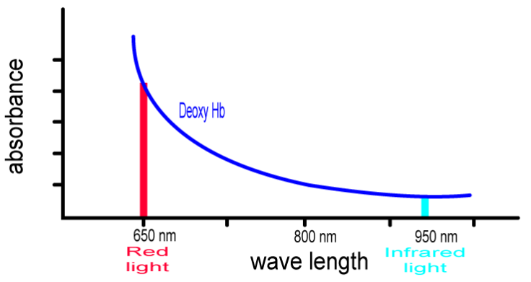
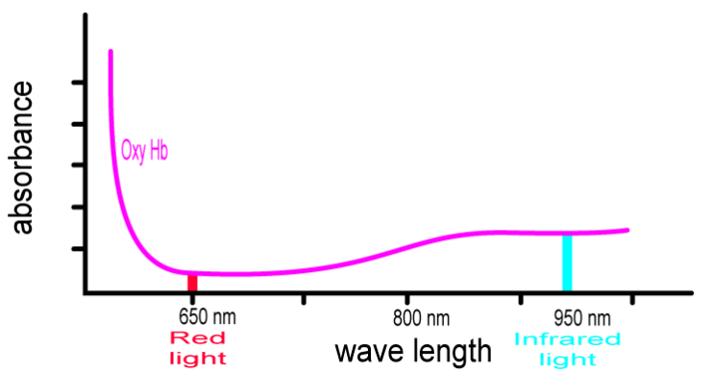
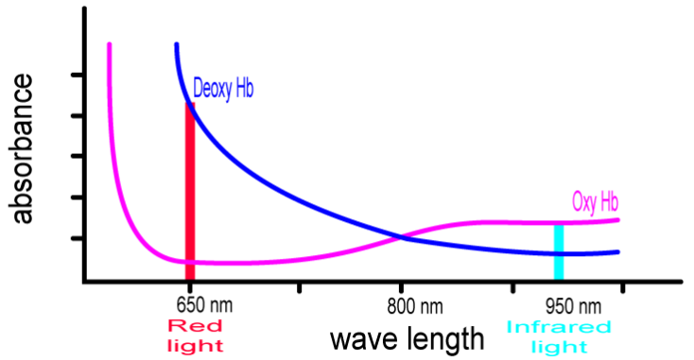





Why do we need two lights

Slide 9
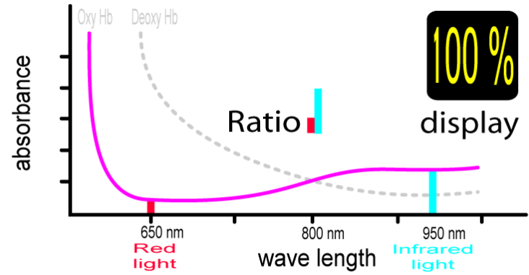
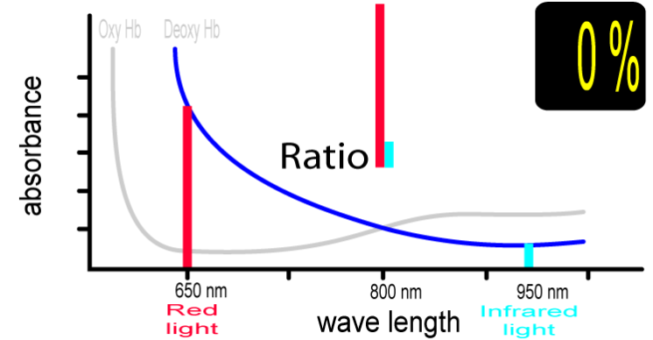



Change in ratio = change in oxygenation

Slide 10
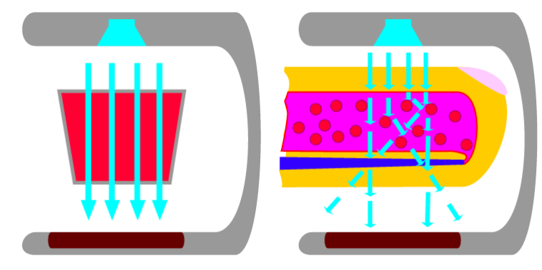
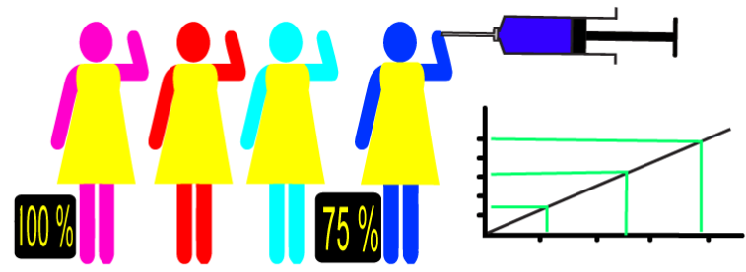
Need for empirical calibration

Slide 11
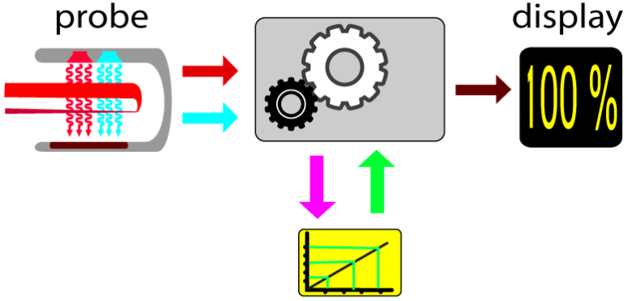




Data collection flow

Slide 12
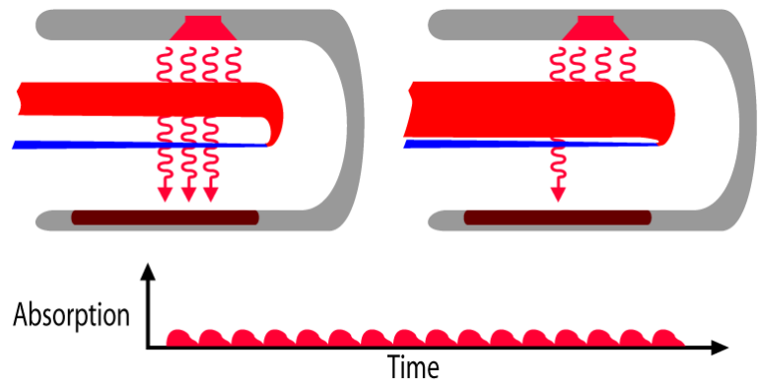
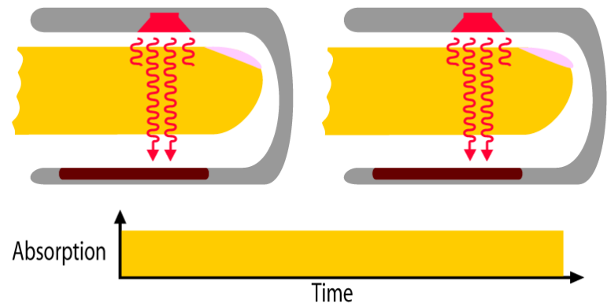
AC and DC part of the signal

Slide 13
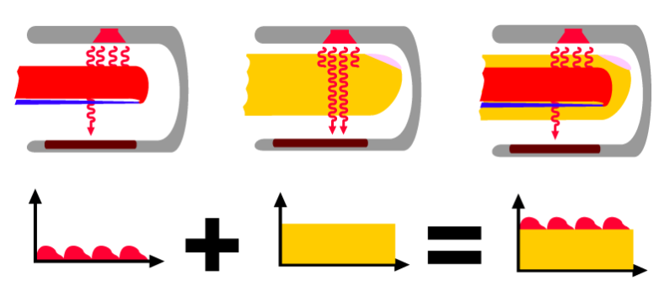


AC and DC part

Slide 14
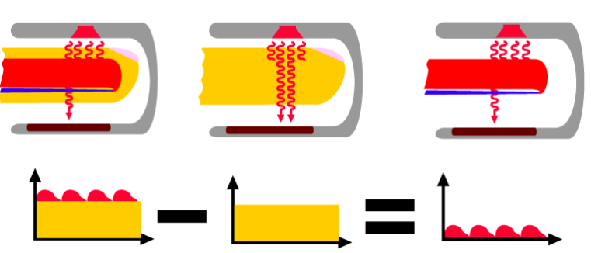
The graphs you will see in your demoboard

Slide 15
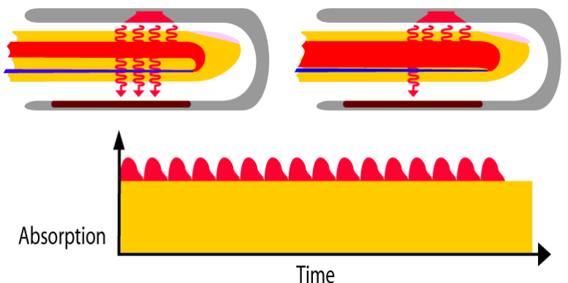
Pulsatile signal

Slide 16
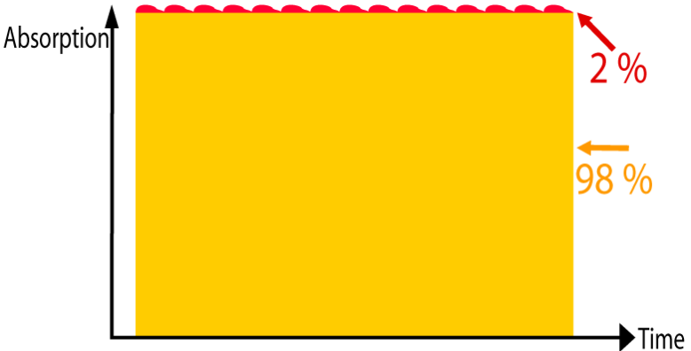
The portion of the AC part is very small

Slide 17
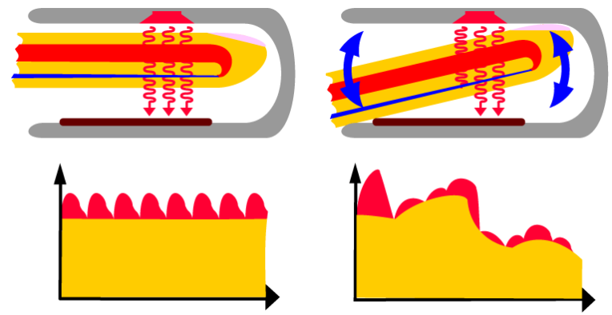
Source of drift

Slide 18
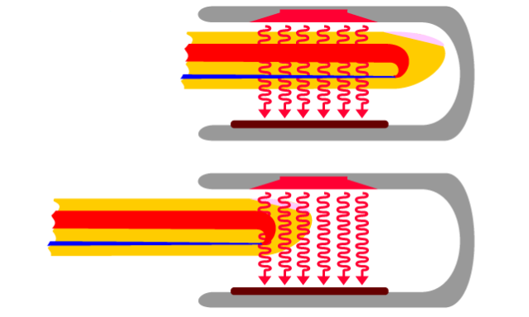
Optical shunting – photodiode gets saturated

Slide 19
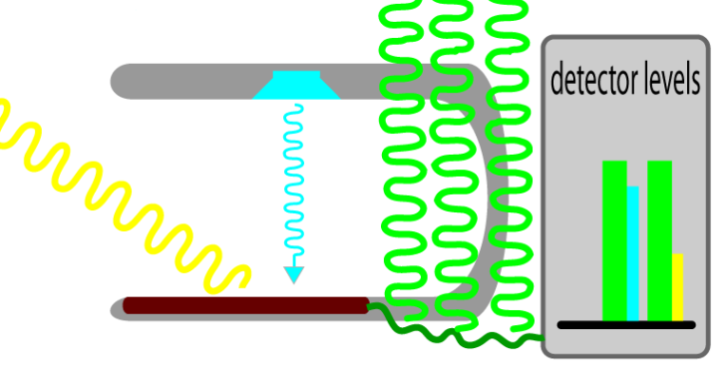
EM noise

Slide 20
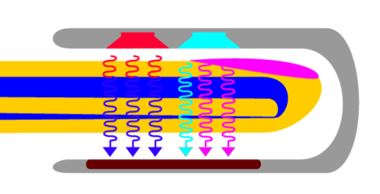
Nail polish

Slide 21
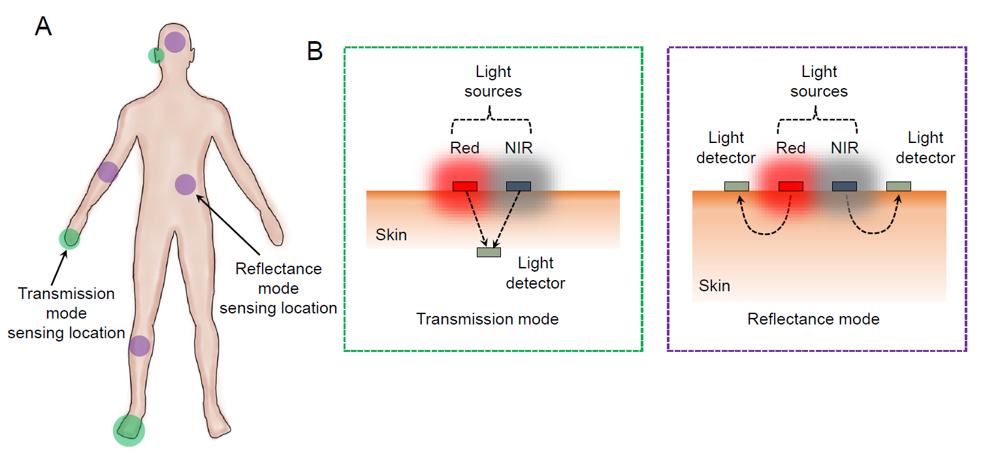
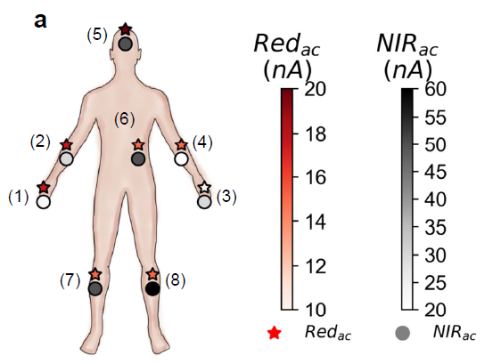
Transmission vs. reflectance oximetry
Transmission-mode pulse oximetry is limited only to tissues that can be transilluminated, such as the earlobes and the fingers.
If reflected light is used as the signal, the sensor can be used beyond the conventional sensing locations.
AC signal is the highest at the forehead for both Red and NIR channels.
Arms provide mid-range AC amplitude, while signal strength is low in the legs and chest area.
Forehead is the best location for reflectance pulse oximetry.

Slide 22
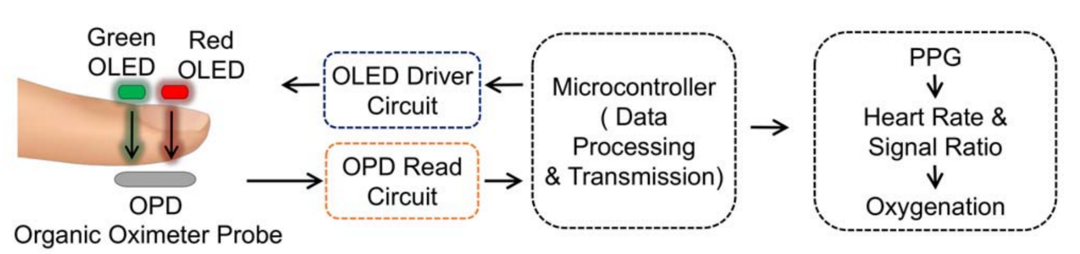
Oximeter readout circuit

Slide 23
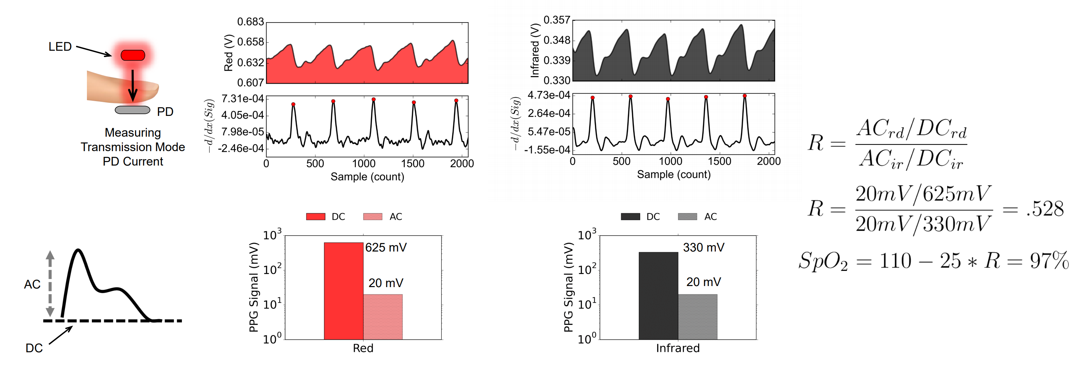
Calculating oxygen saturation

Slide 24
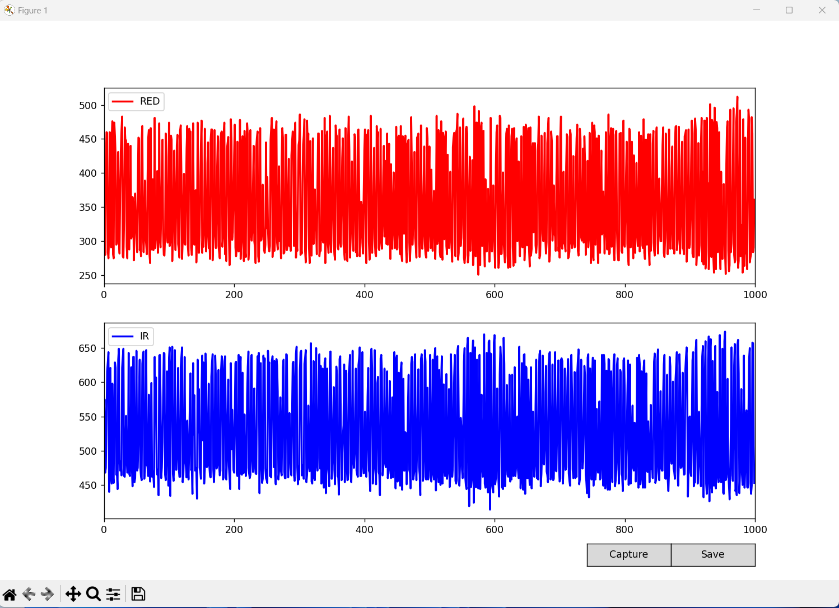
Press capture

Slide 25
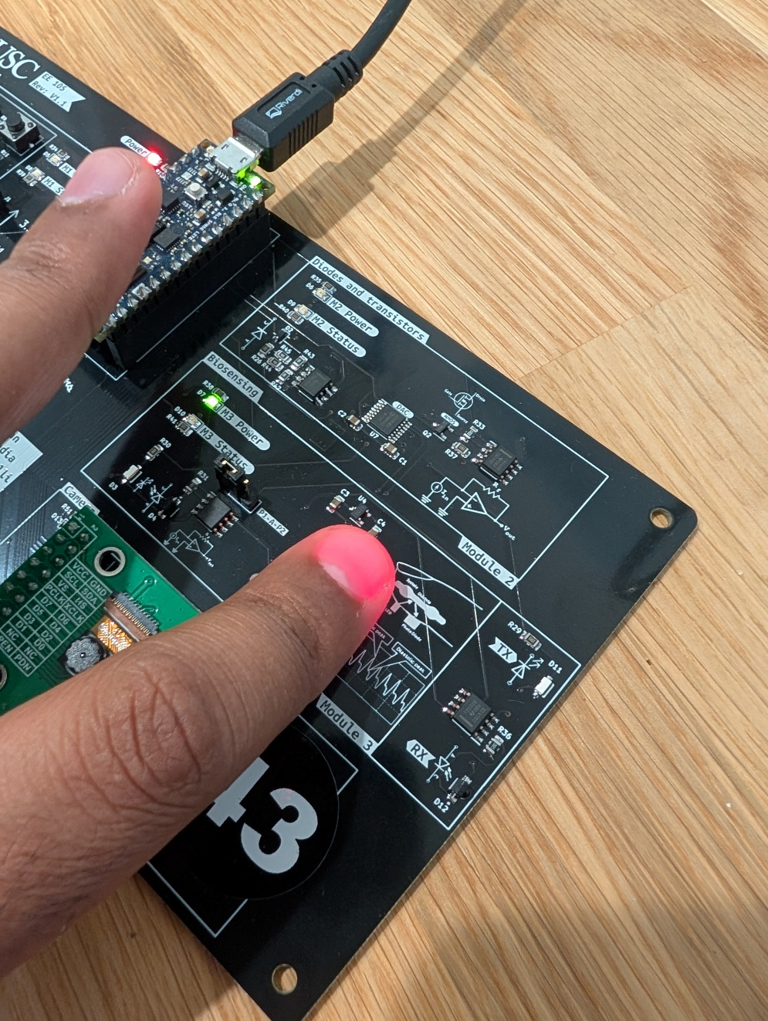
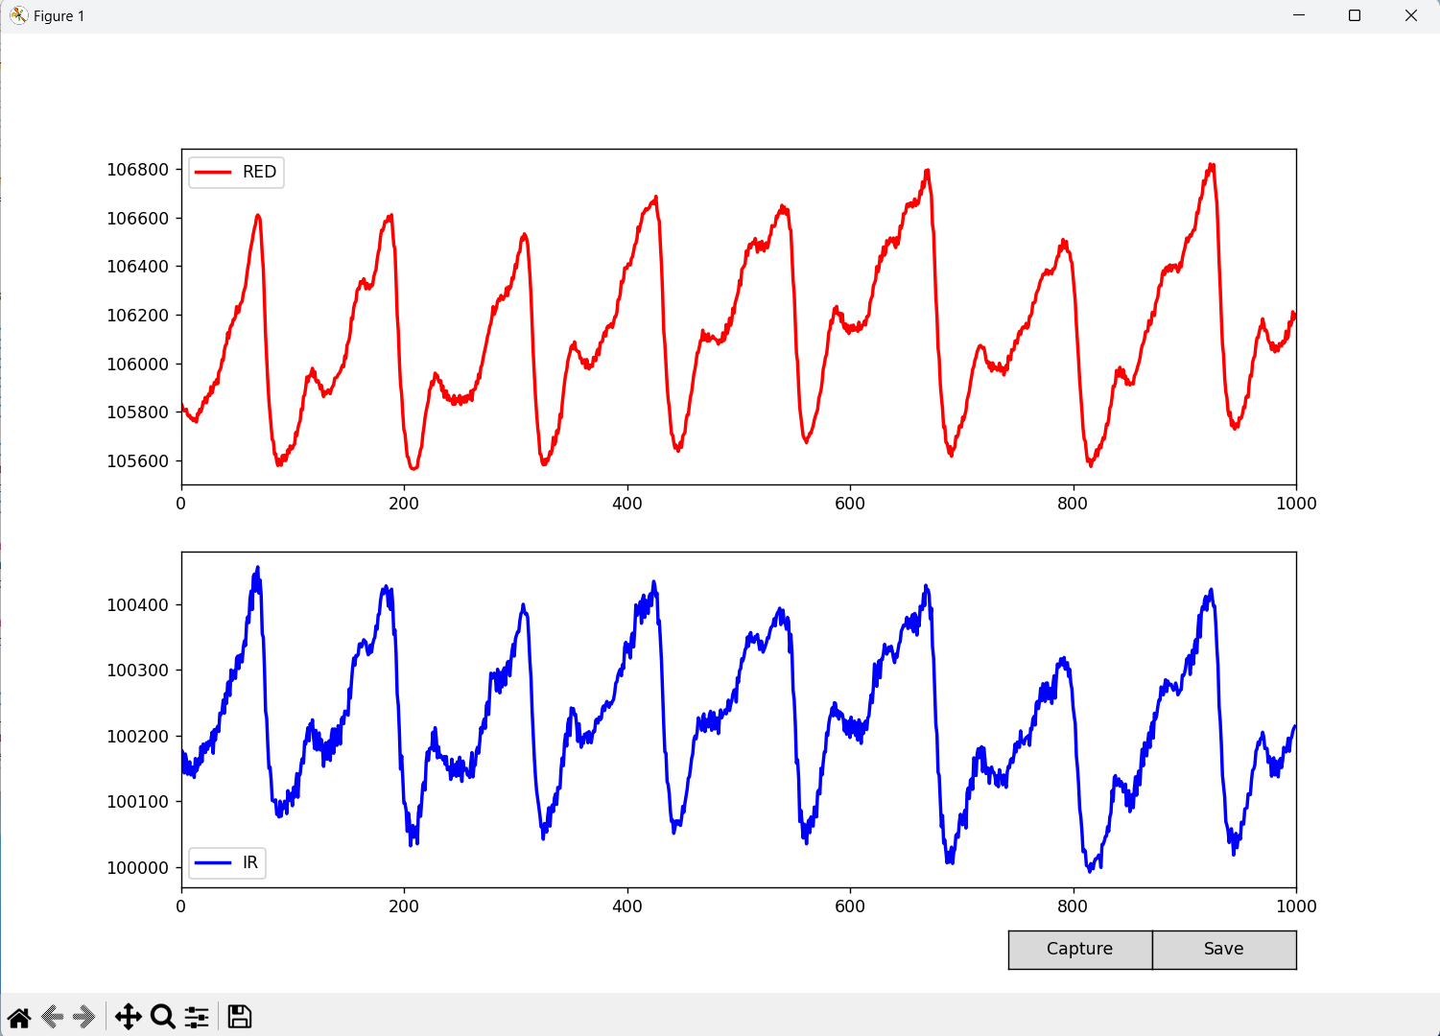
Keep your finger gently on the sensor

Slide 26
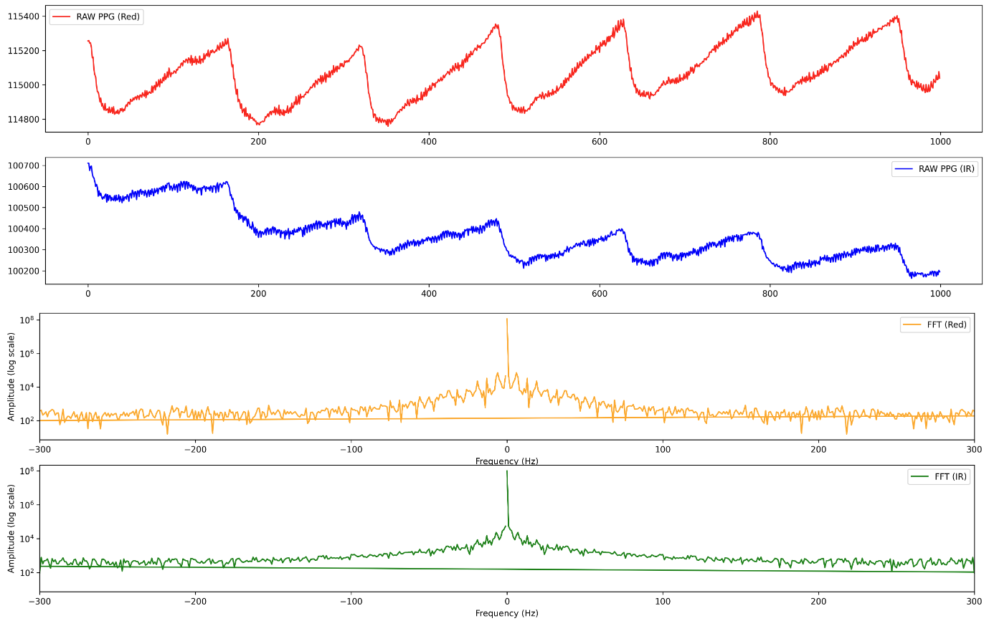



Going back to the PPG data collected

Slide 27
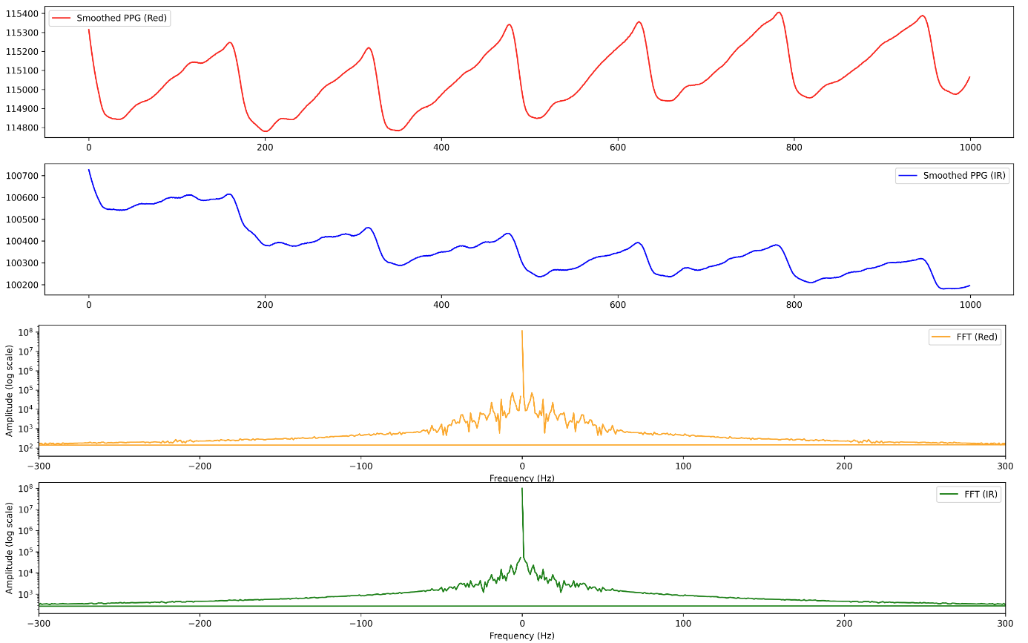


Smoothing

Slide 28
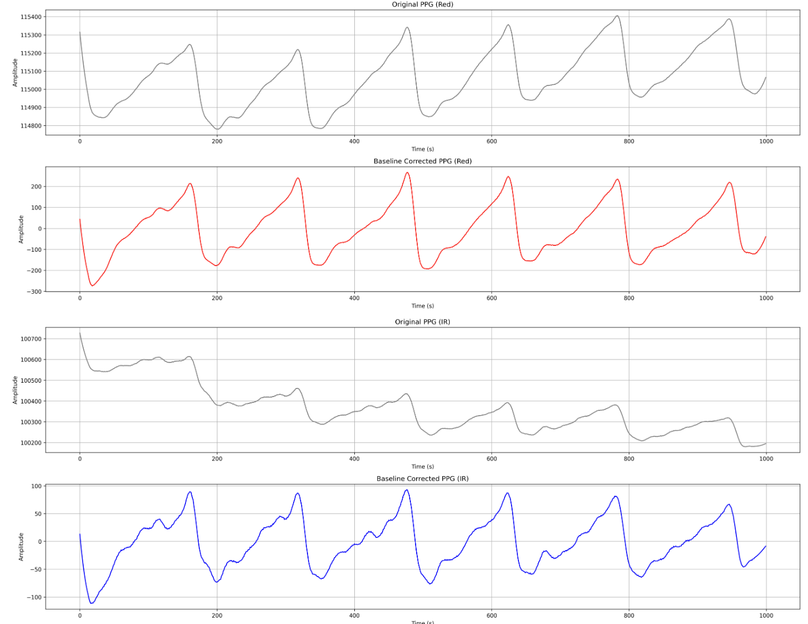
Drift correction

Slide 29
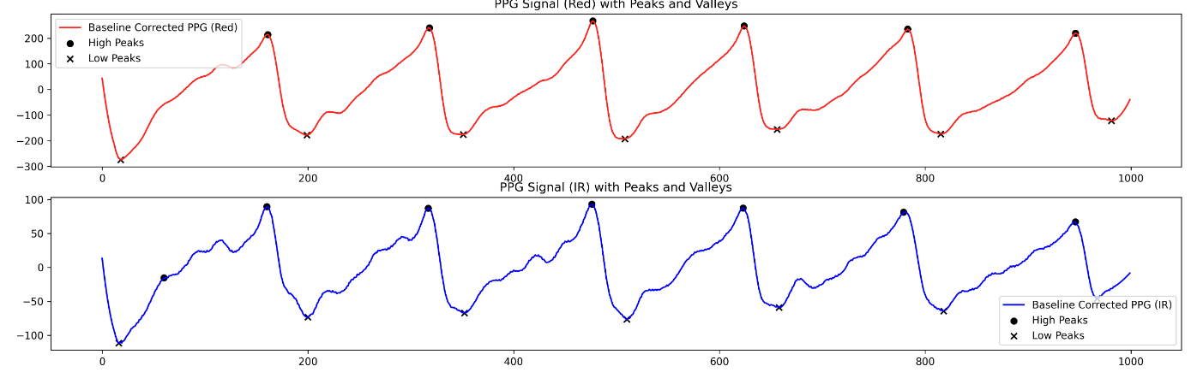
Peak detection

Slide 30
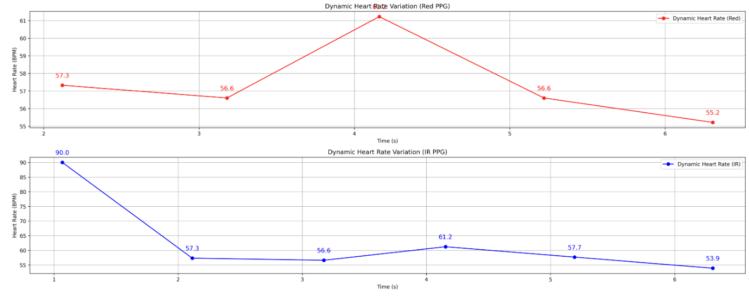
Heart rate

Slide 31
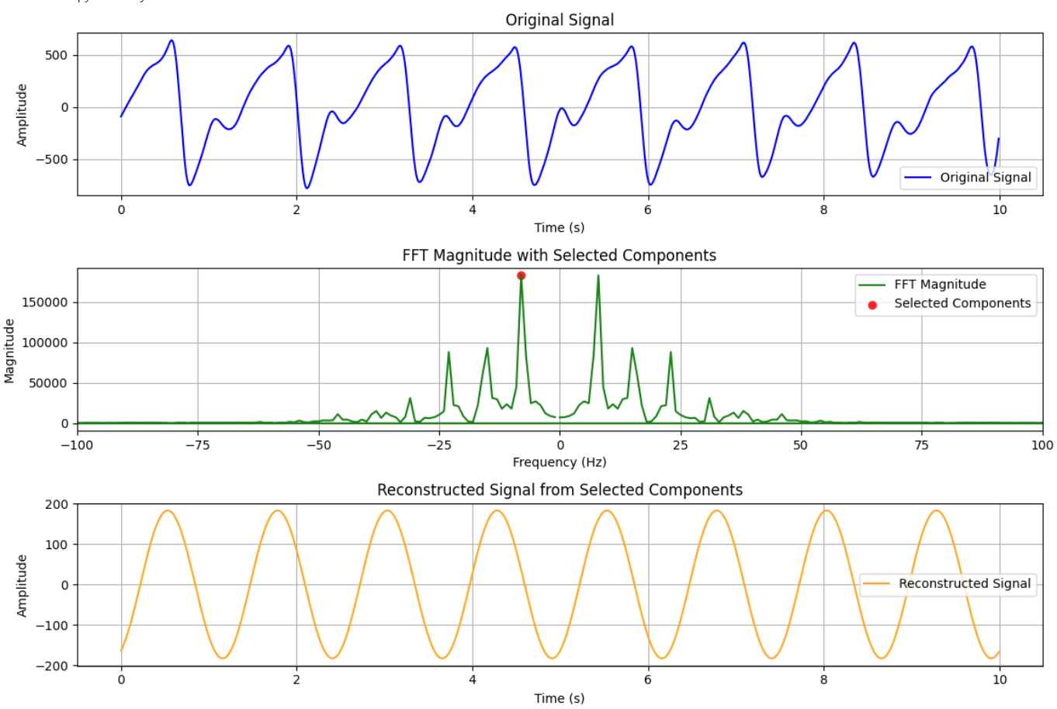

Using single component to find heart rate

Slide 32
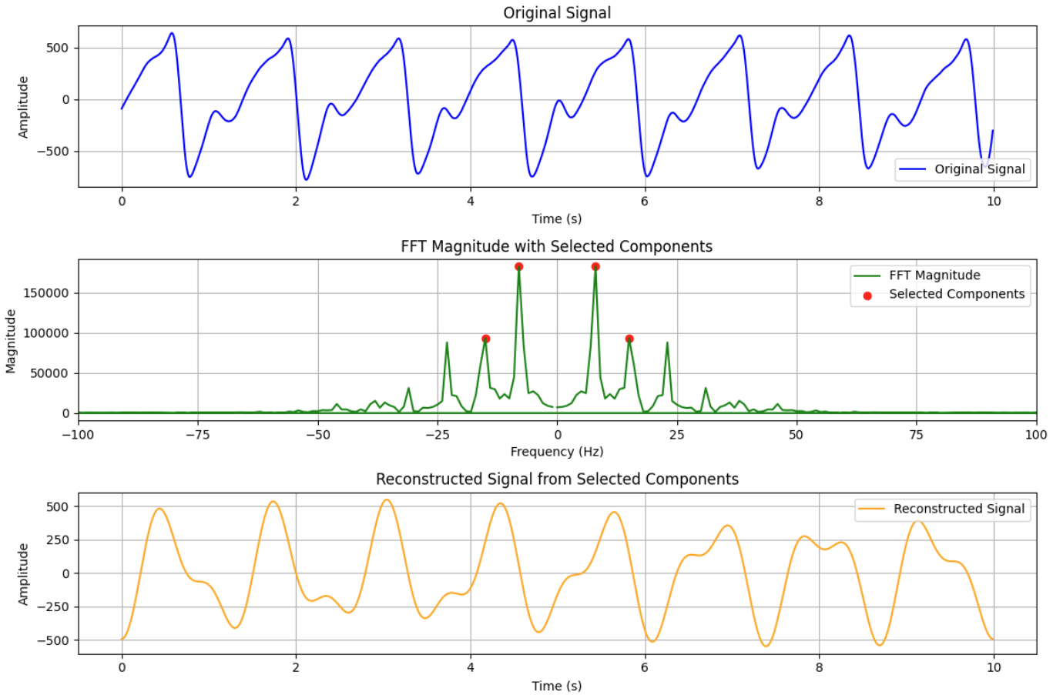
4 components in the PPG signal – signal loss

Slide 33
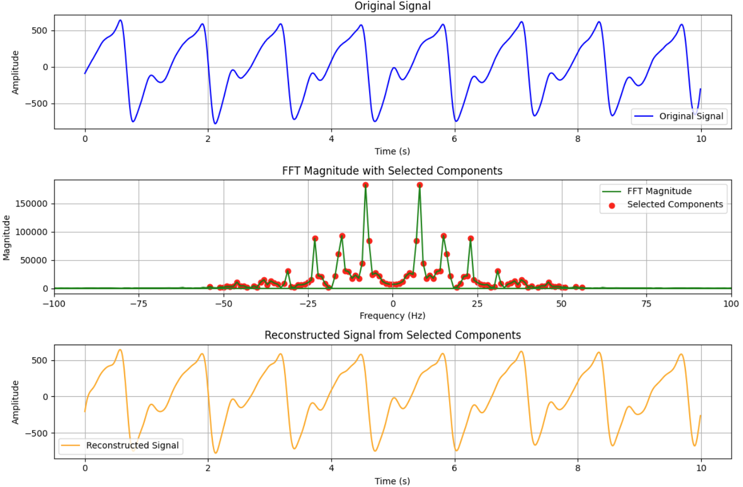
Taking all the components provides the original signal

Slide 34
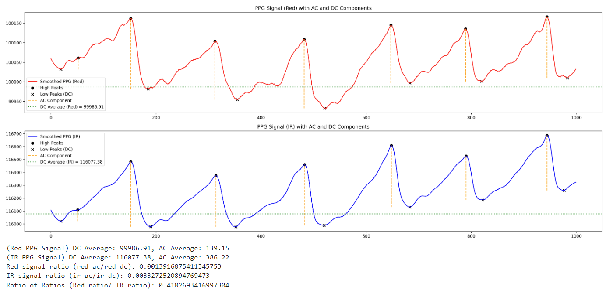
Ratio of the ratios

Slide 35

SpO2 calculation

