Slide 1
ECE 105: Introduction to Electrical Engineering
Lecture 10
Sensors 2
Yasser Khan
Rehan Kapadia

Slide 2
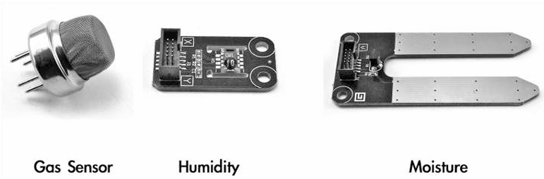
Other sensors

Slide 3
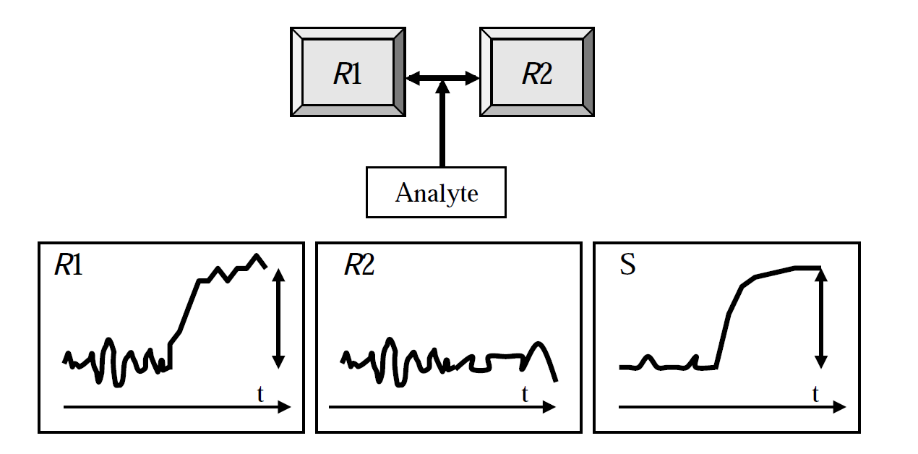
Differential measurement

Slide 4
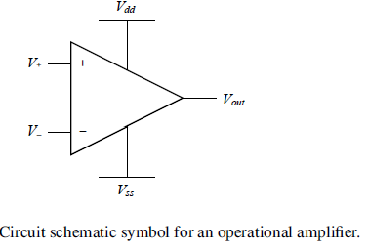
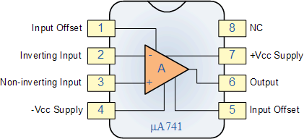



Op Amp
There are three Golden Rules for op-amp circuit design and analysis:
(1) no current flows into the inputs, V+ and V-;
(2) the input voltages are always equal, that is V+ = V-;
(3) the op-amp output can drive any current that is required.

Slide 5
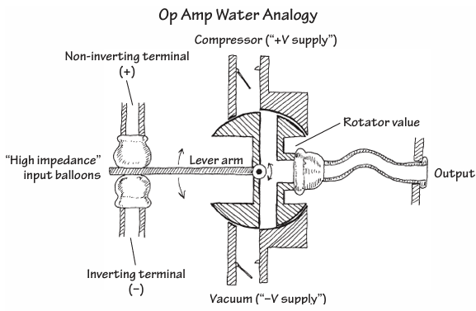












Op Amp Water Analogy

Slide 6
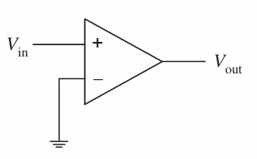
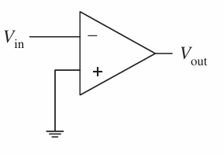


Non-inverting and inverting

Slide 7






Non-inverting Op Amp

Slide 8













Non-inverting Op Amp

Slide 9







Inverting Op Amp

Slide 10













Inverting Op Amp

Slide 11










Slide 12
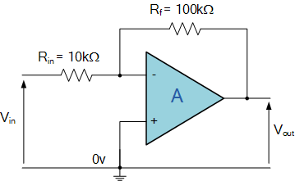


Example

Slide 13
Example

Slide 14
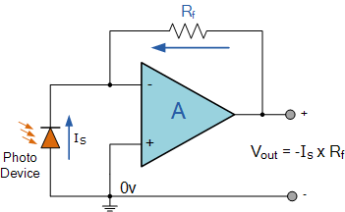













PD readout circuit

Slide 15
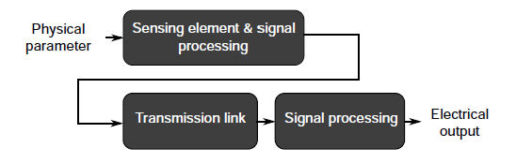
From physical world to getting data on a computer

Slide 16
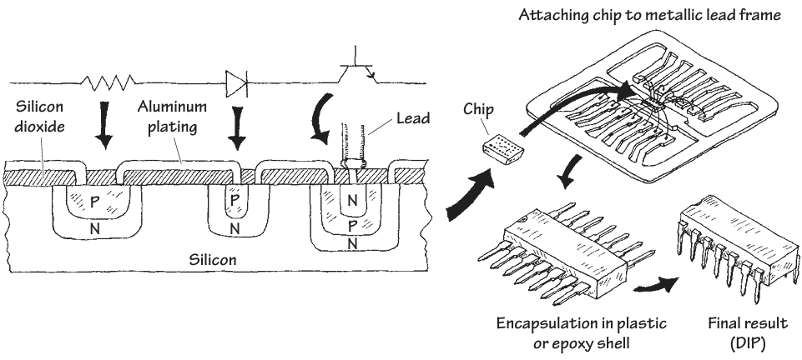
Packaged chips

Slide 17
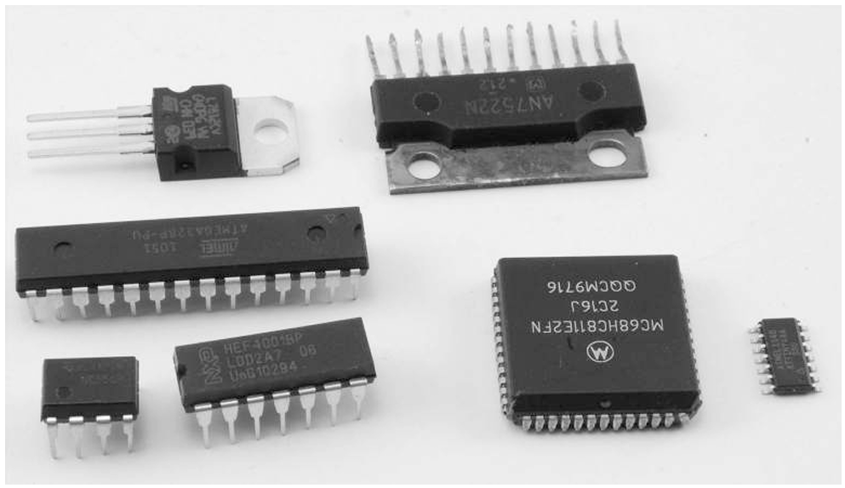
IC packages

Slide 18










Analog front end
An analog front-end (AFE) is a set of analog signal conditioning circuitry that uses sensitive analog amplifiers, often operational amplifiers, filters, and sometimes application-specific integrated circuits for sensors block needed to interface a variety of sensors to analog-to-digital converter or, in some cases, to a microcontroller.

Slide 19
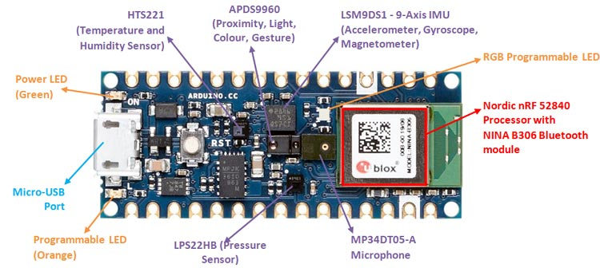


Let’s use an analog front end
https://docs.broadcom.com/doc/AV02-4191EN

Slide 20
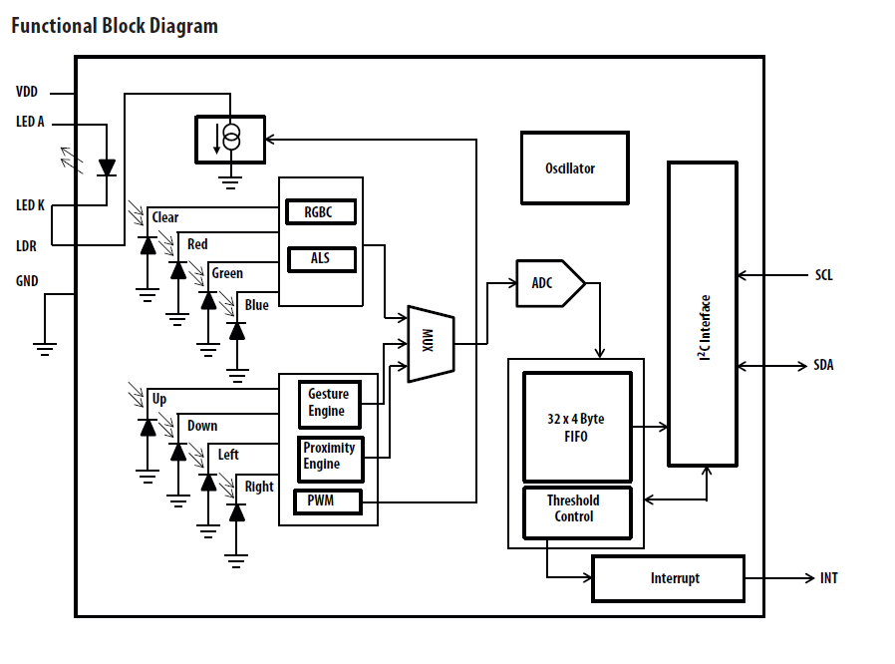










Block diagram of the AFE

Slide 21
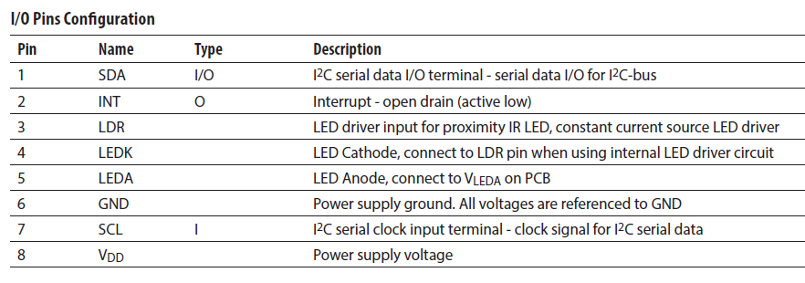
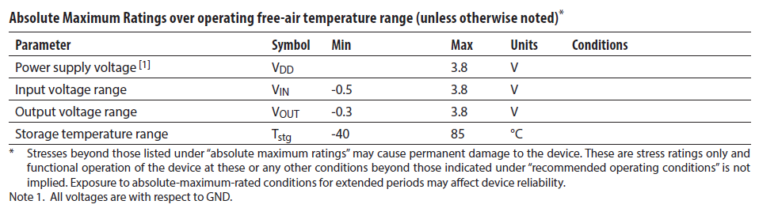







Pin Outs of the AFE

Slide 22
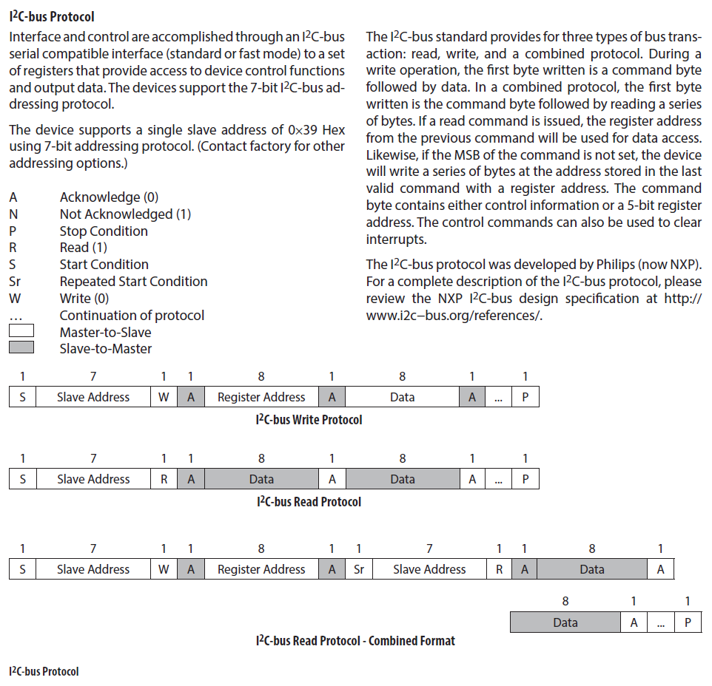
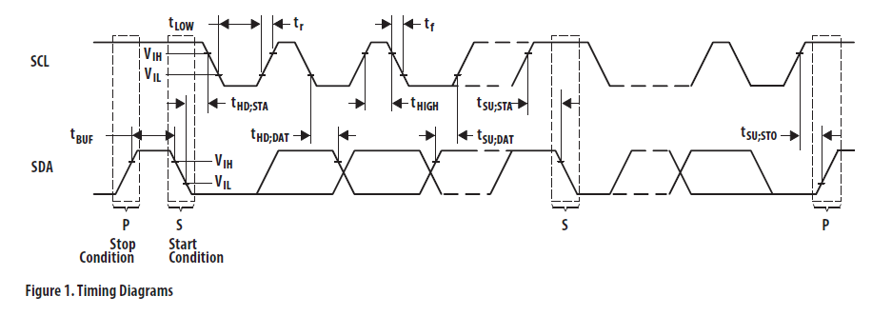
AFE to Arduino communication protocol

Slide 23
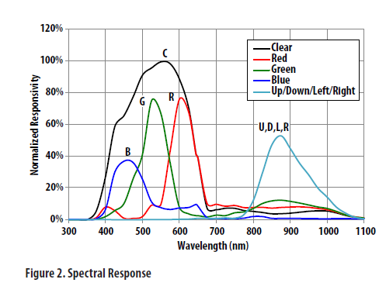

Spectral response of the optical sensor

Slide 24
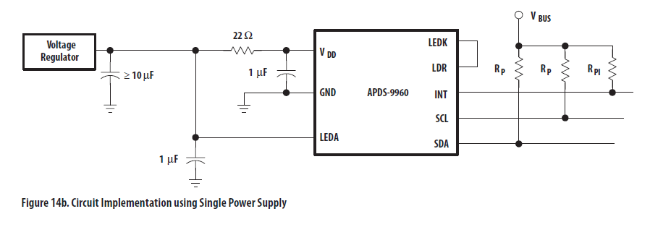







How to connect the AFE to the Arduino

Slide 25
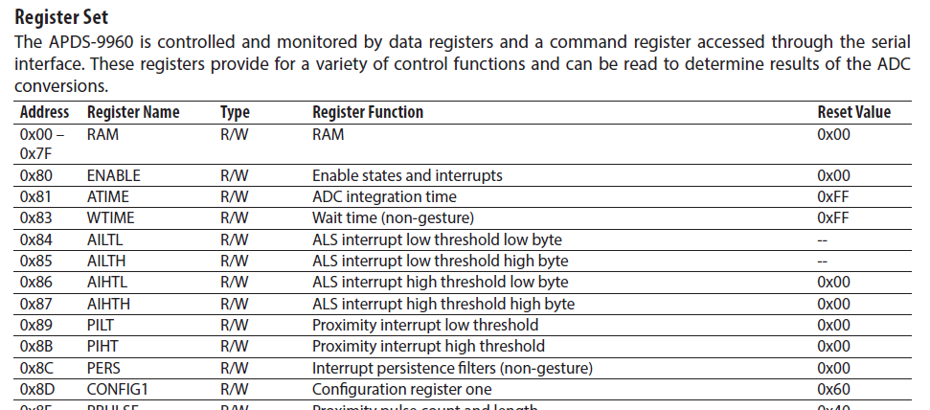




How data is stored in the AFE or the Arduino

Slide 26
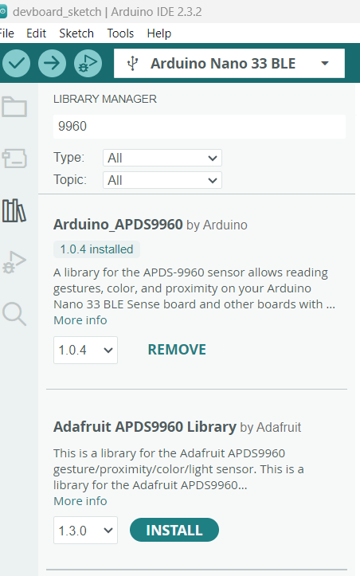
Search and install library for the AFE

Slide 27
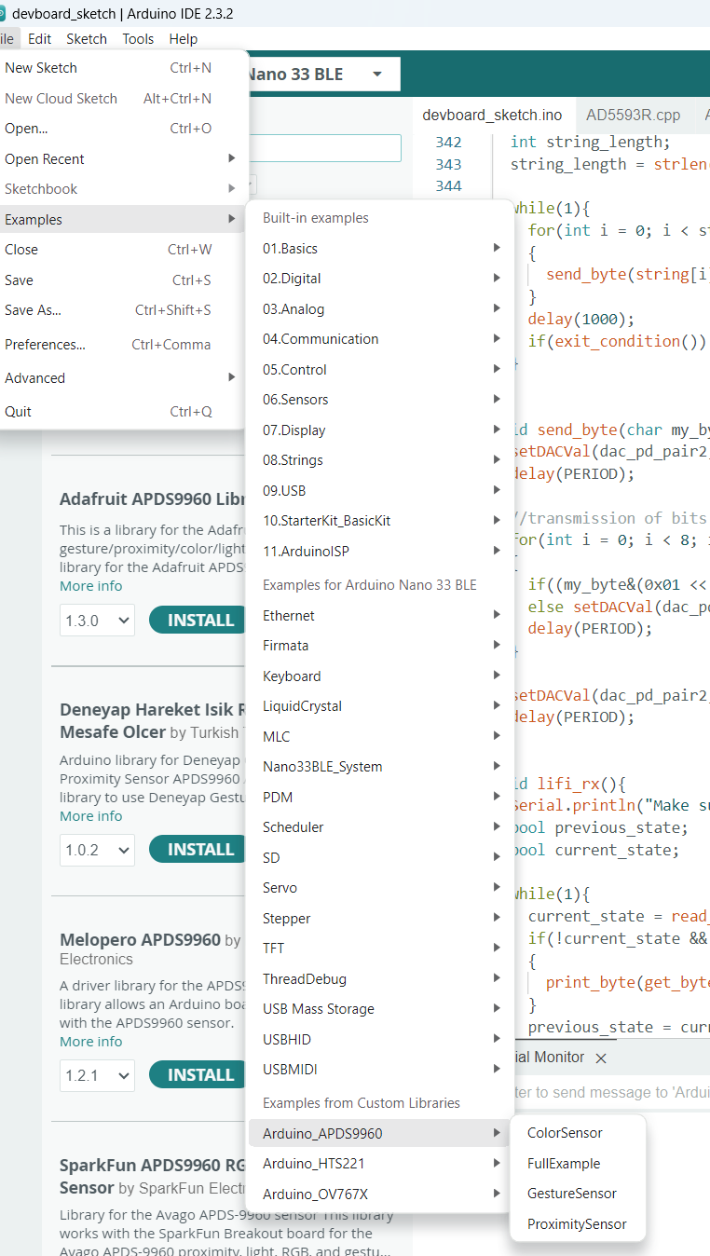
Run an example

Slide 28
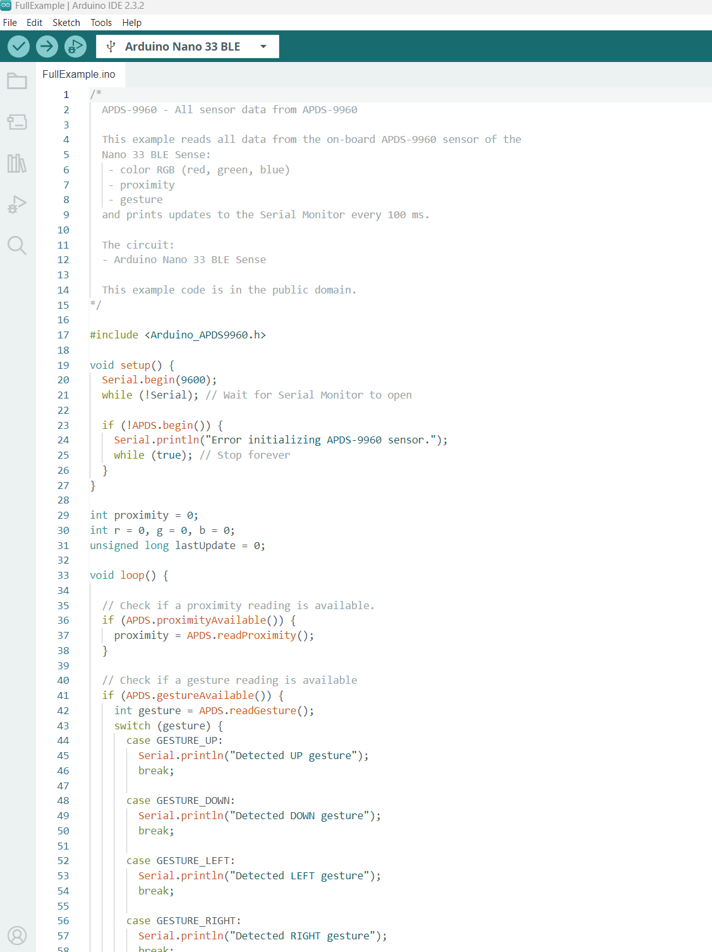
Upload code to Ard.

Slide 29
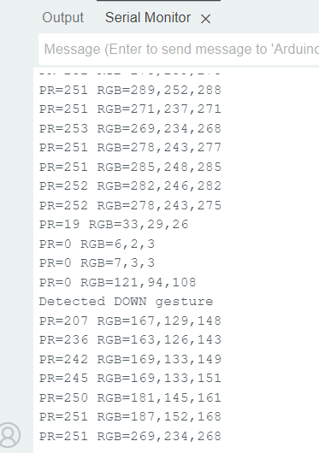
Serial monitor

Slide 30
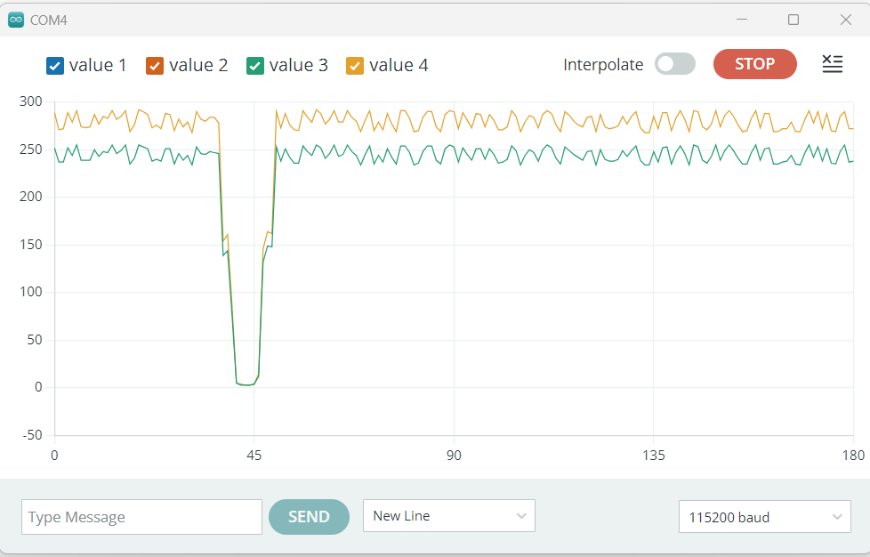
Serial plotter

