Slide 1
ECE 105: Introduction to Electrical Engineering
Review – Circuit, Device, Sensors
Yasser Khan
Rehan Kapadia

Slide 2


Draw circuit from description

Slide 3
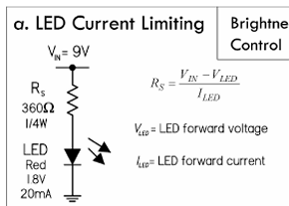






LED driver circuit

Slide 4






Voltage divider

Slide 5
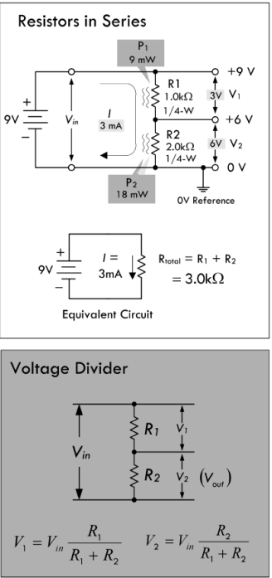

Voltage divider

Slide 6


Resistors in series

Slide 7


Current divider

Slide 8
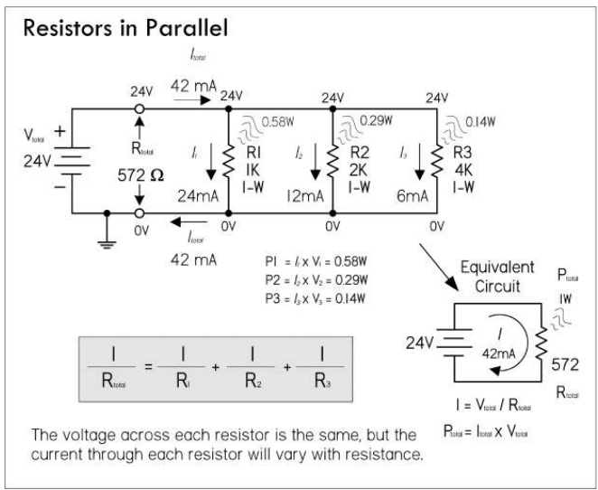
Resistors in parallel

Slide 9
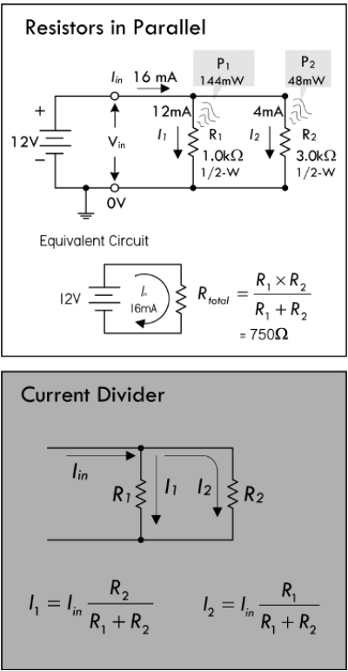








Current divider

Slide 10

Temp sensor

Slide 11
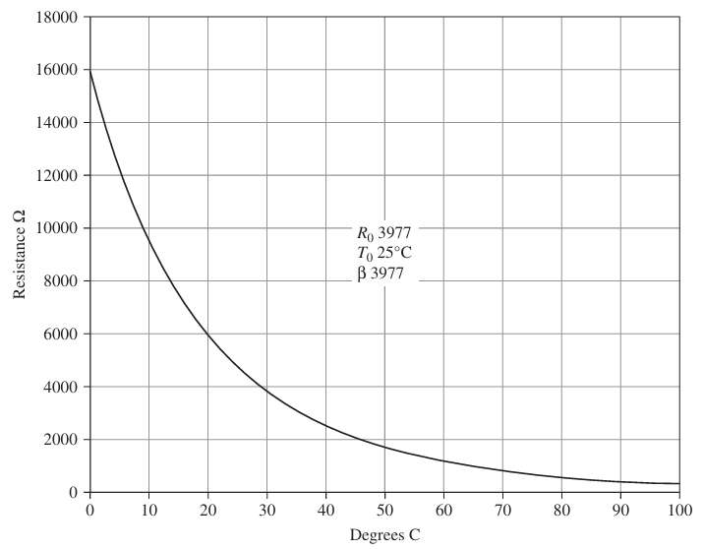
Temperature sensor

Slide 12
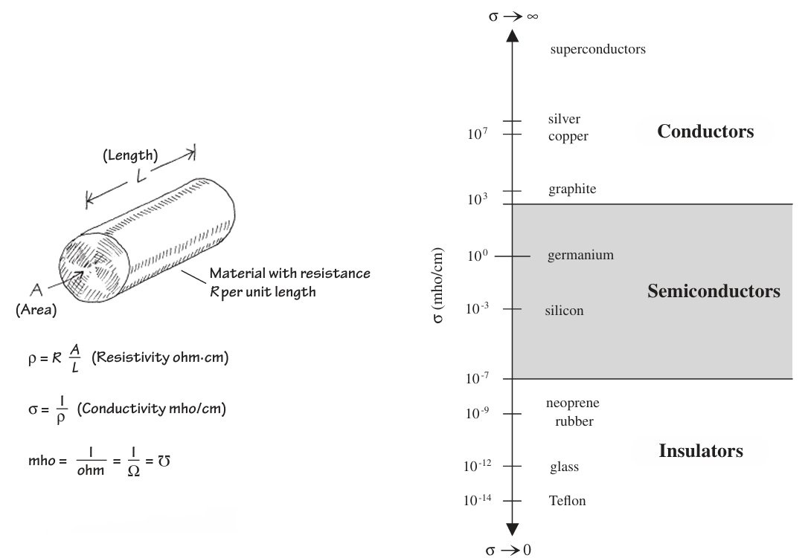





Types of materials used in electronics

Slide 13










Transistors CMOS

Slide 14




Transistors

Slide 15


Slide 16














Op Amp

Slide 17
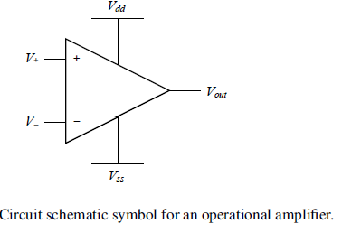
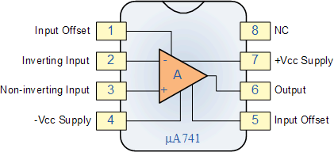



Op Amp
There are three Golden Rules for op-amp circuit design and analysis:
(1) no current flows into the inputs, V+ and V-;
(2) the input voltages are always equal, that is V+ = V-;
(3) the op-amp output can drive any current that is required.

Slide 18







Inverting amp example

Slide 19



Inverting amp example

