Slide 1
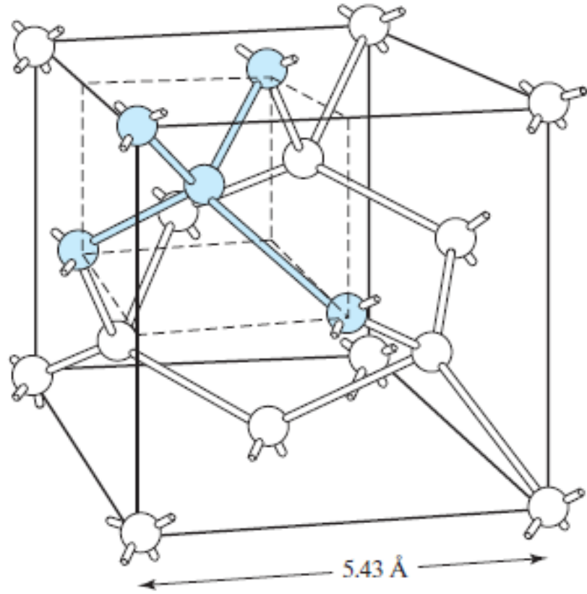
1.1 Silicon Crystal Structure
Chapter 1 Electrons and Holes
in Semiconductors
Unit cell of silicon crystal is cubic.
Each Si atom has 4 nearest neighbors.
Modern Semiconductor Devices for Integrated Circuits (C. Hu)
Slide 1-<number>

Slide 2
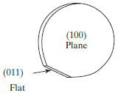
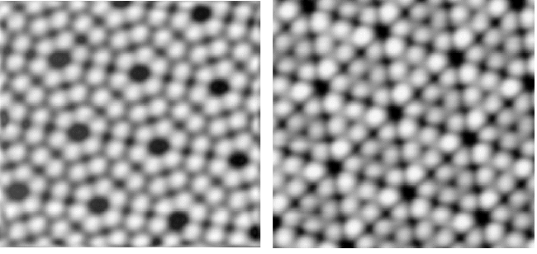
Silicon Wafers and Crystal Planes
z
z
z
•
The standard notation for crystal planes is based on the cubic unit cell.
y
y
y
x
x
x
(100)
(011)
(111)
•
Silicon wafers are usually cut along the (100) plane with a flat or notch to help orient the wafer during IC fabrication.
Si (111) plane
Modern Semiconductor Devices for Integrated Circuits (C. Hu)
Slide 1-<number>

Slide 3
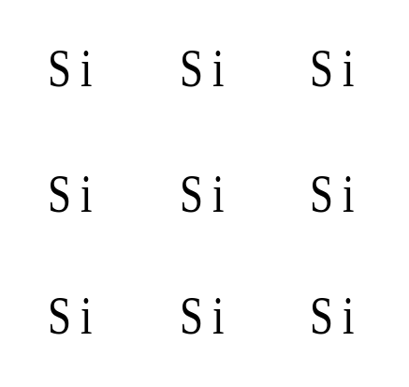
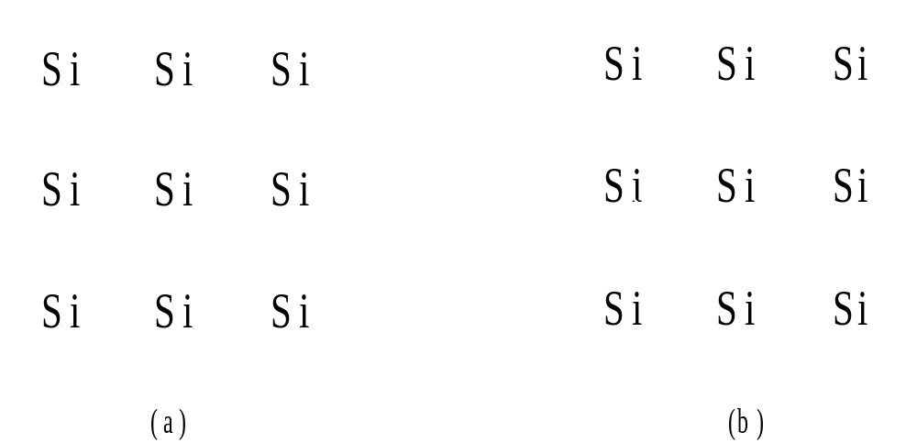
1.2 Bond Model of Electrons and Holes
•
Silicon crystal in
a two-dimensional
representation.
•
When an electron breaks loose and becomes a
conduction
electron
, a
hole
is also created.
Modern Semiconductor Devices for Integrated Circuits (C. Hu)
Slide 1-<number>

Slide 4
Dopants in Silicon
Si
Si
Si
Si
Si
Si
Si
As
Si
Si
B
Si
Si
Si
Si
Si
Si
Si
•
As, a Group V element, introduces conduction electrons and creates
N-type silicon,
and is called a donor.
•
B, a Group III element, introduces holes and creates P-type silicon,
and is called an acceptor.
•
Donors and acceptors are known
m₀ q⁴
as dopants. Dopant ionization
Hydrogen:
E
ion
=
=
13.6 eV
energy ~50meV (very low).
8ε₀²h²
Modern Semiconductor Devices for Integrated Circuits (C. Hu)
Slide 1-<number>

Slide 5
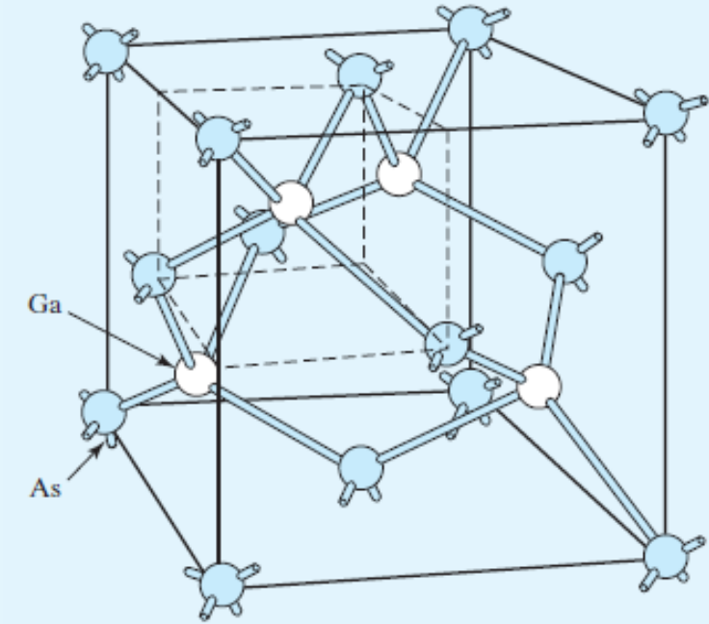
GaAs, III-V Compound Semiconductors, and Their Dopants
Ga
As
Ga
As
Ga
As
Ga
As
Ga
•
GaAs has the same crystal structure as Si.
•
GaAs, GaP, GaN are III-V compound semiconductors, important for
optoelectronics.
•
Wich group of elements are candidates for donors? acceptors?
Modern Semiconductor Devices for Integrated Circuits (C. Hu)
Slide 1-<number>

Slide 6
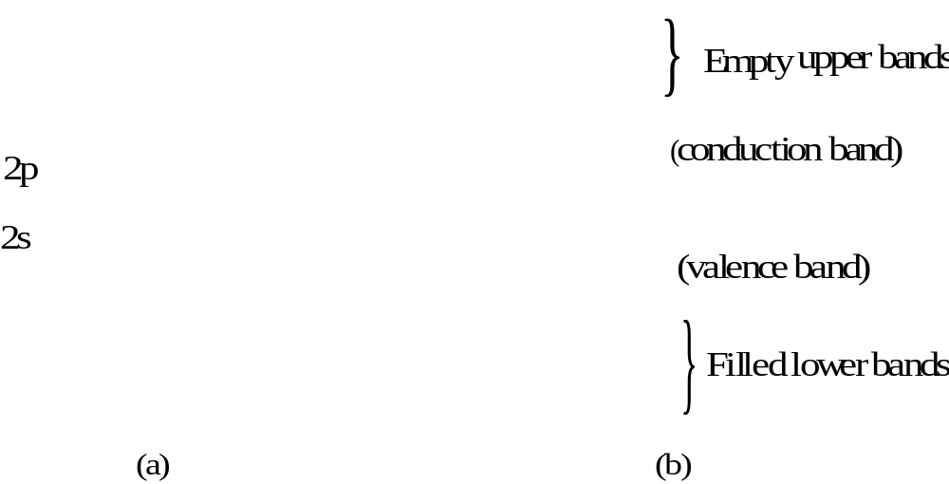
1.3 Energy Band Model
•
Energy states of Si atom (a) expand into energy bands of Si crystal (b).
•
The lower bands are filled and higher bands are empty in a semiconductor.
•
The highest filled band is the
valence band.
•
The lowest empty band is the
conduction band
.
Modern Semiconductor Devices for Integrated Circuits (C. Hu)
Slide 1-<number>

Slide 7
1.3.1 Energy Band Diagram
Conduction band
E
c
Band gap
E
g
E
v
Valence band
•
Energy band diagram shows the bottom edge of conduction band, E_{c} , and top edge of valence band, E_{v} .
•
E_{c} and E_{v} are separated by the band gap energy, E_{g} .
Modern Semiconductor Devices for Integrated Circuits (C. Hu)
Slide 1-<number>

Slide 8
Measuring the Band Gap Energy by Light Absorption
electron
E
c
photons
E
g
photon energy: h
v
> E
g
E
v
hole
E_{g} can be determined from the minimum energy (hν) of photons that are absorbed by the semiconductor.
Bandgap energies of selected semiconductors
Semi-conductor | InSb | Ge | Si | GaAs | GaP | ZnSe | Diamond
Eg (eV) | 0.18 | 0.67 | 1.12 | 1.42 | 2.25 | 2.7 | 6
Modern Semiconductor Devices for Integrated Circuits (C. Hu)
Slide 1-<number>

Slide 9
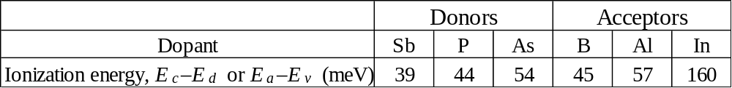
1.3.2 Donor and Acceptor in the Band Model
Conduction Band
E
c
Donor Level
E
d
Donor ionization energy
Acceptor ionization energy
Acceptor Level
E
a
E
v
Valence Band
Ionization energy of selected donors and acceptors in silicon
Modern Semiconductor Devices for Integrated Circuits (C. Hu)
Slide 1-<number>

Slide 10
1.4 Semiconductors, Insulators, and Conductors
E
c
Top of
conduction band
E
g
=
9 eV
E
empty
=
c
E
g
1.1 eV
filled
E
v
E
v
E
c
Si (Semiconductor)
SiO
(Insulator)
Conductor
2
•
Totally filled bands and totally empty bands do not allow
current flow. (Just as there is no motion of liquid in a totally filled or totally empty bottle.)
.
•
Metal conduction band is half-filled.
•
Semiconductors have lower E
's than insulators and can be
g
doped.
Modern Semiconductor Devices for Integrated Circuits (C. Hu)
Slide 1-<number>

Slide 11
1.5 Electrons and Holes
y
y
electron kinetic energy
g
g
r
r
E
e
e
c
n
n
e
e
n
e
o
l
r
o
t
h
c
e
g
l
n
e
i
g
s
n
a
E
i
e
v
s
r
a
c
e
n
r
i
hole kinetic energy
c
n
i
•
Both electrons and holes tend to seek their lowest
energy positions.
•
Electrons tend to fall in the energy band diagram.
•
Holes float up like bubbles in water
.
Modern Semiconductor Devices for Integrated Circuits (C. Hu)
Slide 1-<number>

Slide 12
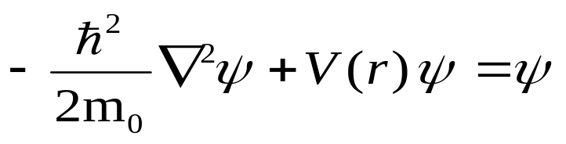
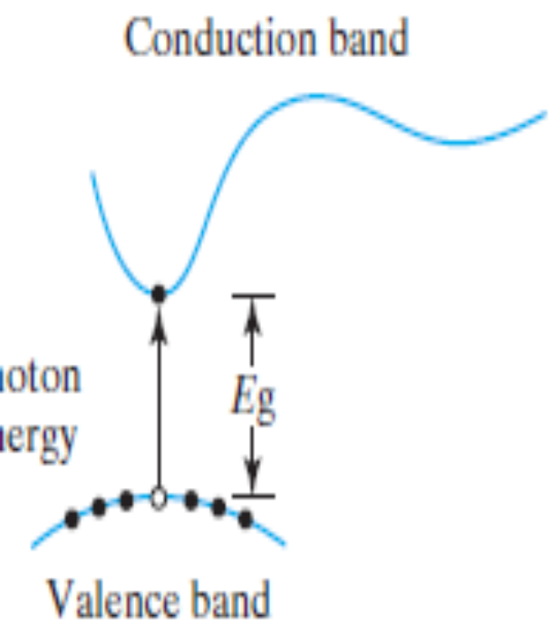

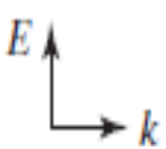
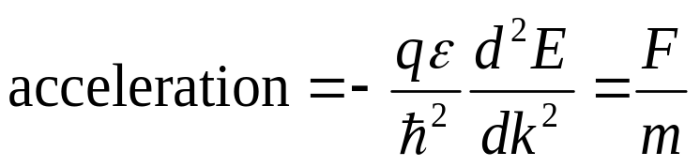
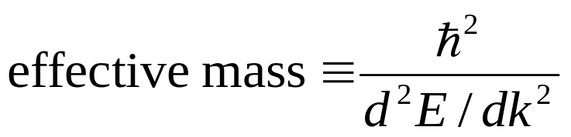
1.5.1 Effective Mass
The electron wave function is the solution of the three dimensional Schrodinger wave equation
The solution is of the form exp( k r)
k = wave vector = 2π/electron wavelength
For each k, there is a corresponding E.
Modern Semiconductor Devices for Integrated Circuits (C. Hu)
Slide 1-<number>

Slide 13

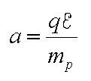
1.5.1 Effective Mass
In an electric field, E, an electron or a hole accelerates.
Electron and hole effective masses
electrons
holes
 | Si | Ge | GaAs | InAs | AlAs
m_{n}/m₀ | 0.26 | 0.12 | 0.068 | 0.023 | 2
m_{p}/m₀ | 0.39 | 0.3 | 0.5 | 0.3 | 0.3
Modern Semiconductor Devices for Integrated Circuits (C. Hu)
Slide 1-<number>

Slide 14
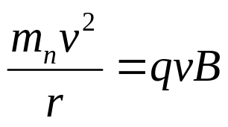
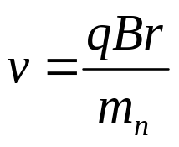
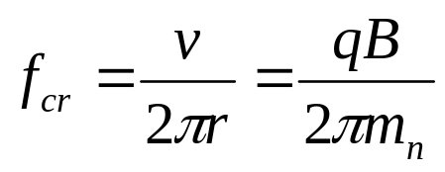
1.5.2 How to Measure the Effective Mass
Cyclotron Resonance Technique
B
-
-
-
Centripetal force = Lorentzian force
Microwave
f_{cr} is the Cyclotron resonance frequency.
It is independent of v and r.
Electrons strongly absorb microwaves of that frequency.
By measuring f_{cr}, m_{n} can be found.
Modern Semiconductor Devices for Integrated Circuits (C. Hu)
Slide 1-<number>

Slide 15
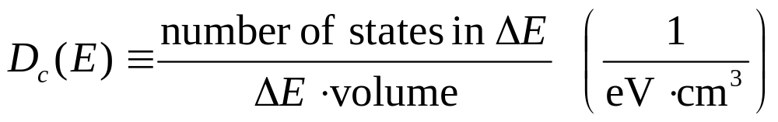
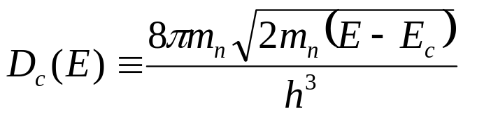
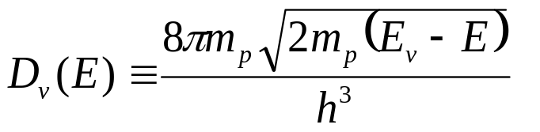
1.6 Density of States
E
D
c
ΔΕ
E
c
E
c
D
E
v
E
v
D
v
Derived in Appendix I
Modern Semiconductor Devices for Integrated Circuits (C. Hu)
Slide 1-<number>

Slide 16
1.7 Thermal Equilibrium and the Fermi Function
1.7.1 An Analogy for Thermal Equilibrium
Sand particles
Dish
Vibrating Table
•
There is a certain probability for the electrons in the
conduction band to occupy high-energy states under the agitation of thermal energy.
Modern Semiconductor Devices for Integrated Circuits (C. Hu)
Slide 1-<number>

Slide 17
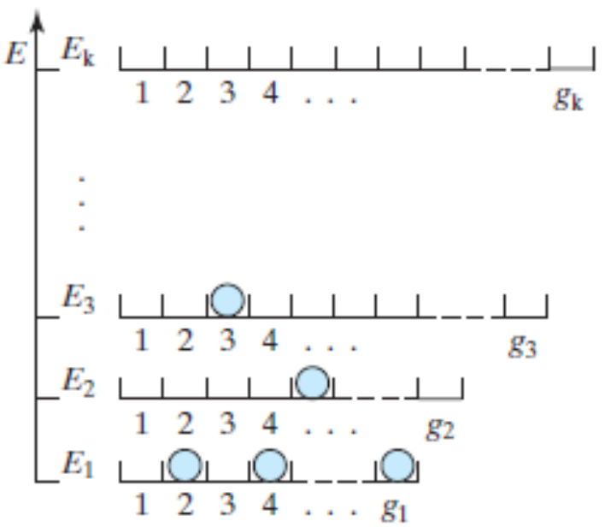
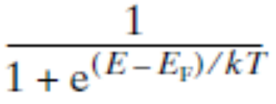
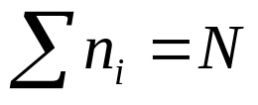
Appendix II. Probability of a State at E being Occupied
There are g₁ states at E₁, g₂ states at E₂… There are N electrons, which constantly shift among all the states but the average electron energy is fixed at 3kT/2.
There are many ways to distribute N among n₁, n₂, n₃….and satisfy the 3kT/2 condition.
The equilibrium distribution is the distribution that maximizes the number of combinations of placing n₁ in g₁ slots, n₂ in g₂ slots…. :
ni/gi =
E_{F} is a constant determined by the condition
Modern Semiconductor Devices for Integrated Circuits (C. Hu)

Slide 18
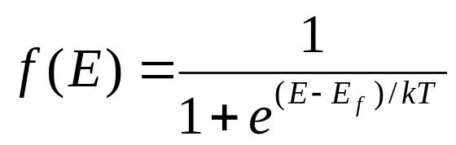
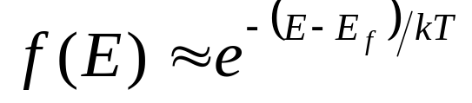

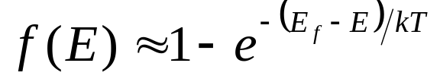

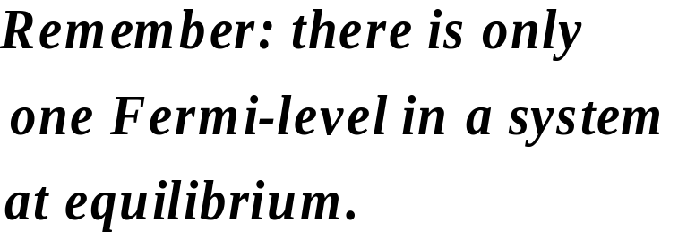
1.7.2 Fermi Function–The Probability of an Energy State Being Occupied by an Electron
E_{f} is called the Fermi energy or
the Fermi level.
Boltzmann approximation:
E
E_{f}
+ 3kT
E_{f}
E
+ 2kT
f
E_{f}
+ kT
E_{f}
E_{f}
– kT
E_{f}
– 2kT
E_{f}
– 3kT
f(E)
0.5
1
Modern Semiconductor Devices for Integrated Circuits (C. Hu)
Slide 1-<number>

Slide 19
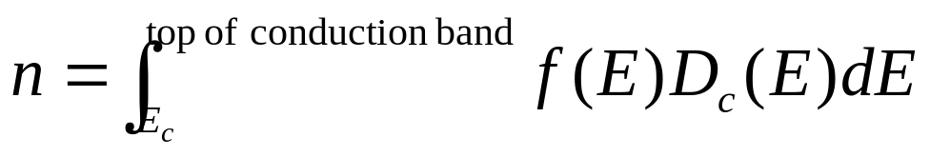
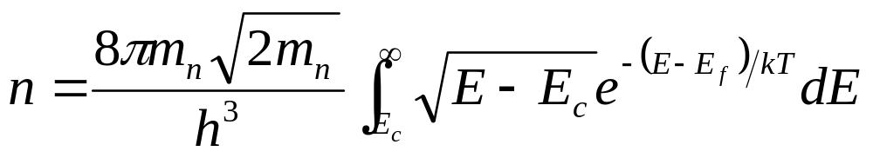
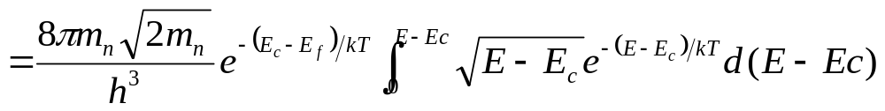
1.8 Electron and Hole Concentrations
1.8.1 Derivation of n and p from D(E) and f(E)
Modern Semiconductor Devices for Integrated Circuits (C. Hu)
Slide 1-<number>

Slide 20
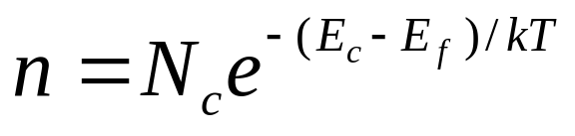
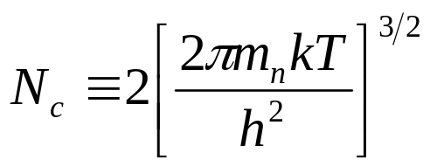
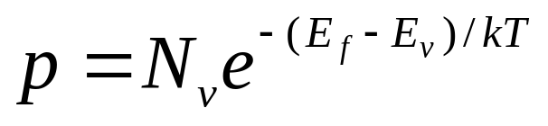
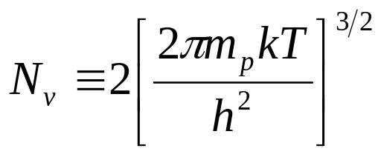
Electron and Hole Concentrations
N_{c} is called the effective
density of states (of the conduction band) .
N_{v} is called the effective
density of states of the
valence band.
Remember: the closer E
f
moves up to N
c
, the larger n is;
the closer E
f
moves down to E
v
, the larger p is.
For Si, N
= 2.8
×
10
19
cm
-3
and N
= 1.04
×
10
19
cm
-3
.
c
v
Modern Semiconductor Devices for Integrated Circuits (C. Hu)
Slide 1-<number>

Slide 21
1.8.2 The Fermi Level and Carrier Concentrations
Where is E_{f} for n =10¹⁷ cm⁻³? And for p = 10¹⁴ cm⁻³?
Solution: (a)
(b) For p = 10¹⁴cm⁻³, from Eq.(1.8.8),
0.146 eV
E
E
c
c
E
f
E
f
0.31 eV
E
v
E
v
(a)
(b)
Modern Semiconductor Devices for Integrated Circuits (C. Hu)
Slide 1-<number>

Slide 22
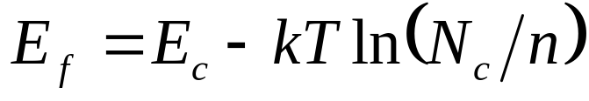
1.8.2 The Fermi Level and Carrier Concentrations
E
c
3
0
0
K
4
0
0
K
r
-
d
o
p
e
d
,
D
o
n
o
E
f
E
,
A
c
c
e
f
p
t
o
r
-
d
o
p
e
d
4
0
0
K
3
0
0
K
E
v
10
13
10
14
10
15
10
16
10
17
10
18
10
19
10
20
N
or
N
(cm
-3
)
a
d
Modern Semiconductor Devices for Integrated Circuits (C. Hu)
Slide 1-<number>

Slide 23
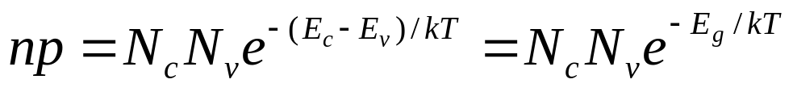
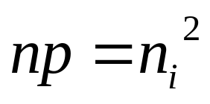
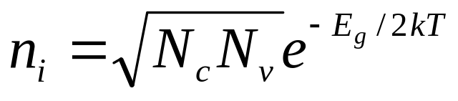
1.8.3 The np Product and the Intrinsic Carrier Concentration
Multiply
and
In an intrinsic (undoped) semiconductor, n = p = n_{i} .
n_{i} is the intrinsic carrier concentration, ~10¹⁰ cm⁻³ for Si.
Modern Semiconductor Devices for Integrated Circuits (C. Hu)
Slide 1-<number>

Slide 24
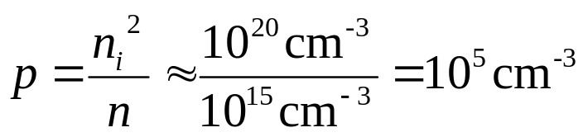

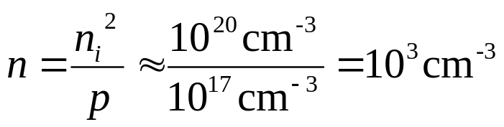
EXAMPLE: Carrier Concentrations
Question: What is the hole concentration in an N-type semiconductor with 10¹⁵ cm⁻³ of donors?
Solution: n = 10¹⁵ cm⁻³.
After increasing T by 60°C, n remains the same at 10¹⁵ cm⁻³ while p increases by about a factor of 2300 because .
Question: What is n if p = 10¹⁷cm⁻³ in a P-type silicon wafer?
Solution:
Modern Semiconductor Devices for Integrated Circuits (C. Hu)
Slide 1-<number>

Slide 25
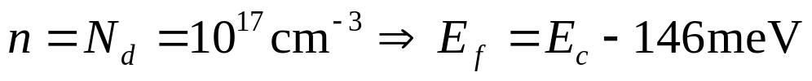
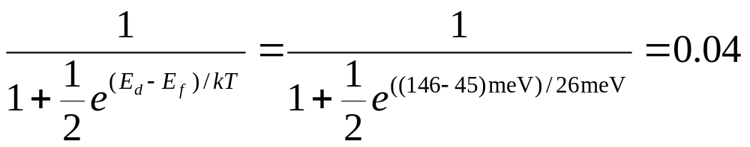
EXAMPLE: Complete ionization of the dopant atoms
1.9 General Theory of n and p
N_{d} = 10¹⁷ cm⁻³. What fraction of the donors are not ionized?
Solution: First assume that all the donors are ionized.
45meV
146 meV
E_{d}
E_{c}
E_{f}
E_{v}
Probability of not being ionized
≈
Therefore, it is reasonable to assume complete ionization, i.e., n = N_{d} .
Modern Semiconductor Devices for Integrated Circuits (C. Hu)
Slide 1-<number>

Slide 26
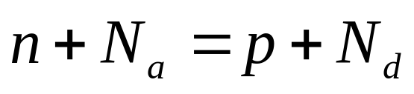
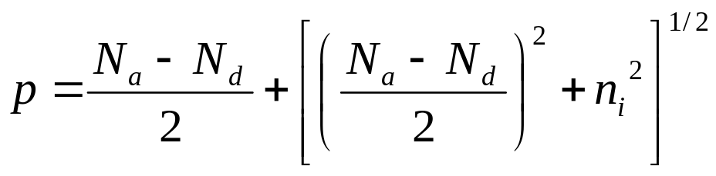
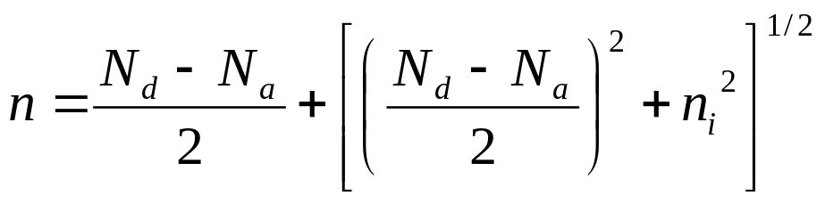
1.9 General Theory of n and p
Charge neutrality:
Modern Semiconductor Devices for Integrated Circuits (C. Hu)
Slide 1-<number>

Slide 27

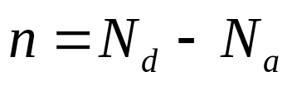
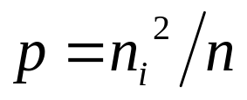


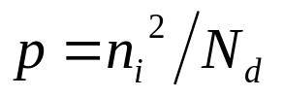

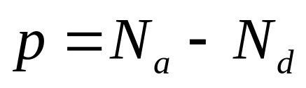
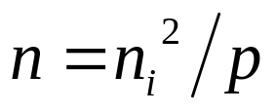



1.9 General Theory of on n and p
I.
(i.e., N-type)
If
,
and
II.
(i.e., P-type)
If
,
and
Modern Semiconductor Devices for Integrated Circuits (C. Hu)
Slide 1-<number>

Slide 28



EXAMPLE: Dopant Compensation
    What are n and p in Si with (a) N_{d} = 6×10¹⁶ cm⁻³ and N_{a} = 2×10¹⁶ cm⁻³ and (b) additional 6×10¹⁶ cm⁻³ of N_{a}?
(a)
(b) N_{a} = 2×10¹⁶ + 6×10¹⁶ = 8×10¹⁶ cm⁻³ > N_{d}
n = 4×10¹⁶ cm⁻³
. . . . . .
+ + + + + +
N_{d} = 6×10¹⁶ cm⁻³
N_{a} = 2×10¹⁶ cm⁻³
. . . . . . . . . . .
. . . . . .
+ + + + + +
N_{d} = 6×10¹⁶ cm⁻³
N_{a} = 8×10¹⁶ cm⁻³
- - - - - - - -
. . . . . .
p = 2×10¹⁶ cm⁻³
Modern Semiconductor Devices for Integrated Circuits (C. Hu)
Slide 1-<number>

Slide 29


1.10 Carrier Concentrations at Extremely High and Low Temperatures
intrinsic regime
n
n = N_{d}
n
l
freeze-out regime
1/T
High temp
Room temp
Cryogenic temp
high T:
low T:
Modern Semiconductor Devices for Integrated Circuits (C. Hu)
Slide 1-<number>

Slide 30
Infrared Detector Based on Freeze-out
To image the black-body radiation emitted by tumors requires a photodetector that responds to hν’s around 0.1 eV.
In doped Si operating in the freeze-out mode, conduction electrons are created when the infrared photons provide the energy to ionized the donor atoms.
electron
photon
E
c
E
d
E
v
Modern Semiconductor Devices for Integrated Circuits (C. Hu)
Slide 1-<number>

Slide 31

1.11 Chapter Summary
Energy band diagram. Acceptor. Donor. m_{n}, m_{p}.
Fermi function. E_{f} .
Modern Semiconductor Devices for Integrated Circuits (C. Hu)
Slide 1-<number>

