Slide 1
ECE 105: Introduction to Electrical Engineering
Lecture 12
Optoelectronics
Yasser Khan
Rehan Kapadia

Slide 2
CMOS (Complementary MOS) Inverter

Slide 3










CMOS (Complementary MOS) Inverter

Slide 4











CMOS (Complementary MOS) Inverter

Slide 5






CMOS (Complementary MOS) Inverter

Slide 6
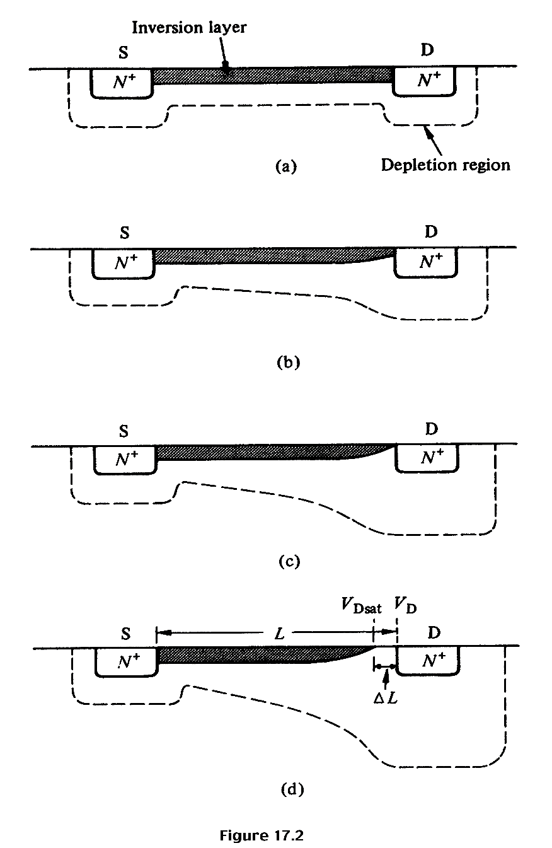














Qualitative discussion: n-MOSFET
V_{G} > V_{T} ; V_{DS} ≈ 0
I_{D} increases with V_{DS}
V_{G} > V_{T}; V_{DS} small, > 0
I_{D} increases with V_{DS} , but rate of increase decreases.
V_{G} > V_{T}; V_{DS} ≈ pinch-off
I_{D} reaches a saturation value, I_{D,sat} The V_{DS} value is called V_{DS,sat}
V_{G} > V_{T}; V_{DS} > V_{DS,sat}
I_{D} does not increase further, saturation region.

Slide 7
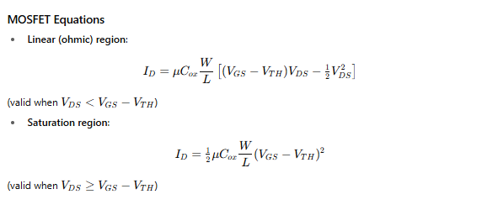




Quantitative I_{D}-V_{DS} Relationships – 1st attempt “Square Law”
;
I_{D} will increase as V_{DS} is increased, but when V_{G} – V_{DS} = V_{T}, pinch-off occurs, and current saturates when V_{DS} is increased further. This value of V_{DS} is called V_{DS,sat}. i.e., V_{DS,sat} = V_{G} – V_{T} and the current when V_{DS}= V_{DS,sat} is called I_{DS,sat}.
;
Here, C_{ox} is the oxide capacitance per unit area, C_{ox} = ε_{ox} / x_{ox}

Slide 8
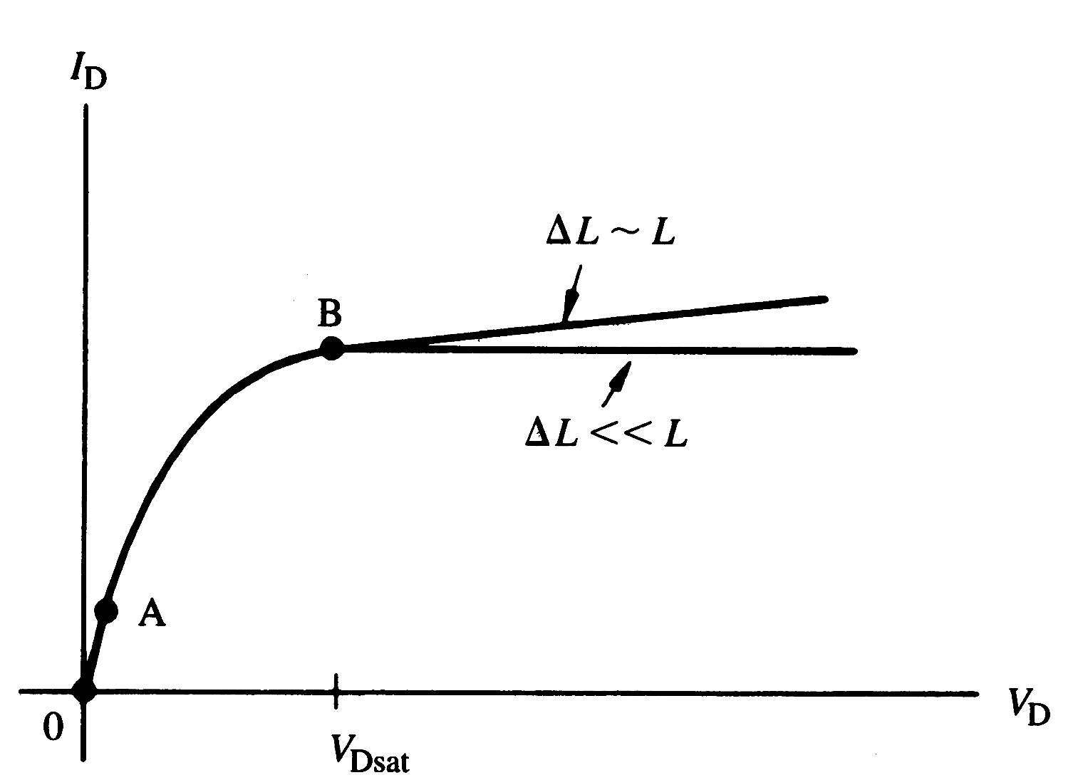
I_{D}-V_{DS} characteristics for n-MOSFET
Linear
region
Saturation
region

Slide 9
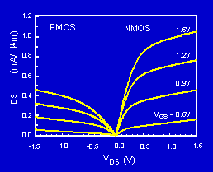
P-MOSFET N-MOSFET IV Characteristics
The PMOS IV is qualitatively similar to the NMOS IV, but the current is about half as large. Why?

Slide 10
Threshold and Subthreshold

Slide 11
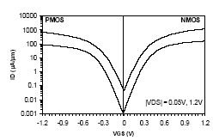
Subthreshold Current
The leakage current that flows at V_{g}<V_{t} is called the subthreshold current. Previously we had assumed that current is zero, but in reality that’s not the case.
)
m
μ
Intel, T. Ghani et al., IEDM 2003
/
90nm technology. Gate length: 45nm for NMOS, 50nm for PMOS
A
μ
(
s
I
d
V_{gs}
The current at V_{gs}=0 and V_{ds}=V_{dd} is called I_{off.}

Slide 12
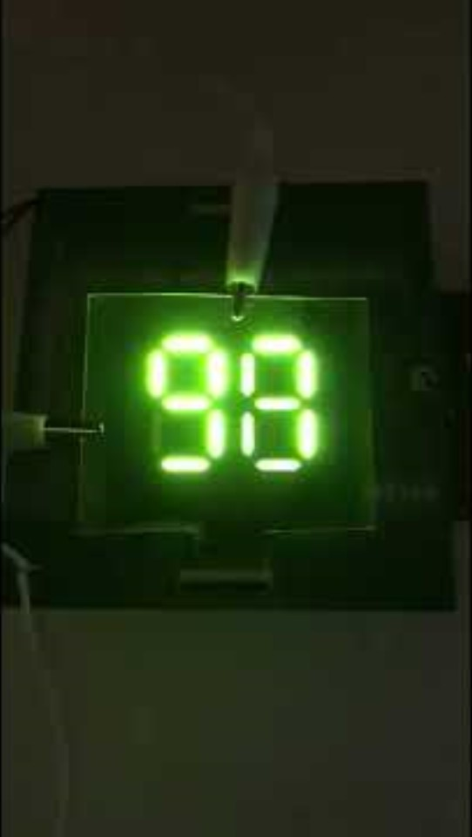
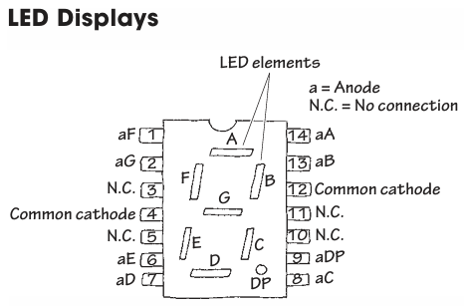







The seven-segment display

Slide 13
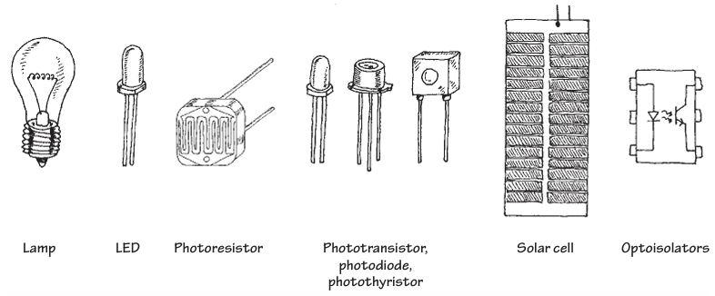






Light-based devices

Slide 14
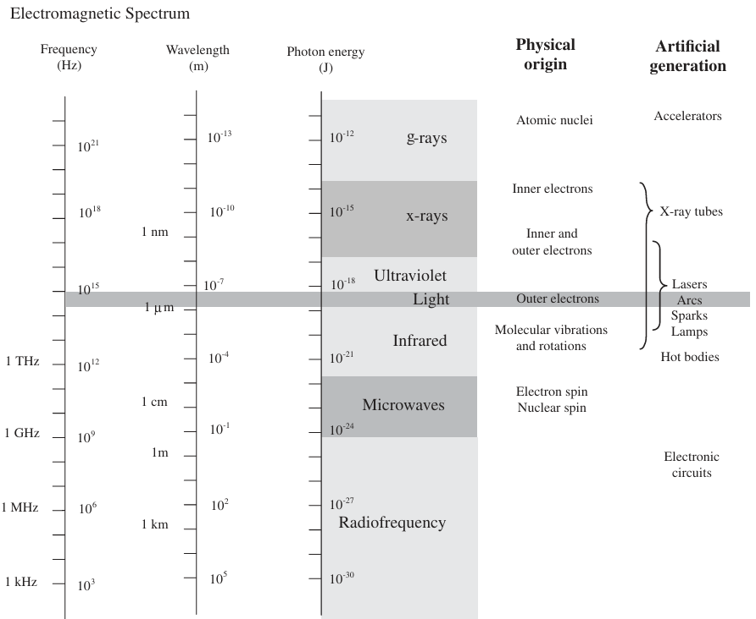
Artificially generating light

Slide 15
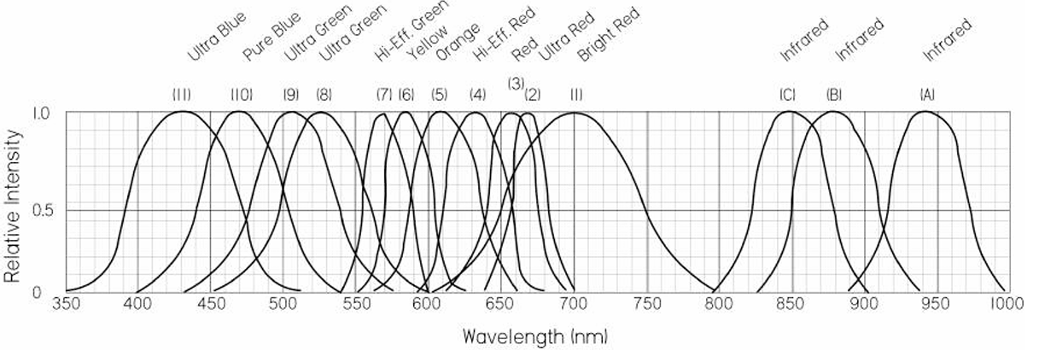
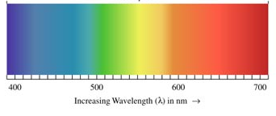
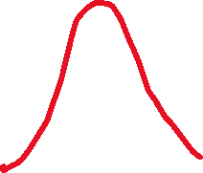
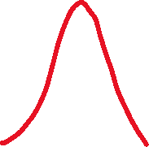
LED emission spectra

Slide 16
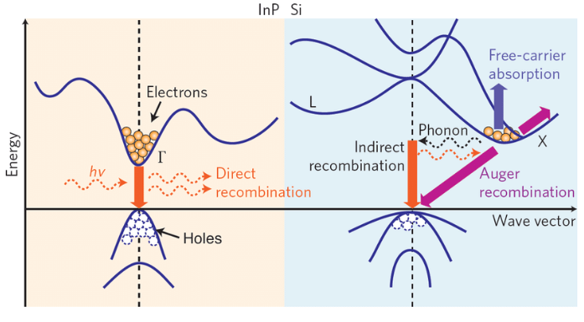





Direct vs indirect semiconductors
2 Energy band diagrams and major carrier transition processes in indium phosphide (direct bandgap) and silicon (indirect bandgap) crystals. Silicon, Germanium and some III/V compounds like GaP and AlAs are indirect bandgap semiconductors. InP, GaAs, GaN and other ternary (AlGaAs, InGaAs) and quaternary (InGaAsP, InAlAsP) compounds are direct bandgap semiconductors commonly used for photonic devices fabrication.

Slide 17
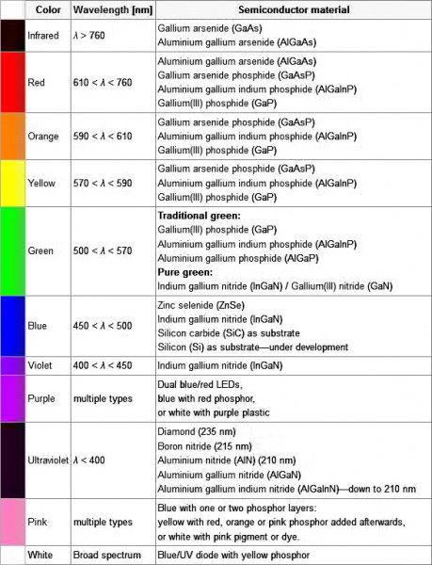
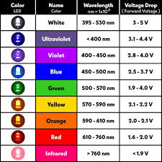

















LEDs are made out of non-silicon semiconductors

Slide 18
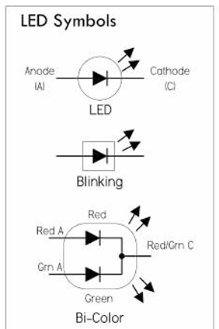






LED symbols

Slide 19
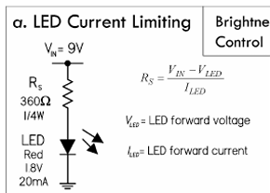



LED driver circuit

Slide 20








LED driver circuit

Slide 21
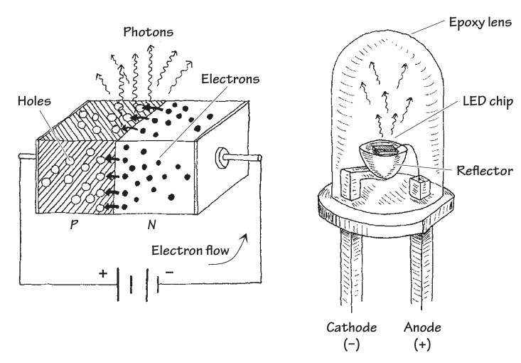



LED is a diode

Slide 22
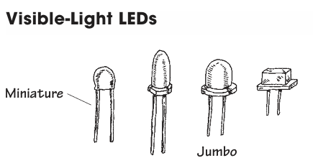
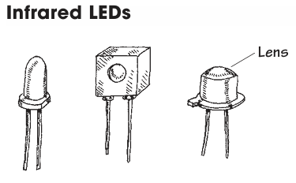
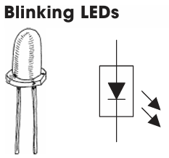
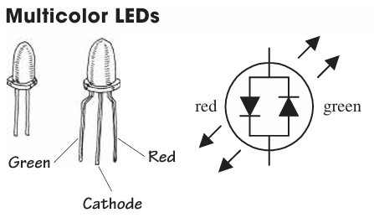



LED packages

Slide 23
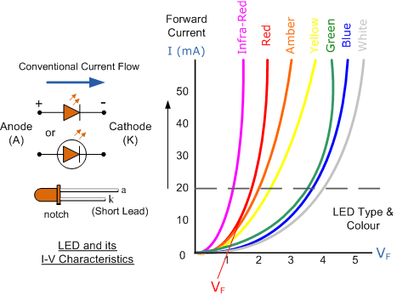





IV characteristics for LEDs

Slide 24

Blue LED won the 2014 Nobel in Physics

Slide 25


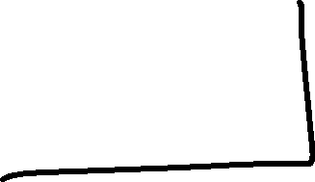

Slide 26
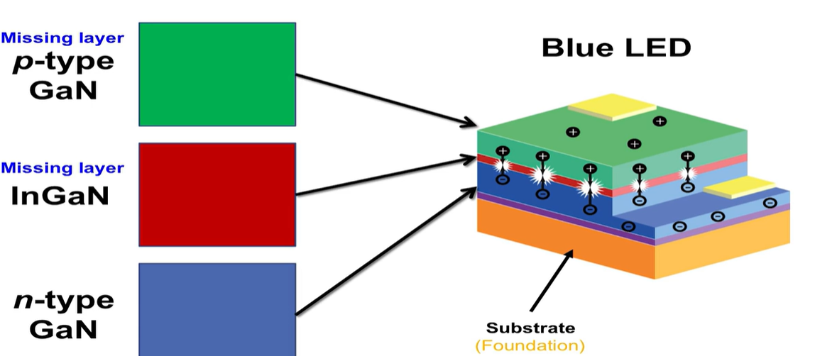

Steps to get the Blue LED
Notes:
Experiments everyday for 1.5 years

Slide 27
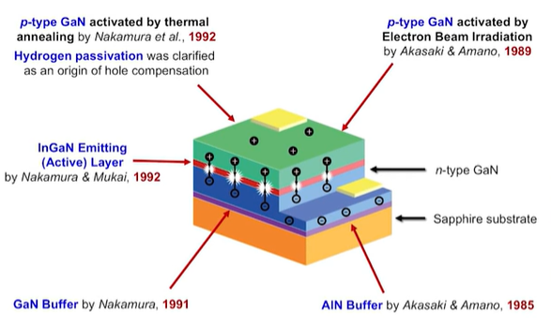
InGaN LEDs

Slide 28
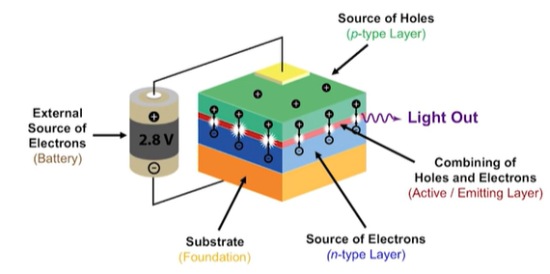
LED colors – single color from on LED

Slide 29
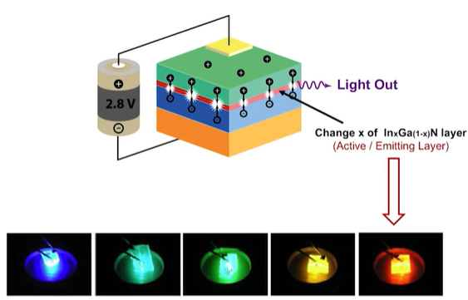
Changing emission colors – can you change color?
Notes:
GaN blue more in

Slide 30
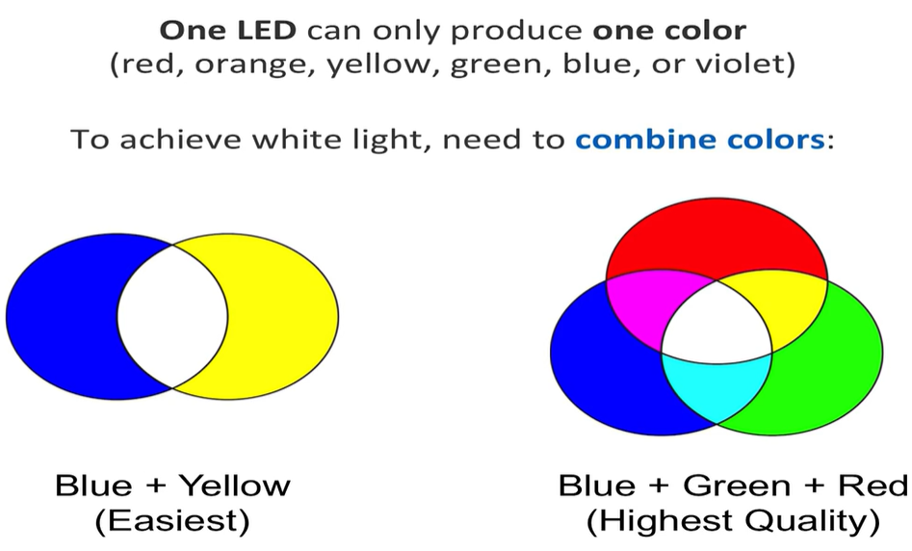
How to get white light

Slide 31
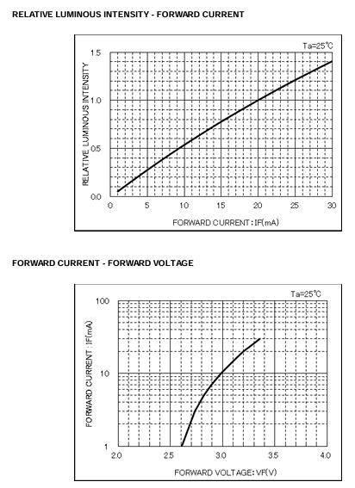
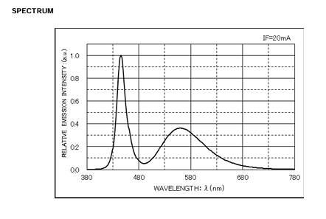



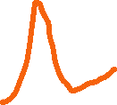




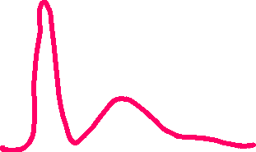
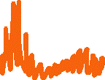






The LED in our demo board
https://fscdn.rohm.com/en/products/databook/datasheet/opto/led/chip_mono/csl0416wbcw1-e.pdf
Notes:
Blue peak and second peak from Yttrium Aluminum Garnet (YAG) LED Phosphor

Slide 32









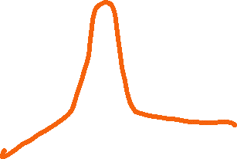
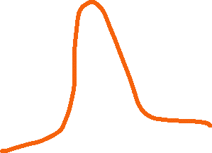


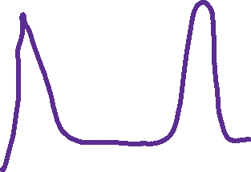



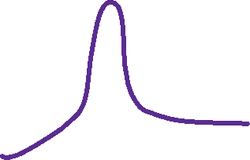


Slide 33














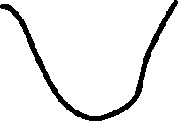
How does a photodiode work

Slide 34








How does a photodiode work

Slide 35


How does a photodiode work

Slide 36
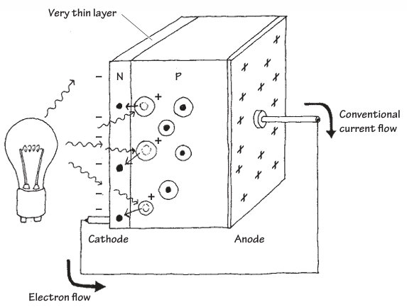

Photodiode

Slide 37














IV of photodiode

Slide 38
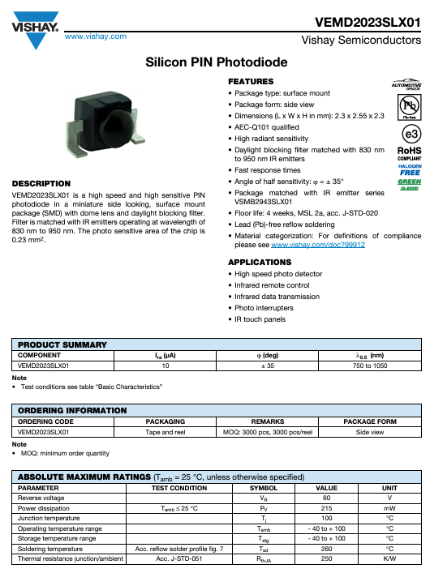
The PD in our demo board
https://www.vishay.com/docs/83493/vemd2023slx01.pdf

Slide 39
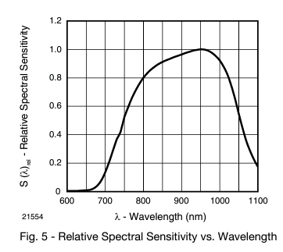
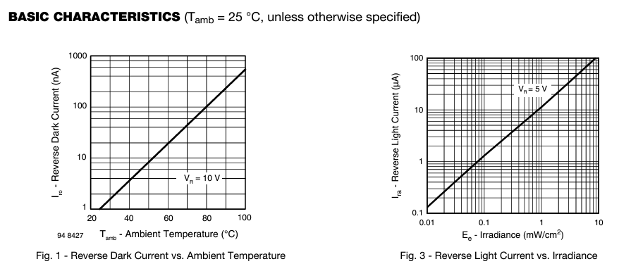
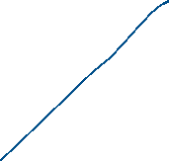

PD characteristics

Slide 40
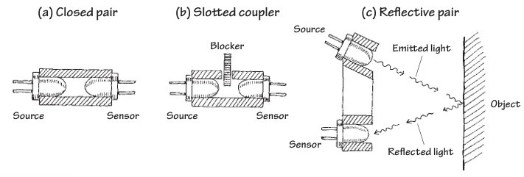
LED-PD combo

