Slide 1
ECE 105: Introduction to Electrical Engineering
Lecture 8
Circuit Problems - Recap
Yasser Khan
Rehan Kapadia

Slide 2
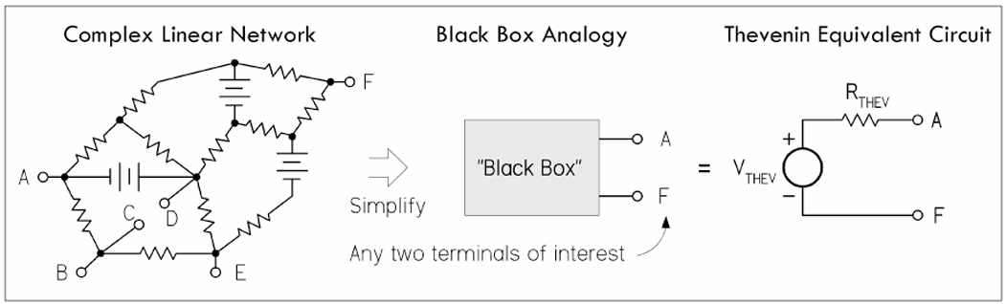




Equivalent circuits

Slide 3











Equivalent circuits

Slide 4
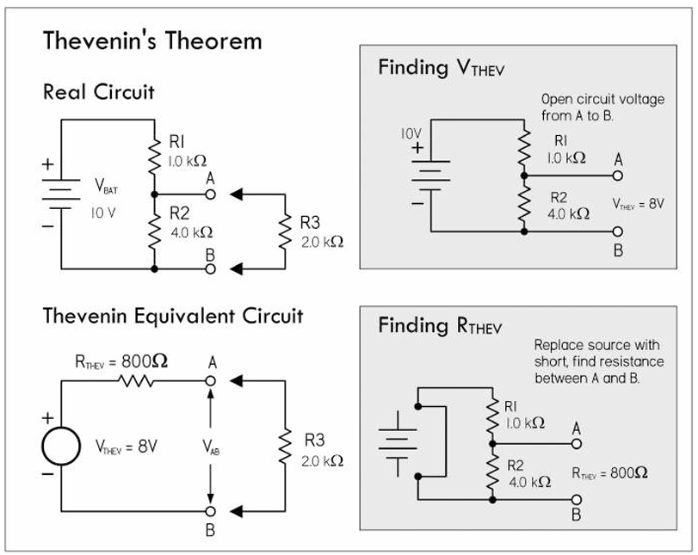



Thevenin’s equivalent circuit

Slide 5












Slide 6

















Slide 7









Slide 8




Slide 9




Slide 10





Slide 11











Slide 12
















Slide 13
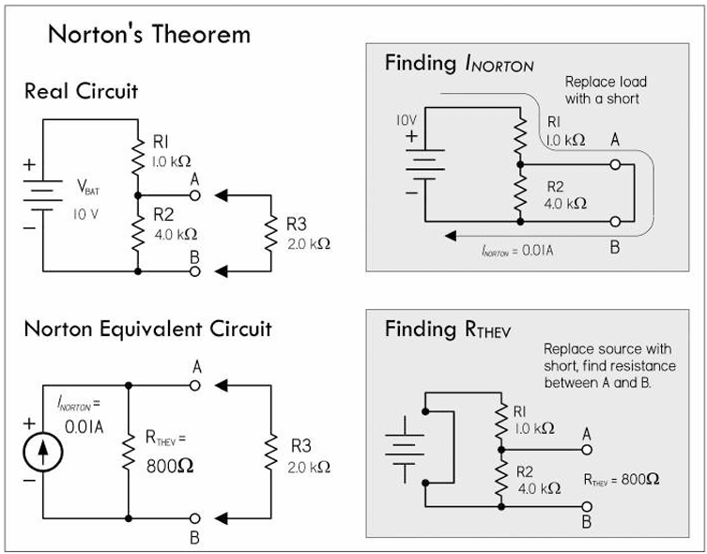
Norton’s equivalent circuit

Slide 14





Norton’s equivalent circuit

Slide 16















Slide 17










Norton’s equivalent circuit

Slide 18
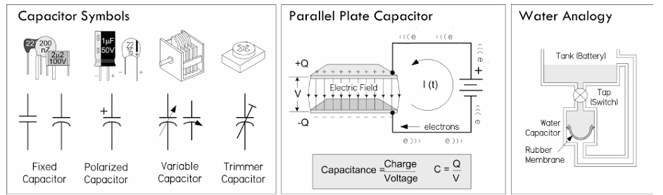





Capacitors

Slide 19
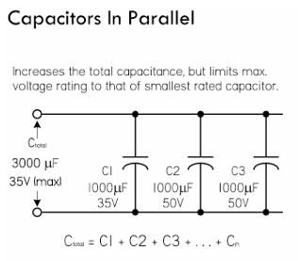
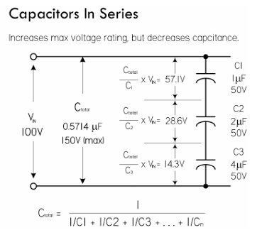
Capacitors

Slide 20
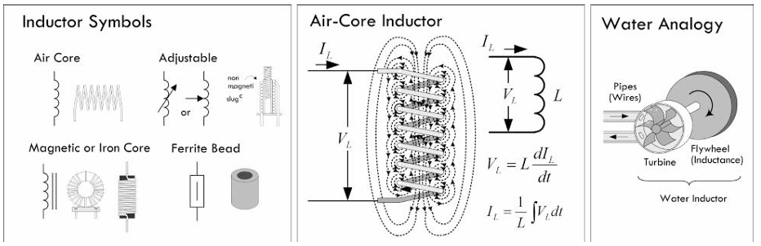


Inductors

Slide 21
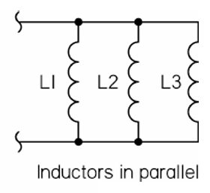
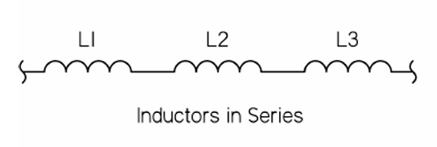


Inductors

Slide 22
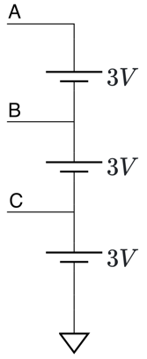








Problem 1
Given the circuit diagram with nodes A, B, and C, each connected to 3V sources as shown. Determine the voltages V_{A}​, V_{B}​, and V_{C}​ at the respective nodes with respect to the ground.

Slide 23








Problem 1
Given the circuit diagram with nodes A, B, and C, each connected to 3V sources as shown. Determine the voltages V_{A}​, V_{B}​, and V_{C}​ at the respective nodes with respect to the ground.

Slide 24
KCL

Slide 25
KVL

Slide 26
Voltage divider

Slide 27
Current divider

Slide 28
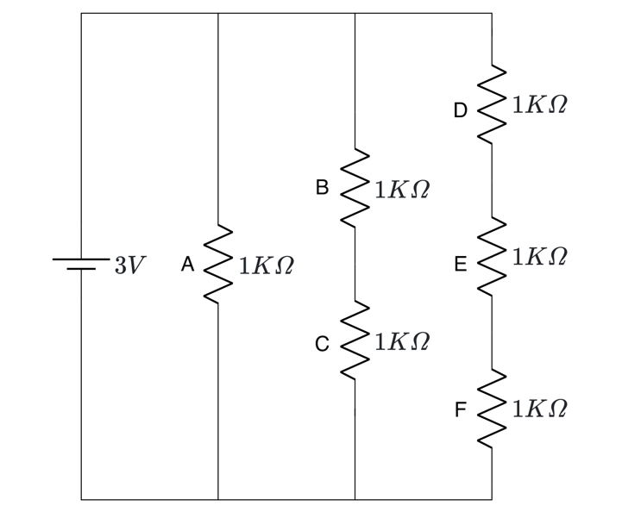













Problem 2
Given the circuit with six resistors connected to a 3V voltage source as shown. Find voltages across the resistors (V_{A}, V_{B}, V_{C}, V_{D}, V_{E}, and V_{F}) and current through resistors (I_{A}, I_{B}, I_{C}, I_{D}, I_{E}, and I_{F}).

Slide 29






















Problem 2
Given the circuit with six resistors connected to a 3V voltage source as shown. Find voltages across the resistors (V_{A}, V_{B}, V_{C}, V_{D}, V_{E}, and V_{F}) and current through resistors (I_{A}, I_{B}, I_{C}, I_{D}, I_{E}, and I_{F}).

Slide 30



Problem 2
Given the circuit with six resistors connected to a 3V voltage source as shown. Find voltages across the resistors (V_{A}, V_{B}, V_{C}, V_{D}, V_{E}, and V_{F}) and current through resistors (I_{A}, I_{B}, I_{C}, I_{D}, I_{E}, and I_{F}).

Slide 31
Problem 2
Given the circuit with six resistors connected to a 3V voltage source as shown. Find voltages across the resistors (V_{A}, V_{B}, V_{C}, V_{D}, V_{E}, and V_{F}) and current through resistors (I_{A}, I_{B}, I_{C}, I_{D}, I_{E}, and I_{F}).

Slide 32
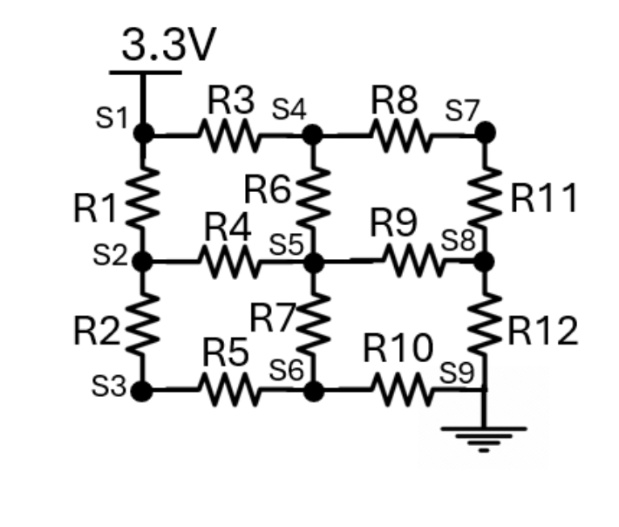



















Problem 3
Given the circuit diagram with nodes S₁ to S₉, S₁ is connected to 3.3V and GND (0V). Determine the voltages S₁ to S₉ ​ at the respective nodes with respect to the ground if R₁ to R₁₂ = R

Slide 33







Problem 3
Given the circuit diagram with nodes S₁ to S₉, S₁ is connected to 3.3V and GND (0V). Determine the voltages S₁ to S₉ ​ at the respective nodes with respect to the ground if R₁ to R₁₂ = R

Slide 34
Problem 3
Given the circuit diagram with nodes S₁ to S₉, S₁ is connected to 3.3V and GND (0V). Determine the voltages S₁ to S₉ ​ at the respective nodes with respect to the ground if R₁ to R₁₂ = R

