Slide 1
ECE 105: Introduction to Electrical Engineering
Lecture 4
Circuit Analysis 2
Yasser Khan
Rehan Kapadia

Slide 2
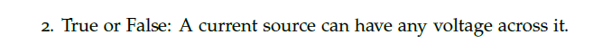
Voltage across a current source
The voltage across an ideal current source is completely determined by the circuit it is connected to.

Slide 3
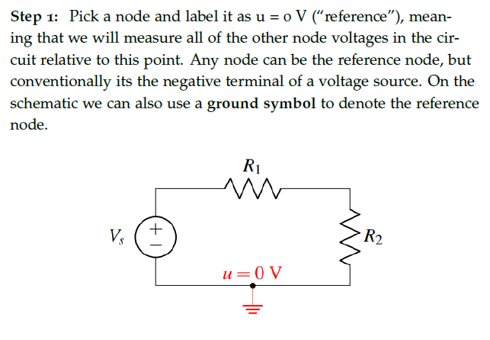
Nodal analysis

Slide 4
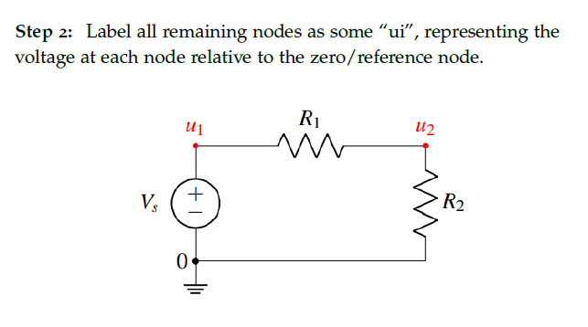
Label nodes

Slide 5
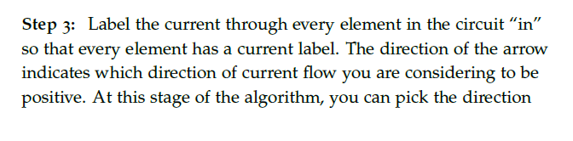
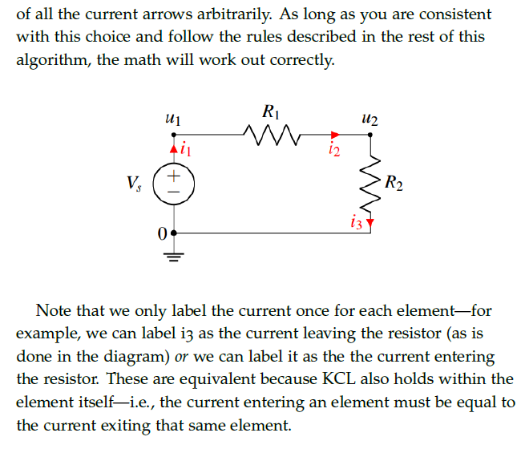
Label currents

Slide 6
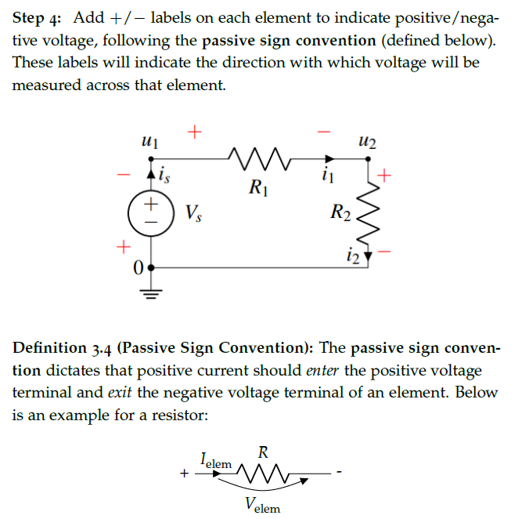
Voltage drop directions

Slide 7
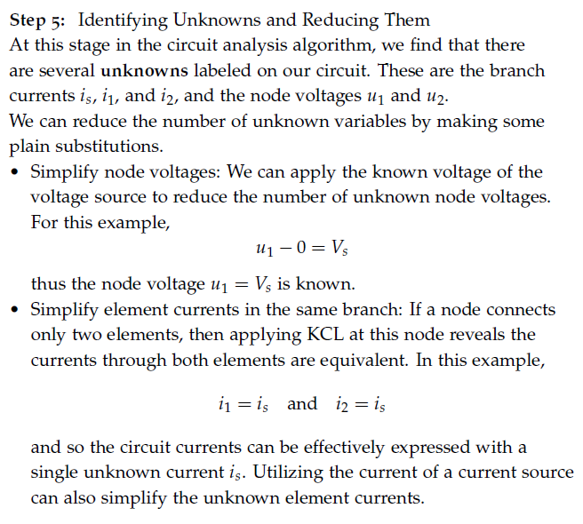
Write equations based on KCL and Ohm’s law

Slide 8
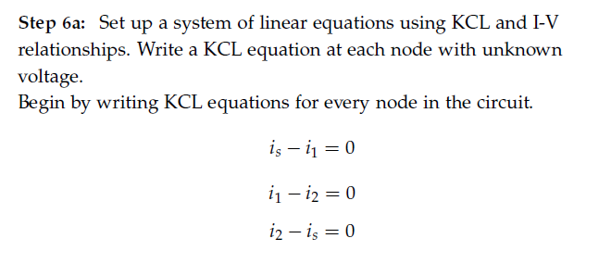
Write equations based on KCL and Ohm’s law

Slide 9
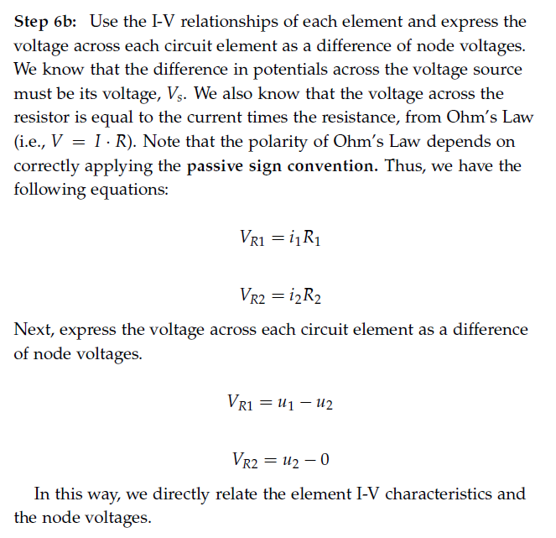
Write equations based on KCL and Ohm’s law

Slide 10
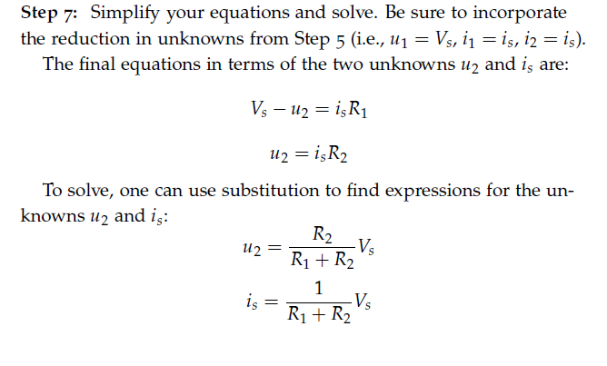
Solve for unknowns

Slide 11








Touchpad – Network 2 in the demo board

Slide 12








Touchpad – Network 2 in the demo board

Slide 13

Touchpad – Network 2 in the demo board

Slide 14






Touchpad – Network 2 in the demo board

Slide 15





Touchpad – Network 2 in the demo board

Slide 16
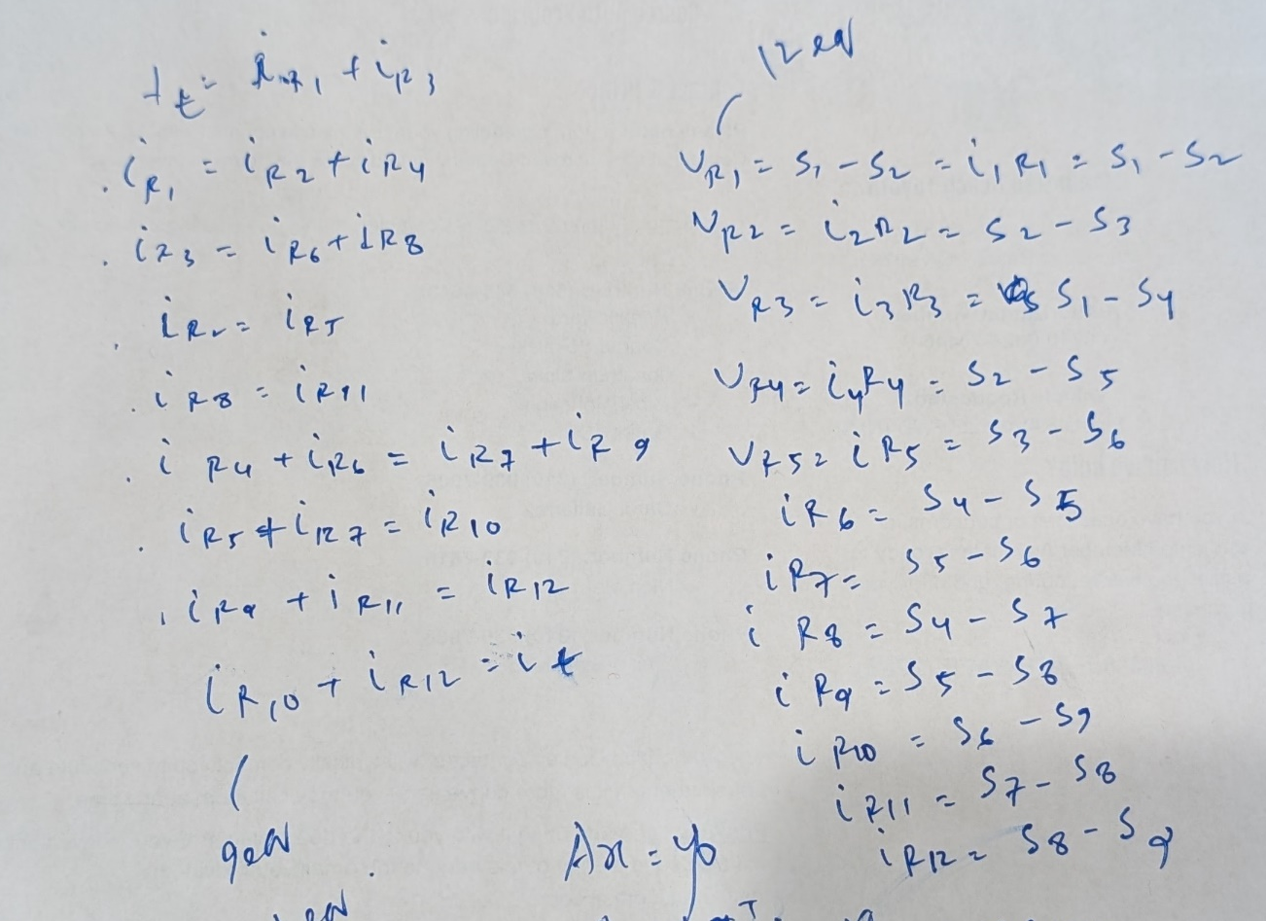
Touchpad – Network 2 in the demo board

Slide 17

Touchpad – Network 2 in the demo board

Slide 18
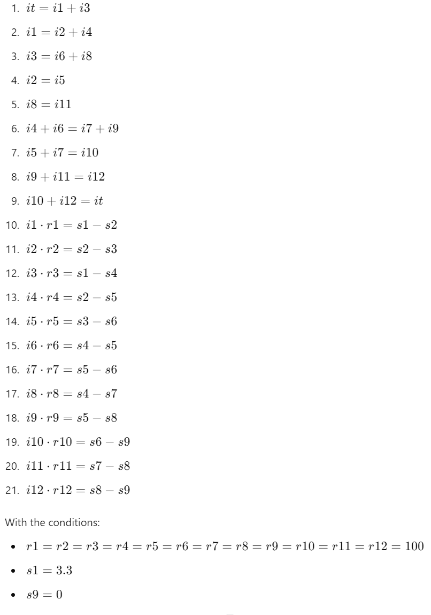
Touchpad – Network 2 in the demo board

Slide 19
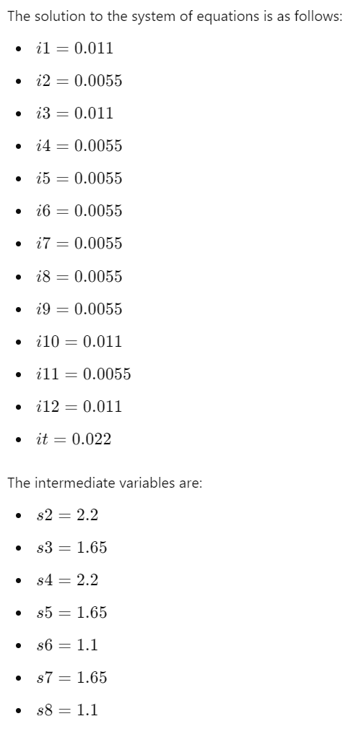
Touchpad – Network 2 in the demo board

Slide 20
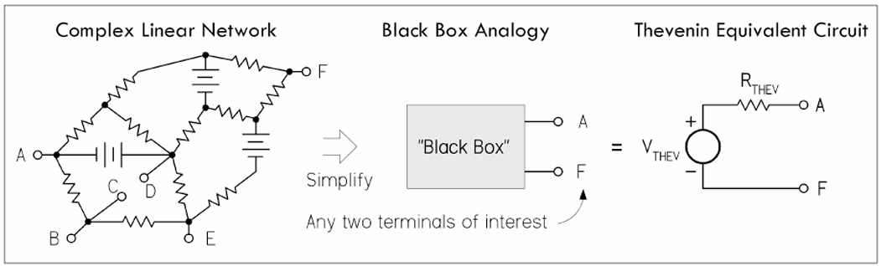
Equivalent circuits

Slide 21
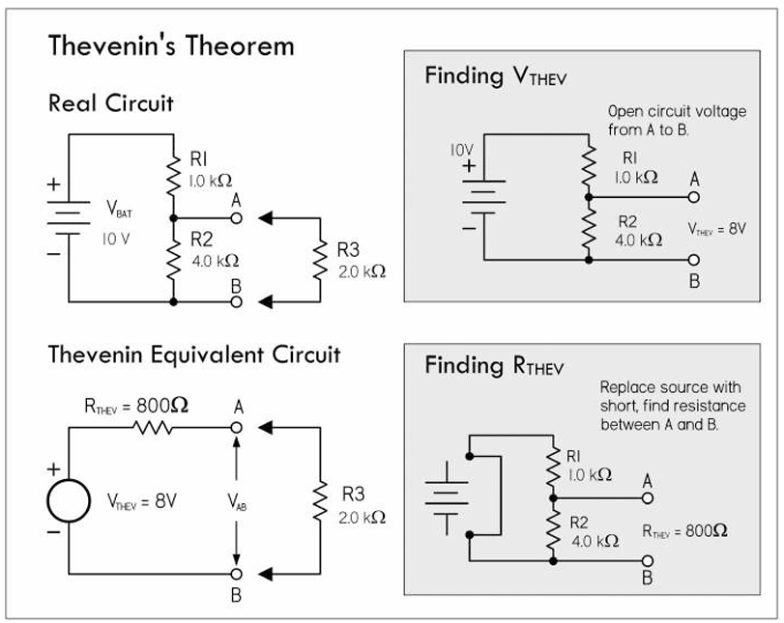
Thevenin’s equivalent circuit

Slide 22
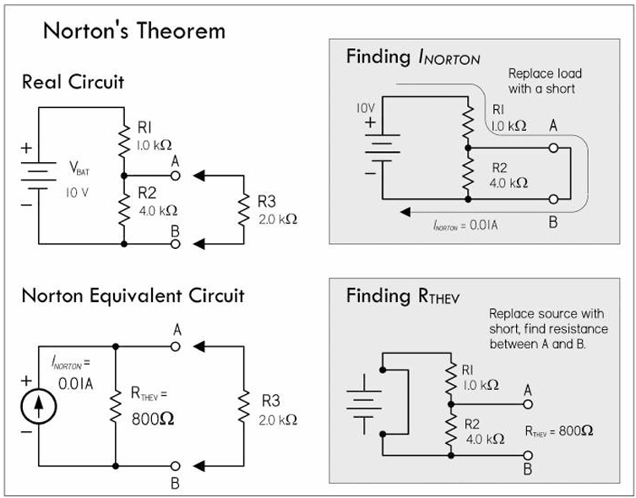
Norton’s equivalent circuit

Slide 23
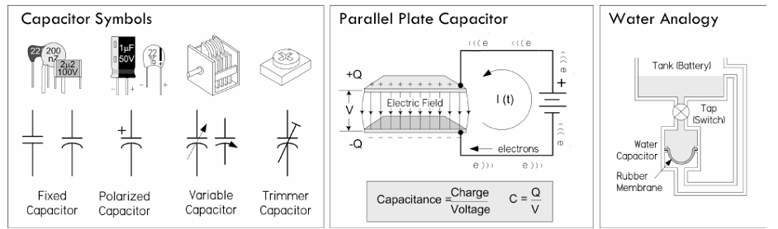
Capacitors

Slide 24
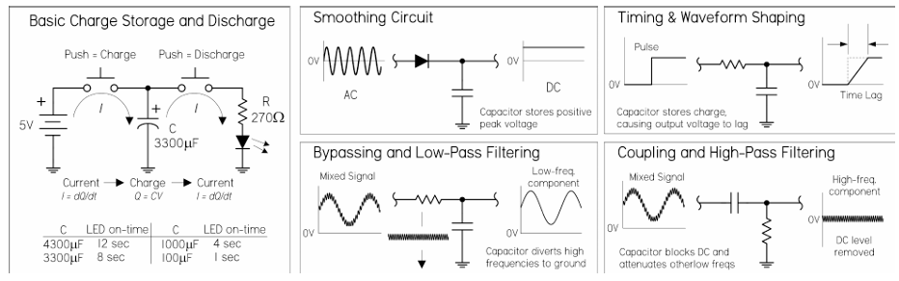
Capacitors

Slide 25
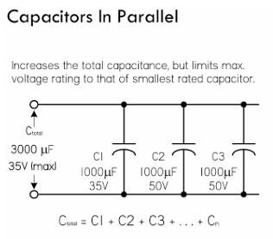
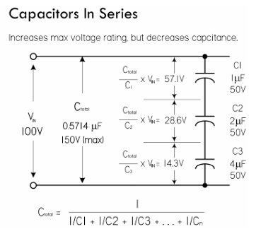
Capacitors

Slide 26
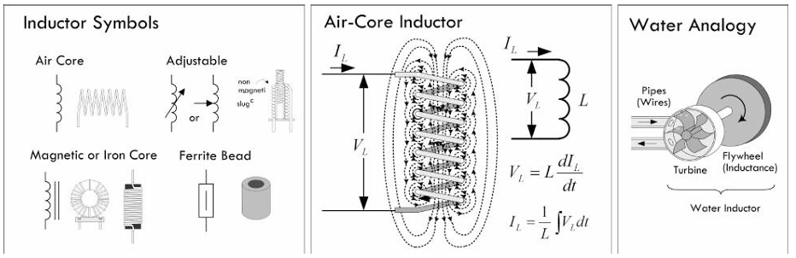
Inductors

Slide 27
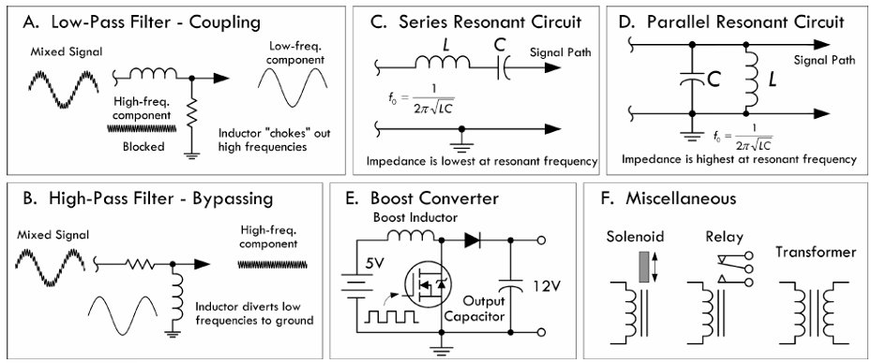
Inductors

Slide 28
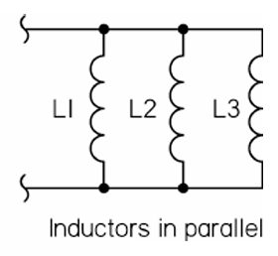
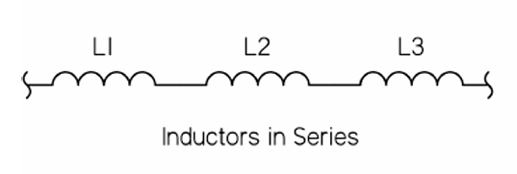
Inductors

