Slide 1
ECE 105: Introduction to Electrical Engineering
Lecture 7
Circuit Problems
Yasser Khan
Rehan Kapadia

Slide 2
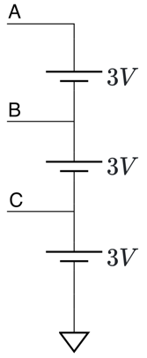
Problem 1
Given the circuit diagram with nodes A, B, and C, each connected to 3V sources as shown. Determine the voltages V_{A}​, V_{B}​, and V_{C}​ at the respective nodes with respect to the ground.

Slide 3
KCL

Slide 4
KVL

Slide 5
Voltage divider

Slide 6
Current divider

Slide 7
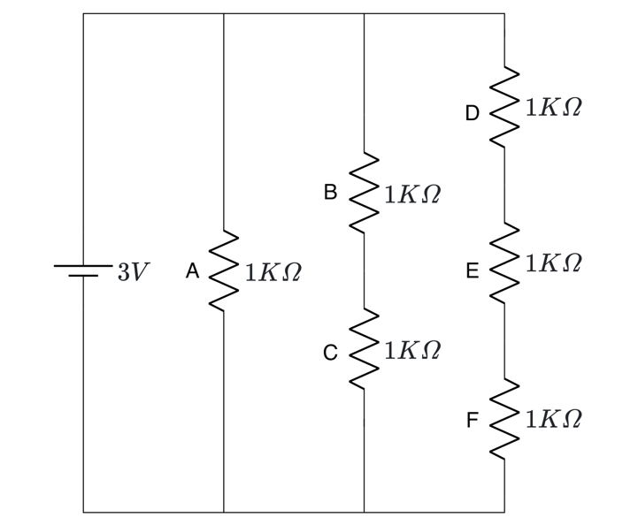
Problem 2
Given the circuit with six resistors connected to a 3V voltage source as shown. Find voltages across the resistors (V_{A}, V_{B}, V_{C}, V_{D}, V_{E}, and V_{F}) and current through resistors (I_{A}, I_{B}, I_{C}, I_{D}, I_{E}, and I_{F}).

Slide 8
Problem 2
Given the circuit with six resistors connected to a 3V voltage source as shown. Find voltages across the resistors (V_{A}, V_{B}, V_{C}, V_{D}, V_{E}, and V_{F}) and current through resistors (I_{A}, I_{B}, I_{C}, I_{D}, I_{E}, and I_{F}).

Slide 9
Problem 2
Given the circuit with six resistors connected to a 3V voltage source as shown. Find voltages across the resistors (V_{A}, V_{B}, V_{C}, V_{D}, V_{E}, and V_{F}) and current through resistors (I_{A}, I_{B}, I_{C}, I_{D}, I_{E}, and I_{F}).

Slide 10
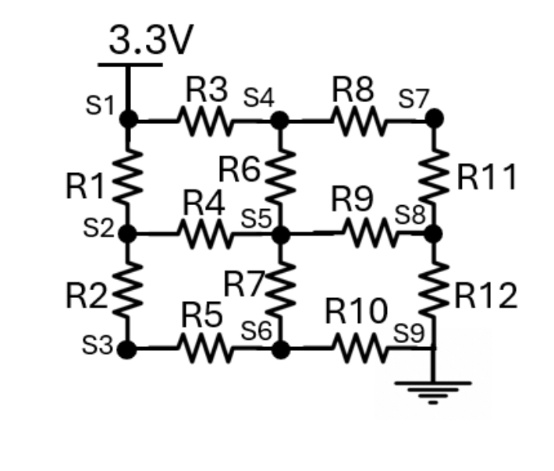
Problem 3
Given the circuit diagram with nodes S₁ to S₉, S₁ is connected to 3.3V and GND (0V). Determine the voltages S₁ to S₉ ​ at the respective nodes with respect to the ground if R₁ to R₁₂ = R

Slide 11
Problem 3
Given the circuit diagram with nodes S₁ to S₉, S₁ is connected to 3.3V and GND (0V). Determine the voltages S₁ to S₉ ​ at the respective nodes with respect to the ground if R₁ to R₁₂ = R

Slide 12
Problem 3
Given the circuit diagram with nodes S₁ to S₉, S₁ is connected to 3.3V and GND (0V). Determine the voltages S₁ to S₉ ​ at the respective nodes with respect to the ground if R₁ to R₁₂ = R

Slide 13
Python notebook

