Slide 1
ECE 105: Introduction to Electrical Engineering
Lecture 2
System design and intro to Arduino
Yasser Khan
Rehan Kapadia

Slide 2
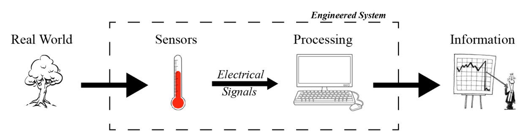






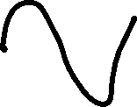


Breaking down engineering systems
Any signal, for example temperature, touch, brain signal, video inputs, etc.
Temperature sensors, resistive touchscreen, brain electrodes, camera, etc.
Processing circuits, analog and digital computing, etc.
Modules in ECE 105: biosensor, linear algebra, neural network, optical comm
Modules in ECE 105: circuits, devices
Industry positions in apple, intel, meta, neuralink, etc
Industry positions in NVIDIA, Raytheon, Qualcomm, etc

Slide 3
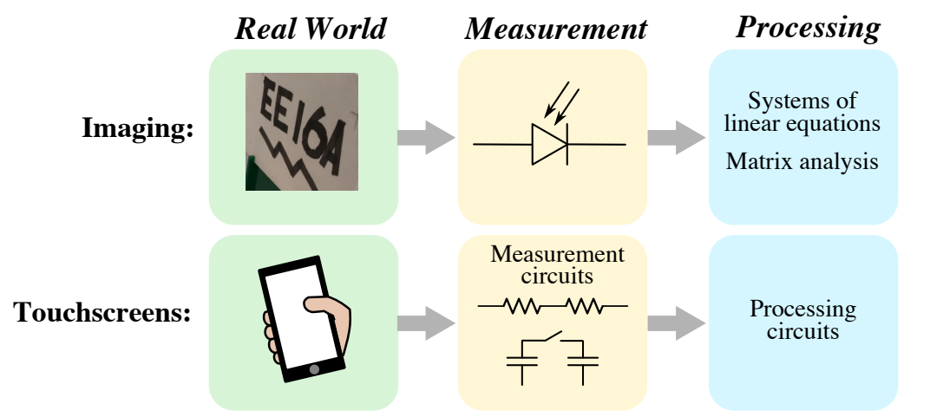
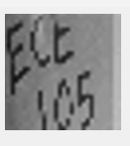
Breakdown of hardware and software
Hardware
Hardware + Software
Our own sensors + Arduino
Software running in Arduino + python (jupyter notebook)

Slide 4
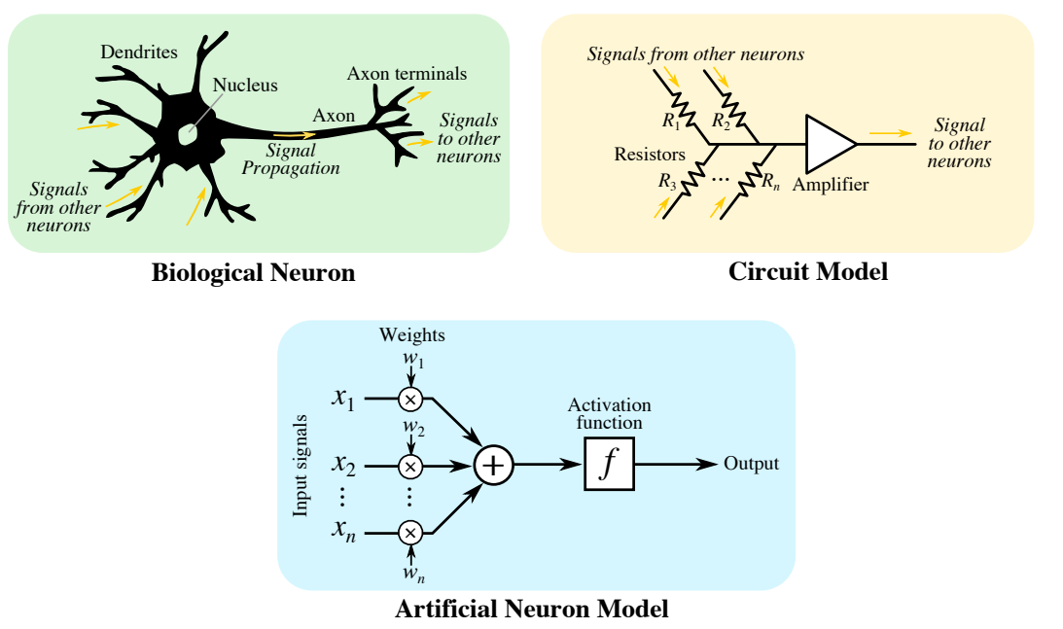
Equivalence to human body

Slide 5
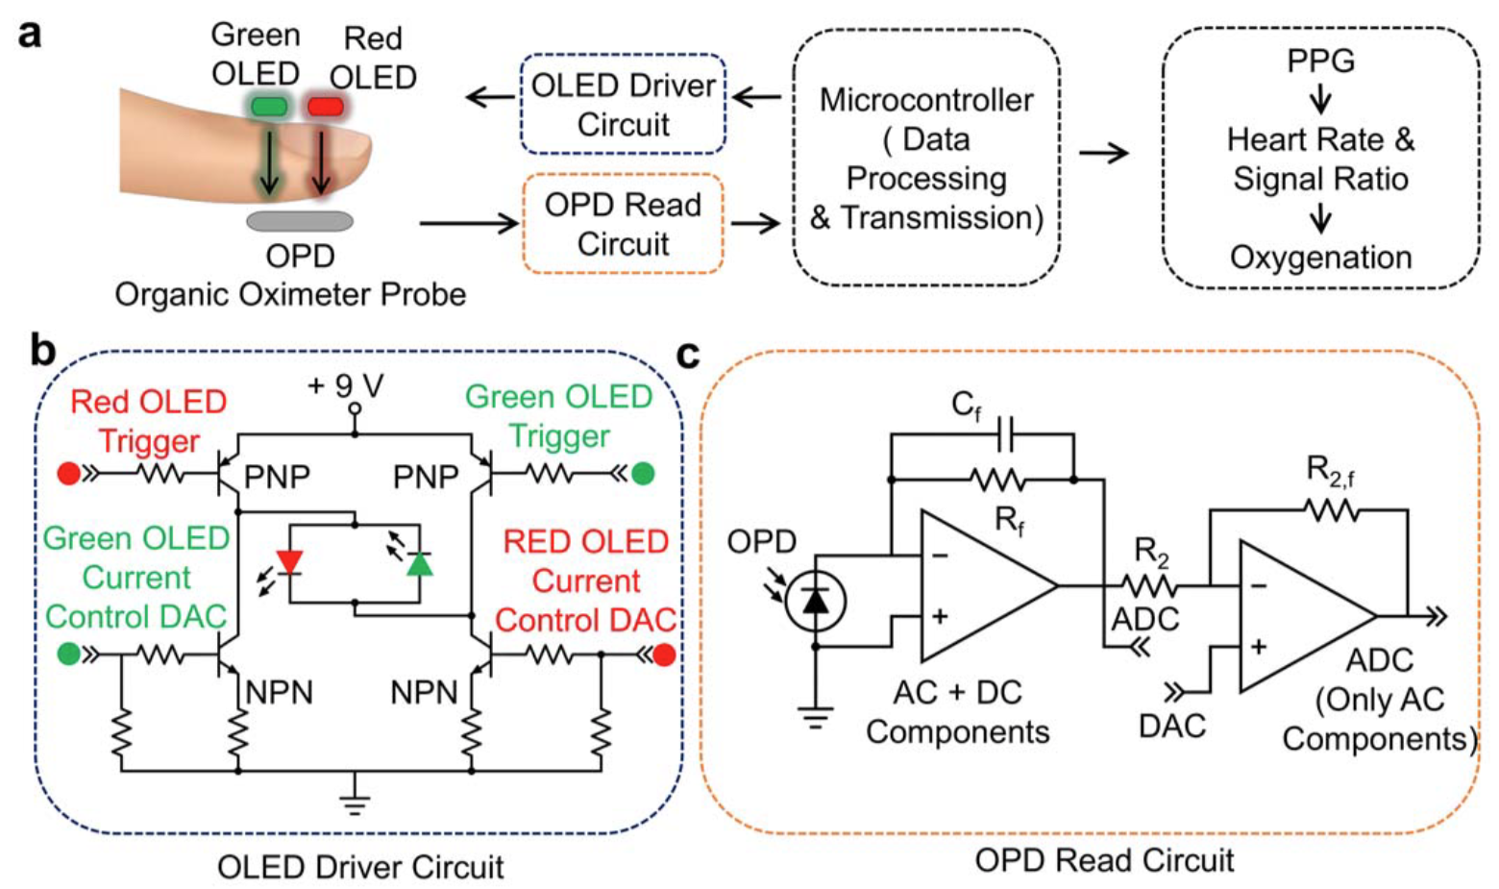

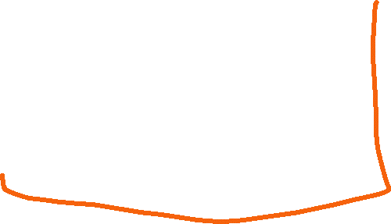

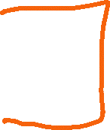

Oximeter system breakdown
Sensors
Processing
Information

Slide 6
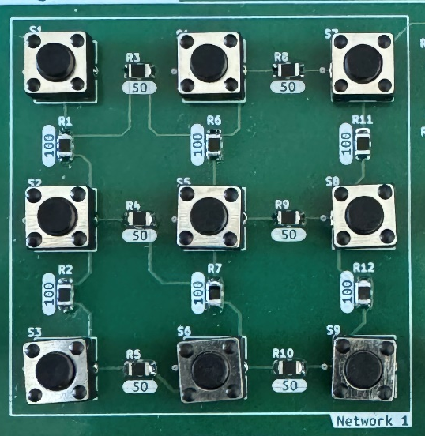
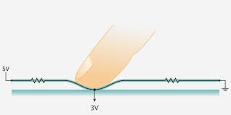
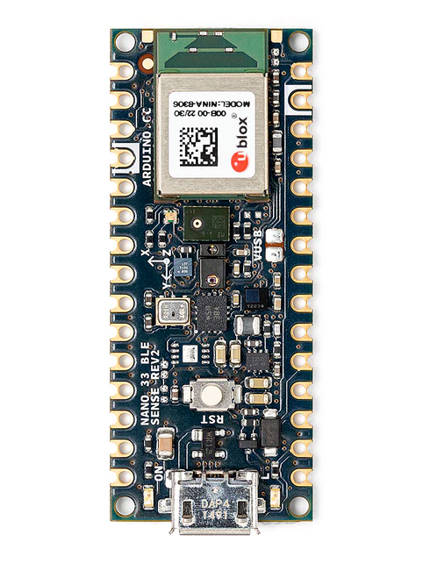
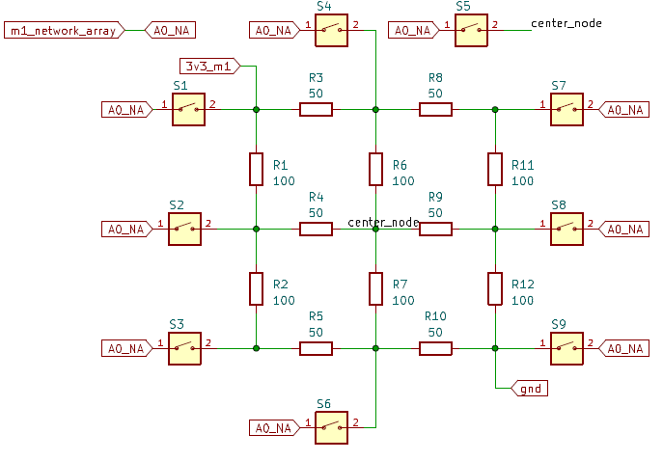
Resistive touchscreen system breakdown
Real world
Sensors
Processing
Information
S1
S4
S7
S2
S5
S8
S3
S6
S9

Slide 7






Resistive touchscreen system approach
Goal
Build a sensor that can detect touch
Connect to Arduino for processing
3.3V
50 Ω
50 Ω
S1
S4
S7
100 Ω
100 Ω
50 Ω
50 Ω
Get location from the voltage measurement
S2
S5
S8
100 Ω
100 Ω
50 Ω
50 Ω
S3
S6
S9
GND

Slide 8
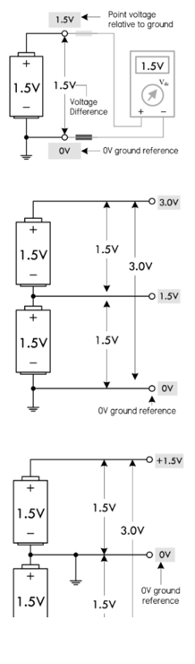
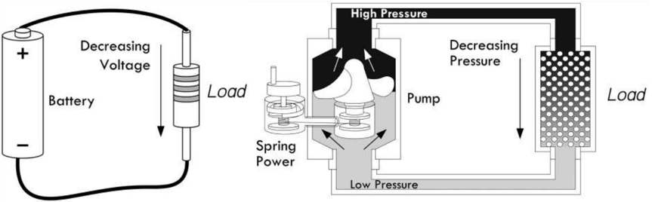

Voltage
Voltage is the pressure from an electrical circuit's power source that pushes charged electrons (current) through a conducting loop, enabling them to do work such as illuminating a light. In brief, voltage = pressure, and it is measured in volts (V). The term recognizes Italian physicist Alessandro Volta (1745-1827), inventor of the voltaic pile—the forerunner of today's household battery. In electricity's early days, voltage was known as electromotive force (emf).

Slide 9
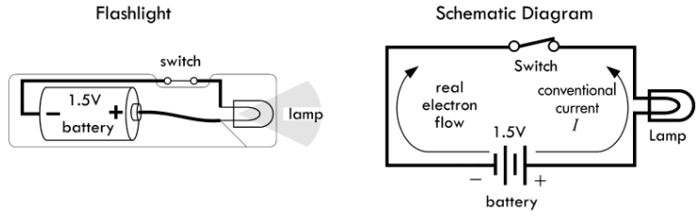
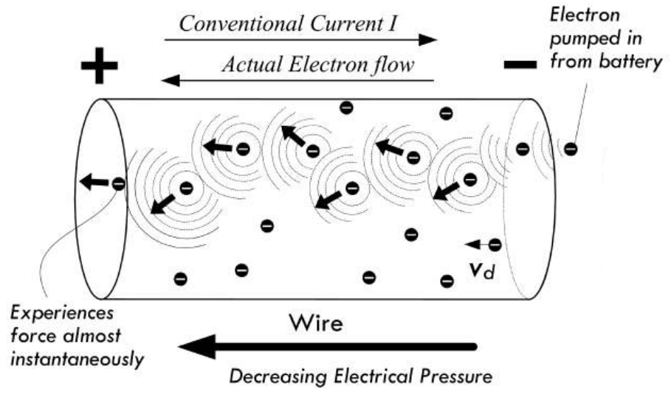
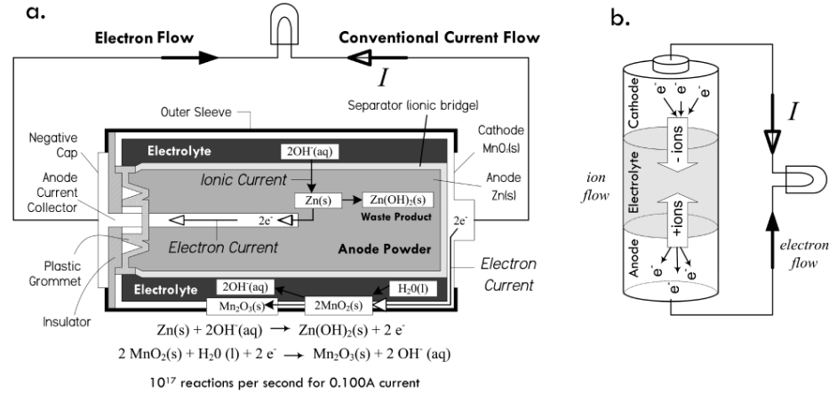





Voltage

Slide 10
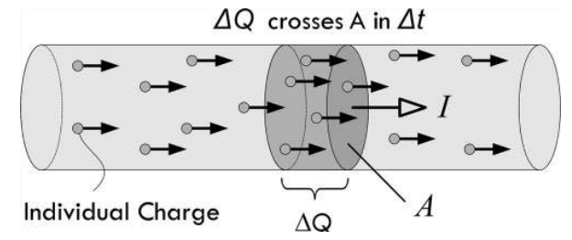
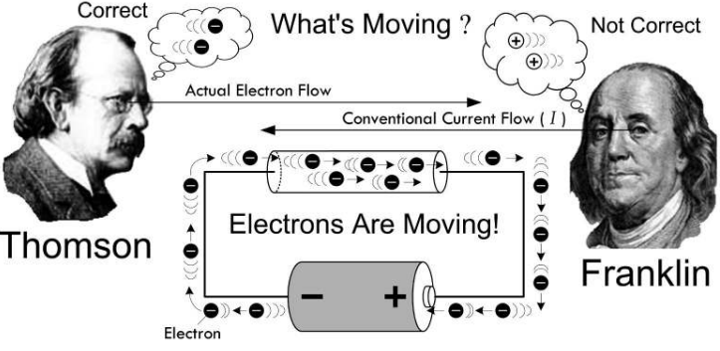
Flow of charge – current
Current is the rate at which electrons flow past a point in a complete electrical circuit. At its most basic, current = flow.
An ampere (AM-pir), or amp, is the international unit used for measuring current. It expresses the quantity of electrons (sometimes called "electrical charge") flowing past a point in a circuit over a given time.
A current of 1 ampere means that 1 coulomb of electrons—that's 6.24 billion billion (6.24 x 10¹⁸) electrons—is moving past a single point in a circuit in 1 second.

Slide 11
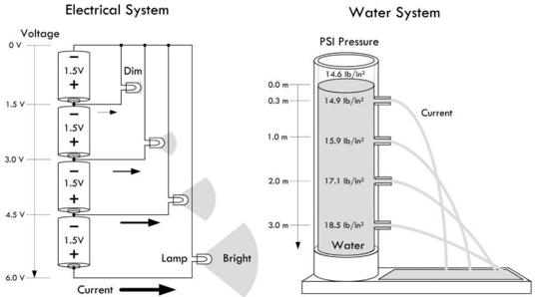
Increasing voltage / increasing water pressure

Slide 12
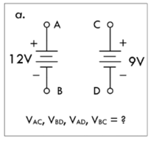








Voltage difference

Slide 13
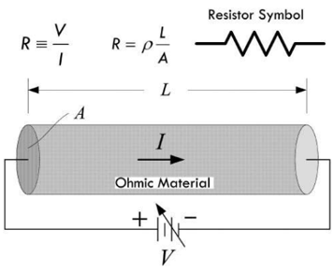
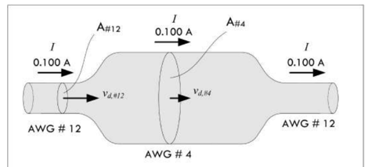
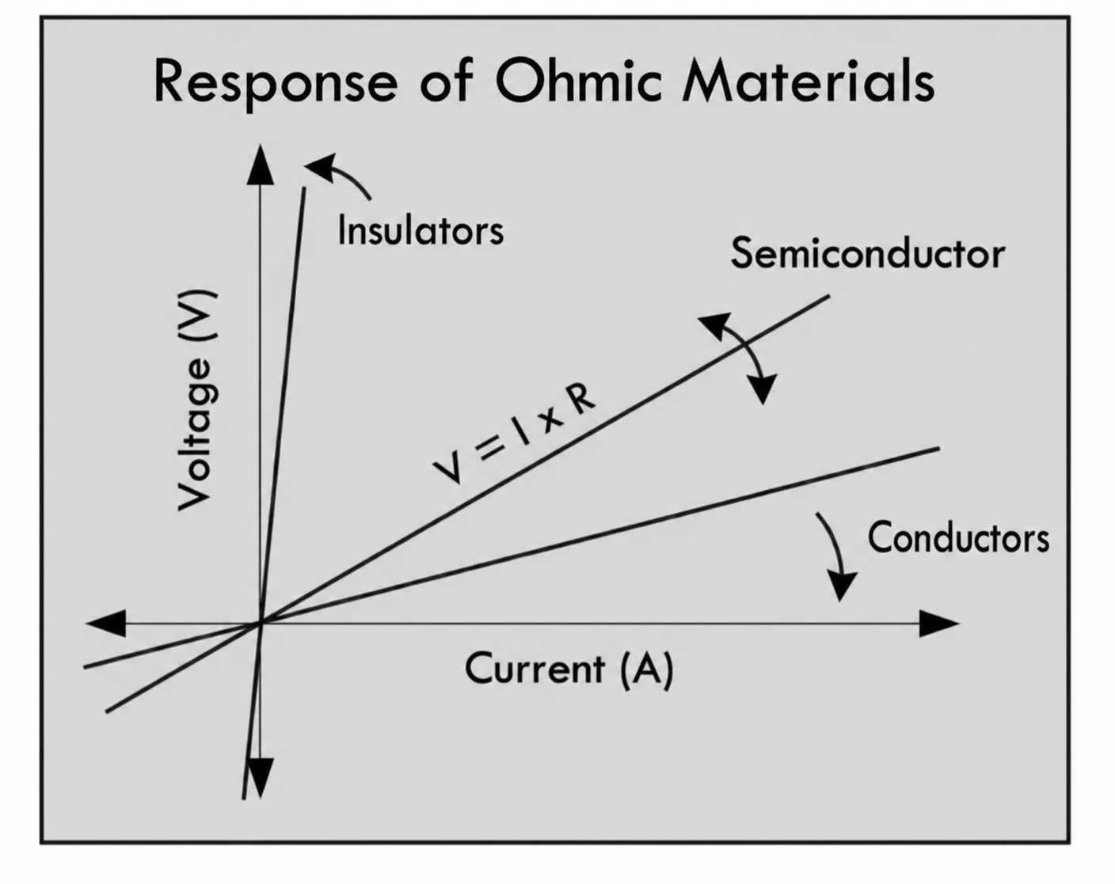

Resistance
Resistance is a measure of the opposition to the flow of current in an electrical circuit. It is influenced by the material's properties, length, cross-sectional area, and temperature.

Slide 14
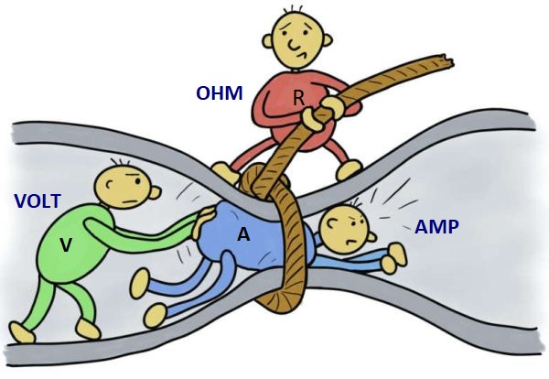
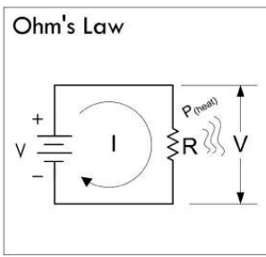
Ohm’s law

Slide 15
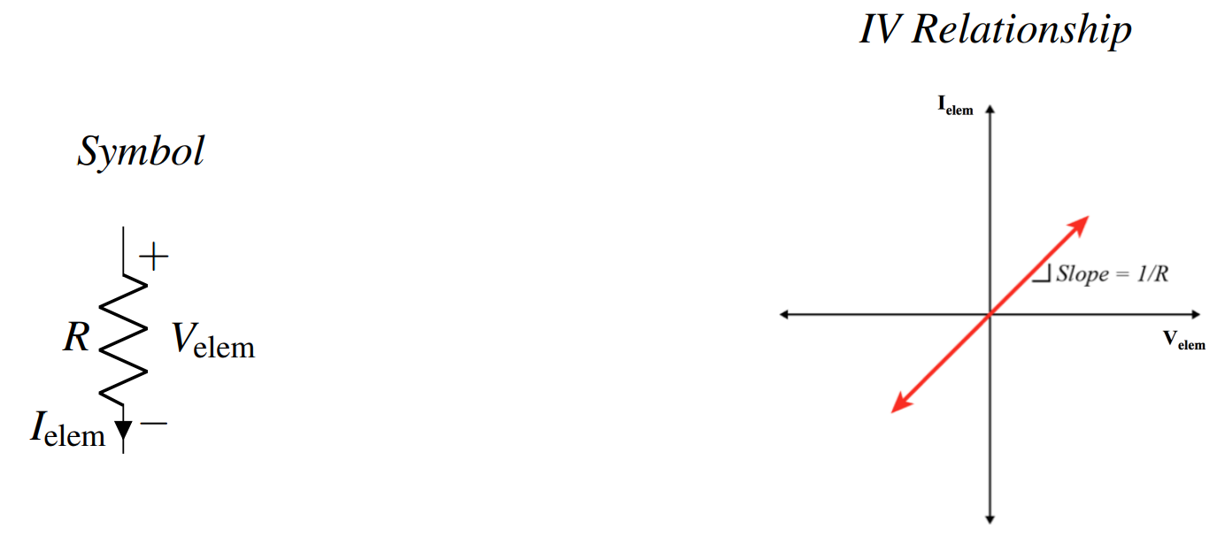

Ohm’s law

Slide 16































Test problems

Slide 17



























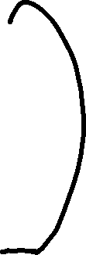


Test problems

Slide 18













Test problems

Slide 19










Test problems

Slide 21
Test problems

Slide 22





Slide 23




Test problems

Slide 24
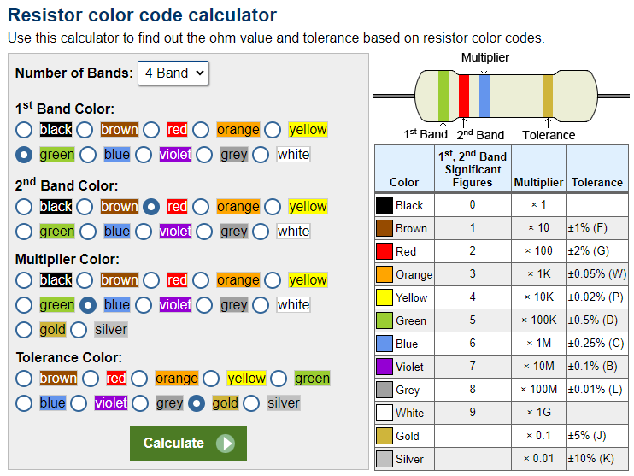
Resistors
https://www.calculator.net/resistor-calculator.html

Slide 25
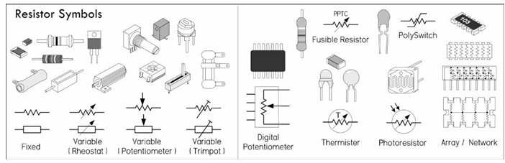





Resistors

Slide 26
Going back to the touchscreen
Build a sensor that can detect touch
Connect to Arduino for processing
3.3V
50 Ω
50 Ω
100 Ω
100 Ω
50 Ω
50 Ω
100 Ω
100 Ω
50 Ω
50 Ω
GND

Slide 27
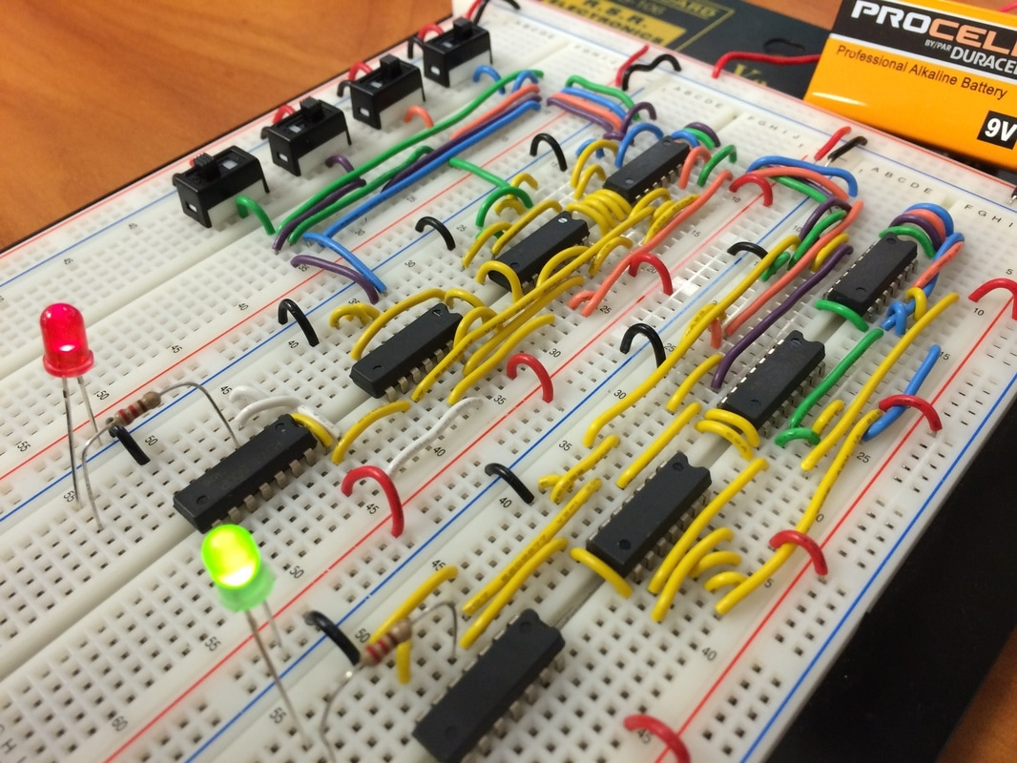
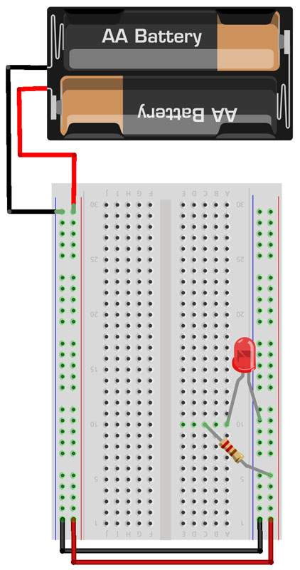


Step 1/a: Breadboarding
The electronic components are inserted in the breadboard to test the prototype circuit

Slide 28
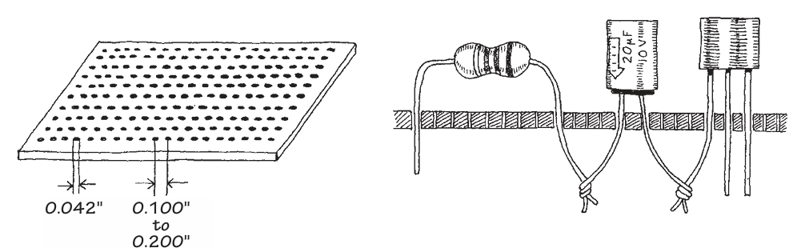
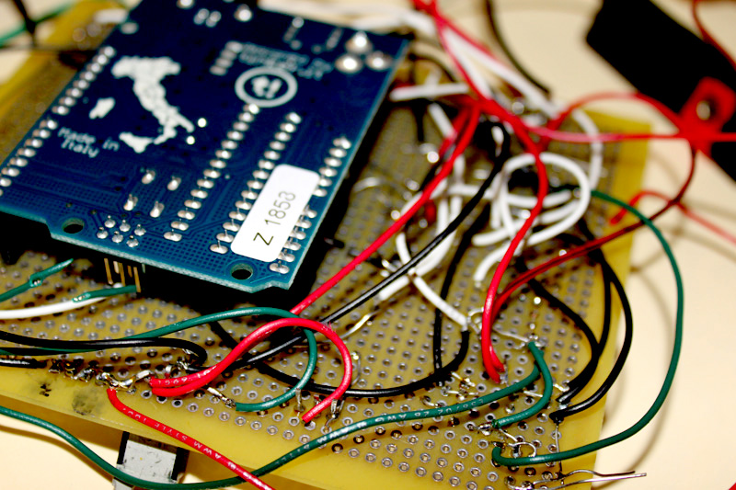
Step 1/b: Protoboards
Yasser’s first protoboard project (2010)
Protoboards are perforated boards with copper plated holes where wire can be connected and soldered

Slide 29
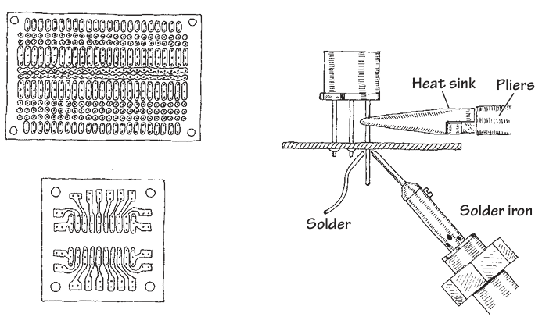
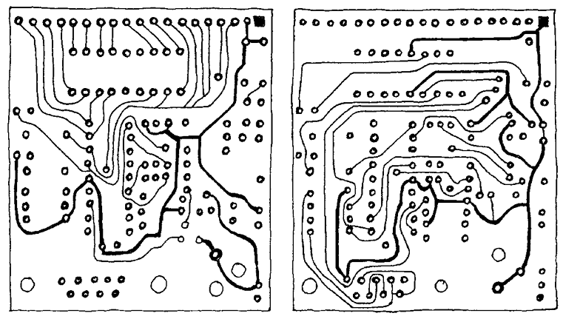
Protoboard soldering and connection

Slide 30
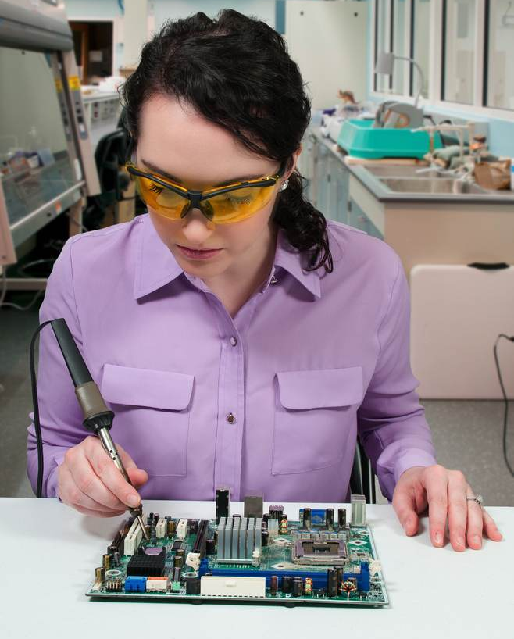
What is happening here 🤔?

Slide 31
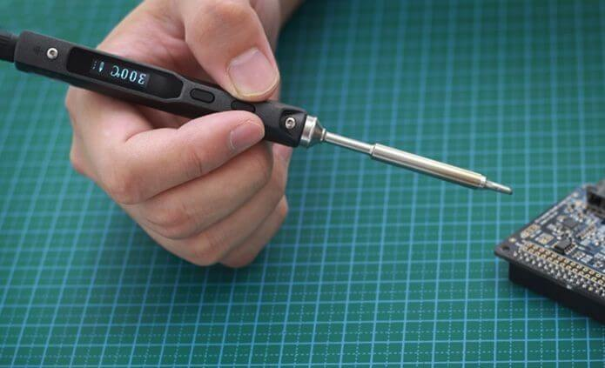
Correct way to hold soldering iron

Slide 32
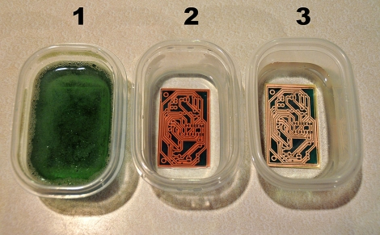
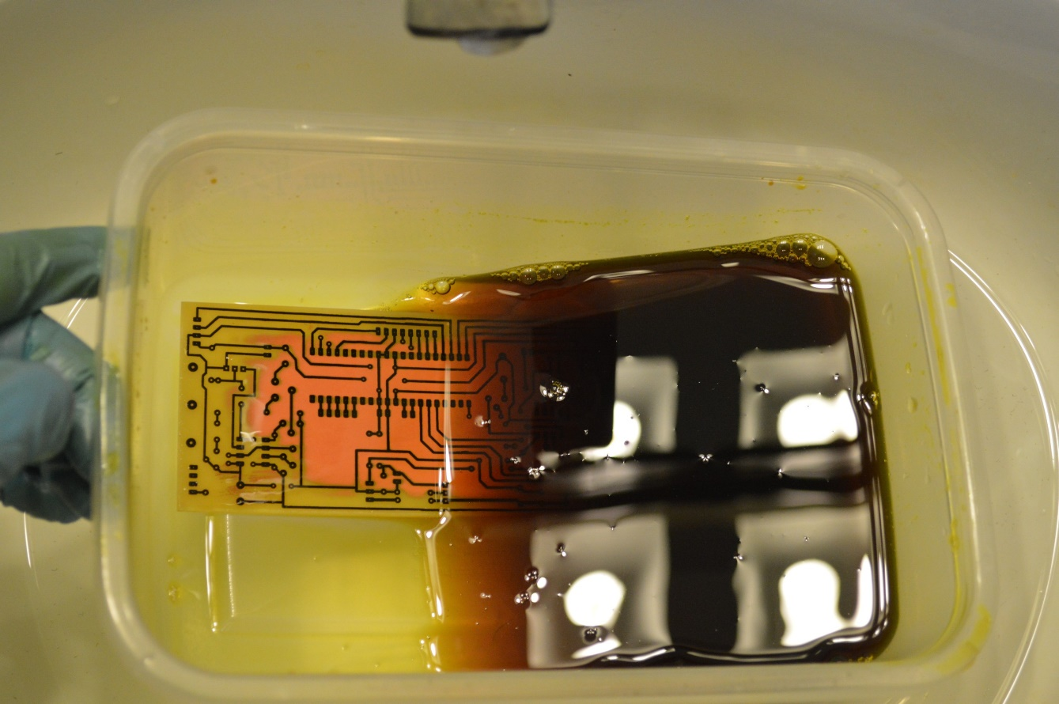


Very old way of making printed circuit boards
Ferric chloride etching of copper boards

Slide 33
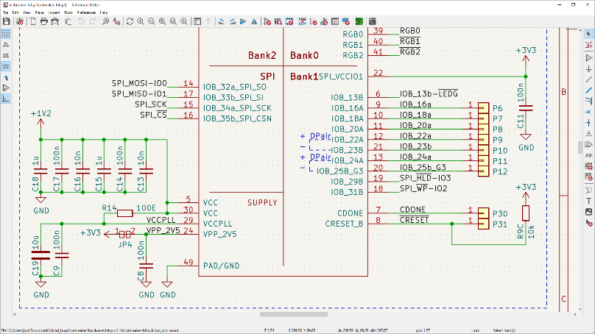
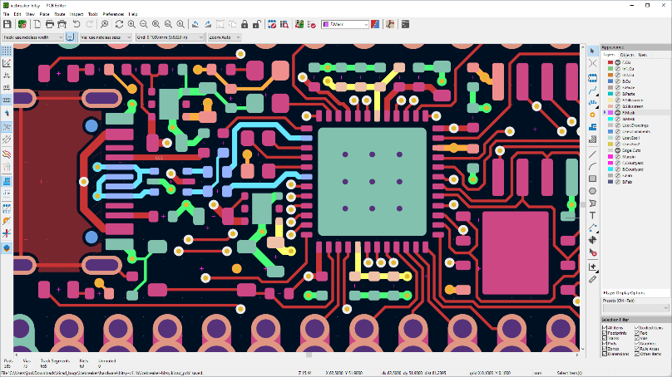
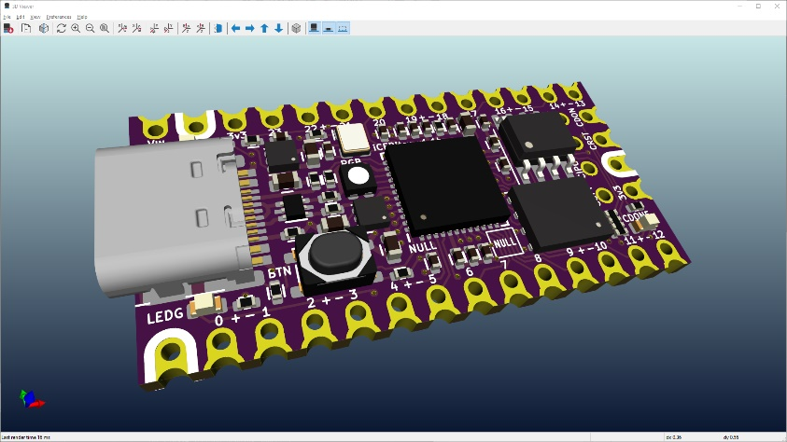
Use of PCB design tools such as eagle / kicad
1. Schematic design
2. Board layout
3. Fabrication

Slide 34
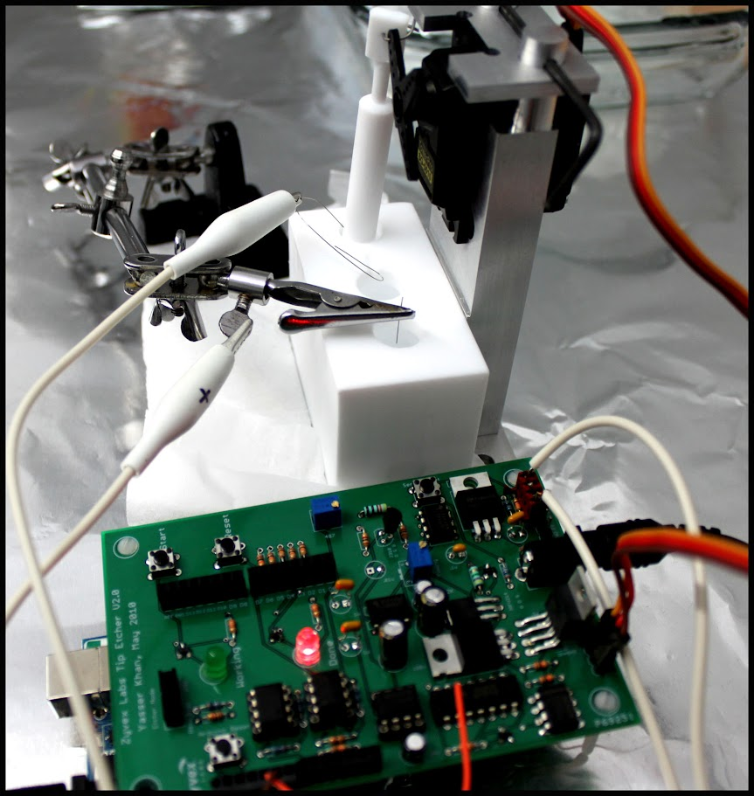
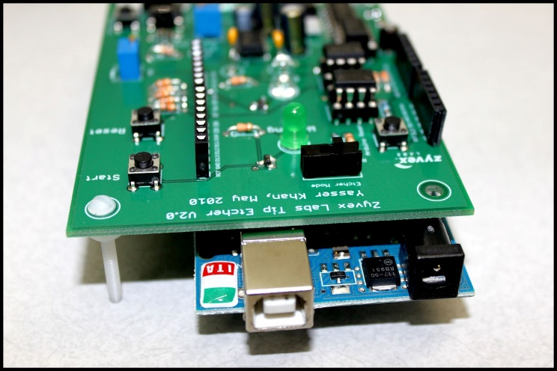
Yasser’s first electronics project (14 years ago )
After learning PCB design
Before learning PCB design

Slide 35
What’s remining now?
Build a sensor that can detect touch
Connect to Arduino for processing
3.3V
50 Ω
50 Ω
100 Ω
100 Ω
50 Ω
50 Ω
100 Ω
100 Ω
50 Ω
50 Ω
GND

Slide 36
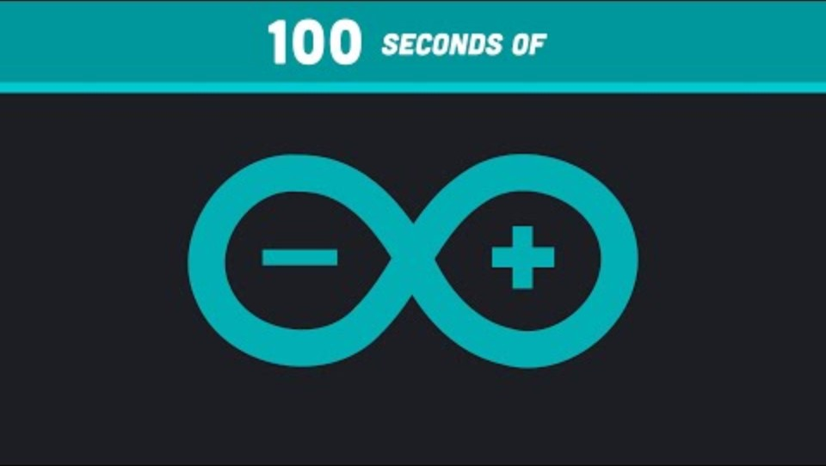
Arduino
https://www.youtube.com/watch?v=1ENiVwk8idM

Slide 37
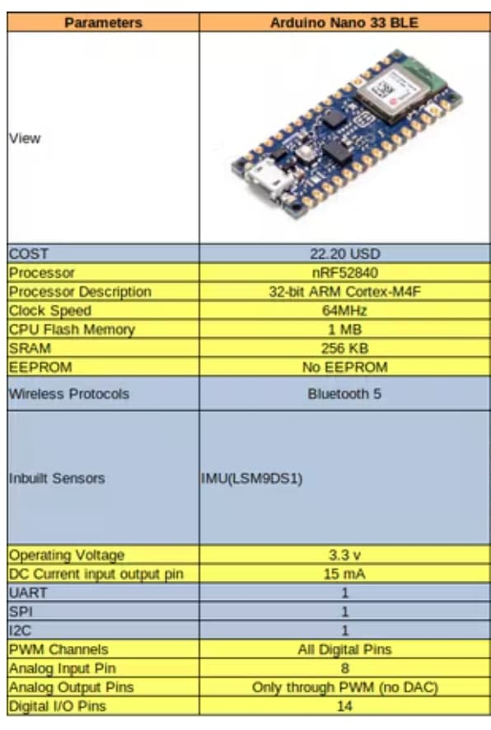
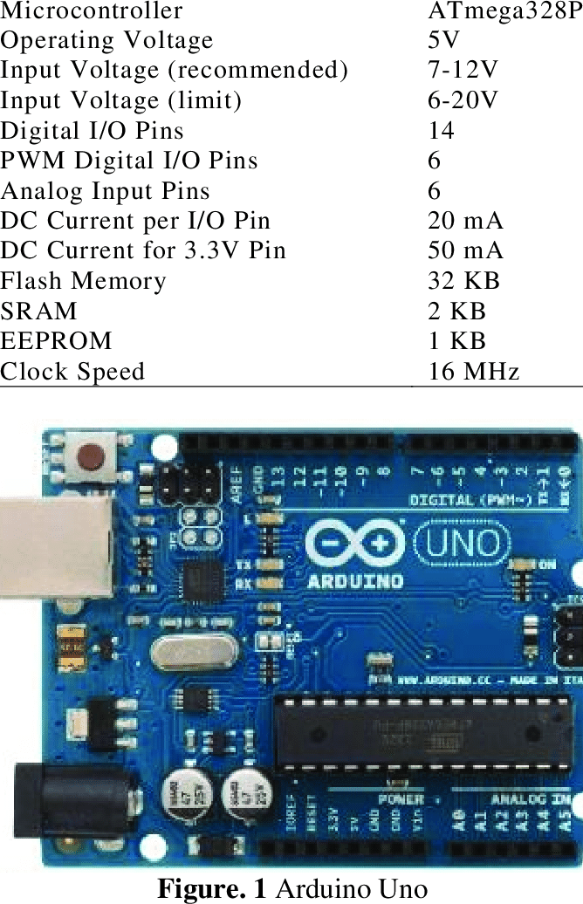
Arduino Nano 33 BLE

Slide 38
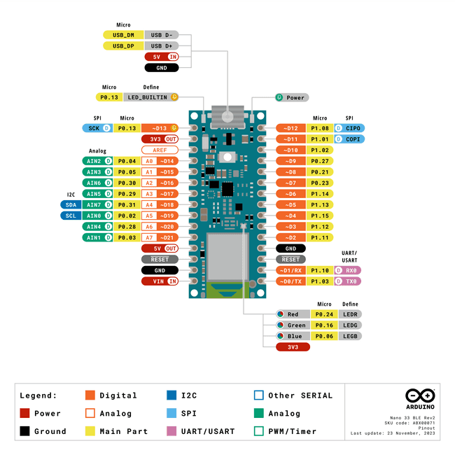
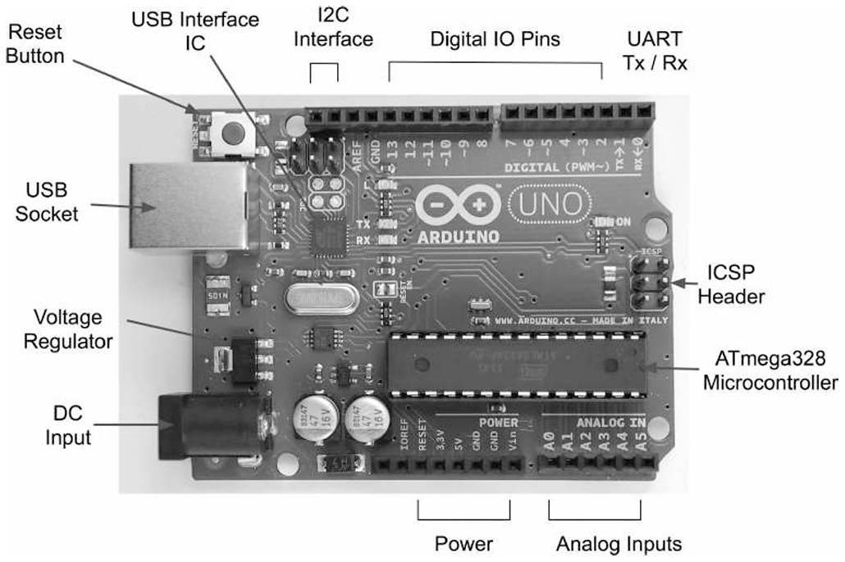
Arduino pinout

Slide 39
Installing and running examples on Arduino
Demo 1: Blink the LED
Demo 2: Wireless data transfer to a web app

