Slide 1
EE-105 NN training on MNIST
3/26/2025

Slide 2
Objective
The objective of this lab session is to introduce students to the foundational concepts of building and evaluating neural networks using PyTorch.
By the end of this lab, students will understand how to:
construct a simple artificial neuron,
Train on the MNIST dataset
Inference on a custom image
analyze training dynamics to visually distinguish between underfitting and overfitting models.

Slide 3
SETUP
For windows users:
Double click on the setup_windows file
For Mac users:
Open a terminal from the “mod-4-nn-labs” folder
Type chmod +x setup_linux_1.bash (you only need to do this once to give the file permission to run).
Run it by typing: bash setup_linux_1

Slide 4
Checkpoint 1
Import libraries
Forward pass Through the Neuron
Understand Perceptrons

Slide 5
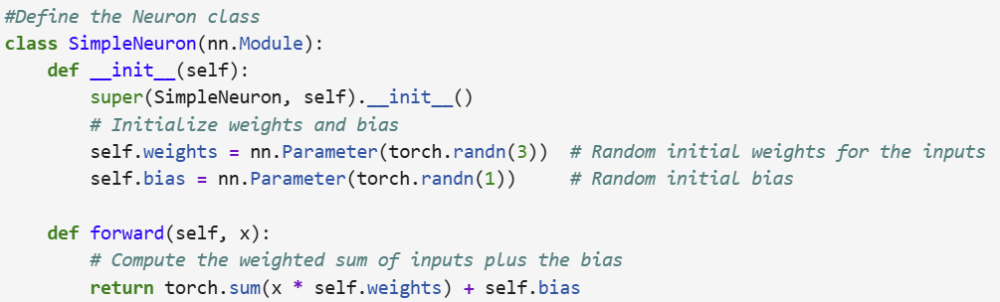
Checkpoint 1 - torch
- torch.nn.Module, torch.nn.Parameter
- activation function: nn.ReLU, nn.Sigmoid, nn.Tanh
- Perceptrons: Using simple NN for a decision making

Slide 6
Checkpoint 2
Data Loading
MNIST
Mini batch gradient descent

Slide 7
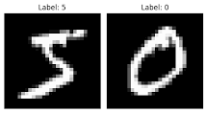
Checkpoint 2 - Data
MNIST: LeCun (1998)
torchvision.transforms: useful data transformation functions
torch.utils.data.DataLoader: used everywhere, gives data batches
Use different dataloaders for train and test
Epochs: number of batches to go through the dataset once

Slide 8
Checkpoint 3
Defining Neural Networks
Loss functions and optimizers
Training and Eval

Slide 9
Checkpoint 3: NN setup
nn.Linear: both weights and biases included
nn.CrossEntropyLoss: used for multi class classification
optim.SGD: Stochastic gradient descent

Slide 10
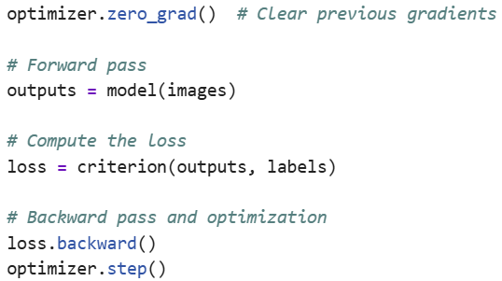
Checkpoint 3: NN training

Slide 11
Checkpoint 4
Evaluate simple NN on custom image
Distribution shifts
prediction

Slide 12
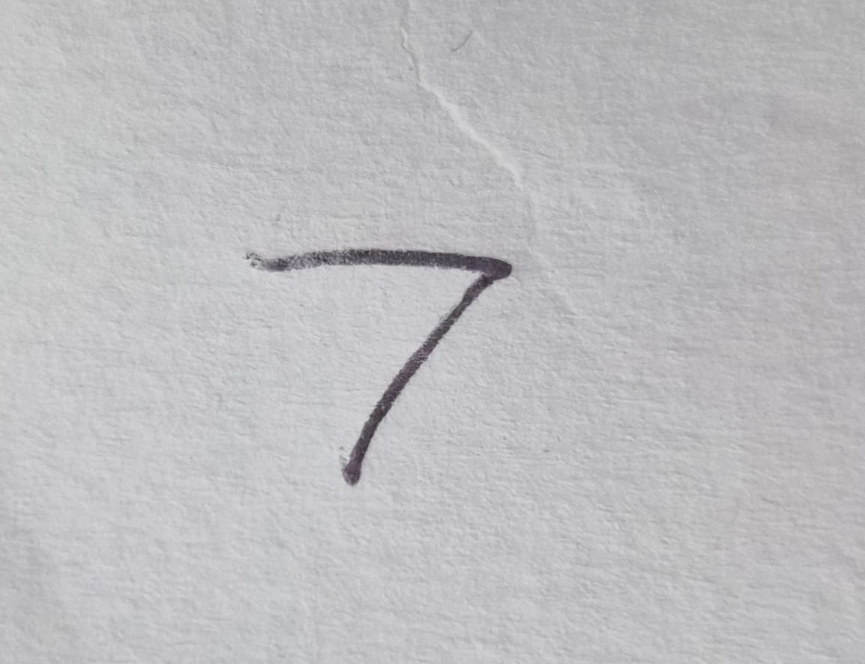

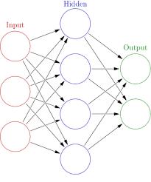
Checkpoint 4: custom NN inference
7

Slide 13
Checkpoint 5
Train 1 hidden layer NN
Train CNN
Eval trained CNN
Experiment with different parameters

Slide 14
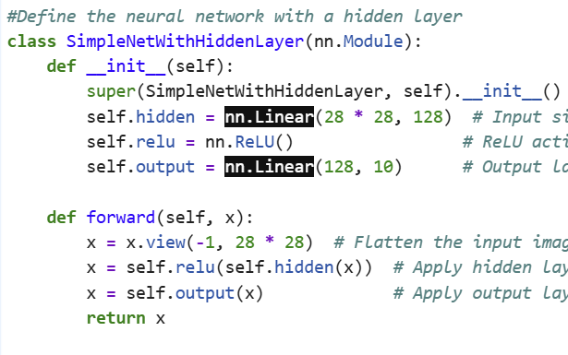
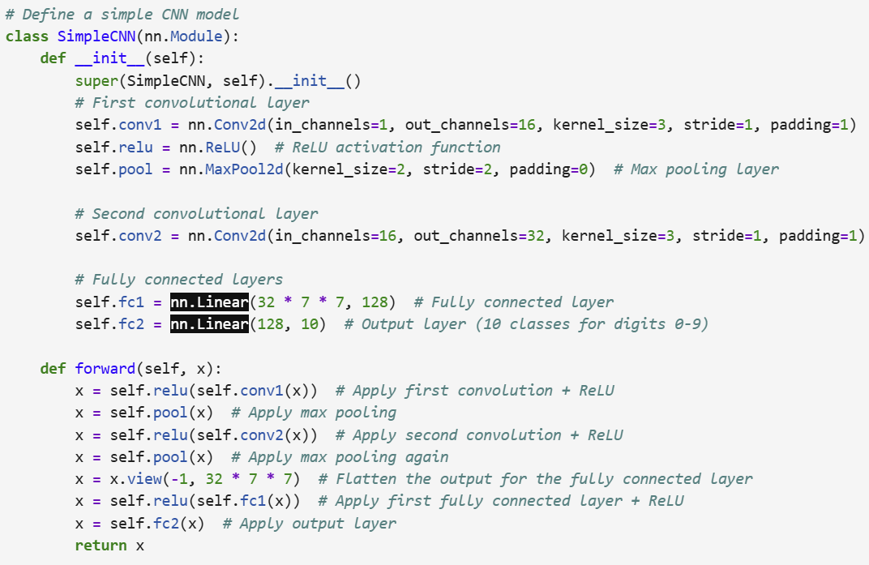
Checkpoint 5: Better architectures

Slide 15
Checkpoint 6
Under fitting
“Simpler” model, fewer epochs
Overfitting
“More complicated” model, more epoch

