Slide 1
ECE 105: Introduction to Electrical Engineering
Lecture 5
Device 1
Yasser Khan
Rehan Kapadia

Slide 2
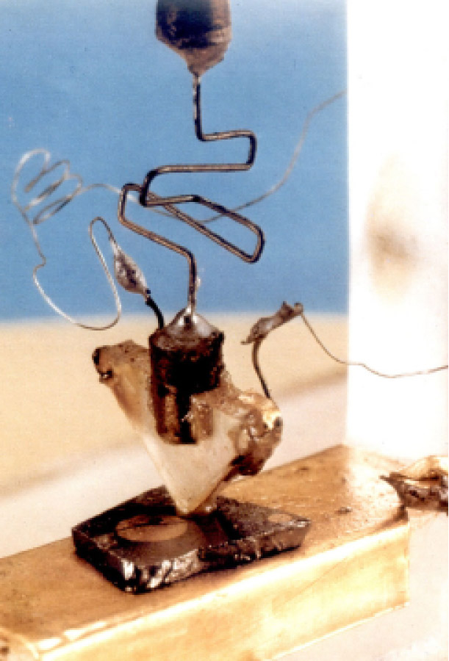
The First Transistor

Slide 3
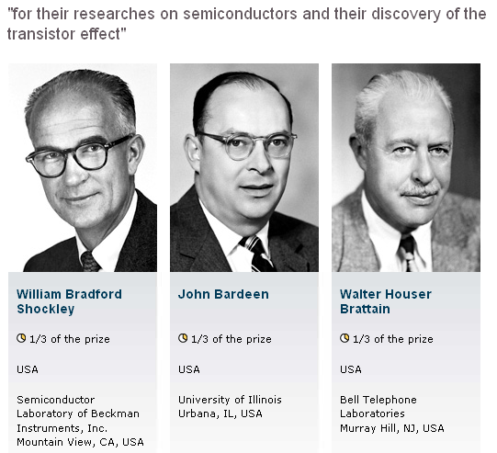
1956 Physics Nobel Prize

Slide 4
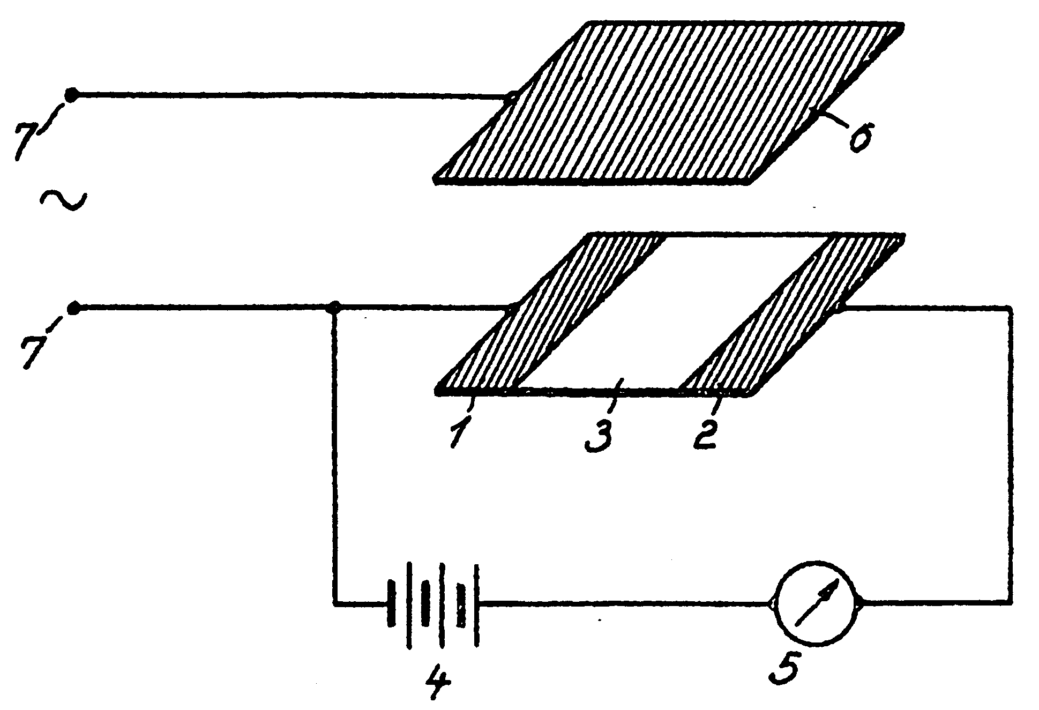
Invention of the Field-Effect Transistor
In 1935, a British patent was issued to Oskar Heil.
A working MOSFET was not demonstrated until 1955.

Slide 6
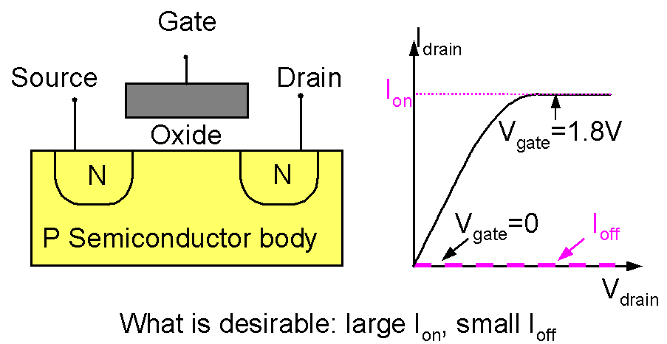
Introduction to the MOSFET
Basic MOSFET structure and IV characteristics

Slide 7
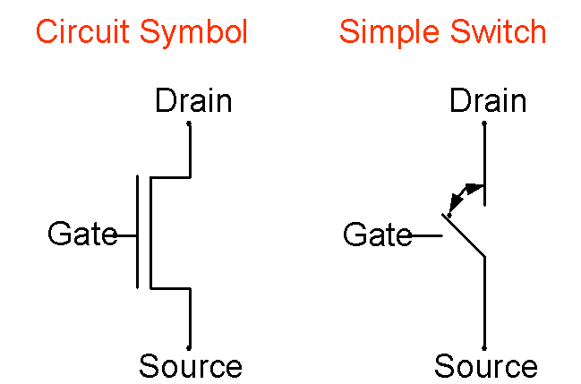
Introduction to the MOSFET
Two ways of representing a MOSFET:

Slide 9
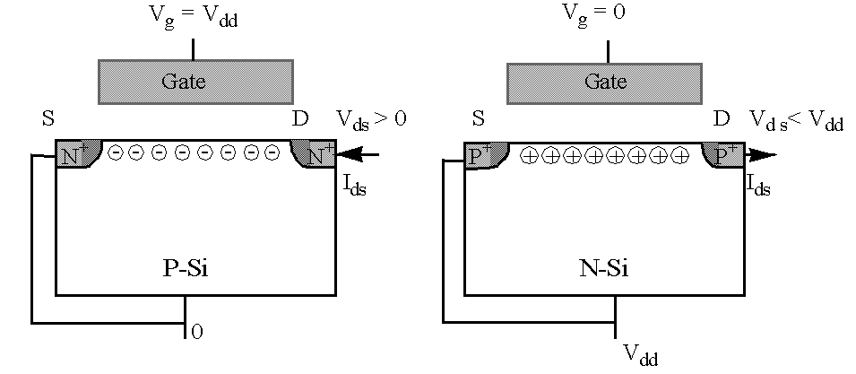
Complementary MOSFETs (CMOS)
NFET PFET
When V_{g} = V_{dd} , the NFET is on and the PFET is off.
When V_{g} = 0, the PFET is on and the NFET is off.

Slide 10
CMOS (Complementary MOS) Inverter

Slide 11
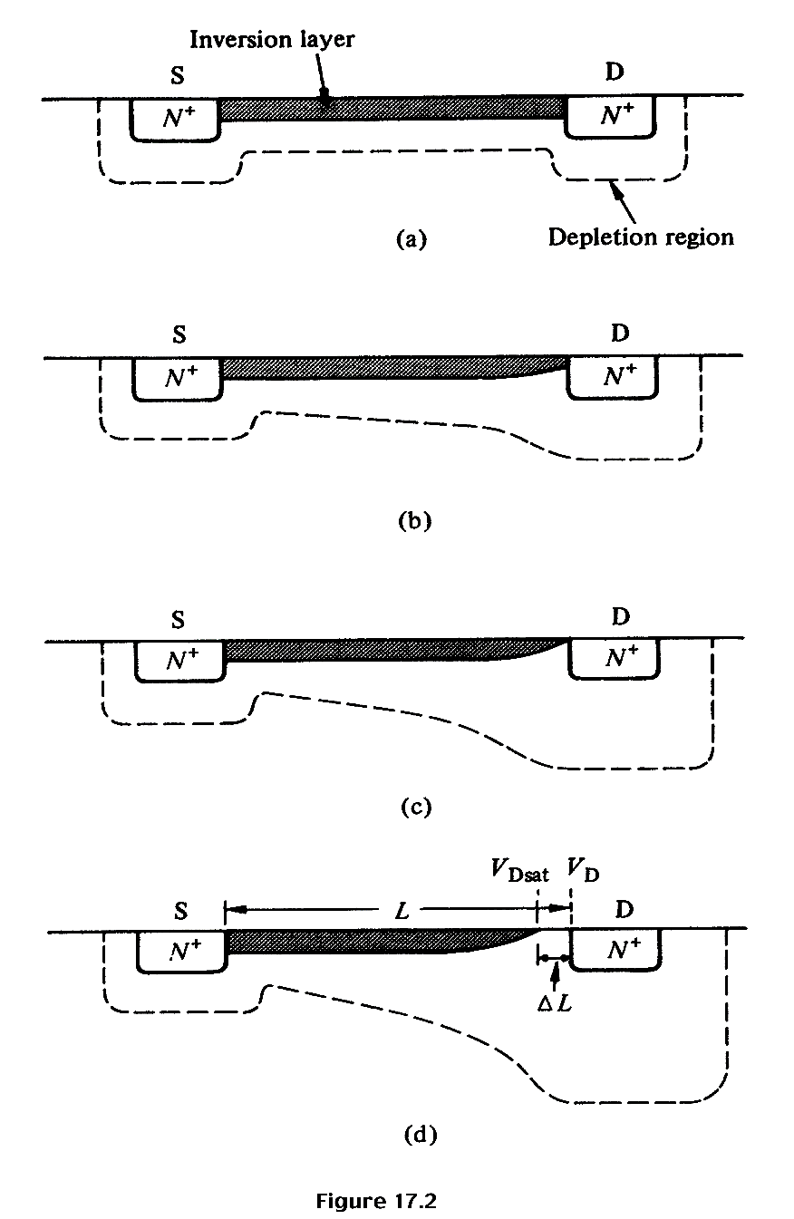
Qualitative discussion: n-MOSFET
V_{G} > V_{T} ; V_{DS} ≈ 0
I_{D} increases with V_{DS}
V_{G} > V_{T}; V_{DS} small, > 0
I_{D} increases with V_{DS} , but rate of increase decreases.
V_{G} > V_{T}; V_{DS} ≈ pinch-off
I_{D} reaches a saturation value, I_{D,sat} The V_{DS} value is called V_{DS,sat}
V_{G} > V_{T}; V_{DS} > V_{DS,sat}
I_{D} does not increase further, saturation region.

Slide 12
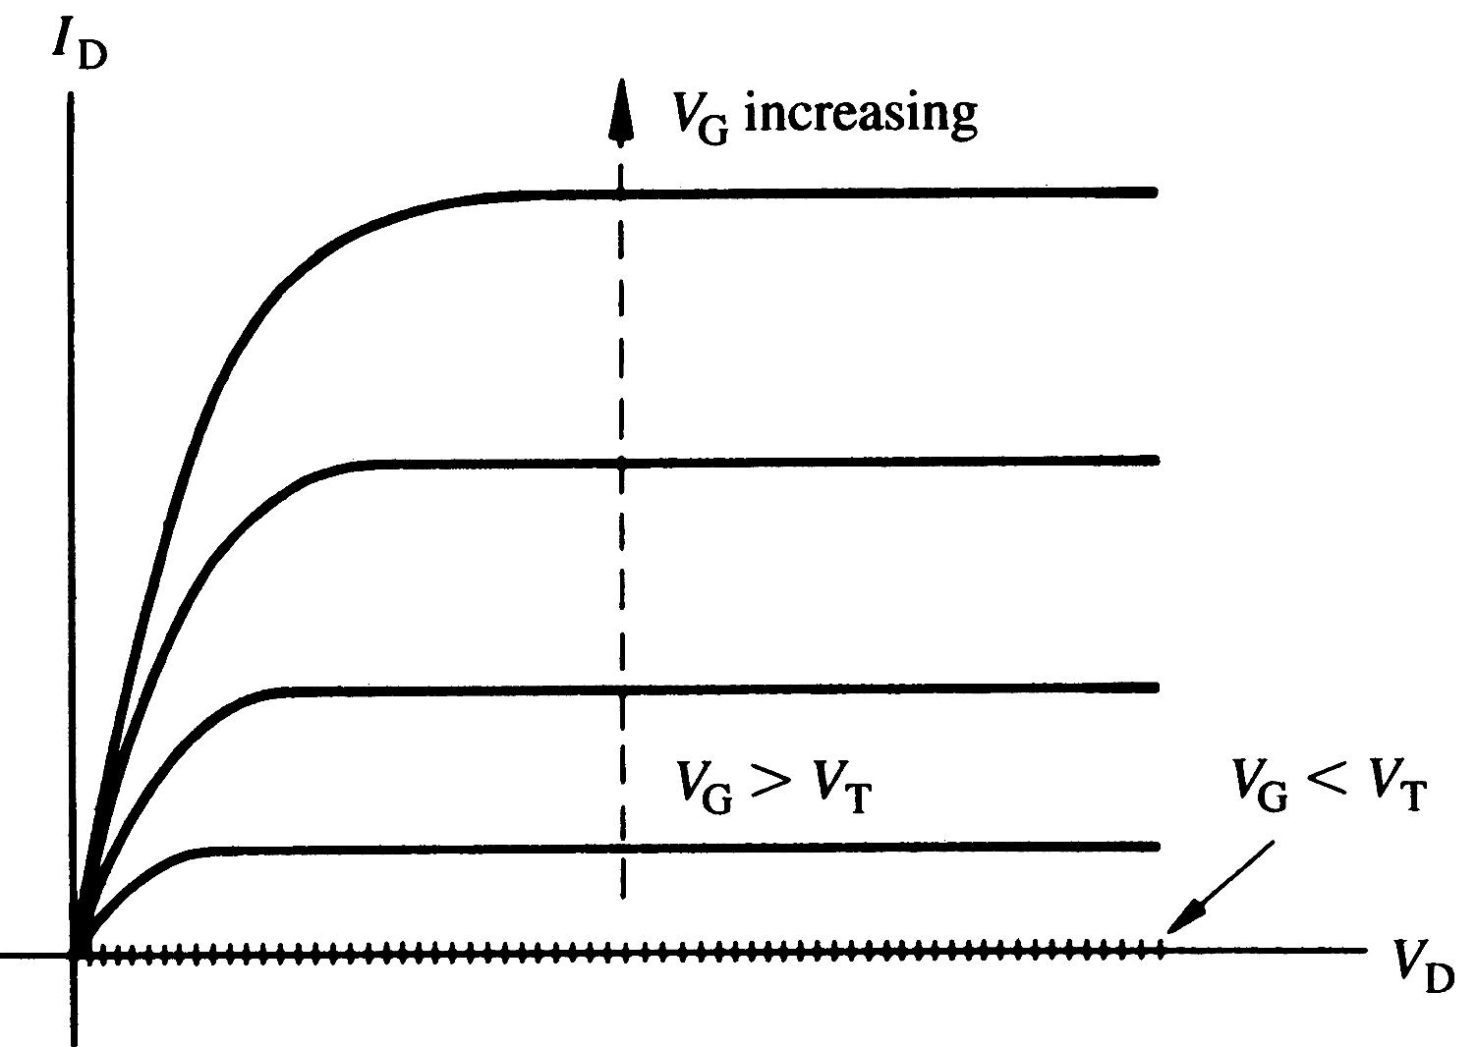
I_{D}-V_{DS} characteristics expected from a long channel (ΔL << L) MOSFET (n-channel), for various values of V_{G}

Slide 13
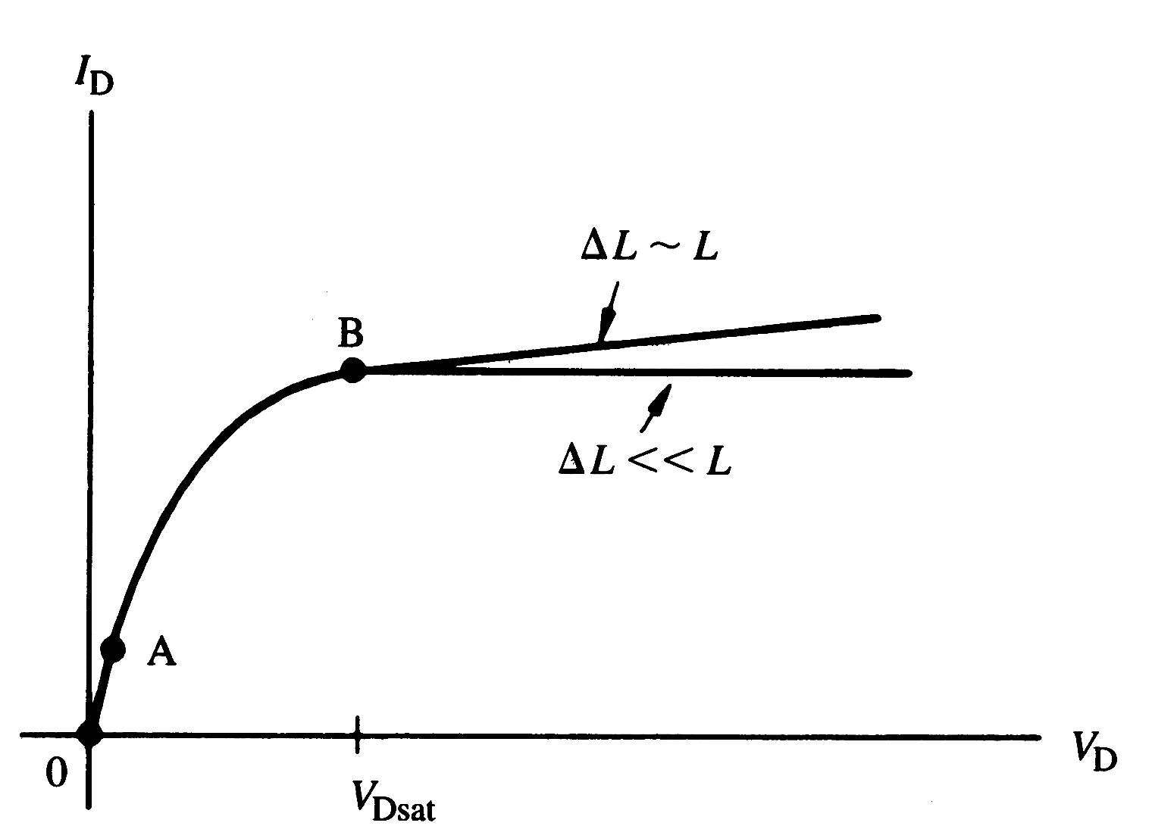
I_{D}-V_{DS} characteristics for n-MOSFET
Linear
region
Saturation
region

Slide 14
Quantitative I_{D}-V_{DS} Relationships – 1st attempt “Square Law”
;
I_{D} will increase as V_{DS} is increased, but when V_{G} – V_{DS} = V_{T}, pinch-off occurs, and current saturates when V_{DS} is increased further. This value of V_{DS} is called V_{DS,sat}. i.e., V_{DS,sat} = V_{G} – V_{T} and the current when V_{DS}= V_{DS,sat} is called I_{DS,sat}.
;
Here, C_{ox} is the oxide capacitance per unit area, C_{ox} = ε_{ox} / x_{ox}

Slide 15
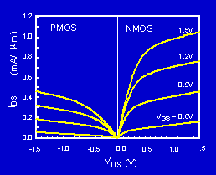
P-MOSFET N-MOSFET IV Characteristics
The PMOS IV is qualitatively similar to the NMOS IV, but the current is about half as large. Why?

Slide 16
Threshold and Subthreshold

Slide 17
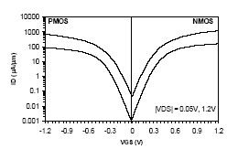
Subthreshold Current
The leakage current that flows at V_{g}<V_{t} is called the subthreshold current. Previously we had assumed that current is zero, but in reality that’s not the case.
)
m
μ
Intel, T. Ghani et al., IEDM 2003
/
90nm technology. Gate length: 45nm for NMOS, 50nm for PMOS
A
μ
(
s
I
d
V_{gs}
The current at V_{gs}=0 and V_{ds}=V_{dd} is called I_{off.}

