Slide 1
Chapter 5 MOS Capacitor
MOS: Metal-Oxide-Semiconductor
V_{g}
V_{g}
gate
metal
gate
SiO₂
SiO₂
N⁺
N⁺
Si body
P-body
MOS capacitor
MOS transistor
Modern Semiconductor Devices for Integrated Circuits (C. Hu)
Slide 5-<number>

Slide 2
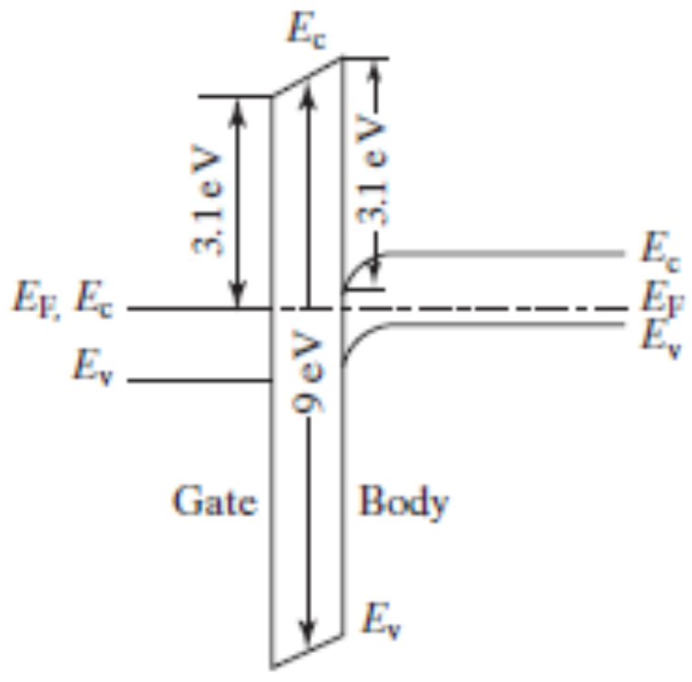
Chapter 5 MOS Capacitor
E_{c}
E_{c}
n
y
o
d
E_{f} , E_{c}
E_{f}
c
o
i
l
b
i
E_{v}
s
O
2
E_{v}
y
n
l
i
o
o
S
c
p
i
l
+
i
N
S
-
Gate
Si Body
P
E_{v}
This energy-band diagram for V_{g} = 0 is not the simplest one.
Modern Semiconductor Devices for Integrated Circuits (C. Hu)
Slide 5-<number>

Slide 3
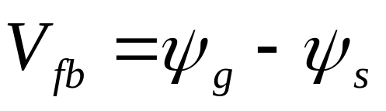
5.1 Flat-band Condition and Flat-band Voltage
E
0
χ
=0.95 eV
SiO
2
E
c
q
ψ
g
q
ψ
=
χ
+ (
E
–
E
)
3.1 eV
3.1 eV
χ
Si
s
Si
c
f
=4.05eV
E
c
,
E
E
f
q
V
c
fb
E
E
f
v
E
v
N
+
-poly-Si
9 eV
P-body
The band is flat at the flat band voltage.
E₀ : Vacuum level
E₀ – E_{f} : Work function
E₀ – E_{c} : Electron affinity
Si/SiO₂ energy barrier
4.8 eV
E
v
SiO
2
Modern Semiconductor Devices for Integrated Circuits (C. Hu)
Slide 5-<number>

Slide 4
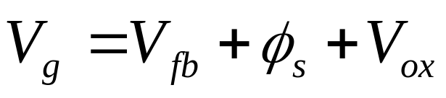
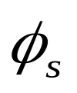
5.2 Surface Accumulation
Make V_{g} < V_{fb}
3.1eV
V
E
E
ox
c
,
f
φ_{s} : surface potential, band bending
V_{ox}: voltage across the oxide
E
E
v
0
qV
g
q
φ
s
E
c
E
is negligible when
E
f
the surface is in accumulation.
v
M
O
S
Modern Semiconductor Devices for Integrated Circuits (C. Hu)
Slide 5-<number>

Slide 5
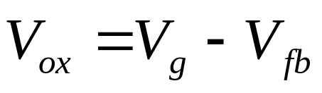
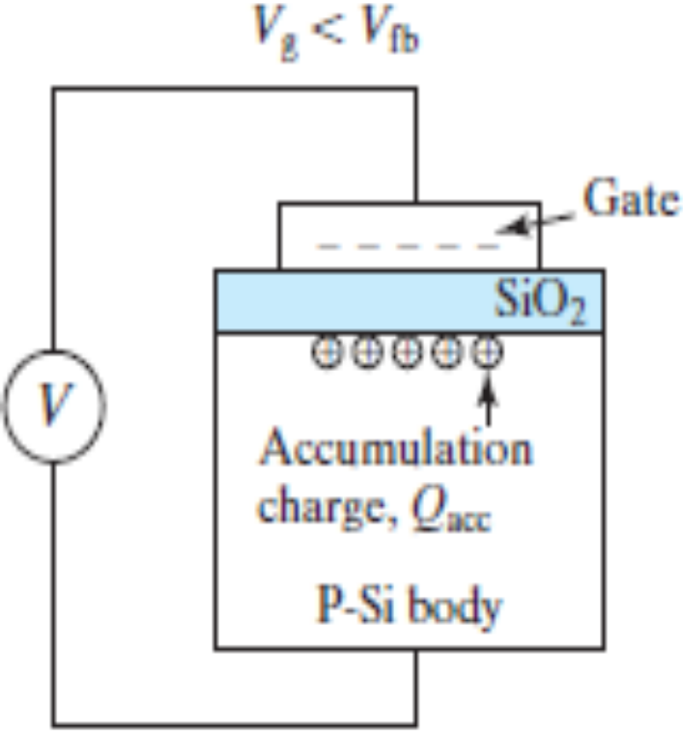
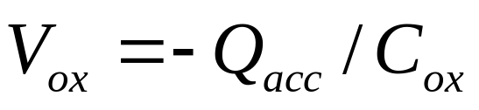
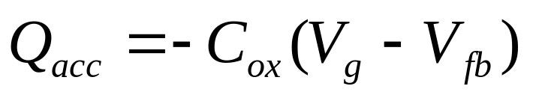
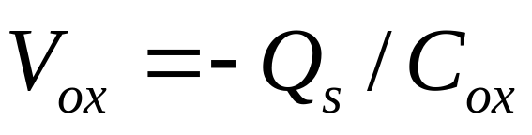
5.2 Surface Accumulation
V_{g} <V_{t}
Gauss’s Law
Modern Semiconductor Devices for Integrated Circuits (C. Hu)
Slide 5-<number>

Slide 6
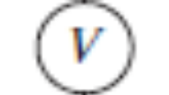
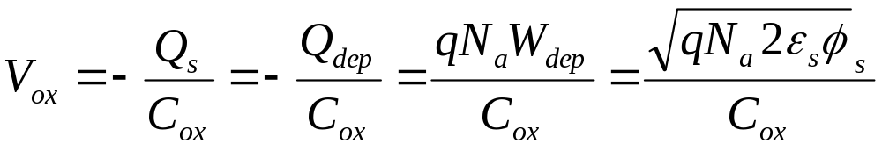
5.3 Surface Depletion ( )
V
>
V
g
fb
qV
ox
E
c
gate
q
φ
s
+ + + + + +
-
E
SiO
-
f
-
E
- - - - - - -
2
-
v
- - - - - - -
qV
- - - - - - -
g
W
V
depletion layer
E
E
dep
c
,
f
depletion
charge,
Q
dep
region
E
v
P-Si body
M
O
S
Modern Semiconductor Devices for Integrated Circuits (C. Hu)
Slide 5-<number>

Slide 7
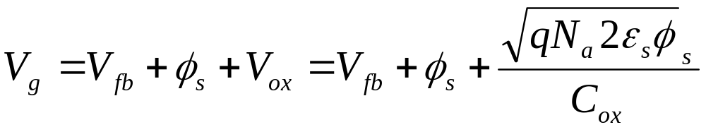
5.3 Surface Depletion
This equation can be solved to yield φ_{s} .
Modern Semiconductor Devices for Integrated Circuits (C. Hu)
Slide 5-<number>

Slide 8
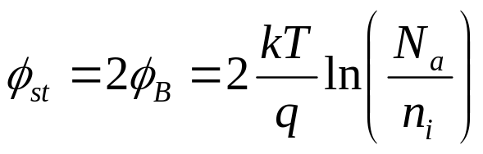
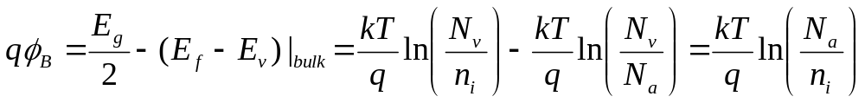
5.4 Threshold Condition and Threshold Voltage
Threshold (of inversion):
n_{s} = N_{a} , or
(E_{c}–E_{f})_{surface}= (E_{f} – E_{v})_{bulk} , or
 A=B, and C = D
E
c
φ
st
E
i
=
φ
A
C
q
Β
D
E
f
B
E
qV
=
qV
v
g
t
E
c
,
E
f
E
v
M
O
S
Modern Semiconductor Devices for Integrated Circuits (C. Hu)
Slide 5-<number>

Slide 9
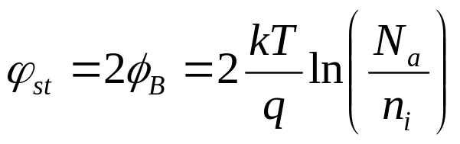
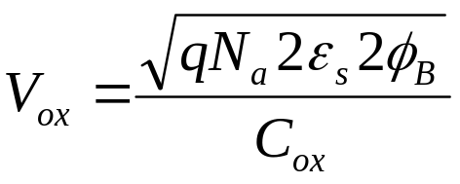
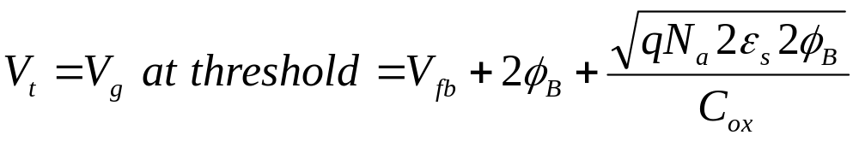
Threshold Voltage
V
=
V
+
φ
+
V
g
fb
s
ox
At threshold,
Modern Semiconductor Devices for Integrated Circuits (C. Hu)
Slide 5-<number>

Slide 10
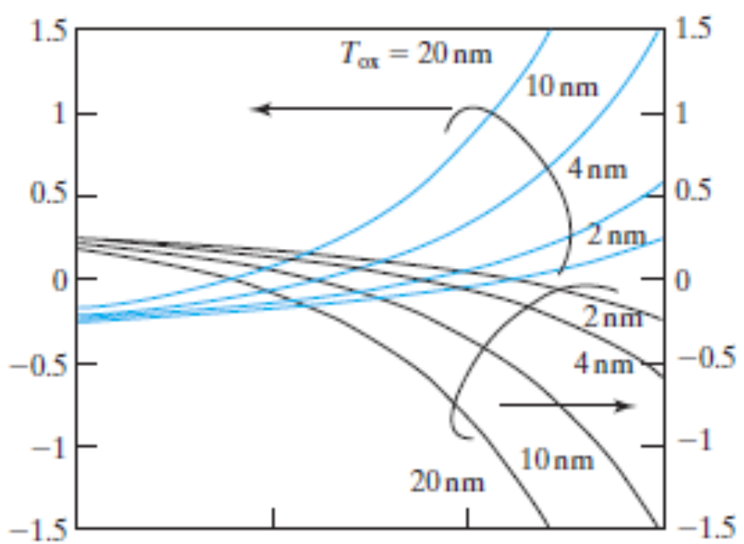
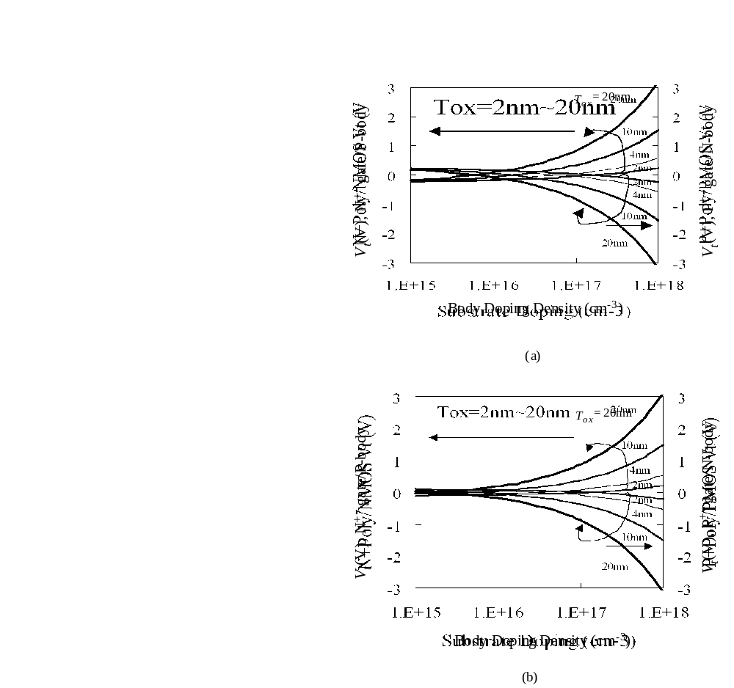
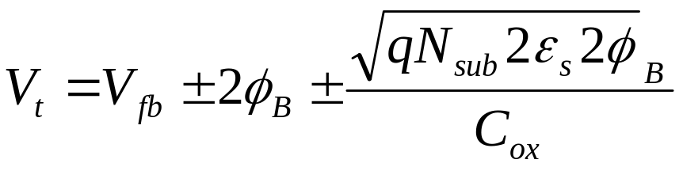
Threshold Voltage
+ for P-body,
– for N-body
Modern Semiconductor Devices for Integrated Circuits (C. Hu)
Slide 5-<number>

Slide 11
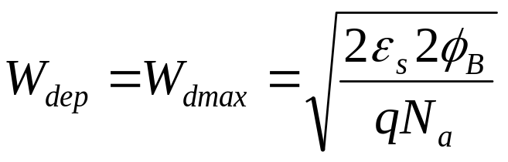

5.5 Strong Inversion–Beyond Threshold
V_{g} > V_{t}
V
>
V
-
E
c
g
t
E
-
f
-
E
gate
-
v
-
-
++++++++++
qV
SiO
g
-
-
-
-
-
-
-
-
2
V
- - - - - - -
E
c
,
E
f
Q
Q
E
dep
inv
v
P
-
Si substrate
M
O
S
Modern Semiconductor Devices for Integrated Circuits (C. Hu)
Slide 5-<number>

Slide 12
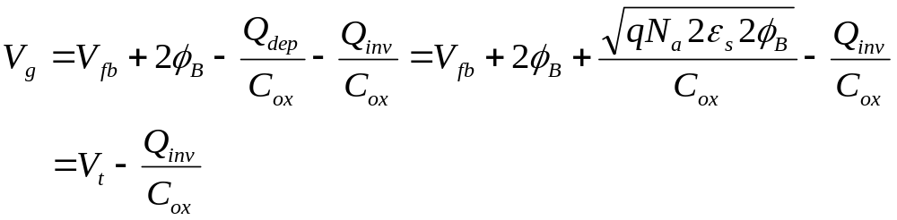
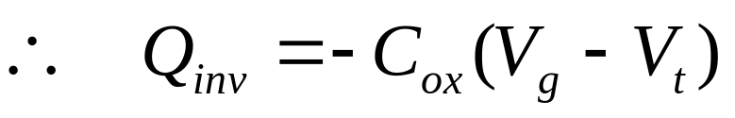
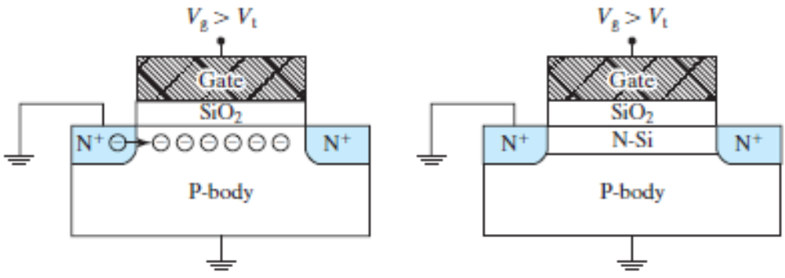
Inversion Layer Charge, Q_{inv} (C/cm²)
V_{g} > V_{t}
V_{g} > V_{t}
Modern Semiconductor Devices for Integrated Circuits (C. Hu)
Slide 5-<number>

Slide 13
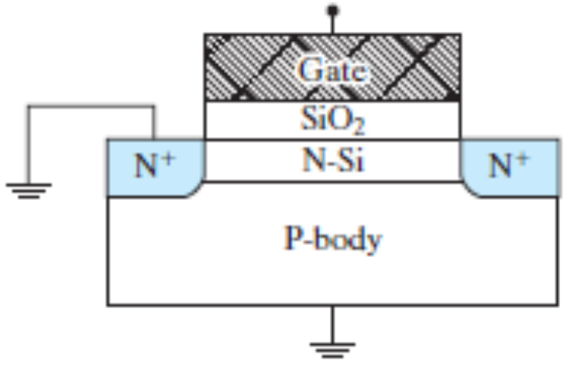
5.5.1 Choice of V_{t} and Gate Doping Type
V_{t} is generally set at a small positive value so that, at V_{g} = 0, the transistor does not have an inversion layer and current does not flow between the two N⁺ regions
P-body is normally paired with N⁺-gate to achieve a small positive threshold voltage.
N-body is normally paired with P⁺-gate to achieve a small negative threshold voltage.
Modern Semiconductor Devices for Integrated Circuits (C. Hu)
Slide 5-<number>

Slide 14
Review : Basic MOS Capacitor Theory
φ_{s}
2φ_{B}
V_{g}
V_{fb}
V_{t}
accumulation
depletion
inversion
W_{dep}
W
dmax
W
= (2
ε
2
φ
/
1/2
dmax
s
Β
q
Ν
a
)
∝
(
φ
)
1/2
s
V_{g}
accumulation
V_{fb}
depletion
V_{t}
inversion
Modern Semiconductor Devices for Integrated Circuits (C. Hu)
Slide 5-<number>

Slide 15
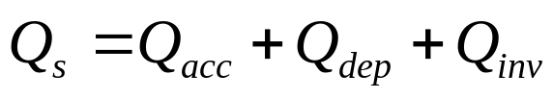
Review : Basic MOS Capacitor Theory
Q_{dep}=- qN_{a}W_{dep}
V_{fb}
total substrate charge, Q_{s}
accumulation
depletion
inversion
V_{g}
(a)
0
V_{t}
–qN_{a}W_{dep}
–qN_{a}W_{dmax}
Q_{inv}
Q_{s}
accumulation
depletion
inversion
accumulation
depletion
inversion
(b)
V_{fb}
V_{t}
V_{g}
regime
regime
regime
slope = − C_{ox}
V_{fb}
0
V_{g}
V_{t}
Q_{acc}
slope = − C_{ox}
Q_{inv}
(c)
slope = − C_{ox}
V_{fb}
V_{t}
V_{g}
accumulation
depletion
inversion
Modern Semiconductor Devices for Integrated Circuits (C. Hu)
Slide 5-<number>

Slide 16
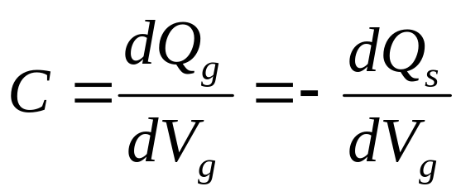
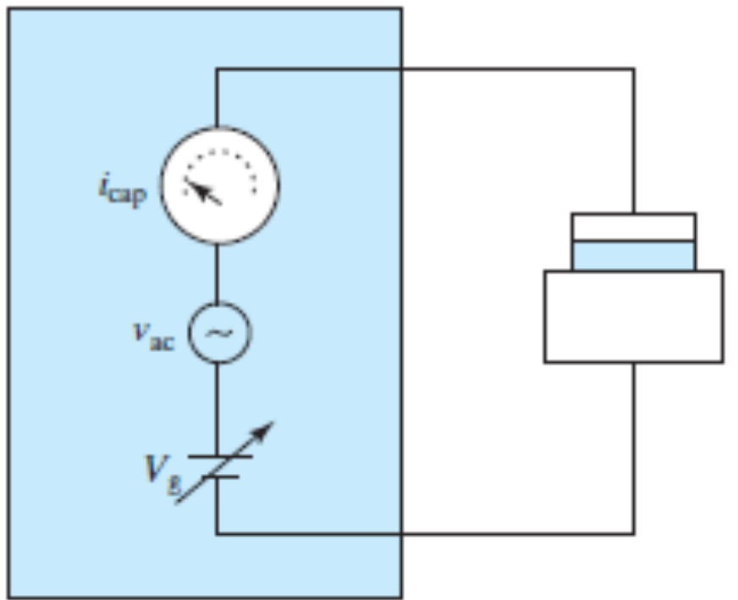
5.6 MOS CV Characteristics
MOS Capacitor
C-V Meter
Modern Semiconductor Devices for Integrated Circuits (C. Hu)
Slide 5-<number>

Slide 17
5.6 MOS CV Characteristics
Q_{s}
accumulation
depletion
inversion
C
regime
regime
regime
C_{ox}
V_{fb}
V_{g}
0
V_{t}
Q_{inv}
slope = − C_{ox}
V_{fb}
V_{t}
V_{g}
accumulation
depletion
inversion
Modern Semiconductor Devices for Integrated Circuits (C. Hu)
Slide 5-<number>

Slide 18
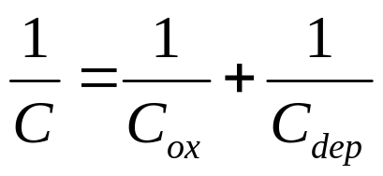
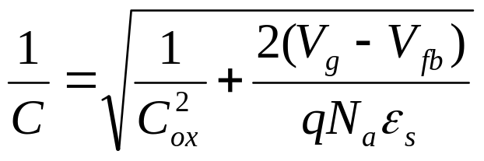
CV Characteristics
C
C_{ox}
V_{g}
accumulation
V_{fb}
depletion
V_{t}
inversion
In the depletion regime:
Modern Semiconductor Devices for Integrated Circuits (C. Hu)
Slide 5-<number>

Slide 19
Supply of Inversion Charge May be Limited
gate
gate
C
ox
C
ox
+
+
+
+
+
+
+
+
+
C
W_{dep}
-
-
-
-
-
dep
-
Accumulation
Depletion
P-substrate
P-substrate
gate
gate
C
ox
C
ox
N
+
-
-
-
-
-
-
-
-
DC
-
-
-
-
-
-
-
-
-
Inversion
-
C
-
dmax
- -
-
W_{dmax}
AC
Inversion
W
DC and AC
dmax
P-substrate
P-substrate
In each case, C = ?
Modern Semiconductor Devices for Integrated Circuits (C. Hu)
Slide 5-<number>

Slide 20
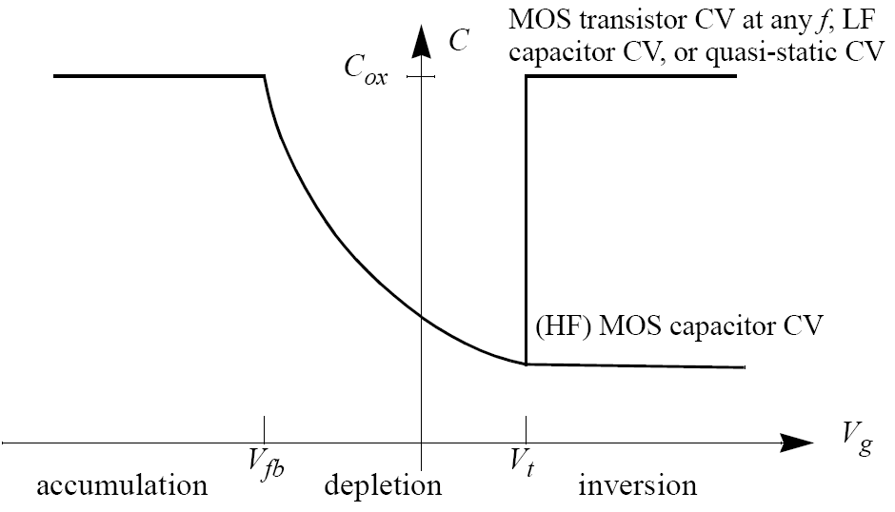
Capacitor and Transistor CV (or HF and LF CV)
Modern Semiconductor Devices for Integrated Circuits (C. Hu)
Slide 5-<number>

Slide 21
Quasi-Static CV of MOS Capacitor
C
C_{ox}
V_{g}
accumulation
V_{fb}
depletion
V_{t}
inversion
The quasi-static CV is obtained by the application of a slow linear-ramp voltage (< 0.1V/s) to the gate, while measuring I_{g} with a very sensitive DC ammeter. C is calculated from I_{g} = C·dV_{g}/dt. This allows sufficient time for Q_{inv} to respond to the slow-changing V_{g} .
Modern Semiconductor Devices for Integrated Circuits (C. Hu)
Slide 5-<number>

Slide 22
EXAMPLE : CV of MOS Capacitor and Transistor
C
MOS transistor CV,
QS CV
Does the QS CV or the HF capacitor CV apply?
HF capacitor CV
V_{g}
(1) MOS transistor, 10kHz. (Answer: QS CV).
(2) MOS transistor, 100MHz. (Answer: QS CV).
(3) MOS capacitor, 100MHz. (Answer: HF capacitor CV).
(4) MOS capacitor, 10kHz. (Answer: HF capacitor CV).
(5) MOS capacitor, slow V_{g} ramp. (Answer: QS CV).
(6) MOS transistor, slow V_{g} ramp. (Answer: QS CV).
Modern Semiconductor Devices for Integrated Circuits (C. Hu)
Slide 5-<number>

Slide 23
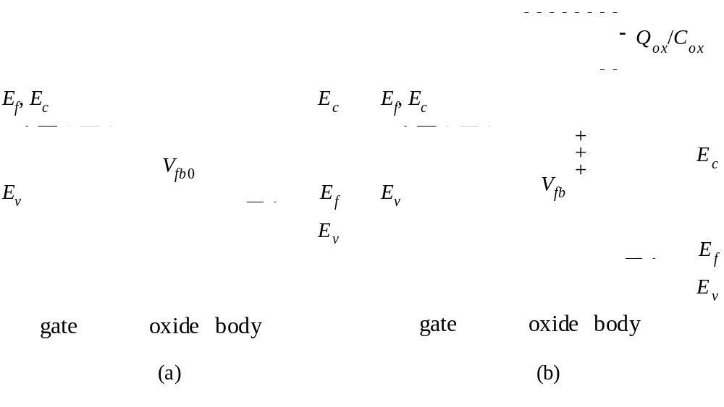
5.7 Oxide Charge–A Modification to V_{fb} and V_{t}
Modern Semiconductor Devices for Integrated Circuits (C. Hu)
Slide 5-<number>

Slide 24
5.7 Oxide Charge–A Modification to V_{fb} and V_{t}
Types of oxide charge:
Fixed oxide charge, Si⁺
Mobile oxide charge, due to Na⁺contamination
Interface traps, neutral or charged depending on Vg.
Voltage/temperature stress induced charge and traps--a reliability issue
Modern Semiconductor Devices for Integrated Circuits (C. Hu)
Slide 5-<number>

Slide 25

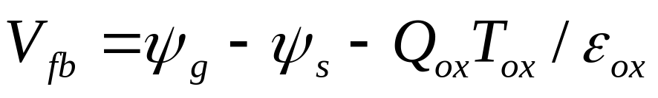
EXAMPLE: Interpret this measured V_{fb} dependence on oxide thickness. The gate electrode is N⁺ poly-silicon.
V_{fb}
10 nm
20 nm
30 nm
T_{ox}
0
–0.15V
–0.3V
What does it tell us? Body work function? Doping type? Other?
Solution:
Modern Semiconductor Devices for Integrated Circuits (C. Hu)
Slide 5-<number>

Slide 26
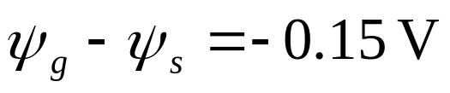
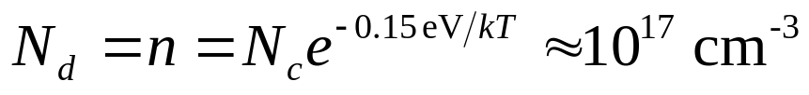

from intercept
E
, vacuum level
0
ψ
ψ
=
ψ
+ 0.15V
g
s
g
E
,
E
E
f
c
c
E
f
E
E
v
v
N
+
-Si gate
Si body
N-type substrate,
from slope
Modern Semiconductor Devices for Integrated Circuits (C. Hu)
Slide 5-<number>

Slide 27
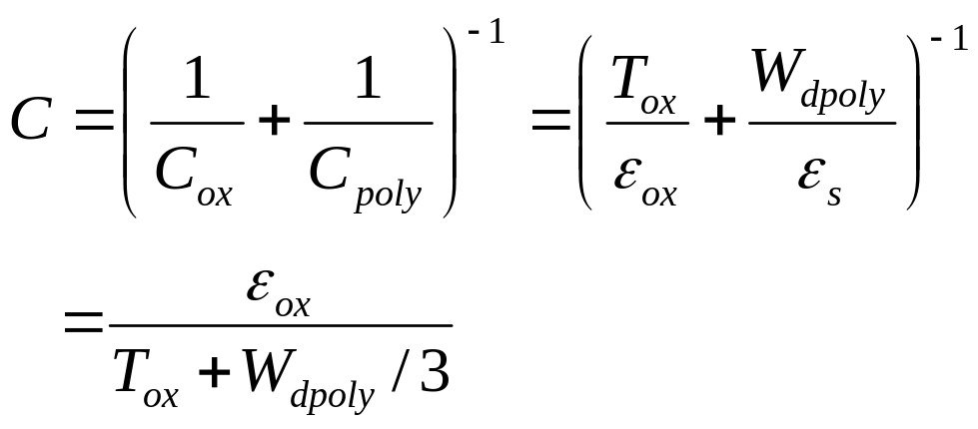
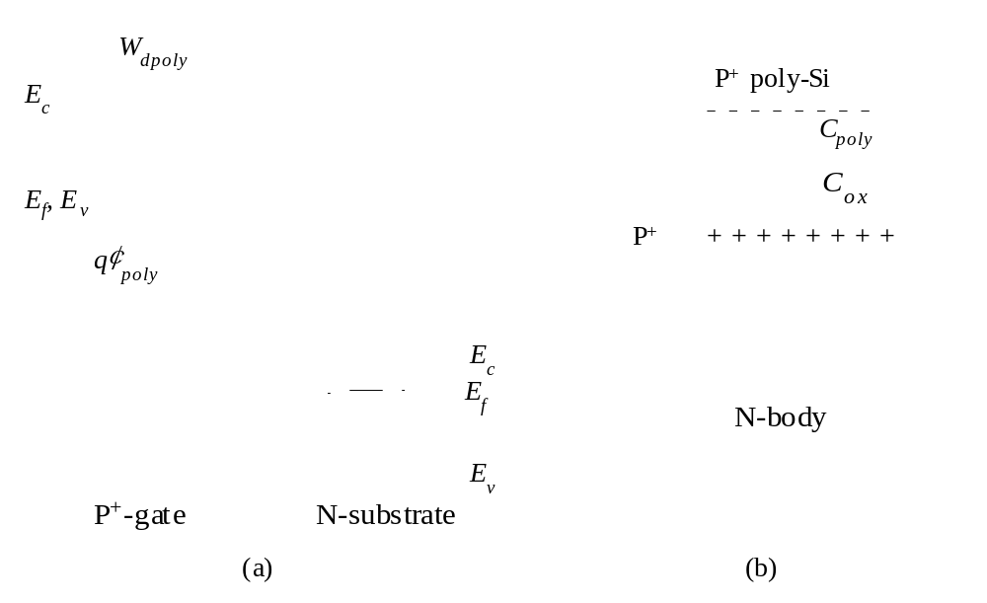
5.8 Poly-Silicon Gate Depletion–Effective
Increase in T_{ox}
Gauss’s Law
W
=
ε
E
/
qN
dpoly
ox
ox
poly
P⁺
If W_{dpoly}= 15 Å, what is the
effective increase in T_{ox}?
Modern Semiconductor Devices for Integrated Circuits (C. Hu)
Slide 5-<number>

Slide 28
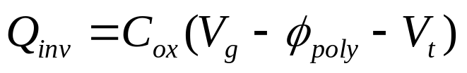
Effect of Poly-Gate Depletion on Q_{inv}
W
Poly-gate depletion degrades MOSFET current and circuit speed.
dpoly
E
c
How can poly-depletion be minimized?
E
f
,
E
v
q
φ
poly
E
c
E
f
E
v
P
+
-gate
N-substrate
Modern Semiconductor Devices for Integrated Circuits (C. Hu)
Slide 5-<number>

Slide 29

EXAMPLE : Poly-Silicon Gate Depletion
V_{ox} , the voltage across a 2 nm thin oxide, is –1 V. The P⁺ poly-gate doping is N_{poly} = 8 ×10¹⁹ cm⁻³ and substrate N_{d} is 10¹⁷cm⁻³. Find (a) W_{dpoly} , (b) φ_{poly} , and (c) V_{g} .
Solution:
(a)
W
=
ε
E
/
qN
=
ε
V
/
T
qN
dpoly
ox
ox
poly
ox
ox
ox
poly
3
.
9
8
.
85
10
−
14
(
F/cm
)
1
V
=
2
10
−
7
−
19
10
19
cm
−
3
cm
1
.
6
10
C
8
=
1
.
3
nm
Modern Semiconductor Devices for Integrated Circuits (C. Hu)
Slide 5-<number>

Slide 30
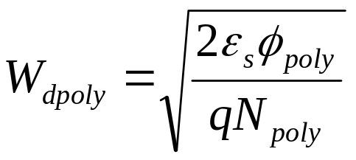
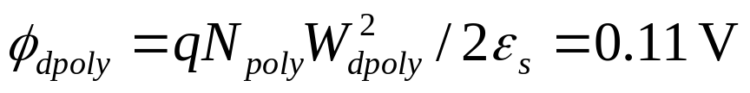
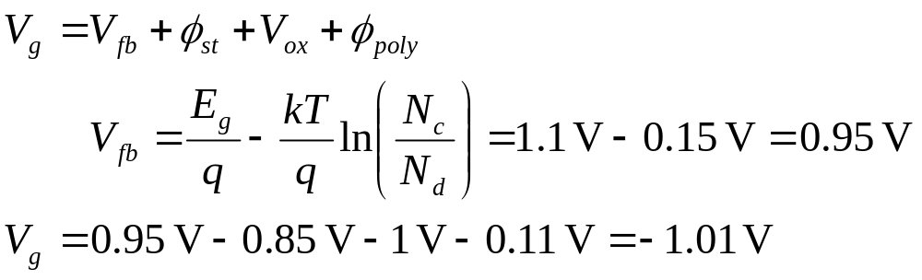
EXAMPLE : Poly-Silicon Gate Depletion
(b)
(c)
Is the loss of 0.11 V from the 1.01 V significant?
Modern Semiconductor Devices for Integrated Circuits (C. Hu)
Slide 5-<number>

Slide 31

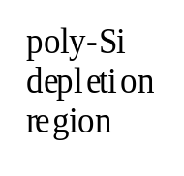
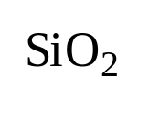



5.9 Inversion and Accumulation Charge-Layer
Thickness–Quantum Mechanical Effect
Average inversion-layer location below the Si/SiO₂ interface is
called the inversion-layer thickness, T_{inv} .
T_{inv}
Gate
Si
-50
-40
-30
-20
-10
0
10
20
30
40
50
A
Physical
T
ox
Effective
T
ox
n(x) is determined by Schrodinger’s eq., Poisson eq., and Fermi function.
Modern Semiconductor Devices for Integrated Circuits (C. Hu)
Slide 5-<number>

Slide 32
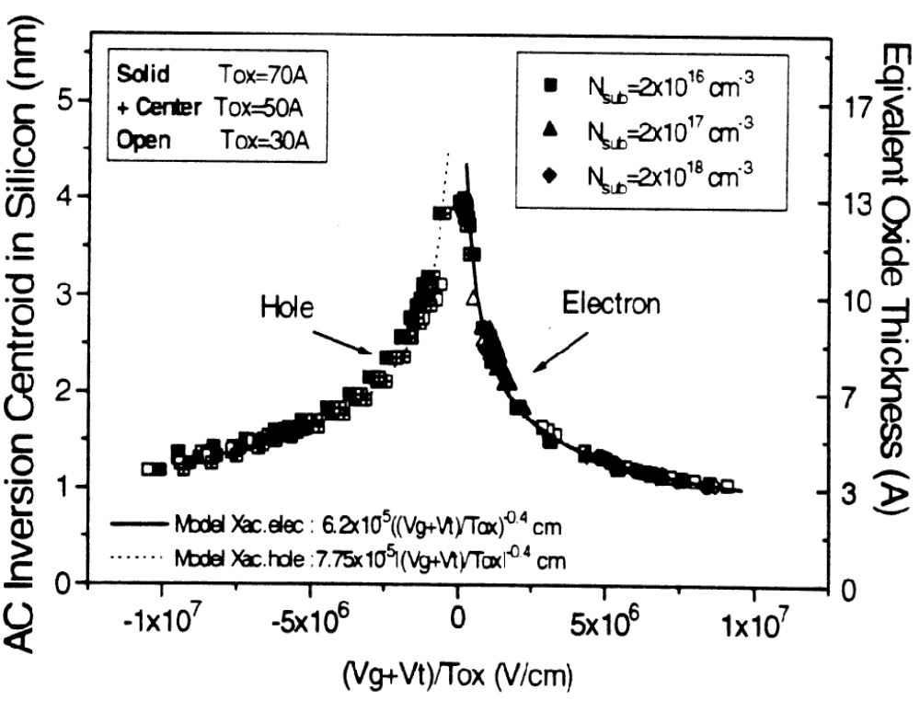
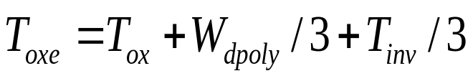
Electrical Oxide Thickness, T_{oxe}
T_{inv} is a function of the average electric field in the inversion layer, which is (V_{g} + V_{t})/6T_{ox} (Sec. 6.3.1).
T_{inv} of holes is larger than that of electrons because of difference in effective mass.
T_{oxe} is the electrical oxide thickness.
at V_{g}=V_{dd}
Modern Semiconductor Devices for Integrated Circuits (C. Hu)
Slide 5-<number>

Slide 33

Effective Oxide Thickness and Effective
Oxide Capacitance
T
=
T
+
W
/
3
+
T
/
3
oxe
ox
dpoly
inv
C
Basic CV
C
ox
with poly-depletion
with poly-depletion and
charge-layer thickness
measured data
V_{g}
Modern Semiconductor Devices for Integrated Circuits (C. Hu)
Slide 5-<number>

Slide 34
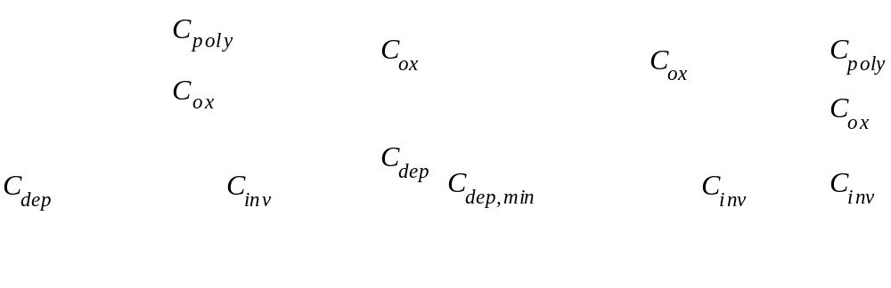
Equivalent circuit in the depletion and the inversion regimes
(a)
(b)
(c)
(d)
General case for both depletion and inversion regions.
In the depletion regions
V_{g} ≈ V_{t}
Strong inversion
Modern Semiconductor Devices for Integrated Circuits (C. Hu)
Slide 5-<number>

Slide 35
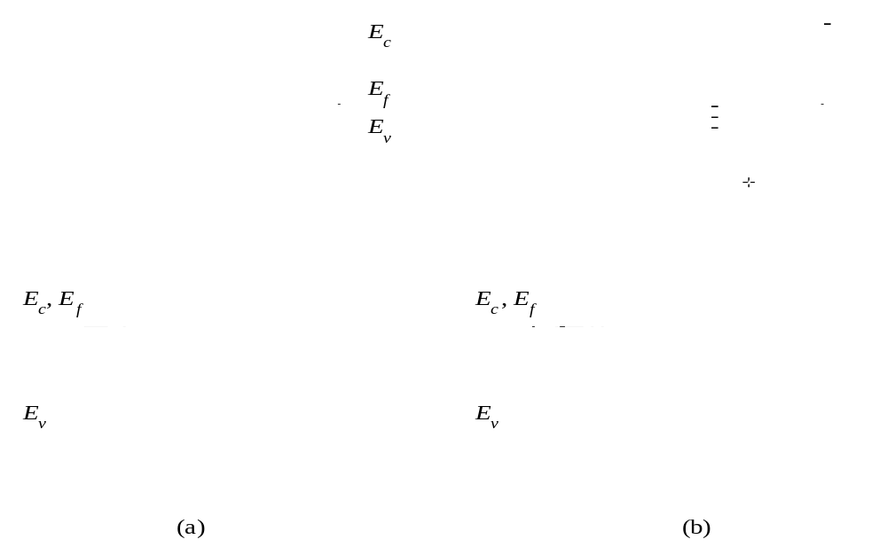
5.10 CCD Imager and CMOS Imager
5.10.1 CCD Imager
Deep depletion, Q_{inv}= 0
Exposed to light
Modern Semiconductor Devices for Integrated Circuits (C. Hu)
Slide 5-<number>

Slide 36
CCD Charge Transfer
V₃
V₂
V₁
V₁ > V₂ = V₃
oxide
(a)
-
-
-
-
-
depletion region
-
-
-
-
-
-
-
-
-
-
P-Si
V₁
V₂
V₃
V₁
V₂
V₃
V₁
V₂ > V₁ > V₃
oxide
(b)
-
-
-
-
-
depletion region
-
-
-
P-Si
V₁
V₂
V₃
V₁
V₂
V₃
V₁
V₂ > V₁ = V₃
oxide
(c)
-
-
-
-
-
depletion region
-
-
-
P-Si
Modern Semiconductor Devices for Integrated Circuits (C. Hu)
Slide 5-<number>

Slide 37
two-dimensional CCD imager
Signal out
Reading row, shielded from light
Charge-to-voltage converter
The reading row is shielded from the light by a metal film. The 2-D charge packets are read row by row.
Modern Semiconductor Devices for Integrated Circuits (C. Hu)
Slide 5-<number>

Slide 38
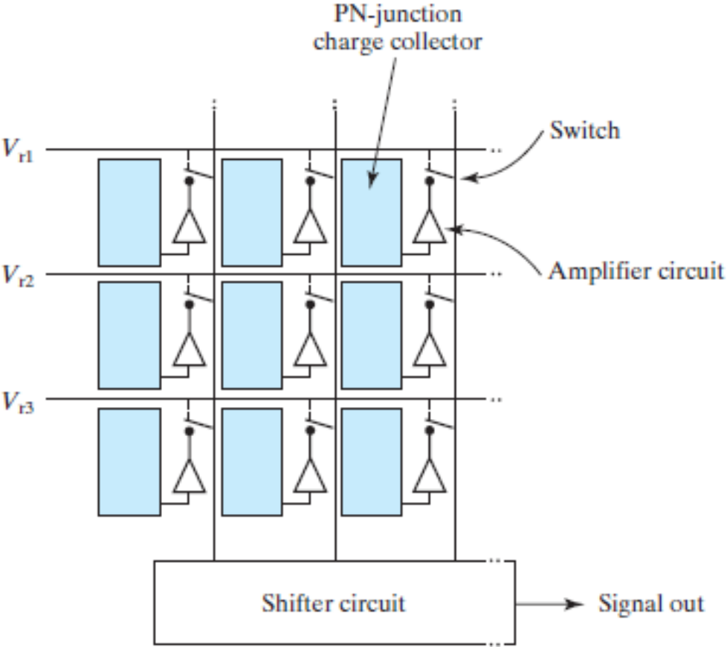
5.10.2 CMOS Imager
PN junction charge collector
CMOS imagers can be integrated with signal processing and control circuitries to further reduce system costs. However, The size constrain of the sensing circuits forces the CMOS imager to use very simple circuits
switch
V1
Amplifier circuit
V2
V3
Shifter circuit
Signal out
Modern Semiconductor Devices for Integrated Circuits (C. Hu)
Slide 5-<number>

Slide 39
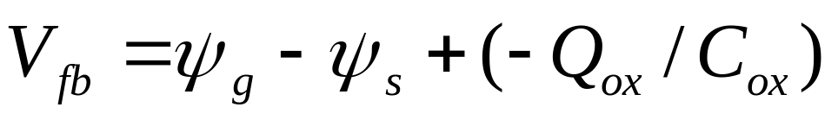
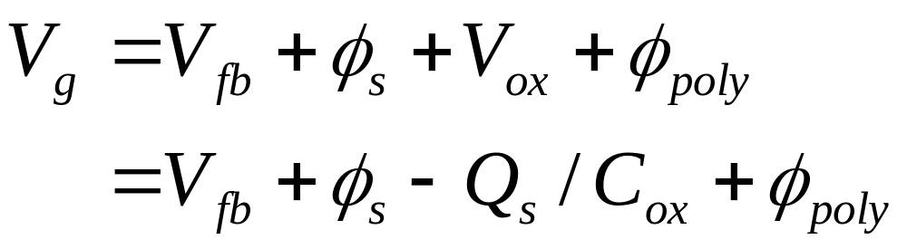
5.11 Chapter Summary
N-type device: N⁺-polysilicon gate over P-body
P-type device: P⁺-polysilicon gate over N-body
Modern Semiconductor Devices for Integrated Circuits (C. Hu)
Slide 5-<number>

Slide 40




5.11 Chapter Summary
or
+ : N-type device, – : P-type device
Modern Semiconductor Devices for Integrated Circuits (C. Hu)
Slide 5-<number>

Slide 41

5.11 Chapter Summary
N-type Device
(N⁺-gate over P-substrate)
P-type Device
(P⁺-gate over N-substrate)
What’s the diagram like at V_{g} > V_{t} ? at V_{g}= 0?
Modern Semiconductor Devices for Integrated Circuits (C. Hu)
Slide 5-<number>

Slide 42

5.11 Chapter Summary
What is the root cause of the low C in the HF CV branch?
Modern Semiconductor Devices for Integrated Circuits (C. Hu)
Slide 5-<number>

