Slide 1

ECE 105: Introduction to Electrical Engineering
Lecture 10
Device 2
Yasser Khan
Rehan Kapadia

Slide 2




Slide 3
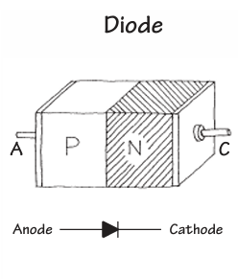
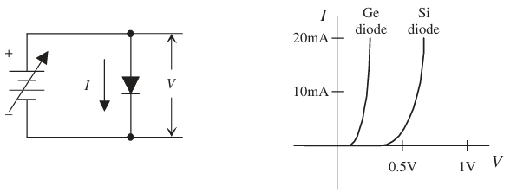





What is a diode
A diode is a device that exhibits ‘rectifying’ behavior
Can be made from a physical junction between an n-type semiconductor and a p-type semiconductor
Can also be made from a physical junction between a metal and semiconductor (not discussed here)

Slide 4











Slide 5
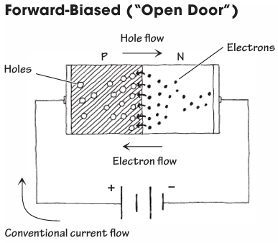

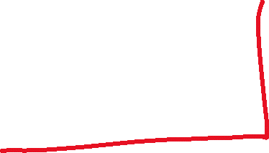



Forward biasing a diode

Slide 6





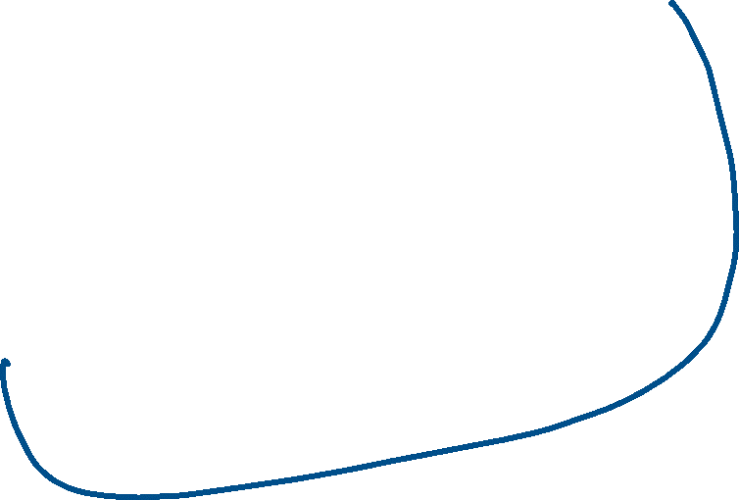












Slide 7
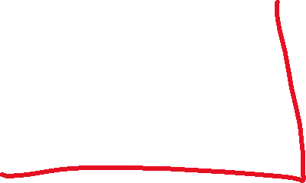



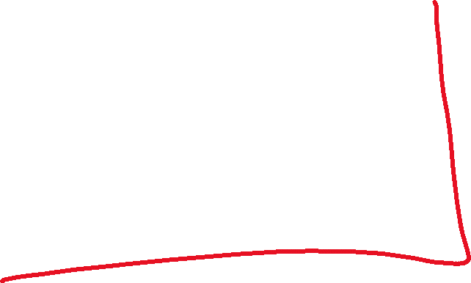











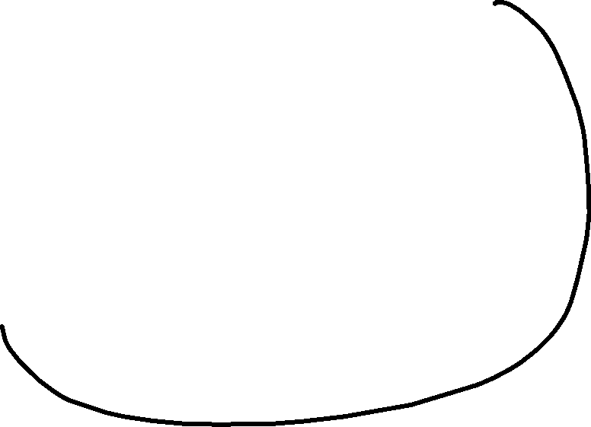












Slide 8




Slide 9
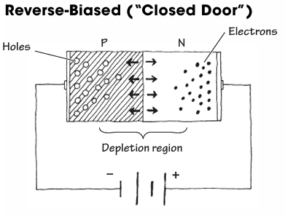
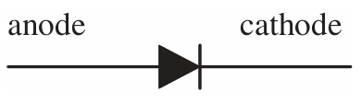








Reverse biasing a diode

Slide 10








Reverse biasing a diode

Slide 11
Diode characterization

Slide 12
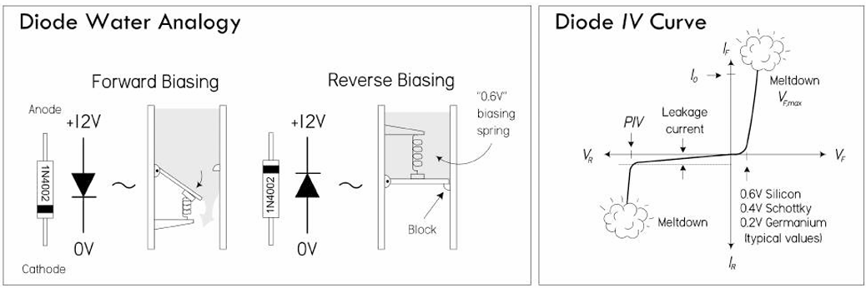
Water analogy

Slide 13





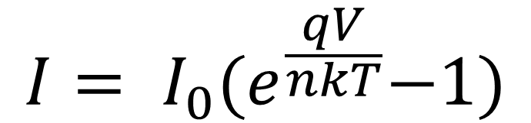













Diode Current Equation
$$I= I_{0}{(e}^{\frac{qV}{nkT}}−1)$$
This equation partially describes the behavior of a non-ideal diode

Slide 14
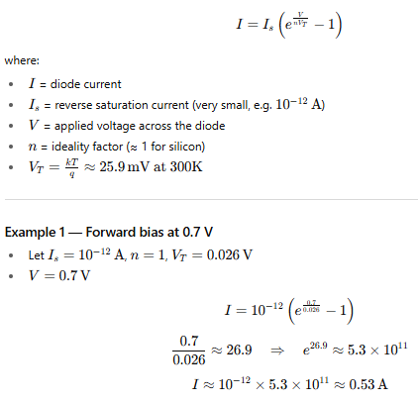










Diode Current Equation

Slide 15



Slide 16
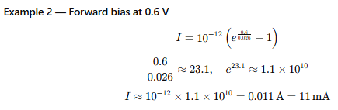
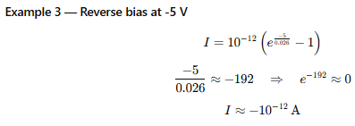
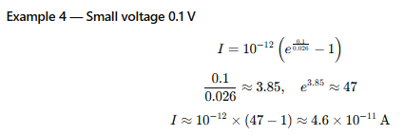
Diode Current Equation

Slide 17
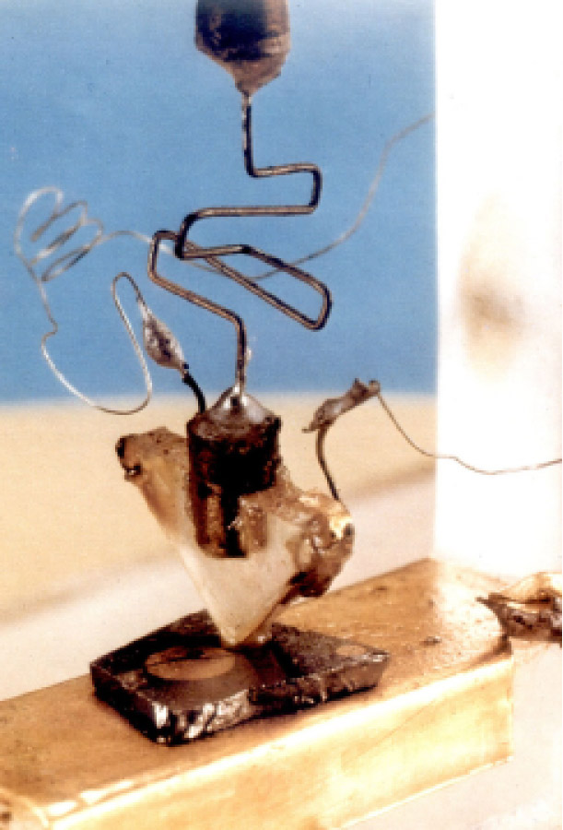
The First Transistor
December 16, 1947: John Bardeen and Walter Brattain successfully demonstrated the first working transistor at Bell Labs.
It was a point-contact transistor made of a small slab of germanium with two closely spaced gold contacts.
When input current was applied to one contact, it modulated the conductivity of the germanium, amplifying the signal seen at the other contact.
Key outcome: It could amplify electrical signals like a vacuum tube, but in a device only a few millimeters wide.
At Bell Telephone Laboratories, research was focused on finding a solid-state amplifier for telephone signal processing.
The three key scientists were:
John Bardeen (theorist)
Walter Brattain (experimentalist)
William Shockley (team leader, physicist)

Slide 18
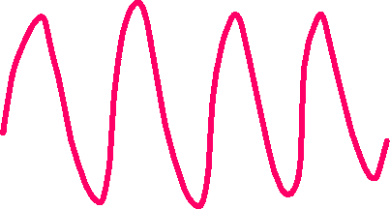


Transistor amplification

Slide 19
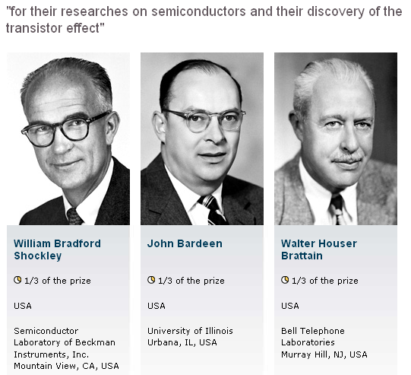
1956 Physics Nobel Prize

Slide 20
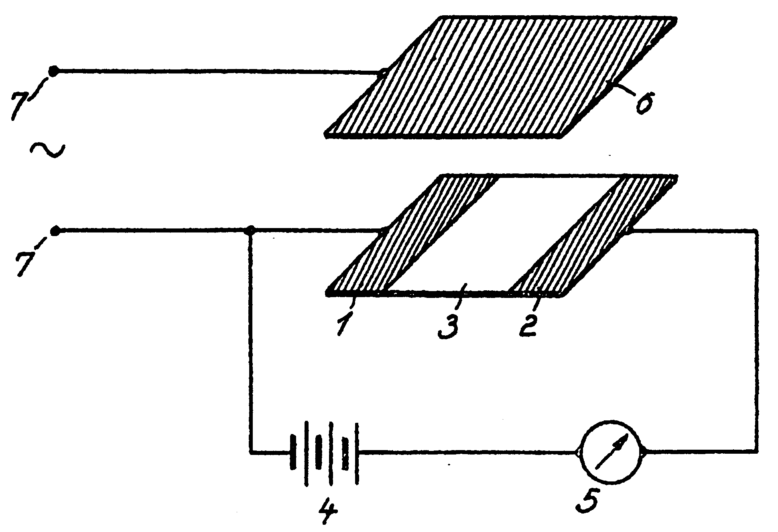
Invention of the Field-Effect Transistor
In 1935, a British patent was issued to Oskar Heil.
A working MOSFET was not demonstrated until 1955.

Slide 21















Slide 22



















Slide 23
















Slide 24



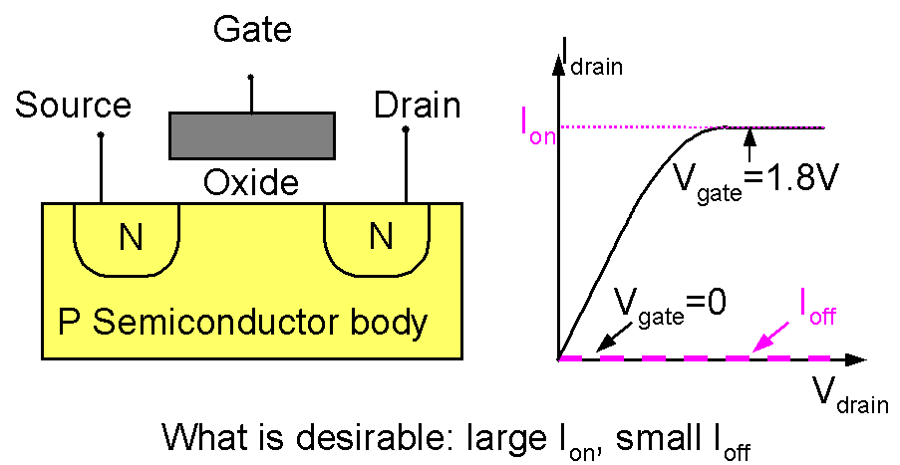
Introduction to the MOSFET
Basic MOSFET structure and IV characteristics

Slide 25





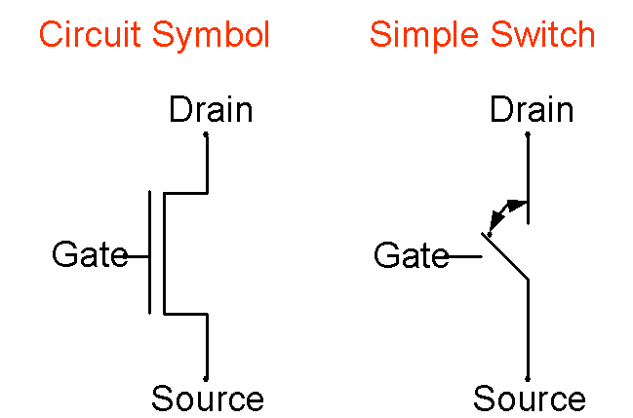









Introduction to the MOSFET
Two ways of representing a MOSFET:

Slide 26





Slide 27
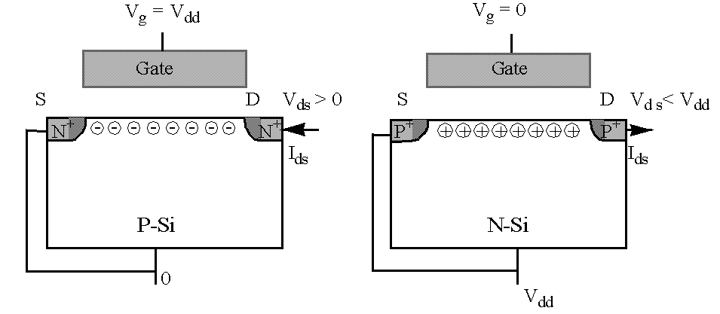
Complementary MOSFETs (CMOS)
NFET PFET
When V_{g} = V_{dd} , the NFET is on and the PFET is off.
When V_{g} = 0, the PFET is on and the NFET is off.

Slide 28
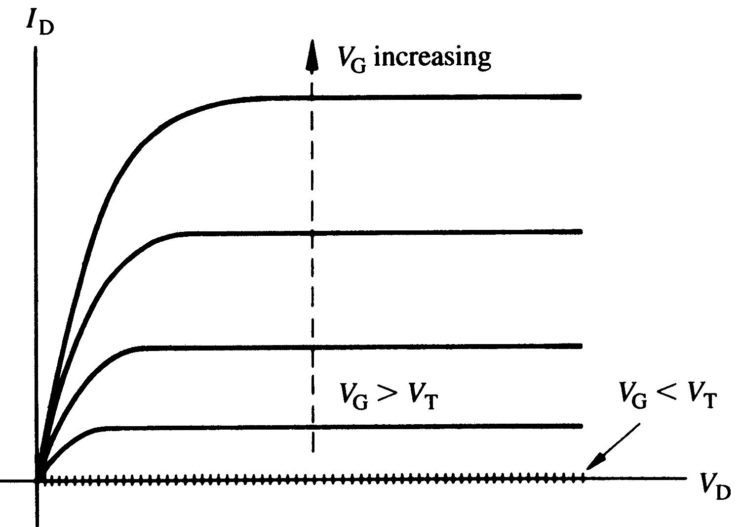




I_{D}-V_{DS} characteristics expected from a long channel (ΔL << L) MOSFET (n-channel), for various values of V_{G}

Slide 29
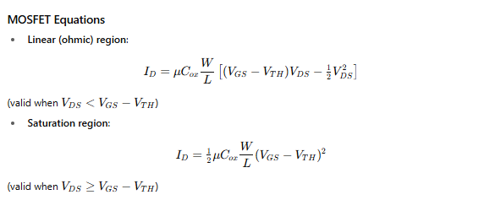
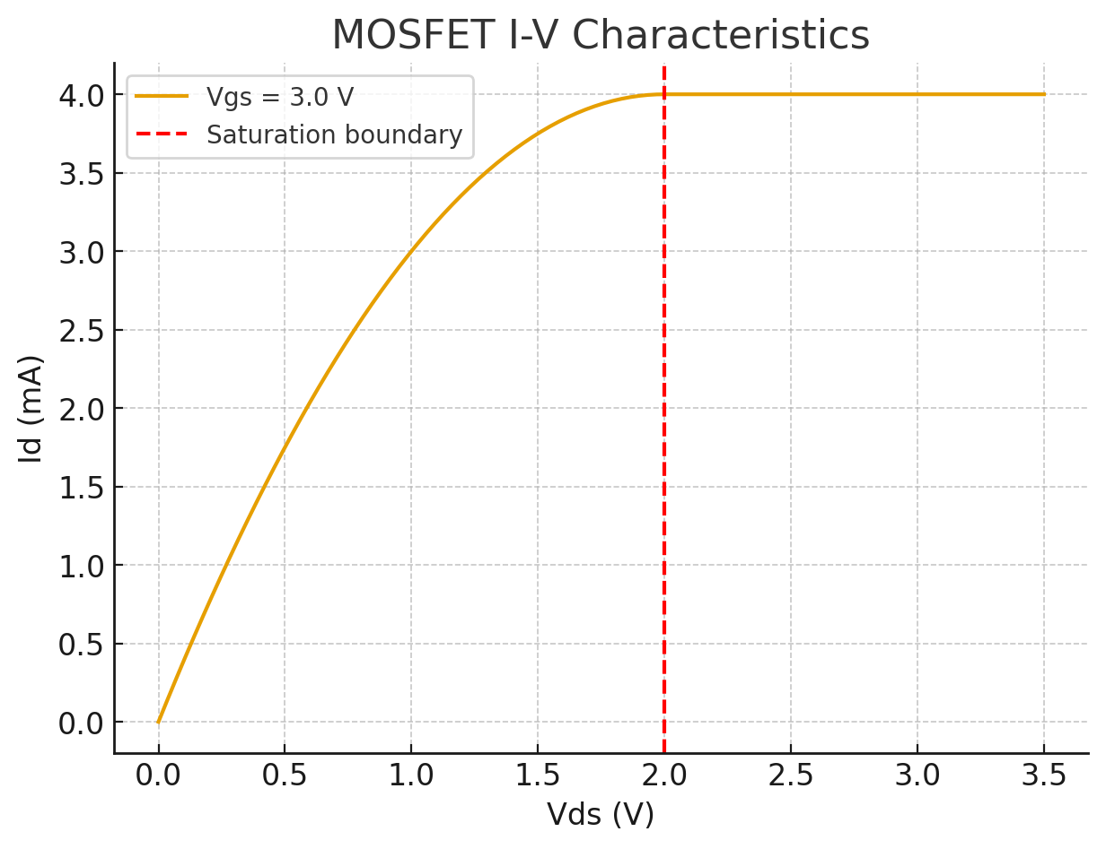
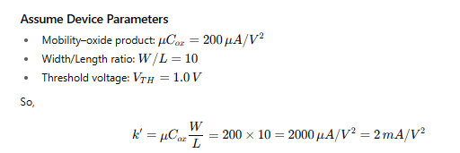









MOSFET current equations

Slide 30
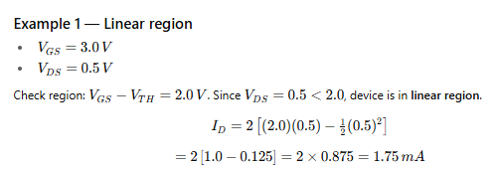


MOSFET current equations

Slide 31
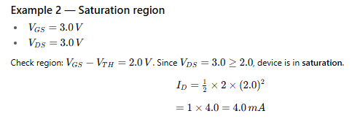


MOSFET current equations

Slide 32
CMOS (Complementary MOS) Inverter

Slide 33










CMOS (Complementary MOS) Inverter

Slide 34











CMOS (Complementary MOS) Inverter

Slide 35






CMOS (Complementary MOS) Inverter

Slide 36
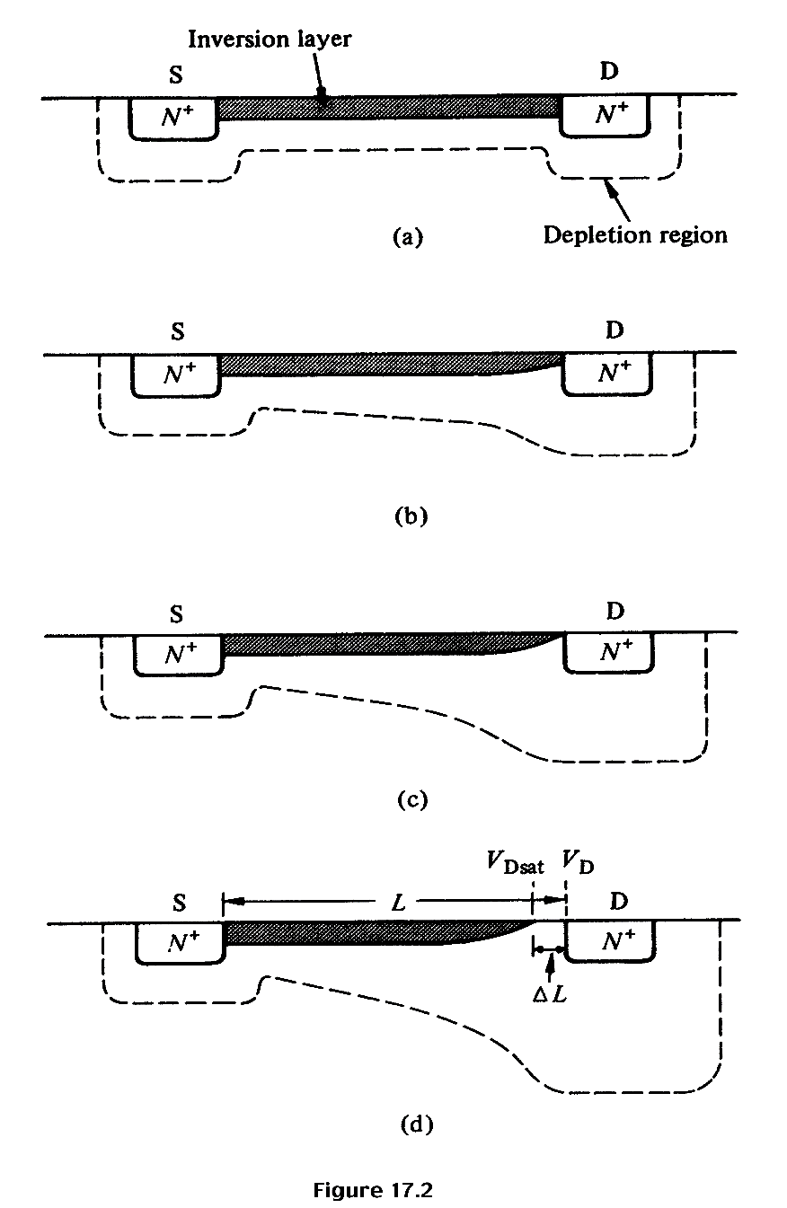














Qualitative discussion: n-MOSFET
V_{G} > V_{T} ; V_{DS} ≈ 0
I_{D} increases with V_{DS}
V_{G} > V_{T}; V_{DS} small, > 0
I_{D} increases with V_{DS} , but rate of increase decreases.
V_{G} > V_{T}; V_{DS} ≈ pinch-off
I_{D} reaches a saturation value, I_{D,sat} The V_{DS} value is called V_{DS,sat}
V_{G} > V_{T}; V_{DS} > V_{DS,sat}
I_{D} does not increase further, saturation region.

Slide 37




Quantitative I_{D}-V_{DS} Relationships – 1st attempt “Square Law”
;
I_{D} will increase as V_{DS} is increased, but when V_{G} – V_{DS} = V_{T}, pinch-off occurs, and current saturates when V_{DS} is increased further. This value of V_{DS} is called V_{DS,sat}. i.e., V_{DS,sat} = V_{G} – V_{T} and the current when V_{DS}= V_{DS,sat} is called I_{DS,sat}.
;
Here, C_{ox} is the oxide capacitance per unit area, C_{ox} = ε_{ox} / x_{ox}

Slide 38
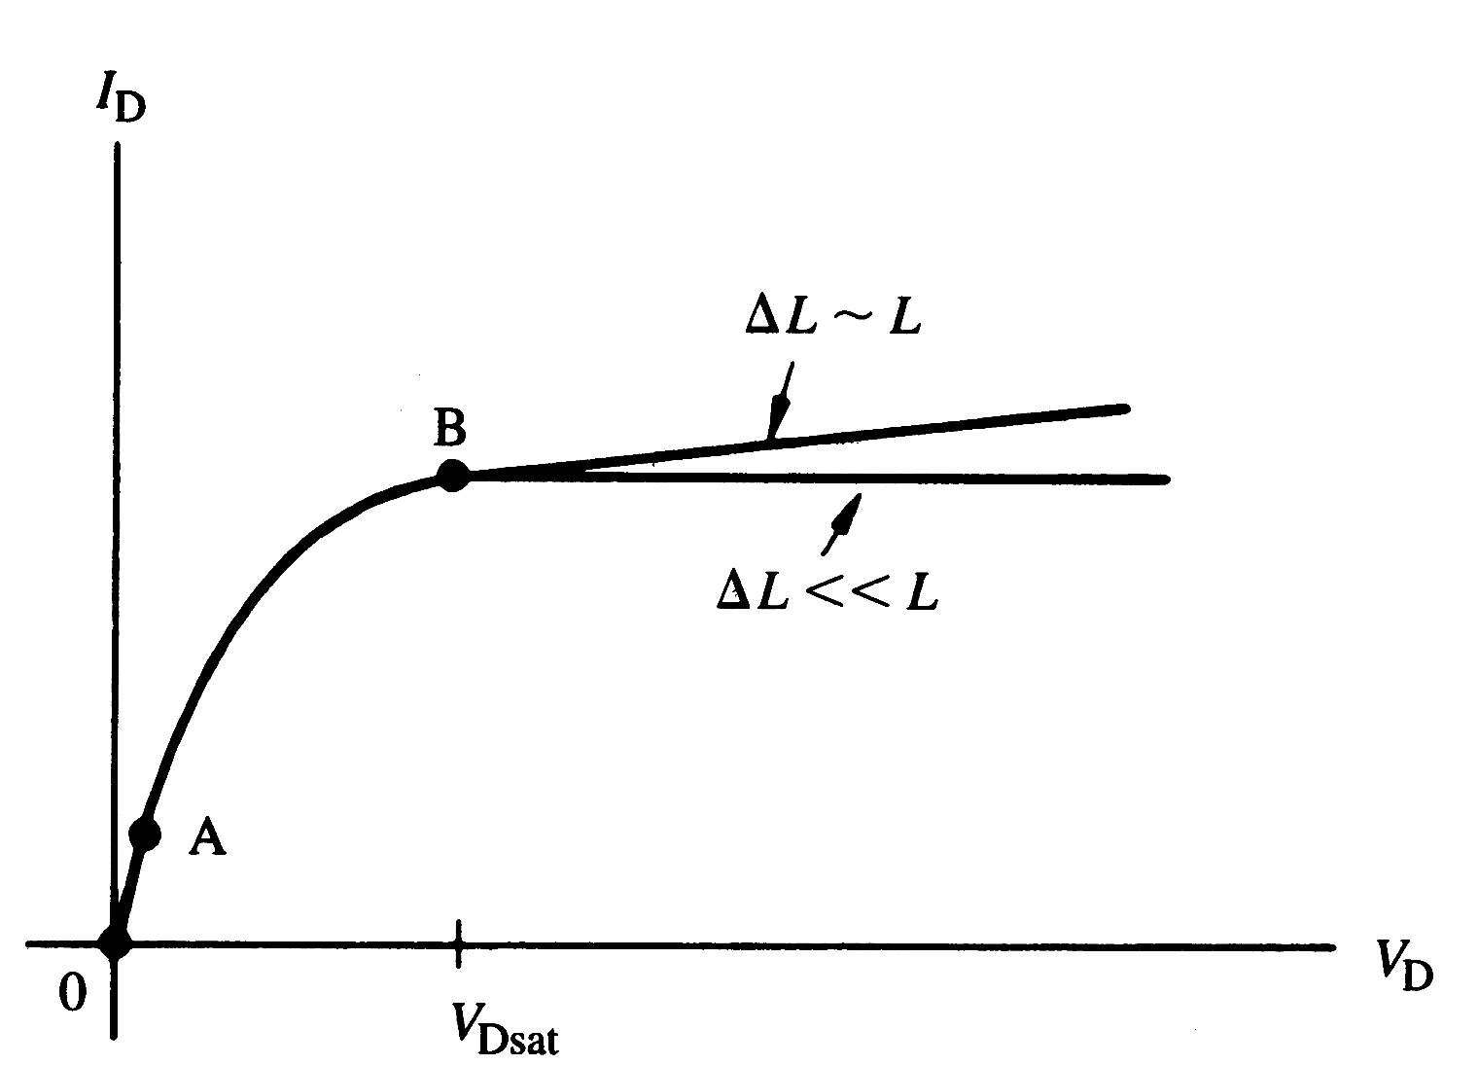
I_{D}-V_{DS} characteristics for n-MOSFET
Linear
region
Saturation
region

Slide 39
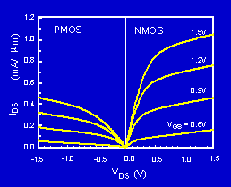
P-MOSFET N-MOSFET IV Characteristics
The PMOS IV is qualitatively similar to the NMOS IV, but the current is about half as large. Why?

Slide 40
Threshold and Subthreshold

Slide 41
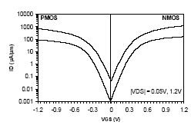
Subthreshold Current
The leakage current that flows at V_{g}<V_{t} is called the subthreshold current. Previously we had assumed that current is zero, but in reality that’s not the case.
)
m
μ
Intel, T. Ghani et al., IEDM 2003
/
90nm technology. Gate length: 45nm for NMOS, 50nm for PMOS
A
μ
(
s
I
d
V_{gs}
The current at V_{gs}=0 and V_{ds}=V_{dd} is called I_{off.}

