Slide 1
ECE 105: Introduction to Electrical Engineering
Lecture 3
Circuit analysis 1
Yasser Khan
Rehan Kapadia

Slide 2



Basic circuit quantities
Quantity | Symbol | Units
Voltage | V | Volts (V)
Current | I | Amperes (A)
Resistance | R | Ohms (Ω)
Capacitance | C | Farads (F)
Inductance | L | Henry (H)

Slide 3
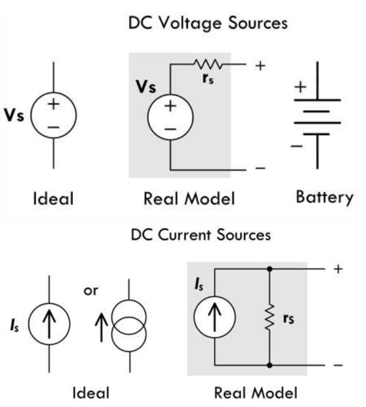






Notations

Slide 4




















Slide 5
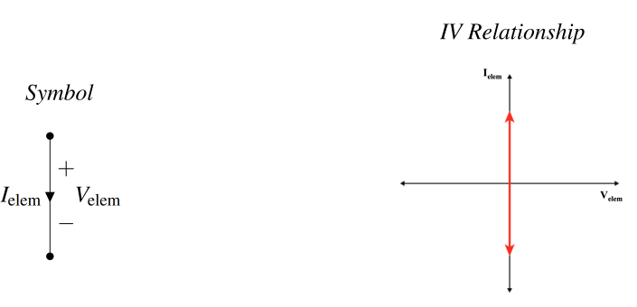
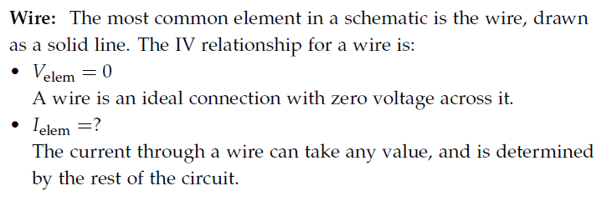




Wire

Slide 6
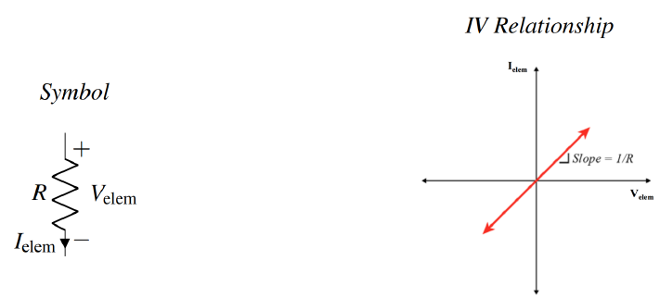
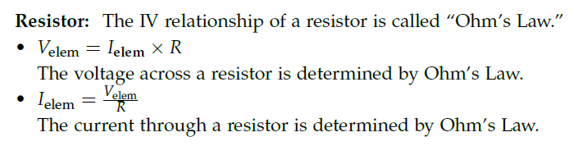
Resistor

Slide 7















Resistor

Slide 8
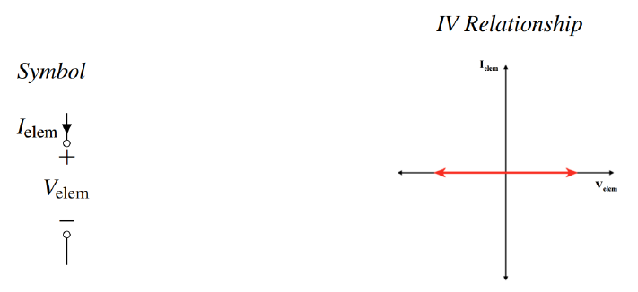
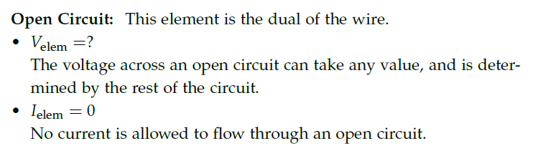





Open circuit

Slide 9
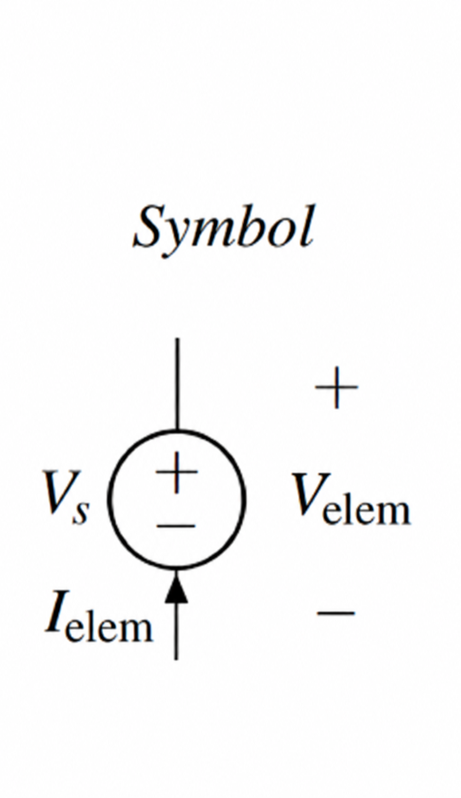
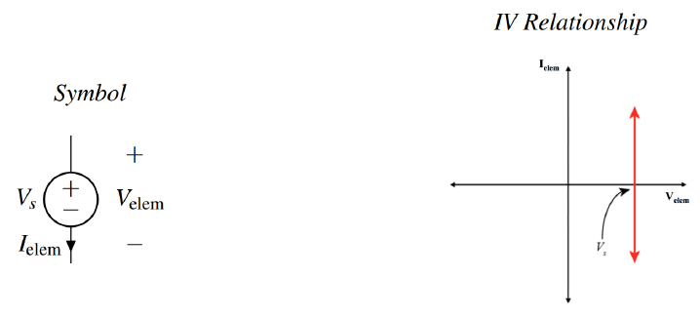
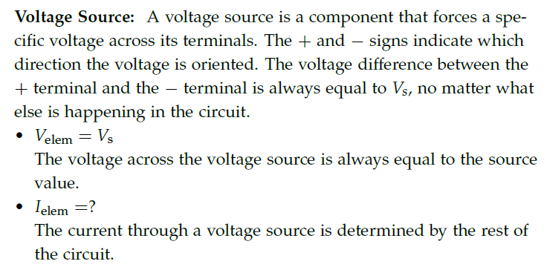




Voltage source

Slide 10
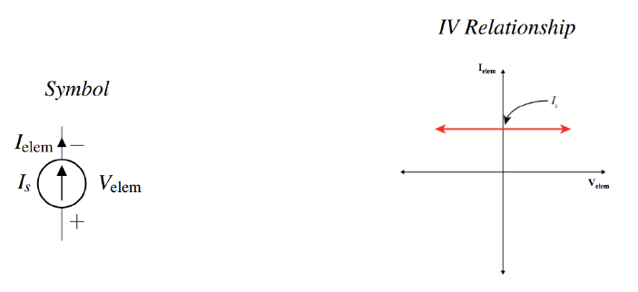
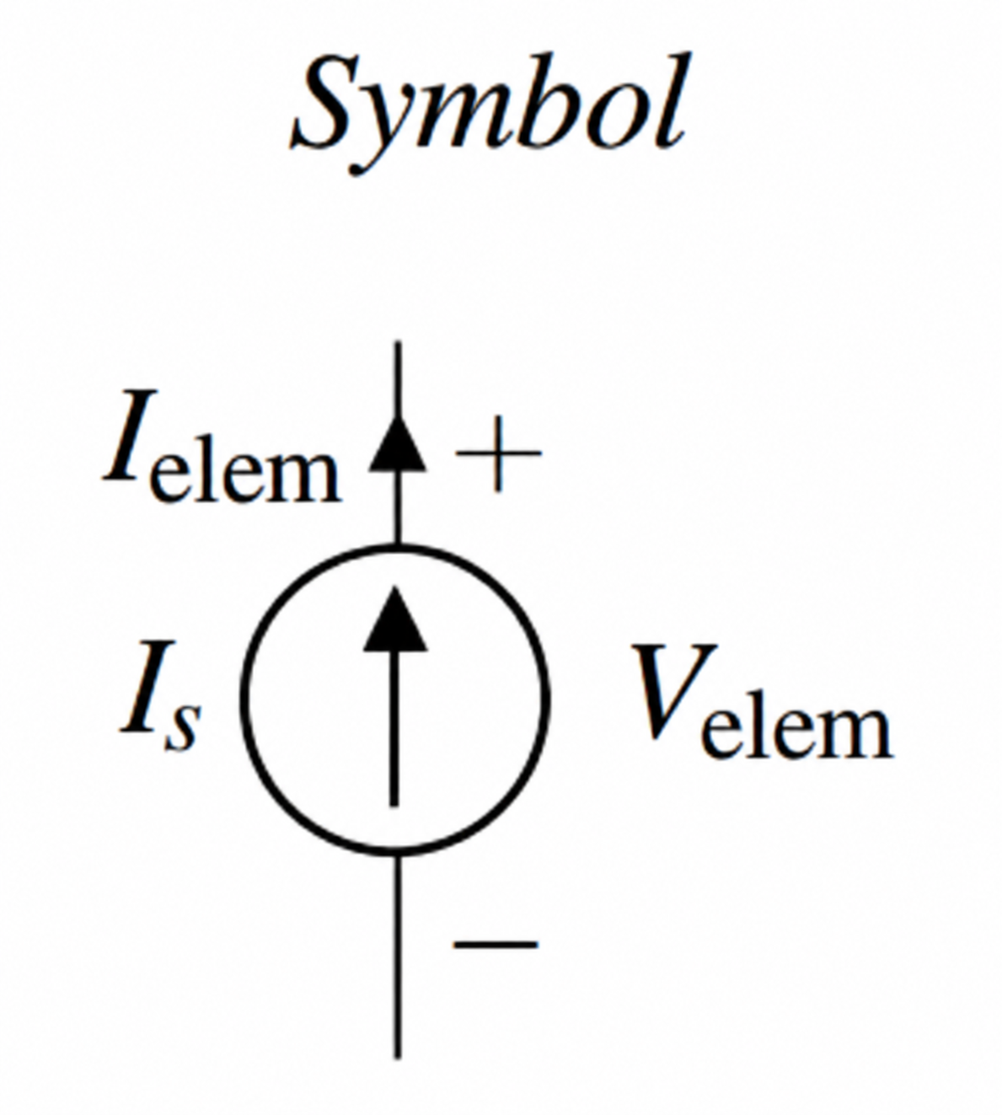
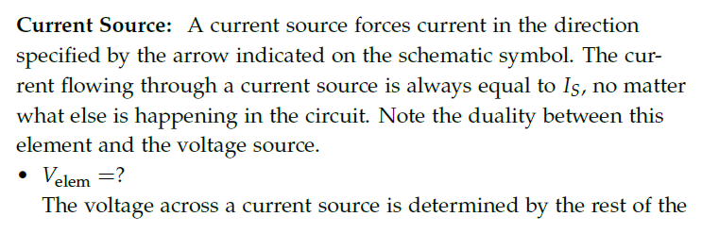
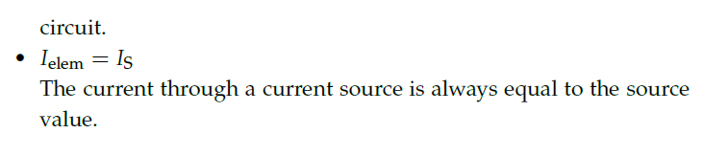
Current source

Slide 11
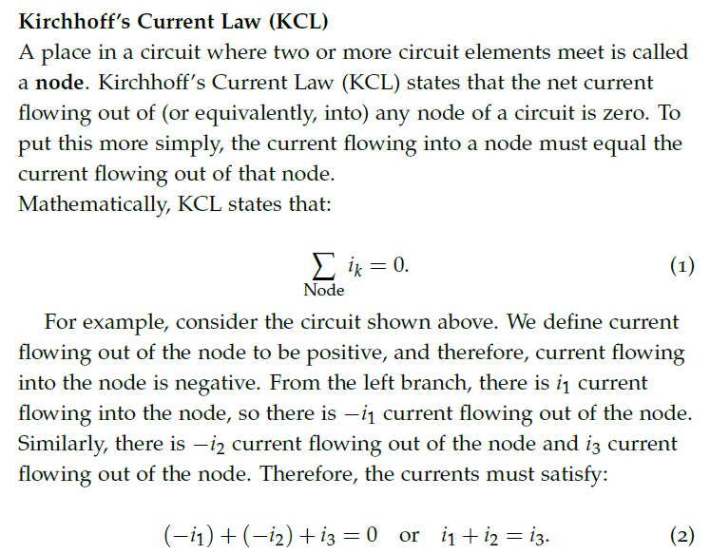
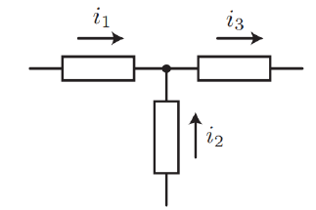




Rule of circuit analysis - KCL

Slide 12












Rule of circuit analysis - KCL

Slide 13































Slide 14

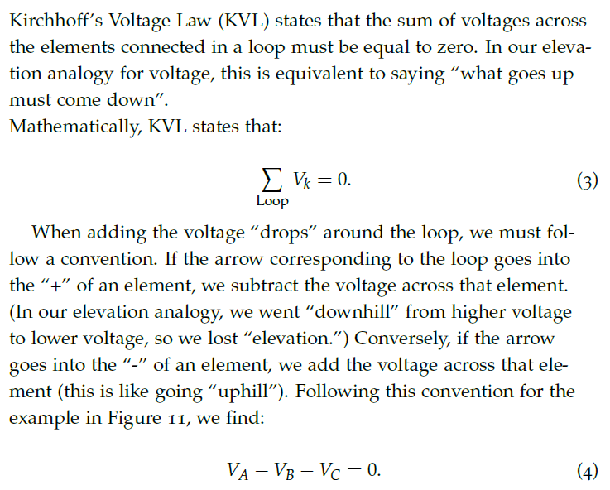
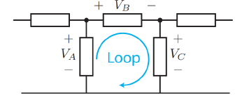

Rule of circuit analysis - KVL

Slide 15













Rule of circuit analysis - KVL

Slide 16





























Slide 17
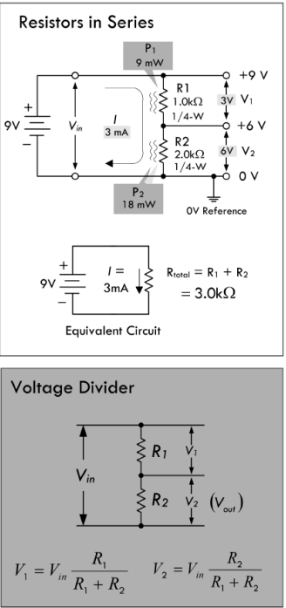
Resistors in series

Slide 18




















Resistors in series

Slide 19











Slide 20
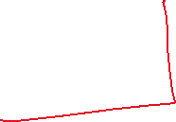
Voltage divider

Slide 21
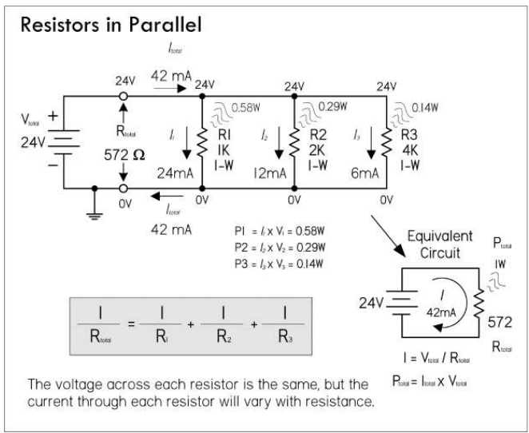
Resistors in parallel

Slide 22
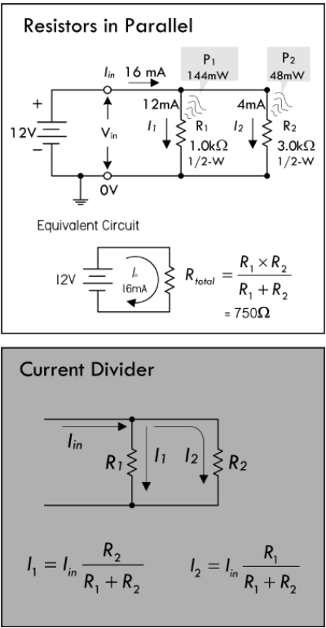








Current divider

Slide 23













Current divider

Slide 24








Slide 25













Slide 26





Slide 27
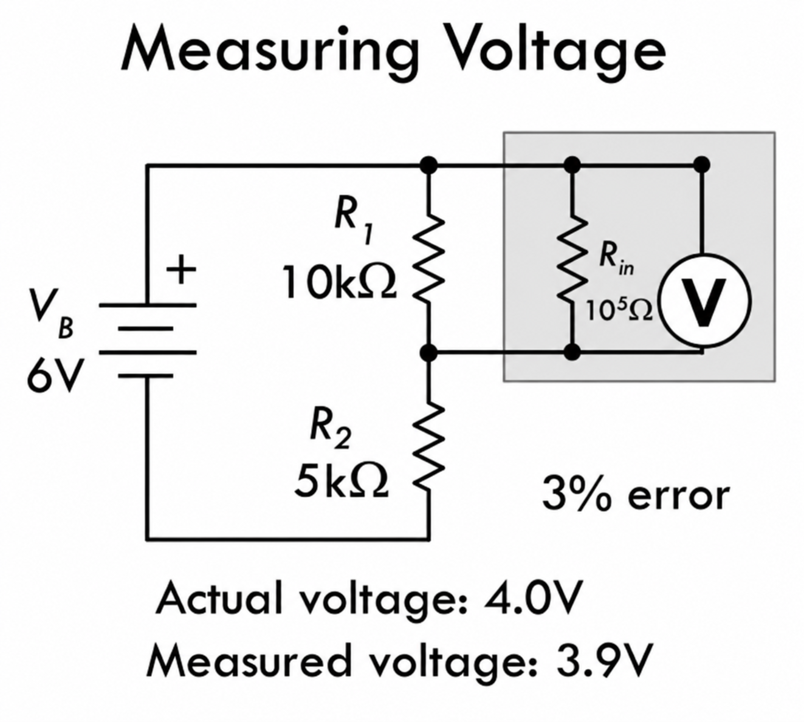
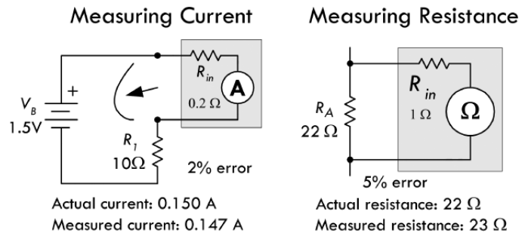
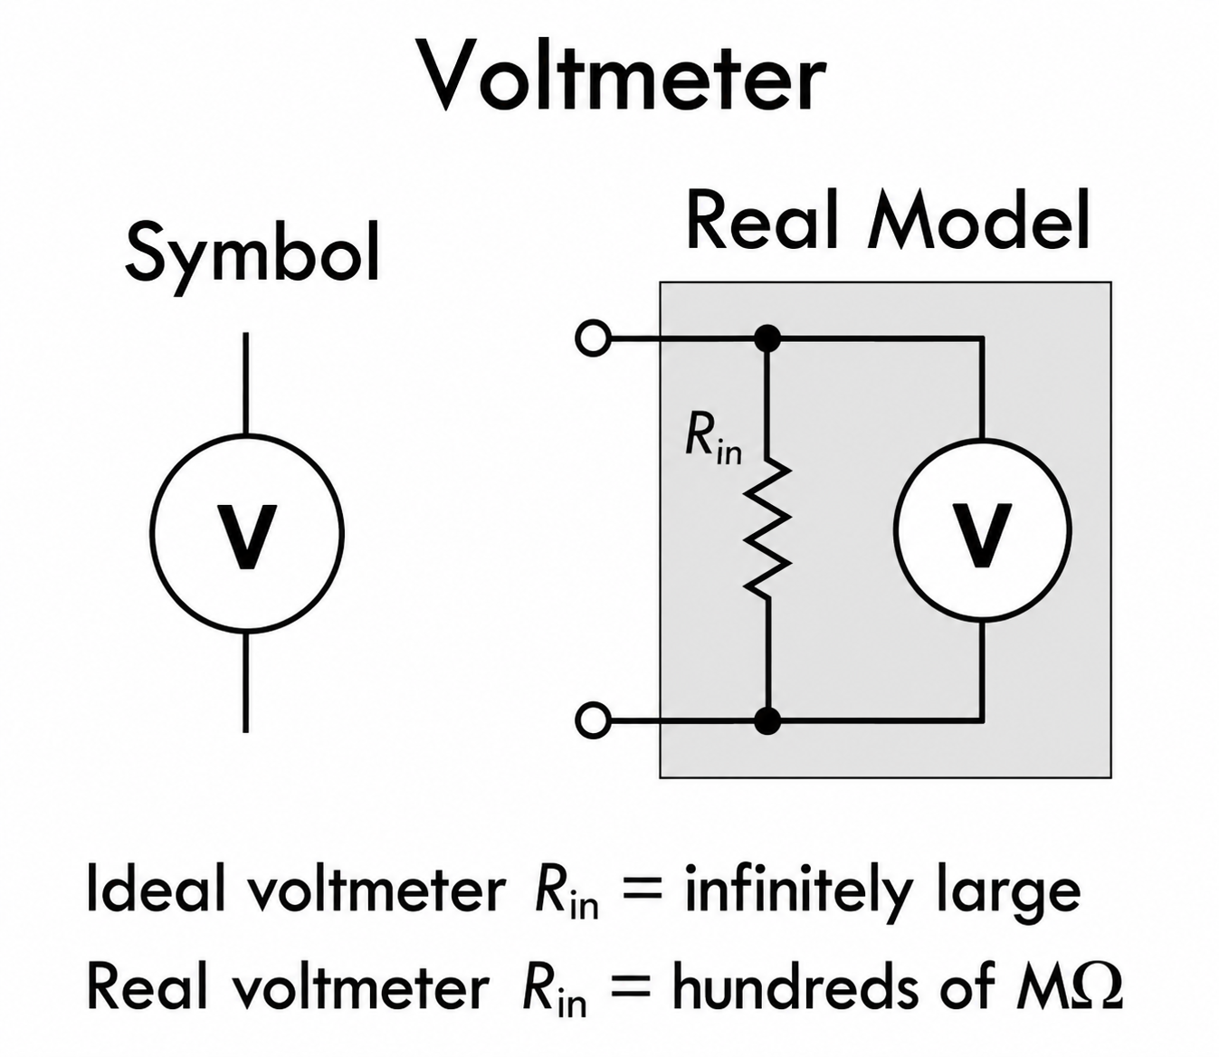
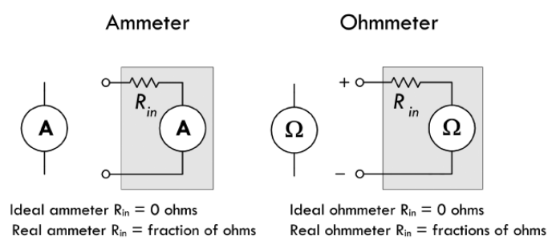






Measuring voltage, current, resistance

Slide 28
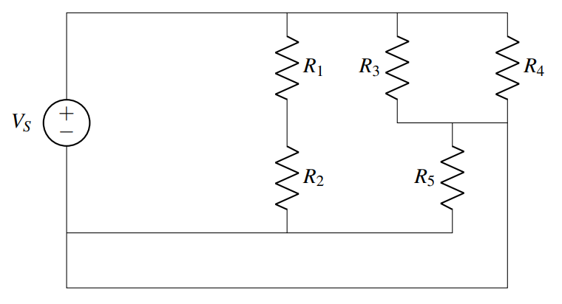
Finding nodes

Slide 29
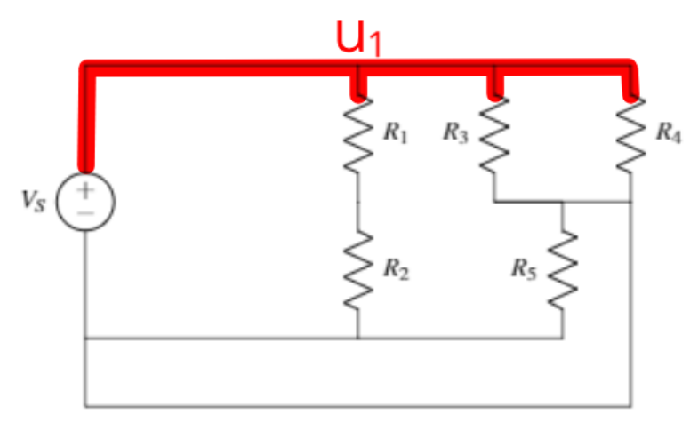



Find the node connected to the source

Slide 30
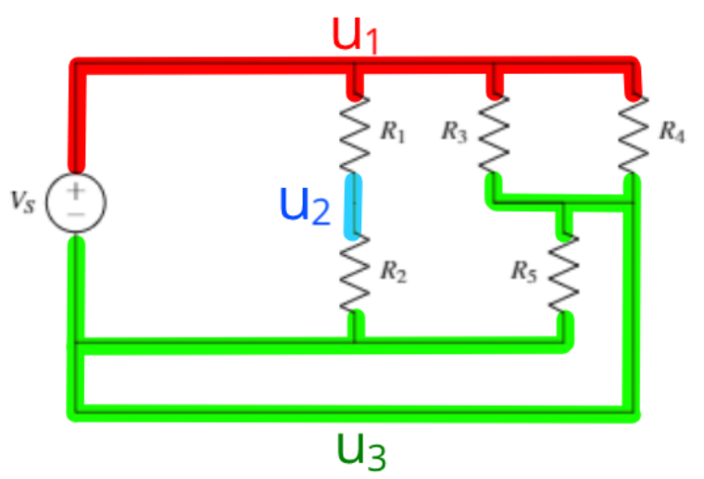


Find other nodes

Slide 31
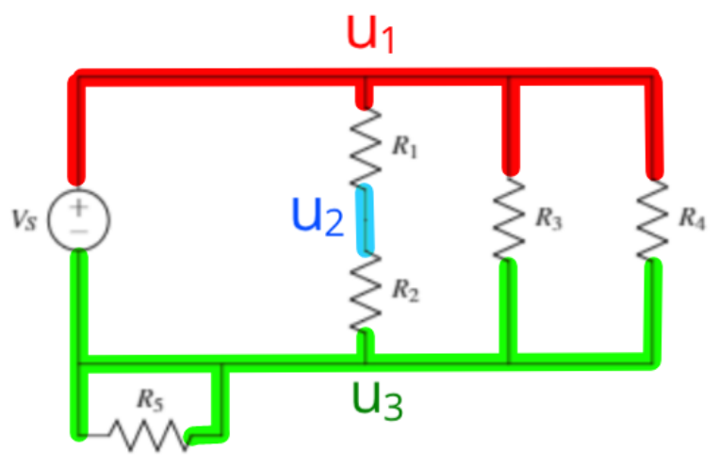




Merge elements sharing the same nodes

Slide 32
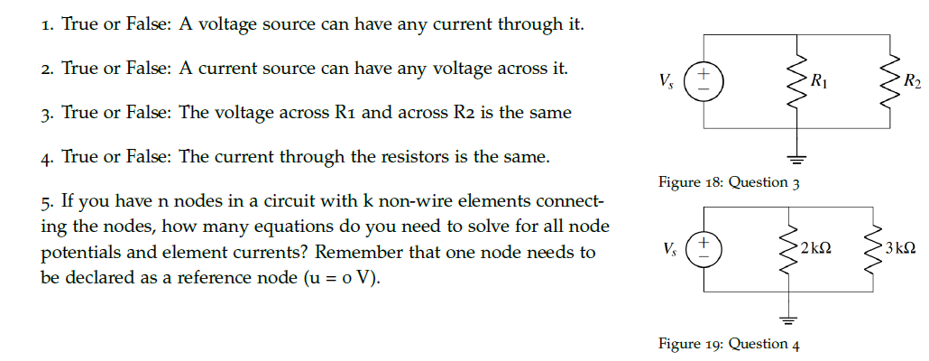





Practice problems

Slide 33
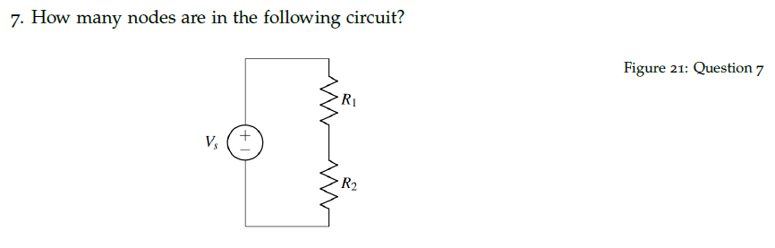
Practice problems

Slide 34
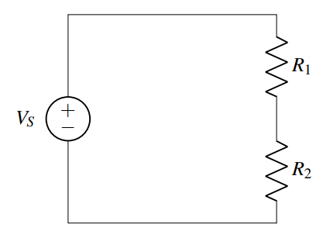


Practice

Slide 35
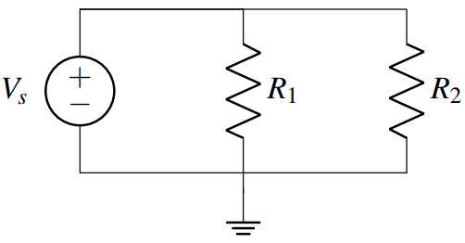
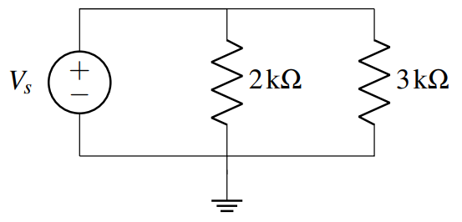



Practice

Slide 36
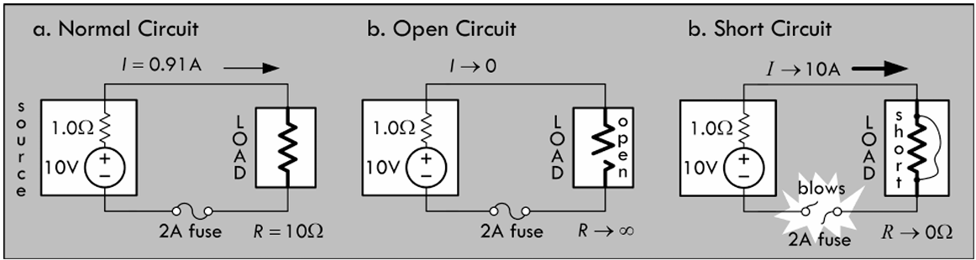
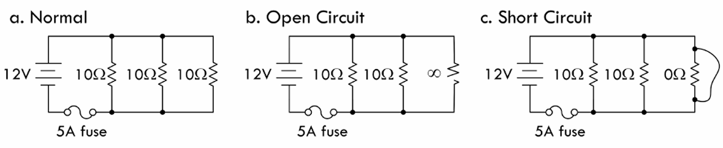


Fuse

