Slide 1
ECE 105: Introduction to Electrical Engineering
Lecture 19-20 Neural Networks Yasser Khan Rehan Kapadia

Slide 2









Timeframe
1943: McCulloch–Pitts “neuron”
Started the field
1962: Rosenblatt’s perceptron
Learned its own weight values; convergence proof
1969: Minsky & Papert book on perceptrons
Proved limitations of single-layer perceptron networks
1982: Hopfield and convergence in symmetric networks
Introduced energy-function concept
1986: Backpropagation of errors
Method for training multilayer networks
Present: Probabilistic interpretations, Bayesian and spiking networks

Slide 3









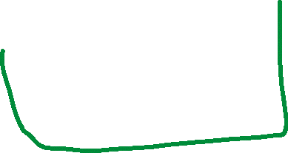
























Timeframe
1943: McCulloch–Pitts “neuron”
Started the field
1962: Rosenblatt’s perceptron
Learned its own weight values; convergence proof
1969: Minsky & Papert book on perceptrons
Proved limitations of single-layer perceptron networks
1982: Hopfield and convergence in symmetric networks
Introduced energy-function concept
1986: Backpropagation of errors
Method for training multilayer networks
Present: Probabilistic interpretations, Bayesian and spiking networks

Slide 4
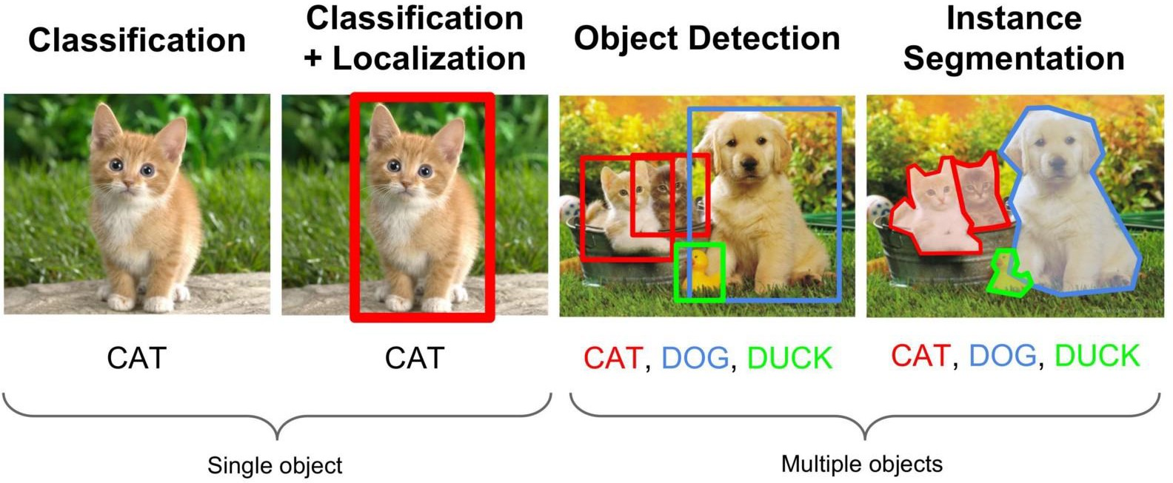
Why Deep Neural Networks?
Deep neural networks are excellent for certain classes of problems, such as image recognition, speech recognition etc.
Importantly, as the amount of data scales, the performance of deep learning continues to improve
Image from Medium: “Review of Deep Learning Algorithms for Object Detection”

Slide 5
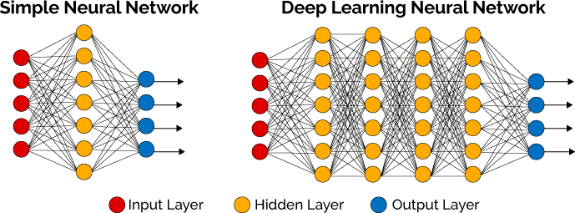
What’s so deep about Deep Neural Networks?
The “deep” refers to the number of layers of ‘units’ between the input
layer and output layer.
Since this is a neural network, the units are called neurons
https://becominghuman.ai/deep-learning-made-easy-with-deep-cognition-403fbe445351

Slide 6














Fundamental Unit of a Neural Network
x1
w1
x2
w2
Neuron
w3
x3
Mathematical Definition Y = f(w1*x1 + w2*x2 + w3*x3 + b)
The above is the fundamental unit of a neural network
W_{i} refers to the weights, sometimes called synaptic weights
The neuron is the mathematical function that connects inputs to outputs
X_{i} refers to the inputs
Y refers to the output

Slide 7
























Fundamental Unit of a Neural Network
x1
w1
x2
w2
Neuron
w3
x3
Mathematical Definition Y = f(w1*x1 + w2*x2 + w3*x3 + b)
The above is the fundamental unit of a neural network
W_{i} refers to the weights, sometimes called synaptic weights
The neuron is the mathematical function that connects inputs to outputs
X_{i} refers to the inputs
Y refers to the output

Slide 8










Slide 9










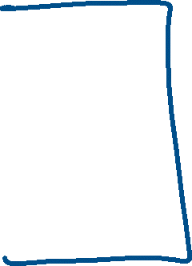



Fundamental Unit of a Neural Network
x1
w1
x2
y
w2
Neuron
w3
x3
Mathematical Definition Y = f(w1*x1 + w2*x2 + w3*x3 + b)
The above is the fundamental unit of a neural network
W_{i} refers to the weights, sometimes called synaptic weights
The neuron is the mathematical function that connects inputs to outputs
X_{i} refers to the inputs
Y refers to the output

Slide 10










Fundamental Unit of a Neural Network
x1
w1
x2
y
w2
Neuron
w3
x3
Mathematical Definition Y = f(w1*x1 + w2*x2 + w3*x3 + b)
Many different functions are used for the neuron, but the three most
popular are
Sigmoid: σ(x) = 1/(1+exp(-x))
Rectified Linear Unit (ReLU): f(x) = max(0,x)
tanh: tanh(x) = 2σ(2x) - 1

Slide 11
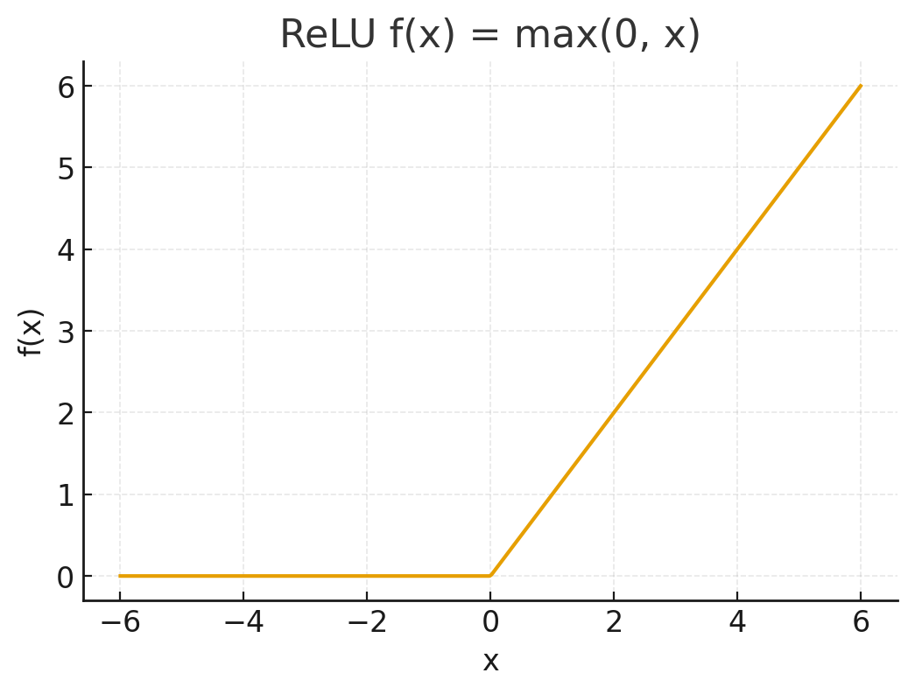
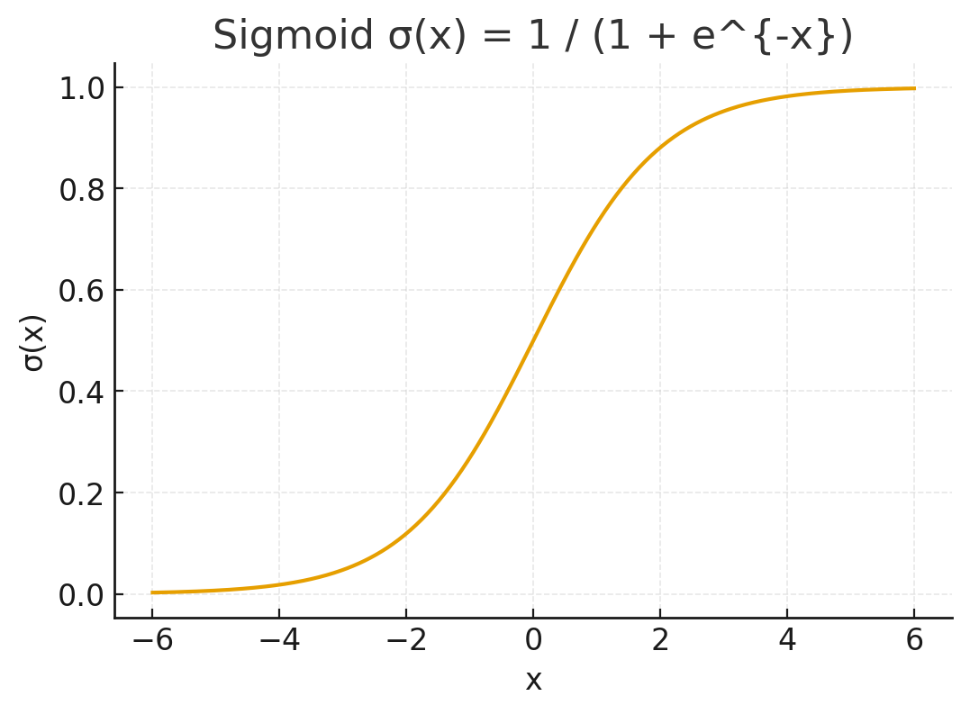
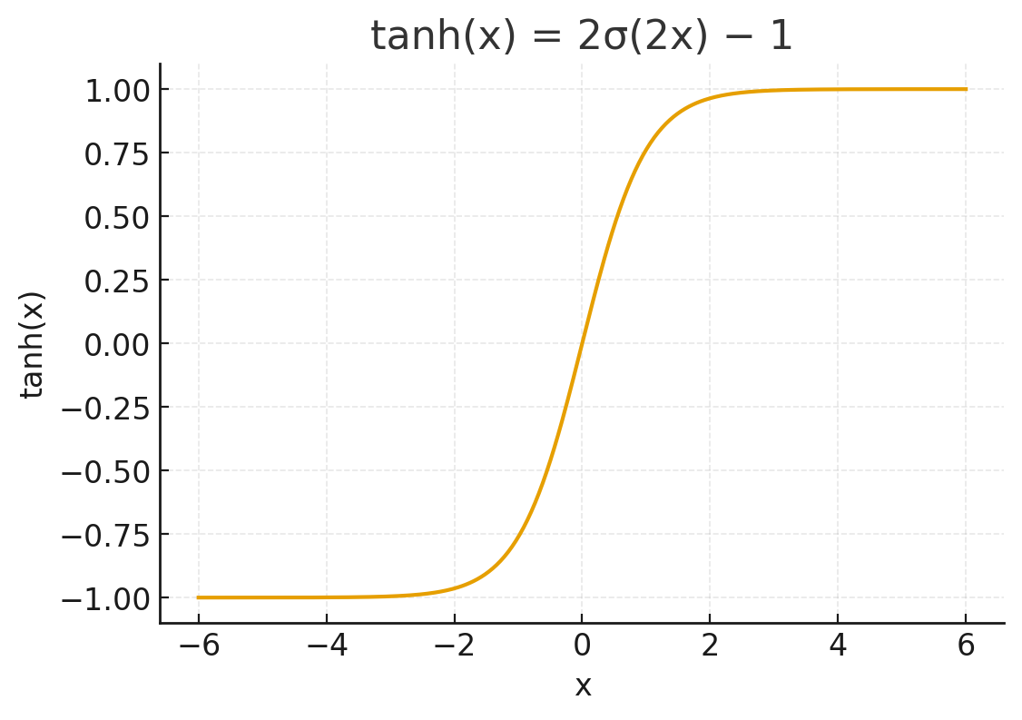
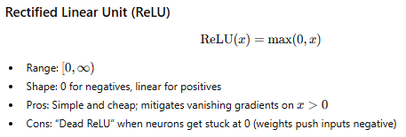
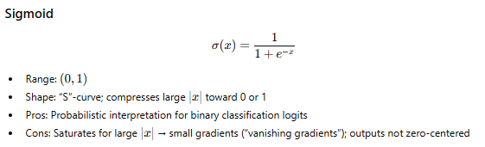
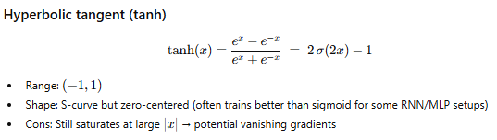


Activation functions of a Neural Network

Slide 12






Activation functions of a Neural Network

Slide 13
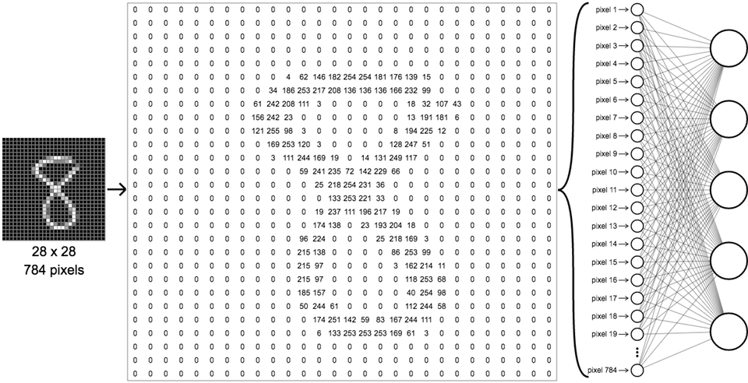






















Operation of a neural network
Image is made up of a set number of pixels
Each pixel becomes an input
Example here: each pixel is from 0 to 256 in greyscale
Each input is connected to all the neurons of the hidden layer
Adjusting the weights will then eventually allow recognition of the digits
https://becominghuman.ai/deep-learning-made-easy-with-deep-cognition-403fbe445351

Slide 14














































Operation of a neural network
Image is made up of a set number of pixels
Each pixel becomes an input
Example here: each pixel is from 0 to 256 in greyscale
Each input is connected to all the neurons of the hidden layer
Adjusting the weights will then eventually allow recognition of the digits
https://becominghuman.ai/deep-learning-made-easy-with-deep-cognition-403fbe445351

Slide 15

























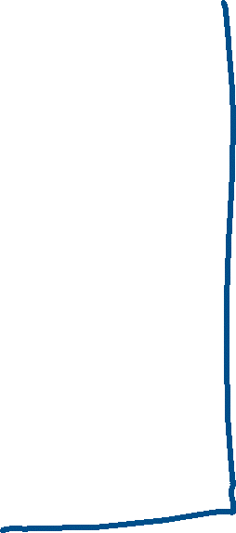






Slide 16
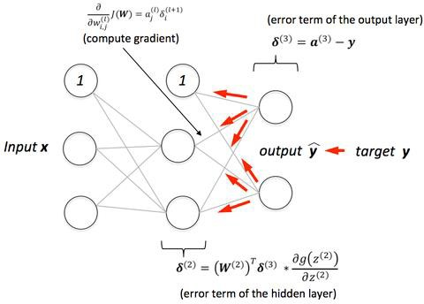





Training of an Artificial Neural Network
Backpropagation algorithm a form of supervised learning
We initialize all the weights of the ANN, and then feed the data into it
Each training example generates an output.
We know the correct output for those training samples, so for each output, we can define an error
Then, we can essentially go backwards, assigning some part of that error to the weights between output
neuron and previous neurons
Adjusting the weights allows us to move towards the correct answer, as defined by us
https://github.com/rasbt/python-machine-learning-book/blob/master/faq/visual-backpropagation.md

Slide 17






Training of an Artificial Neural Network
Backpropagation algorithm a form of supervised learning
We initialize all the weights of the ANN, and then feed the data into it
Each training example generates an output.
We know the correct output for those training samples, so for each output, we can define an error
Then, we can essentially go backwards, assigning some part of that error to the weights between output
neuron and previous neurons
Adjusting the weights allows us to move towards the correct answer, as defined by us
https://github.com/rasbt/python-machine-learning-book/blob/master/faq/visual-backpropagation.md

Slide 18





Training of an Artificial Neural Network
Backpropagation algorithm a form of supervised learning
We initialize all the weights of the ANN, and then feed the data into it
Each training example generates an output.
We know the correct output for those training samples, so for each output, we can define an error
Then, we can essentially go backwards, assigning some part of that error to the weights between output
neuron and previous neurons
Adjusting the weights allows us to move towards the correct answer, as defined by us
https://github.com/rasbt/python-machine-learning-book/blob/master/faq/visual-backpropagation.md

Slide 19

Handwriting Recognition
We can easily recognize these numbers
But this uses a huge number of neurons (~billion or more) and an even
larger number of connections/synapses (100’s of billions)

Slide 20
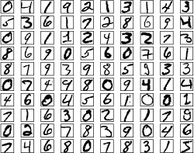
Approach
Need a large set of training data
Also need a set on which to test your trained model

Slide 21



Perceptron
x1
w1
x2
y
w2
Neuron
w3
x3
Mathematical Definition Y = f(w1*x1 + w2*x2 + w3*x3 + b)
For the perceptron:
Output = 0 if Σw*x ≤threshold
Output = 1 if Σw*x >threshold

Slide 22
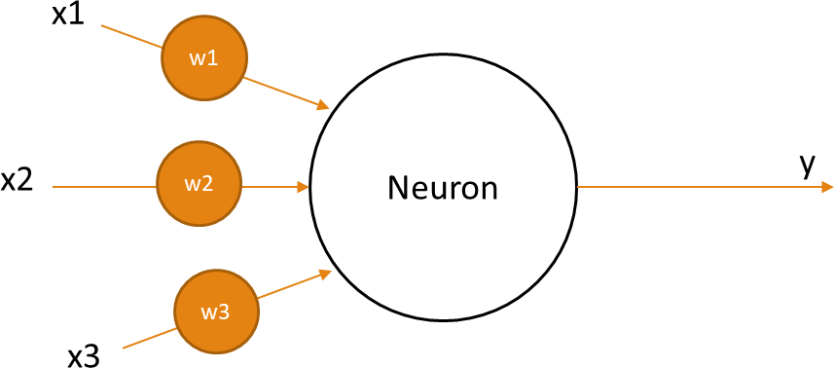












What can we answer with a perceptron?
Do we want to go to Coachella?
Factor 1: Good weather?
Factor 2: Friends going?
Factor 3: Do we have tickets?

Slide 23
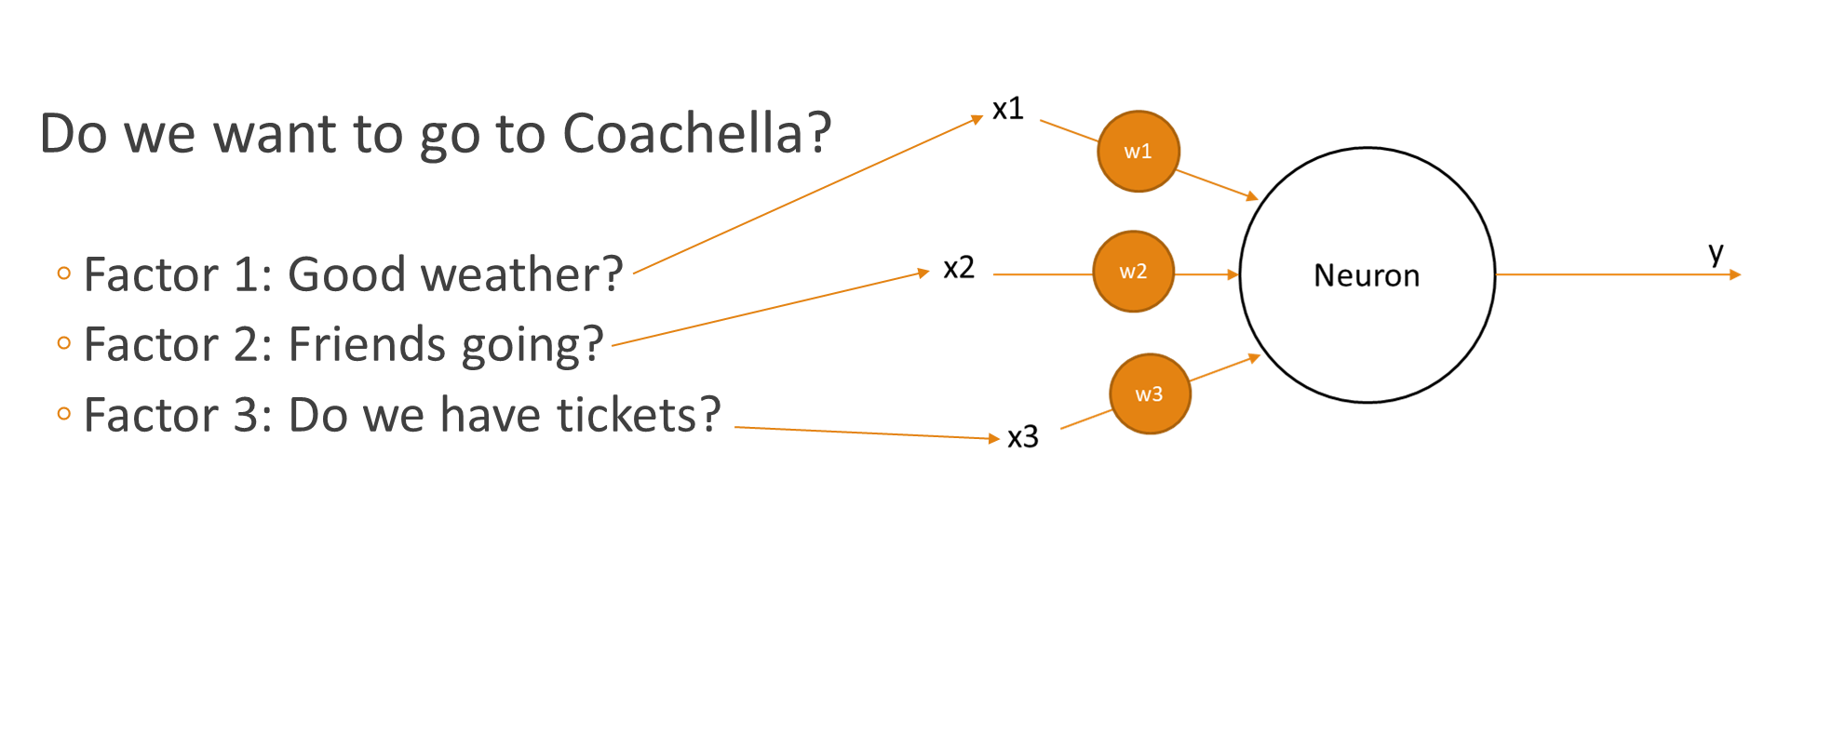
How would we decide this?
Each variable is either a 1 or 0
The decision making happens in the weights
Here we have to assign weights and a threshold value

Slide 24
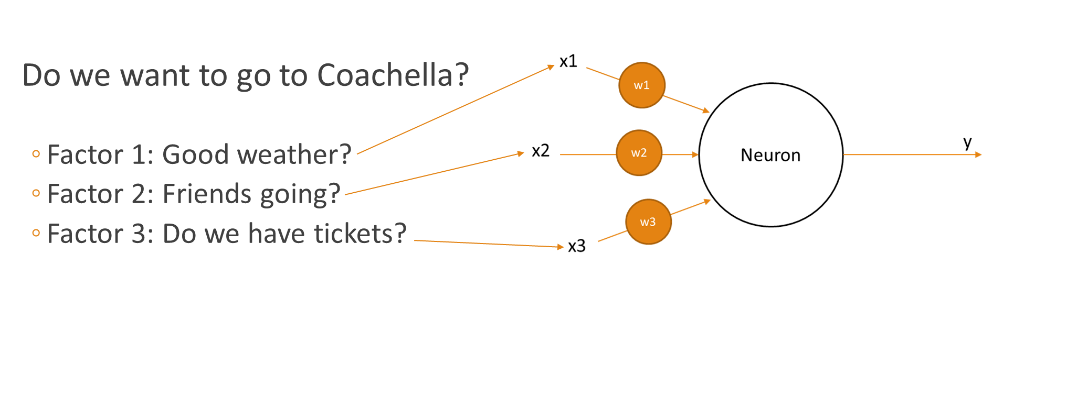





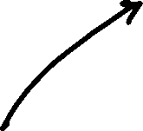





How would we decide this?
Threshold = 10
w1 = 5
w2 = 5
w3 = 11
This is a silly distribution. Either you have tickets and you’re going, or you don’t and you aren’t.

Slide 25




How would we decide this?
Threshold = 12
w1 = 5
w2 = 5
w3 = 11
Now this basically says that we only go if we have tickets AND one of the other conditions are true, but not both of them.
This is a silly example, but a reasonable starting point to think about how we build up complex decision making.

Slide 26
Addition of other nodes increases complexity
We can now make decisions based on more inputs, and have a more nuanced way of getting to the outputs.

Slide 27
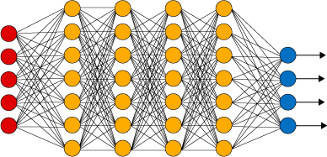
How does information change through layers?
As we move through the layers of the DNN, we are somewhat making decisions on more and more abstract items

Slide 28
Perceptrons
We can assume
Inputs as a vector x = {x1, x2, x3}
Weights as vector w = {w1, w2,w3}
Then sum is just the dot product, and the become
0 when when x●w+b≤0
1 when when x●w+b>0

Slide 29




Perceptrons
We can assume
Inputs as a vector x = {x1, x2, x3}
Weights as vector w = {w1, w2,w3}
Then sum is just the dot product, and the become
0 when when x●w+b≤0
1 when when x●w+b>0

Slide 30




















Slide 31






Slide 32





Perceptrons
0 when when x●w+b≤0
1 when when x●w+b>0
b can be thought of the bias
Large positive b -> neuron that fires on most inputs
Negative b-> neuron that rarely fires

Slide 33



Perceptrons for logical functions?
x1
w1
x2
y
w2
Neuron
How could we implement
AND
OR
NAND

Slide 34
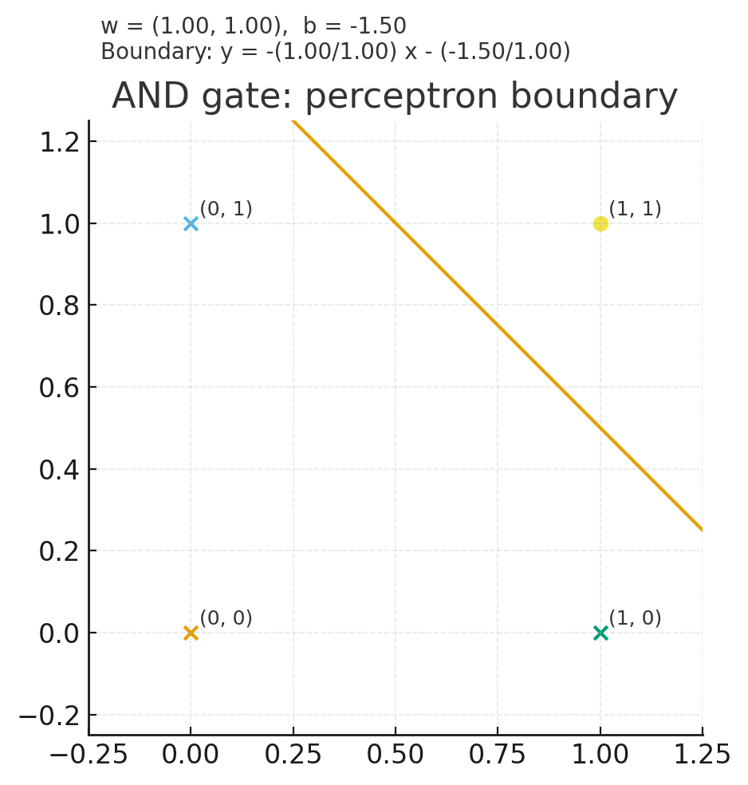
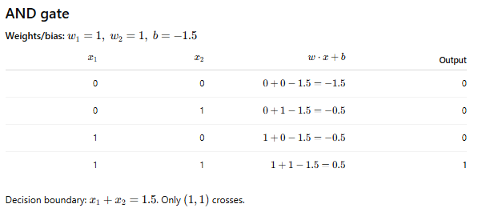
AND gate

Slide 35














AND gate

Slide 36








AND gate

Slide 37



AND gate

Slide 38
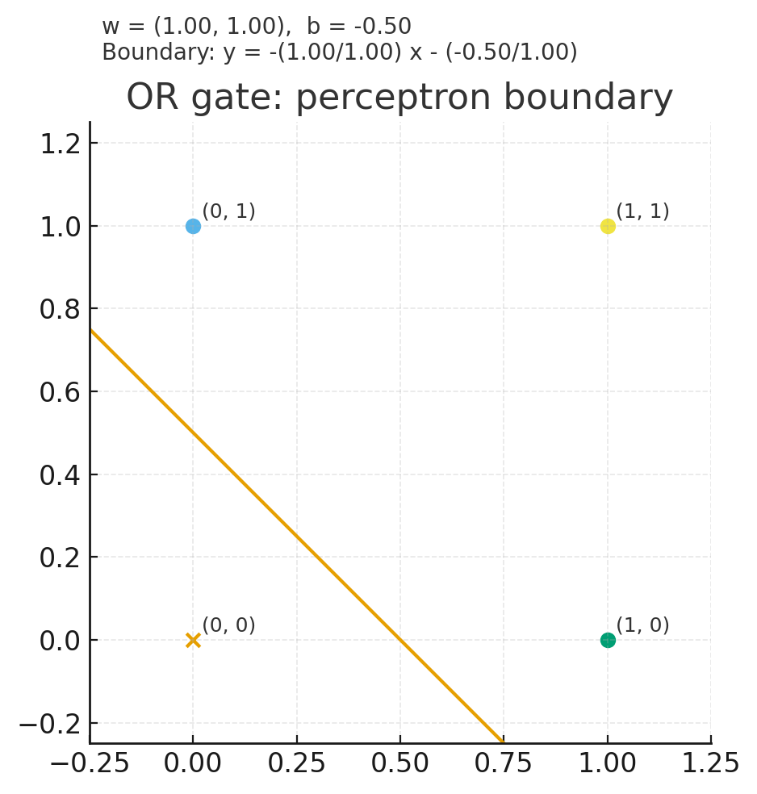
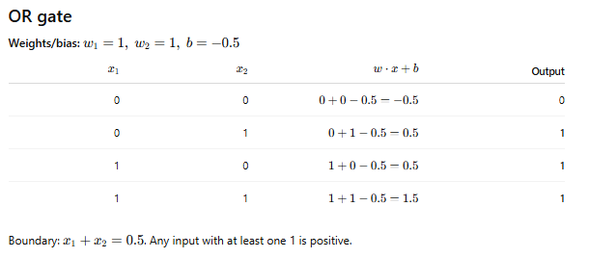






OR gate

Slide 39
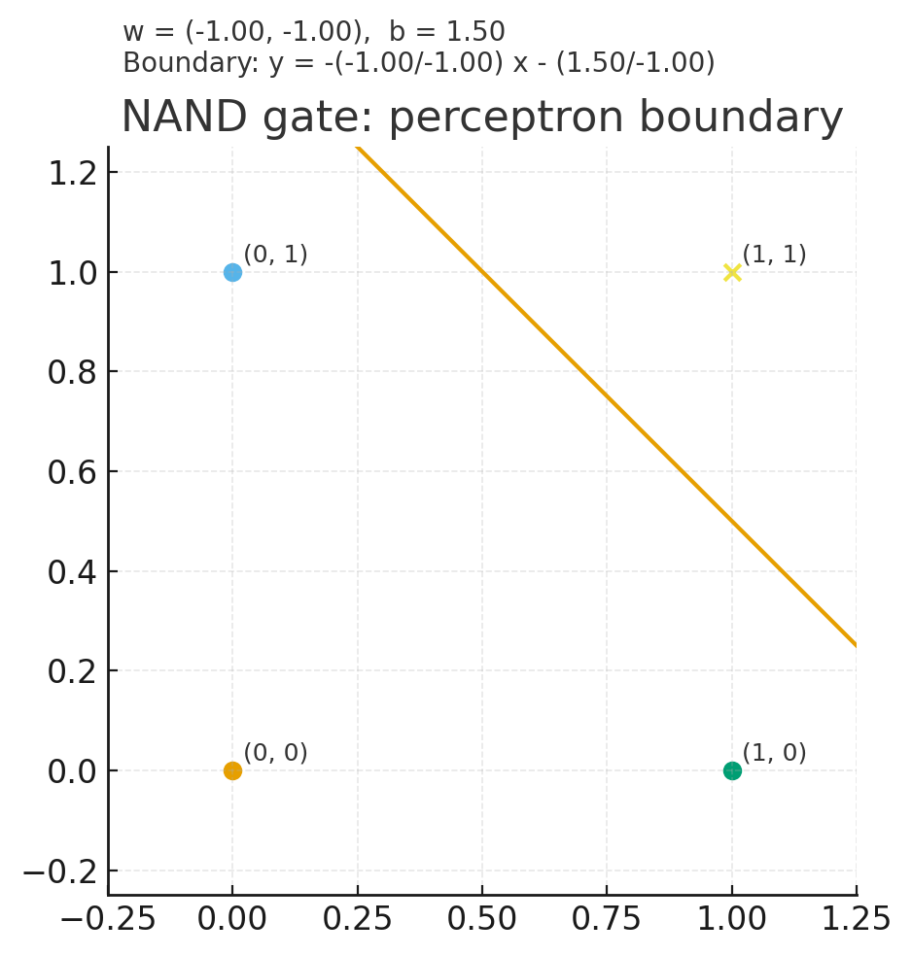
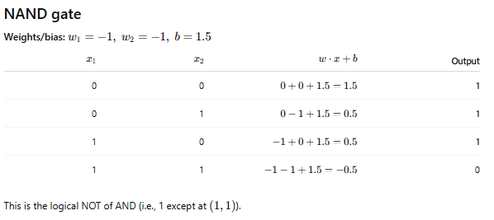

NAND gate

Slide 40
So are perceptrons just more complex NAND gates?
No
The key strength lies in the algorithms which allow us to tune the
weights
It also needs to be something that’s done with just the input, and not
something that relies on a human
What’s so important about this?
When we create a circuit, we basically presolve some set of problems
Then we lay out the circuit to solve those
However, with our ‘learning’ approach, we don’t have to do that. We just create some basic architecture, and let it automatically tune itself to get the right answer

Slide 41
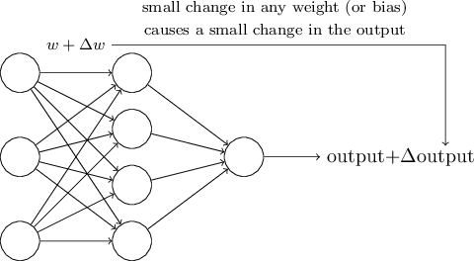

Sigmoid Neurons
If we want to learn, then we should have a small change in weight in some synapse to have a corresponding small change in the output

Slide 42
Sigmoid Neurons
Why is this important?
Let’s say we feed an input which is a handwritten digit
It’s a 3
Our NN classifies it as a 4…
It would be great if we could just change it slightly and have a small change in
our output

Slide 43
Sigmoid Neurons
Why is this important?
But if we have a perceptron, then any small weight change can invert the neuron output
This then propagates down the NN and can radically change everything in a fashion that is complex to precalculate
You fixed your incorrect classification of the 3, but messed up others

Slide 44
Sigmoid Neurons
Why is this important?
So with perceptrons, it is challenging to have an algorithm that will allow you to easily learn complex data
To circumvent this, the sigmoid neuron was introduced

Slide 45
Sigmoid Neurons
Looks the same as before…
However, inputs can now be anything between 0 and 1, not just 0 or 1.
Equation is now more complex:
σ(x●w+b)=σ(z)=
1
1+𝑒^{−𝑧}

Slide 46
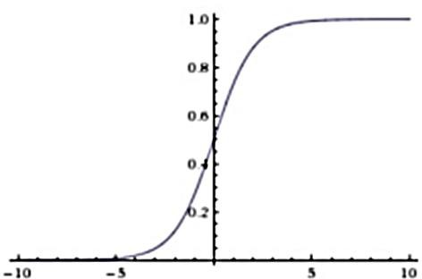
Similarities between Perceptrons and Sigmoids
σ(x●w+b)=σ(z)=
1
1+𝑒^{−𝑧}
When z is large positive number, then σ(z) ~1
When z is large negative number, then σ(z) ~0
Key difference is that we have smoothed out any sudden changes…

Slide 47
Why is smoothness crucial?
σ(x●w+b)=σ(z)=
1
1+𝑒^{−𝑧}
Now, when we have a small change in a specific weight Δw_{i}
We also have a small change in the output
𝜕𝑜𝑢𝑡 𝜕𝑜𝑢𝑡
∆𝑜𝑢𝑡 ~ Σ ∆𝑤_{𝑗} +
𝜕𝑤 𝜕𝑏
∆𝑏
𝑗
𝑗
𝜕𝑜𝑢𝑡 𝜕𝑜𝑢𝑡
The sum is over all the weights, w , and
, represent the partial
j
𝜕𝑤
𝜕𝑏
𝑗
derivatives of the output with respect to the weight or bias.
So in this range, we essentially have a linear equation approximating our output

Slide 48
Sigmoid Neurons
In the end the actual neuron doesn’t matter that much
Smoothness lets us use the approximation given in the last slide
It’s a bonus if computing the derivatives are easy to do, because we
will be doing a lot of that when training.

Slide 49
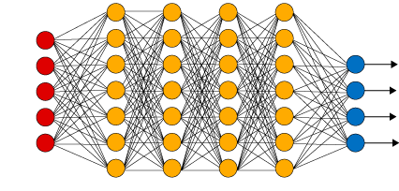
Sigmoid Neurons
Now, if we have our NN
Perceptron neurons are easy to evaluate
0 or 1; yes, or no;
Since sigmoids are continuous, we have to setup some criteria to decide what that output neuron is saying
Maybe if a value is >0.5, then that input is a 9.

Slide 50
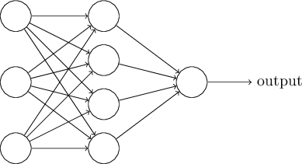
Neural Network Architecture
Three Layer Neural Network
Input Layer
Output Layer
Hidden Layer

Slide 51
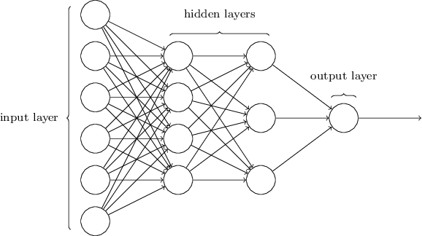
Four Layer Neural Network
This is a multi-layer perceptron (MLP)

Slide 52
How do we design our Neural Network Topology?
Inputs
Depends on the number and type of inputs
Outputs
If we are trying to do handwritten digit recognition, then we could use
10 outputs (0, 1, … , 9)

Slide 53
How do we design our Neural Network Topology?
Input: 64 x 64 pixel greyscale image
We could have 4096 input neurons, each with values between 0 and 1, which represent the greyscale intensity of the pixel
Here each input represents a pixel

Slide 54
How do we design our Neural Network Topology?
Output: 0-9
With 10 output neurons, we could assign each one a digit, and then depending on the outputs, only 1 of those neurons should output a ‘yes’
Recall ‘yes’ is defined as output being greater than some value (e.g. output>0.5)

Slide 55
How do we design our Neural Network Topology?
Hidden layers?
This part is art, not science
Driven by heuristics depending on problem

Slide 56
How do we design our Neural Network Topology?
Note:
These are feed-forward neural networks
All inputs move forward, never backward, during operation

Slide 57
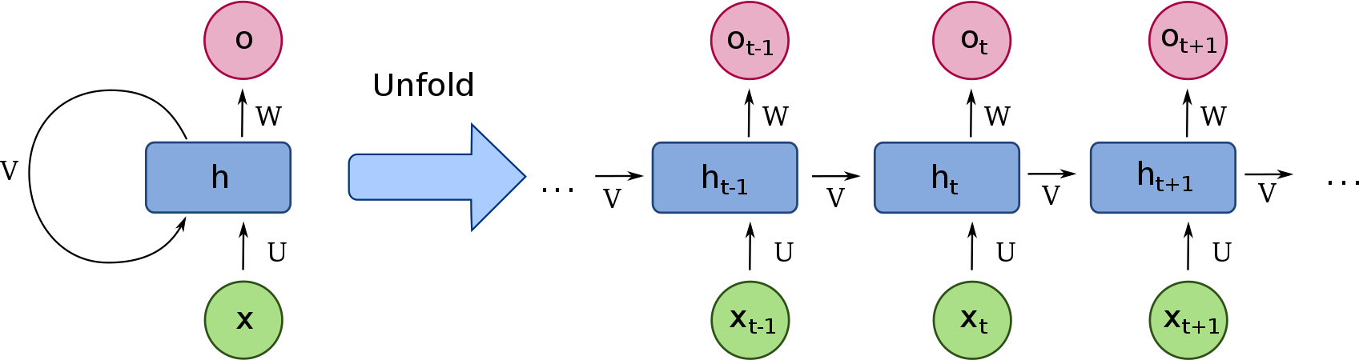
Aside: Recurrent Neural Networks
Note:
The output of a neuron actually is an input
RNN has memory
There is some kind of time dependence, where the behavior can evolve over time
This is necessary as the output of a neuron cant be fed back in if it were to
be evaluated intantaneously

Slide 58

Getting back to handwriting
This number is 6 different images
Building an algorithm to automatically recognize and segment is a bit outside the scope of what we cover here and relatively do-able.
So we will focus on a single digit
Once we have that, segmenting can be done by taking a single image, and segmenting it into many different portions, and then using the handwritten digit classifier to assign scores to the segmentation and use the most highly scored version

Slide 59
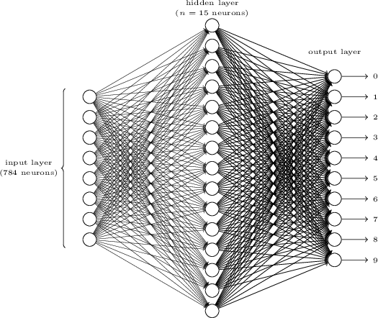
An ANN for Handwriting
What are the inputs?
28 x 28 pixels images of
scanned handwritten digits
Input layer has 784 neurons
Input pixels are greyscale with 0 representing white and 1 representing black
One hidden layer
This only has 15 neurons, need to try different numbers of neurons to figure out how many hidden layers

Slide 60
An ANN for Handwriting
Output layer
10 neurons, each
representing a digit
For a given digit, one neuron should be 1, while the others should be 0.
In reality, we find the neuron with the highest value, and say that is the one which activated

Slide 61

An ANN for Handwriting
Why do 10 neurons work better than 4?
Need to consider how this network is working
The ‘0’ output neuron is basically summing up all the inputs from the hidden layer
and trying to decide whether the digit is a 0.
So then, what are the hidden layer neurons doing?
As a heuristic, let’s assume that the first hidden neuron detects whether a
certain pattern is present in the image:

Slide 62
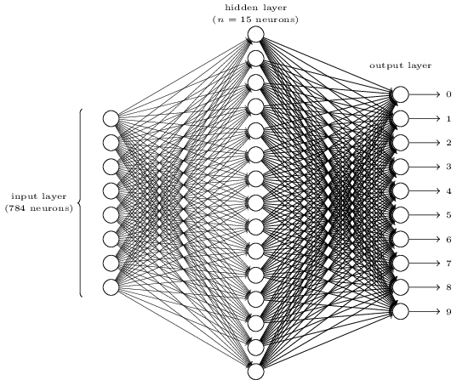

How does the hidden layer neuron find a specific image?
Recall, every single input is connected to the hidden layer
So if I want the first hidden layer neuron to find that pattern, how would I bias it?

Slide 63
Let’s do a simple example
x1
x1 | x2
x3 | x4
w1
x2
y
w2
Neuron
x3
w3
w4
x4
I want to design a hidden layer neuron which tells me if the top left box is filled
So, we have four inputs
We want the output y to be high if x1 is dark and x2-4 are light

Slide 64
Let’s do a simple example
x1
x1 | x2
x3 | x4
w1
x2
y
w2
Neuron
x3
w3
w4
x4
Recall: σ(x●w+b)=σ(z)=
1
1+𝑒
−𝑧
So, want to weight w1 heavily, while dramatically lowering the weights of x2-x4
We want the output y to be high if x1 is dark and x2-4 are light

Slide 65
Back to the task at hand
x1
w1
x2
y
w2
Neuron
x3
w3
w4
x4
So, want to weight the pixels which make up this pattern heavily, while reduce the weights of the other pixels

Slide 66
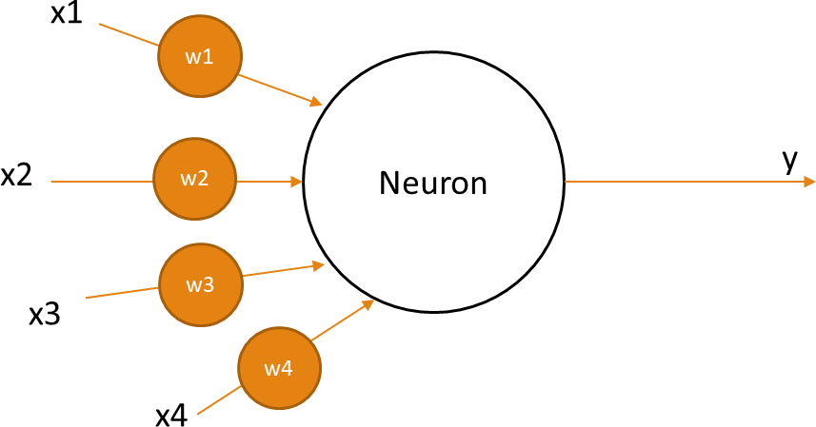



Other hidden layer neurons could then be detecting other images
N1 N2 N3 N4
Then neuron 2 and 3 and 4 could be detecting these other patterns
Together these 4 images make up a zero

Slide 67
Other hidden layer neurons could then be detecting other images
N1 N2 N3 N4
If we see that all 4 of these neurons are firing, then we can make the assumption
that we are seeing a zero.
Obviously this is a toy example, don’t get carried away trying to poke holes into it
Now, we can possibly see why it’s better to have 10 outputs over 4
With the above example, the 0 output neuron could just put the most weight on
the outputs from the hidden neurons N1 through N4, and weaken the others
But, if we had only 4 output neurons, our neural network would have to essentially do 2 calculations
First, we would need to figure out what the number was
Then we would need to transform that into binary

Slide 68
Learning how Artificial Neural Networks Learn with your Biological Neural network
We will use the MNIST Data set
http://yann.lecun.com/exdb/mnist/
Two parts
60,000 Training images (28 x 28 pixels, greyscale)
They were scanned samples from >200 people, ½ government employees, ½ high school students
10,000 Test images
These test data were collected from different people

Slide 69
How to train your artificial neural network
Use x as the annotation for the input data vector, a 784 long string of digits between 0 and 1 representing the greyscale values.
The output is then a vector y=y(x) with 10 digits.
As an example:
If input image x represents a 1
Output vector y(x) = (0,1,0,0,0,0,0,0,0,0)
What we need to do is develop an algorithm that let’s us find the weights and biases so output is as close to y(x) given above as possible.

Slide 70
How to train your artificial neural network
We need to figure out what we want to optimize
Obviously, the number of images correctly recognized, duh….
But what if we used that as the objective function?
C(w,b)=Number of correctly classified images
Could we easily optimize with this?
Not really, this is not a smooth function of w (all the weights in the NN) or b (all the biases in the NN)

Slide 71
How to train your artificial neural network
So what if we defined another ‘cost function’?
C(w,b)=Number of correctly classified images
Could we easily optimize with this?
Not really, this is not a smooth function of w (all the weights in the
NN) or b (all the biases in the NN)

Slide 72
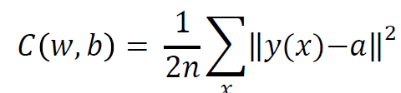

Cost Function
w represents all the weights in^{𝑥} the network
b represents all the biases in the network
a is the output vector when input vector x is input
y(x) is the desired output vector when x is the input vector
|| y-a|| is just the magnitude of the difference between what we want and what we have.
Essentially, we take the square of the error
This is called the quadratic cost function, or mean squared error (MSE)

Slide 73
Cost Function
C is going to be positive or zero
If C is small, then the actual network outputs are close to the inputs
If C is large, our NN is outputting garbage
We need an algorithm to minimize C by tuning w, b
The chosen algorithm is gradient descent

Slide 74
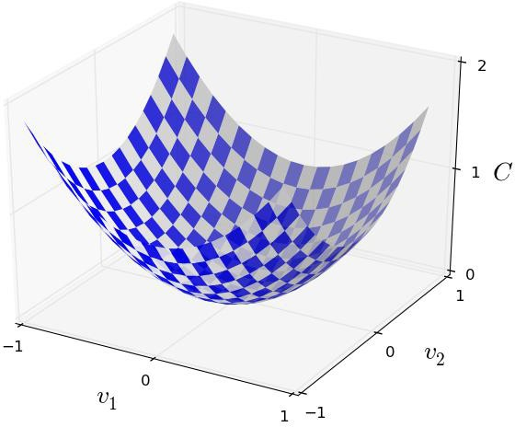
Gradient Descent
Let’s assume we want to minimize function C(v), where v is the
vector of inputs.
This could be a single variable, with v being a number, or a million variables, with v being a vector with a length of 1,000,000.
For ease of visualization, let’s just say it has 2 variables

Slide 75
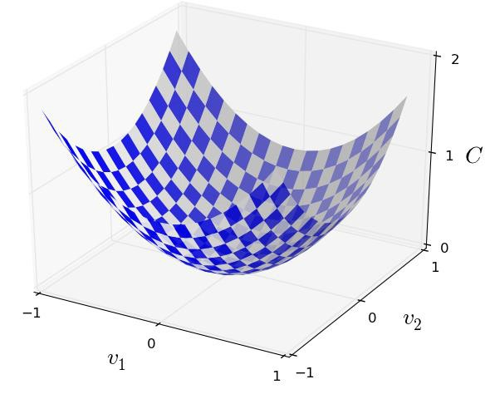
Minimization
This seems easy enough…
I can just see it, what’s the big deal?
Not so easy with 10⁶ variables
Calculus also not tractable with huge dimensionalities
However we can still use these principles
Imagine that we want to start at some point here and then roll down to the bottom of the valley

Slide 76
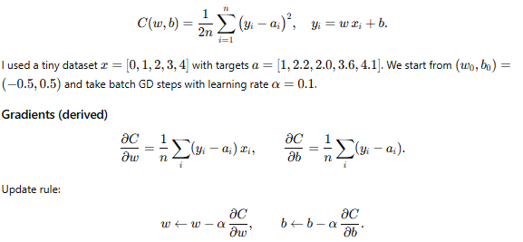
Example gradient descent

Slide 77
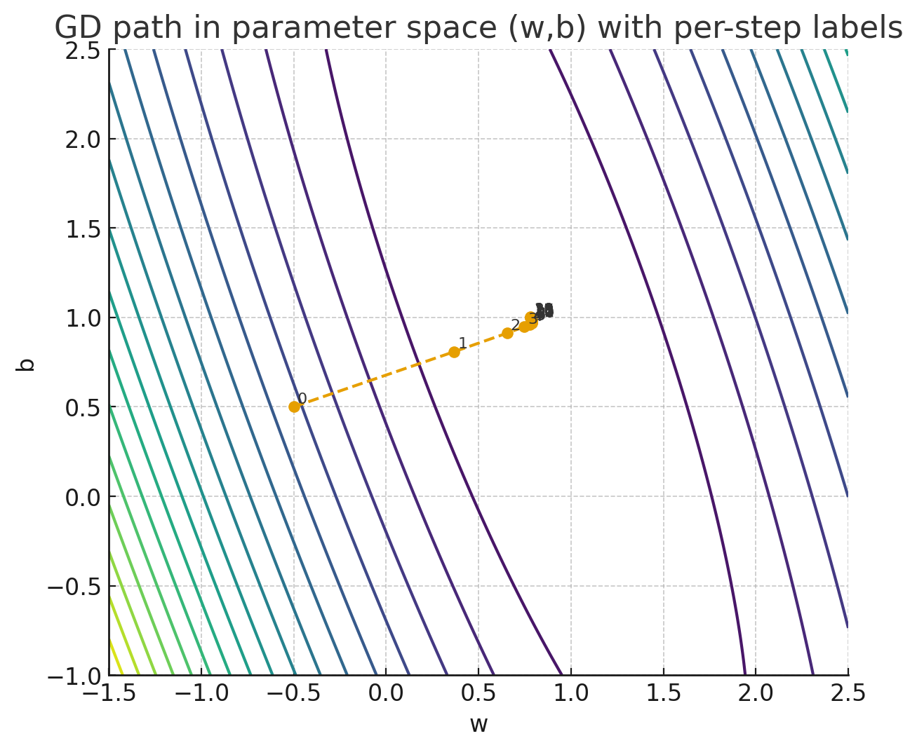
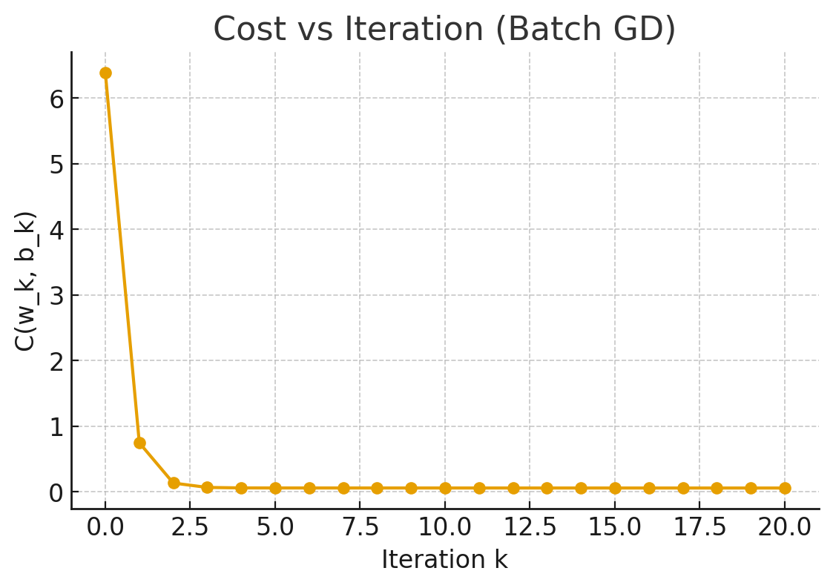
Example gradient descent

