Slide 1
ECE 105: Introduction to Electrical Engineering
Lecture 21
Optical Communications
Yasser Khan
Rehan Kapadia

Slide 2


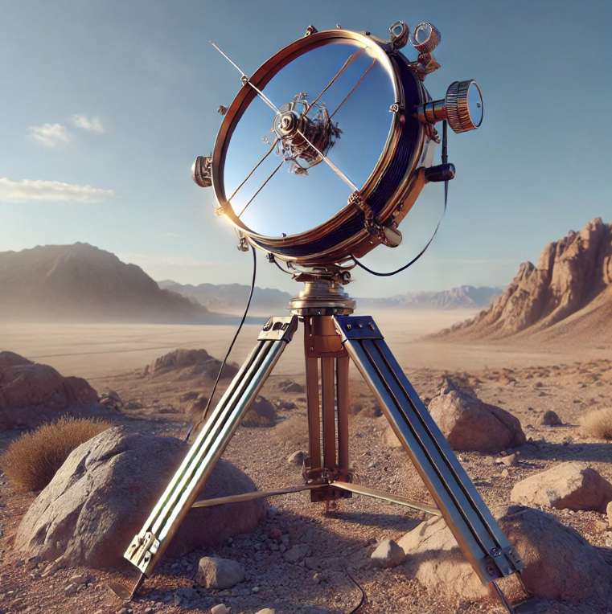
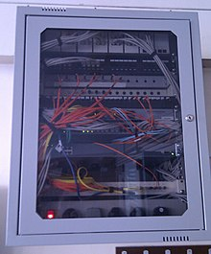
How have we done optical communications in the past?
What kind of systems have people used in the past to do optical communications?
Smoke Signals
Signal Lamp
Heliograph
Fiber Optics

Slide 3









How fast could we communicate using smoke signals?
We could have a short or long pulse to represent a 1 or 0.
Let’s assume 0.5 seconds for short and 1.5 seconds for long pulse
The gap between the pulses needs to be at least 0.5 seconds for it to be seen
That means that we would need 0.5+0.5 to send out a short pulse
We would need 1.5+0.5 to send out a long pulse
Average time to send a bit = (Short + Long)/2 = 1.5 s
Our bitrate is 1 bit/1.5s = 0.66 bps

Slide 4

















How fast could we communicate using smoke signals?
We could have a short or long pulse to represent a 1 or 0.
Let’s assume 0.5 seconds for short and 1.5 seconds for long pulse
The gap between the pulses needs to be at least 0.5 seconds for it to be seen
That means that we would need 0.5+0.5 to send out a short pulse
We would need 1.5+0.5 to send out a long pulse
Average time to send a bit = (Short + Long)/2 = 1.5 s
Our bitrate is 1 bit/1.5s = 0.66 bps

Slide 5
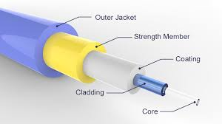
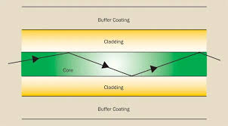



Optical Fiber
Optical fibers guide light from one point to another confined inside a fiber core.
These work based on the principle of total internal reflection. Depending on the angle that light hits the fiber/cladding interface, it can be fully reflected

Slide 6




Optical Fiber
Optical fibers guide light from one point to another confined inside a fiber core.
These work based on the principle of total internal reflection. Depending on the angle that light hits the fiber/cladding interface, it can be fully reflected

Slide 7
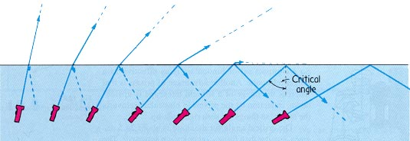





Total internal reflection
When light moves from a medium of high refractive index to a medium of low refractive index, or vice versa, there is a change in the angle of propagation of light.

Slide 8
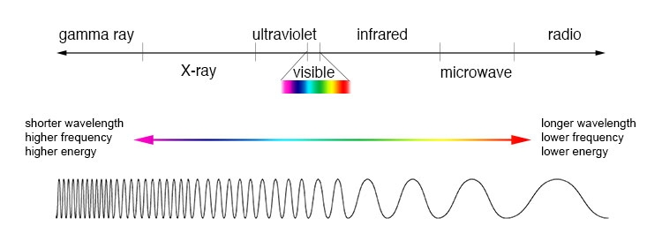

General properties of light
The wavelength of light represents the spatial dimension over which it is periodic

Slide 9

Speed of light in different mediums
There is a concept called the refractive index, which is:
n = c/v
Where
n: refractive index
c: speed of light
v: speed of light in the medium
This emerges due to the oscillations of electrons in a material creating dipoles that interact with electromagnetic waves and slow them down

Slide 10
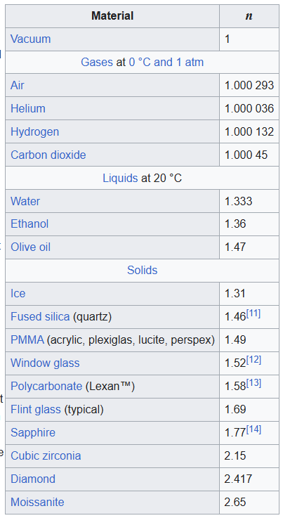
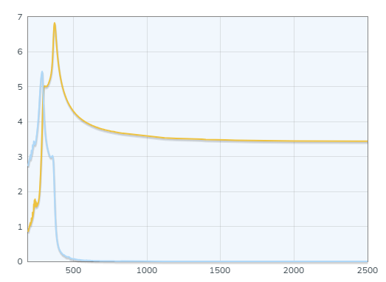









Refractive index of different materials
The refractive index is a function of material AND wavelength of the electromagnetic radiation
Si
RI or EC
Refractive Index
Extinction Coefficient
Wavelength (nm)

Slide 11
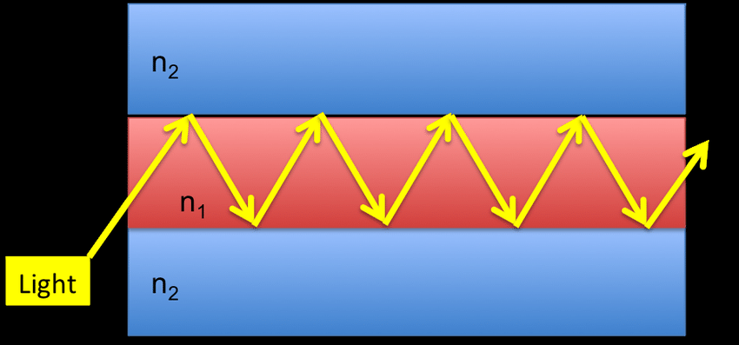

Waveguides
If light is incident on an interface at an angle beyond the critical angle, then it is reflected back. It will also be incident on the lower surface at an angle that enables total internal reflection. This allows us to create a waveguide, where light will just propagate in a confined guide as long as possible.

Slide 12
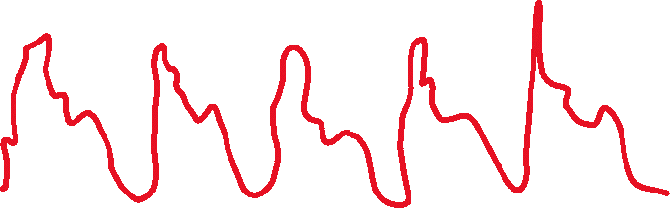

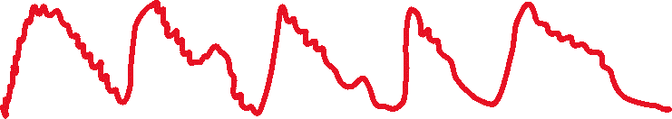



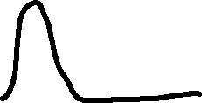




Noise

Slide 13






























Signal to noise ratio

Slide 14
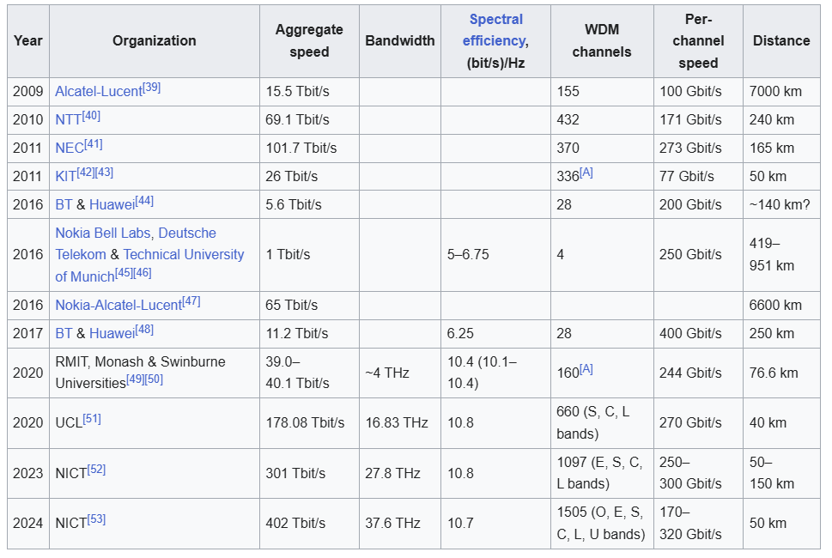






Optical Fiber Transmission Speeds

Slide 15
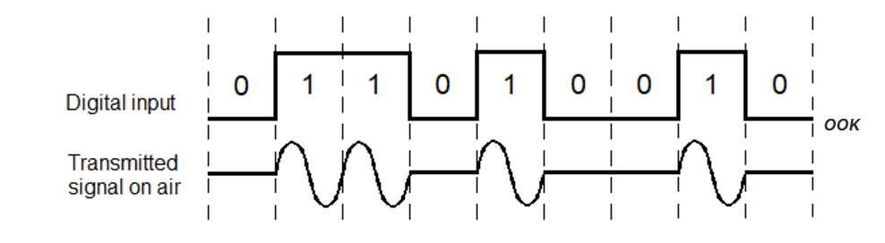
Optical Modulation Techniques
Intensity Modulation: Where you modulate the intensity of the light, and have predetermined values for each intensity of light.
On-off keying is where you have two values that represent 1 and 0, allowing you to transmit binary information

Slide 16




























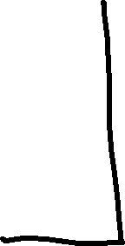



Let’s design optical comm system

Slide 17





Let’s design optical comm system

Slide 18






Let’s design optical comm system

Slide 19












Slide 20



Let’s talk about a real world system
Digital to Analog Converter
LED
Driver Circuit
Analog to Digital Converter
Computer
LED
PD
Amplifier
Computer
Let’s imagine a system where we would like to send information from one place to another using light.
Seems easy, right? We just flash an LED, detect those flashes, and then we are done. But how much data could we send with such a signal?
What components would we need? How can we accomplish this?

Slide 21
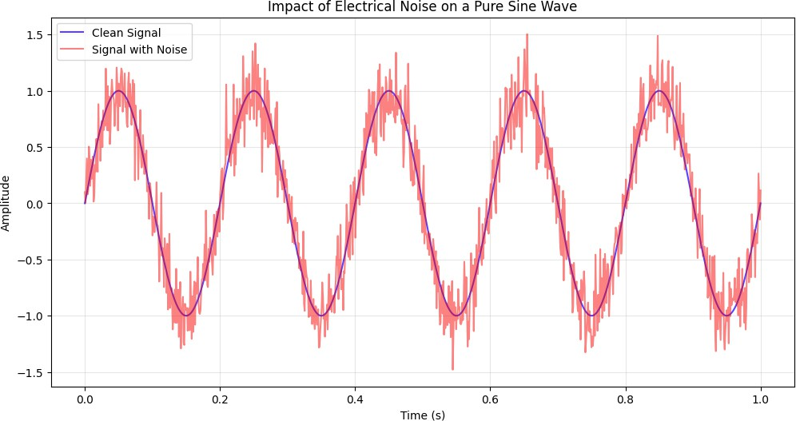
What is noise?

Slide 22

















Types of Noise
Noise refers to anything that you don’t want in your signal
It can have many different sources and many different resulting affects on your system
At the component level, here are a few fundamental mechanisms of noise:
Thermal Noise (Johnson-Nyquist): Arises from the random motion of charge carriers in resistive materials.
Flicker Noise: Generally related to defects and impurities
Shot Noise: Arises from the discrete nature of charge carriers

Slide 23







Slide 24



Slide 25
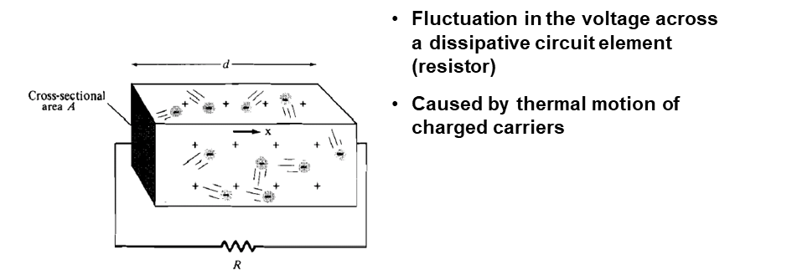
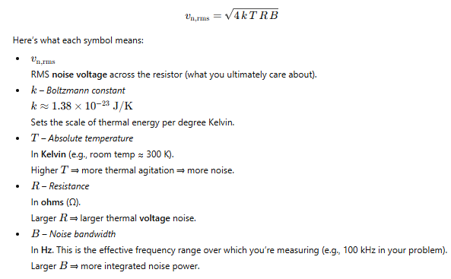


Thermal Noise

Slide 26
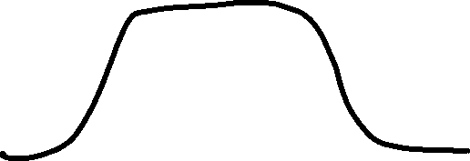











Bandwidth

Slide 27








Thermal Noise

Slide 28
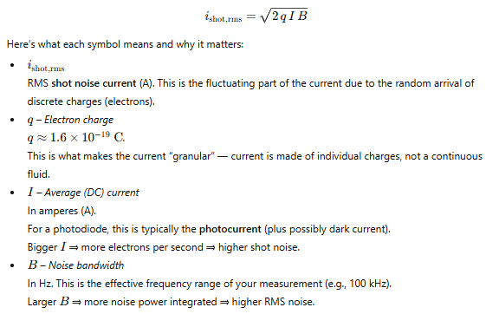



Shot Noise
Shot noise is caused by the random arrival of charge carriers (e.g., electrons or holes) at a potential barrier or through a quantum tunneling process. Unlike thermal noise, which depends on temperature, shot noise arises solely due to the quantization of charge.
Key Characteristics:
It is independent of temperature.
It is proportional to the average current and depends on the bandwidth of observation.
It is most commonly observed in semiconductor junctions, vacuum diodes, and
photodetectors.

Slide 29











Shot Noise
Shot noise is caused by the random arrival of charge carriers (e.g., electrons or holes) at a potential barrier or through a quantum tunneling process. Unlike thermal noise, which depends on temperature, shot noise arises solely due to the quantization of charge.
Key Characteristics:
It is independent of temperature.
It is proportional to the average current and depends on the bandwidth of observation.
It is most commonly observed in semiconductor junctions, vacuum diodes, and
photodetectors.

Slide 30
Shot Noise
Proportional to Current:
Shot noise increases linearly with the current III. Systems with higher currents generate more shot noise.
Statistical Nature:
Shot noise is inherently random and follows a Poisson distribution because it is governed by the discrete and independent arrival of charge carriers.
Independence from Temperature:
Unlike thermal noise, shot noise does not depend on the ambient temperature, making it a fundamental noise source.
Quantum Nature:
Shot noise is a direct consequence of the quantized nature of charge, highlighting its quantum mechanical origin.

Slide 31
Flicker Noise
Definition:
Flicker noise, also known as 1/f noise, is a type of electrical noise that is dominant at low frequencies. It is caused by imperfections and defects in materials or processes and is observed in electronic devices like resistors, transistors, and semiconductors.
Key Characteristics:
Frequency Dependence:
The power spectral density (PSD) decreases as the frequency increases, following a 1/f^{α} relationship where α is typically between 0.8 and 1.2.
Low-Frequency Dominance:
Flicker noise is most prominent at lower frequencies and becomes negligible at higher frequencies.
Material-Dependent:
It arises from defects, impurities, and surface traps in materials.

Slide 32
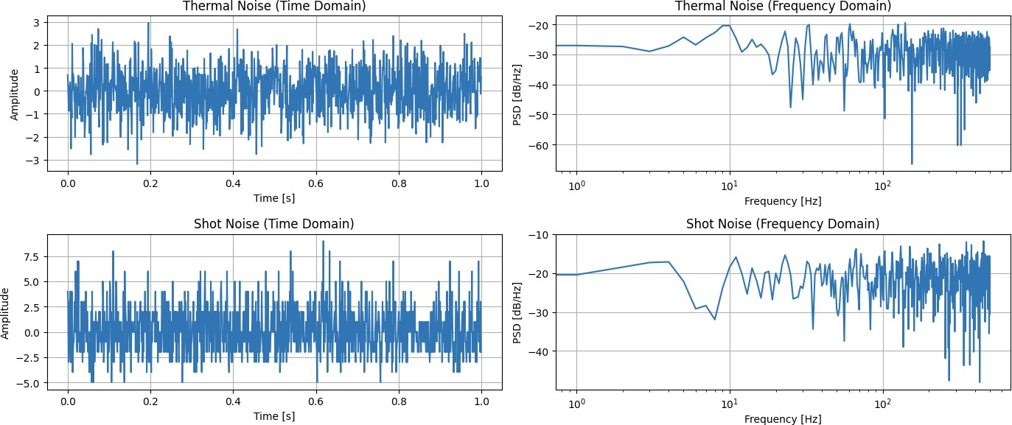



Time and Frequency Domain Visualizations

Slide 33
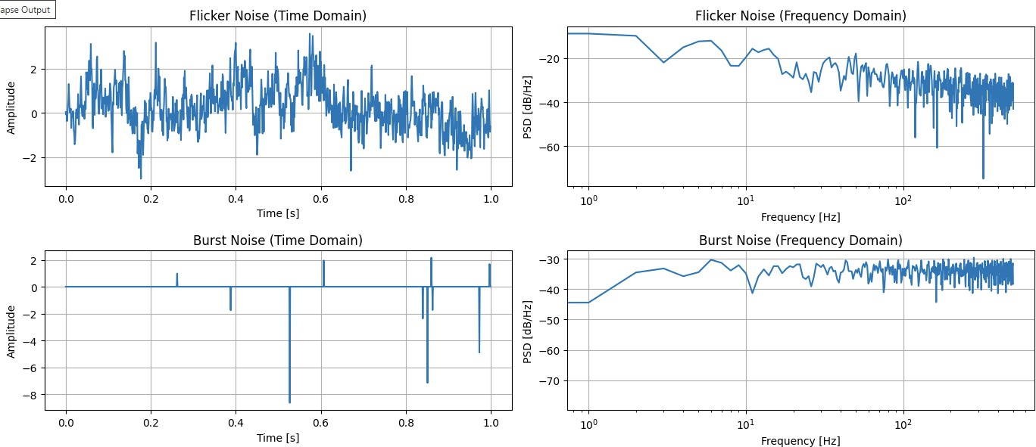
Time and Frequency Domain Visualizations

Slide 34
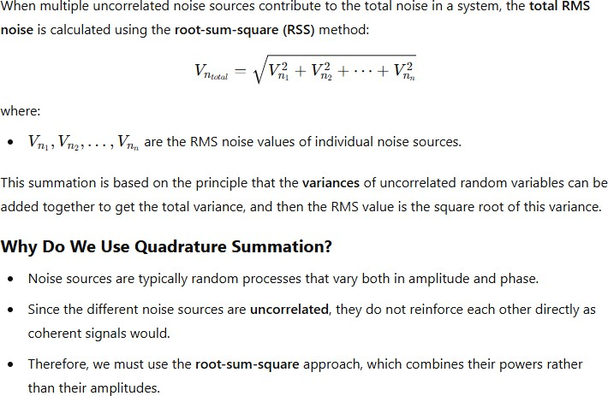





How do different noise sources add?

Slide 35
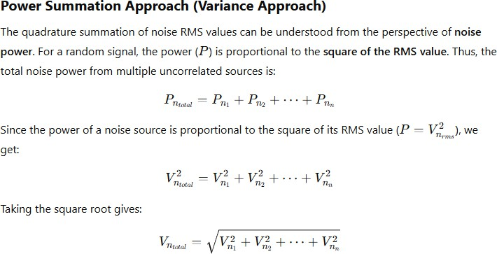
Power perspective of noise addition

Slide 36
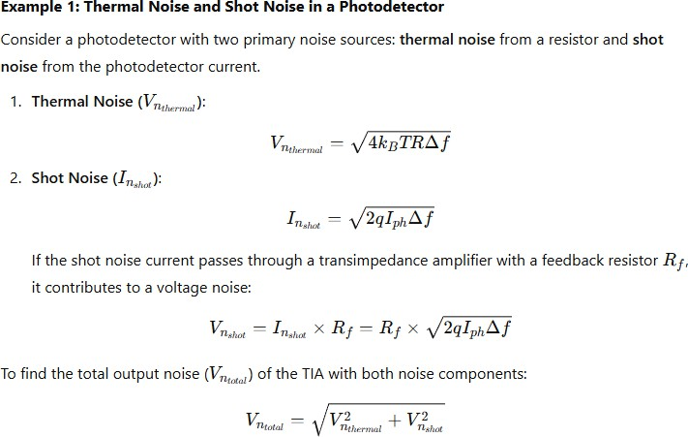

















Examples of calculating Noise

Slide 37










Examples of calculating Noise

Slide 38
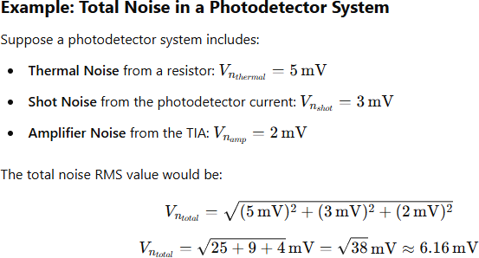
Power perspective of noise addition

Slide 39
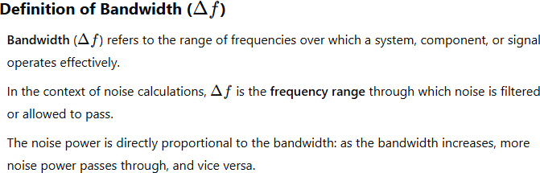





How do we calculate Β
B
B
B

Slide 40


How do we calculate Δf / B
There are different bandwidths to consider, depending on the context of the system:
Signal Bandwidth
This is the frequency range over which the actual signal is transmitted or detected.
If you are analyzing the noise in a communication system, the signal bandwidth is often used as Δf
Example: For a radio signal modulated over a frequency range of 10 kHz, the signal bandwidth is Δf=10 kHz
Amplifier Bandwidth
In systems where an amplifier (e.g., a TIA, voltage amplifier, or operational amplifier) is present, the bandwidth of the amplifier limits the range of frequencies over which noise can be amplified.
The amplifier bandwidth, typically specified as the -3 dB bandwidth, is often used as Δf in noise calculations.
Example: If a transimpedance amplifier (TIA) has a -3 dB bandwidth of 1 MHz, the noise calculation should use Δf=1 MHz
Filter Bandwidth
If the signal passes through an electronic filter, the bandwidth of that filter determines Δf
Filters are used to limit noise contributions by restricting the frequency range that can pass through.
Example: A low-pass filter with a cutoff frequency of 100 kHz has a bandwidth of Δf=100 kHz
Measurement Instrument Bandwidth
When using instruments like oscilloscopes or spectrum analyzers, the measurement device itself has a limited bandwidth, which may affect noise readings.
The instrument bandwidth may be specified and needs to be considered when interpreting noise measurements.
Example: If an oscilloscope has a bandwidth of 20 MHz, then the noise observed on the oscilloscope is limited by Δf=20 MHz\Delta f = 20 \,
\text{MHz}Δf=20MHz.

Slide 41
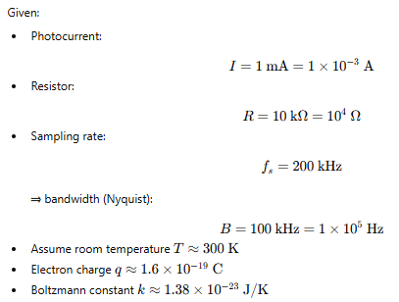

Example
Imagine I had a photodetector in reverse bias with light shining on it connected to a 10 kOhm resistor. We measure the voltage across this resistor. A) What are the sources of noise for the voltage measured across the device? B) If I have 1 mA of photocurrent in my photodetector, what will the actual RMS noise level of the voltage measured across the resistor be? Assume a sampling rate of 200 kHz (leading to a bandwidth of 100 KHz).

Slide 42
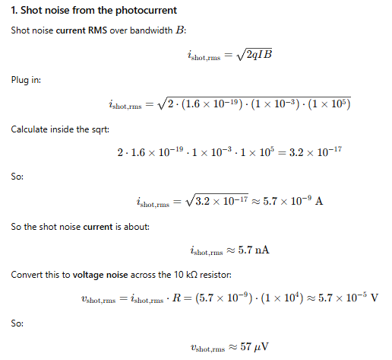
Example
Imagine I had a photodetector in reverse bias with light shining on it connected to a 10 kOhm resistor. We measure the voltage across this resistor. A) What are the sources of noise for the voltage measured across the device? B) If I have 1 mA of photocurrent in my photodetector, what will the actual RMS noise level of the voltage measured across the resistor be? Assume a sampling rate of 200 kHz (leading to a bandwidth of 100 KHz).

Slide 43
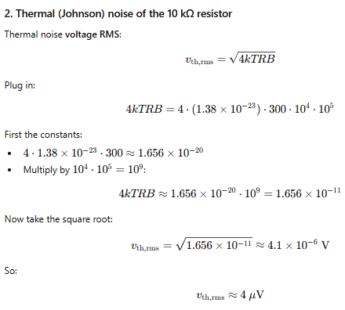
Example
Imagine I had a photodetector in reverse bias with light shining on it connected to a 10 kOhm resistor. We measure the voltage across this resistor. A) What are the sources of noise for the voltage measured across the device? B) If I have 1 mA of photocurrent in my photodetector, what will the actual RMS noise level of the voltage measured across the resistor be? Assume a sampling rate of 200 kHz (leading to a bandwidth of 100 KHz).

Slide 44
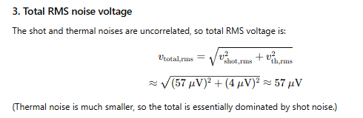
Example
Imagine I had a photodetector in reverse bias with light shining on it connected to a 10 kOhm resistor. We measure the voltage across this resistor. A) What are the sources of noise for the voltage measured across the device? B) If I have 1 mA of photocurrent in my photodetector, what will the actual RMS noise level of the voltage measured across the resistor be? Assume a sampling rate of 200 kHz (leading to a bandwidth of 100 KHz).

Slide 45
Let’s talk about a real world system
Digital to Analog Converter
LED
Driver Circuit
Analog to Digital Converter
Computer
LED
PD
Amplifier
Computer
In the computer, we can define a signal as an array of numbers.
If we wanted to define a sine wave, we could define it as an array of double precision numbers, where each point in the array corresponded to a given time.
Integers from −2⁵³ to 2⁵³ (−9,007,199,254,740,992 to 9,007,199,254,740,992) can be exactly represented
We could then take this range, which is 2⁵⁴ and spread our output voltage range across that, giving us a very precise number for each time step.
However, there is still going to be one level per timestep, so there is some level of quantization in both voltage and time

Slide 46
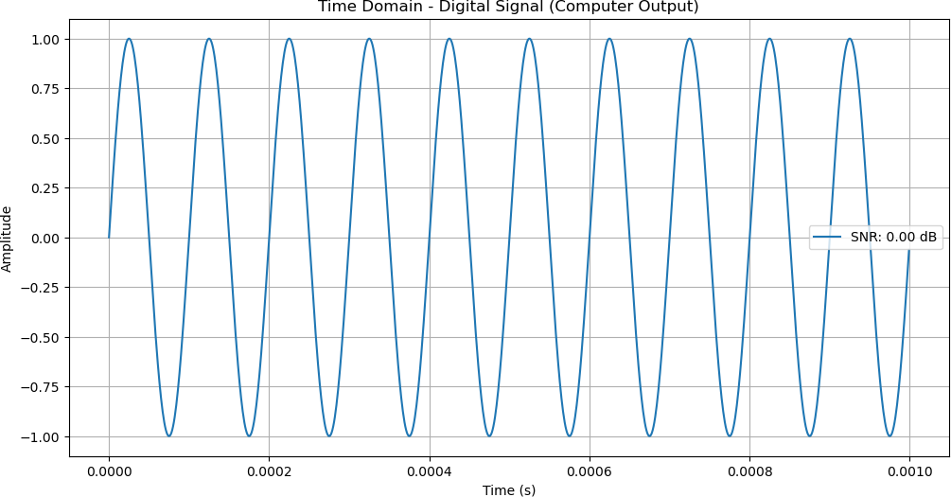
Let’s talk about a real world system
Digital to Analog Converter
LED
Driver Circuit
Analog to Digital Converter
Computer
LED
PD
Amplifier
Computer

Slide 47
Let’s talk about a real world system
Digital to Analog Converter
LED
Driver Circuit
Analog to Digital Converter
Computer
LED
PD
Amplifier
Computer
However, we can’t drive an led with a double precision number, that’s just a bunch of 1’s and 0’s
We need to convert those into an actual voltage value to apply to the LED.
We would use a digital to analog converter (DAC) to do this. This takes in some number of bits, and depending on the values, it outputs the corresponding analog signal
This DAC needs to be able to take an input, and “instantly” change the output analog voltage to reflect that input.

Slide 48
Let’s talk about a real world system
Digital to Analog Converter
LED
Driver Circuit
Analog to Digital Converter
Computer
LED
PD
Amplifier
Computer
There are a number of noise sources that are relevant:
Quantization Noise: Introduced by the discrete steps used to represent a continuous signal, dependent on DAC resolution.
Thermal Noise: Arises from resistive components, increases with temperature and resistance.
Nonlinearity (Distortion Noise): Due to imperfections in the DAC's response, results in harmonic distortion.
Clock Jitter: Variations in clock timing, affecting precision especially at higher frequencies.
Power Supply Noise: Coupling from power supply fluctuations into the analog output.

Slide 49
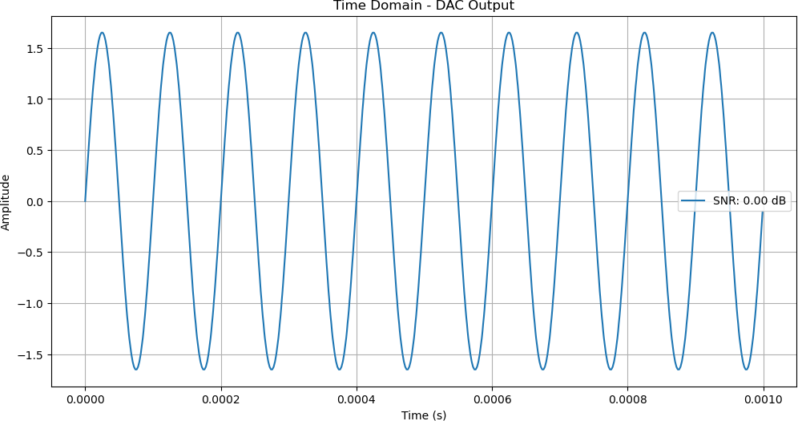
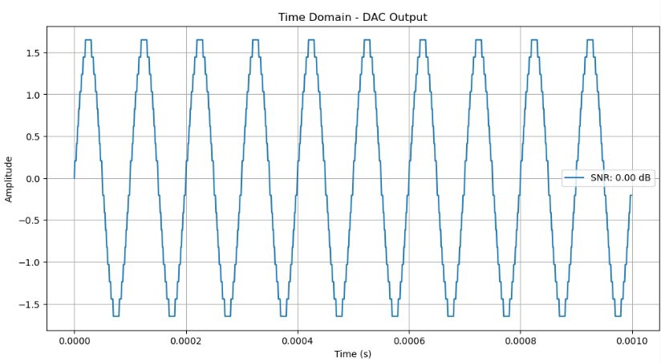





Let’s talk about a real world system
Digital to Analog Converter
LED
Driver Circuit
Analog to Digital Converter
Computer
LED
PD
Amplifier
Computer
What is the number of bits for a DAC? It defines the number of different output levels it can generate. A 2 bit DAC would generate 4 values, a 10 bit DAC would generate 1024 values
8 Bit DAC, 3.3 V
4 Bit DAC, 3.3 V

Slide 50
Let’s talk about a real world system
Digital to Analog Converter
LED
Driver Circuit
Analog to Digital Converter
Computer
LED
PD
Amplifier
Computer
There will be a circuit which drives the LED to the appropriate values, and the LED itself, which will also introduce noise based on the device properties. The key noise components will be:
Thermal Noise:
Found in the resistive elements of the LED driver circuit.
It is directly proportional to temperature and resistance.
Shot Noise:
Found in the LED itself due to the random nature of current flow.
Proportional to the square root of the average current through the LED.
Flicker Noise:
Found in driver components due to material imperfections.
Dominates at low frequencies and adds to the overall noise in the driver stage.

Slide 51
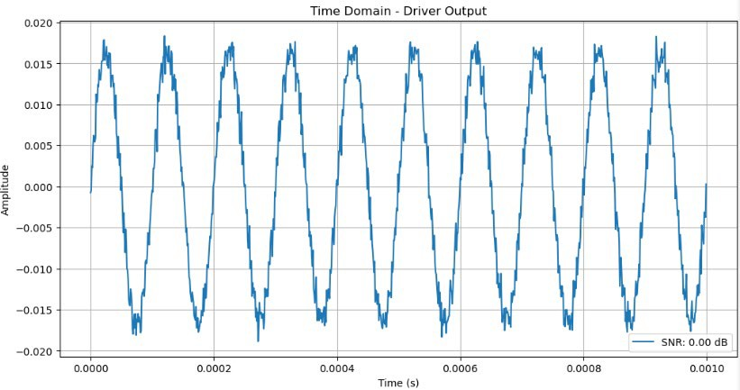
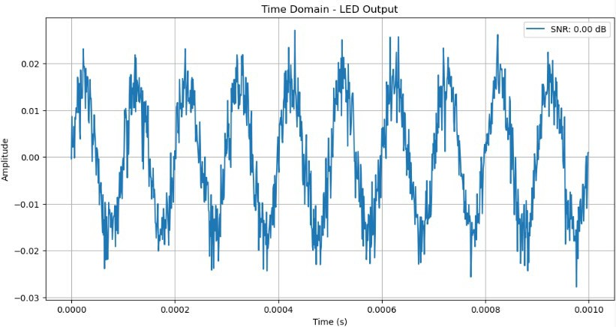
Let’s talk about a real world system
Digital to Analog Converter
LED
Driver Circuit
Analog to Digital Converter
Computer
LED
PD
Amplifier
Computer

Slide 52
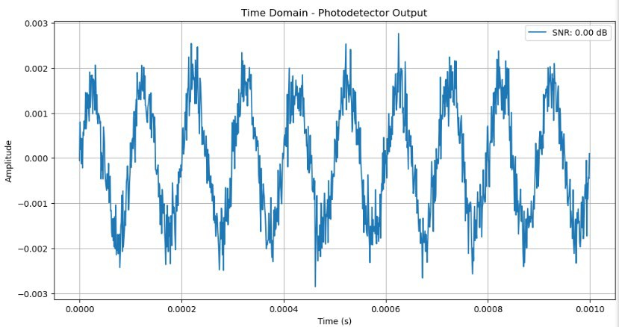
Let’s talk about a real world system
Digital to Analog Converter
LED
Driver Circuit
Analog to Digital Converter
Computer
LED
PD
Amplifier
Computer
What noise in photodetectors do we see?
Shot Noise:
Due to the statistical variation in the arrival of photons.
Significant at low light levels.
White noise, with uniform power distribution across all frequencies.
Thermal Noise:
Due to thermal agitation of electrons in resistive components.
Increases with temperature and resistance.
Present in the circuit regardless of light exposure.
Dark Current Noise:
Due to thermally generated carriers in the absence of light.
Increases with temperature.
Reduces signal accuracy, especially in low-light applications.
Flicker Noise (1/f Noise):
Caused by material imperfections and traps.
Prominent at low frequencies.
Inversely proportional to frequency, affecting low-frequency applications.

Slide 53
Let’s talk about a real world system
Digital to Analog Converter
LED
Driver Circuit
Analog to Digital Converter
Computer
LED
PD
Amplifier
Computer
What noise in amplifiers do we see?
Thermal Noise from Feedback Resistor:
Arises from the feedback resistor.
Increases with resistance and temperature.
Affects the output directly as voltage noise.
Shot Noise from Photocurrent:
Originates from the statistical nature of the current generated by the photodetector.
Amplified by the TIA, contributing to the output noise.
Op-Amp Voltage Noise:
Intrinsic noise from the operational amplifier.
Modeled as a noise voltage at the input.
Amplified by the gain of the TIA.
Op-Amp Current Noise:
Due to bias currents of the op-amp transistors.
Creates additional voltage noise when interacting with the impedance of the circuit.
Flicker Noise (1/f Noise):
Low-frequency noise due to imperfections in the op-amp.
Dominant at low frequencies, decreasing with increasing frequency.

Slide 54
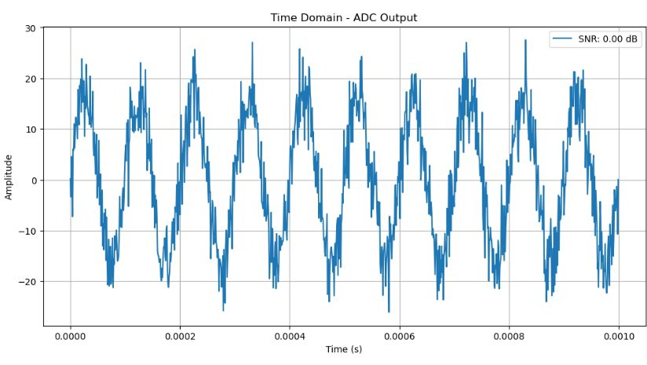
Let’s talk about a real world system
Digital to Analog Converter
LED
Driver Circuit
Analog to Digital Converter
Computer
LED
PD
Amplifier
Computer
What noise do we see in the ADC?
Quantization Noise:
Cause: Due to approximating a continuous signal with discrete levels.
Characteristics: Inversely proportional to the number of bits. Modeled as white noise.
Thermal Noise:
Cause: Due to resistive elements in the analog front end.
Characteristics: Proportional to temperature and resistance. Sets a noise floor for the ADC.
Sampling (Aperture) Jitter:
Cause: Timing uncertainty during sampling.
Characteristics: Affects high-frequency signals more severely, proportional to input frequency and signal amplitude.
Reference Voltage Noise:
Cause: Noise or fluctuation in the reference voltage.
Impact: Leads to inaccurate conversions if the reference is not stable.
Clock Noise:
Cause: Instability or noise in the sampling clock signal.
Impact: Affects the timing of samples, resulting in inaccuracies.
Nonlinearity (Distortion Noise):
Cause: Imperfections in the ADC's transfer function.
Impact: Causes harmonic distortion of the signal, seen as additional unwanted frequency components.
Flicker Noise (1/f Noise):
Cause: Semiconductor imperfections and low-frequency irregularities.
Characteristics: Dominates at low frequencies and can degrade signal quality in low-frequency applications.

Slide 55
Let’s talk about a real world system
Digital to Analog Converter
LED
Driver Circuit
Analog to Digital Converter
Computer
LED
PD
Amplifier
Computer

