Slide 1
ECE 105: Introduction to Electrical Engineering
Lecture 11
Optoelectronics
Yasser Khan
Rehan Kapadia

Slide 2
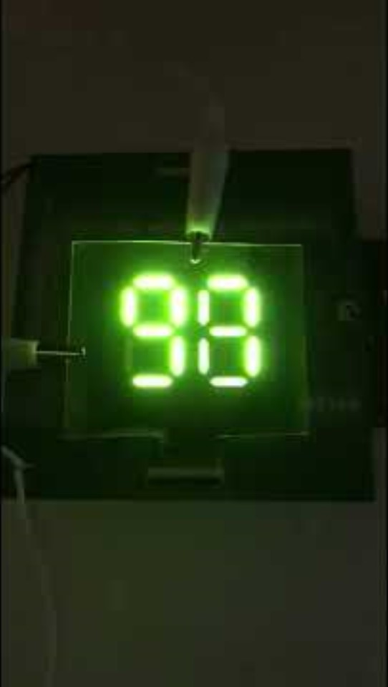
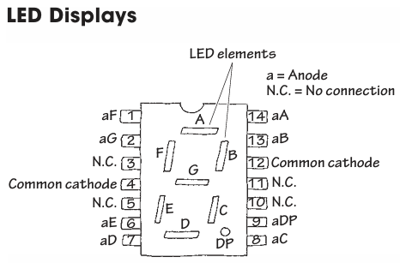







The seven-segment display

Slide 3
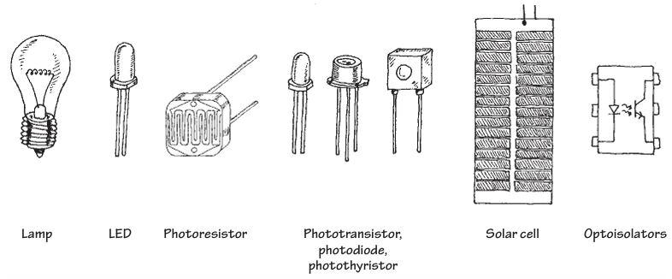
Light-based devices

Slide 4
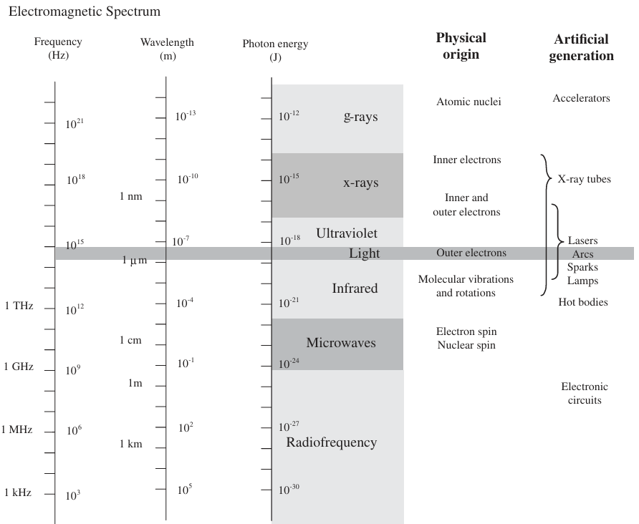
Artificially generating light

Slide 5
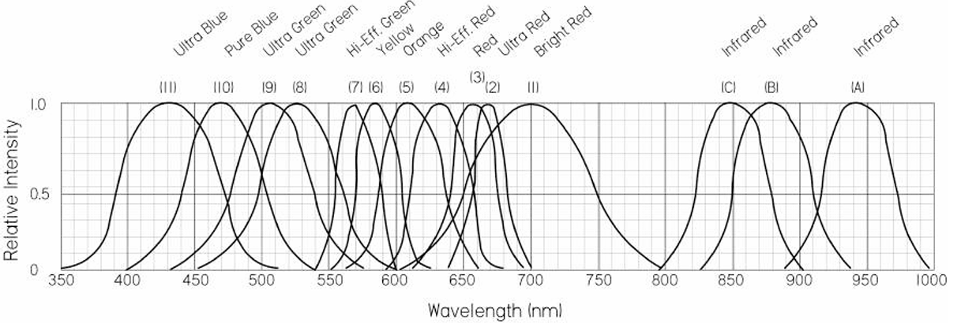
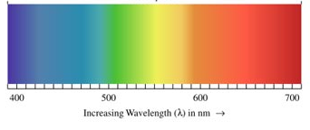
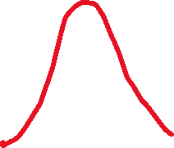
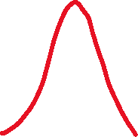
LED emission spectra

Slide 6
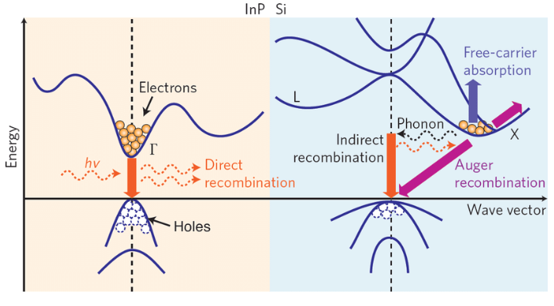





Direct vs indirect semiconductors
2 Energy band diagrams and major carrier transition processes in indium phosphide (direct bandgap) and silicon (indirect bandgap) crystals. Silicon, Germanium and some III/V compounds like GaP and AlAs are indirect bandgap semiconductors. InP, GaAs, GaN and other ternary (AlGaAs, InGaAs) and quaternary (InGaAsP, InAlAsP) compounds are direct bandgap semiconductors commonly used for photonic devices fabrication.

Slide 7
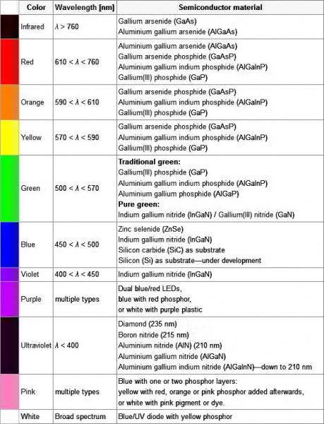
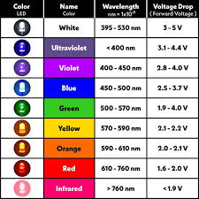



LEDs are made out of non-silicon semiconductors

Slide 8
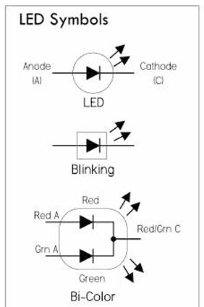






LED symbols

Slide 9
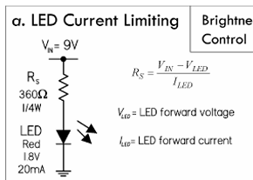



LED driver circuit

Slide 10
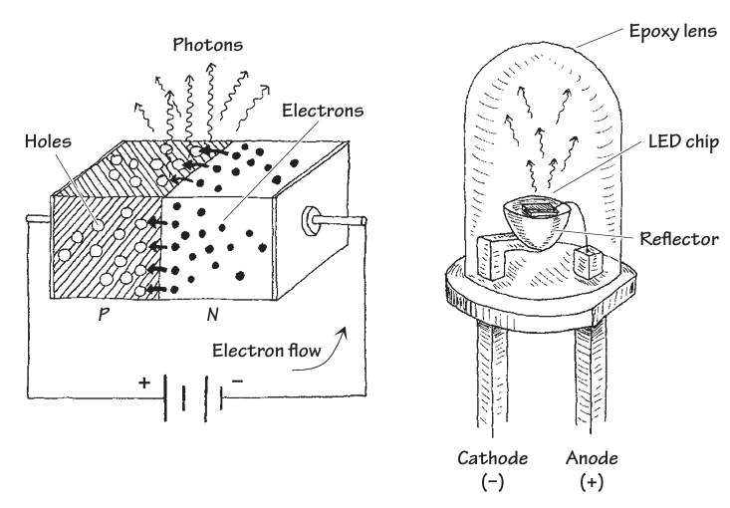




LED is a diode

Slide 11
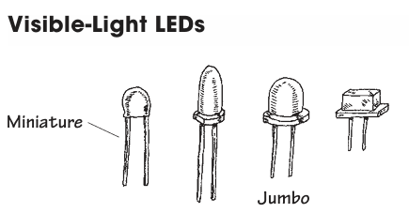
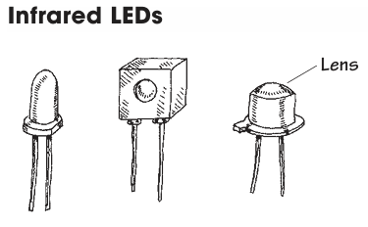
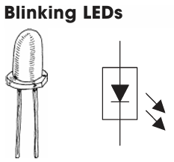
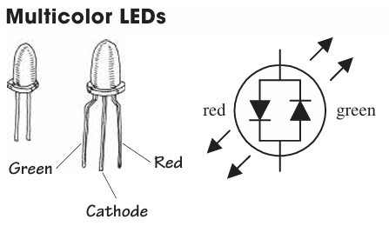
LED packages

Slide 12
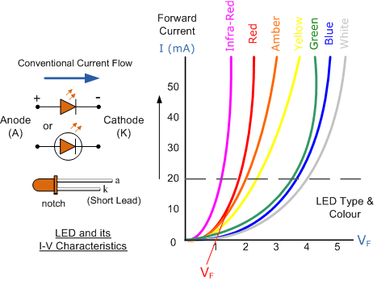





IV characteristics for LEDs

Slide 13

Blue LED won the 2014 Nobel in Physics

Slide 14




Slide 15
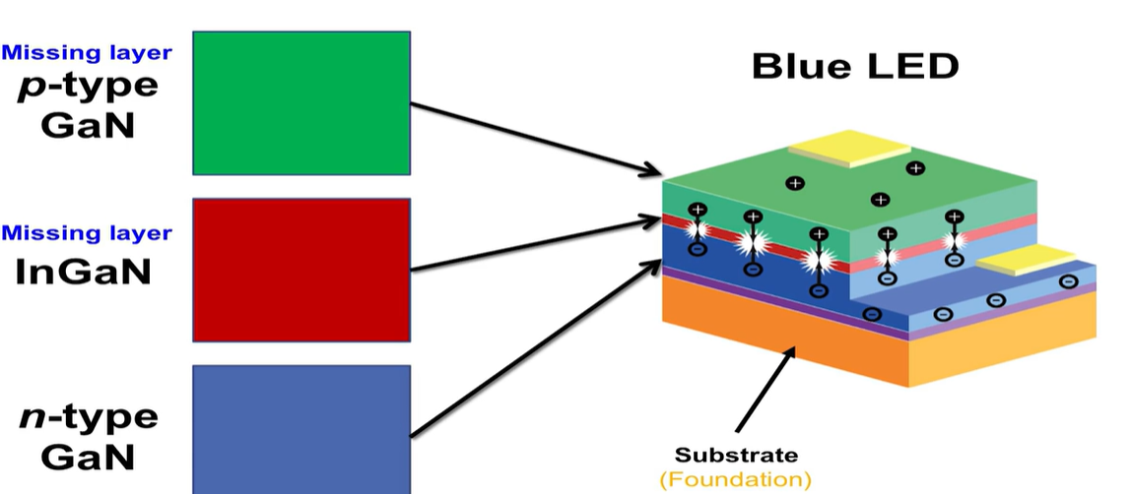
Steps to get the Blue LED
Notes:
Experiments everyday for 1.5 years

Slide 16
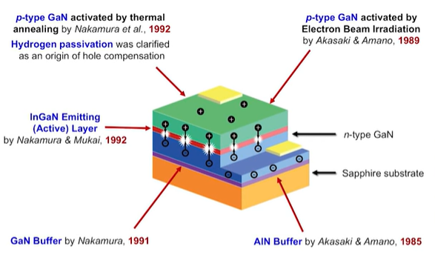
InGaN LEDs

Slide 17
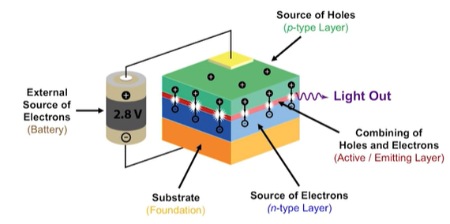
LED colors – single color from on LED

Slide 18
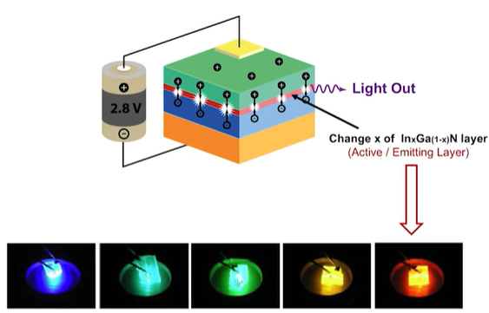
Changing emission colors – can you change color?
Notes:
GaN blue more in

Slide 19
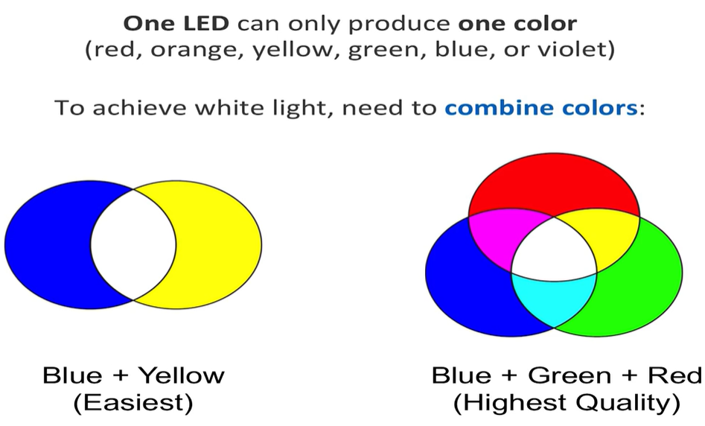
How to get white light

Slide 20
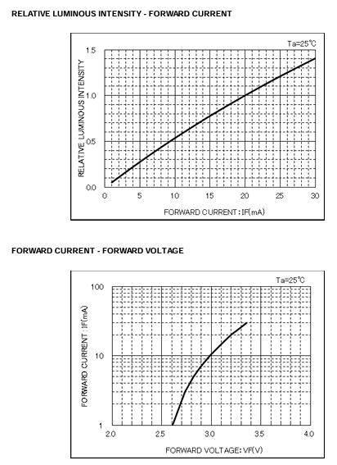
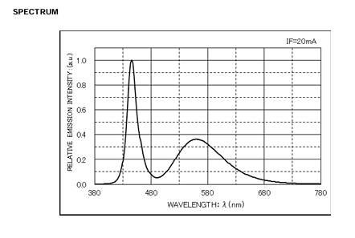









The LED in our demo board
https://fscdn.rohm.com/en/products/databook/datasheet/opto/led/chip_mono/csl0416wbcw1-e.pdf
Notes:
Blue peak and second peak from Yttrium Aluminum Garnet (YAG) LED Phosphor

Slide 21









How does a photodiode work

Slide 22








How does a photodiode work

Slide 23


How does a photodiode work

Slide 24
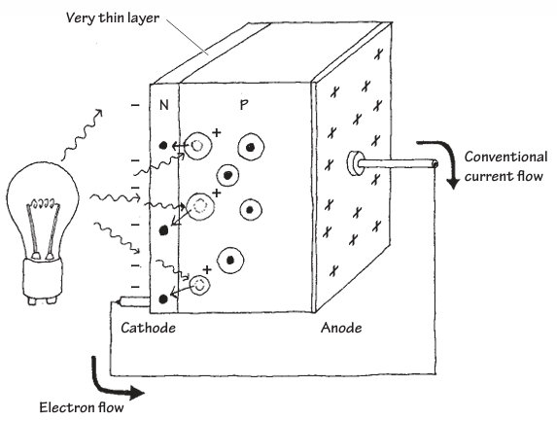

Photodiode

Slide 25







IV of photodiode

Slide 26
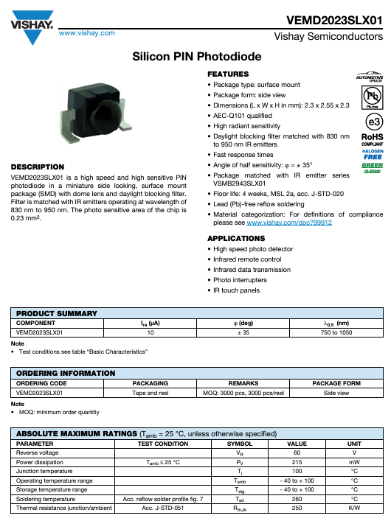
The PD in our demo board
https://www.vishay.com/docs/83493/vemd2023slx01.pdf

Slide 27
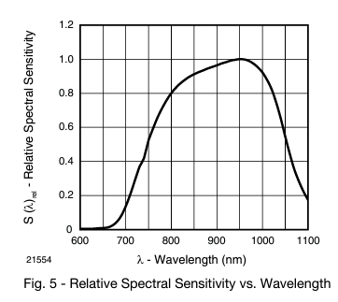
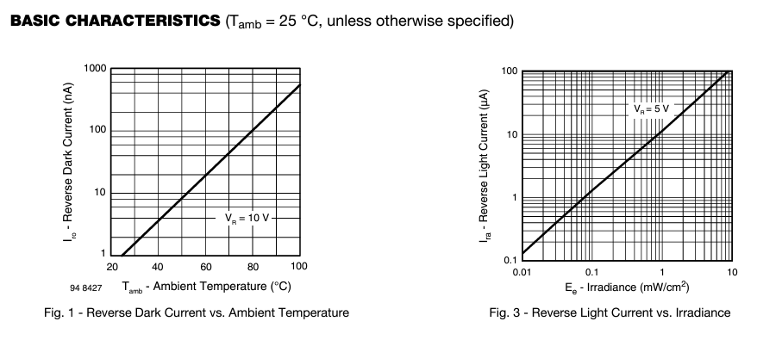




PD characteristics

Slide 28
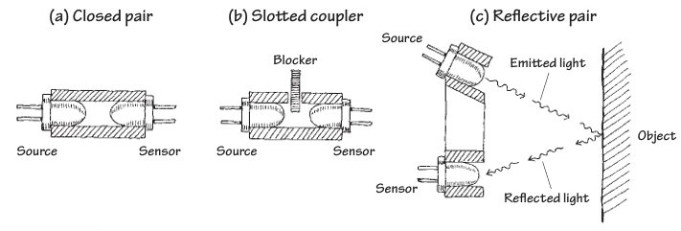
LED-PD combo

