Slide 1
ECE 105: Introduction to Electrical Engineering
Lecture 17
Intro to hardware ML
Yasser Khan
Rehan Kapadia

Slide 2
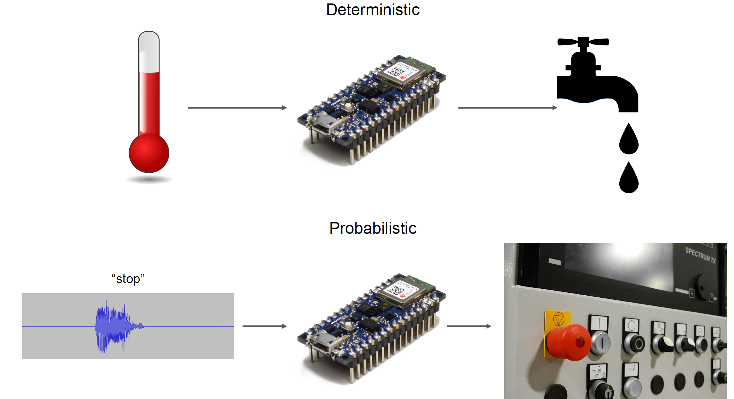
Why use NN when your can hardcode?
Temperature measurement is absolute
Voice can vary

Slide 3
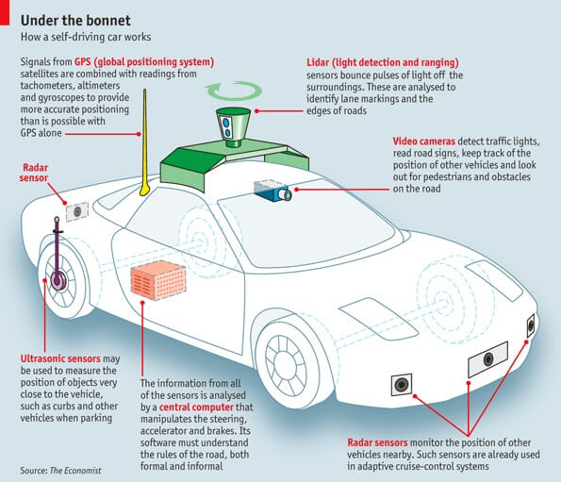
Self-driving car

Slide 4
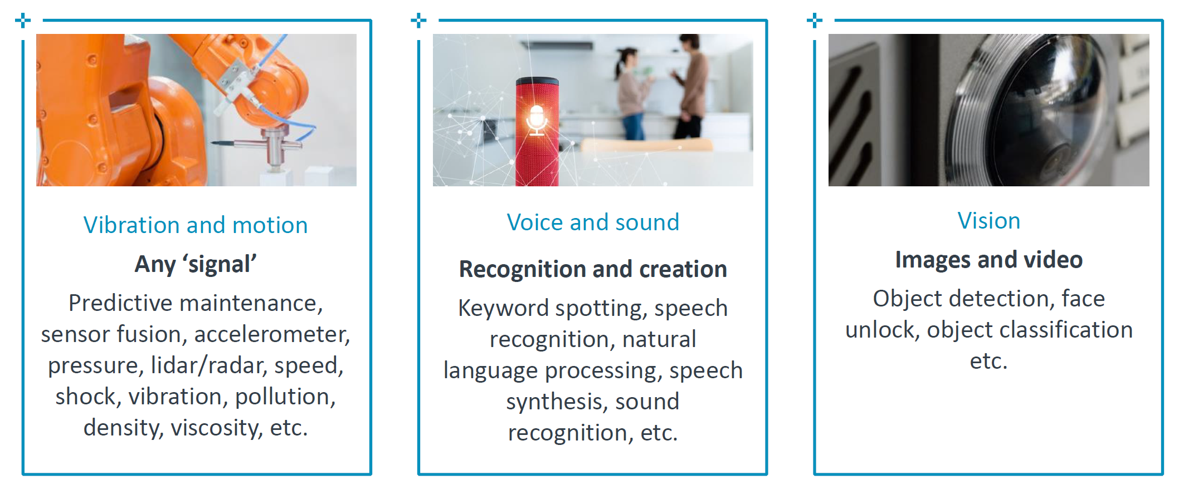
On-device machine learning applications in the single mW and below

Slide 5
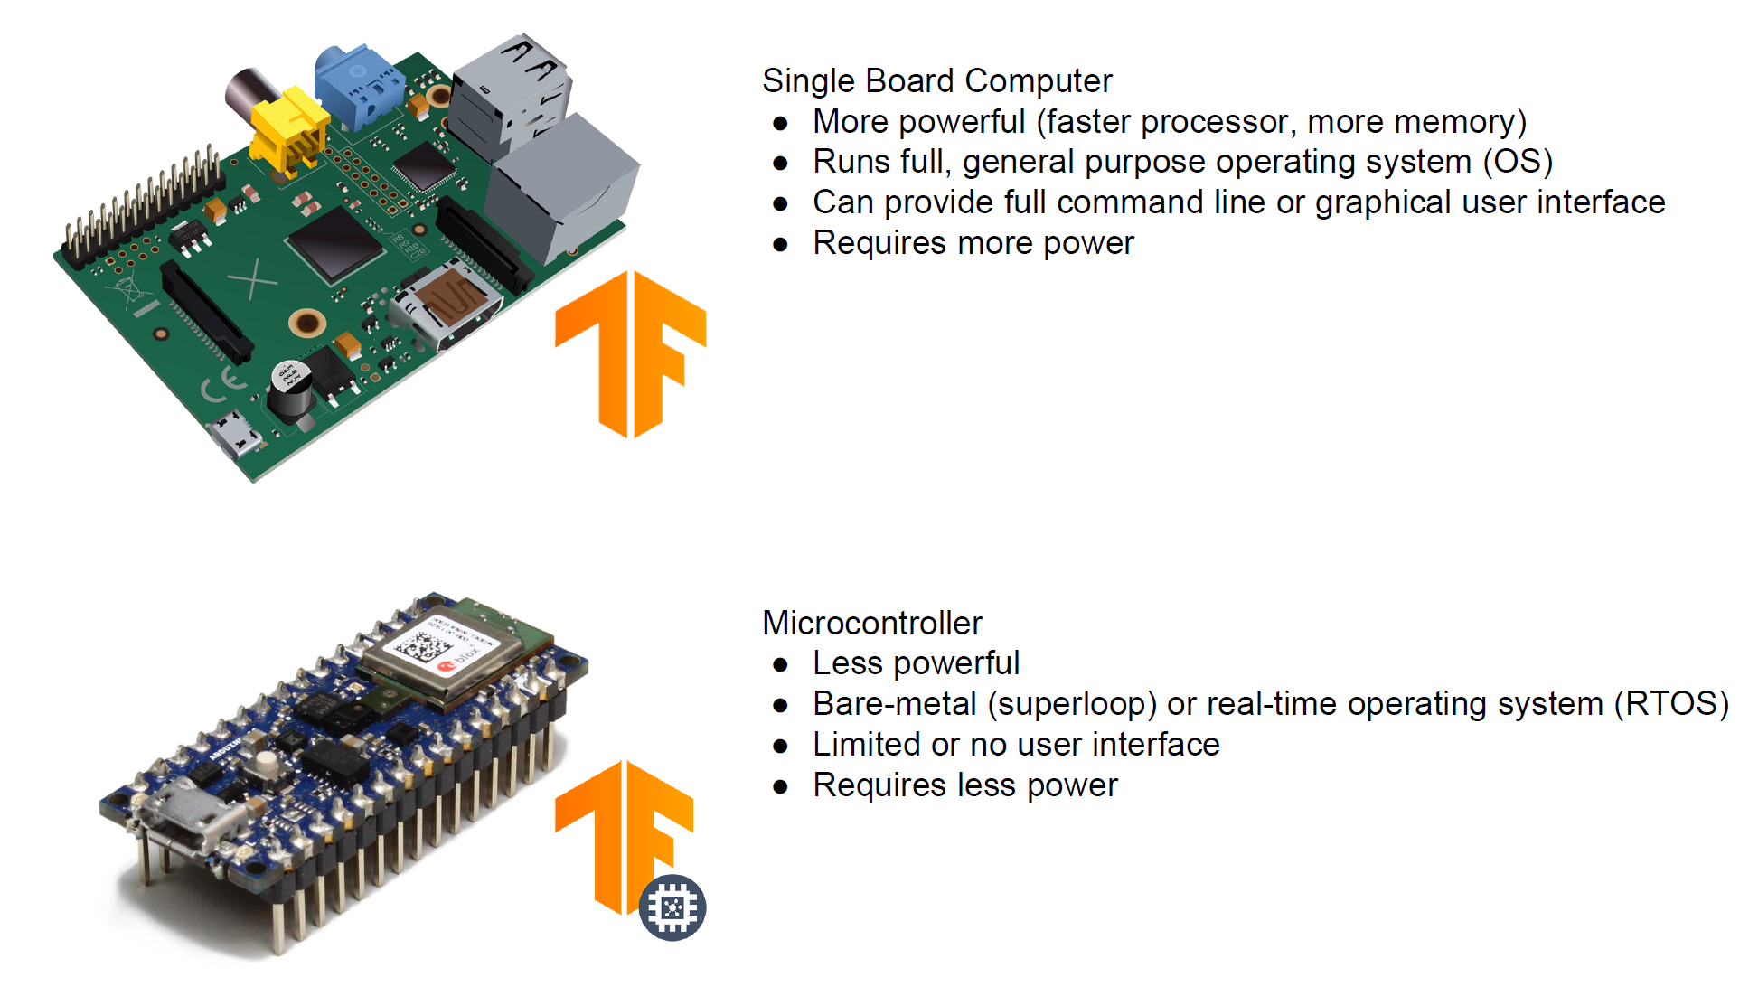
Sub-mW computing vs 100s of mW computing

Slide 6
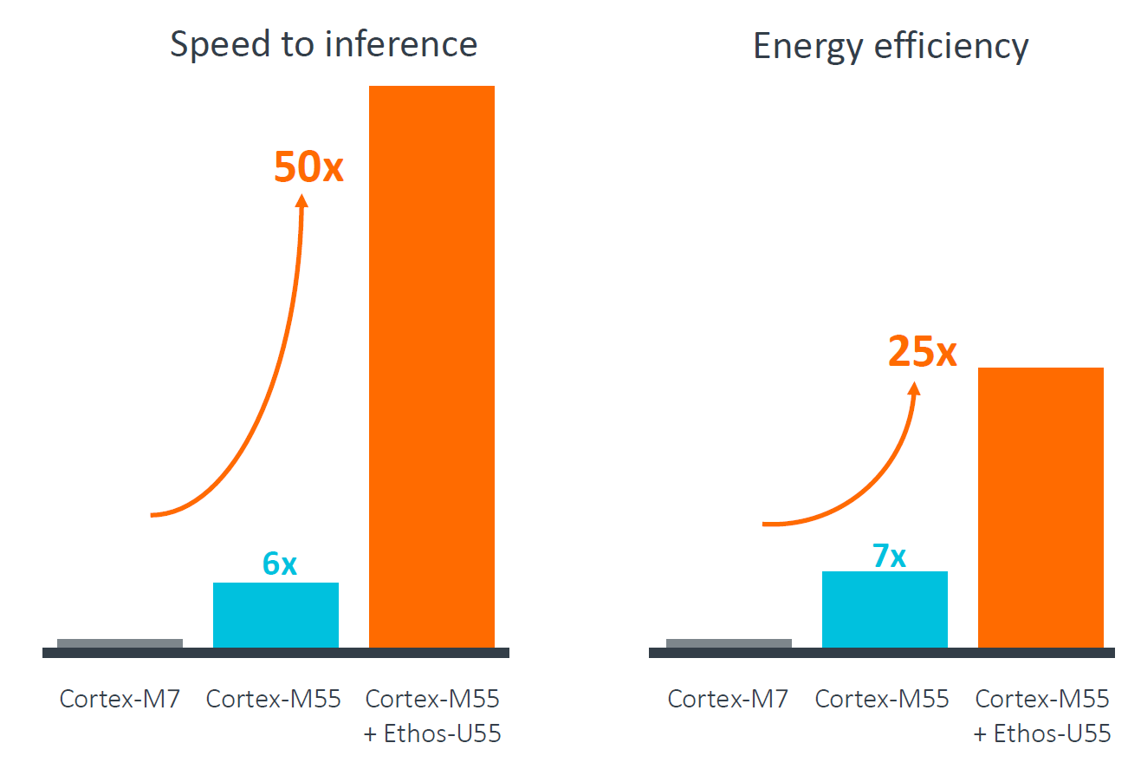
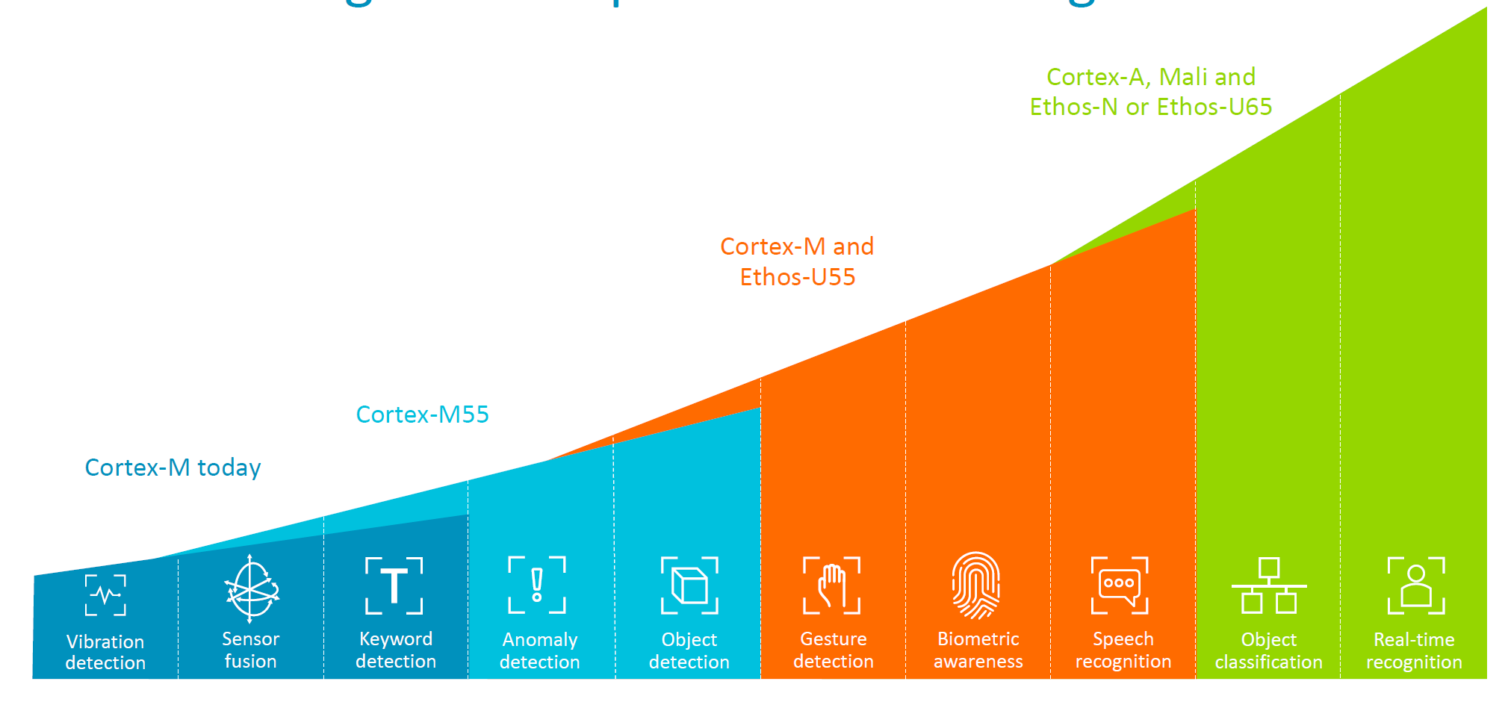
Cortex-M series microcontrollers are becoming powerful
nRF52840 is built around the 32-bit ARM® Cortex™-M4 CPU with floating point unit running at 64 MHz.

Slide 7
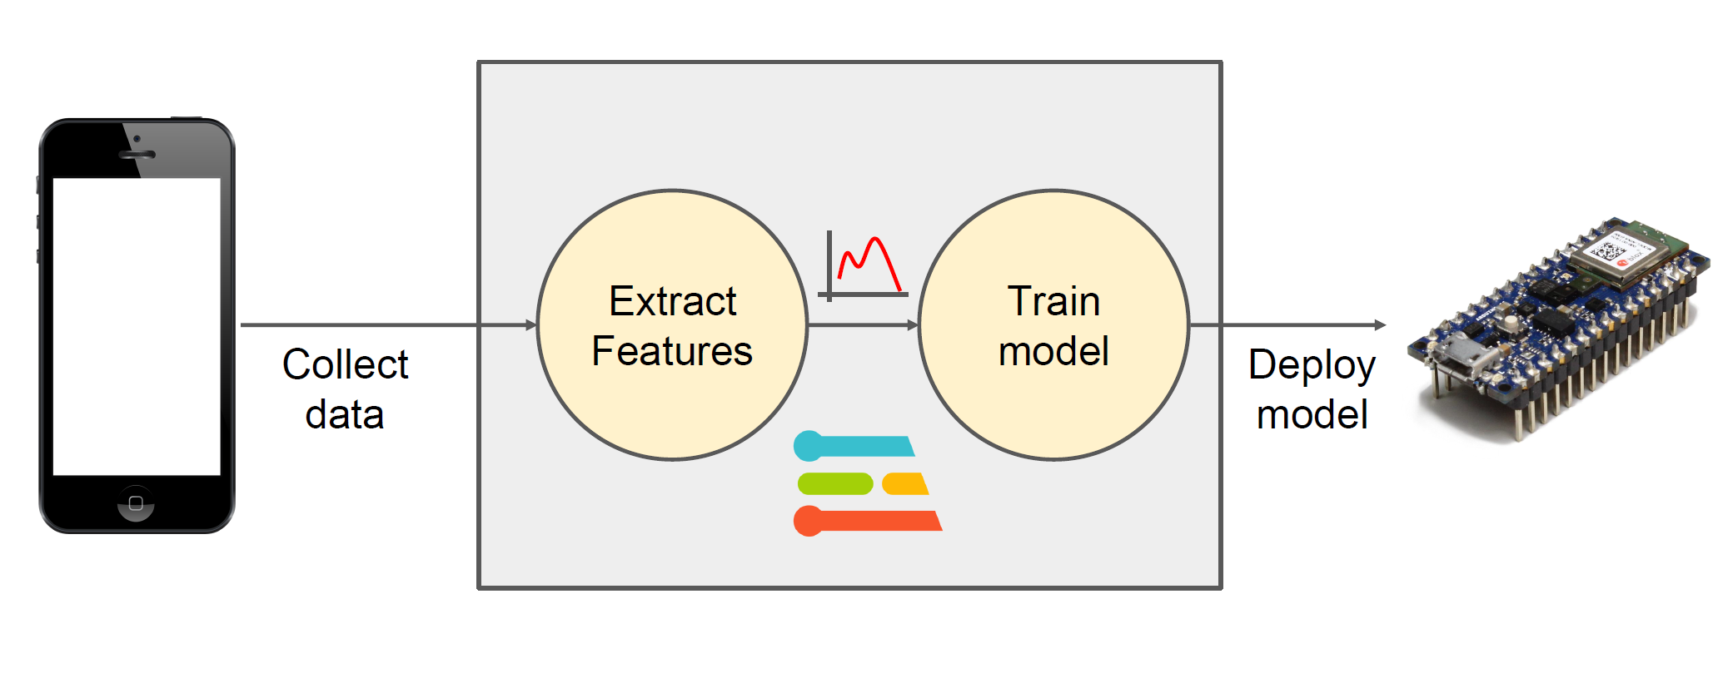
ML in microcontrollers TinyML

Slide 8
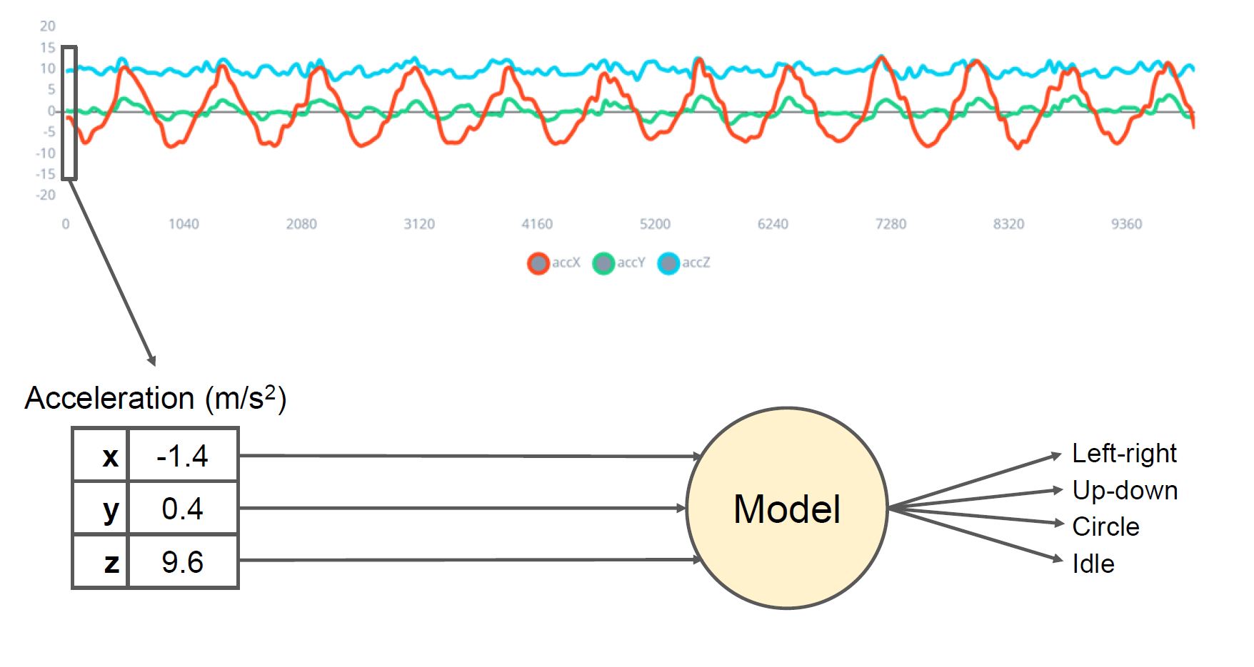
Motion classification from accelerometer data

Slide 9
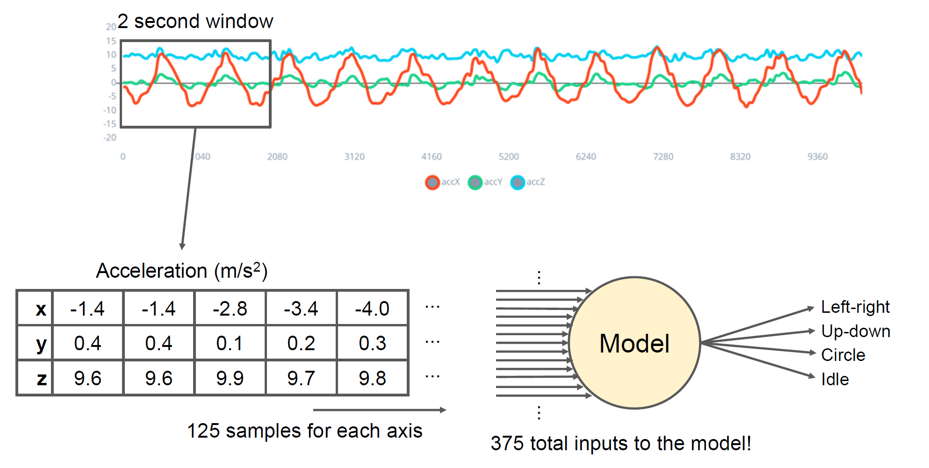




Motion classification from accelerometer data

Slide 10
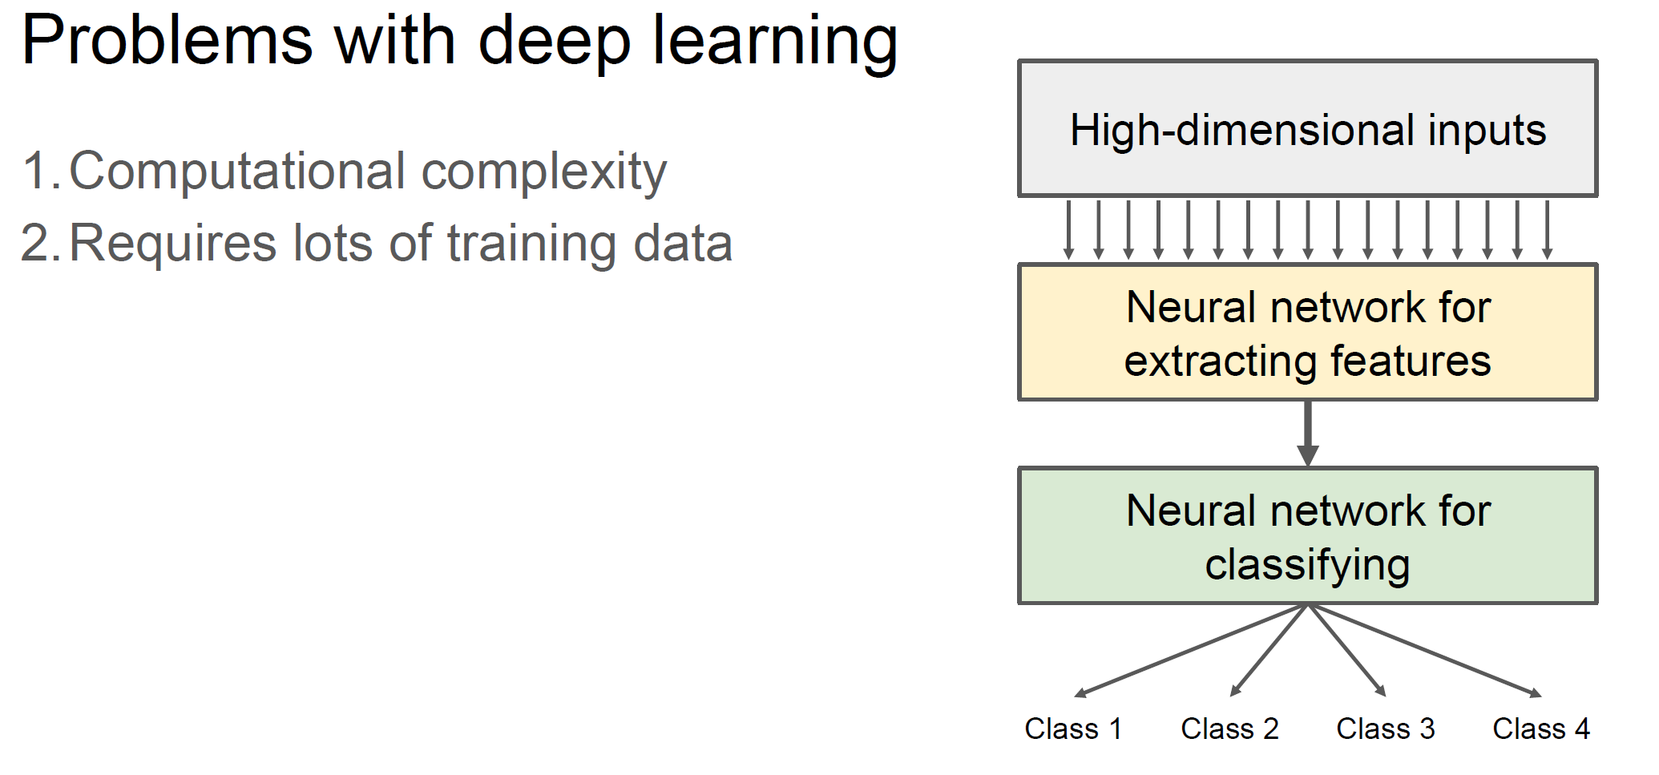
Way too many inputs to the model

Slide 11
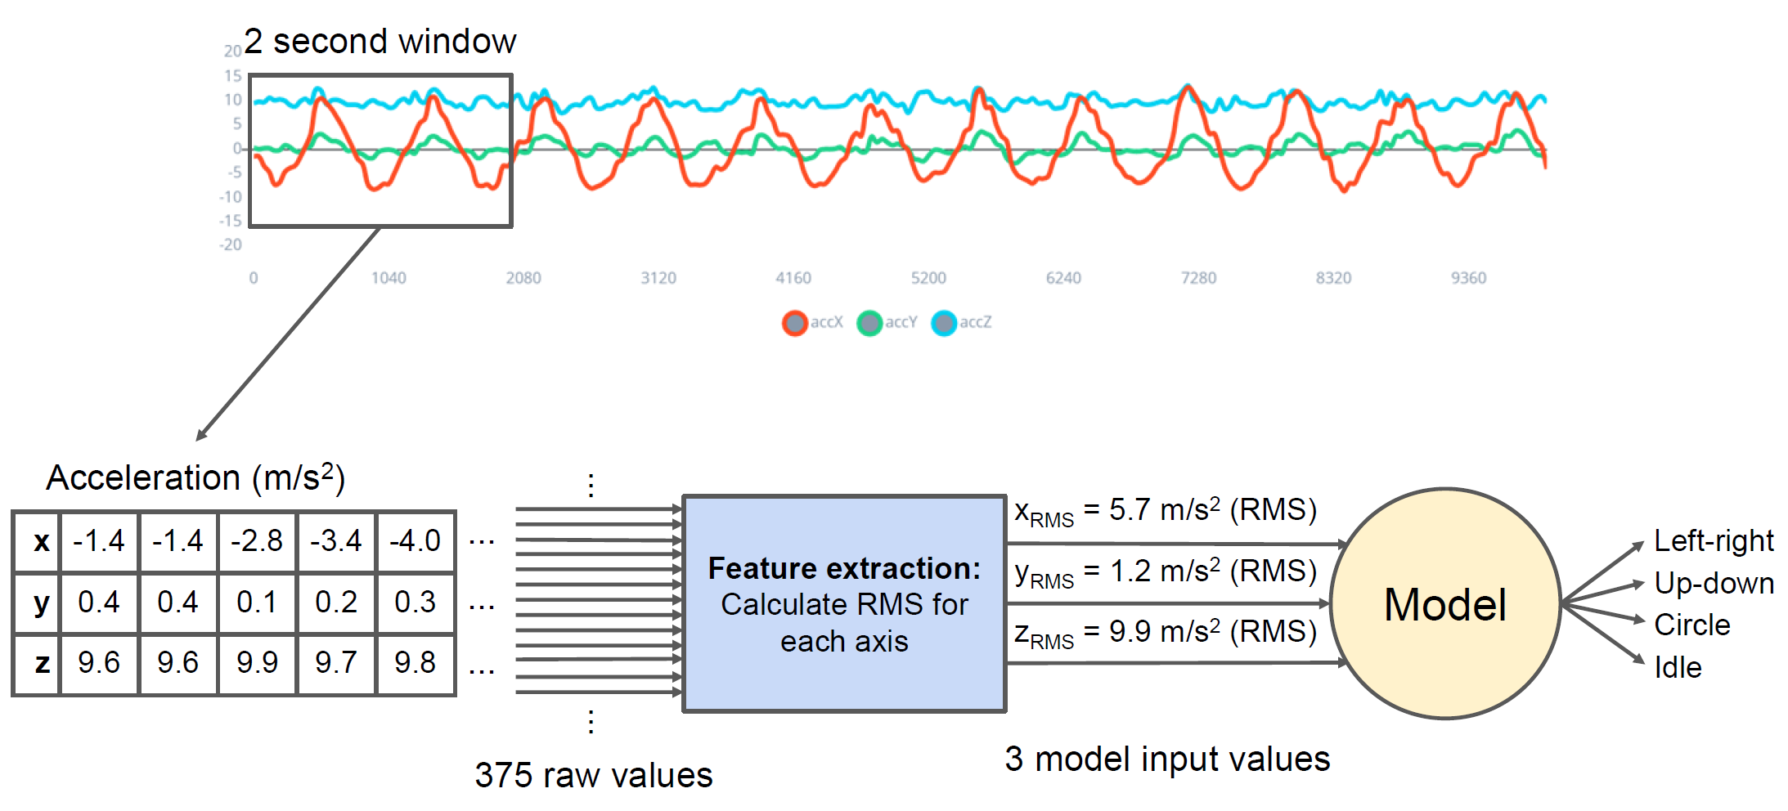



Feature extraction

Slide 12






What is a feature
Individual measurable property or characteristic of a phenomenon being observed

Slide 13
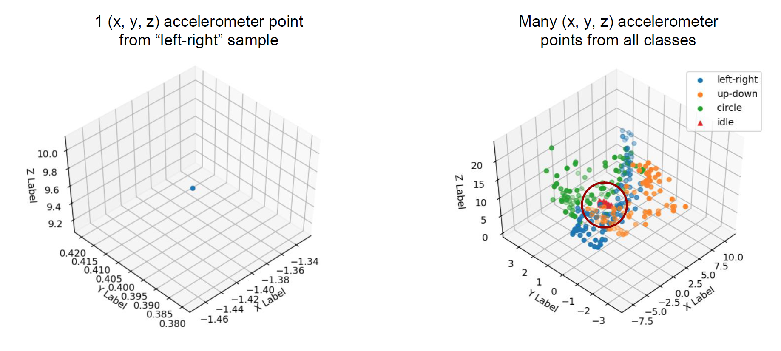
Raw data

Slide 14
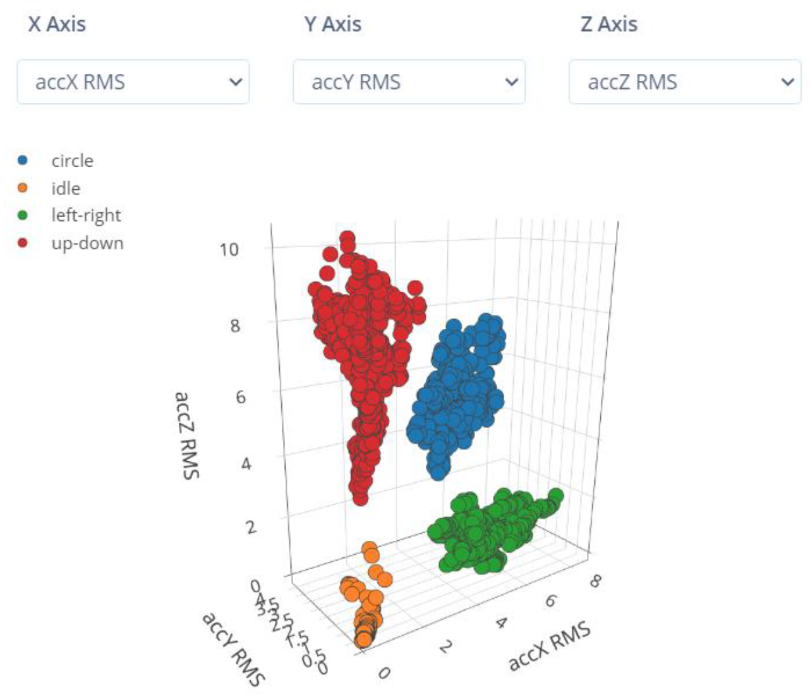
RMS of acceleration in each axis as the feature

Slide 15
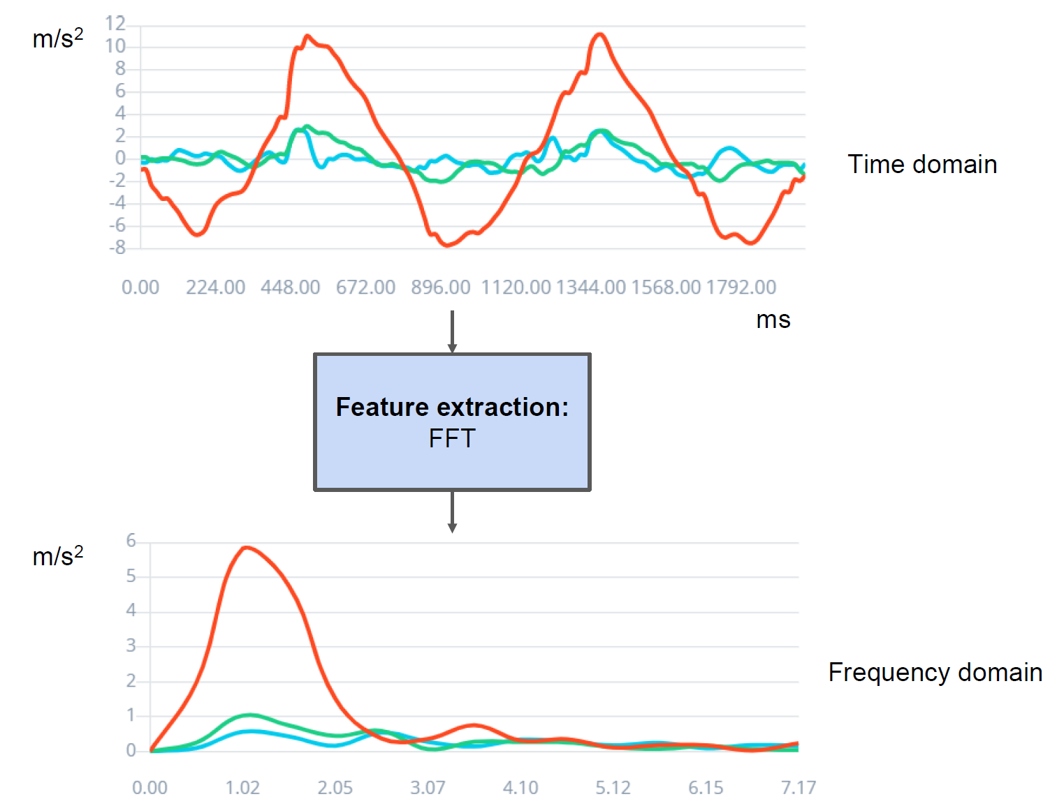
Features don’t need to be only in the time domain

Slide 16
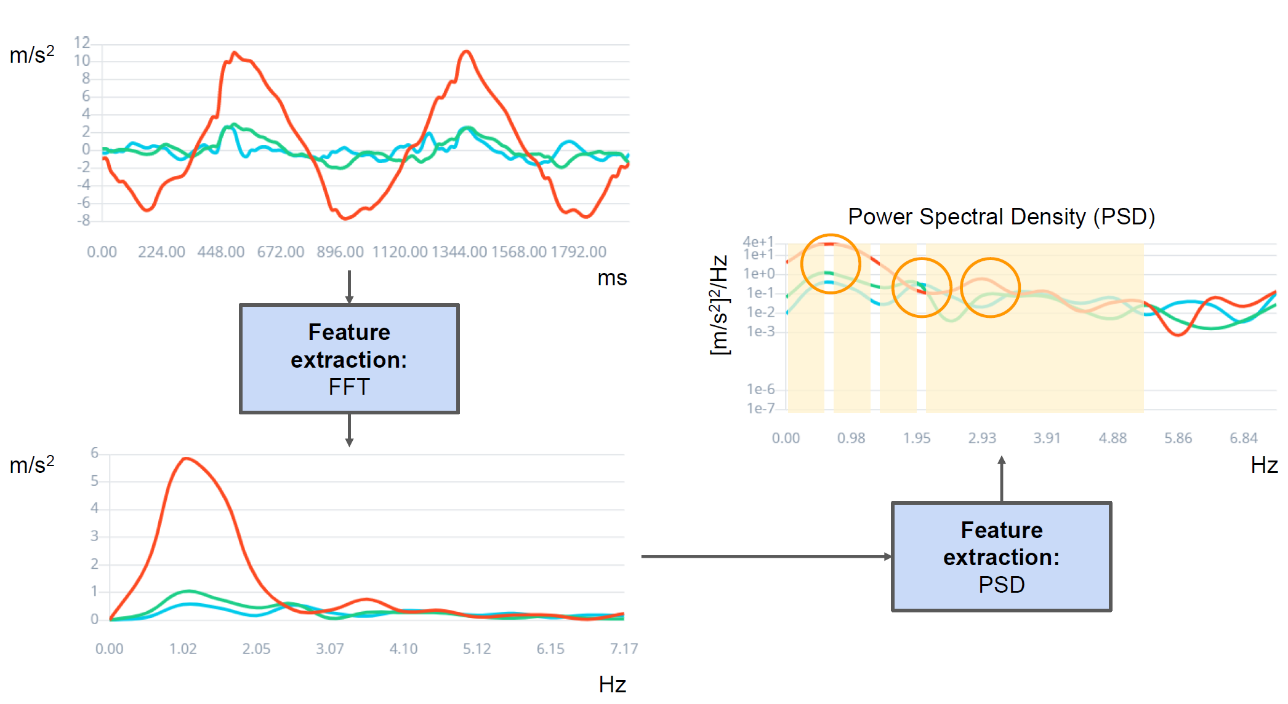
Features in the frequency domain

Slide 17
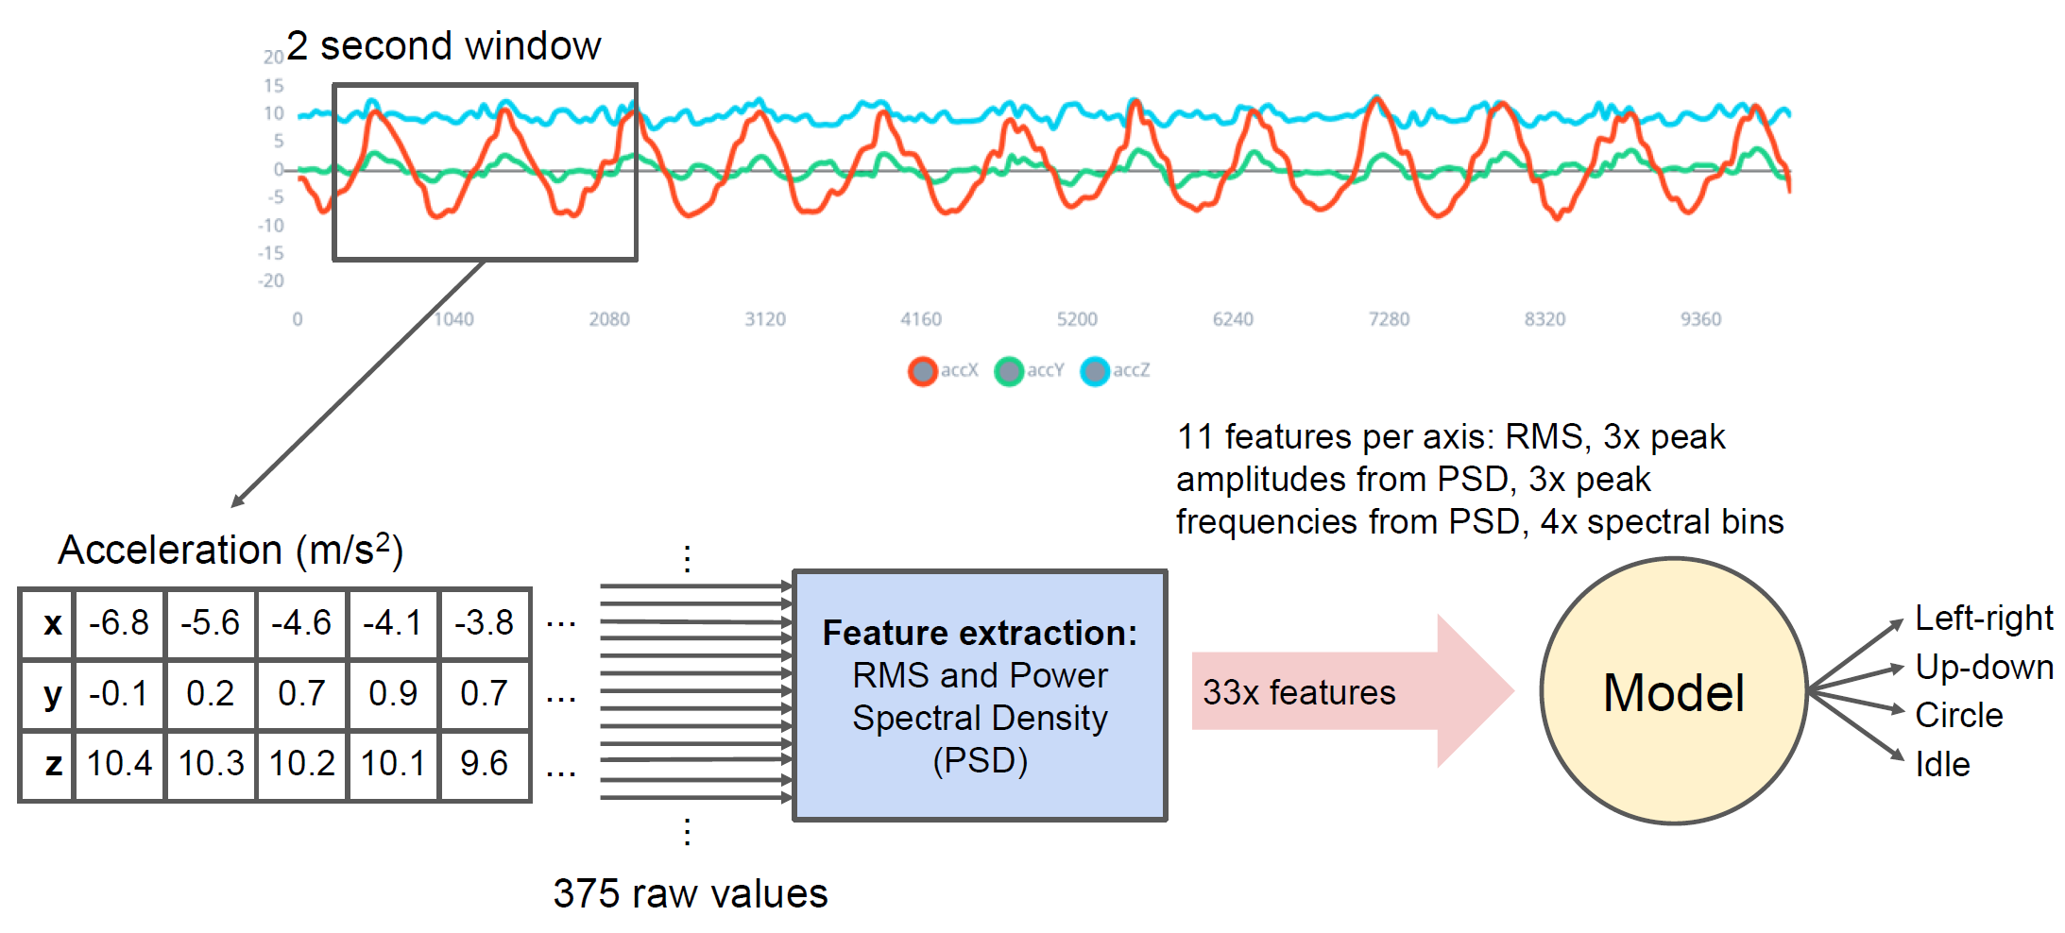
Using both time and frequency domain features

Slide 18
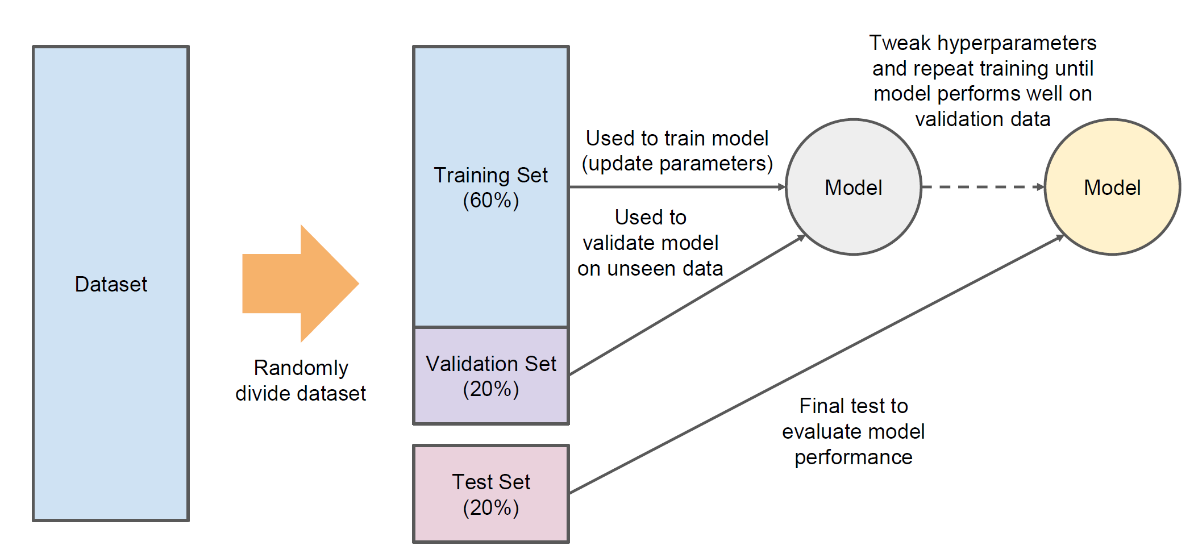
Holdout Method for training, validation, and testing

Slide 19
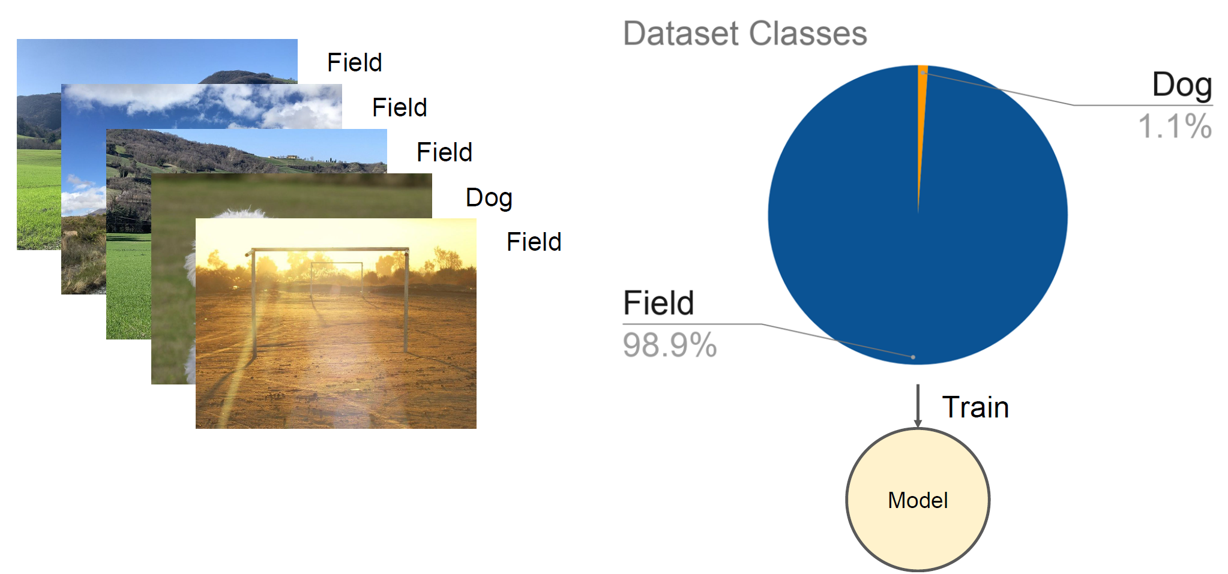
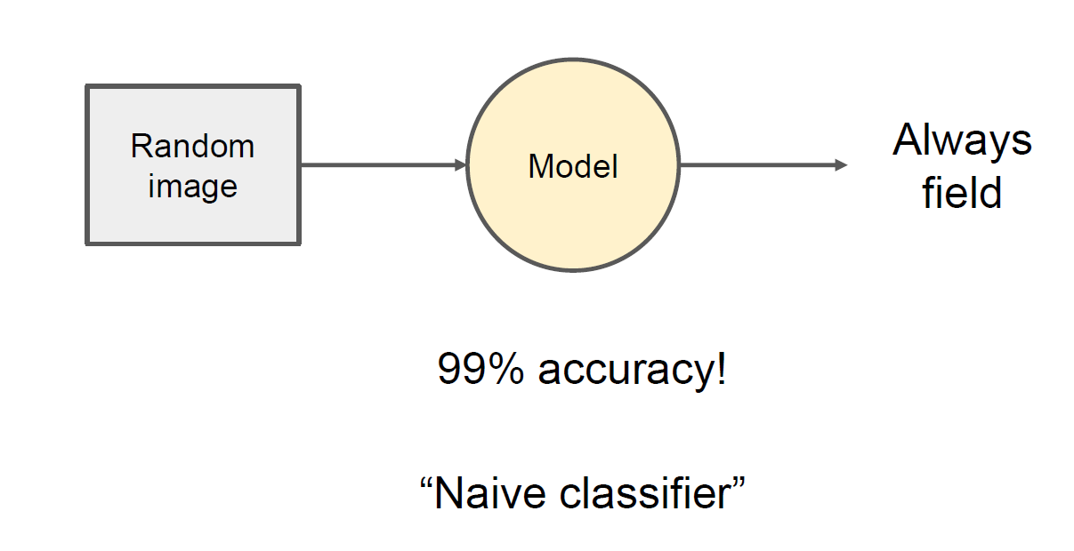
Dataset balance

Slide 20
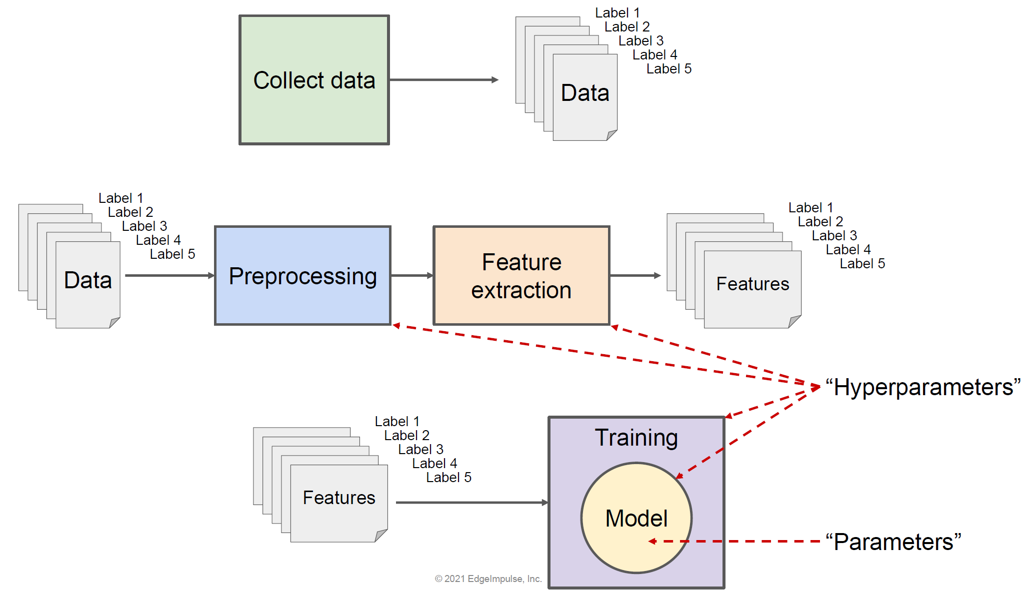
Data flow diagram

Slide 21
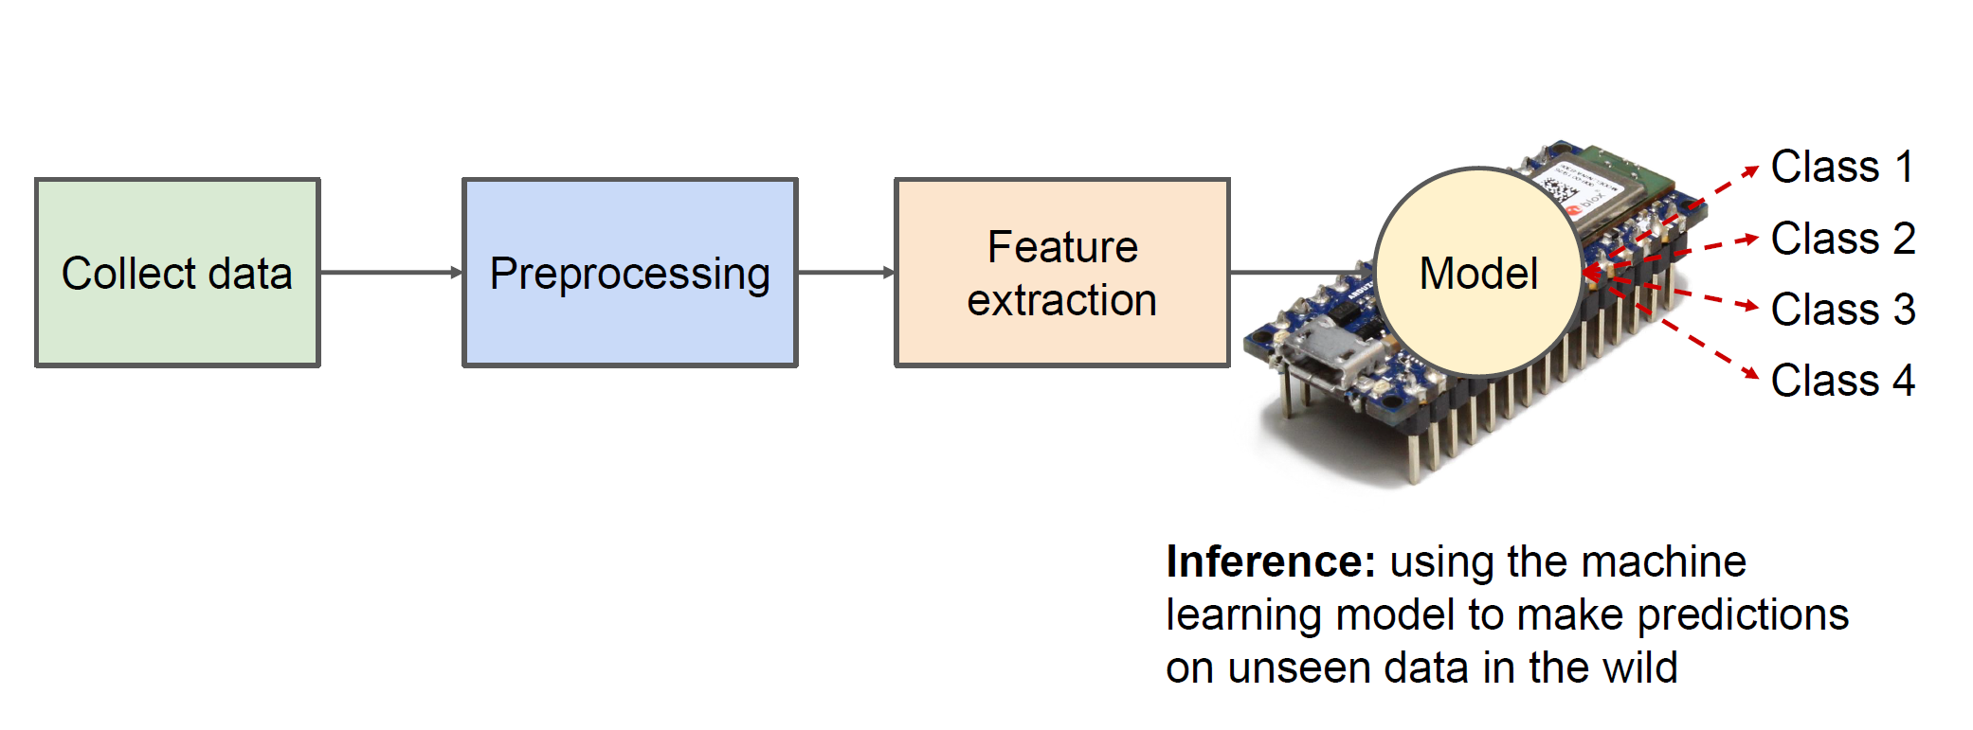
Final implementation

Slide 22
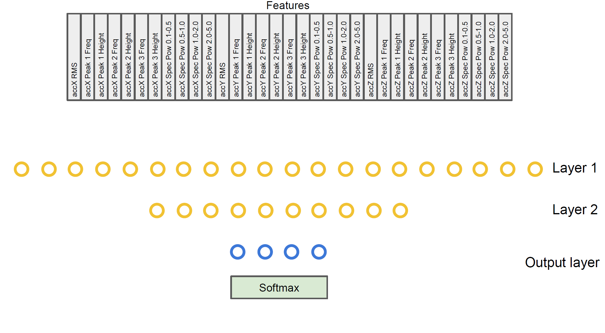
Final implementation

Slide 23
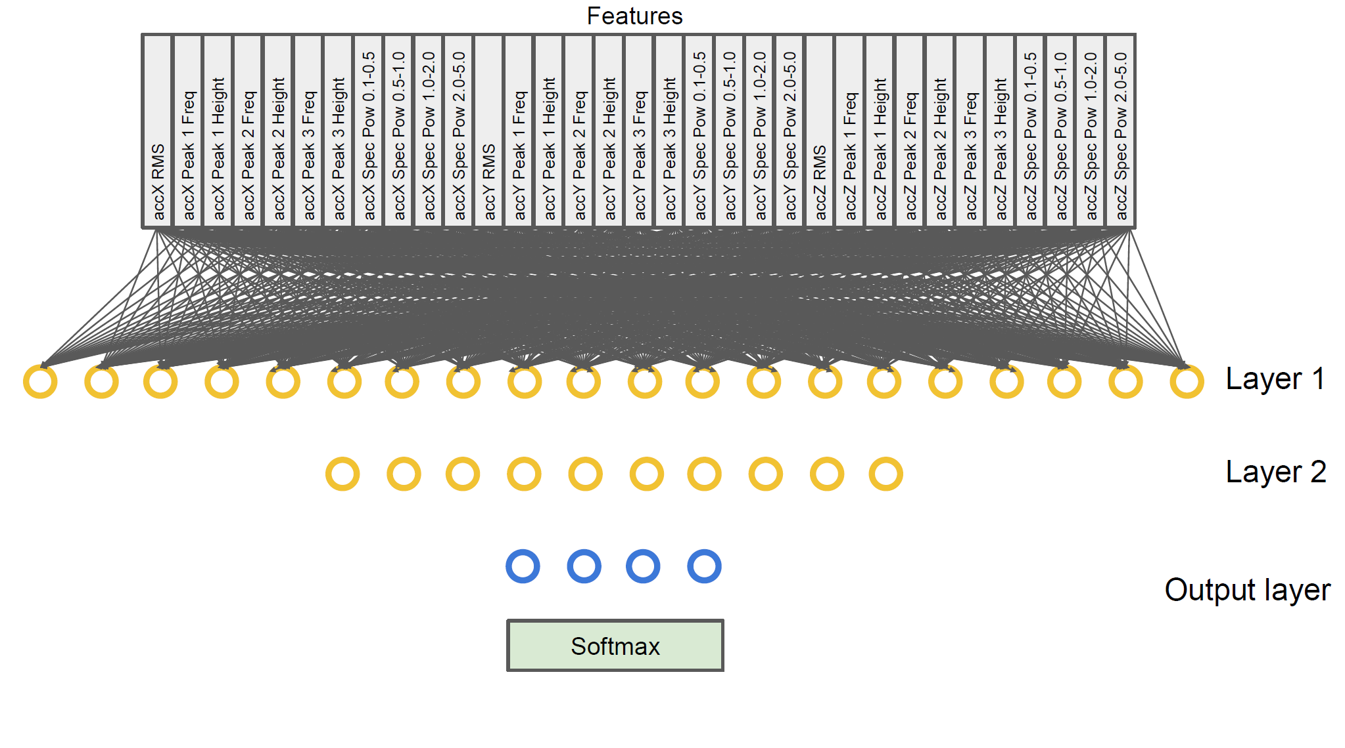
Final implementation

Slide 24
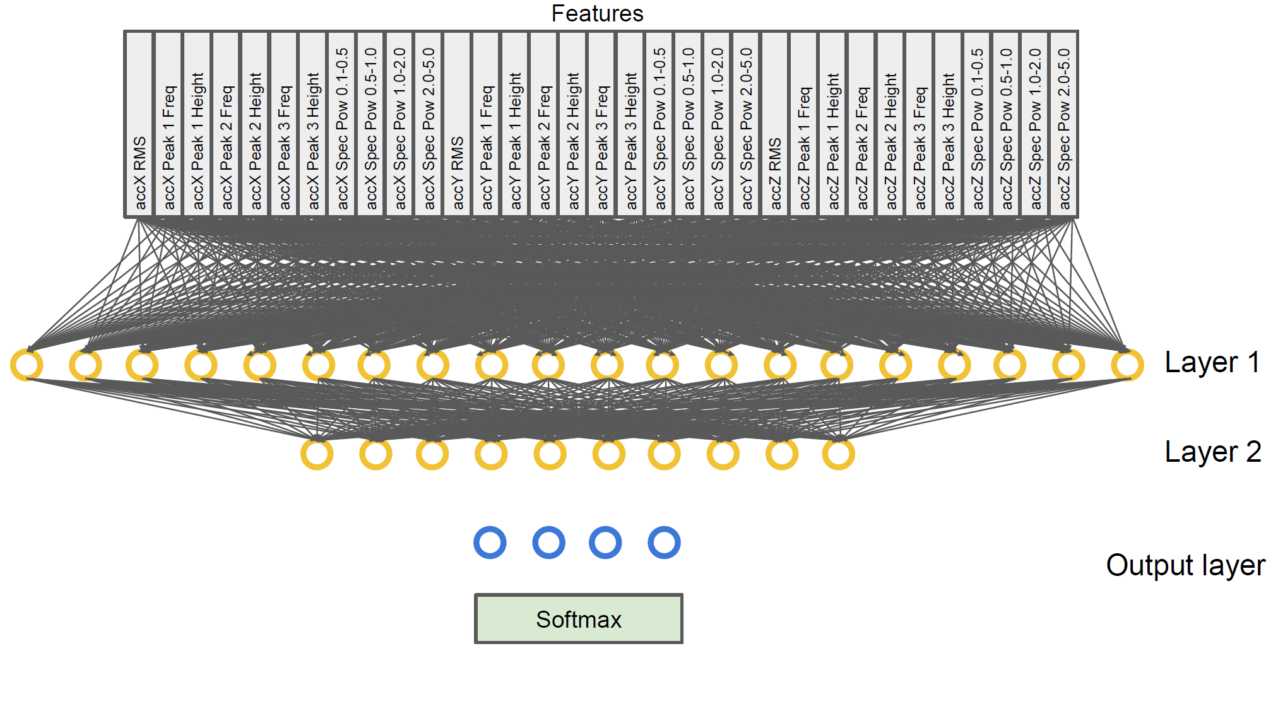
Final implementation

Slide 25
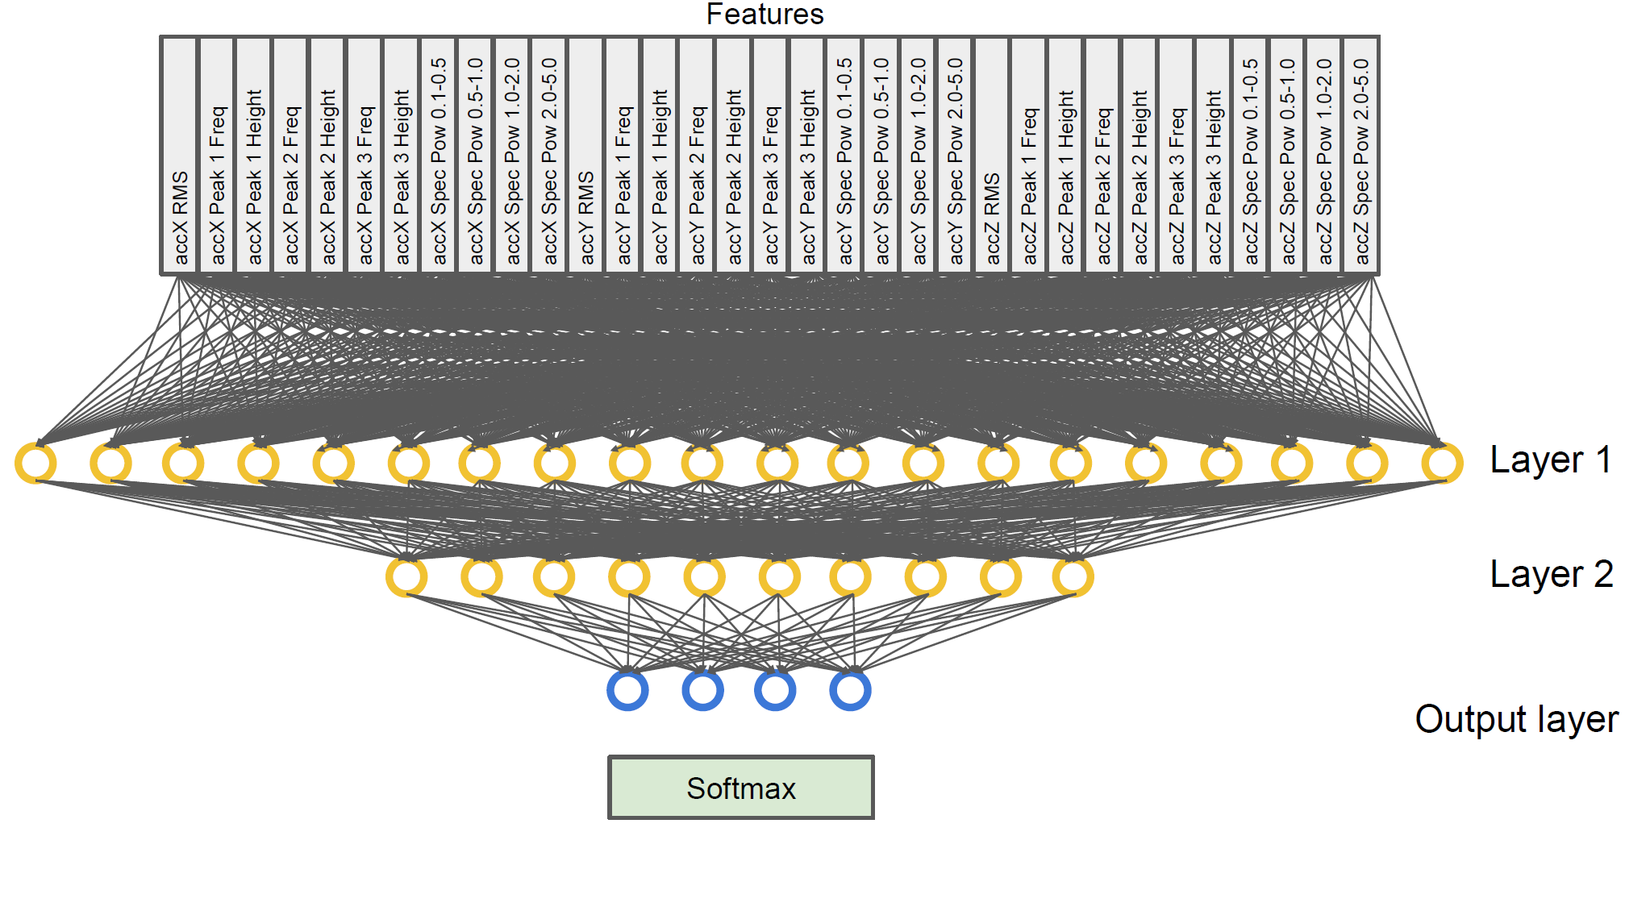
Final implementation

Slide 26
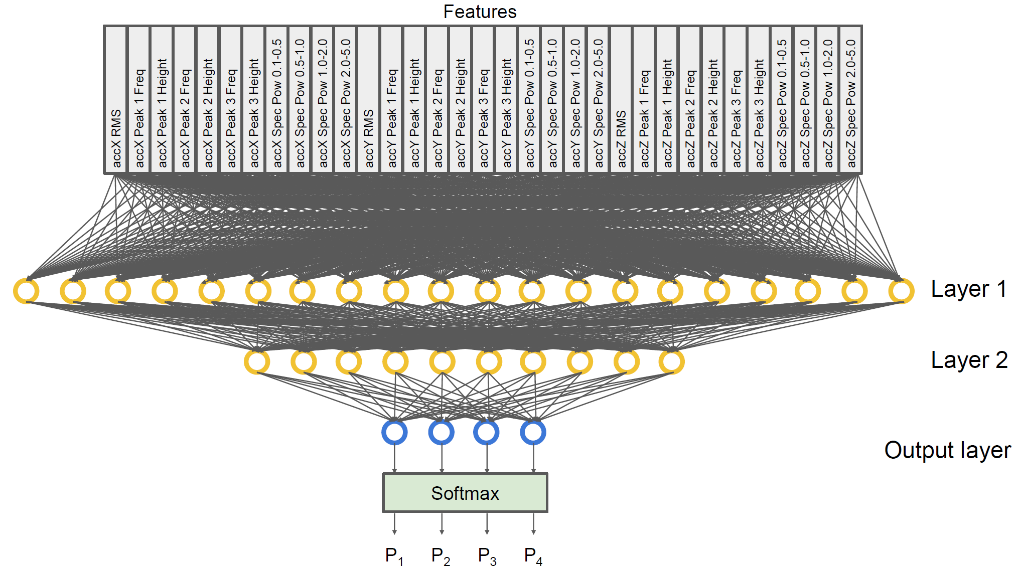
Final implementation

Slide 27
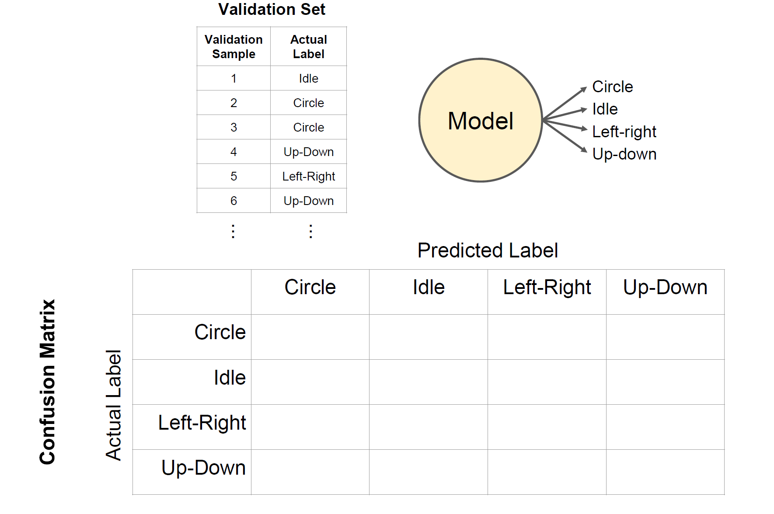


Confusion matrix in classification

Slide 28
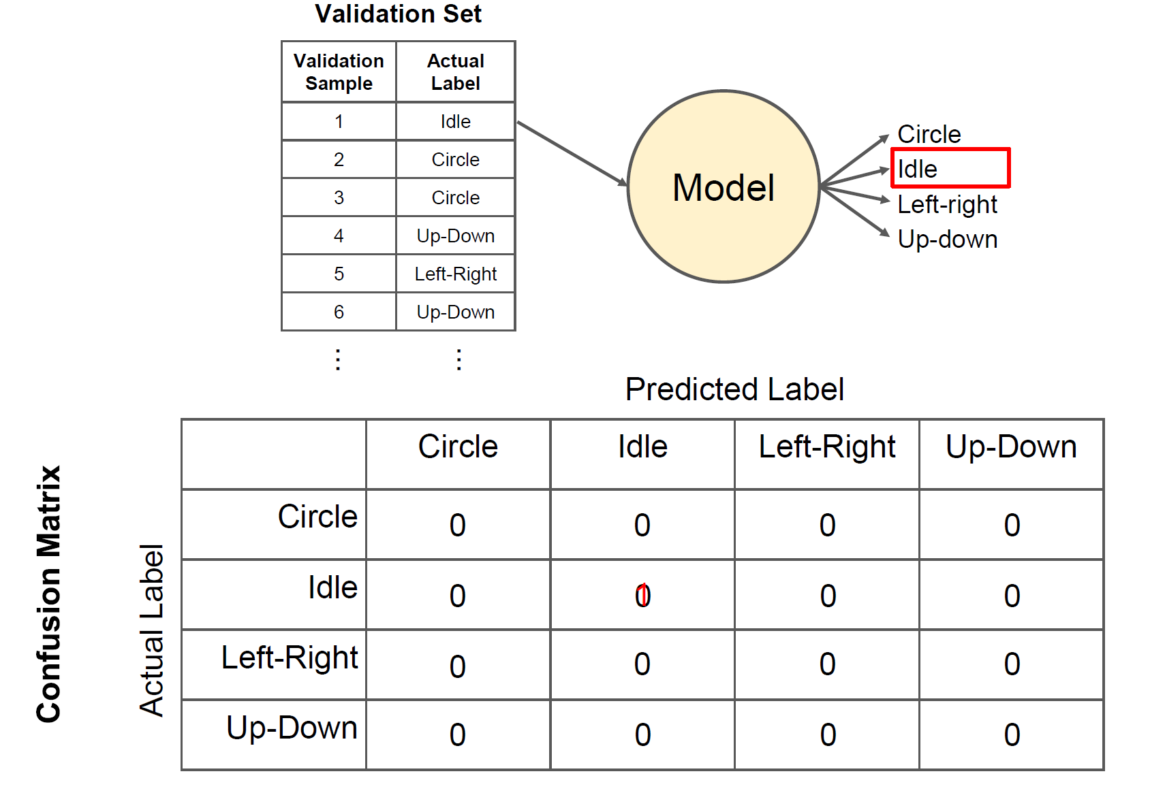


Confusion matrix in classification

Slide 29
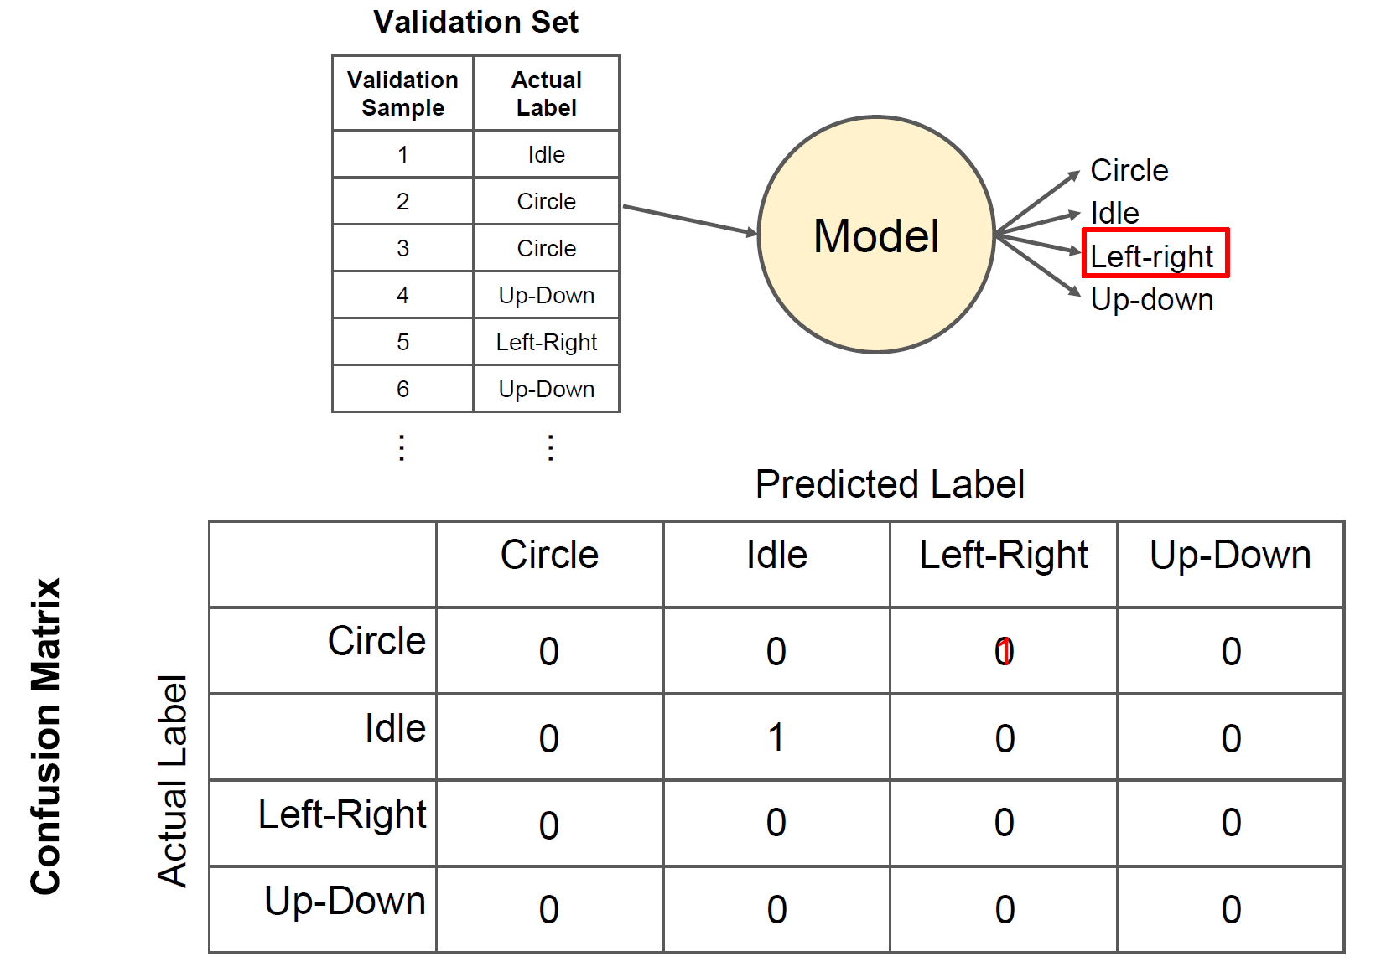


Confusion matrix in classification

Slide 30
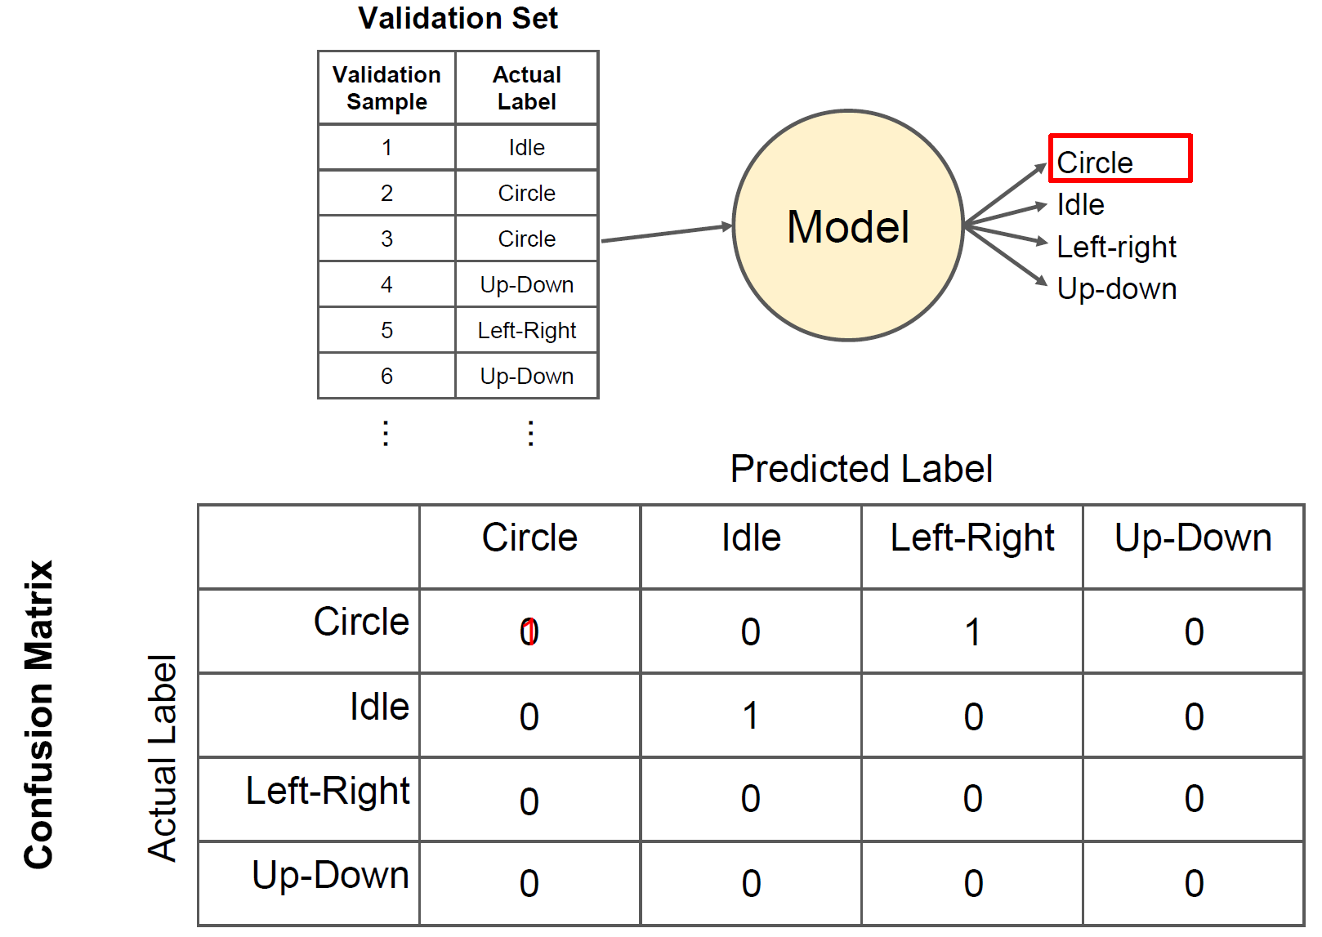
Confusion matrix in classification

Slide 31
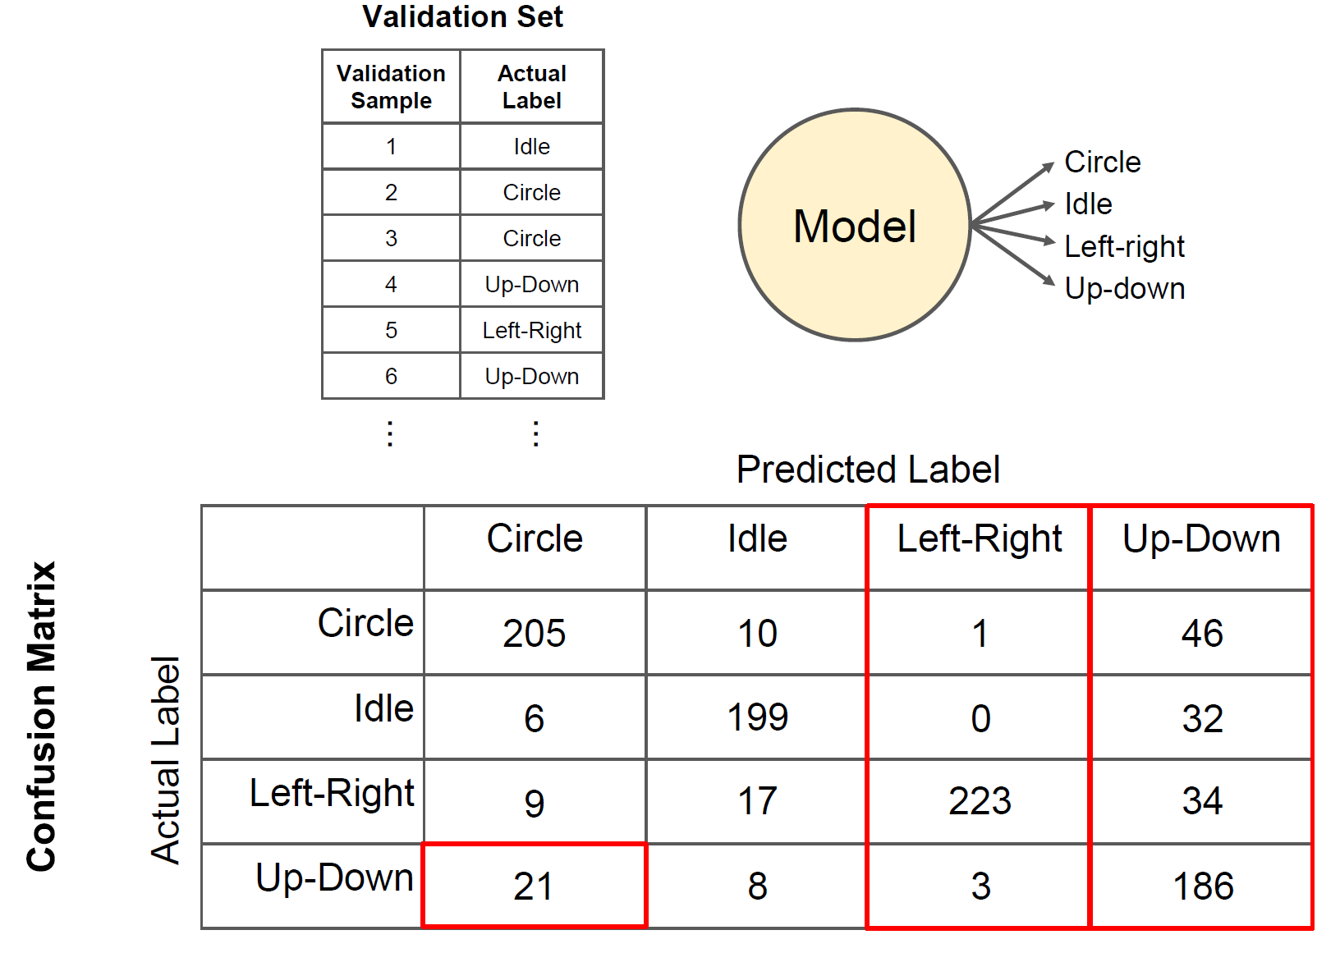
Confusion matrix in classification

Slide 32
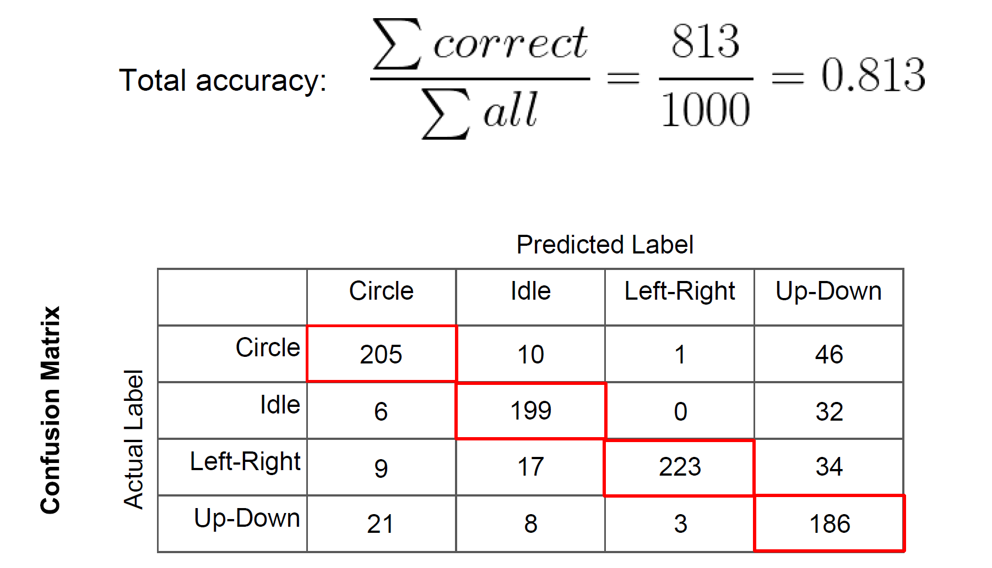
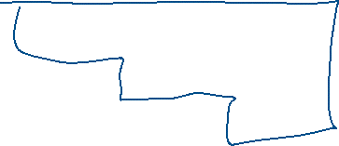







Confusion matrix accuracy

Slide 33
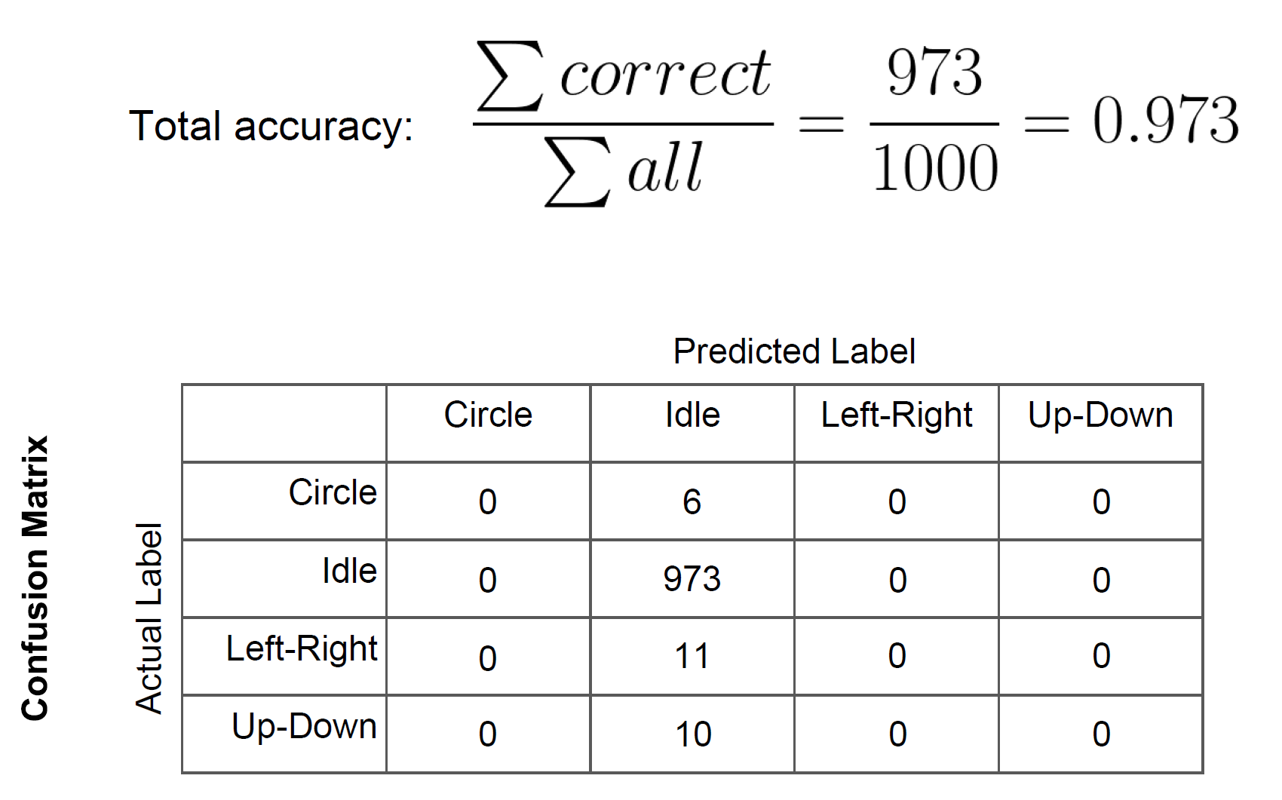
Is this a good dataset?

Slide 34
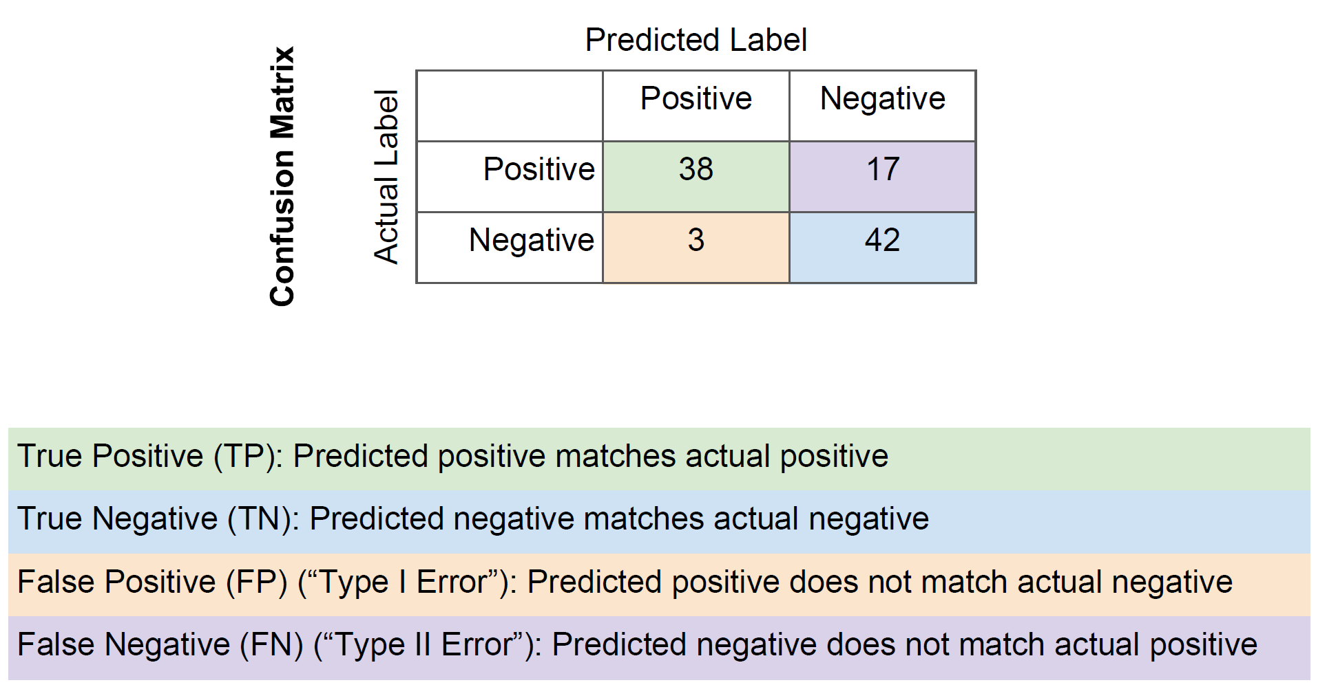





Positives and negatives

Slide 35
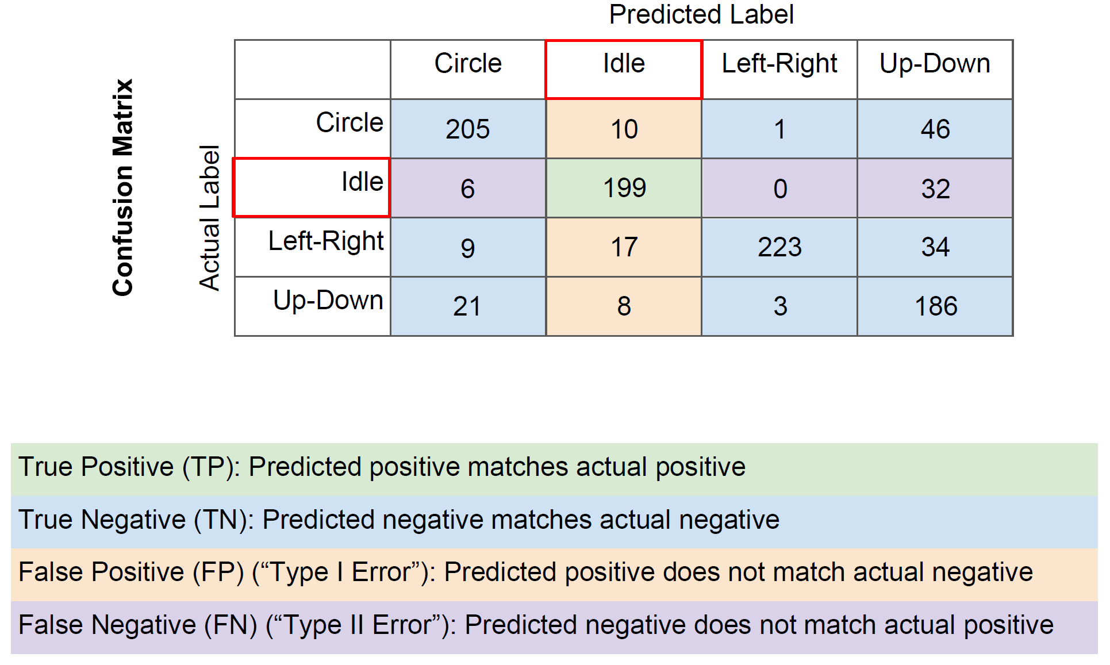
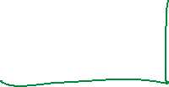





False positives, false negatives

Slide 36
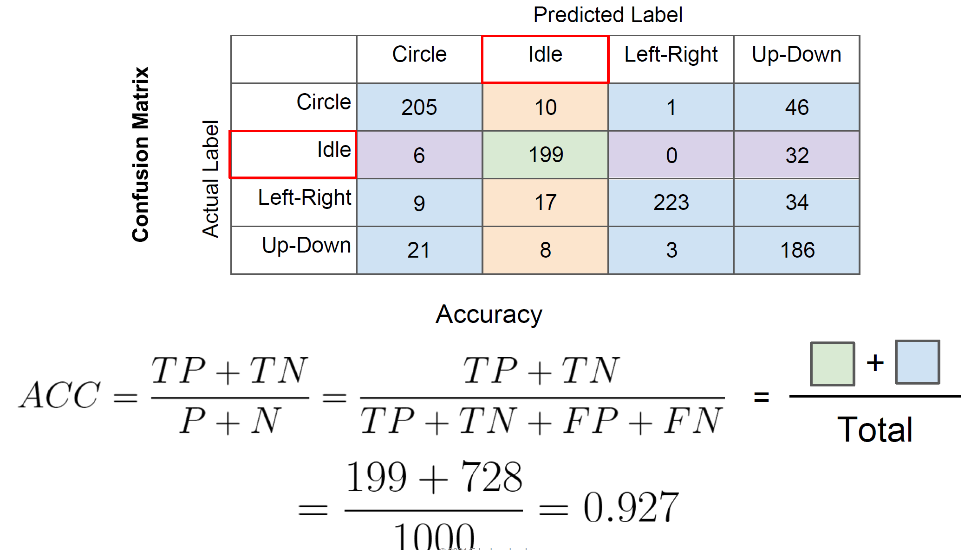
Accuracy for a single class

Slide 37
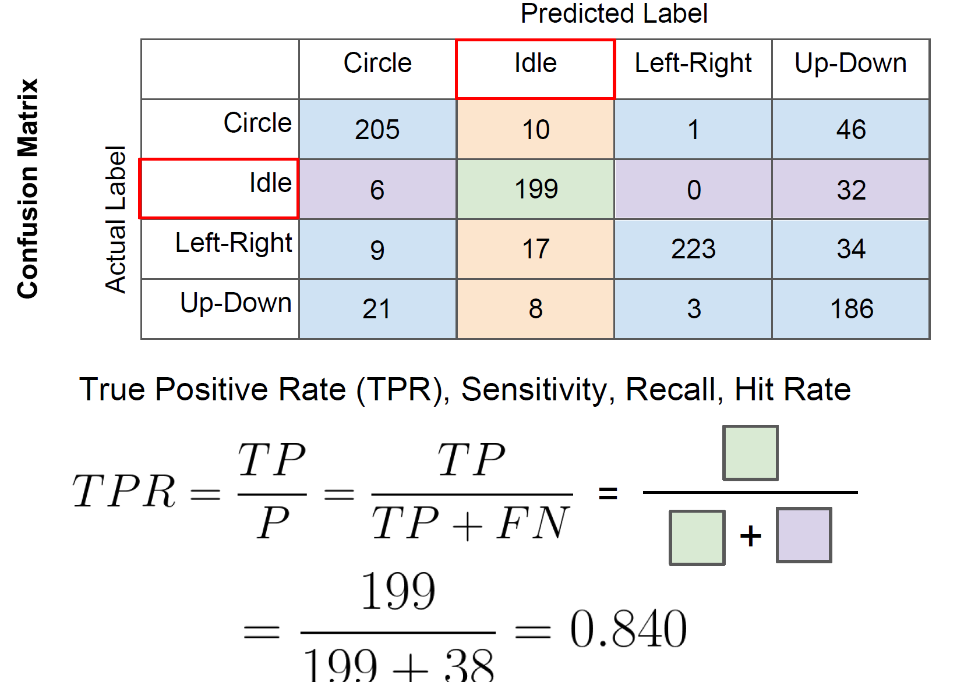
True Positive Rate, Sensitivity

Slide 38
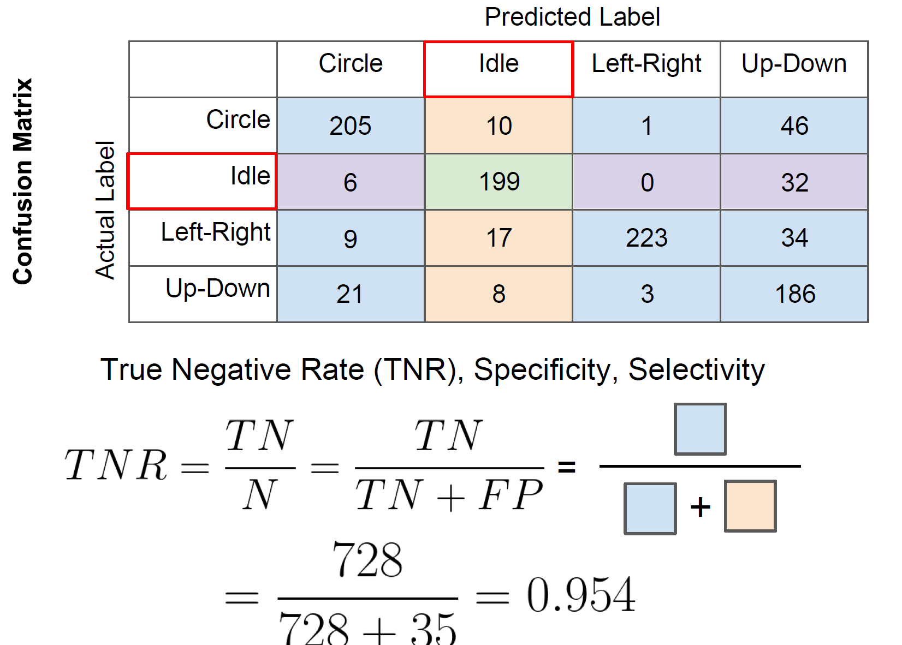
True Negative Rate, Selectivity

Slide 39
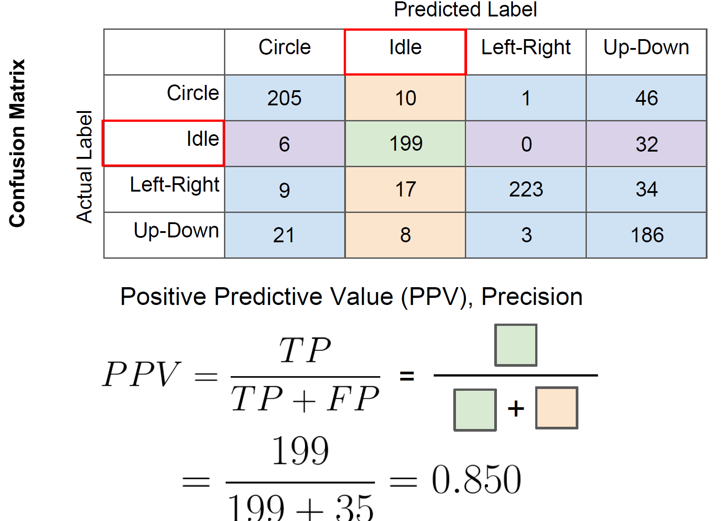
Precision (Positive Predictive Value)

Slide 40
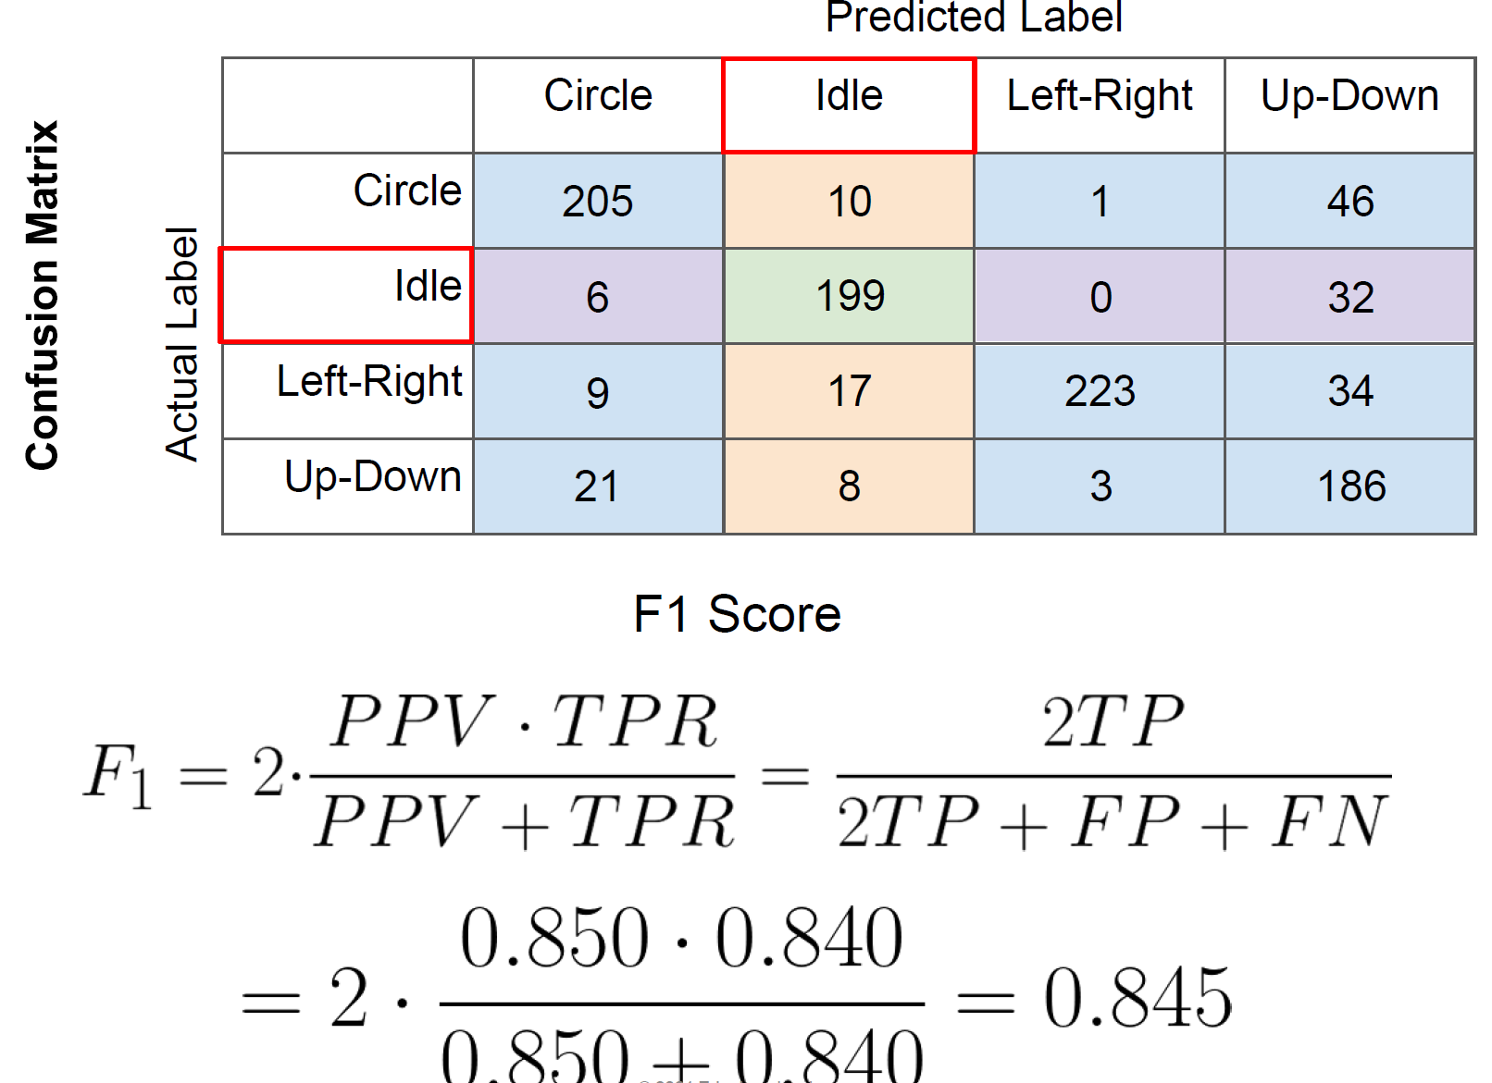
F1 score

Slide 41
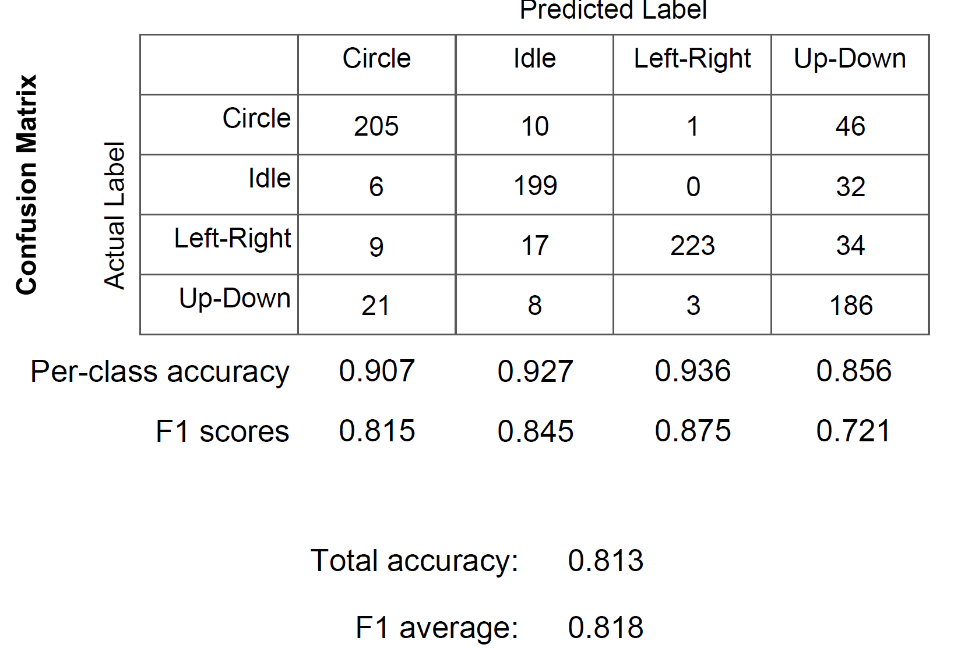
Classifier metrics

Slide 42
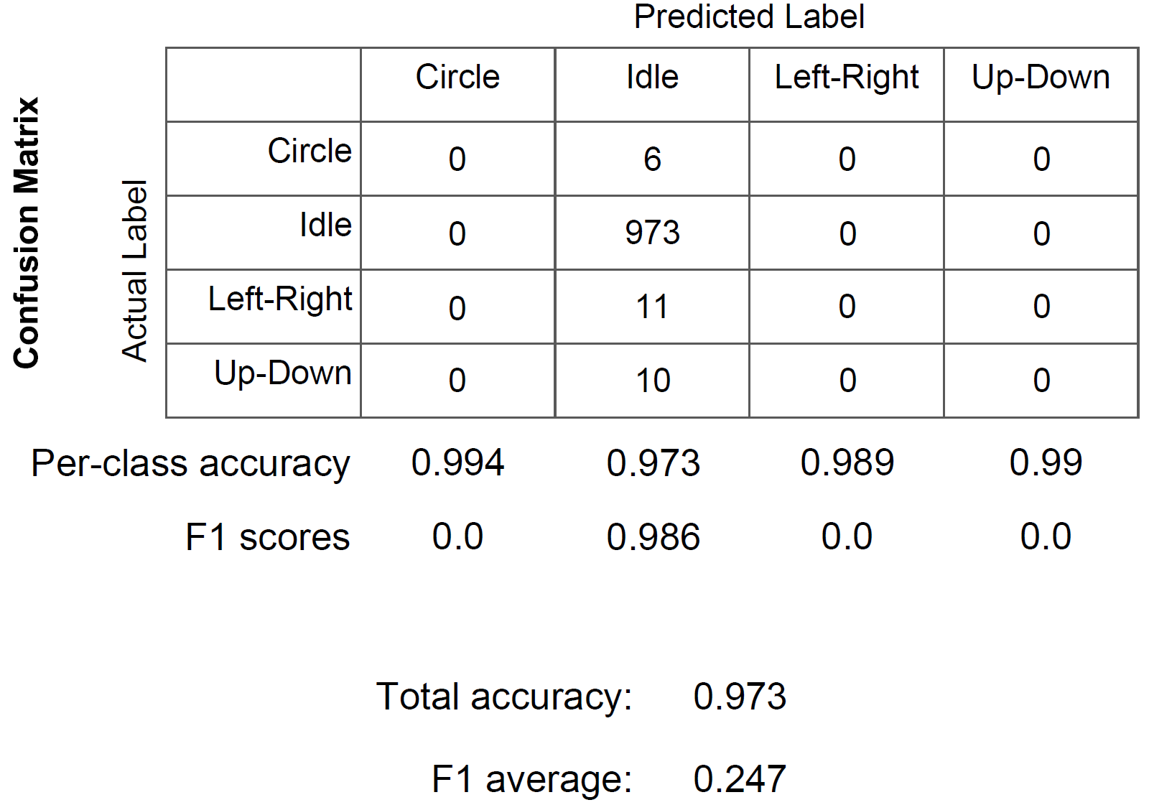
F1 score is indicative of dataset balance

Slide 43
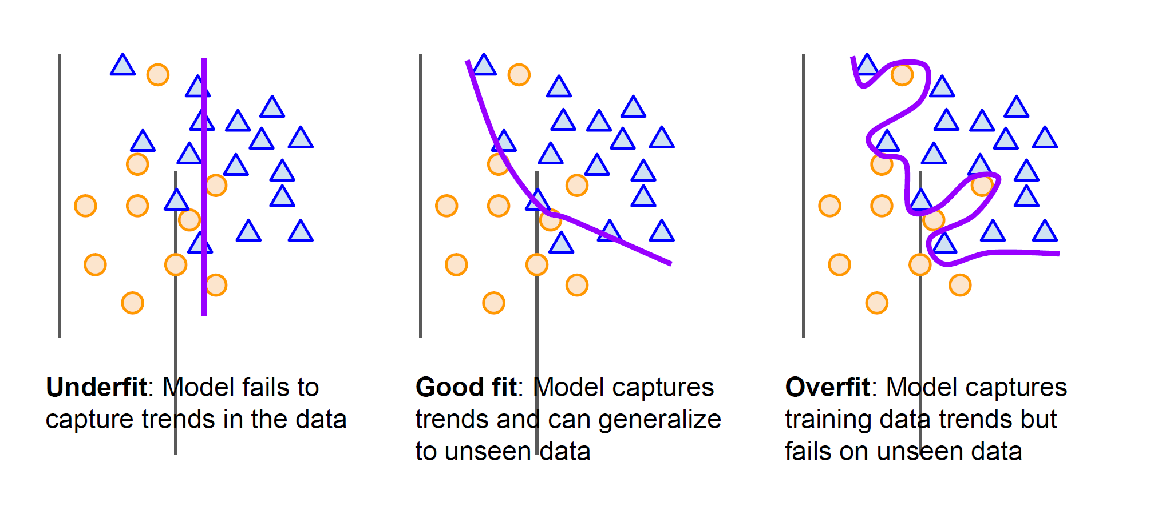
Model fit

Slide 44
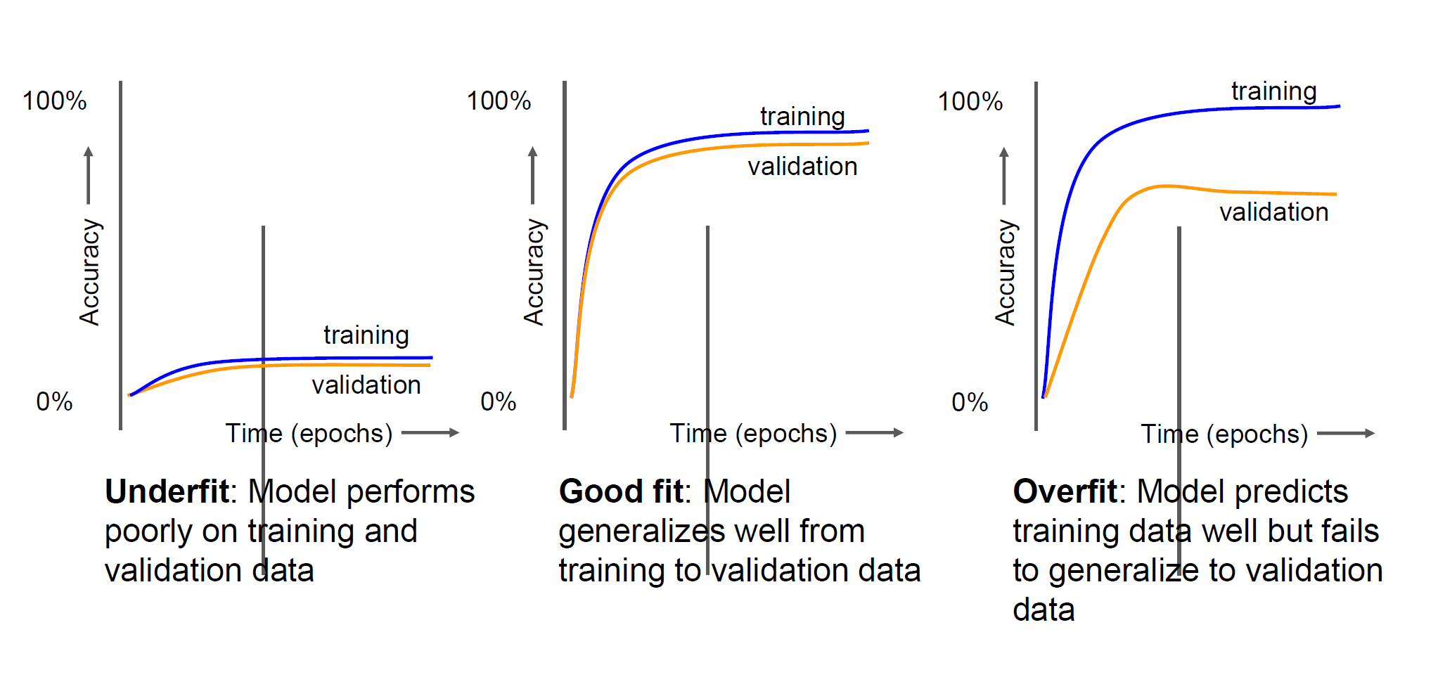
Accuracy vs epoch to understand dataset

Slide 45
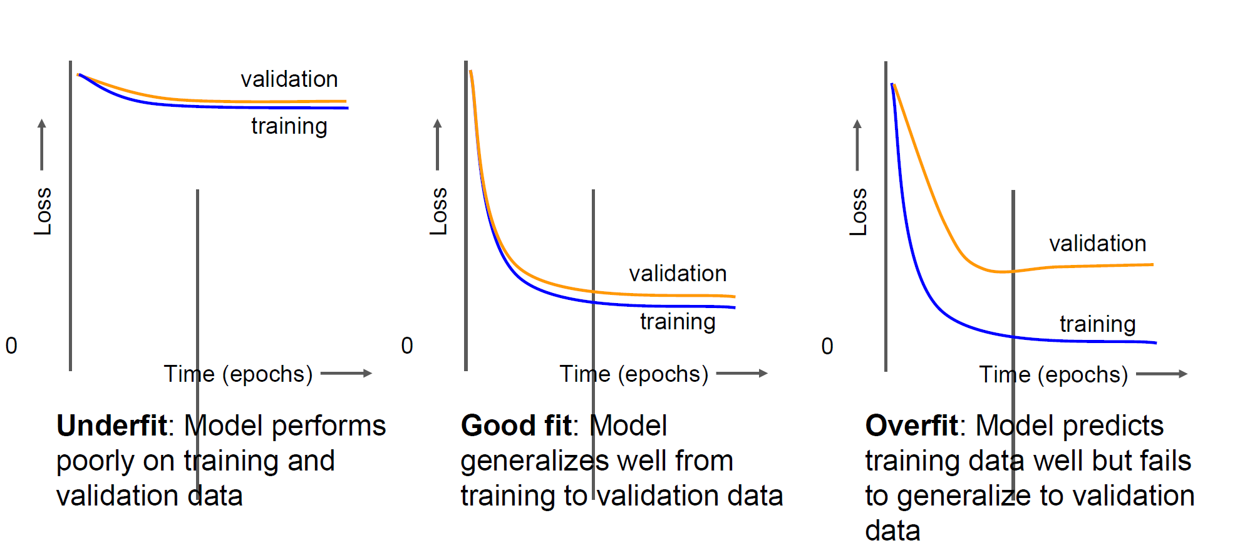
Loss vs epoch to understand dataset

Slide 46
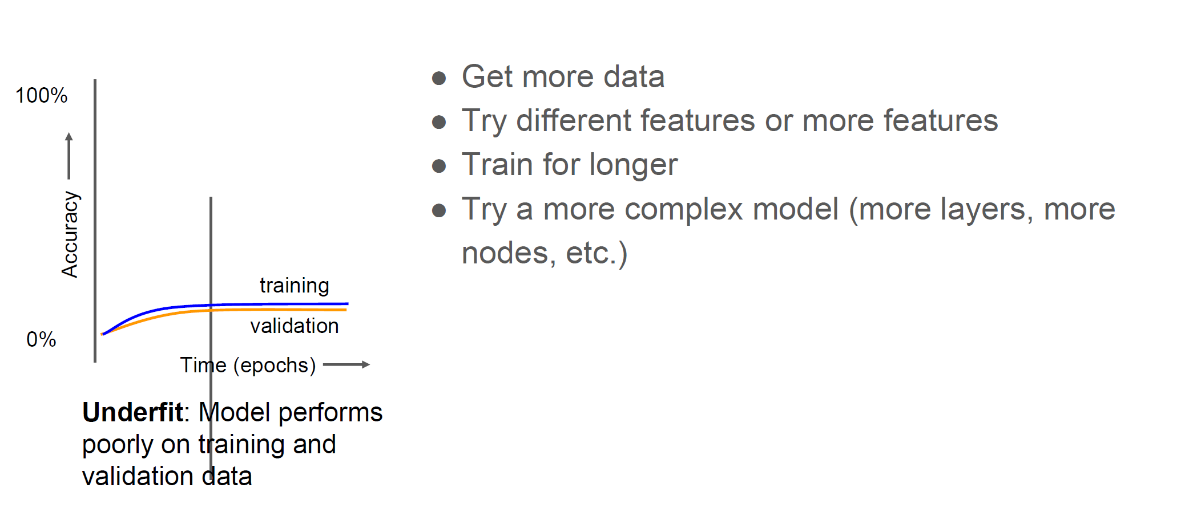
Fixing underfit

Slide 47
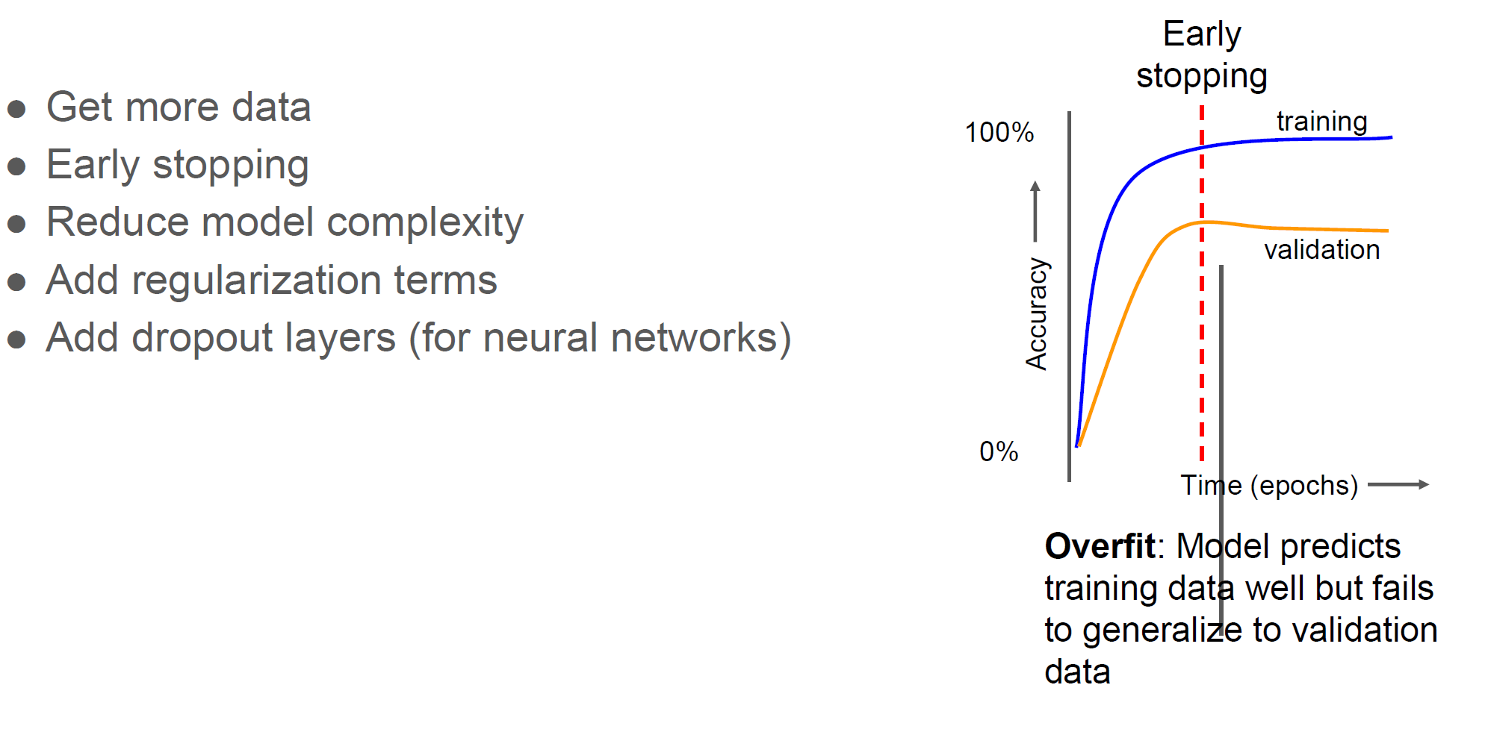
Fixing overfit

Slide 48
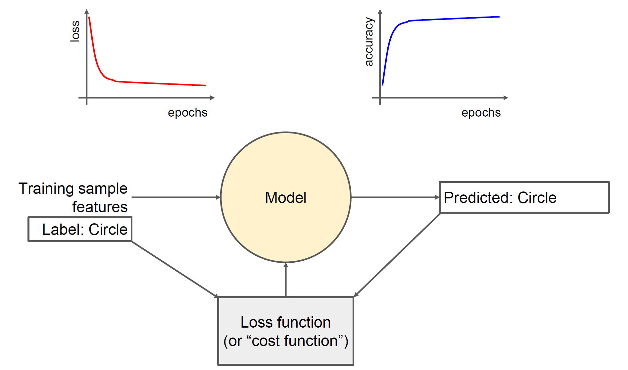
Model characterization in realtime

Slide 49

Output of the model

Slide 50

Action after classification

