Slide 1
EE-105 NN eval on MNIST
3/26/2025

Slide 2
Objective
Objectives:
Cloud based training
GPU acceleration
Data augmentation
Real time hand written digit classification

Slide 3
Files
NN training:
Colab notebook: https://colab.research.google.com/drive/1rN-xKptCIfcoZG2GLx4XZI0PTeYfAdEx?usp=sharing
NN Eval:
Arduino (Camera stream): tinyML_camera.ino
Notebook (Image classification): tinyML_camera_capture.ipynb

Slide 4
Checkpoint 1 – Cloud GPU training
Open Colab notebook
If prompted to create profile/account/sign in/etc, do it

Slide 5
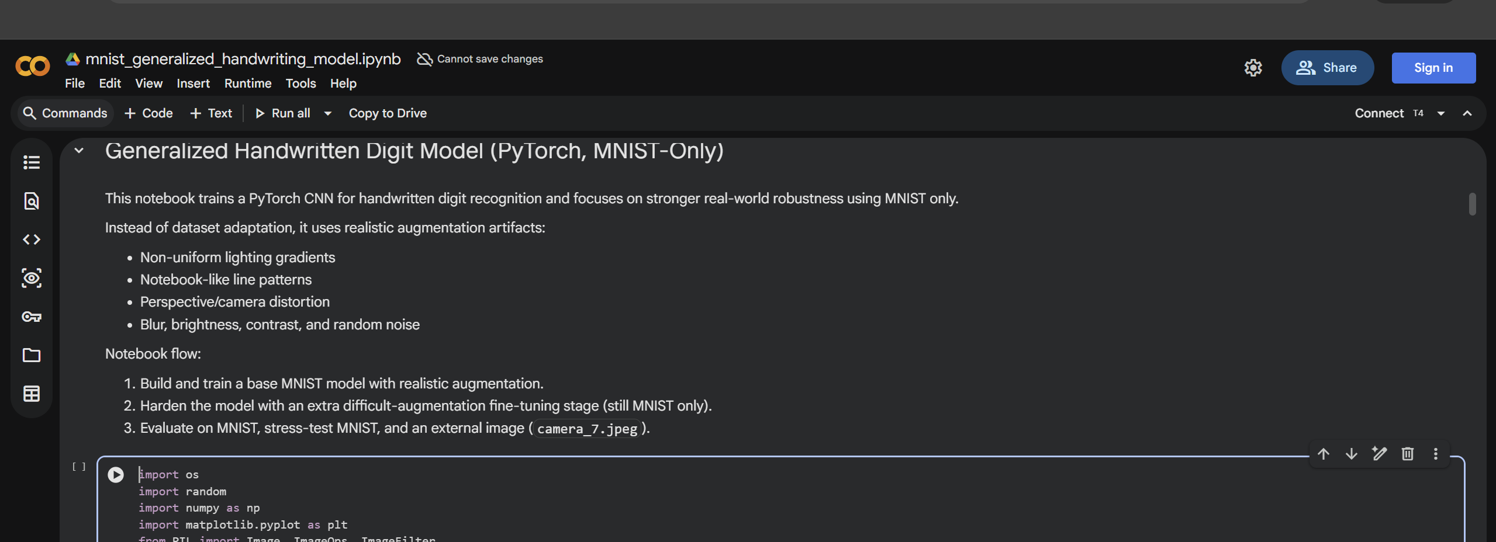
Checkpoint 1 – Cloud GPU training
Selecting GPU instance:
Click on the drop down
Select “T4 GPU”
Click save
Click connect

Slide 6
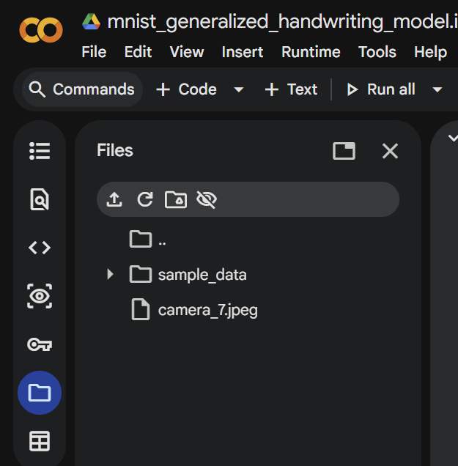
Checkpoint 1 – Cloud GPU training
Upload a custom handwritten digit photo
Drag and drop jpeg here
NOT INSDE “SAMPLE DATA”
Change the file name in:
“Add File name here”
Run all!
Once done: download “mnist_generalized_model.pth”

Slide 7
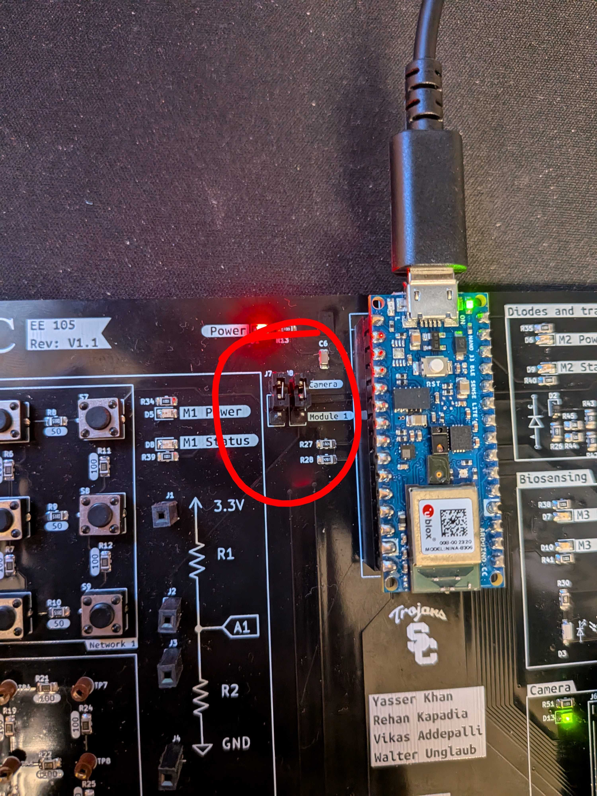
Checkpoint 2 – Arduino code
Change the jumper connection on the board
Connect the board, change the selector to the camera module
Open tinyML_camera.ino
Arduino/tinyML_camera
Locate and add "Arduino_OV767X.zip“
Arduino
Upload the sketch

Slide 8
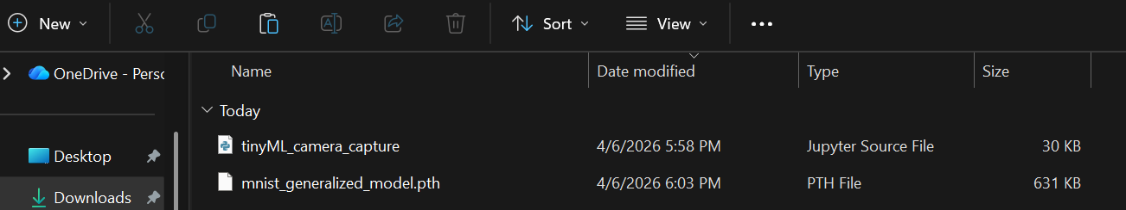
Checkpoint 3 – NN Eval
Open tinyML_camera_capture.ipynb
Inside “Python”
Move the downloaded checkpoint next to the notebook
Select kernel same as last lab’s
Run all!
Select the correct Port
Capture

