Slide 1
ECE 105: Introduction to Electrical Engineering
Lab 4.1
Neural network training on MNIST
Yasser Khan
Rehan Kapadia

Slide 2
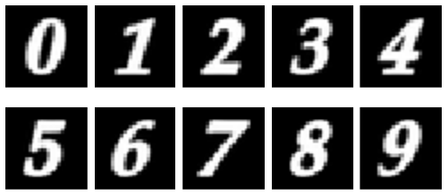
Objective
Build, train and test neural networks in PyTorch, one part at a time.
By the end of this lab you can:
Construct a simple artificial neuron and perceptrons in PyTorch
Train neural networks on the MNIST handwritten digits
Run inference on a custom image of your own digit
Read the training curves to tell underfitting from overfitting
MNIST digits: 28 × 28 gray pixels, white on black.
Notes:
This lab follows Chapter 4 in order: the neuron, perceptrons, MNIST data, training, testing on your own handwriting, and judging the fit. Students work in lab4.1-neural-networks.ipynb from the lab kit; the letters in the flow are the notebook's Parts A to I (Part J counts the cost of each network and saves the CNN for Lab 4.2; Part K is optional). No board today. All the training in the notebook takes 2 to 4 minutes on a laptop CPU. Students check the notebook's four checkpoints themselves. The last cell writes lab4.1_submission.json, which they upload on the course portal, ee105.org/portal, where it is graded automatically.

Slide 3
SETUP
No setup files to run: unzip the lab kit and open the notebook.
Windows and Mac
Unzip mod-4-nn-labs.zip
Open lab4.1-neural-networks.ipynb in Jupyter
Select EE105 as the kernel
Run the first cell: it installs torch (PyTorch)
No board today.
A
B, C
D
E
F
G, H
I
Setup
Neuron and perceptrons
Data in mini-batches
Train a network
Your own digit
Better architectures
Under- and overfitting
Notes:
Every student unzips ee105-labs.zip once and runs the setup file for their computer: setup-windows.bat (double-click; if Windows says it protected your PC, click More info, then Run anyway) or setup-mac.command (the first time, right-click it and choose Open). The first run installs Python, JupyterLab, PyTorch, the Arduino tools and the board package (15 to 30 minutes, about 5 GB) and opens JupyterLab; later runs only start JupyterLab. Nothing else to install: no Anaconda, no Colab, no Arduino IDE. In JupyterLab, open the folder lab4.1-neural-networks and its notebook; Part A prints [ok] PyTorch and the version. If it says PyTorch is not installed, run the setup file again (or the %pip line the cell prints), then Kernel, Restart. The MNIST digits come with the kit (data/mnist), so nothing is downloaded. This lab uses no board.

Slide 4
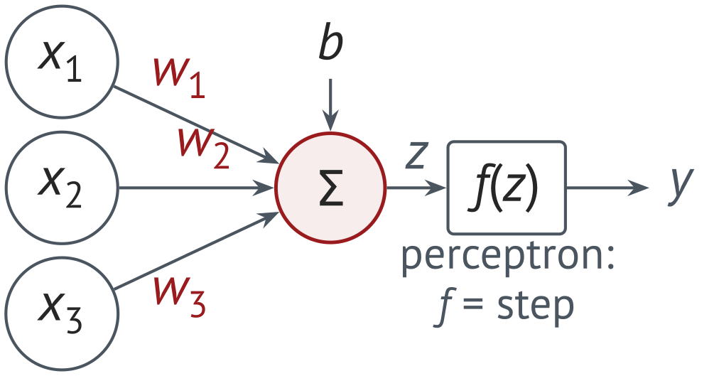
Parts B and C
A neuron multiplies, adds and applies an activation; a perceptron uses a step.
PARTS B, C
Goal: build one neuron in PyTorch and choose perceptron weights by hand.
Forward pass through one neuron: z, then step, ReLU, sigmoid, tanh
B1, B2: check z and σ(z) by hand
Understand perceptrons: the Coachella decision, then AND and OR
Perceptron challenge (C1): fix w and b in the NOR cells
x₁ | x₂ | AND | OR | NAND | NOR
0 | 0 | 0 | 0 | 1 | 1
0 | 1 | 0 | 1 | 1 | 0
1 | 0 | 0 | 1 | 1 | 0
1 | 1 | 1 | 1 | 0 | 0
Check (Checkpoint 1): your NAND and NOR tables both print “correct”, and the NOR table is right.
A
B, C
D
E
F
G, H
I
Setup
Neuron and perceptrons
Data in mini-batches
Train a network
Your own digit
Better architectures
Under- and overfitting
Notes:
The neuron is Eq. (4.4) of the book, y = f(w·x + b). The perceptron replaces f with a step: the notebook's gates use output 1 if w·x + b > 0. The NAND and NOR challenge cells (C1) are given with the AND parameters (w = [1, 1], b = -1) and print the AND table. One answer, checked in Python: NAND w = [-1, -1], b = 1.5; NOR w = [-1, -1], b = 0.5. The next cell feeds OR and the student's NAND into an AND to compute XOR. Students check Checkpoint 1 themselves; the submission file records their NAND and NOR outputs and their B2 values.

Slide 5
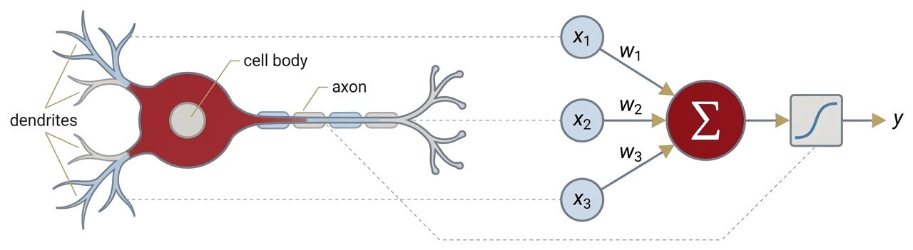
Fundamental Unit of a Neural Network
A neuron multiplies each input by a weight, adds a bias, and passes the sum through a function.
A biological neuron (left) and the artificial neuron it inspired (right): weighted inputs, a sum, an activation, one output.
Mathematical definition
x_{i}: the inputs; y: the output
w_{i}: the weights, also called synaptic weights
b: the bias, a constant added to the sum
f: the neuron function that maps inputs to output
Notes:
A biological neuron collects signals from other neurons through synapses of different strengths and fires when the combined input crosses a threshold. The artificial neuron keeps only the arithmetic: dendrites become weighted inputs, the cell body becomes a sum, and the axon becomes the output. The weights are sometimes called synaptic weights. The bias b shifts the sum; we come back to it with the perceptron.

Slide 6
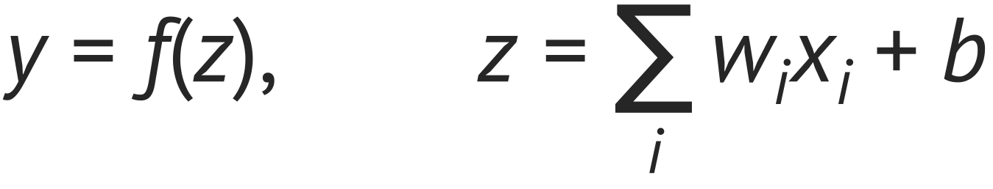
Part B: torch
nn.Module holds a model; nn.Parameter marks the values that training may change.
# Define the neuron class
class SimpleNeuron(nn.Module):
def __init__(self):
super(SimpleNeuron, self).__init__()
# Initialize weights and bias
self.weights = nn.Parameter(torch.randn(3)) # w1..w3
self.bias = nn.Parameter(torch.randn(1)) # b
def forward(self, x):
# Weighted sum of the inputs plus the bias
return torch.sum(x * self.weights) + self.bias
torch.manual_seed(105) # same weights for everyone
neuron = SimpleNeuron()
inputs = torch.tensor([1.0, 2.0, 3.0])
output = neuron(inputs) # raw output z
activated = nn.ReLU()(output) # also nn.Sigmoid, nn.Tanh
One neuron
CHECK BY HAND
Notebook prints w = (−0.2055, 0.0008, 1.0546), b = −0.2668; x = (1, 2, 3)
z = −0.2055 + 0.0016 + 3.1638 − 0.2668 = 2.693 (matches z)
ReLU: max(0, z) = 2.693; sigmoid 0.937; tanh 0.991
Notes:
SimpleNeuron inherits from torch.nn.Module, so PyTorch tracks its parameters. The notebook seeds the random generator with 105 before it makes the neuron, so every student gets the same weights and z = 2.693 (book, Lab 4.1 typical results); the check on the right uses those printed values. Have students check z by hand the same way (exercise B1), then compare step, ReLU, sigmoid and tanh on the same z. In B2 (HW 5, Problem 2) they compute the activations at z = 2.5: sigmoid 0.924, ReLU 2.5, tanh 0.987.

Slide 7
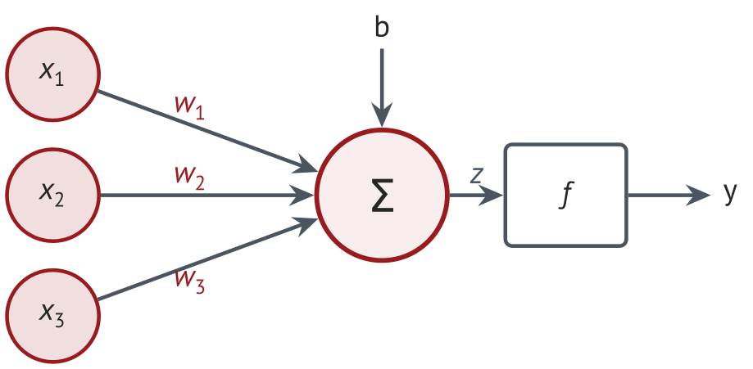
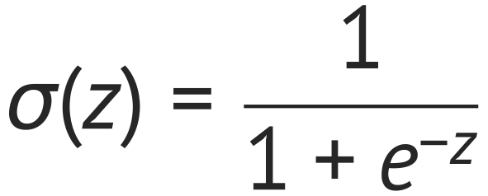
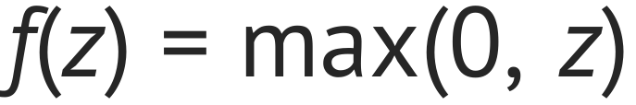
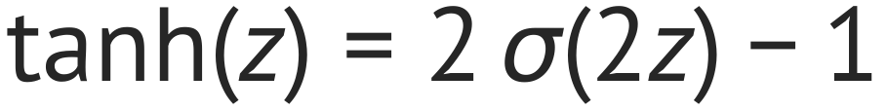
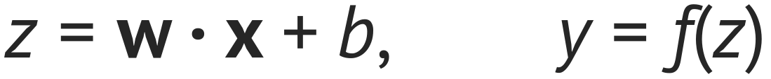
Fundamental Unit of a Neural Network
Many functions can serve as the neuron's f; the three most popular are sigmoid, ReLU and tanh.
Sigmoid
Rectified linear unit (ReLU)
Hyperbolic tangent
Pre-activation, then activation
Notes:
The weighted sum z = w1 x1 + w2 x2 + w3 x3 + b is called the pre-activation, and the function f is the activation function. The sigmoid runs from 0 to 1, tanh from -1 to 1, and ReLU passes positive values and blocks negative ones. tanh is a stretched and shifted sigmoid: tanh(z) = 2 sigma(2z) - 1. The next slide plots them.

Slide 8
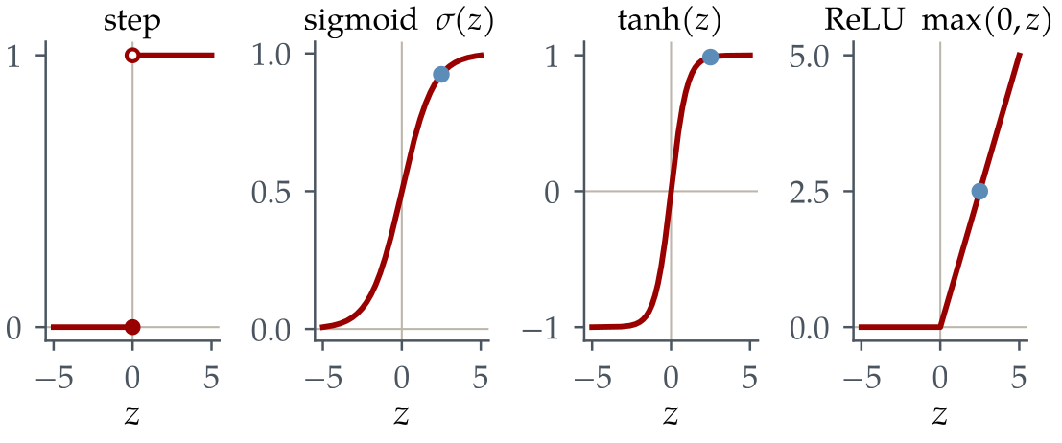
Activation functions of a Neural Network
Each activation squashes or clips the weighted sum z; its shape sets how well a network learns.
Blue dots: outputs at z = 2.5, where σ = 0.924, tanh = 0.987 and ReLU = 2.5.
Function | Range | Shape | Pros | Cons
Step | 0 or 1 | jumps from 0 to 1 at z = 0 | clean yes/no decision | zero slope: cannot learn by small steps
Sigmoid σ(z) | (0, 1) | S-curve, σ(0) = 0.5 | smooth; reads as a probability | saturates for large |z|; not zero-centered
tanh(z) | (−1, 1) | S-curve centered on 0 | zero-centered | still saturates for large |z|
ReLU max(0, z) | [0, ∞) | 0 for z < 0, z for z > 0 | cheapest; no saturation for z > 0 | “dead” neurons stuck at 0
Notes:
The step is the original perceptron: a clean yes or no, but its slope is zero everywhere, so a small weight change cannot nudge the output. The sigmoid is a smoothed step through 0.5 at z = 0; for |z| above about 5 it is flat (sigma'(5) = 0.0066) and learning slows. tanh has the same S shape but is centered on zero. ReLU costs one comparison and is the default for hidden layers in modern networks, including those of Lab 4.1. The blue dots are the outputs at z = 2.5 (HW 5, Problem 2): sigma = 0.924, tanh = 0.987, ReLU = 2.5.

Slide 9
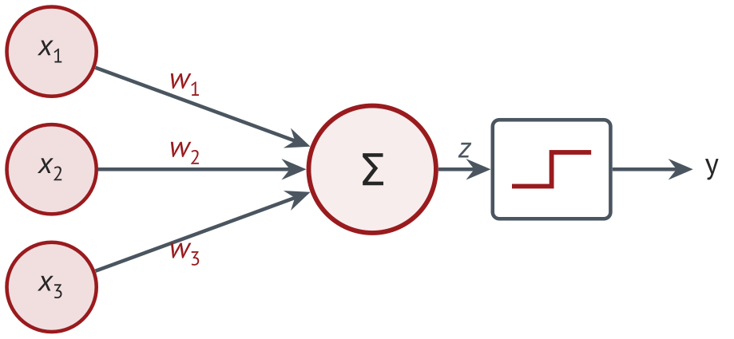
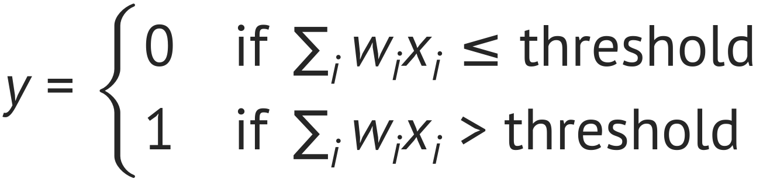
Perceptron
A perceptron uses a step: it outputs 1 only when the weighted sum is above a threshold.
Same unit as before, with a step function
Inputs x_{i} and output y are 0 or 1
The weights set how much each input counts
The threshold sets how much evidence is enough
Perceptron rule
Notes:
Rosenblatt's perceptron uses the simplest neuron function, a step. The inputs and output are binary. The weights say how much each input matters, and the threshold says how much total evidence is needed to answer yes. Next we use it to make a decision.

Slide 10
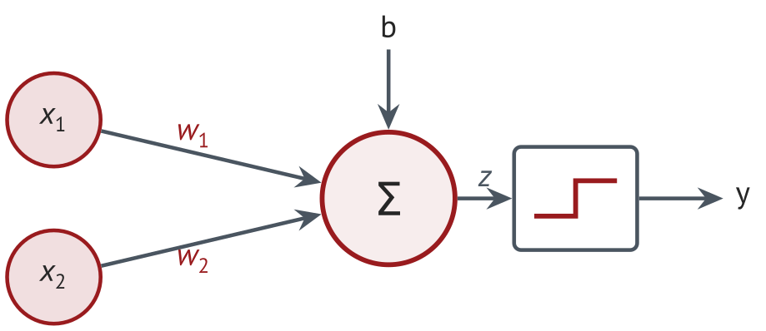
Perceptrons for logical functions?
A two-input perceptron can act as a logic gate: we only need the right weights and bias.
Target truth tables
x₁ | x₂ | AND | OR | NAND
0 | 0 | 0 | 0 | 1
0 | 1 | 0 | 1 | 1
1 | 0 | 0 | 1 | 1
1 | 1 | 1 | 1 | 0
How could we implement AND, OR and NAND?
Find w₁, w₂ and b for each gate
TRY IT
Start with AND: which inputs need z > 0?
Notes:
Ask the class to find w1, w2 and b for each gate before showing the next three slides. Inputs and output are 0 or 1, and the rule is y = 1 when w1 x1 + w2 x2 + b > 0. AND needs both inputs, OR needs at least one, NAND is NOT-AND.

Slide 11
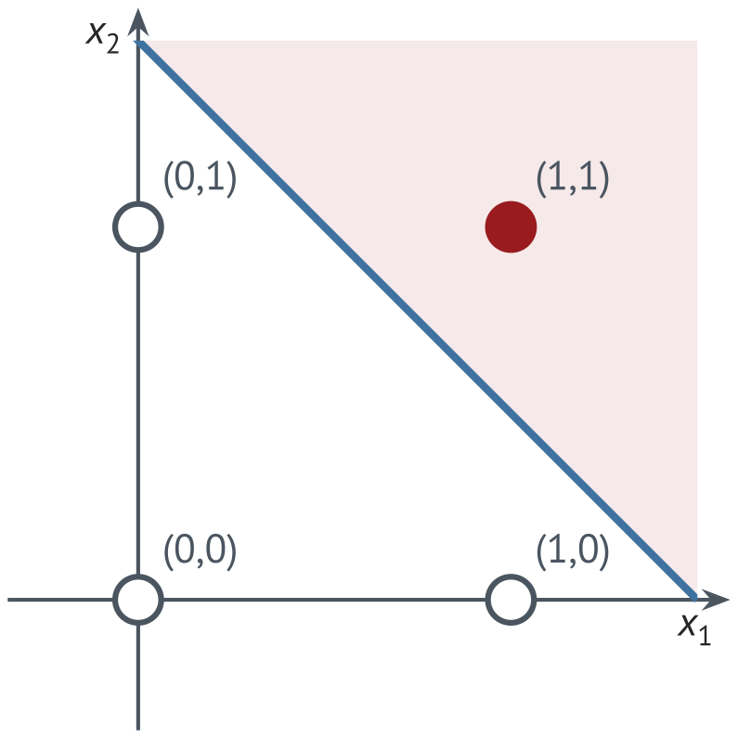
AND gate
With w = (1, 1) and b = −1.5, only (1, 1) lands on the positive side of the line.
AND gate: weights and bias
x₁ | x₂ | z = w₁x₁ + w₂x₂ + b | y
0 | 0 | 0 + 0 − 1.5 = −1.5 | 0
0 | 1 | 0 + 1 − 1.5 = −0.5 | 0
1 | 0 | 1 + 0 − 1.5 = −0.5 | 0
1 | 1 | 1 + 1 − 1.5 = 0.5 | 1
Decision boundary: x₁ + x₂ = 1.5. Any b with −2 < b ≤ −1 works; −1.5 is the middle.
Filled: y = 1. Shaded: w·x + b > 0. Line: w·x + b = 0.
Notes:
AND must give 1 only for (1,1): w1 + w2 + b > 0 while w1 + b, w2 + b and b are all <= 0. With w1 = w2 = 1 that means -2 < b <= -1; b = -1.5 sits in the middle of the range. The sums for (0,0), (0,1), (1,0), (1,1) are -1.5, -0.5, -0.5, 0.5. The line x1 + x2 = 1.5 is the decision boundary.

Slide 12
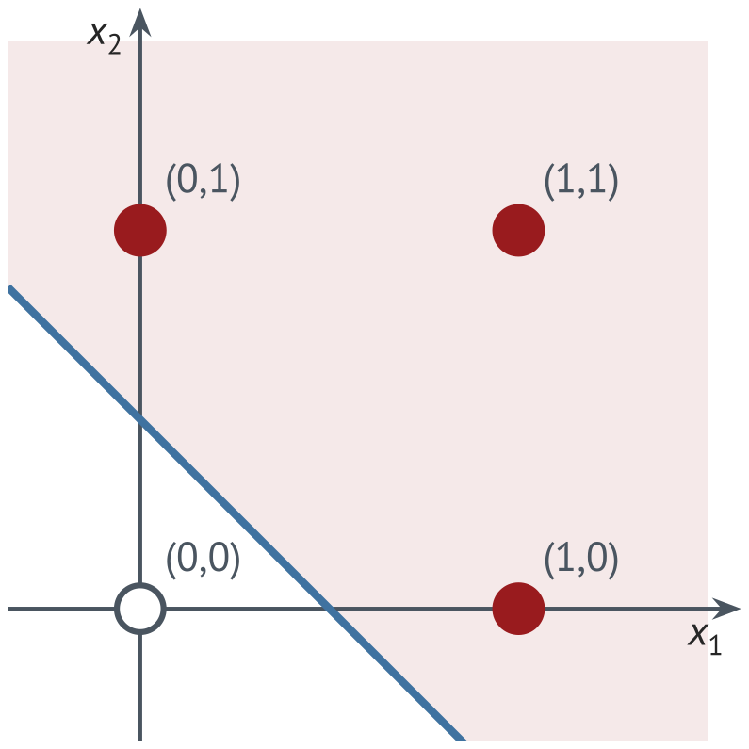
OR gate
Lower the bias to −0.5 and the line moves down: any input with a 1 now gives y = 1.
OR gate: weights and bias
x₁ | x₂ | z = w₁x₁ + w₂x₂ + b | y
0 | 0 | 0 + 0 − 0.5 = −0.5 | 0
0 | 1 | 0 + 1 − 0.5 = 0.5 | 1
1 | 0 | 1 + 0 − 0.5 = 0.5 | 1
1 | 1 | 1 + 1 − 0.5 = 1.5 | 1
Decision boundary: x₁ + x₂ = 0.5. Same weights as AND; only the bias moved.
Filled: y = 1. Shaded: w·x + b > 0. Line: w·x + b = 0.
Notes:
OR needs (0,0) to give 0 (b <= 0) and the other three to give 1 (1 + b > 0), so -1 < b <= 0 with w1 = w2 = 1; b = -0.5 is the middle. Sums: -0.5, 0.5, 0.5, 1.5. Only the bias changed from AND: the boundary slid from x1 + x2 = 1.5 to x1 + x2 = 0.5.

Slide 13
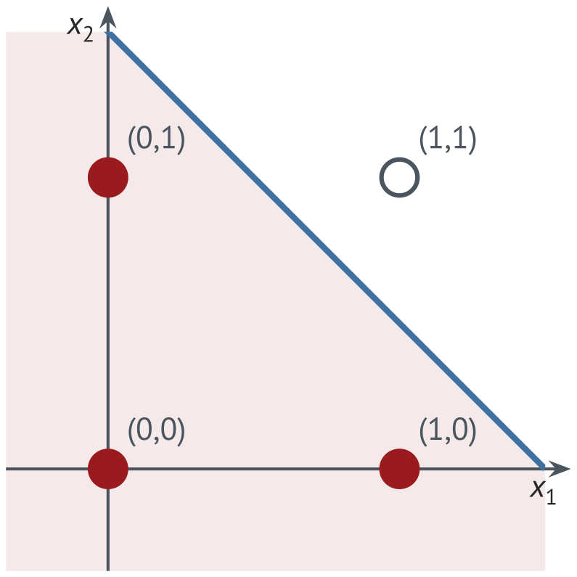
NAND gate
Flip the sign of every weight and of the bias of AND, and every output flips: NAND.
NAND gate: weights and bias
x₁ | x₂ | z = w₁x₁ + w₂x₂ + b | y
0 | 0 | 0 + 0 + 1.5 = 1.5 | 1
0 | 1 | 0 − 1 + 1.5 = 0.5 | 1
1 | 0 | −1 + 0 + 1.5 = 0.5 | 1
1 | 1 | −1 − 1 + 1.5 = −0.5 | 0
NOT of AND: 1 except at (1, 1). Same line x₁ + x₂ = 1.5, with the sides swapped.
Filled: y = 1. Shaded: w·x + b > 0. Line: w·x + b = 0.
Now a NOR gate: in the notebook's NOR cell, choose w₁, w₂ and b so the output is 1 only at (0, 0).
TRY IT
Notes:
Negating w and b moves each point to the other side of the same line, so the AND perceptron becomes NAND: 1 everywhere except at (1,1). Sums: 1.5, 0.5, 0.5, -0.5. Because NAND alone can build any logic function, a network of perceptrons can compute anything a digital circuit can. NOR follows the same way from OR: w1 = w2 = -1, b = 0.5.

Slide 14
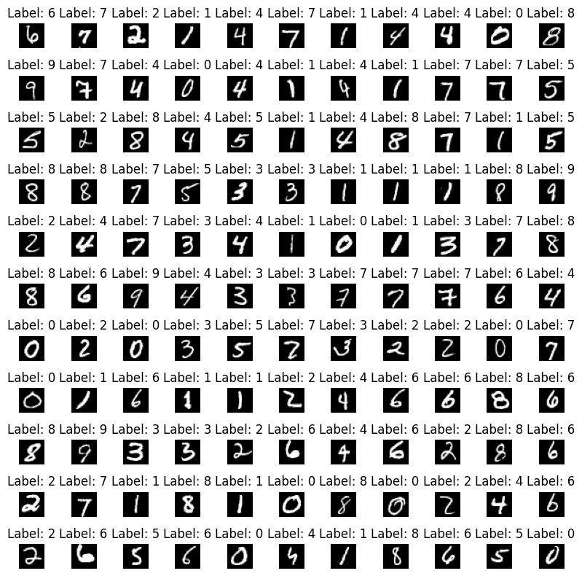
Part D
Mini-batch gradient descent: estimate the gradient from 128 images, update, repeat.
PART D
Goal: load MNIST in shuffled mini-batches and look at one batch.
Data loading: torchvision downloads MNIST, 60,000 training and 10,000 test images (fallback: MNIST_ORG.zip)
Each pixel is scaled to [0, 1], then (x − 0.5)/0.5 maps it to [−1, 1]
Display one shuffled mini-batch of 128 as an 11 × 11 grid
One mini-batch of 128 (the notebook shows 121 in an 11 × 11 grid)
Check: one batch has the shape [128, 1, 28, 28] (128 images, 1 channel, 28 × 28 pixels), and an epoch has 469 batches.
A
B, C
D
E
F
G, H
I
Setup
Neuron and perceptrons
Data in mini-batches
Train a network
Your own digit
Better architectures
Under- and overfitting
Notes:
A mini-batch is the set of images passed through the network in one step; the gradient is averaged over the batch and the weights update after every batch. With 128 images per batch, one epoch (one pass through all 60,000 training images) is 469 updates. Smaller batches use less memory and add useful randomness; larger batches give smoother gradient estimates. The digits come with the lab kit (folder data/mnist), so nothing is downloaded.

Slide 15
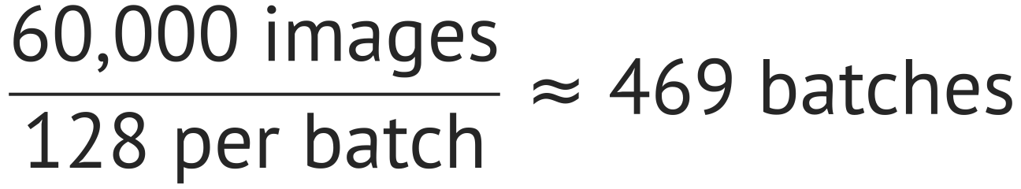
Part D: Data
torchvision downloads MNIST; Normalize maps the pixels to [−1, 1]; a DataLoader serves batches.
transform = transforms.Compose([transforms.ToTensor(),
transforms.Normalize((0.5,), (0.5,))]) # [0, 1] -> [-1, 1]
train_dataset = torchvision.datasets.MNIST('./data',
train=True, download=True, transform=transform)
test_dataset = torchvision.datasets.MNIST('./data',
train=False, download=True, transform=transform)
trainloader = DataLoader(train_dataset,
batch_size=128, shuffle=True)
60,000 training + 10,000 test images
Epoch: one pass through the training set
MNIST: LeCun et al. (1998), handwritten digits 0 to 9
torchvision.datasets.MNIST: downloads the digits to ./data (fallback: MNIST_ORG.zip)
torch.utils.data.DataLoader: used everywhere, gives shuffled batches of the training set
Notes:
MNIST (LeCun et al., 1998) has 60,000 training and 10,000 test images of handwritten digits, 28 × 28 pixels each. In the lab kit, ee105.datasets.load_mnist reads them from the folder data/mnist (no torchvision, no download). Dividing by 255 scales the pixels to [0, 1], and normalize, with mean 0.5 and standard deviation 0.5, maps them to [-1, 1]. Every image given to these networks later (the photos in Part F, the camera pictures in Lab 4.2) must get exactly the same scaling. The helper train() makes a shuffled DataLoader like this one for each run, and evaluate() tests all 10,000 test images after every epoch. An epoch is one full pass through the training set, 469 batches of 128.

Slide 16
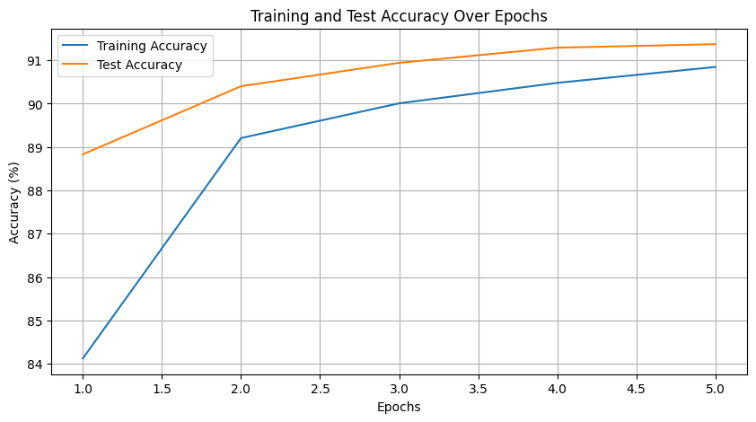
Part E
Define the network, pick a loss and an optimizer, then train and evaluate.
PART E
Goal: train a one-layer network on MNIST to about 91% test accuracy.
Define the neural network: SimpleNet, one nn.Linear(784, 10) layer
Loss function and optimizer: nn.CrossEntropyLoss and optim.SGD with lr = 0.02
Training and eval: 5 epochs with train().
One run: accuracy over 5 epochs
Check (Checkpoint 2): the one-layer network reaches about 91% on the test set.
A
B, C
D
E
F
G, H
I
Setup
Neuron and perceptrons
Data in mini-batches
Train a network
Your own digit
Better architectures
Under- and overfitting
Notes:
The one-layer network maps the 784 pixels straight to 10 class scores. In the book's run it reaches 91.4% test accuracy after 5 epochs; the seeds are fixed, but results vary by about a point between computers and library versions. Test accuracy above training accuracy in the first epochs is normal here: training accuracy is averaged over an epoch in which the weights were still improving. Each output neuron's 784 weights, drawn as a 28 × 28 image, look like a template of its digit (book, Example 'A neuron that looks for a pattern').

Slide 17
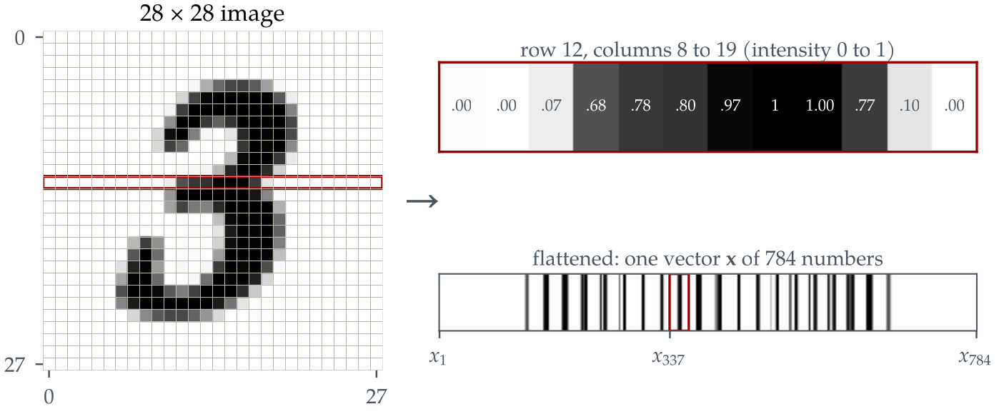
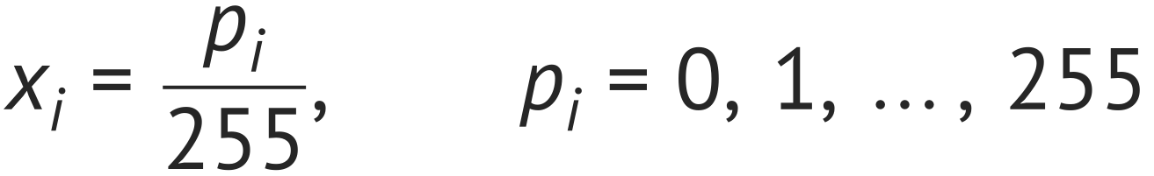
Operation of a neural network
An image is a grid of pixels; each pixel becomes one input, connected to every hidden neuron.
An image is made of a set number of pixels: 28 × 28 = 784
Each pixel becomes an input
8-bit greyscale: each pixel is 0 to 255, scaled to 0 to 1
Each input connects to all the neurons of the hidden layer
Adjusting the weights eventually lets the network recognize the digits
Row 12 of a 28 × 28 digit with its values; reading all 28 rows gives the input vector x of 784 numbers.
Pixel value to input
Source: becominghuman.ai
Notes:
A 28 x 28 image has 784 pixels. Reading the rows in order gives one long vector of 784 numbers; the network does not know the numbers came from a picture. An 8-bit greyscale pixel runs from 0 to 255 (the original slide said 0 to 256), and we divide by 255 so each input lies between 0 and 1. Every input connects to every neuron of the hidden layer, and adjusting those weights is what eventually lets the network recognize the digits.

Slide 18
Part E: NN setup
SimpleNet flattens each image to 784 numbers and maps them to 10 class scores.
class SimpleNet(nn.Module):
def __init__(self):
super(SimpleNet, self).__init__()
self.linear = nn.Linear(28 * 28, 10)
def forward(self, x):
x = x.view(-1, 28 * 28) # flatten to 784
return self.linear(x) # 10 scores
model = SimpleNet()
criterion = nn.CrossEntropyLoss()
optimizer = optim.SGD(model.parameters(), lr=0.02)
x.view(-1, 28 * 28): rows laid end to end
nn.Linear: both weights and biases included
nn.CrossEntropyLoss: used for multi-class classification
optim.SGD: stochastic gradient descent
Parameters in nn.Linear(784, 10)
A
B, C
D
E
F
G, H
I
Setup
Neuron and perceptrons
Data in mini-batches
Train a network
Your own digit
Better architectures
Under- and overfitting
Notes:
nn.Linear(784, 10) holds a 10 × 784 weight matrix and 10 biases: 7,850 parameters. x.view(-1, 28 * 28) flattens each 28 × 28 image into a 784-long row; the -1 keeps the batch size. nn.CrossEntropyLoss applies the softmax internally, so the model outputs raw scores (logits). optim.SGD is stochastic gradient descent with learning rate 0.02.

Slide 19
Part E: NN training
Every batch: clear the gradients, forward pass, loss, backward pass, update.
for epoch in range(epochs): # epochs = 5
model.train()
for images, labels in loader: # 469 batches
optimizer.zero_grad() # clear previous gradients
outputs = model(images) # forward pass
loss = criterion(outputs, labels) # compute the loss
loss.backward() # backward pass
optimizer.step() # update weights and biases
model.eval()
with torch.no_grad(): # testing: no gradients
outputs = model(X_test) # all 10,000 test images
_, predicted = torch.max(outputs, 1)
test_acc = (predicted == y_test).float().mean()
Epoch | Loss | Training | Test
1 | 0.613 | 84.1% | 88.8%
2 | 0.386 | 89.2% | 90.4%
3 | 0.352 | 90.0% | 90.9%
4 | 0.335 | 90.5% | 91.3%
5 | 0.324 | 90.8% | 91.4%
SimpleNet, SGD, lr = 0.02: one run. Results vary by about a point between runs.
Loss falls and accuracy levels off near 91%: one linear layer has reached its limit.
Notes:
optimizer.zero_grad() clears the gradients left from the previous batch, since PyTorch adds new gradients to old ones. loss.backward() runs backpropagation and optimizer.step() moves every weight a small step downhill. During testing, torch.no_grad() skips the gradient bookkeeping, and torch.max(outputs, 1) picks the class with the highest score. In the notebook this loop is the helper train(), and evaluate() does the testing in chunks of 2,000 images. The table is one run, the same as the plot on the Part E slide. The current notebook is seeded and also ends at 91.4% (as in the book), but the epoch values differ a little; results vary by about a point between runs.

Slide 20
Part F
A network only knows its training data; a photo of your handwriting looks different.
PART F
Distribution shift
Goal: classify a photo of your own handwritten digit with the trained SimpleNet.
MNIST training digit | Your phone photo
White digit on black | Dark ink on white paper
Thick, smooth strokes | Thin pen lines
Centered, fills the frame | Any size, any position
Even, clean background | Shadows and paper texture
Write a digit in thick dark ink, photograph it, crop it to the paper
Save it as a JPEG in the notebook's folder and put its file name in image_path
Run predict_image: grayscale, 28 × 28, normalize, invert, gamma, prediction
Try another digit: change the file name in image_path
Every row is a difference the network never saw in training.
Check: the notebook prints the predicted label; if it is wrong, explain why with the table.
A
B, C
D
E
F
G, H
I
Setup
Neuron and perceptrons
Data in mini-batches
Train a network
Your own digit
Better architectures
Under- and overfitting
Notes:
This mismatch between training images and real images is a distribution shift, and it is the main reason a 91% network can fail on your own handwriting. check_photos reduces it in four steps: load_gray opens the photo in grayscale and turns it upright; frame_digit cuts a square around the ink, 1.4 times the digit's size (MNIST digits fill a 20 × 20 box inside 28 × 28); to_digit resizes it to 28 × 28, inverts it to a white digit on black and stretches the contrast; normalize maps it to [-1, 1] exactly as in training. Students add each photo as one line, for example photos["my_digit_3.jpg"] = 3. Two sample photos of a 5 come with the lab. iPhones save HEIC, which Python cannot open here: Settings, Camera, Formats, Most Compatible.

Slide 21
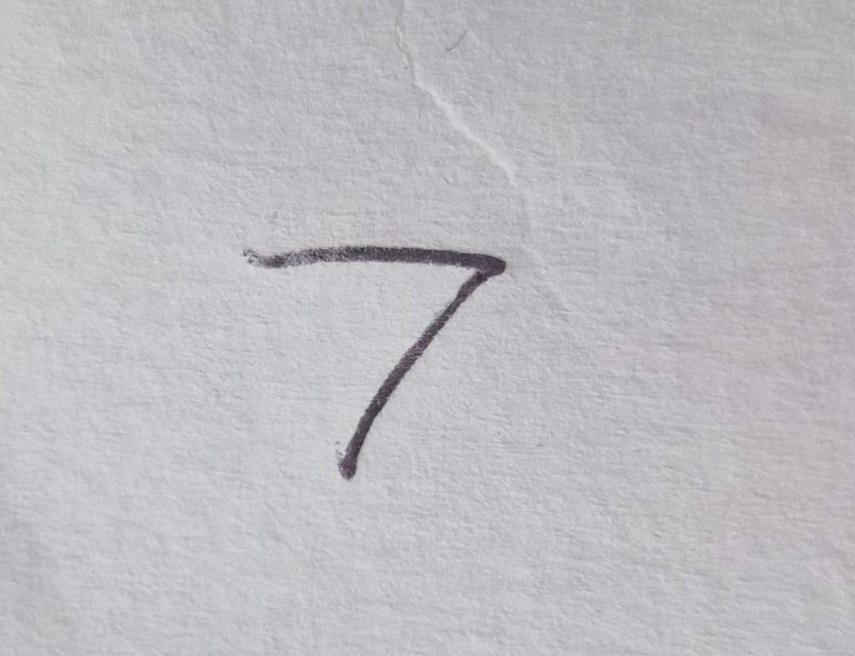

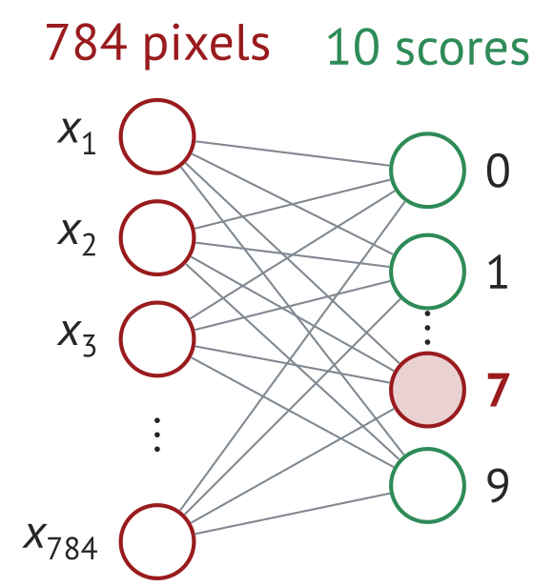
Part F: custom NN inference
Photo, then a 28 × 28 input, then the network: the highest of 10 scores is the answer.
7
Phone photo of a digit
28 × 28 input
SimpleNet, 784 to 10
Prediction
predict_image
Distribution shift
Grayscale, resize to 28 × 28, scale to [−1, 1], invert, gamma correction
The thin pen line breaks into a few pixels; MNIST strokes are thick and solid
Notes:
Walk through the chain: the phone photo is converted to grayscale, cut to a square around the ink, shrunk to 28 × 28, inverted so the digit is white on black like MNIST, contrast-stretched and normalized. The 28 × 28 picture here comes from the earlier version of the notebook (no framing, no contrast stretch): the thin pen stroke survives the shrink only as a few disconnected pixels, far from the thick MNIST strokes. The current notebook keeps a thin, faint but connected stroke, which is still a distribution shift. A thick marker and a digit that fills the frame give much better results.

Slide 22
Parts G and H
A hidden layer and a convolutional network beat the one-layer model; then tune them.
PARTS G, H
Experiment | Hidden units | Learning rate | Epochs | Test acc.
Baseline | 128 | 0.001 | 5 | 96.7%
Higher learning rate | 128 | 0.01 | 5 | 93.5%
More hidden units | 256 | 0.001 | 5 | 95.5%
More epochs | 128 | 0.001 | 10 | 96.1%
Goal: train deeper networks and find which parameter change helps most.
Train a 1-hidden-layer NN: SimpleNetWithHiddenLayer (784-128-10), SGD, 10 epochs
Train a CNN: SimpleCNN, Adam, 10 epochs
Eval both networks on your own digit with predict_image
Experiment with different parameters: hidden units, learning rate, epochs
Typical final test accuracy (Adam, all 60,000 training images). Yours will be within about a point.
Check (Checkpoint 3): at least one digit you wrote is predicted correctly, and you can say which parameter change helped most.
A
B, C
D
E
F
G, H
I
Setup
Neuron and perceptrons
Data in mini-batches
Train a network
Your own digit
Better architectures
Under- and overfitting
Notes:
The hidden-layer network trains with SGD, learning rate 0.02 and batches of 64; the CNN with Adam, learning rate 0.001. In a typical run the 784-128-10 network reaches about 96.2% after 10 epochs and the CNN about 98.5% after 2 epochs. In G1 students take the digit with the most mistakes (usually 2) and compute its sensitivity, precision and F1 from the confusion matrix. The four Part H experiments all use Adam, batches of 64 and only the first 20,000 training images (N_FAST) to stay quick. The higher learning rate (0.01) is the only change that hurts: its steps overshoot (book Figure 4.18). Ask which change helped most per extra computation. In H1 (HW 5, Problem 4) they sweep the hidden layer from 2 to 32 neurons: 8 is the smallest that reaches 85%.

Slide 23
Part G: Better architectures
Both models end in nn.Linear layers; the CNN first finds local features with 3 × 3 filters.
784-128-10: 101,770 parameters
SimpleCNN: 206,922 parameters
class SimpleNetWithHiddenLayer(nn.Module):
def __init__(self):
super(SimpleNetWithHiddenLayer,
self).__init__()
self.hidden = nn.Linear(28 * 28, 128)
self.relu = nn.ReLU()
self.output = nn.Linear(128, 10)
def forward(self, x):
x = x.view(-1, 28 * 28) # 784
x = self.relu(self.hidden(x))
x = self.output(x) # 10
return x
class SimpleCNN(nn.Module):
def __init__(self):
super(SimpleCNN, self).__init__()
self.conv1 = nn.Conv2d(1, 16, 3, padding=1)
self.conv2 = nn.Conv2d(16, 32, 3, padding=1)
self.pool = nn.MaxPool2d(2, 2)
self.relu = nn.ReLU()
self.fc1 = nn.Linear(32 * 7 * 7, 128)
self.fc2 = nn.Linear(128, 10)
def forward(self, x): # 1x28x28
x = self.pool(self.relu(self.conv1(x))) # 16x14x14
x = self.pool(self.relu(self.conv2(x))) # 32x7x7
x = x.view(-1, 32 * 7 * 7) # 1568
x = self.relu(self.fc1(x))
return self.fc2(x)
Typical: hidden layer 96.1% after 10 epochs (SGD); CNN 96.9% after 10 epochs (Adam). SimpleNet: 91.4%.
Notes:
The hidden layer adds a nonlinearity (ReLU) between two nn.Linear layers. The CNN applies 16, then 32, 3 × 3 filters; padding 1 keeps the image size and each 2 × 2 max pooling halves it, so 28 × 28 becomes 14 × 14 and then 7 × 7, and the flattened feature map has 32 × 7 × 7 = 1,568 values. The listings are condensed: in the notebook the hidden-layer network is built as MLP([784, 128, 10]) and the CNN is SmallCNN, with the same layers. Part J saves the CNN as data/models/mnist_cnn.pt, and Lab 4.2 defines the same class to load it.

Slide 24
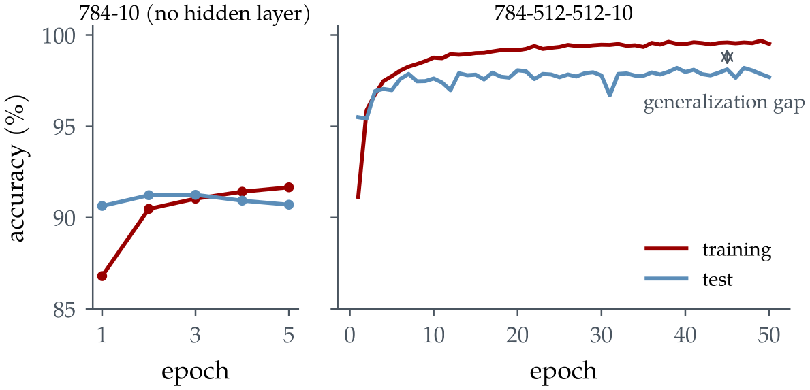
Part I
Underfit: both accuracies low. Overfit: training keeps rising while test stalls.
PART I
Goal: see underfitting and overfitting in the training and test curves.
Underfitting: a “simpler” model, fewer epochs (784-10, 5 epochs)
Overfitting: a “more complicated” model, 20 epochs on all 60,000 images (784-512-512-10, Adam)
Plot accuracy for both; find the best epoch (I1)
Notebook run, all 60,000 images. Left: both near 91%. Right: training above 99%, test near 98%.
Check (Checkpoint 4): both plots and an early-stopping epoch. Then submit your work through the task tracker.
A
B, C
D
E
F
G, H
I
Setup
Neuron and perceptrons
Data in mini-batches
Train a network
Your own digit
Better architectures
Under- and overfitting
Notes:
The 784-10 network stops near 91% on both sets: it is too simple. The figure is the book's run on all 60,000 images for 50 epochs: the 784-512-512-10 network (669,706 parameters) reaches 99.6% on the training set but stays near 98% on the test set. In the lab the same network trains for 30 epochs on only 5,000 images, so the gap opens sooner and wider: training 100%, test about 94.6%, lowest test cost near epoch 13 to 15 (I1). Fixes: for underfitting use a bigger model or train longer; for overfitting stop early, use more data, a smaller model, or dropout. Part J then counts parameters and MACs and saves the CNN as data/models/mnist_cnn.pt for Lab 4.2; Part K (reading a written number) is optional. The last cell writes lab4.1_submission.json, which students upload on the course portal, ee105.org/portal; it is graded automatically.

