Slide 1
ECE 105: Introduction to Electrical Engineering
Lecture 9
Sensors 1
Yasser Khan
Rehan Kapadia

Slide 2

What is a sensor?

Slide 3
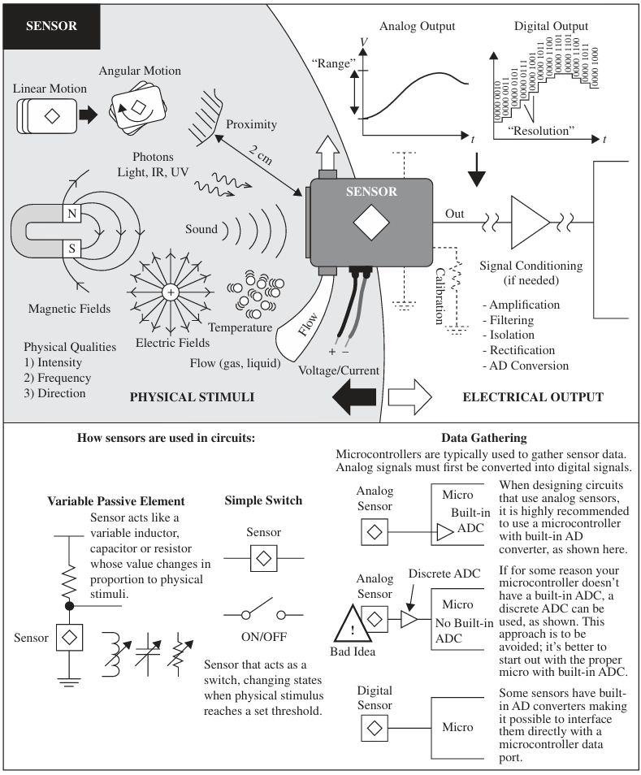









What is a sensor?

Slide 4






Sensors in circuits:

Slide 5
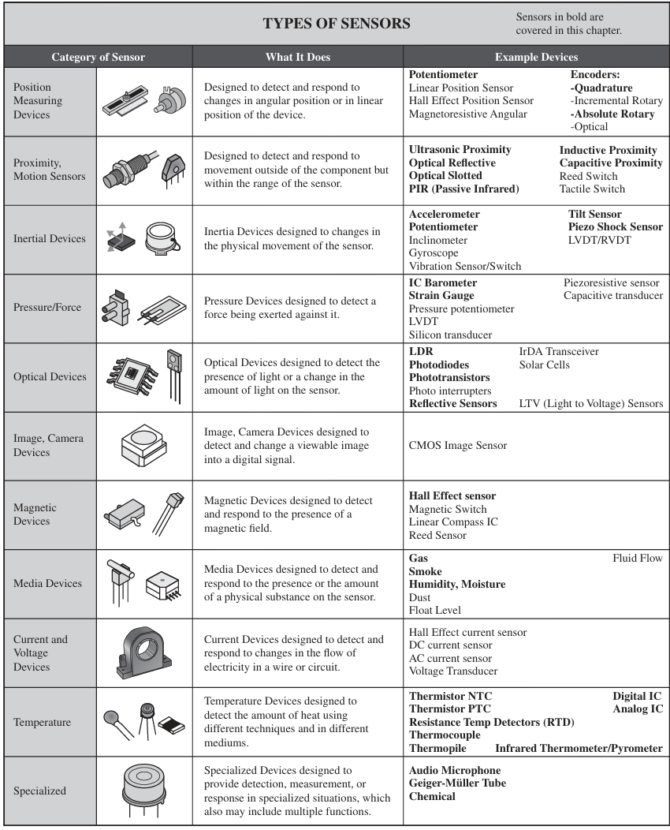
Types of sensors

Slide 6
Types of sensors

Slide 7
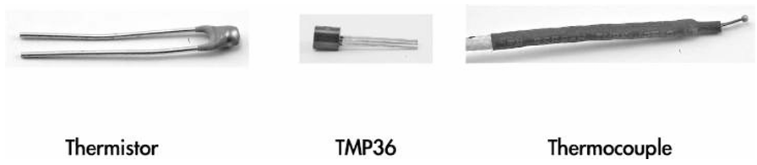

Temperature sensor
Notes:
TMP transistor based
A thermocouple is a device for measuring temperature. It comprises two dissimilar metallic wires joined together to form a junction. When the junction is heated or cooled, a small voltage is generated in the electrical circuit of the thermocouple which can be measured, and this corresponds to temperature.

Slide 8
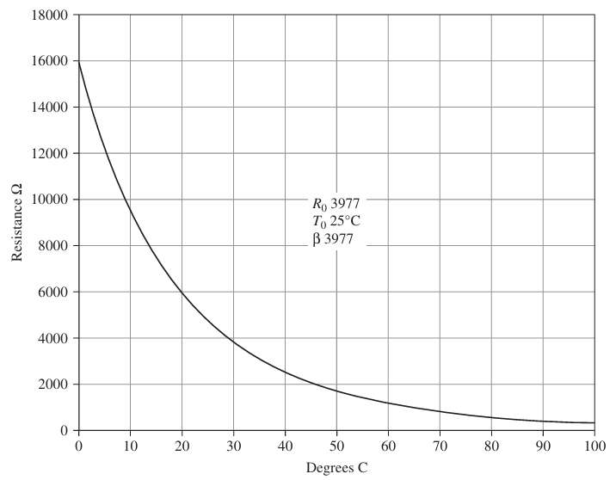
Sensor calibration

Slide 9
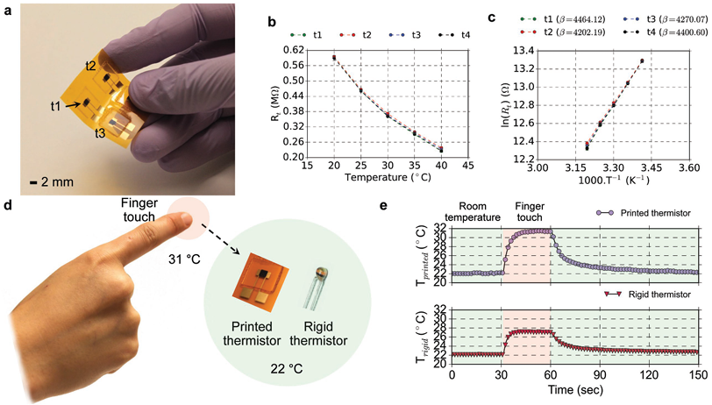





Sensor calibration

Slide 10
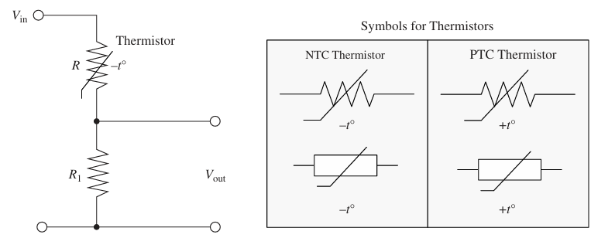
Using sensors in circuits

Slide 11
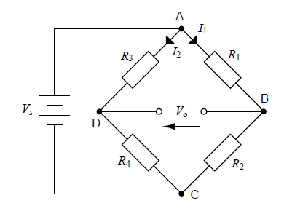
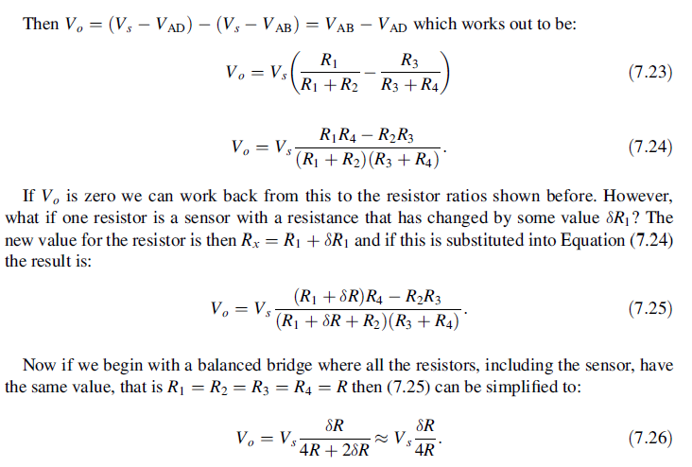
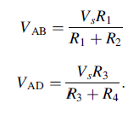




Wheatstone bridge

Slide 12
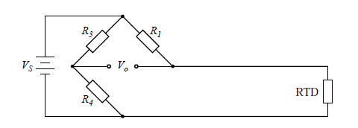
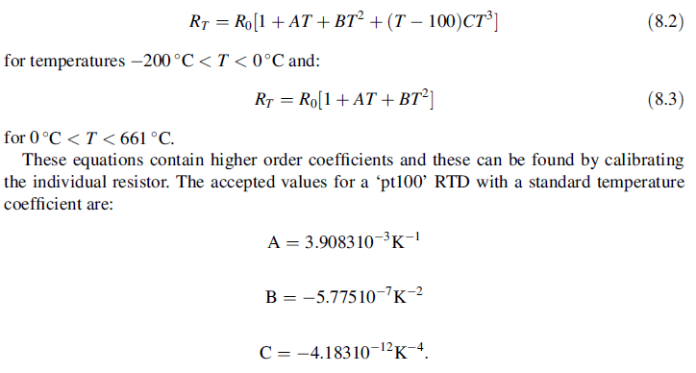


Precise thermistor measurement steps

Slide 13
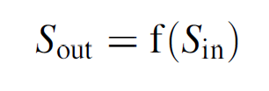
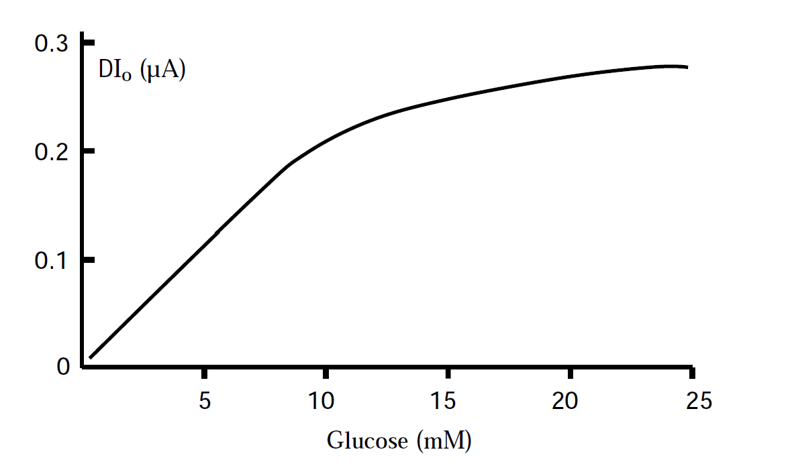


Sensitivity

Slide 14
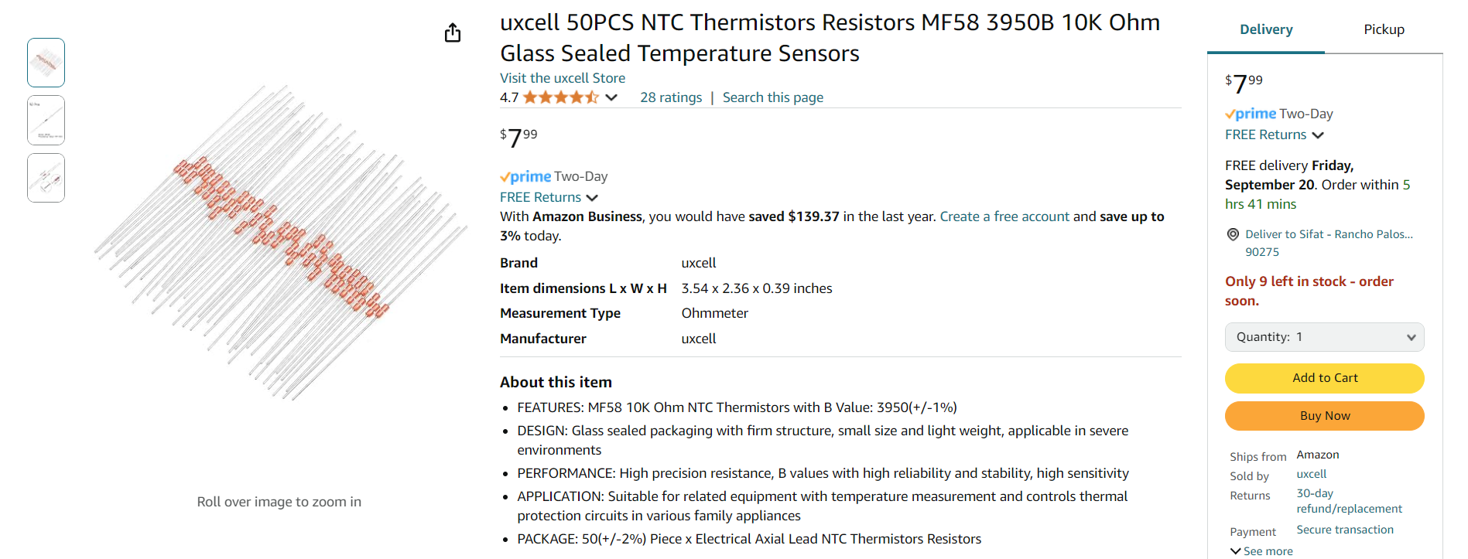
Let’s build our temperature sensor circuit

Slide 15
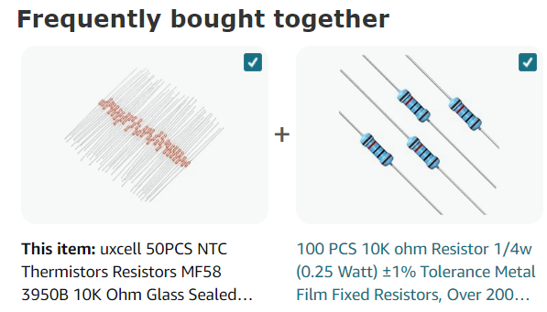
What else is needed to create this circuit?

Slide 16
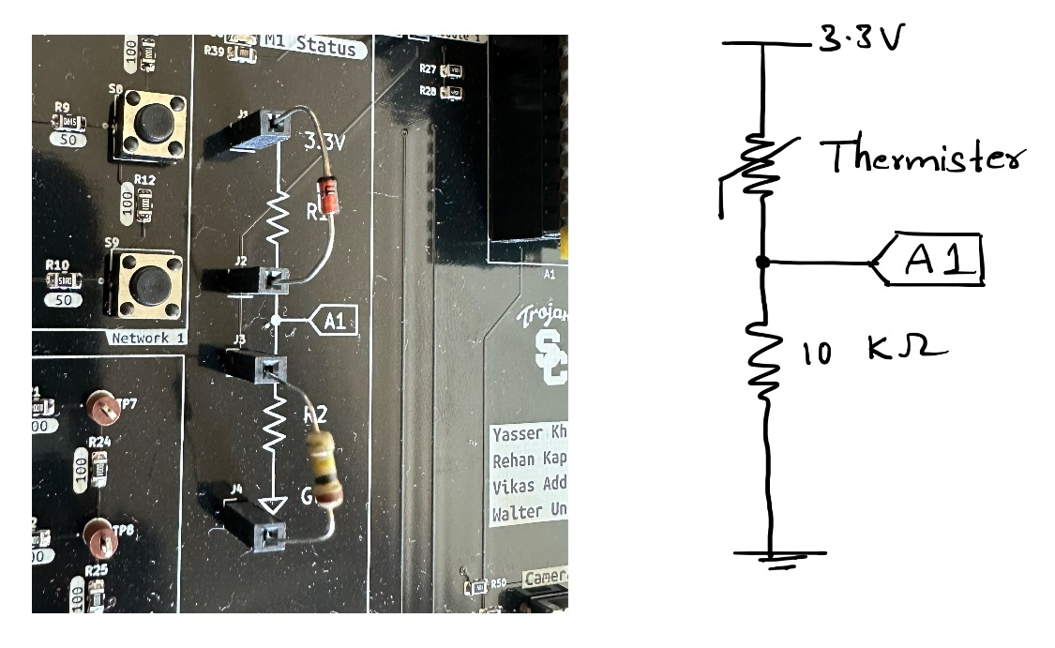
Demo board setup

Slide 17
Sensor circuit

Slide 18
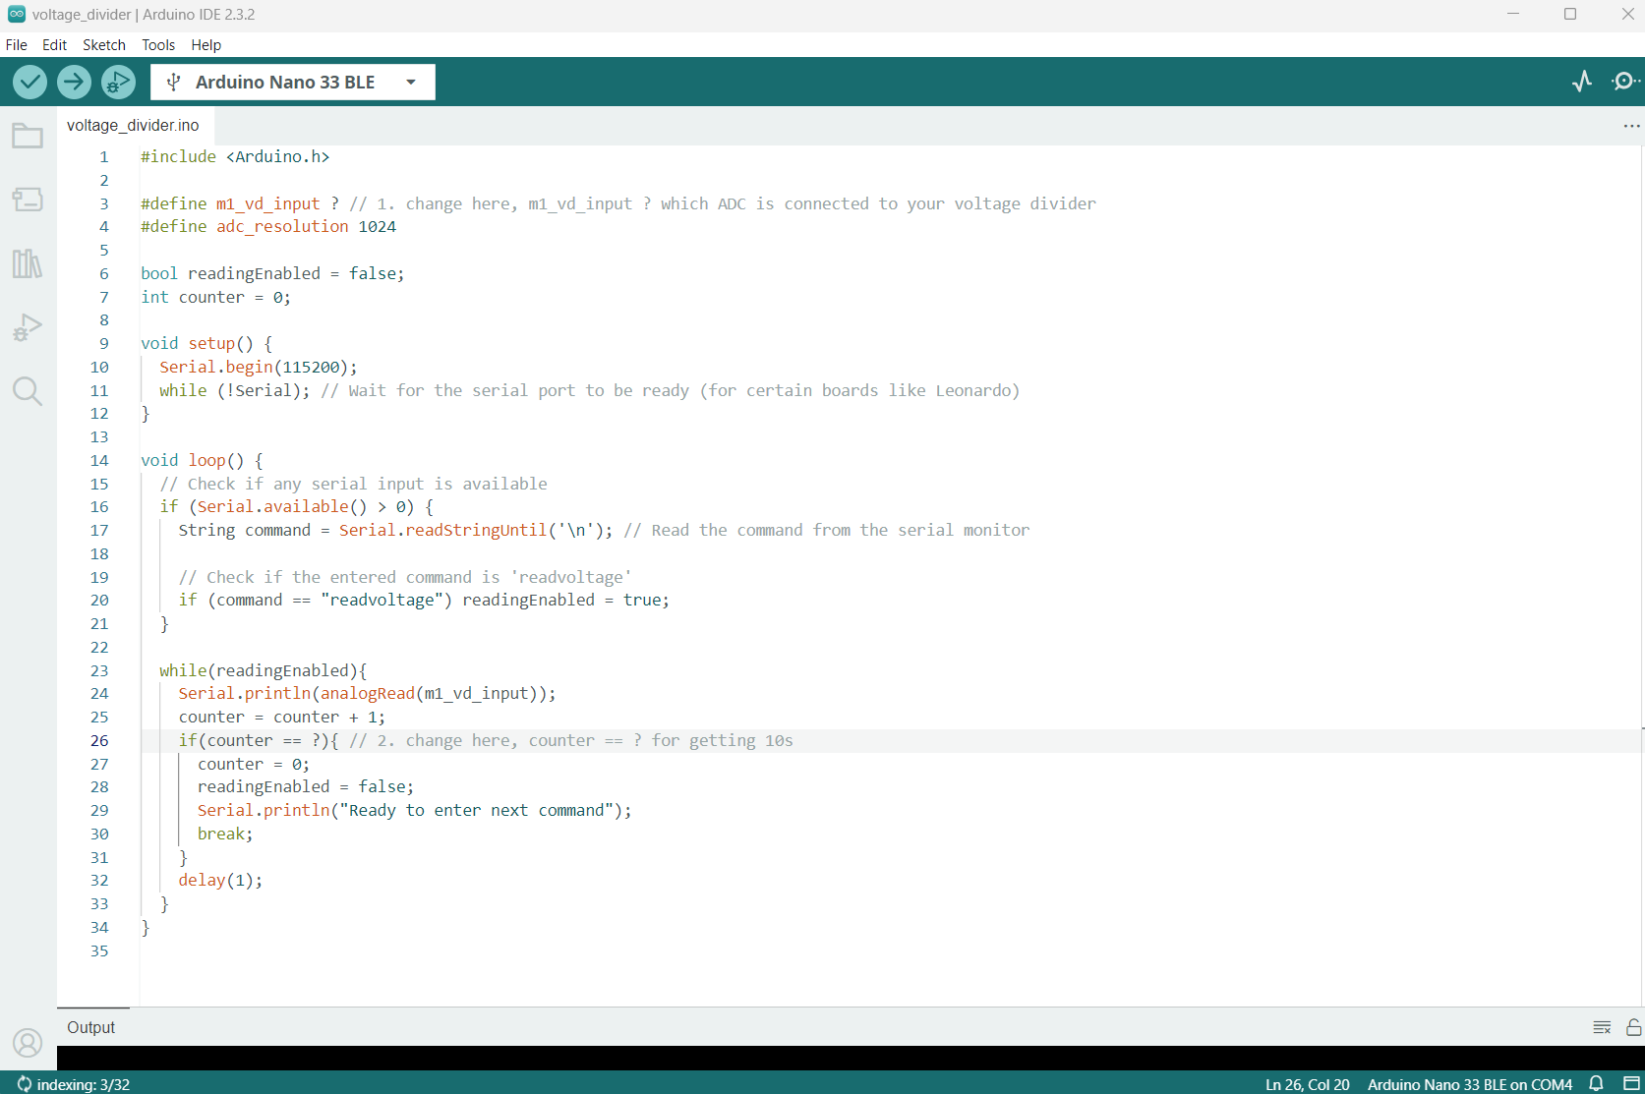






Arduino sketch

Slide 19
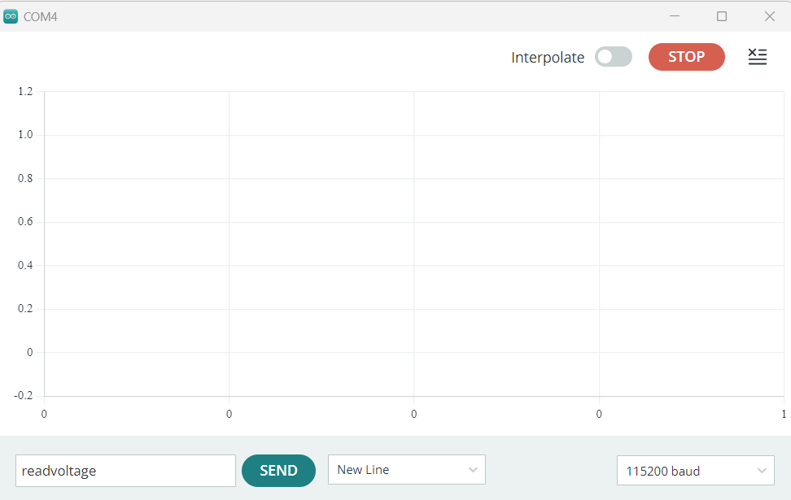
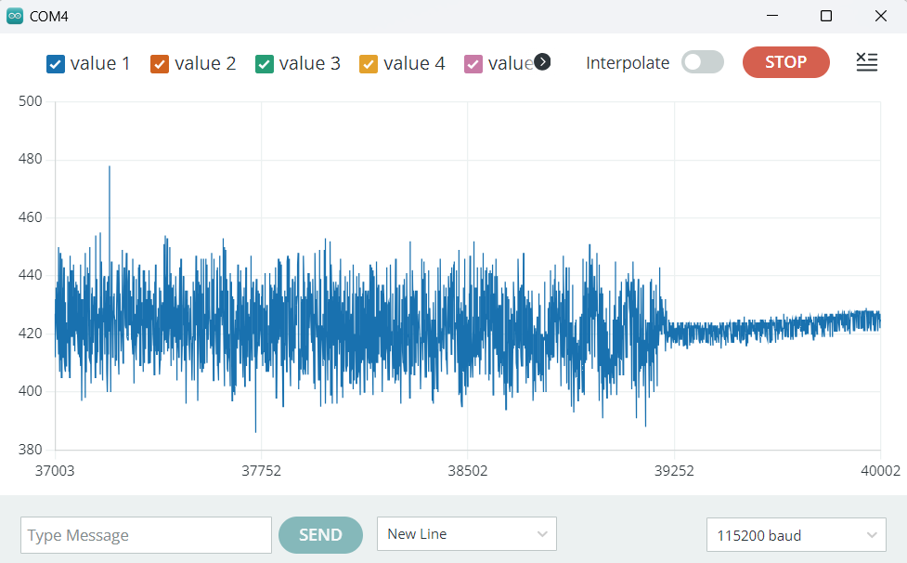
Serial plotter

Slide 20
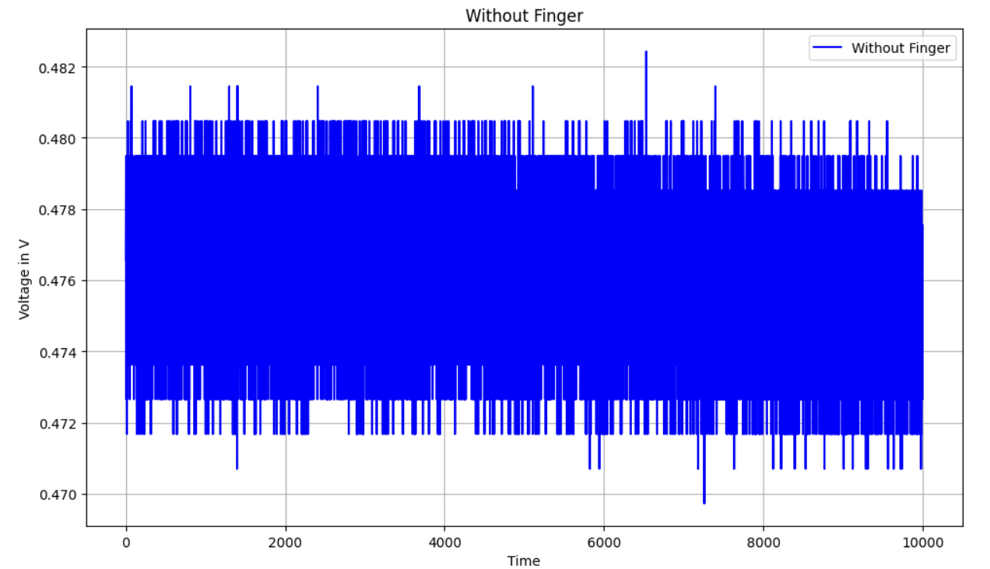
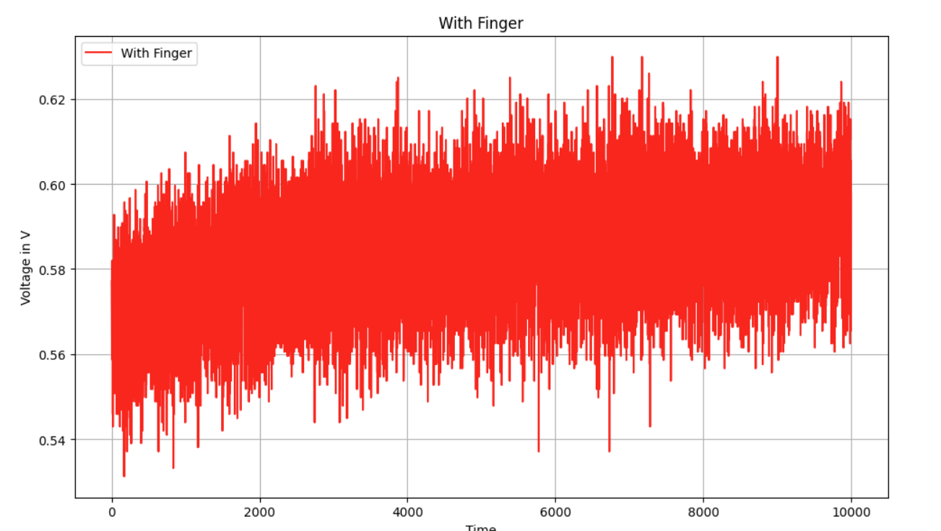
Temperature plots

Slide 21
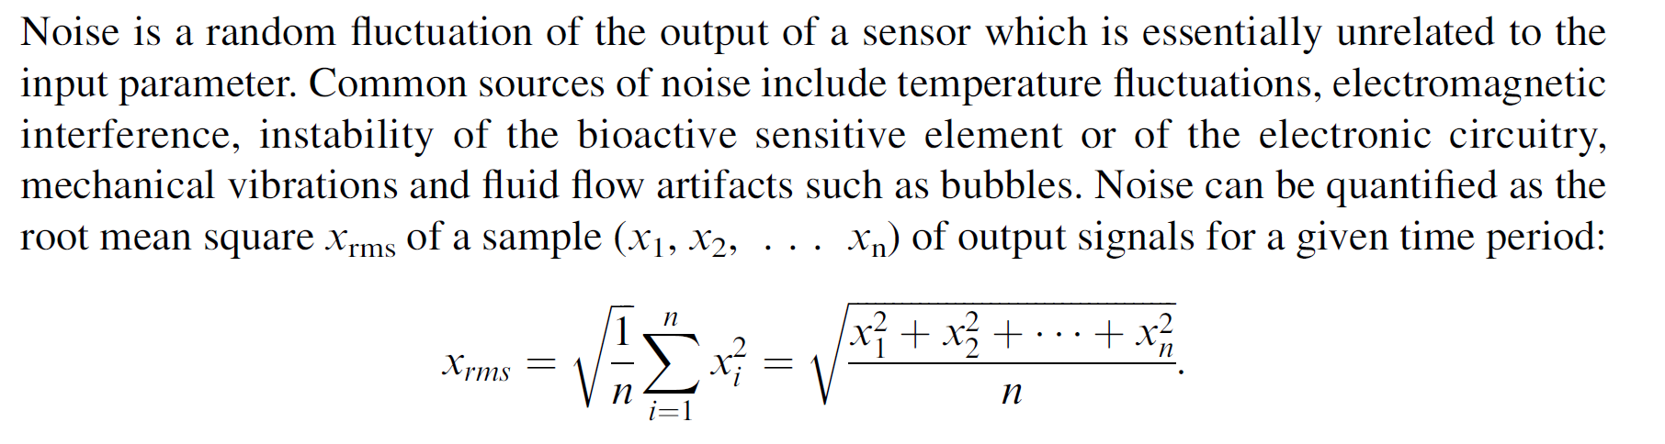
Noise

