Slide 1
ECE 105: Introduction to Electrical Engineering
Lecture 6
Circuit Analysis 2
Yasser Khan
Rehan Kapadia

Slide 2
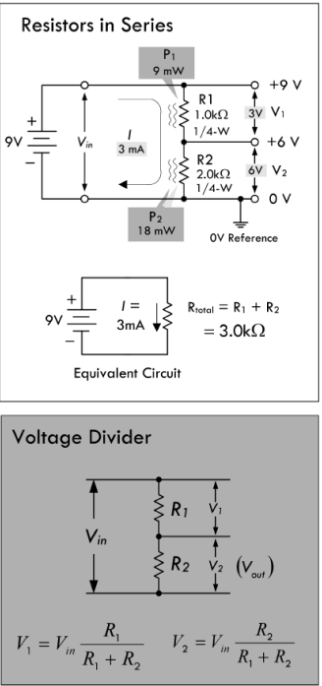





Voltage divider

Slide 3
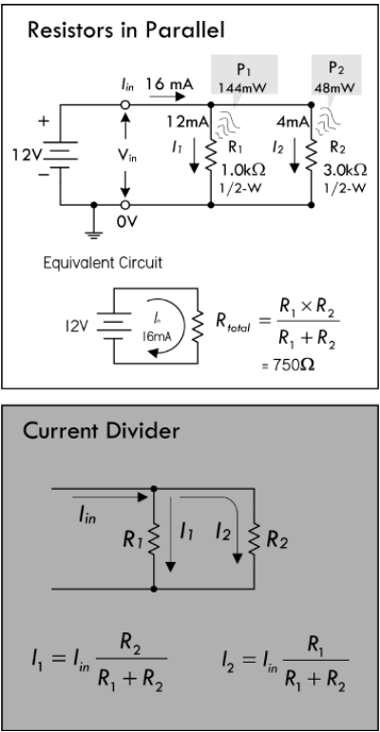






Current divider

Slide 4
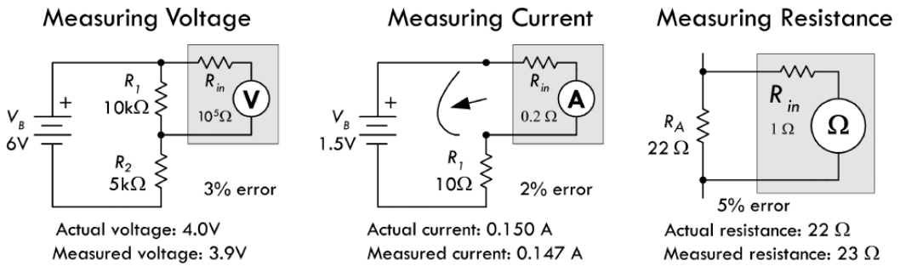
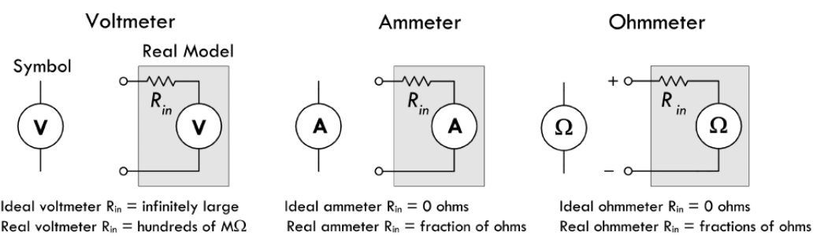












Measuring voltage, current, resistance

Slide 5
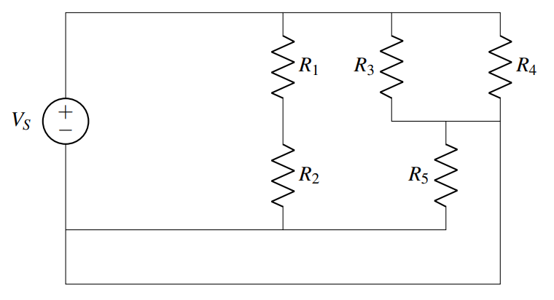
Finding nodes

Slide 6
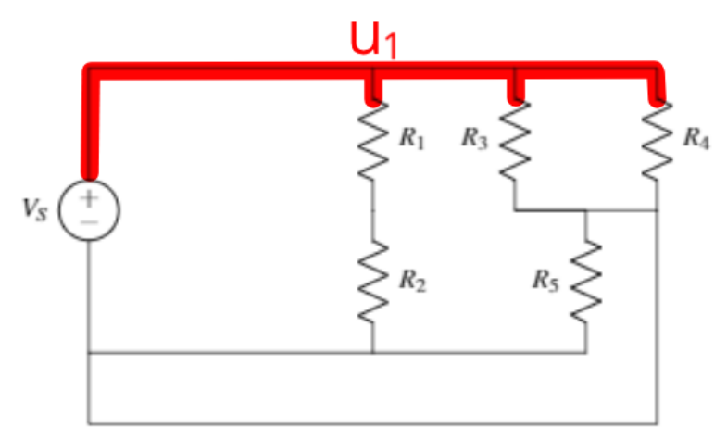

Find the node connected to the source

Slide 7
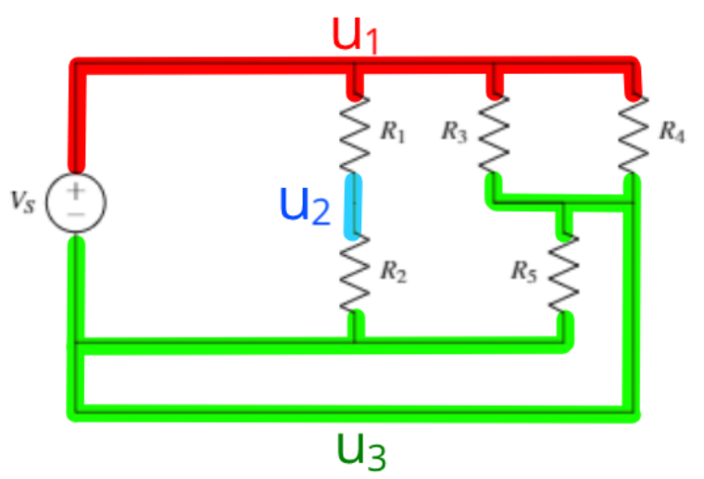



Find other nodes

Slide 8
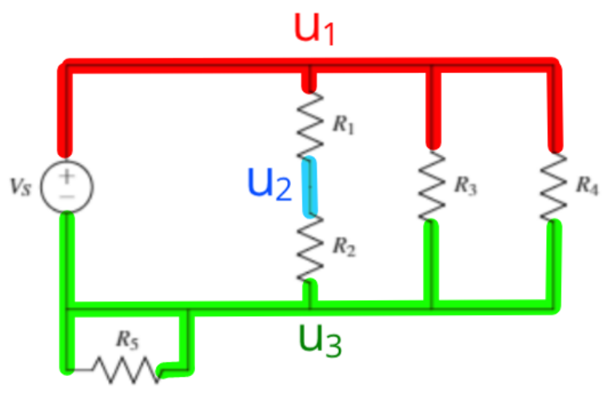























Merge elements sharing the same nodes

Slide 9
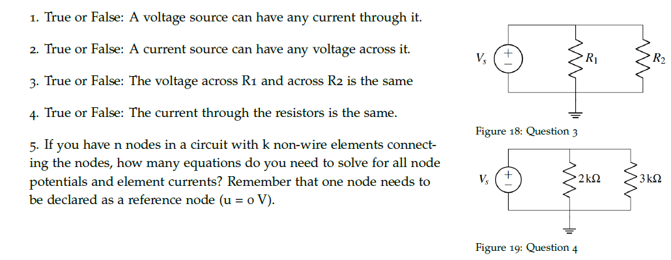











Practice problems

Slide 10
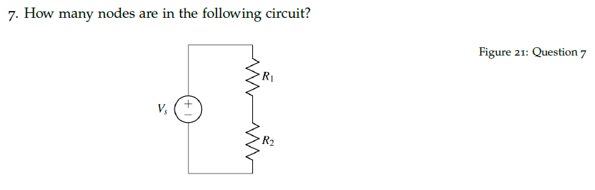
Practice problems

Slide 11
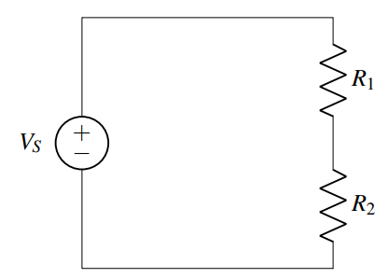




Practice

Slide 12
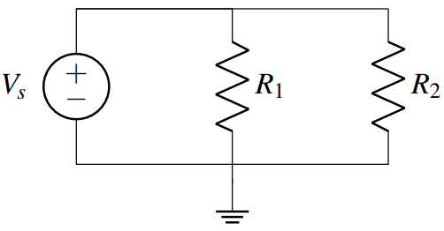
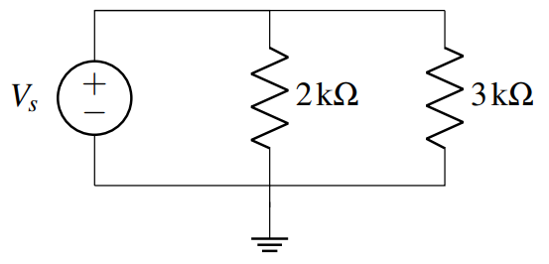
Practice

Slide 13
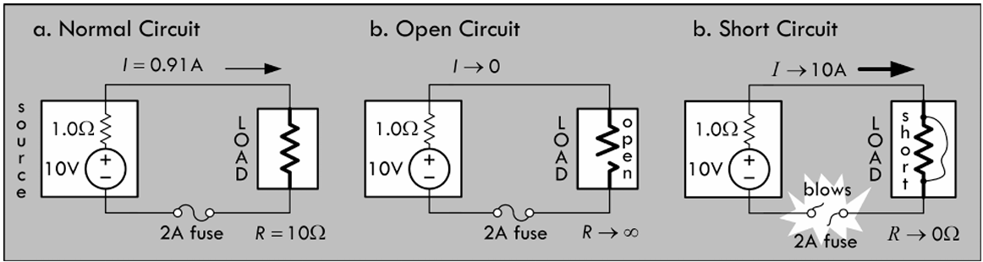
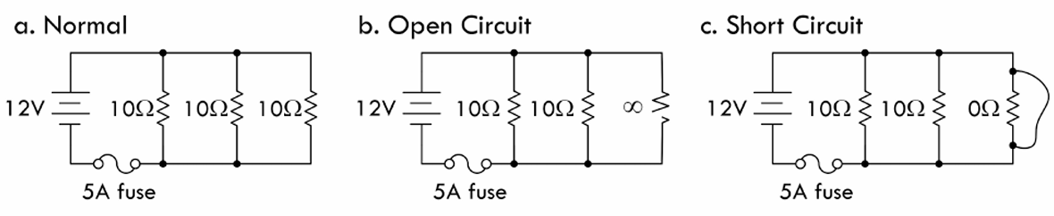

Fuse

Slide 14
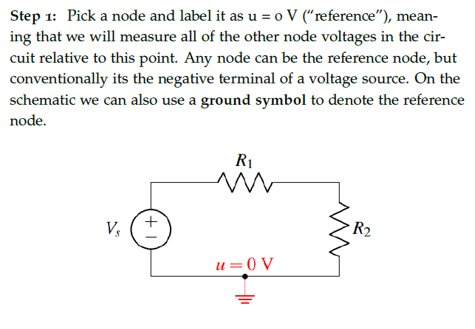

Nodal analysis

Slide 15
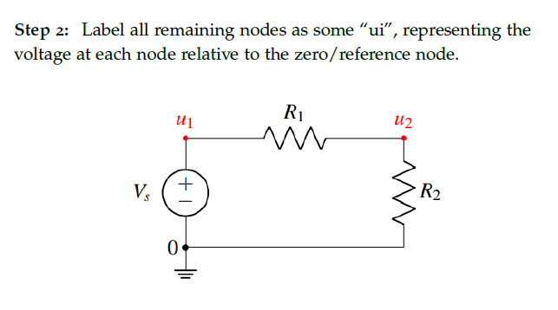
Label nodes

Slide 16
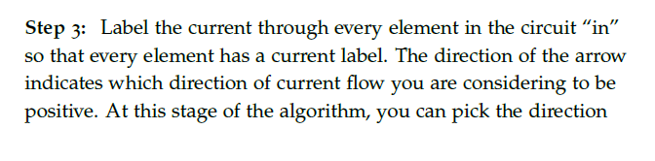
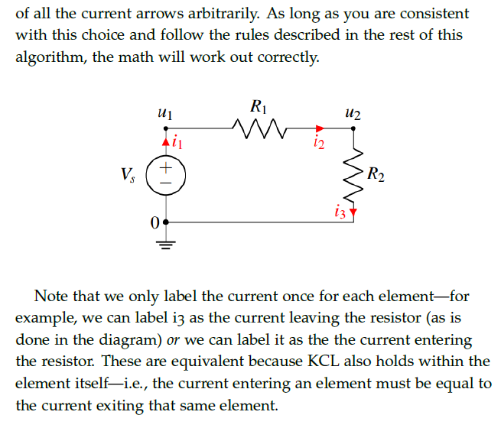



Label currents

Slide 17
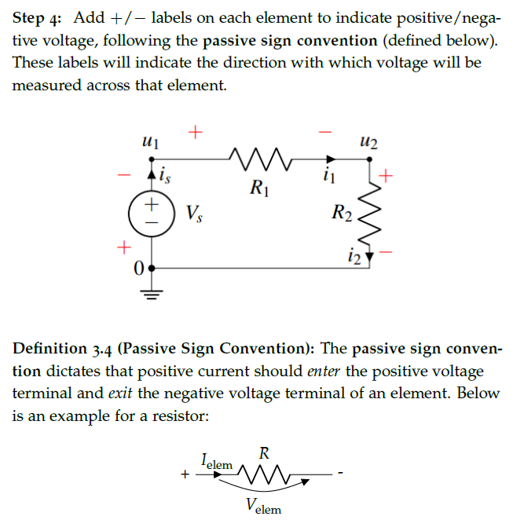
Voltage drop directions

Slide 18
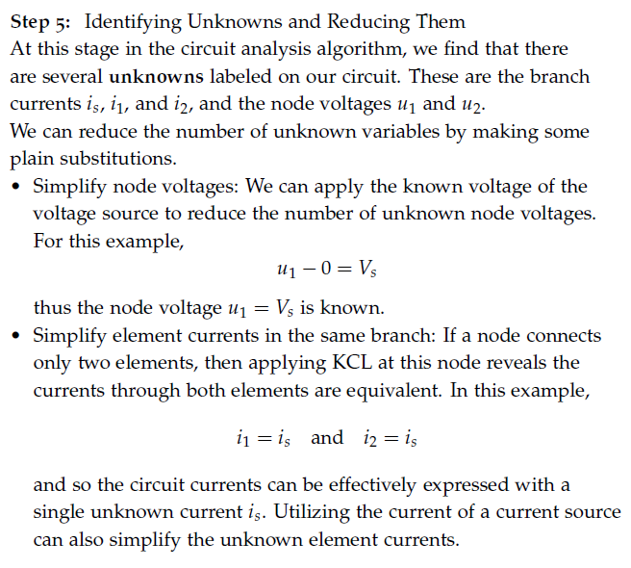





Write equations based on KCL and Ohm’s law

Slide 19
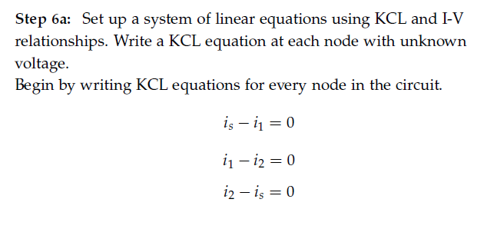











Write equations based on KCL and Ohm’s law

Slide 20
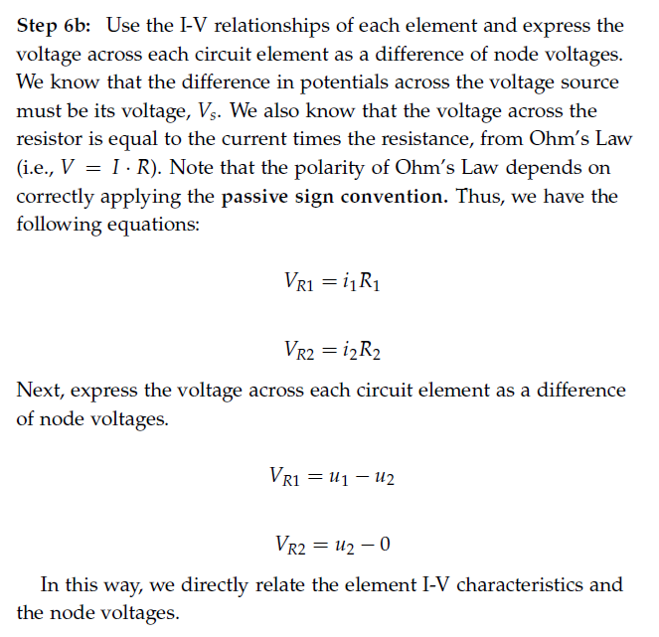
Write equations based on KCL and Ohm’s law

Slide 21
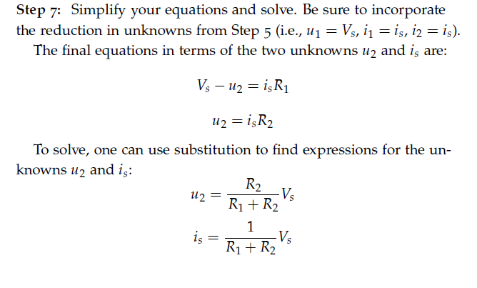
Solve for unknowns

Slide 22








Touchpad – Network 2 in the demo board

Slide 23








Touchpad – Network 2 in the demo board

Slide 24

Touchpad – Network 2 in the demo board

Slide 25













Touchpad – Network 2 in the demo board

Slide 26



















Touchpad – Network 2 in the demo board

Slide 27
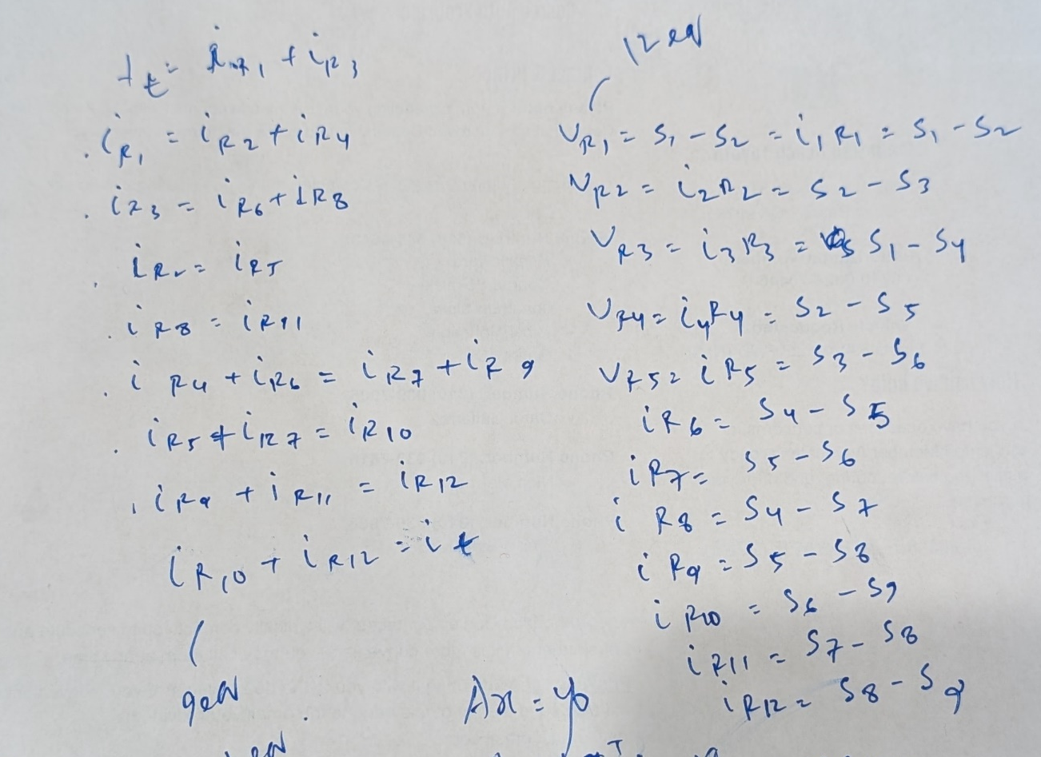
Touchpad – Network 2 in the demo board

Slide 28

Touchpad – Network 2 in the demo board

Slide 29
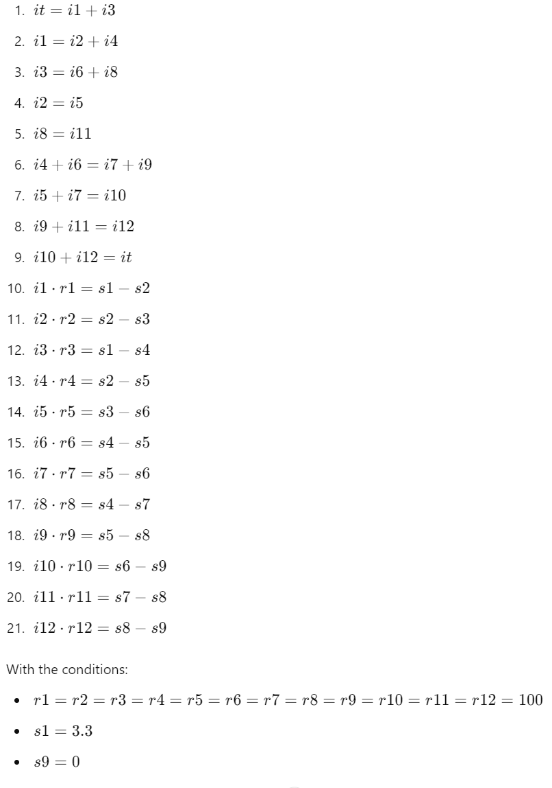
Touchpad – Network 2 in the demo board

Slide 30
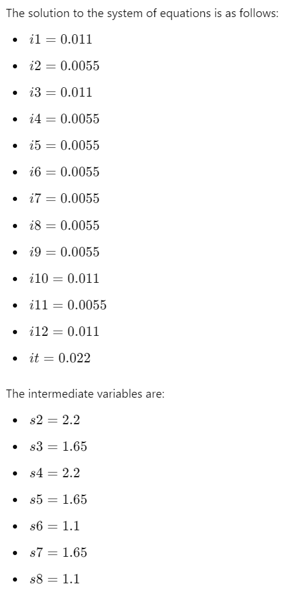
Touchpad – Network 2 in the demo board

Slide 31
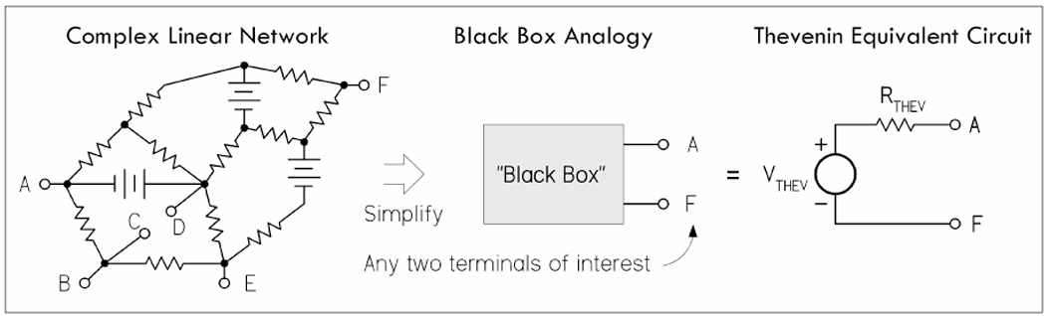
Equivalent circuits

Slide 32
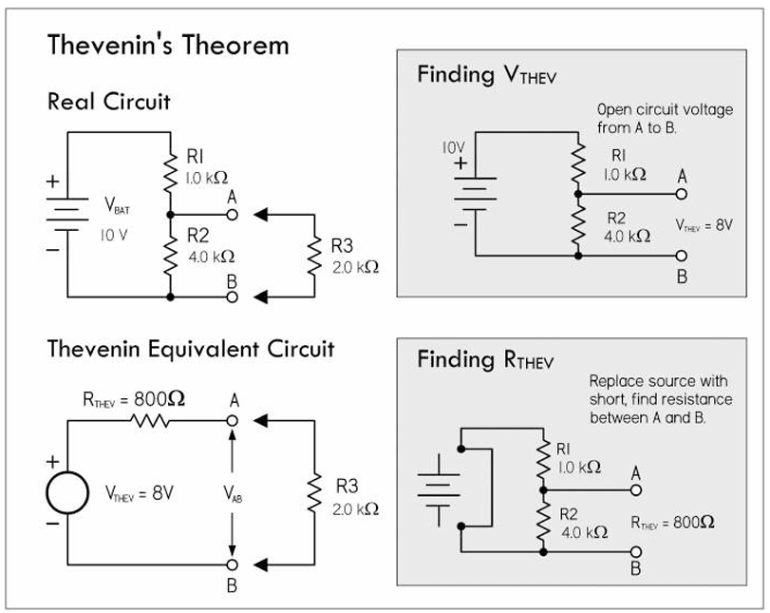
Thevenin’s equivalent circuit

Slide 33
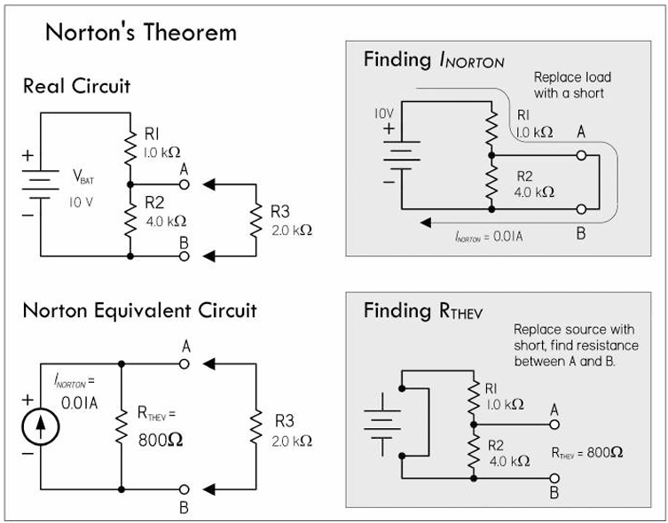
Norton’s equivalent circuit

Slide 34
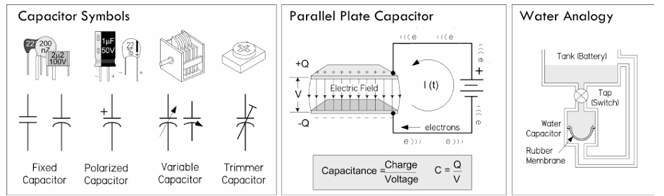
Capacitors

Slide 35
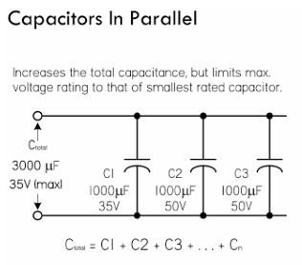
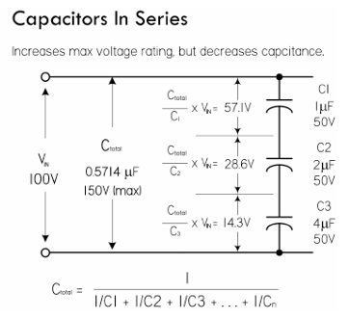
Capacitors

Slide 36
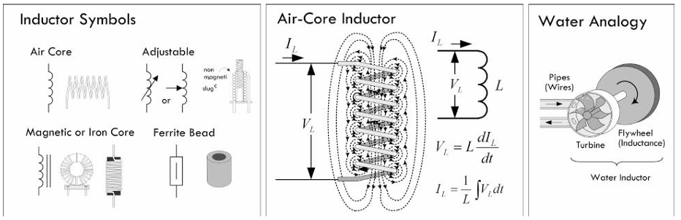
Inductors

Slide 37
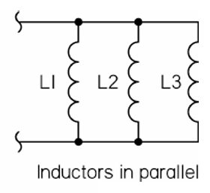
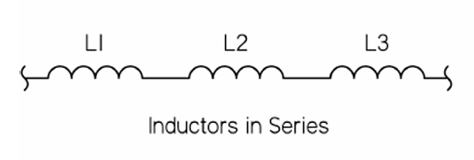
Inductors

