Slide 1


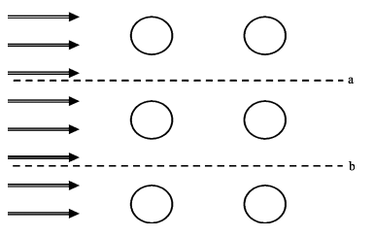
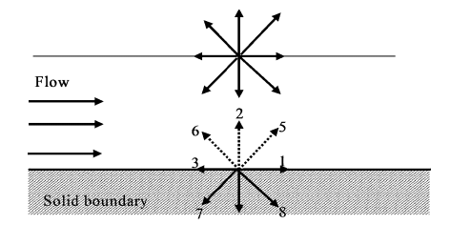
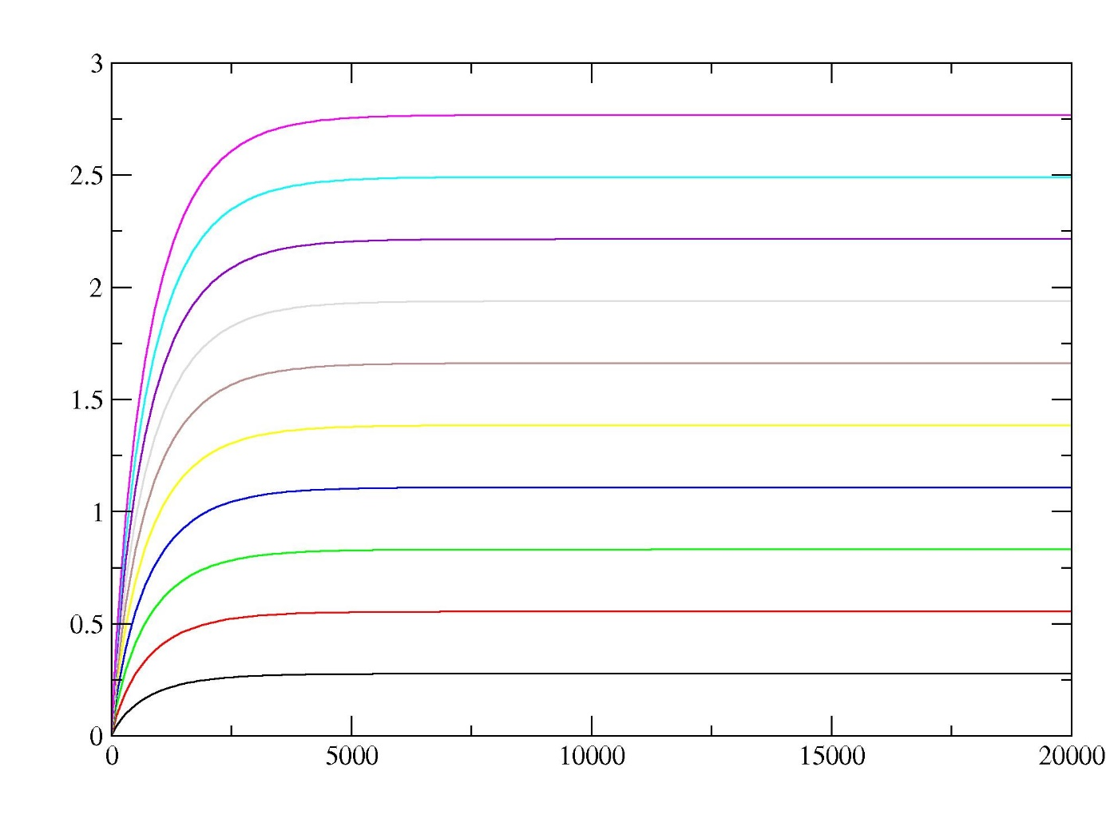
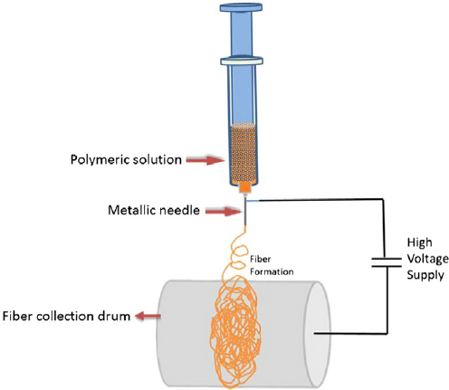
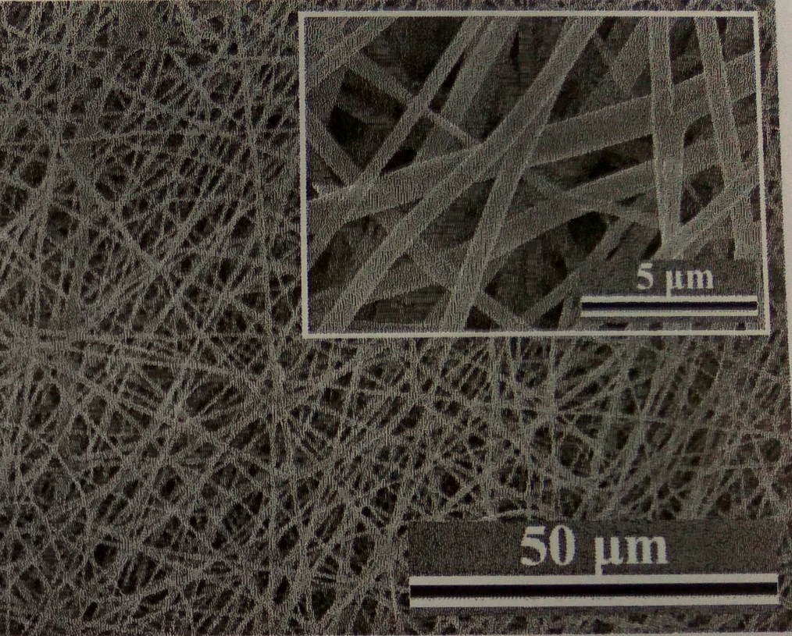
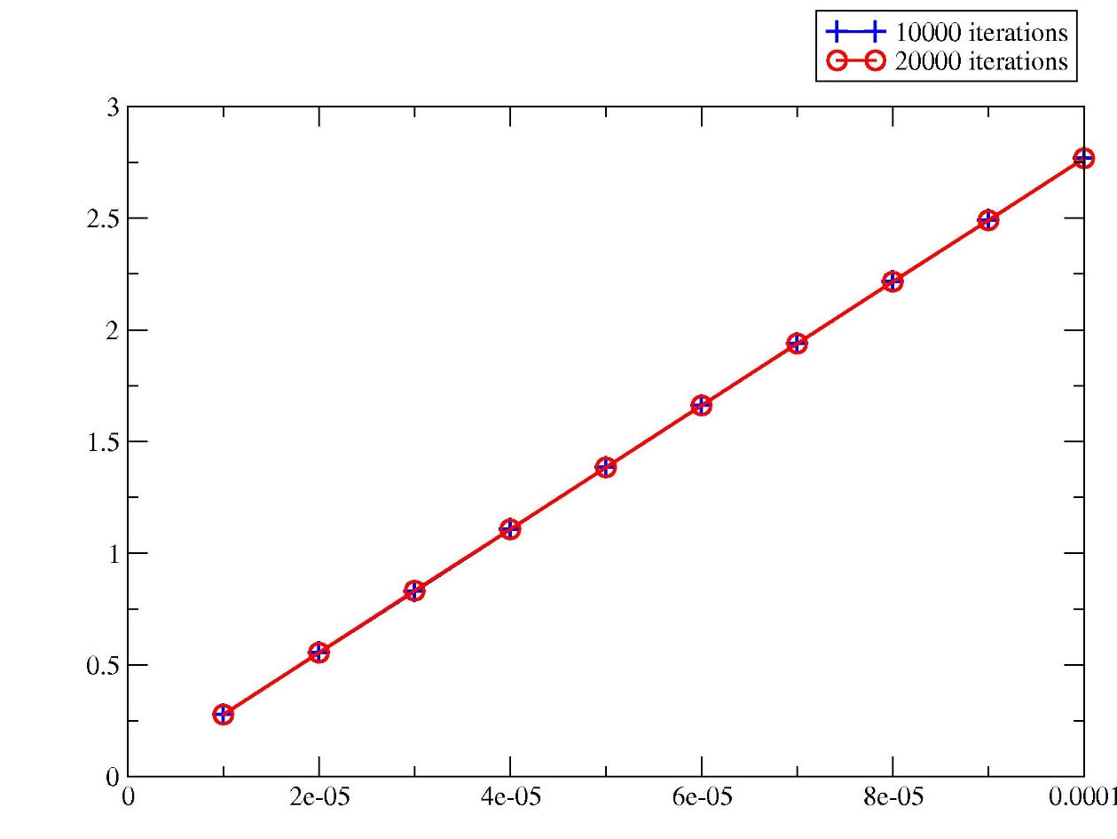
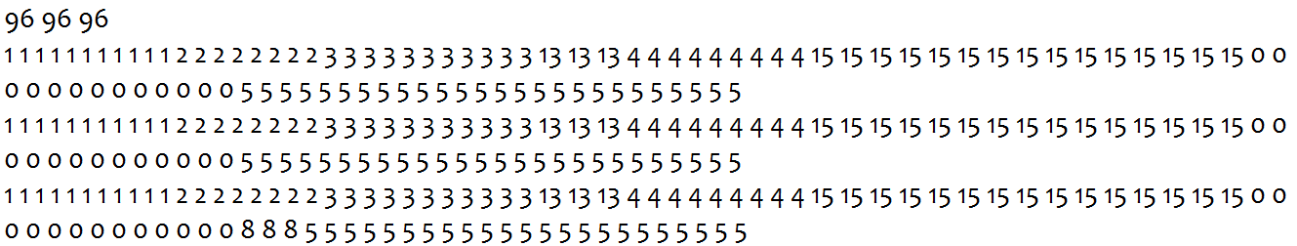
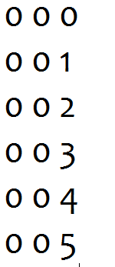
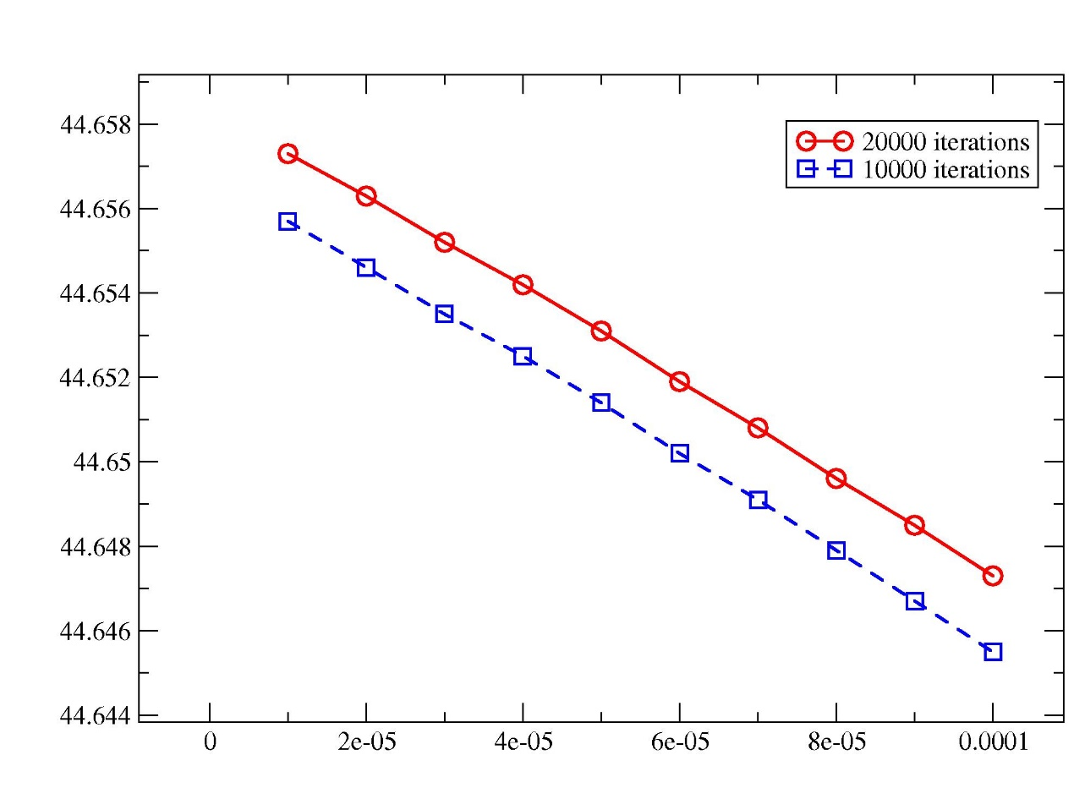
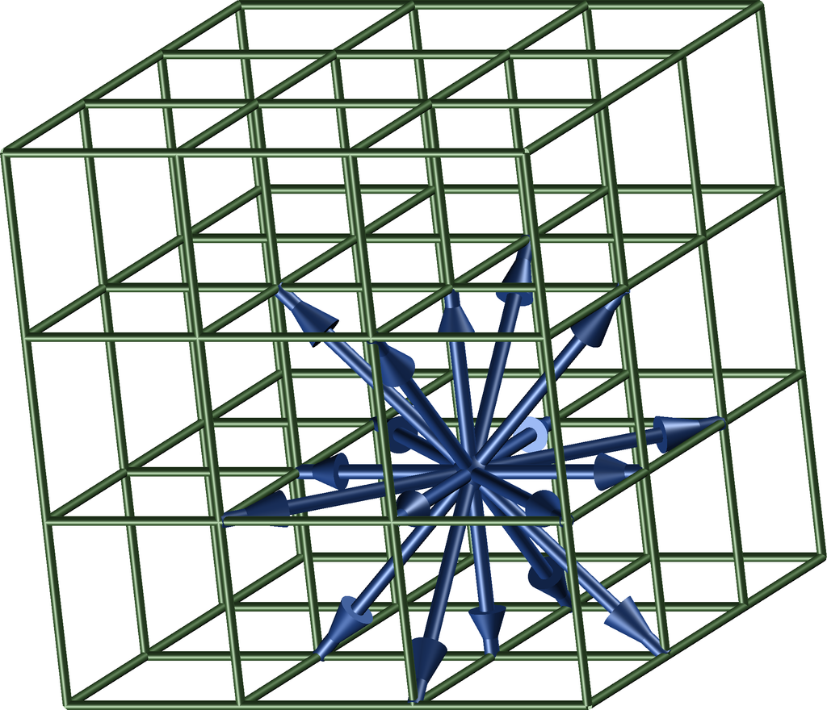
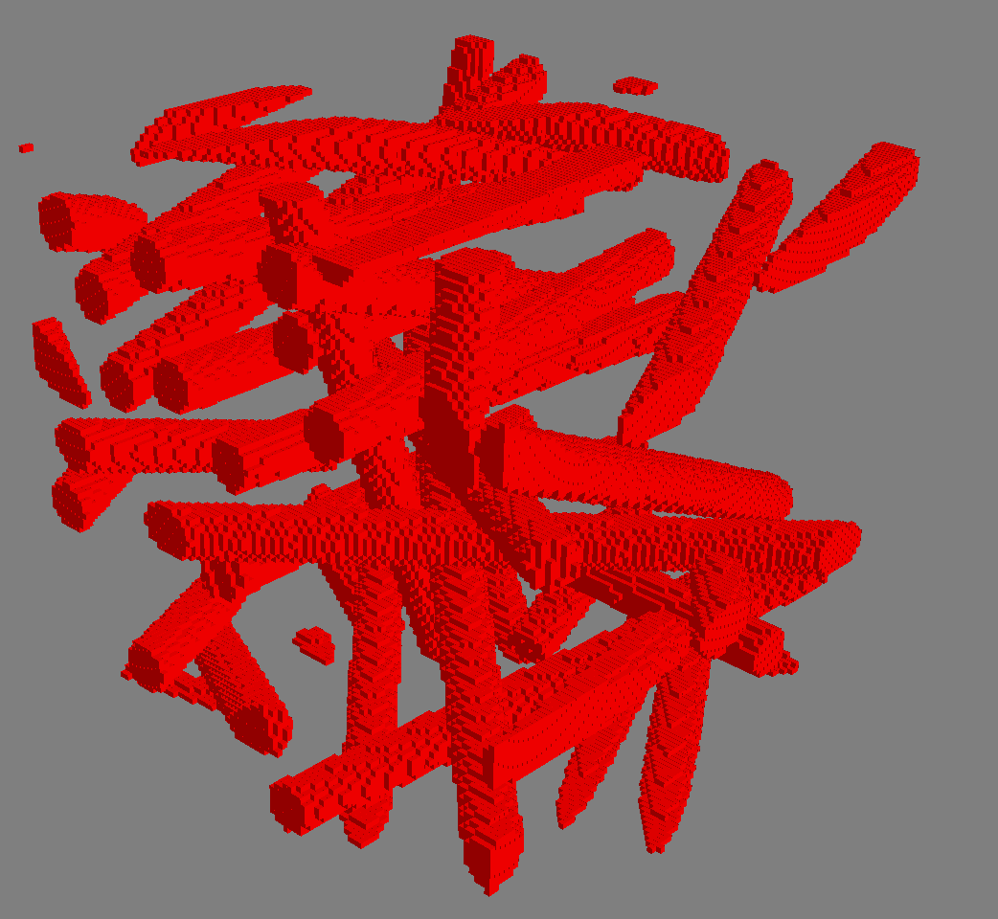
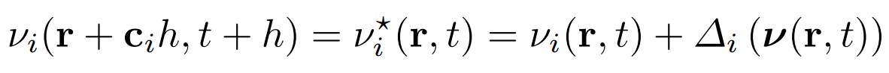



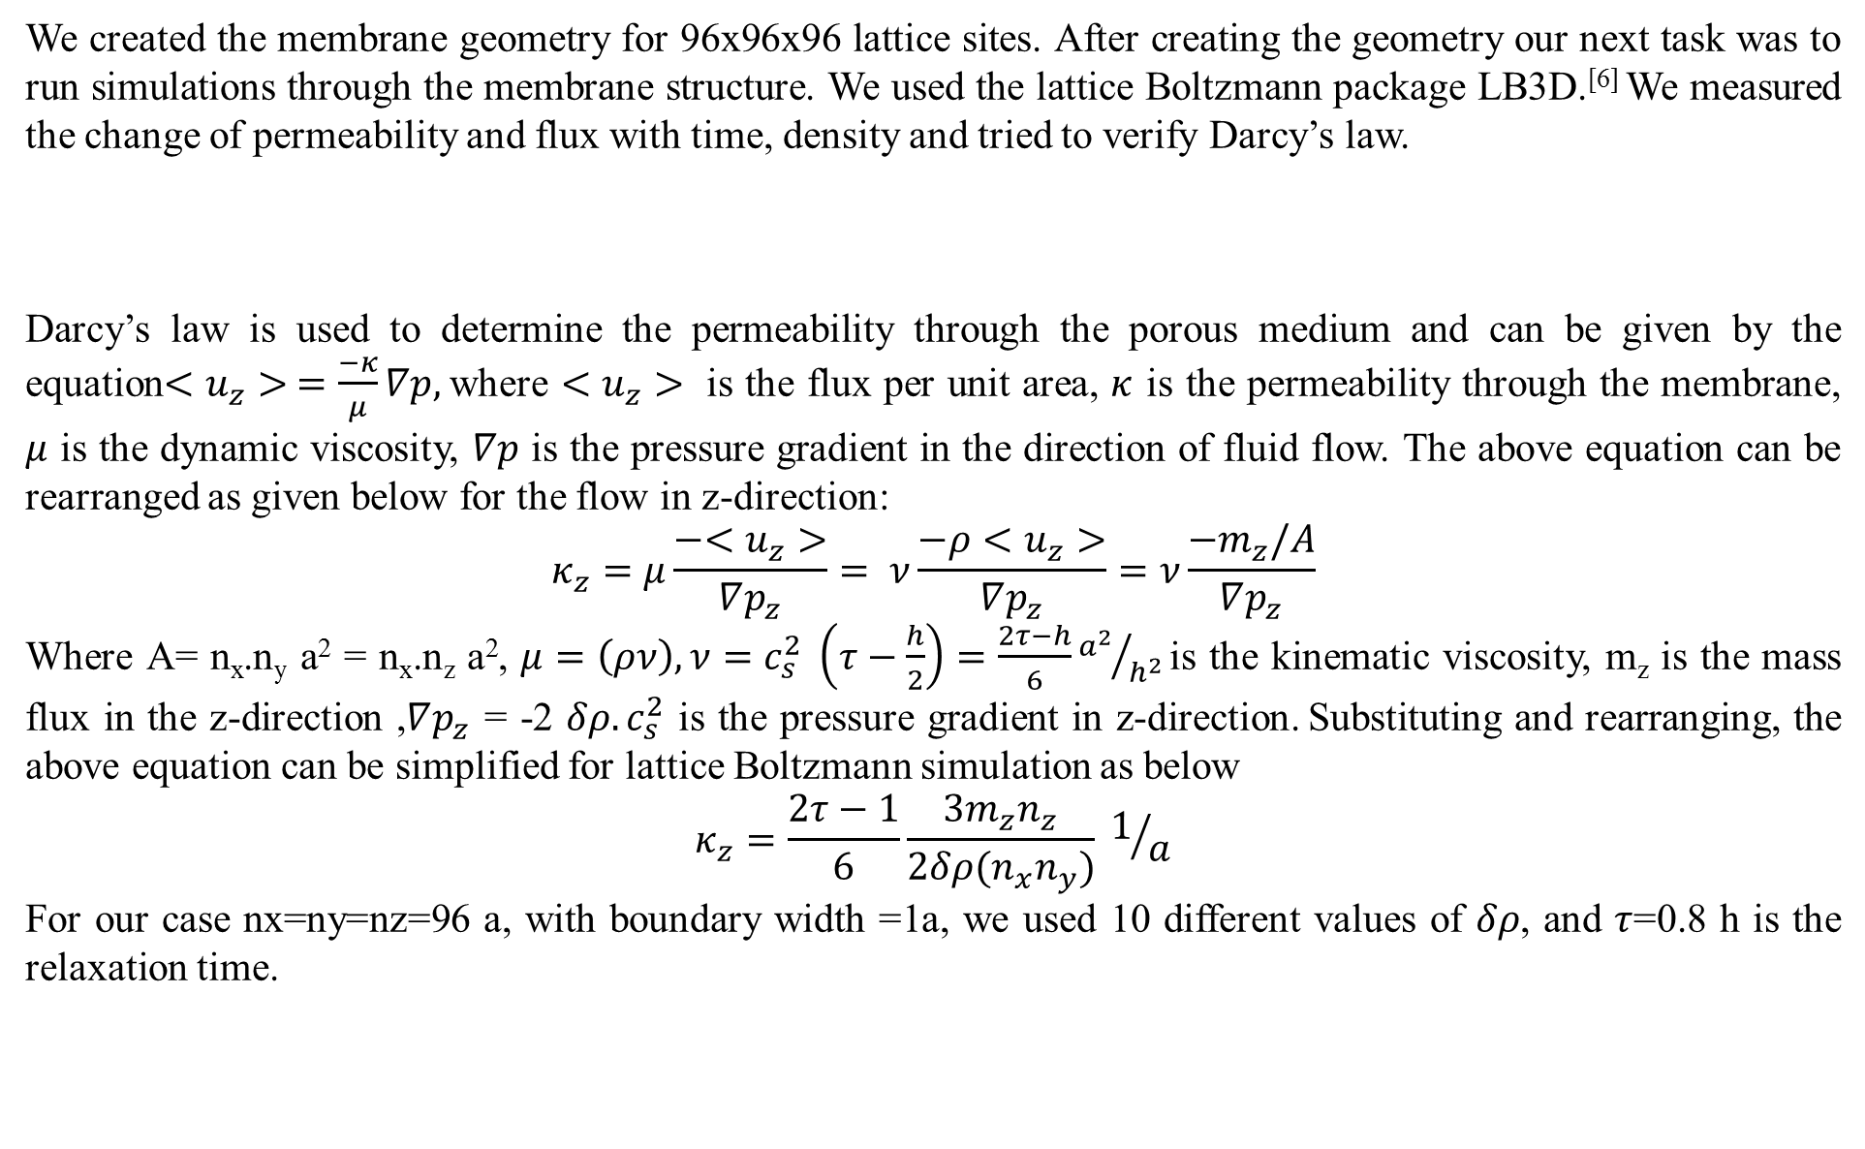

Predicting the permeability of non-woven fibrous membranes by Lattice Boltzmann simulations
S. Kumari, Indian Institute of Technology Gandhinagar
U. D. Schiller, Department of Materials Science and Engineering, Clemson University
Introduction
Results and Discussions
Membranes are widely used in many fields such as in fabrics, textiles, filters, lasers etc. The membrane morphology significantly affects membrane performance. For filtration process, permeability is very important. So with the help of computational models and simulations one can predict the permeability based on composition and material properties. Experimentally, non-woven membranes are prepared by electrospinning process as shown in Figure 1. By controlling the operating conditions and solution parameters highly porous structure of smooth and defect free non-woven fibers can be formed.^{[1]}
(a) Mass flux(m_{z}) vs time
We got the results from the simulations which are shown in the plots of figure 9.
In Figure 9 (a), we can see that the results have been converged. As the mass flux has reached to certain value after some time, which shows that results have been converged.
In Figure 9 (b) we have the plot of mas flux vs $δρ. We$ expected this linear behavior from the Darcy’s law as given by equation (3).
After fitting the plot (b), the equation of the plot comes out to be: y = 0.00051554 + 27684 x,
slope= 27684${ a^{3}}/h$
From the equation (3) we have ,
$$\frac{m_{z}}{δρ}=\frac{κ_{z}. 4. n_{x}n_{y}}{\left(2τ−h\right)n_{z}}a=27684{ a^{3}}/h$$
$$⇒ κ_{z}=44.646 a^{2}$$
The permeability of the membrane comes out to be 44.64 a² with this method.
We also did the validation test for LBM, in which the permeability through the square duct comes out to be ~310 a². Membrane is offering a resistance to the flow as a result of which the permeability of membrane is decreasing.
In Figure9(c), we expected permeability to be constant with$δρ$ ,but it is showing a non-constant behavior. It may be because, lattice Boltzmann method that we are using is for incompressible fluids. But we are using$δρ$ across the fluid flow, which is affecting compressibility of fluid. There may be numerical errors in LB method with increase in$δρ$.
Further investigation needs to be done, to fully understand the functional dependency of permeability on other parameters.
Figure 5.
Periodic boundary condition^{[4]}
Figure 6.
Bounce back boundary condition^{[4]}
m_{z}[m.h⁻¹]
We applied periodic boundary condition in the z-direction i.e. the direction of fluid flow and bounce back boundary condition at the four walls. The boundary of the system is like as if the fluid is flowing through a square pipe with the membrane inside it.
Simulation Workflow
Time [h]
(b) Mass Flux ($m_{z}$)vs $δρ$
Figure 1.
(a) Schematic of electrospinning Process^{[1]}
Figure 2.
SEM micrographs of non-woven fiber membrane (YAG) obtained from an electro-spinning solution^{[2]}
GeoDict
(generate geometry)
Convert files
(in Python)
LB3D simulation^{[6]}
Scope
Figure 7.
Sequence of simulation workflow
m_{z}[m.h⁻¹]
Creating the geometry and setting up the framework for lattice Boltzmann simulation with the help of software tools (like GeoDict, Mayavi, LB3D)
Predicting the permeability by lattice Boltzmann simulations and verifying the Darcy’s law
In our computational model we used the GeoDict to generate the non-woven membrane. But the output files generated were not in the proper format for running simulations. So we interpret the output given by the GeoDict (Figure 8 (a)) and convert it into the format that we required (Figure 8(b)) and generated the membrane as shown in Figure 4.
y = 0.00051554+27684 x
$δρ$ [m/a³]
Computational model
(c) Permeability ($κ_{z}$) vs $δρ$
(a)
(b)
$$κ_{z}[a^{2}]$$
Figure 8. (a) Pore data generated by GeoDict which needs to be converted in to the format of (x y z) as given in (b)
We created the membrane geometry for 96x96x96 lattice sites. After creating the geometry our next task was to run simulations through the membrane structure. We used the lattice Boltzmann package LB3D.^{[6]} We measured the change of permeability and flux with time, density and tried to verify Darcy’s law.
Darcy’s law is used to determine the permeability through the porous medium and can be given by the equation$<u_{z}> =\frac{−κ}{μ}∇p,$where $<u_{z}>$ is the flux per unit area, $κ$ is the permeability through the membrane, $μ$ is the dynamic viscosity, $∇p$ is the pressure gradient in the direction of fluid flow. The above equation can be rearranged as given below for the flow in z-direction:
$$κ_{z}=μ\frac{−<u_{z}>}{∇p_{z}}= ν\frac{−ρ<u_{z}>}{∇p_{z}}=ν\frac{−m_{z}/A}{∇p_{z}}$$
Where A= n_{x}.n_{y} a² = n_{x}.n_{z} a², $μ=\left(ρν\right), ν=c_{s}^{2} \left(τ−\frac{h}{2}\right)=\frac{2τ−h}{6}{a^{2}}/{h^{2}}$ is the kinematic viscosity, m_{z} is the mass flux in the z-direction ,$∇p_{z}$ = -2 $δρ. c_{s}^{2}$ is the pressure gradient in z-direction. Substituting and rearranging, the above equation can be simplified for lattice Boltzmann simulation as below
$$κ_{z}=\frac{2τ−1}{6}\frac{3m_{z}n_{z}}{2δρ(n_{x}n_{y})} 1/a$$
For our case nx=ny=nz=96 a, with boundary width =1a, we used 10 different values of $δρ$, and $τ$=0.8 h is the relaxation time.
$δρ$ [m/a³]
Calculations
Figure 9. Simulations results
Conclusion
Figure 3.
D3Q19 Lattice Boltzmann model ^{[3]}
Figure 4.
Computational model of membrane
With the help of GeoDict we were able to create our membrane geometry. GeoDict allows us to generate realistic geometries that resemble the actual experimental systems. Preliminary results show that the flow through the membrane follows Darcy’s law, with the help of which we were able to determine the permeability of membrane. Our analysis reveals that there are some numerical errors which needs further investigation.
Lattice Boltzmann model is a computational model which considers the volume of fluid to be consists of discrete points and is based upon solving discretized Boltzmann equation. Boundary conditions plays an important role in fluid simulation. This model has the ability to incorporate complex boundary conditions which made it possible to simulate real world things. This model has two basic processes: streaming and collision and its algorithm can be summarized by the equation^{[4]} given below:
Where v_{i}(r,t) is the number of particle at position r and time t before the collision with velocity c_{i}. v*_{i}(r,t) indicates the velocity distribution juster after the collison. Δ_{i} is collision operator and it depends on the complete set of particles at v(r,t). Left hand side of this equation determines advection or streaming of the particles along the links connecting neighboring sites.^{[4]}
For the fluid to flow in a volume, boundary conditions are very necessary. Periodic and bounce-back are two simple boundary conditions to begin with. Periodic boundary conditions are applied in a repeating flow system.^{[5]} The system becomes closed by the edges and behave as if they are attached to opposite edges. Whereas, bounce back boundary conditions are used to model solid stationary walls, moving boundary, non- slip or flow over obstacles.^{[5]}
(2)
References
(1)
(3)
[1] F. E. Ahmed, B. S. Lalia, R. Hashaikeh. A review on electrospinning for membrane fabrication: Challenges and applications. Desalination 356, 15-30 (2015).
[2] Z. Chen, A.A. Trofimov, L.G. Jacobsohn, H. Xiao, K. Kornev, D. Xu, F. Peng. Transport properties of YAG: Er⁺³ fiber membrane scintillators prepared by electrospinning method. In preparation.
[3] U. D. Schiller. Personal communication. http://espressomd.org/html/ess2012/Day4/T1-01-Hydrodynamics/talk1-LB.pdf
[4] B. Dünweg and A. J. C. Ladd. Lattice Boltzmann simulations of soft matter systems. Adv. Polym. Sci. 221, 89-166 (2008).
[5] A. A. Mohamad. Lattice Boltzmann methods. Fundamentals and engineering applications with computer codes. Springer (2011).
[6] S. Schmieschek, L. Shamardin, S. Frijters, T. Krüger, U. D. Schiller, J. Harting, P. V. Coveney. LB3D: A Parallel Implementation of the Lattice-Boltzmann Method for simulation of Interacting Amphiphilic Fluids. Submitted (2016).
S.No. | Quantity | Unit
1 | Length | a
2 | Time | h
3 | Mass | m
Table 1: Units of measurement

