Slide 1

Introduction to Artificial Neural Networks
Hao Ji, Data Scientist
USC Center for Advanced Research Computing

Slide 2
Introduction
Neural Networks
Applications
PyTorch
Content
Introduction
Section 1: Introduction to Deep Learning
Section 2: Neural Networks
Neural Networks
Applications
Section 3: Applications
PyTorch
Section 4: Building Neural Networks with PyTorch

Slide 3
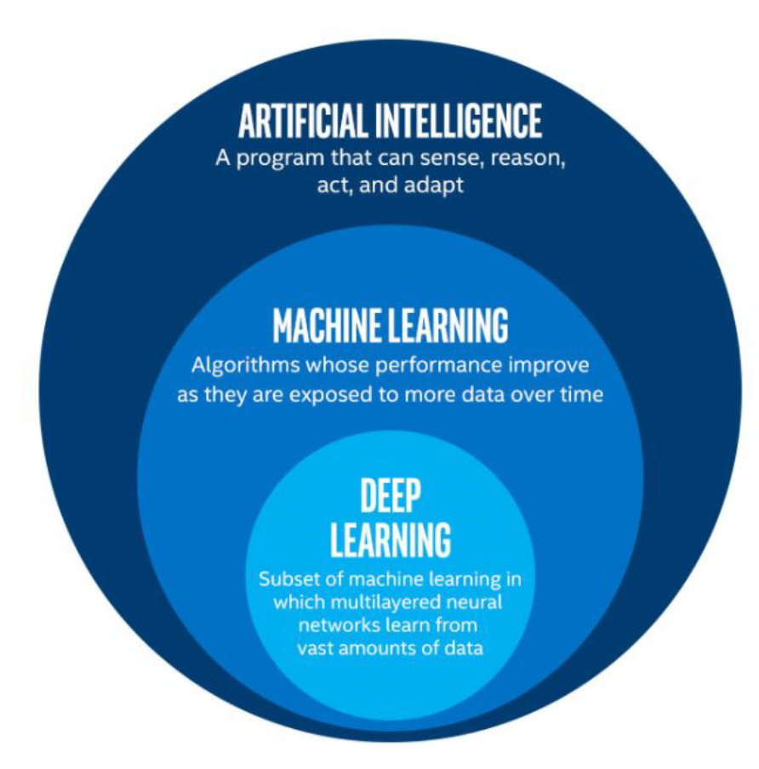
Introduction
Neural Networks
Applications
PyTorch
Introduction to Deep Learning
Deep Learning: subfield of traditional machine learning
Inspired by the structure and function of the brain: Artificial Neural Networks
Computer vision: Tesla recognizing items on a street
Text Generation: An algorithm trained to create a new Shakespeare piece
Speech recognition
Computer Games: AlphaGo

Slide 4
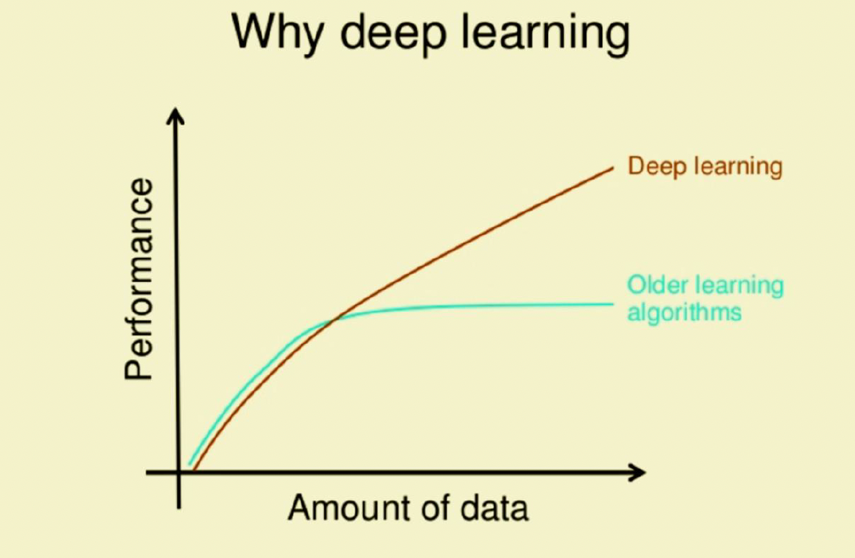
Introduction
Neural Networks
Applications
PyTorch
Introduction to Deep Learning
What drives the recent development of Deep Learning?
Larger amounts of data available
Data Storage
Strong computation units such as GPU’s

Slide 5
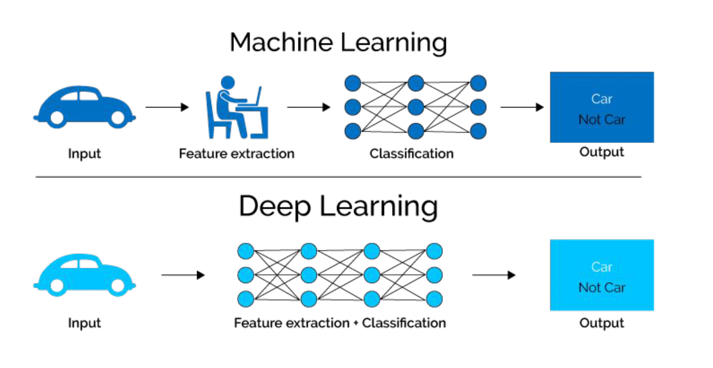
Introduction
Neural Networks
Applications
PyTorch
Introduction to Deep Learning

Slide 6
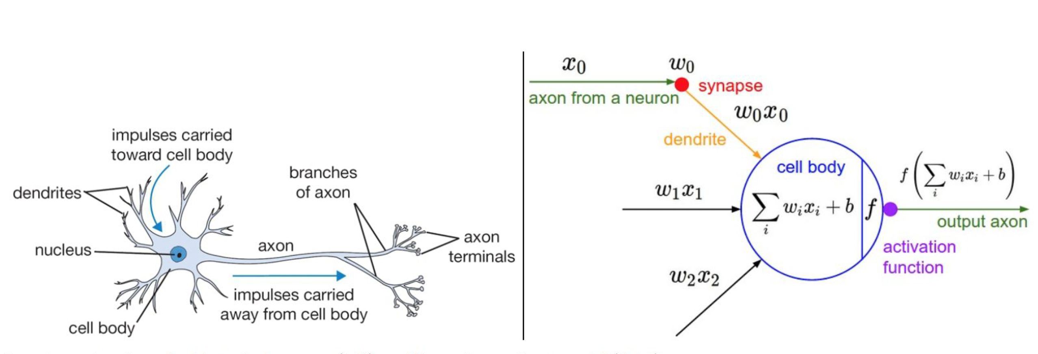
Introduction
Neural Networks
Applications
PyTorch
Neural Networks
biological neuron
artificial neural networks

Slide 7
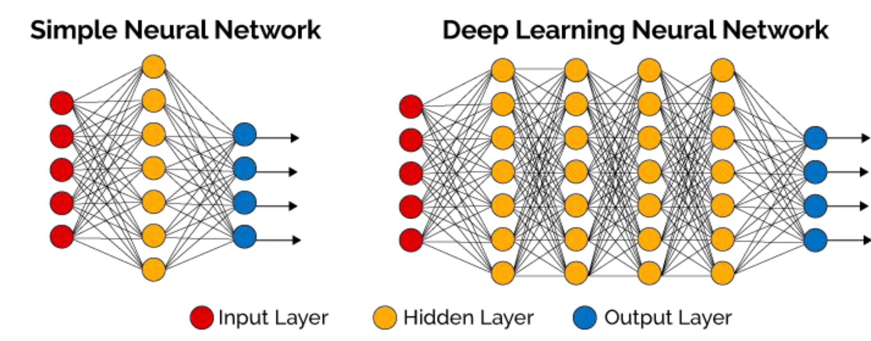
Introduction
Neural Networks
Applications
PyTorch
Neural Networks
Deep neural networks (DNN) usually has more hidden layers
Still has same 3 types of layers
A neural network (NN) has 3 types of layers:
Input layer Hidden layer Output layer

Slide 8
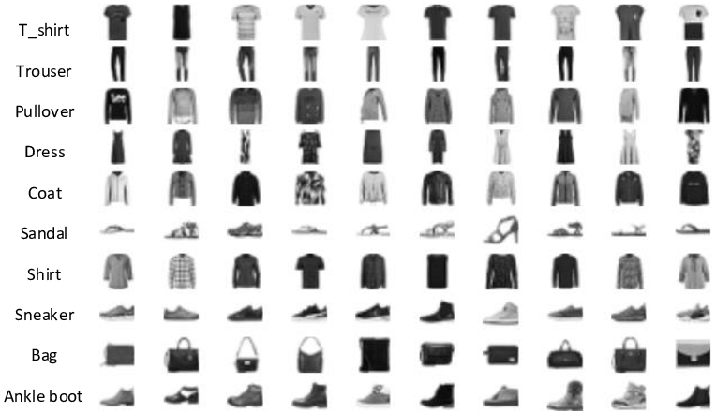
Introduction
Neural Networks
Applications
PyTorch
Building Neural Networks
Task: Predict if an input image belongs to one of the following classes: T-shirt/top, Trouser, Pullover, Dress, Coat, Sandal, Shirt, Sneaker, Bag, or Angle boot.
FasionMNIST Dataset
Fashion-MNIST is a dataset comprising of 28×28 grayscale images of 70,000 fashion products from 10 categories, with 7,000 images per category. The training set has 60,000 images and the test set has 10,000 images.

Slide 9
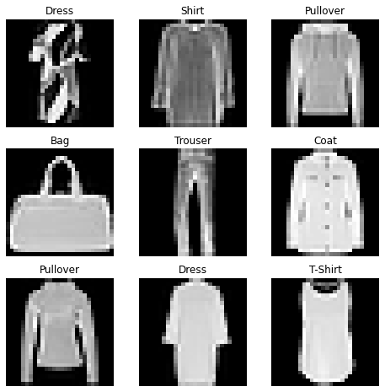
Introduction
Neural Networks
Applications
PyTorch
Building Neural Networks
Make Predictions based on Logits
Input X: (28 * 28)

Slide 10





Introduction
Neural Networks
Applications
PyTorch
Building Neural Networks
0.5
$$w_{11}^{[1]}$$
0.4
$$w_{12}^{[1]}$$
$Z_{1}^{[1]}= w_{11}^{[1]}x_{1}+w_{12}^{[1]}x_{2}$+ $w_{13}^{[1]}x_{3}+ b_{1}^{[1]}$
0.2
$$w_{13}^{[1]}$$
$=0.5 ∗0.4+0.1 ∗0.2+0.8 ∗0.1+0.2=0.5$
$$a_{1}^{[1]}=f\left(0.5\right)=ReLU\left(0.5\right)=0.5$$
0.1
Weights are initialized randomly
28 * 28 = 784
A_1

Slide 11
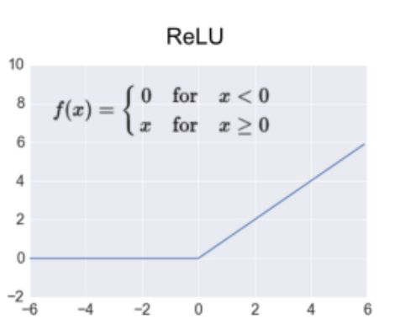


Introduction
Neural Networks
Applications
PyTorch
Building Neural Networks
$Z_{1}^{[1]}= w_{11}^{[1]}x_{1}+w_{12}^{[1]}x_{2}$+ $w_{13}^{[1]}x_{3}+ b_{1}^{[1]}$
$=0.5 ∗0.4+0.1 ∗0.2+0.8 ∗0.1+0.2=0.5$
$$a_{1}^{[1]}=f\left(0.5\right)=ReLU\left(0.5\right)=0.5$$

Slide 12








Introduction
Neural Networks
Applications
PyTorch
Building Neural Networks
$$a_{1}^{[1]}$$
0.5
$$w_{11}^{[2]}$$
0.4
$$a_{2}^{[1]}$$
0.89
0.2
$$w_{12}^{[2]}$$
0.2
2
$$a_{3}^{[1]}$$
$$w_{13}^{[2]}$$
0.3
3
$Z_{1}^{[2]}= w_{11}^{[2]}a_{1}^{[1]}+w_{12}^{[2]}a_{2}^{[1]}$+ $w_{13}^{[2]}a_{3}^{[1]}+w_{14}^{[2]}a_{4}^{[1]}+b_{1}^{[2]}$
0.1
$$w_{14}^{[2]}$$
$$a_{4}^{[1]}$$
$=0.3 ∗0.5+0.1 ∗0.2+0.2 ∗0.3+0.4 ∗0.9+ 0.3$
$=0.89$
0.9
$$a_{1}^{[2]}=f\left(Z_{1}^{[2]}\right)=f\left(0.89\right)=ReLU\left(0.89\right)=0.89$$
A_1

Slide 13
Introduction
Neural Networks
Applications
PyTorch
Neural Networks
Three steps to training a neural network
1 Forward propagation: push example through the network to get a predicted output
2 Compute the cost: calculate the difference between predicted output and actual data
3 Backward propagation: push back the derivative of the error and apply to each weight, such that next time it will result in a lower error

Slide 14
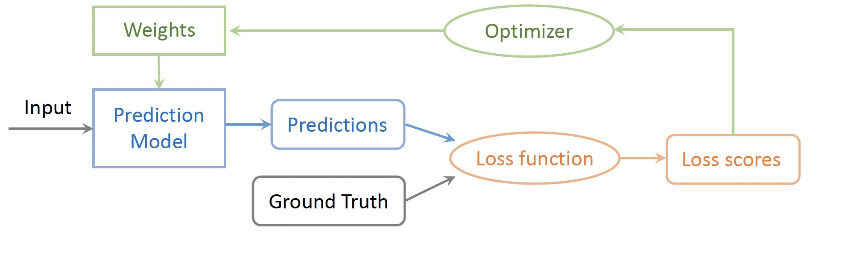
Introduction
Neural Networks
Applications
PyTorch
Training Pipeline
The training pipeline consists of choosing the prediction model, the loss function and the optimizer.
Once these choices are made, we can feed the input data and labels to start the training process.

Slide 15
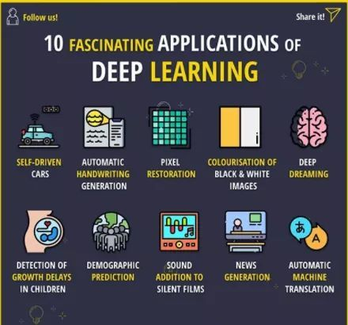
Introduction
Neural Networks
Applications
PyTorch
Deep Learning Applications
Deep Learning Applications
Notes:
DeepDream is a computer vision program created by Google engineer Alexander Mordvintsev that uses a convolutional neural network to find and enhance patterns in images via algorithmic pareidolia, thus creating a dream-like appearance reminiscent of a psychedelic experience in the deliberately overprocessed images

Slide 16
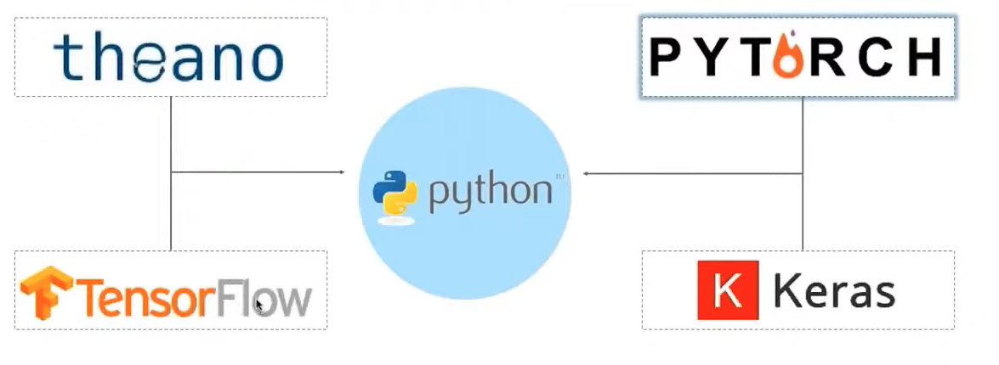
Introduction
Neural Networks
Applications
PyTorch
Neural Networks Packages
Facebook
Google

Slide 17
Introduction
Neural Networks
Applications
PyTorch
Pytorch Tensors
Tensors are a specialized data structure similar to arrays and matrices
PyTorch uses tensors to encode the inputs and outputs of a model, as well as model’s parameters
Can run on GPUs or other hardware accelerators
Optimized for automatic differentiation

Slide 18
Introduction
Neural Networks
Applications
PyTorch
Pytorch Tutorial
Machine Learning Workflows
Working with data
Creating models
Optimizing model parameters
Saving the trained models

Slide 19
Introduction
Neural Networks
Applications
PyTorch
Pytorch Tutorial
Predict if an input image belongs to one of the following classes: T-shirt/top, Trouser, Pullover, Dress, Coat, Sandal, Shirt, Sneaker, Bag, or Angle boot.
FasionMNIST Dataset

Slide 20
Introduction
Neural Networks
Applications
PyTorch
Using Anaconda & Juypyter Kernel
Let’s build our Conda Environment First:
https://github.com/uschpc/Building-NeuralNetworks.git
Conda Environment
Jupyter Kernel
OpenOnDemand
Jupyter Notebook

Slide 21
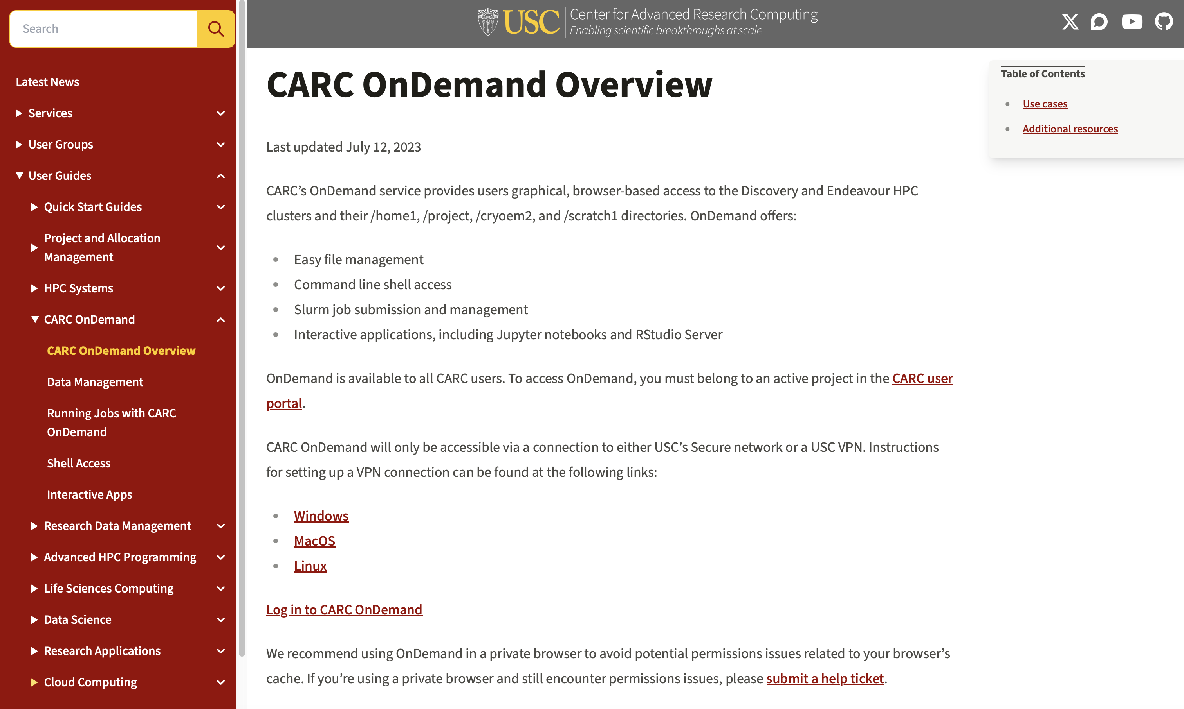
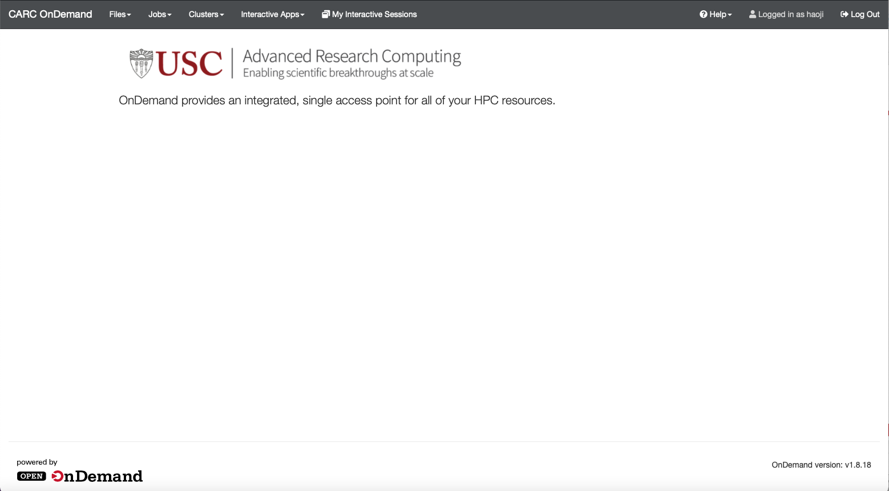
Introduction
Neural Networks
Applications
PyTorch
CARC OnDemand
https://www.carc.usc.edu

Slide 22
Introduction
Neural Networks
Applications
PyTorch
Pytorch Tutorial: Working with Data
Dataset: stores the samples and their corresponding labels TorchText, TorchVision, and TorchAudio
torchvision.datasets: CIFAR, COCO, FashionMNIST
PyTorch
DataLoader: wraps an iterable around the Dataset
Notes:
transform and target_transform to modify the samples and lables respectively

Slide 23
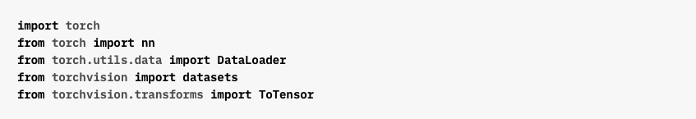
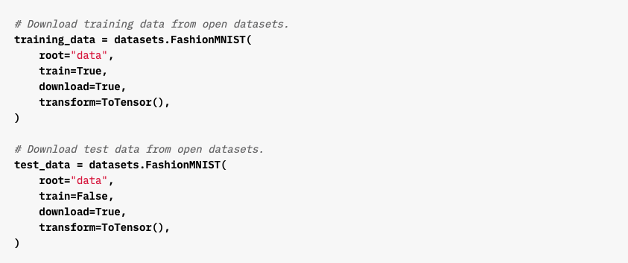
Introduction
Neural Networks
Applications
PyTorch
Working with Data
Importing Modules
Define Training and Test Dataset

Slide 24
Introduction
Neural Networks
Applications
PyTorch
Working with Data
Importing Modules
Define Training and Test Dataset

Slide 25
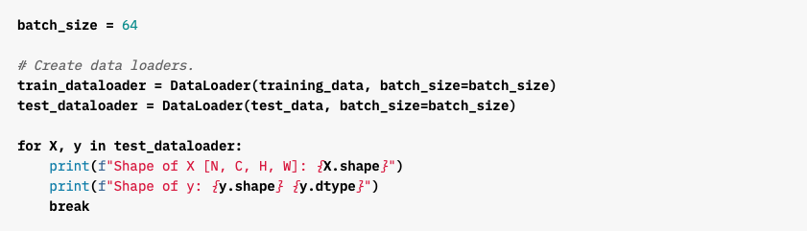
Introduction
Neural Networks
Applications
PyTorch
Working with Data
Pass the Dataset as an argument to DataLoader
Wraps an iterable over dataset and supports automatic batching, sampling, shuffling and multiprocess data loading
Define DataLoader

Slide 26
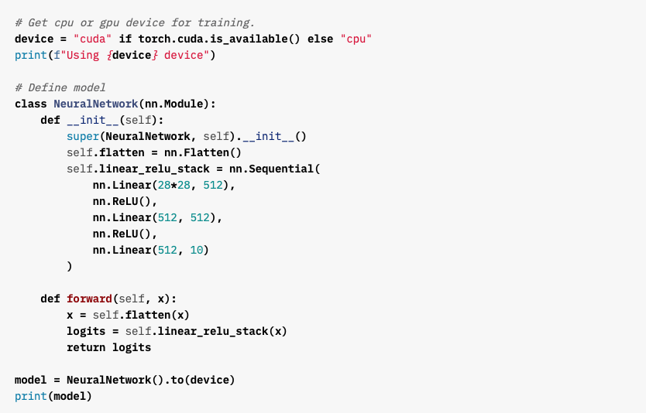
Introduction
Neural Networks
Applications
PyTorch
Creating Models
Check if GPU is Available
Create Neural Networks Model

Slide 27
Introduction
Neural Networks
Applications
PyTorch
Optimizing the Model Parameters

Slide 28
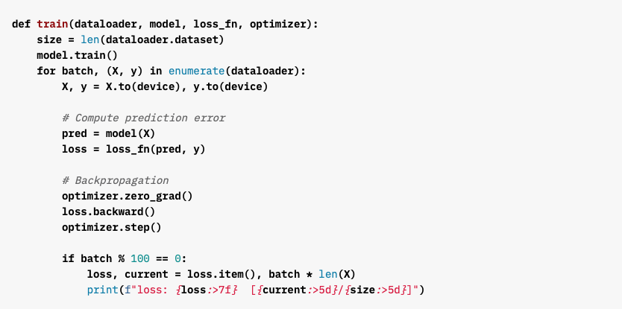
Introduction
Neural Networks
Applications
PyTorch
Define Training Loop

Slide 29
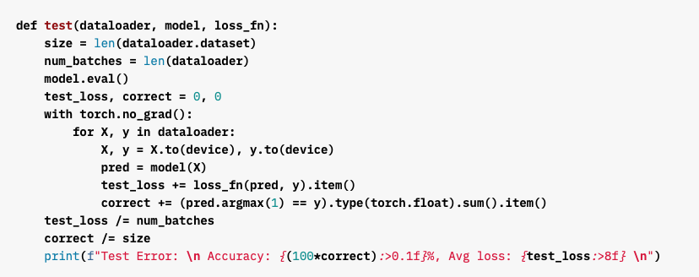
Introduction
Neural Networks
Applications
PyTorch
Define Test Dataset

Slide 30
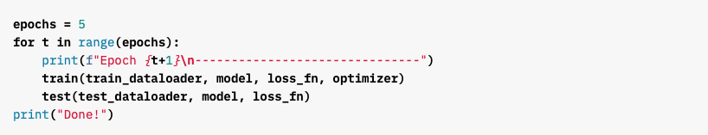
Introduction
Neural Networks
Applications
PyTorch
Training Loop

Slide 31
Introduction
Neural Networks
Applications
PyTorch
Saving Models

Slide 32
Introduction
Neural Networks
Applications
PyTorch
Loading Models

Slide 33
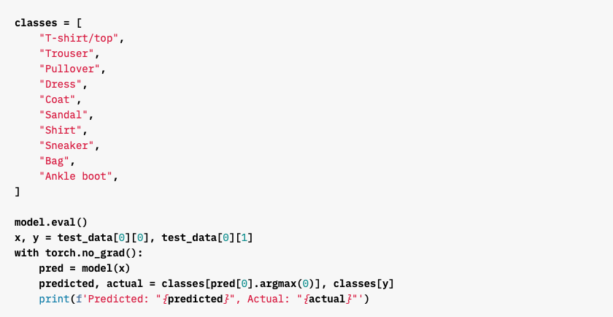
Introduction
Neural Networks
Applications
PyTorch
Make Predictions

